Slide 1
NFS: A Networked File System
CS 161: Lecture 12
3/10/2020

Slide 2
A Brief Overview of Sockets
A socket is a file descriptor that allows a program to send and receive network data
Socket-specific incantations are needed to create a socket
Afterwards, read(int fd, . . .) and write(int fd,. . .) can be used
Here’s a (slightly simplified) example:
Server
Client
int l_sock = socket(/*TCP*/);
bind(l_sock, /*network addr
*of server*/);
listen(l_sock);
int c_sock = accept(l_sock);
read(c_sock, buf, 4);
write(c_sock, buf, 5);
close(c_sock);
int sock = socket(/*TCP*/);
connect(sock, /*network addr
*of server*/);
write(sock, buf, 4);
read(sock, buf, 5);
close(sock);
Notes:
Sockets are similar to pipes. To create a pipe, you have to invoke a pipe-specific method call pipe(). To create a socket, you have to call a socket-specific method called socket(). Note that a socket file descriptor allows for reading and writing; this contrasts with a pipe, where one file descriptor is for writing, and another is for reading.

Slide 3
The VFS Layer
VFS decouples the POSIX file system interface from an underlying implementation of that interface
Application-specific code
libc
syscall
interface
VFS
ext3
ext4
btrfs
NFS
Network
Local
Local
Local
Remote
storage
storage
storage
storage

Slide 4
The VFS Layer
VFS decouples the POSIX file system interface from an underlying implementation of that interface
Why use a network
file system?
Application-specific code
Make cross-user data sharing easier
Outsource administration (e.g., data backup)
Improve data availability by storing it on well-maintained servers instead of flaky client machines
libc
syscall
interface
VFS
ext3
ext4
btrfs
NFS
Network
Local
Local
Local
Remote
storage
storage
storage
storage

Slide 5
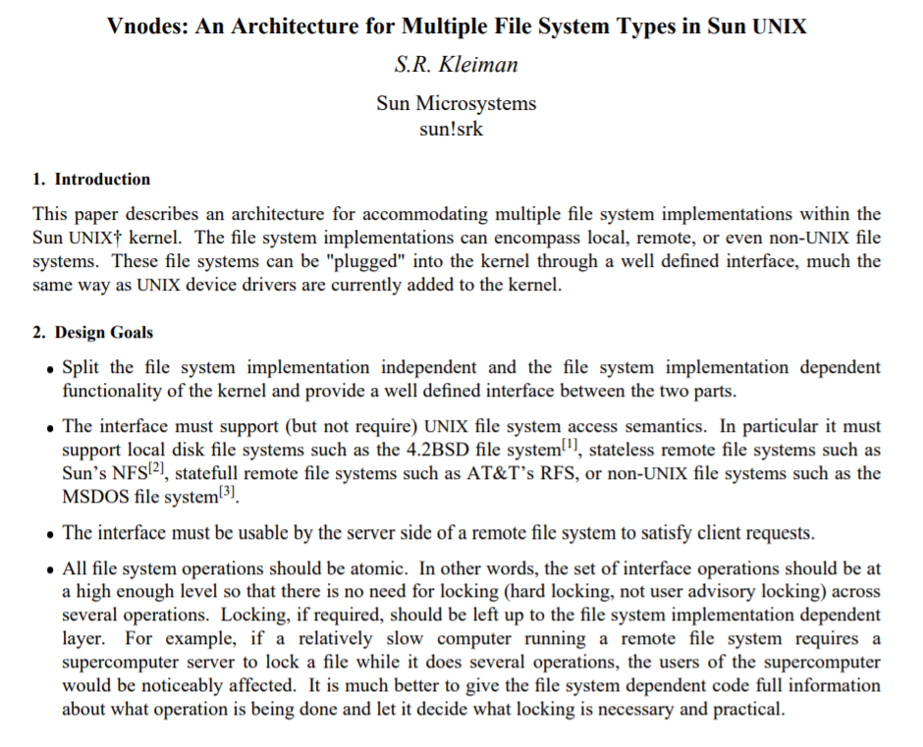
NFS was a primary motivation for the development of the VFS layer!
Notes:
[Quoth the Wikipedia, “One of the first virtual file system mechanisms on Unix-like systems was introduced by Sun Microsystems in SunOS 2.0 in 1985.[2] It allowed Unix system calls to access local UFS file systems and remote NFS file systems transparently. For this reason, Unix vendors who licensed the NFS code from Sun often copied the design of Sun's VFS.” https://en.wikipedia.org/wiki/Virtual_file_system]

Slide 6
NFS: One Possible Design
Implement the NFS server as a user-mode process on server!
Use a traditional local file system (e.g., ext4) to actually store data
Mirror client-side file descriptors using server-side file descriptors
It’s good to avoid kernel implementations if possible
Kernel bugs affect system-wide stability and security
Also, kernel programming is hard
YOU KNOW THIS PERSONALLY

Slide 7
NFS: One Possible Design
fd = open(“/foo.txt”)
Application
NFS server
libc
libc
App fd table
VFS
VFS
Network
Network
NFS client
stack
stack
ext4
in/out/err
NEW_NFS_CLIENT;
OPEN<“/foo.txt”>;
socket
Network
local: 52.3.0.7:2391
remote: 71.3.3.9:8220
Local storage
Notes:
Note that the socket is not visible to the application-level code; in other words, the socket is owned by the NFS client. This is why we don’t see the socket being pointed to by the application’s file descriptor table.

Slide 8
NFS: One Possible Design
fd = open(“/foo.txt”)
fd = open(“/foo.txt”)
fork()
Application
NFS server
NFS child
After some dup() and close() shenanigans...
libc
libc
App fd table
VFS
VFS
NFS child fd table
Network
Network
NFS client
stack
stack
ext4
in/out/err
in/out/err
NEW_NFS_CLIENT;
OPEN<“/foo.txt”>;
name: “/foo.txt”
pos: 0
socket
socket
Network
local: 71.3.3.9:8220
local: 52.3.0.7:2391
remote: 52.3.0.7:2391
remote: 71.3.3.9:8220
Local storage

Slide 9
NFS: One Possible Design
fd = open(“/foo.txt”)
fd = open(“/foo.txt”)
Application
NFS server
NFS child
libc
libc
App fd table
VFS
VFS
NFS child fd table
Network
Network
NFS client
stack
stack
ext4
in/out/err
in/out/err
name: “/foo.txt”
name: “/foo.txt”
pos: 0
OPEN_OK(“/foo.txt”);
pos: 0
socket
socket
Network
local: 71.3.3.9:8220
local: 52.3.0.7:2391
remote: 52.3.0.7:2391
remote: 71.3.3.9:8220
Local storage

Slide 10
NFS: One Possible Design
fd = open(“/foo.txt”)
read(fd, buf, 10);
fd = open(“/foo.txt”)
read(fd, buf, 10);
Application
NFS server
NFS child
libc
libc
App fd table
VFS
VFS
NFS child fd table
Network
Network
NFS client
stack
stack
ext4
in/out/err
in/out/err
name: “/foo.txt”
name: “/foo.txt”
pos: 0
READ<fd, 10>;
pos: 0
socket
socket
Network
local: 71.3.3.9:8220
local: 52.3.0.7:2391
remote: 52.3.0.7:2391
remote: 71.3.3.9:8220
Local storage

Slide 11
NFS: One Possible Design
fd = open(“/foo.txt”)
read(fd, buf, 10);
fd = open(“/foo.txt”)
read(fd, buf, 10);
Application
NFS server
NFS child
libc
libc
App fd table
VFS
VFS
NFS child fd table
Network
Network
NFS client
stack
stack
ext4
in/out/err
in/out/err
name: “/foo.txt”
name: “/foo.txt”
pos: 0
READ_OK<data>;
pos: 10
pos: 10
pos: 0
socket
socket
Network
local: 71.3.3.9:8220
local: 52.3.0.7:2391
remote: 52.3.0.7:2391
remote: 71.3.3.9:8220
Local storage

Slide 12
NFS: One Possible Design
fd = open(“/foo.txt”)
read(fd, buf, 10);
read(fd, buf, 20);
fd = open(“/foo.txt”)
read(fd, buf, 10);
read(fd, buf, 20);
Application
NFS server
NFS child
libc
libc
App fd table
VFS
VFS
NFS child fd table
Network
Network
NFS client
stack
stack
ext4
in/out/err
in/out/err
name: “/foo.txt”
name: “/foo.txt”
pos: 10
READ<fd, 20>;
pos: 10
socket
socket
Network
local: 71.3.3.9:8220
local: 52.3.0.7:2391
remote: 52.3.0.7:2391
remote: 71.3.3.9:8220
Local storage

Slide 13
NFS: One Possible Design
fd = open(“/foo.txt”)
read(fd, buf, 10);
read(fd, buf, 20);
fd = open(“/foo.txt”)
read(fd, buf, 10);
read(fd, buf, 20);
Application
NFS server
NFS child
libc
libc
App fd table
VFS
VFS
NFS child fd table
Network
Network
NFS client
stack
stack
ext4
in/out/err
in/out/err
name: “/foo.txt”
name: “/foo.txt”
pos: 10
READ_OK<data>;
pos: 30
pos: 30
pos: 10
socket
socket
Network
local: 71.3.3.9:8220
local: 52.3.0.7:2391
remote: 52.3.0.7:2391
remote: 71.3.3.9:8220
Local storage

Slide 14
NFS: One Possible Design
fd = open(“/foo.txt”)
read(fd, buf, 10);
read(fd, buf, 20);
close(fd);
fd = open(“/foo.txt”)
read(fd, buf, 10);
read(fd, buf, 20);
close(fd);
Application
NFS server
NFS child
libc
libc
App fd table
VFS
VFS
NFS child fd table
Network
Network
NFS client
stack
stack
ext4
in/out/err
in/out/err
name: “/foo.txt”
name: “/foo.txt”
pos: 30
CLOSE<fd>;
pos: 30
socket
socket
Network
local: 71.3.3.9:8220
local: 52.3.0.7:2391
remote: 52.3.0.7:2391
remote: 71.3.3.9:8220
Local storage

Slide 15
NFS: One Possible Design
fd = open(“/foo.txt”)
read(fd, buf, 10);
read(fd, buf, 20);
close(fd);
fd = open(“/foo.txt”)
read(fd, buf, 10);
read(fd, buf, 20);
close(fd);
Application
NFS server
NFS child
libc
libc
App fd table
VFS
VFS
NFS child fd table
Network
Network
NFS client
stack
stack
ext4
in/out/err
in/out/err
name: “/foo.txt”
pos: 30
CLOSE_OK<fd>;
socket
socket
Network
local: 71.3.3.9:8220
local: 52.3.0.7:2391
remote: 52.3.0.7:2391
remote: 71.3.3.9:8220
Local storage

Slide 16
NFS: One Possible Design
This design uses a stateful server
Server has a mirror of client-side file descriptor state
Client commands reference that state; e.g., READ<fd, 20>
Explicitly references the file descriptor fd
Implicitly references the seek position pos
What happens if the server crashes and then reboots between the first and second read()s?

Slide 17
fd = open(“/foo.txt”)
read(fd, buf, 10);
fd = open(“/foo.txt”)
read(fd, buf, 10);
Application
NFS server
NFS server
NFS child
libc
libc
libc
App fd table
VFS
VFS
NFS child fd table
Network
Network
NFS client
stack
stack
ext4
in/out/err
in/out/err
name: “/foo.txt”
name: “/foo.txt”
pos: 10
pos: 10
socket
socket
Network
local: 71.3.3.9:8220
local: 52.3.0.7:2391
remote: 52.3.0.7:2391
remote: 71.3.3.9:8220
Local storage

Slide 18
fd = open(“/foo.txt”)
read(fd, buf, 10);
read(fd, buf, 20);
ERROR: No matching local socket!
Application
NFS server
libc
libc
App fd table
VFS
VFS
Network
Network
NFS client
stack
stack
ext4
in/out/err
name: “/foo.txt”
pos: 10
READ<fd, 20>;
socket
Network
local: 52.3.0.7:2391
remote: 71.3.3.9:8220
Local storage

Slide 19
Suppose that the NFS server spawns a new child after detecting an unexpected NFS command . . .

Slide 20
fd = open(“/foo.txt”)
read(fd, buf, 10);
read(fd, buf, 20);
ERROR: No matching fd!
READ<fd, 20>
Application
NFS server
NFS server
NFS child
libc
libc
App fd table
VFS
VFS
NFS child fd table
Network
Network
NFS client
stack
stack
ext4
in/out/err
in/out/err
name: “/foo.txt”
pos: 10
READ<fd, 20>;
socket
socket
Network
local: 71.3.3.9:8220
local: 52.3.0.7:2391
remote: 52.3.0.7:2391
remote: 71.3.3.9:8220
Local storage

Slide 21
Protocol Design: Stateful vs. Stateless
Stateful protocol: Client and server have to maintain a consistent view of shared state
Advantage: Network messages can be small because additional state (e.g., seek position) is implicitly present on client and server
Disadvantage: Crash recovery is challenging due to state desynchronization
Stateless protocol: Each request contains all of the information needed to satisfy the request
Ex: An HTTP request specifies a resource name (i.e., URL) and must explicitly include additional session state (e.g., via cookies)
Ex: The real NFSv3 protocol is stateless

Slide 22
The Real NFSv3 Protocol

Slide 23
The Core Protocol
An NFS handle specifies a file to manipulate
From a server’s perspective, a handle is logically similar to the two-tuple <inode_num, inode_version>
Server increments the version number when an inode is reused
Ensures that a client with a handle to old version of file cannot access new version
From client’s perspective, the handle is an opaque value (max=64 bytes)
Important NFS commands:
MOUNT //Get handle for root directory “/”
LOOKUP dir_fh, name //Return handle for a file or
//directory contained in parent
//directory pointed to by dir_fh
READ fh, offset, count //Read some data
WRITE fh, offset, count, data //Write some data

Slide 24
The Core Protocol
An NFS handle specifies a file to manipulate
From a server’s perspective, a handle is logically similar to the two-tuple <inode_num, inode_version>
Server increments the version number when an inode is reused
Ensures that a client with a handle to old version of file cannot access new version
From client’s perspective, the handle is an opaque value (max=64 bytes)
Important NFS commands:
Each request embeds all of the information needed to satisfy the request
Ex: LOOKUP assumes that the caller has already acquired the handle for the prefix of the path to look up
Ex: NFS’s READ and WRITE specify explicit file offsets, unlike the equivalent POSIX commands
No NFS “open” or “close” command: server-side statelessness!
MOUNT //Get handle for root directory “/”
LOOKUP dir_fh, name //Return handle for a file or
//directory contained in parent
//directory pointed to by dir_fh
READ fh, offset, count //Read some data
WRITE fh, offset, count, data //Write some data

Slide 25
NFSv3
fd = open(“/foo.txt”)
Application
NFS server
libc
libc
App fd table
VFS
VFS
Network
Network
NFS client
stack
stack
ext4
in/out/err
MOUNT
socket
Network
local: 52.3.0.7:2391
remote: 71.3.3.9:8220
Local storage

Slide 26
NFSv3
fd = open(“/foo.txt”)
Application
NFS server
libc
libc
App fd table
VFS
VFS
Network
Network
NFS client
stack
stack
ext4
in/out/err
MOUNT_OK:fh“/”
socket
Network
local: 52.3.0.7:2391
remote: 71.3.3.9:8220
Local storage

Slide 27
NFSv3
fd = open(“/foo.txt”)
Application
NFS server
libc
libc
App fd table
VFS
VFS
Network
Network
NFS client
stack
stack
ext4
in/out/err
LOOKUP fh“/”, “foo.txt”
socket
Network
local: 52.3.0.7:2391
remote: 71.3.3.9:8220
Local storage

Slide 28
NFSv3
fd = open(“/foo.txt”)
Application
NFS server
libc
libc
App fd table
VFS
VFS
Network
Network
NFS client
stack
stack
ext4
in/out/err
name: “/foo.txt”
pos: 0
LOOKUP_OK:fh_{“/foo.txt”}
socket
Network
local: 52.3.0.7:2391
remote: 71.3.3.9:8220
Local storage

Slide 29
NFSv3
fd = open(“/foo.txt”)
read(fd, buf, 10);
Application
NFS server
libc
libc
App fd table
VFS
VFS
Network
Network
NFS client
stack
stack
ext4
in/out/err
name: “/foo.txt”
READ fh_{“/foo.txt”}, 0, 10
pos: 0
socket
Network
local: 52.3.0.7:2391
remote: 71.3.3.9:8220
Local storage

Slide 30
NFSv3
fd = open(“/foo.txt”)
read(fd, buf, 10);
Application
NFS server
libc
libc
App fd table
VFS
VFS
Network
Network
NFS client
stack
stack
ext4
in/out/err
name: “/foo.txt”
READ_OK<data>
pos: 0
pos: 10
socket
Network
local: 52.3.0.7:2391
remote: 71.3.3.9:8220
Local storage

Slide 31
NFSv3
fd = open(“/foo.txt”)
read(fd, buf, 10);
read(fd, buf, 20);
Application
NFS server
libc
libc
App fd table
VFS
VFS
Network
Network
NFS client
stack
stack
ext4
in/out/err
name: “/foo.txt”
READ fh_{“/foo.txt”}, 10, 20
pos: 10
socket
Network
local: 52.3.0.7:2391
remote: 71.3.3.9:8220
Local storage

Slide 32
NFSv3
fd = open(“/foo.txt”)
read(fd, buf, 10);
read(fd, buf, 20);
Application
NFS server
libc
libc
App fd table
VFS
VFS
Network
Network
NFS client
stack
stack
ext4
in/out/err
name: “/foo.txt”
READ_OK<data>
pos: 10
pos: 30
socket
Network
local: 52.3.0.7:2391
remote: 71.3.3.9:8220
Local storage

Slide 33
NFSv3
fd = open(“/foo.txt”)
read(fd, buf, 10);
read(fd, buf, 20);
close(fd)
Application
NFS server
libc
libc
App fd table
VFS
VFS
Network
Network
NFS client
stack
stack
ext4
in/out/err
name: “/foo.txt”
No NFS command
Not always true;
pos: 30
sent!
see upcoming
socket
discussion of
Network
local: 52.3.0.7:2391
caching!
remote: 71.3.3.9:8220
Local storage

Slide 34
Server Crashes and Network Disruptions
A client retransmits an NFS request if the server does not respond before a timer fires (default timeout: 60 seconds)
Most NFS operations are idempotent: they will do the same thing if executed multiple times
Read-only operations (e.g., LOOKUP and READ) are trivially idempotent
WRITE is also idempotent, since the offset and data are explicitly provided
Notes:
[Ref: https://www.freesoft.org/CIE/RFC/1813/47.htm]

Slide 35
Server Crashes and Network Disruptions
What about non-idempotent operations (e.g., MKDIR and RMDIR)?
NFS server has a duplicate request cache of recently-received non-idempotent requests
If server receives a non-idempotent request that hits in the cache, the server doesn’t execute the request
Instead, the server responds with the return value of the original request
If the duplicate request cache is too small, then non-idempotent requests may be replayed :-(
If the duplicate request cache is only stored in RAM, then it only protects against transient network faults, not server crashes :-(

Slide 36
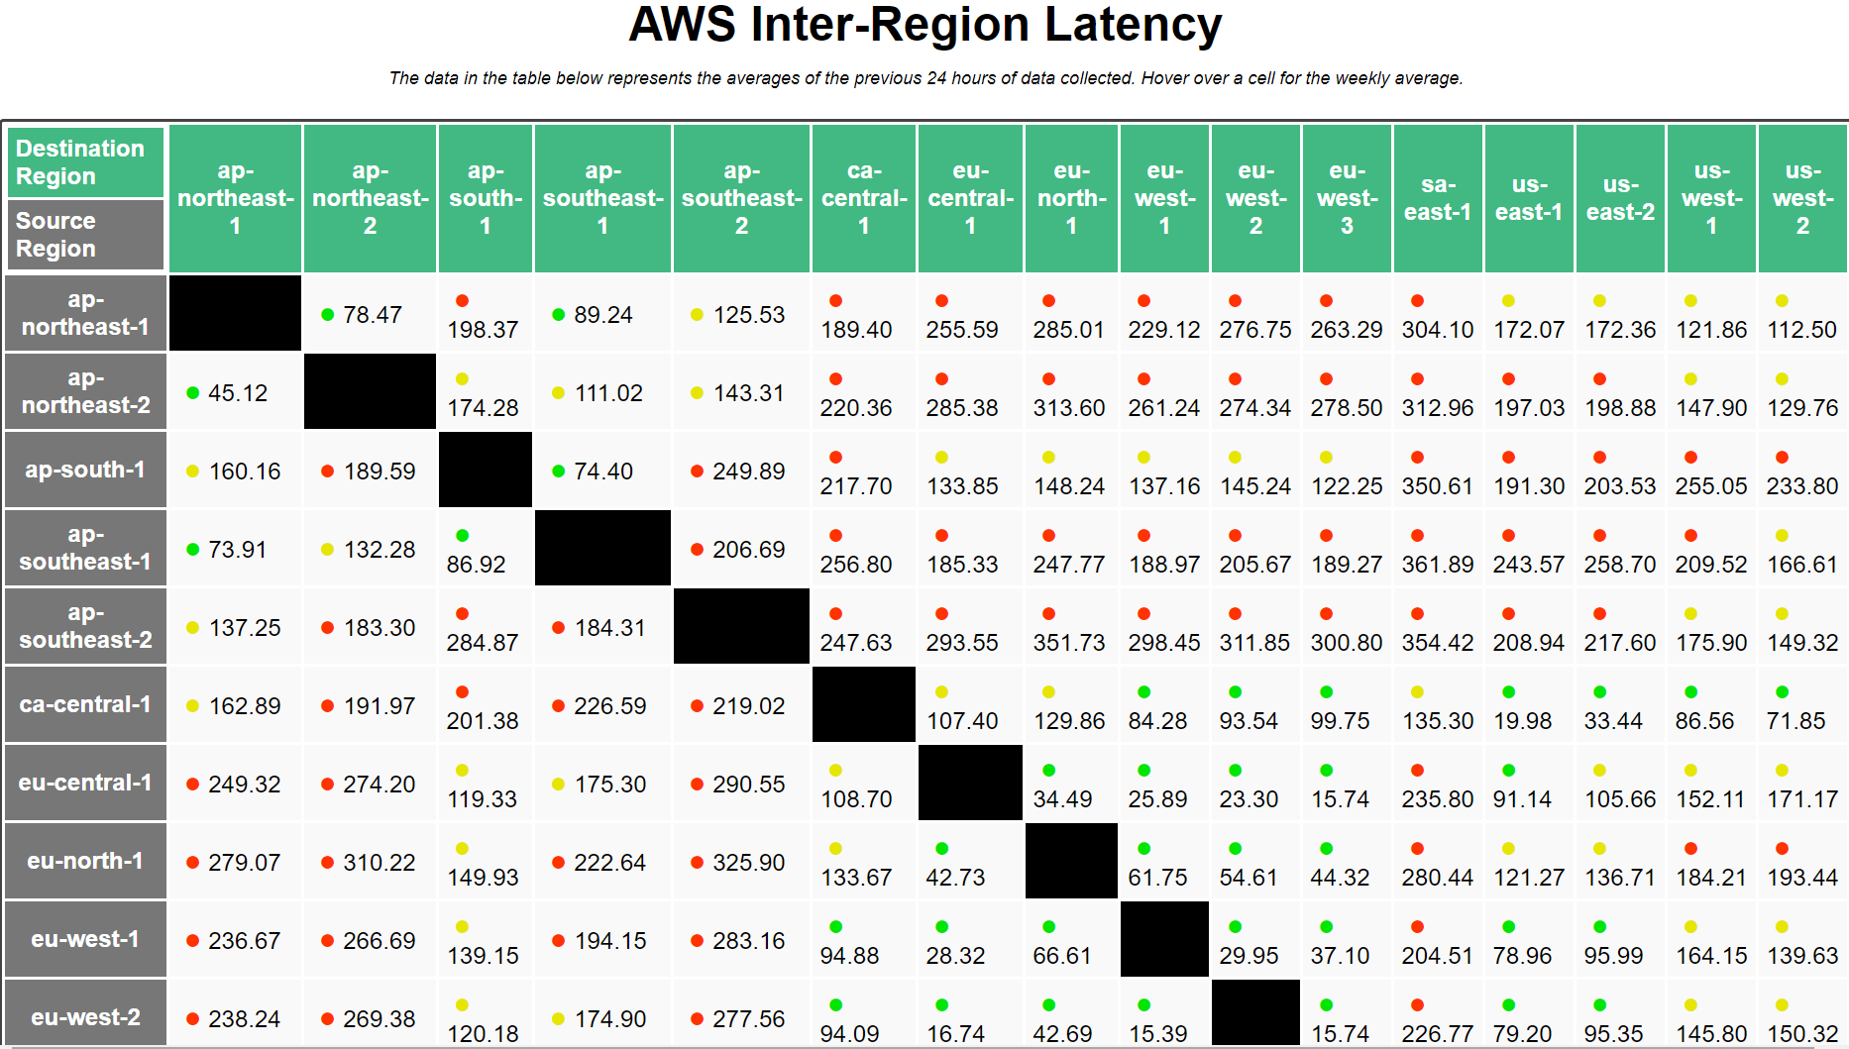
The Costs of Accessing Remote Storage
Network latencies might be worse than local storage IO latencies!
SSD access latency: ~30μs—1.5ms
Disk access latency: ~6ms—17ms
Local area round-trip time: ~200μs—3ms
Wide area round-trip time: Let’s look at https://www.cloudping.co/ . . .
Notes:
“ap” means “Asia/Pacific.” “sa” means “South America.” “eu” means “Europe.” “ca” means “Canada,” and “us” means “United States.”

Slide 37
Notes:
us-west-1 is in California. us-east-1 is in Virginia.
[Ref: https://www.stevesouders.com/blog/2010/07/13/velocity-tcp-and-the-lower-bound-of-web-performance/
https://docs.aws.amazon.com/AWSEC2/latest/UserGuide/using-regions-availability-zones.html]

Slide 38
Client-side Caching
To hide network latencies, NFS clients aggressively cache data
Data read from server is cached and used to satisfy later reads
Writes hit the cache first; are immediately acknowledged to VFS layer
NFS client lazily writes dirty blocks to server
NFS protocol does not requires a specific write-back order!
Alice
Bob
Charlie
Reads foo.txt_{v0}
Reads foo.txt_{v0}
Writes to foo.txt_{v0},
Time
creating foo.txt_{v1}
Reads foo.txt_{v0}
(stale cache!)
Reads foo.txt_{v0}
(stale server copy!)
Writes dirty foo.txt_{v1}
blocks to server

Slide 39
Improving Data Consistency
NFS leverages two techniques to improve consistency
Flush-on-close(): NFS client always writes dirty blocks to server upon close()
Cached block validation
Periodically (e.g., every 15 seconds), the client issues a GETATTR command to check whether the server has received new writes for client-cached blocks
Client drops invalidated blocks
This doesn’t totally fix the consistency problem!
If a reader and a writer use a local file system, a write to a block is immediately visible to the reader
NFS doesn’t provide this property, even with flush-on-close() and cached block validation
Client applications can invoke fsync(int fd) to force NFS to write a file’s dirty pages to server
Notes:
[As described by the man page for fsync(), “fsync() transfers ("flushes") all modified in-core data of (i.e., modified buffer cache pages for) the file referred to by the file descriptor fd to the disk device (or other permanent storage device) so that all changed information can be retrieved even after the system crashed or was rebooted. This includes writing through or flushing a disk cache if present.” [Ref: https://linux.die.net/man/2/fsync]]

