Slide 1

CS 161: Lecture 6
2/12/2020
Interrupts, Concurrency, and Synchronization

Slide 2

SECTION TIMES HAVE BEEN ANNOUNCED
[Tina] Wednesday, 4:30p -- 5:45pm
Northwest::B166
[Noah] Wednesday, 7:30pm -- 8:45pm
Pfoho::Moors Classroom
[Vincent] Thursday, 3:00pm -- 4:15pm
Northwest::B103

Slide 3
Your fork() should deallocate memory upon failure!
Your fork() implementation is probably a very long God function (which is probably ok in this scenario)
In OS code, goto statements are a common way to unwind from a deeply-nested failure

Slide 4
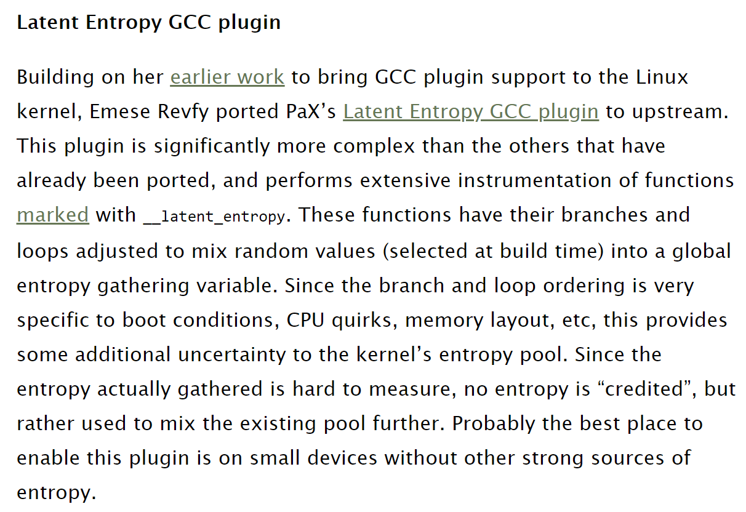
Linux’s fork() Implementation
/*
* This creates a new process as a copy of the old one,
* but does not actually start it yet.
*
* It copies the registers, and all the appropriate
* parts of the process environment (as per the clone
* flags). The actual kick-off is left to the caller.
*/
static __latent_entropy struct task_struct *copy_process(
struct pid *pid,
int trace,
int node,
struct kernel_clone_args *args){
//...stuff...
if (atomic_read(&p->real_cred->user->processes) >=
task_rlimit(p, RLIMIT_NPROC)) {
if (p->real_cred->user != INIT_USER &&
!capable(CAP_SYS_RESOURCE) &&
!capable(CAP_SYS_ADMIN))
goto bad_fork_free;
}
current->flags &= ~PF_NPROC_EXCEEDED;
retval = copy_creds(p, clone_flags);
if (retval < 0)
goto bad_fork_free;
/*
* If multiple threads are within copy_process(),
* then this check triggers too late. This doesn’t
* hurt, the check is only there to stop root fork
* bombs.
*/
retval = -EAGAIN;
if (nr_threads >= max_threads)
goto bad_fork_cleanup_count;
//...other stuff...
retval = copy_mm(clone_flags, p);
if (retval)
goto bad_fork_cleanup_signal;
retval = copy_namespaces(clone_flags, p);
if (retval)
goto bad_fork_cleanup_mm;
retval = copy_io(clone_flags, p);
if (retval)
goto bad_fork_cleanup_namespaces;
retval = copy_thread_tls(clone_flags, args->stack,
args->stack_size, p,
args->tls);
if (retval)
goto bad_fork_cleanup_io;
//Etc, and then at the end of the
//function . . .
return p; //This is a “fork succeeded”
//return path.
//If we reach any of the goto statements
//here, A SADNESS HAS OCCURRED.
bad_fork_free_pid:
if (pid != &init_struct_pid)
free_pid(pid);
bad_fork_cleanup_thread:
exit_thread(p);
bad_fork_cleanup_io:
if (p->io_context)
exit_io_context(p);
bad_fork_cleanup_mm:
if (p->mm) {
mm_clear_owner(p->mm, p);
mmput(p->mm);
}
//...etc...
}
Notes:
[Ref: https://github.com/torvalds/linux/blob/master/kernel/fork.c
https://outflux.net/blog/archives/2016/12/12/security-things-in-linux-v4-9/]

Slide 5
//Etc, and then at the end of the
//function . . .
return p; //This is a “fork succeeded”
//return path.
//If we reach any of the goto statements
//here, A SADNESS HAS OCCURRED.
bad_fork_free_pid:
if (pid != &init_struct_pid)
free_pid(pid);
bad_fork_cleanup_thread:
exit_thread(p);
bad_fork_cleanup_io:
if (p->io_context)
exit_io_context(p);
bad_fork_cleanup_mm:
if (p->mm) {
mm_clear_owner(p->mm, p);
mmput(p->mm);
}
//...etc...
return ERR_PTR(retval);
}

Slide 6

IN GENERAL, DO NOT USE GOTO STATEMENTS

Slide 7
Kernel Code Should (Almost Never)
Cause Exceptions!
Exceptions are typically a sign of bugs (or debugging)
  Ex: Divide by zero
  Ex: Misaligned memory access
  Ex: Invalid opcode
  Ex: Debugging exception
A kernel should not have bugs!
So, in real OSes, exceptions can nest at most two deep
  Exception 1: A divide-by-zero or whatever
  Exception 2: A page fault exception triggered by the kernel’s handler for Exception 1; e.g., the handler tries to read a user-level page that is currently swapped out to disk
Exception
User
Kernel
Process is killed, debugged, etc.
Page fault exception
iret
During this time, there would be two Chickadee regstates on the stack!
Notes:
[Ref: https://www.oreilly.com/library/view/understanding-the-linux/0596005652/ch04s03.html]

Slide 8

A Potential Thing: Nested Interrupt Handlers!
An OS can allow interrupts to nest
  For example, an interrupt handler could reenable interrupts as soon as the old register state has been saved on the stack
IRQ₀
User
Kernel
iret
IRQ₁
iret
IRQ₂
iret
IRQ₃
iret
Notes:
[Remember that, on x86, interrupts that occur in kernel mode do not perform a stack switch!]
[Ref: https://www.oreilly.com/library/view/understanding-the-linux/0596005652/ch04s03.html]

Slide 9
A Potential Thing: Nested Interrupt Handlers!
An OS can allow interrupts to nest
  For example, an interrupt handler could reenable interrupts as soon as the old register state has been saved on the stack
Advantage: Nesting interrupts can improve system responsiveness
Disadvantage: Writing correct kernel code (and debugging that code) becomes more difficult!
  If an interrupt can interrupt itself, then handler code must be reentrant
  Stack overflows become more likely
  Doing stack backtraces becomes harder
Notes:
Stack backtraces become more difficult because the stack can contain a mix of <normal stack frames for interrupt handler X, saved register state for handler X>.
[Remember that, on x86, interrupts that occur in kernel mode do not perform a stack switch!]
[Ref: https://www.oreilly.com/library/view/understanding-the-linux/0596005652/ch04s03.html]

Slide 10

Linux’s Solution to Nested Interrupts
Top-half handlers
  Run with interrupts disabled
  Are fast (i.e., run small amounts of code)
  Can mark a kernel data structure to indicate that a softirq needs to run later
Bottom-half softirqs
  Run with interrupts enabled
  Do stuff that takes a medium amount of time, but does not require sleeping
  Pending softirqs are checked:
    When returning from a top-half handler
    By per-cpu ksoftirq kernel threads
Bottom-half work-queue kernel threads
  Run with interrupts enabled
  Can do computations that are slow-running or might sleep
Notes:
[Note that tasklets are another bottom-half mechanism that are built atop softirqs, and have similar properties—in particular, they run with interrupts are enabled and cannot sleep.]
[Ref: http://books.gigatux.nl/mirror/kerneldevelopment/0672327201/ch07lev1sec2.html
http://books.gigatux.nl/mirror/kerneldevelopment/0672327201/ch07lev1sec4.html]

Slide 11
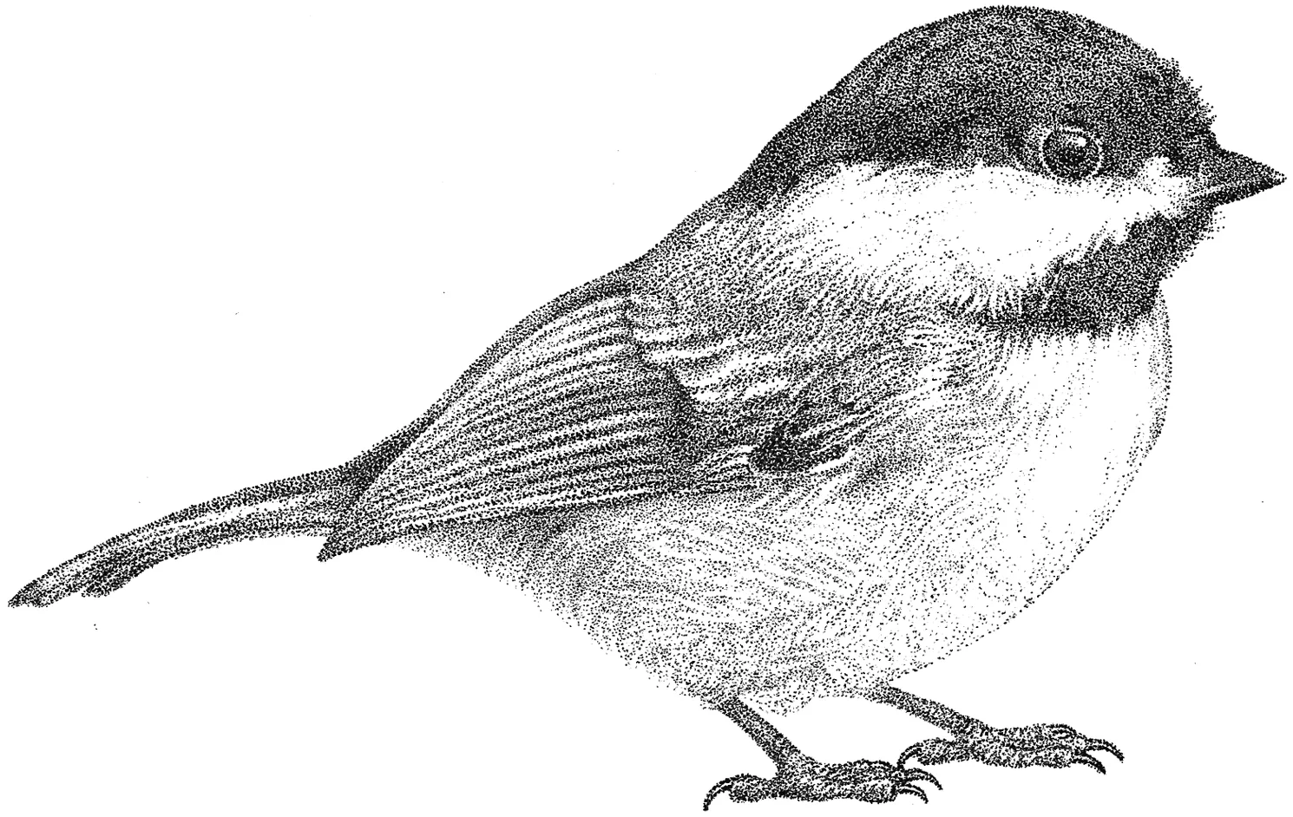
Chickadee’s proc::exception()
Timer interrupt: Suspend the currently-running process
Page fault: Mark the faulting process as broken, because stock Chickadee doesn’t swap pages between RAM and disk
regs_ = regs;
yield_noreturn();
break; //Won't be reached
pstate_ = proc::ps_broken;
yield(); //Won’t run again because
//cpustate::schedule() will
//notice the sad pstate_
Notes:
[Remember that the x86 hardware automatically disables interrupts before invoking an interrupt handler! See Section 6.8.1 of Volume 3A of the Intel Developer’s manual.]

Slide 12
Chickadee’s proc::exception()
Keyboard interrupt: Read a character and then immediately return to the interrupted execution context
keyboardstate::get().handle_interrupt();
//Uses `inb` instruction to read
//a char from the keyboard
break; //Kernel goes to k-exception.S::
//restore_and_iret
Notes:
In a few lectures, when we talk about how OSes handle hardware devices, we’ll talk more about the inb instruction. For now, it suffices to say that the inb instruction allows a CPU to pull a byte of data from certain kinds of devices like keyboards.
Remember that k-exception.S::restore_and_iret pops a bunch of saved register content from the stack into actual registers, and then does an iret to return to the interrupted execution context.

Slide 13

Locking: Sacrificing Parallelism to Ensure Correctness
OSes were originally designed for single-processor machines
  Disabling interrupts was sufficient for the kernel to prevent race conditions on kernel state
//k-cpu.cc::cpustate::schedule() will
//eventually run, and try to examine
//the run queue.
runq_lock_.lock_noirq();
//Deadlock: will spin forever
//because the lock is already
//held by this core!
//A kernel task wants to add
//a new process to the local
//run queue.
this_cpu()->runq_lock_.lock();
//Timer interrupt occurs
//on the same core!
Time
Notes:
As we discussed in the last lecture, race conditions can occur even in a single-core machine . . .
[Ref: https://www.kernel.org/doc/htmldocs/kernel-locking/uniprocessor.html]

Slide 14
Locking: Sacrificing Parallelism to Ensure Correctness
OSes were originally designed for single-processor machines
  Disabling interrupts was sufficient for the kernel to prevent race conditions on kernel state
  If you compile Linux without enabling multicore support, then:
    Spinlock acquires just save the old interrupt state and disable interrupts
    Spinlock releases just restore the old interrupt state
When Linux first added multicore support in 1996, Linux used a Big Kernel Lock that was acquired at the start of any context switch into the kernel
    Advantage: Simple, and still allowed user-level code to be parallel
    Disadvantage: Only one core can execute in the kernel at a time
Over many years, Linux (and other OSes) developed much finer-grained locking strategies
Notes:
[Ref: https://stackoverflow.com/questions/3372541/spin-lock-on-non-preemtive-linux-kernels
http://halobates.de/lk09-scalability.pdf //Section 6 in particular
https://www.kernel.org/doc/htmldocs/kernel-locking/uniprocessor.html]

Slide 15

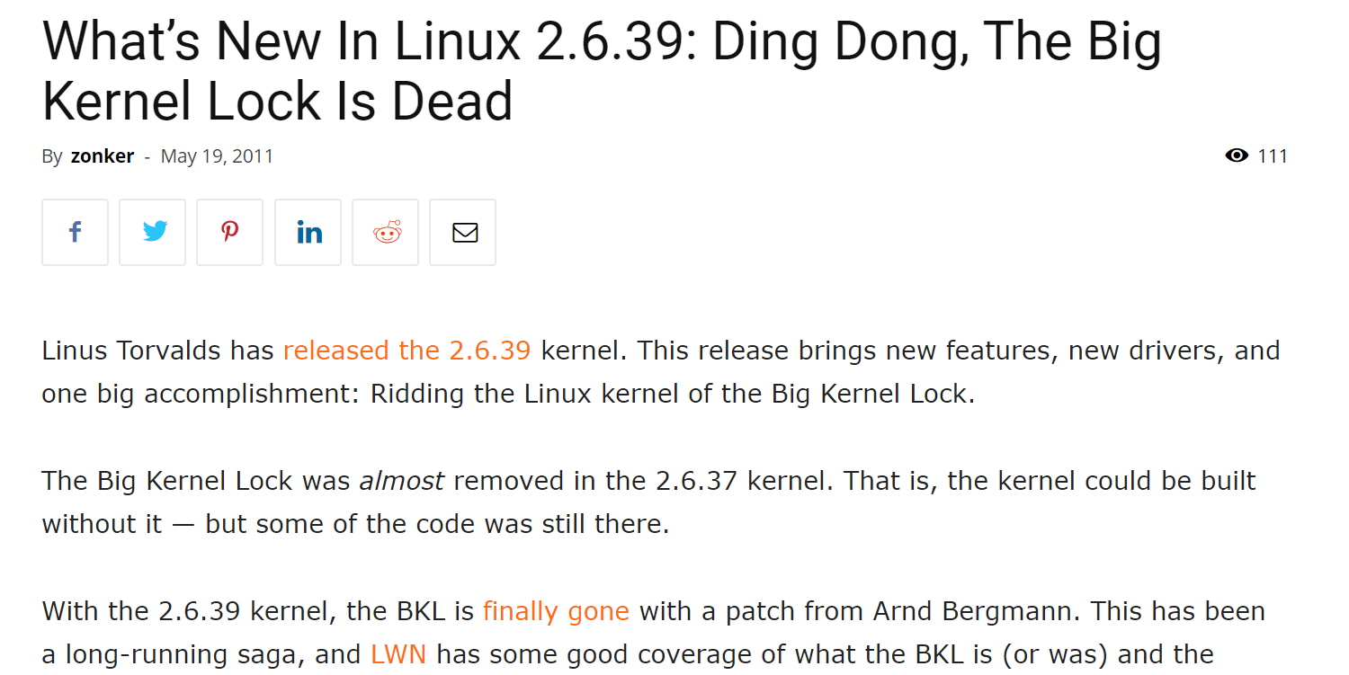

Slide 16
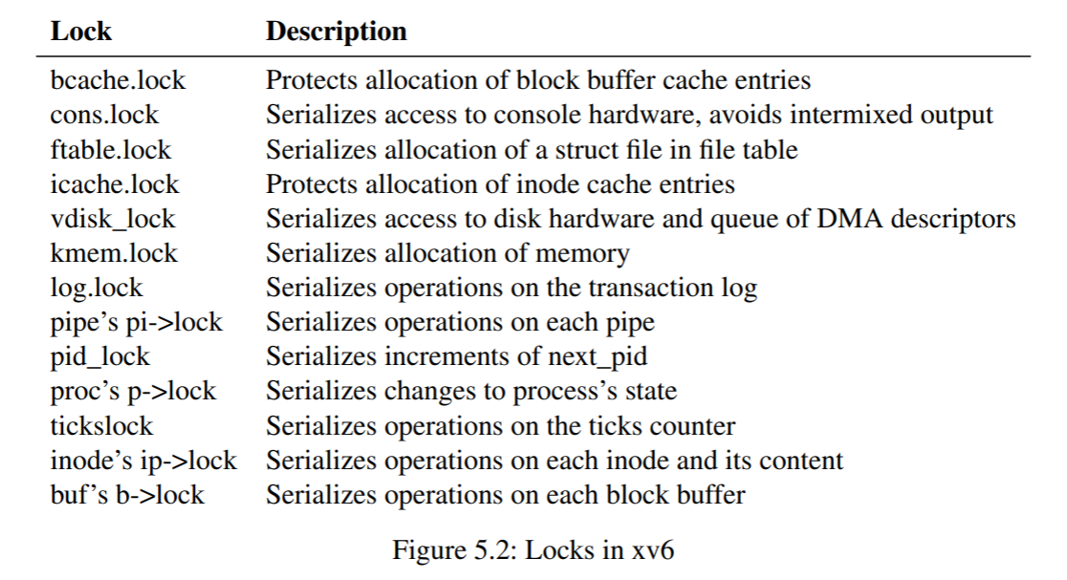
Case study: The xv6 Teaching OS
Notes:
[Ref: https://pdos.csail.mit.edu/6.828/2019/xv6/book-riscv-rev0.pdf]

Slide 17
Case study: The xv6 Teaching OS
Impact when two distinct CPUs execute fork()
  The parallel fork()s may serialize during pid allocation and memory allocation
  However, parallel fork()s can simultaneously configure page tables and copy data from parent pages to child pages

Slide 18

A (Partial) List of Chickadee Locks
ptable_lock: Protects the process table
page_lock: Protects memory allocation metadata
Per-CPU runq_lock: Protects a CPU’s list of runnable processes
cursor_lock: Serializes console output

Slide 19
Designing a Locking Strategy
A lock is used to protect a sequence of events that must be atomic
  Usually, a single function will acquire and release a lock
  However, if the event sequence to protect is complex, then locking and unlocking may occur in different functions
Atomicity reduces the difficulty of defining invariants
  Invariants are properties that must be true before and after an operation on a data structure
  Invariants may only be false in the middle of an atomic update that is protected by a lock!
Locks are typically needed when:
  CPU_{X} can write a variable at the same time that CPU_{Y} can read or write it
  An invariant requires atomic reading and writing of multiple memory locations—consider why spinlocks disable interrupts!
Notes:
Locks are typically needed when an invariant requires atomic reading and writing of multiple memory locations. As a concrete example, consider why spinlocks disable interrupts. Even in the case of a single-core machine, kernel code can be updating a data structure, and then an interrupt can fire. If the interrupted kernel code was trying to perform an atomic operation, then it’s possible that the interrupt handler might touch the memory locations being updated by the ostensibly atomic operation! Thus, even on a single-core machine, locks are helpful for ensuring the atomicity of operations that affect multiple memory locations.

Slide 20

Case Study: getppid()
The fork() system call allows a parent process to create a child process
The getppid() system call allows a child to get the pid of its parent
In Unix-derived systems, a special undying init process is the first process created
  init has getpid()==1 and getppid()==1
  When a parent dies, its children are reparented to init
  The reasons for init will become clearer in pset2!
2
3
4
5
6

Slide 21
A Possible getppid() Implementation
We could add a ppid_ field to struct proc
  Initialize it during fork()
  Set it to 1 if the parent exit()s before the child
Are we done?
  Initializing ppid_ is fast
    The parent process can directly access the parent’s id_ and assign it to the child’s ppid_
    There are no race conditions between the parent and the child, because the child isn’t running yet!
  The getppid() system call is fast: just return the ppid_ value
  But what happens when the parent calls exit()?

Slide 22
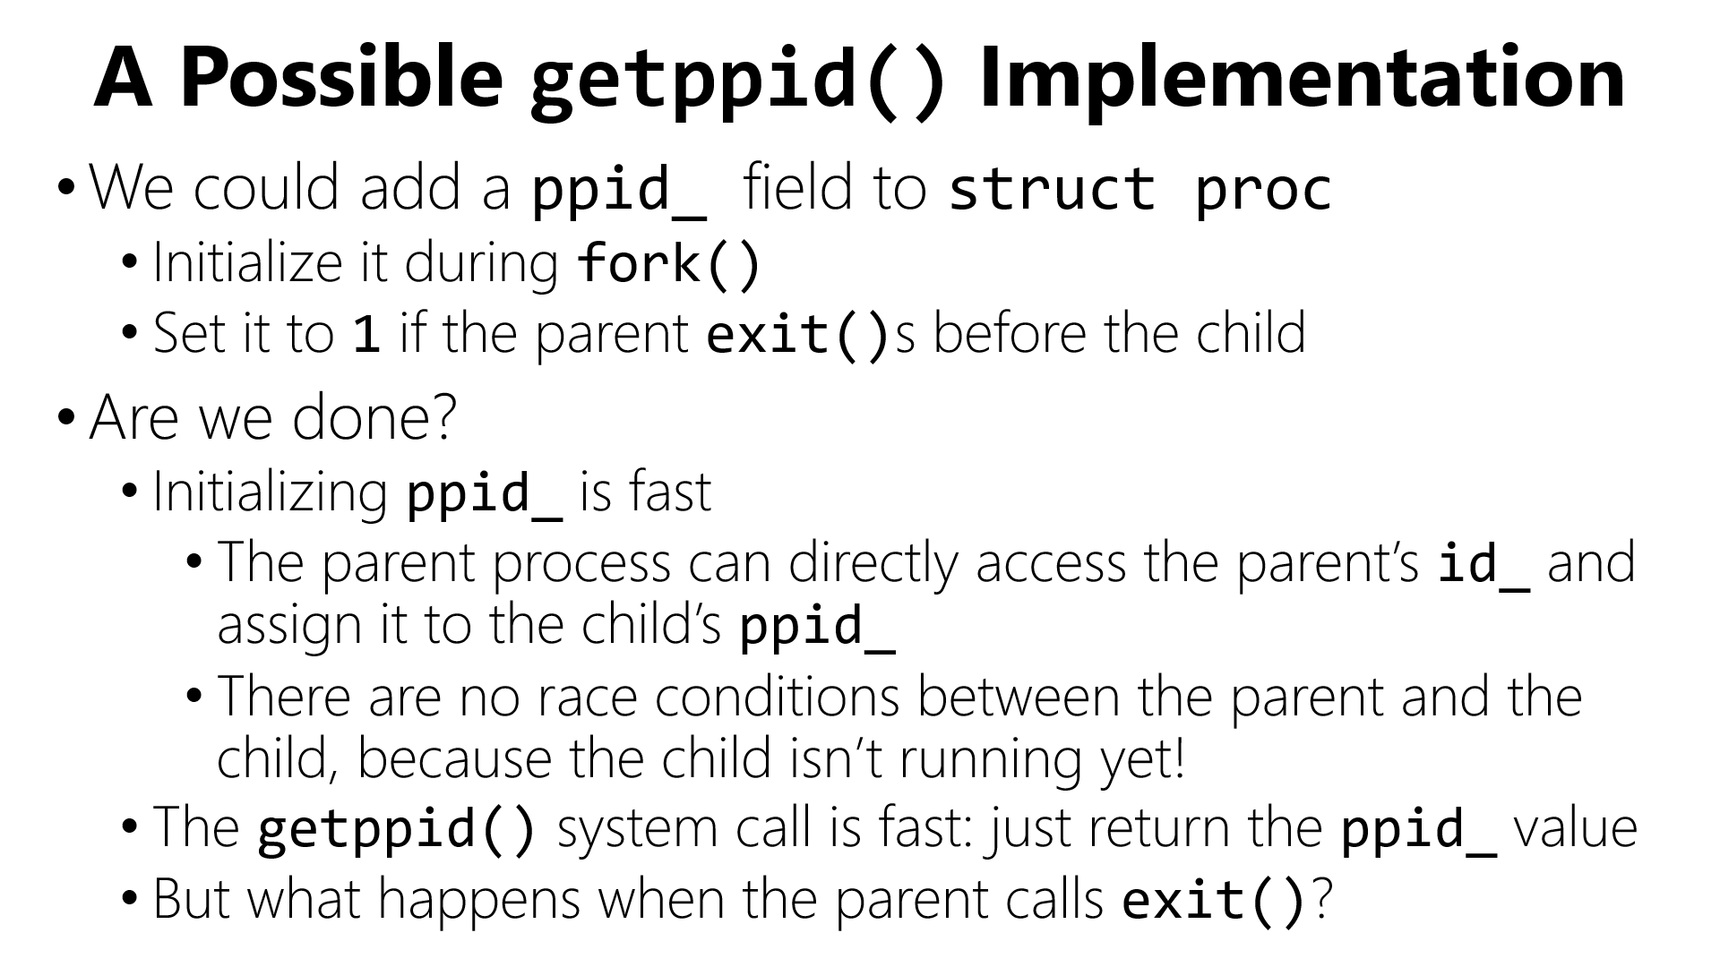


Slide 23


Problem 1: Scalability
//The exit() code must examine each child’s
//ppid_ field to determine who to reparent!
for(int i = 0; i != NPROC; ++i){
if (ptable[i] &&
(ptable[i]->ppid_ == current()->id_){
ptable[i]->ppid_ = 1;
}
}
The running
time for exit()
should be linear in the number of
children, not the total number of processes!
We need per-parent child lists!

Slide 24


Problem 2: Synchronization
How do we coordinate access to ppid_?
“If two threads simultaneously access a memory location, then both accesses must be reads, otherwise the program behavior is undefined.”
THE FUNDAMENTAL LAW OF SYNCHRONIZATION

Slide 25



Problem 2: Synchronization
How do we coordinate access to ppid_?
Core 1
Core 2
P
C
Calls exit()
//Must write
//the child’s
//ppid_!
Calls getppid()
//Must read
//the child’s
//ppid_!
Time

Slide 26
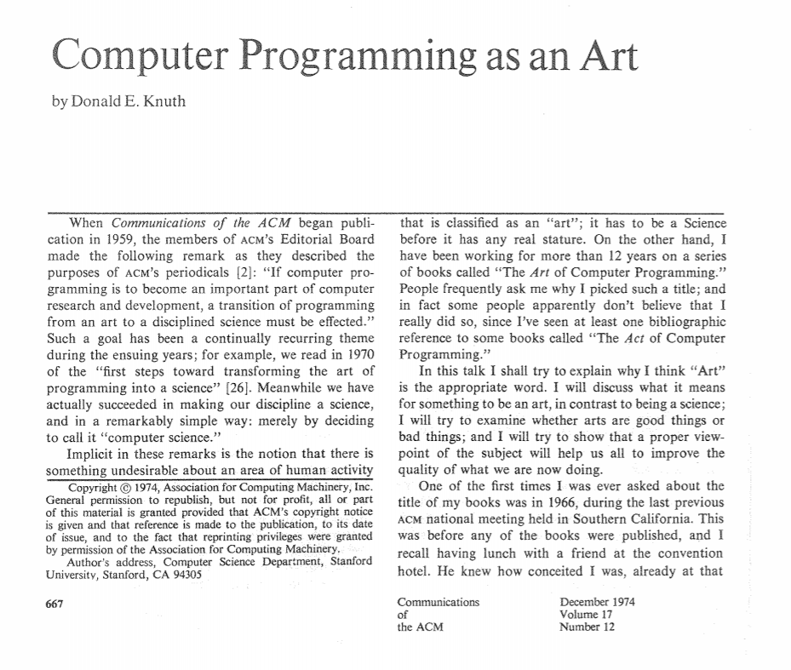
Problem 2: Synchronization
How do we coordinate access to ppid_?
“Premature optimization
is the root of all evil.”
//A possible solution: Use ptable_lock
//to protect ppid_.
uintptr_t proc::syscall(regstate* regs) {
switch (regs->reg_rax) {
case SYSCALL_GETPPID: {
spinlock_guard g(ptable_lock);
return ppid_;
}
case SYSCALL_EXIT: {
spinlock_guard g(ptable_lock);
//Find children and reparent
}
}
//Do we care that getppid() and exit()
//will contend with fork() to acquire
//ptable_lock?
Notes:
fork() has to acquire ptable_lock to find an empty ptable slot for the newly-created process!
[Ref: http://www.cs.bilkent.edu.tr/~canf/knuth1974.pdf]

Slide 27
A Different getppid() Implementation
We could protect ppid_ with a per-process ppid_lock_ instead of the global ptable_lock . . .
struct proc {
pid_t ppid_;
spinlock ppid_lock_;
//...other stuff...
}
Good: getppid() is faster (since contention on per-process lock should be lower than contention on the global ptable_lock), and we decrease the contention pressure on ptable_lock
auto irqs = ptable_lock.lock();
for (int i = 0; i != NPROC; ++i) {
if (ptable[i]) {
spinlock_guard guard(ptable[i]->ppid_lock_);
if (ptable[i]->ppid_ == current()->id_) {
ptable[i]->ppid_ = 1;
}
}
}
ptable_lock.unlock(irqs);
Bad (?): Reparenting now has to acquire multiple locks (a global one and NPROC local ones) . . . but isn’t exit() uncommon?
Notes:
Note that exit() still needs to grab ptable_lock (because the parent is examining ptable and we don’t want ptable changing as the parent iterates through it).

Slide 28

DON’T START HERE
Lesson 1: Start simple but correct

Slide 29

Before optimizing, actually measure why your program is slow!
  Too few CPUs?
  Waiting on slow IOs?
  Synchronization stalls?

Slide 30

Monday, February 17: No class (President’s Day)
Wednesday, February 19: In-class midterm
  Open notes, open slides, open Chickadee source code, no Internet
  There will be a review session at the beginning of next week (time TBD)

