Slide 1
Wait queues
CS 161: Lecture 7
2/24/20

Slide 2
Implementing sleep(ms) Inefficiently
//kernel.hh
#define HZ 100 // # of ticks per second
//kernel.cc
std::atomic<unsigned long> ticks; // # of timer interrupts
// so far on CPU 0; it’s
// incremented when the
// timer interrupt fires
Will overflow if machine runs for a long time!

Slide 3
Implementing sleep(ms) Inefficiently
//kernel.cc
switch(regs->reg_rax) {
case SYSCALL_MSLEEP: {
unsigned long wakeup_time = ticks +
(regs->reg_rdi + 9) / 10;
while (long(wakeup_time - ticks) > 0) {
this->yield();
}
return 0;
}
//...Other syscalls...
User-mode part of process goes to sleep, but . . .
. . . kernel-half stays runnable, repeatedly testing the exit condition and then yielding! Polling is gross.
Like wakeup_ticks > ticks, but works even if ticks or wakeup_ticks overflows!
Notes:
The +9 part ensures that we sleep for at least one timer interrupt period if a positive ms argument is used. For example, if the caller specifies a sleep duration of 1 ms, then the kernel will sleep for (1+9)/10=1 timer interrupt period; since HZ = 100, one timer interrupt period is 10 ms. If the caller specifies a sleep duration of 9 ms, then the kernel will sleep for (9+9)/10 = 1 timer interrupt period; remember that in C, integer division uses truncation towards 0. [Ref: https://stackoverflow.com/a/3602857]
The long() trick works as long as (1) the computer uses two’s complement to represent numbers, (2) the subtraction of two unsigned longs wraps around, and (3) the difference between the two is in the range of an unsigned long. Note that hardware ensures (1), and the C++ standard guarantees (2).
For example:
a = 0101 b = 0110
0101
1001
+ 1
-----
1111 = 15 unsigned = -1 signed
Remember that in two’s complement, a leading bit of 1 means the number is negative, and a leading bit of 0 means that the number is positive. For a negative number, the magnitude is determined by flipping all of the bits and then adding 1. This is why 1111 in binary is -1 signed decimal.
[Ref: https://stackoverflow.com/questions/2061245/how-to-subtract-two-unsigned-ints-with-wrap-around-or-overflow
https://en.wikipedia.org/wiki/Signed_number_representations#History
https://www.cs.cornell.edu/~tomf/notes/cps104/twoscomp.html]

Slide 4
The Challenges of Blocking
Kernel tasks often need to block until an event occurs
Ex: A certain amount of time has elapsed (as in sleep(ms))
Ex: Keyboard data arrives
Ex: A (non-spinlock) lock is released
How can the kernel create an efficient mechanism to handle arbitrary types of blocking events?
Notes:
[Note: A spinlock doesn’t have a queue because acquiring a spin lock “blocks” by just repeatedly testing the lock condition!]

Slide 5
Wait Queues to the Rescue!
Have a queue for each type of blocking event
Threads that wait for the same event will sleep on the same queue
When the event is noticed by a running thread, that thread will wake the sleepers in the relevant queue
Correctly implementing the wait queue is tricky!
True blocking is
now possible!
Notes:
Note that I’m being a bit sloppy with terminology here. By “thread” here, I mean “a kernel-level execution context.” However, “thread” is easier to say than “kernel-level execution context” :-D.

Slide 6
Formalizing the Blocking Problem
Let x be a subset of program state
A sleeping thread blocks until f(x) is true
A running thread modifies x in a way that makes f(x) true
Sounds trivial, right?
COMPLETELY AND UTTERLY FALSE
YOU MORTAL FOOLS

Slide 7
Computes f(x) == false
Decides to sleep (but hasn’t slept yet!)
Modifies x so that f(x) is true
Looks for sleeping threads, finds none to wake up
Does other stuff
Goes to sleep, blocks forever, infinite suffering occurs
Maybe locks can help us avoid bad interleavings?

Slide 8
Sleep/wakeup: Attempt #2
x_lock.lock()
Computes f(x) == false
Decides to sleep and goes to sleep
Tries to x_lock.lock() and blocks
Sleeps forever (holding x_lock), society degenerates into chaos

Slide 9
Sleep/wakeup: Attempt #3
x_lock.lock()
Computes f(x) == false
Decides to sleep (but hasn’t slept yet!)
x_lock.unlock()
x_lock.lock()
Does stuff so f(x) is true
Finds no sleeping threads to wake
x_lock.unlock()
Goes to sleep, blocks forever, all teddy bears are destroyed
Problem: Lost wakeups
Cause: Releasing the lock and blocking aren’t atomic!

Slide 10
Sleep/wakeup: Solution #1
x_lock.lock()
Computes f(x) == false
Decides to block (but isn’t sleeping yet!)
cond_wait(&x_cond, &x_lock)
x_lock.lock()
Does stuff so f(x) is true
cond_signal(&x_cond) wakes up sleeping thread
x_lock.unlock()
Atomically releases lock
and blocks thread; when it
returns, lock held by caller
What if the wakeup thread runs first?

Slide 11
Sleep/wakeup: Solution #1
x_lock.lock()
Computes f(x) == false
Decides to block (but isn’t sleeping yet!)
cond_wait(&x_cond, &x_lock)
with no threads to wake
x_lock.lock()
Does stuff so f(x) is true
cond_signal(&x_cond) wakes up sleeping thread
x_lock.unlock()
Computes f(x) == true
Does stuff involving x
x_lock.unlock()
Locking and cond_* semantics eliminate bad interleavings!

Slide 12
Case study: OS/161

Slide 13
Case Study: OS/161
/* Wait channel. A wchan is protected by
* an associated spinlock. */
struct wchan{
char *wc_name; //Name for this channel
struct threadlistwc_threads; //Queue of waiting
//threads for this
//channel
};

Slide 14
Case Study: OS/161
/**
* Yield the cpu to another process, and go to sleep on the
* specified wait channel whose associated spinlock is lk.
* The spinlock must be locked.
*/
void wchan_sleep(struct wchan *wc,
struct spinlock *lk){
thread_switch(S_SLEEP, wc, lk); //Similar to Chickadee’s
//proc::yield(), but also
//adds the current thread
//to wc->wc_threads and
//then releases the lock.
spinlock_acquire(lk);
}
Notes:
Note that, at the end of wchan_sleep(), the spinlock_acquire() may block if the waker hasn’t released the lock yet! [See wchan_wakeone() in two slides—after the waker calls wchan_wakeone(), the waker needs to release the spinlock.]

Slide 15
Case Study: OS/161
/**
* Puts the current thread on the appropriate queue;
* another thread to run is selected and switched
* to. If NEWSTATE is S_SLEEP, the thread is queued
* on the wait channel wc, protected by the spinlock
* lk. Otherwise wc and lk should be NULL.
*/
void thread_switch(threadstate_t newstate,
struct wchan *wc,
struct spinlock *lk){
/* Lock the run queue. */
spinlock_acquire(&curcpu->c_runqueue_lock);
switch (newstate) {
case S_READY:
/* Enqueue the thread on the runqueue! */
thread_make_runnable(cur);
break;
case S_SLEEP:
/* Add the thread to the list in the wait
* channel, and unlock it. If the wakeup
* thread was spinning on the lock, the
* wakeup thread can grab the lock now. */
threadlist_addtail(&wc->wc_threads, cur);
spinlock_release(lk);
break;
/* ...Other code...
* Scheduler eventually dequeues a thread
* from the runqueue and runs it.
*/
From the perspective of a different thread X, the current thread has atomically released
the lock and blocked!
Notes:
The S_SLEEP case is subtle—it does the atomic releasing of the lock and putting the holder to sleep. The code may not look like its atomic, since the two lines of code are executing a bunch of instructions. However, the two lines of code are atomic from the perspective of an outside party who wants to acquire the wait channel lock. There’s no way for a lost wakeup to occur, because the wakeup thread cannot grab the lock and send the wakeup without the sleeper already being asleep and moving to the wait queue.

Slide 16
Case Study: OS/161
/**
* Wake up one thread sleeping on a wait channel.
* The associated spinlock should be locked.
*/
void wchan_wakeone(struct wchan *wc, struct spinlock *lk) {
struct thread *target = threadlist_remhead(&wc->wc_threads);
if (target == NULL) {
/* Nobody was sleeping. */
return;
}
/* Add the thread to a runqueue. */
thread_make_runnable(target);
}
/**
* Yield the cpu to another process, and go to
* sleep, on the specified wait channel whose
* associated spinlock is lk. The spinlock must
* be locked.
*/
void wchan_sleep(struct wchan *wc,
struct spinlock *lk){
thread_switch(S_SLEEP, wc, lk);
spinlock_acquire(lk);
}
Sleeping thread wakes up and runs the code after thread_switch() . . .

Slide 17
Condition variables in OS/161
//The sleeper thread
x_lock->lock()
while (f(x) != true) {
wchan_sleep(wc, x_lock);
//Atomically block and
//release the lock via
//thread_switch(S_SLEEP,
//wc, x_lock); upon
//return, grab x_lock.
}
do_stuff(x);
x_lock->unlock();
//The waker thread
x_lock->lock()
make_fx_true(x);
wchan_wakeone(wc, x_lock);
x_lock->unlock();

Slide 18
What Do Other OSes Do?
FreeBSD and xv6 implement blocking in a similar way to OS/161
Scheduler must be aware of wait queue abstractions
Linux and Chickadee employ a different wait queue design
Goal: Loosen the binding between the scheduler and the condition/wait abstraction
Idea: Maintain wait queues outside of the scheduler

Slide 19
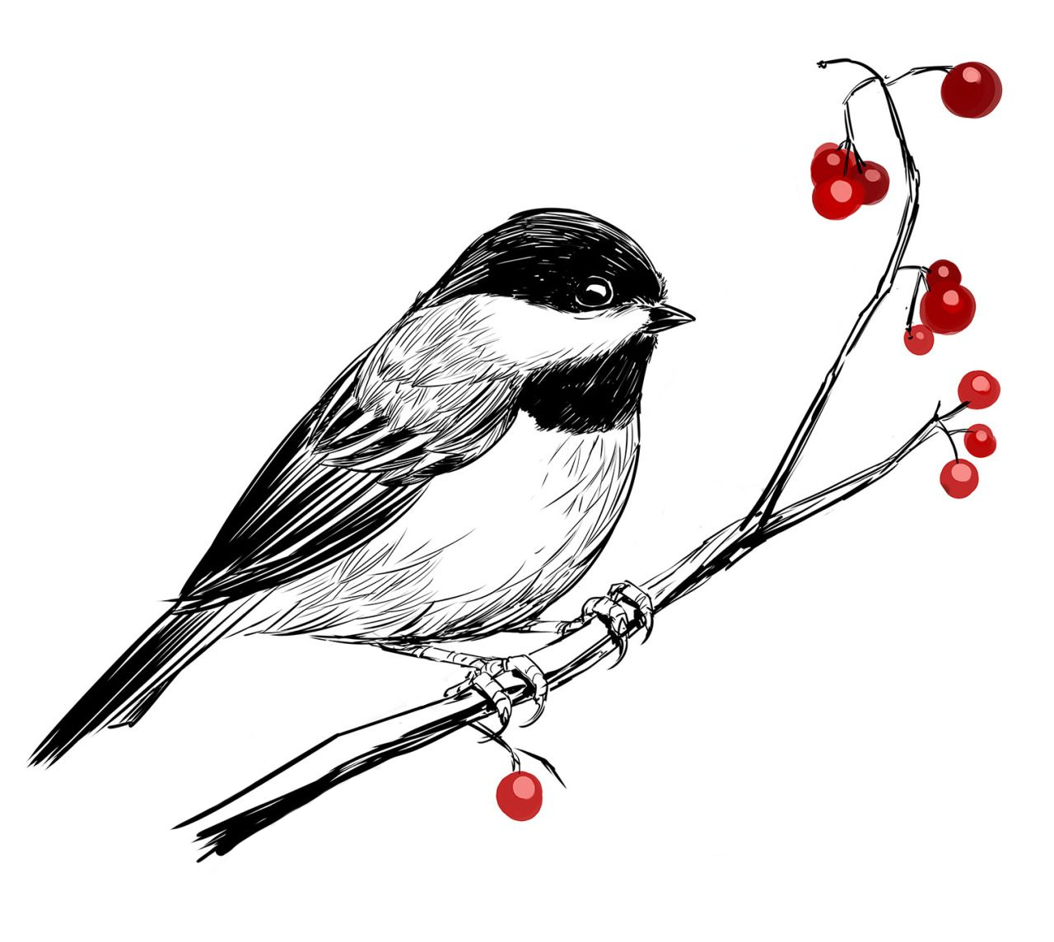
Chickadee Wait Queues
//The sleeper thread
waiter w;
auto irqs = x_lock.lock();
while (1) {
w.prepare(waitq);
if (f(x)) {
break;
}
x_lock.unlock(irqs);
w.block();
irqs = x_lock.lock();
}
w.clear();
//Compute using x
x_lock.unlock(irqs);
//The wakeup thread
void wt_func() {
spinlock_guard guard(x_lock);
//Code that makes f(x) true,
//and then . . .
wq.wake_all();
}
Grab the lock that protects x, because we’re about to check whether f(x) is true.
Notes:
[Ref: https://read.seas.harvard.edu/cs161/2020/doc/wait-queues/]

Slide 20
Chickadee Wait Queues
//The sleeper thread
waiter w;
auto irqs = x_lock.lock();
while (1) {
w.prepare(waitq);
if (f(x)) {
break;
}
x_lock.unlock(irqs);
w.block();
irqs = x_lock.lock();
}
w.clear();
//Compute using x
x_lock.unlock(irqs);
Add the current process to the wait queue, but don’t actually block yet! Then, see if we need to block. If not (because f(x) is true), break out of the loop with x_lock still held.

Slide 21
Chickadee Wait Queues
//The sleeper thread
waiter w;
auto irqs = x_lock.lock();
while (1) {
w.prepare(waitq);
if (f(x)) {
break;
}
x_lock.unlock(irqs);
w.block();
irqs = x_lock.lock();
}
w.clear();
//Compute using x
x_lock.unlock(irqs);
Remove the current process from the wait queue. Then, compute using x. Finally, release the lock.

Slide 22
Now imagine that we didn’t break out of the loop . . .

Slide 23
Chickadee Wait Queues
//The sleeper thread
waiter w;
auto irqs = x_lock.lock();
while (1) {
w.prepare(waitq);
if (f(x)) {
break;
}
x_lock.unlock(irqs);
w.block();
irqs = x_lock.lock();
}
w.clear();
//Compute using x
x_lock.unlock(irqs);
f(x) was false, so we must block. Release the lock (so that someone else can make f(x) true!), and go to sleep. When we wake up, we’ve been popped off the wait queue; acquire the lock again and see if f(x) is now true.

Slide 24
Chickadee Wait Queues
//The sleeper thread
waiter w;
auto irqs = x_lock.lock();
while (1) {
w.prepare(waitq);
if (f(x)) {
break;
}
x_lock.unlock(irqs);
w.block();
irqs = x_lock.lock();
}
w.clear();
//Compute using x
x_lock.unlock(irqs);
This eventually calls proc::yield() on the current process
Note that cpustate::scheduler() doesn’t know anything about the wait queue abstraction!
Compare this to OS161’s wchan abstraction

Slide 25
Notes:
Remember that thread_switch() is similar to Chickadee’s proc::yield(). In OS161’s thread switch, the wait queue and the associated spinlock have to be exposed to the scheduler.

Slide 26
SAID NO ONE IN CLASS

Slide 27
Chickadee Wait Queues
//The sleeper thread
waiter w;
auto irqs = x_lock.lock();
while (1) {
w.prepare(waitq);
if (f(x)) {
break;
}
x_lock.unlock(irqs);
w.block();
irqs = x_lock.lock();
}
w.clear();
//Compute using x
x_lock.unlock(irqs);
struct waiter {
proc* p_;
wait_queue* wq_;
list_links links_;
//...other stuff...
};
struct wait_queue {
list<waiter,...> q_;
spinlock lock_;
inline void wake_all();
};
Notes:
[Ref: https://read.seas.harvard.edu/cs161/2020/doc/wait-queues/]

Slide 28
Chickadee Wait Queues
Does waitq.lock_.lock()
Sets w.p_ to current()
Sets w.p_->pstate_ to ps_blocked; note that the associated kernel thread is still running!
Adds w to the list of waiters associated with the waitq
Does waitq.lock_.unlock()
//The sleeper thread
waiter w;
auto irqs = x_lock.lock();
while (1) {
w.prepare(waitq);
if (f(x)) {
break;
}
x_lock.unlock(irqs);
w.block();
irqs = x_lock.lock();
}
w.clear();
//Compute using x
x_lock.unlock(irqs);
Notes:
The function current() simply returns the struct proc for the currently-executing process.

Slide 29
Chickadee Wait Queues
//The sleeper thread
waiter w;
auto irqs = x_lock.lock();
while (1) {
w.prepare(waitq);
if (f(x)) {
break;
}
x_lock.unlock(irqs);
w.block();
irqs = x_lock.lock();
}
w.clear();
//Compute using x
x_lock.unlock(irqs);
Locks waitq.lock_
Calls w.p_->wake(), which will set w.p_->pstate_ to ps_runnable (because it was set to ps_blocked by w.prepare())
Removes the waiter from the linked list, if it is currently linked
Unlocks waitq.lock_

Slide 30
Chickadee Wait Queues
if(p_->pstate_ == proc::ps_blocked){
p_->yield(); //Allows another thread to run.
//Note that cpustate::schedule() will NOT
//add p_ to the CPU’s runqueue, because
//p_->pstate_ doesn’t equal ps_runnable!
} //else{
// /* p_->pstate_ was set to proc::ps_runnable
// * by a call to waitq.wakeall() that snuck
// * in before the call to w.block()! Recall
// * that p_->pstate_ is a std:atomic<int>.*/
//}
clear();
//The sleeper thread
waiter w;
auto irqs = x_lock.lock();
while (1) {
w.prepare(waitq);
if (f(x)) {
break;
}
x_lock.unlock(irqs);
w.block();
irqs = x_lock.lock();
}
w.clear();
//Compute using x
x_lock.unlock(irqs);
Notes:
Note that cpustate::schedule() doesn’t add a blocked process to the runqueue; however, the scheduler WILL pick a new process to run. So the sleeper thread has indeed yielded the CPU!

Slide 31
Chickadee Wait Queues
//In the wakeup thread...
void f() {
spinlock_guard guard(x_lock);
//Stuff making f(x) true, then...
wq.wake_all();
}
void wait_queue::wake_all() {
spinlock_guard guard(lock_);
while (auto w = q_.pop_front()) {
w->wake();
}
}
void waiter::wake() {
p_->wake();
}
void proc::wake(...) {
int s = ps_blocked;
if (pstate_.compare_exchange_strong(s,
ps_runnable)) {
cpus[cpu_].enqueue(this);
}
}

Slide 32
Wakeup thread makes f(x) true, so the sleeper will never actually try to block; it will break out of the loop, and then w.clear() will remove w from the waitq and set w.p_’s state to ps_runnable (overwriting the ps_blocked set by w.prepare()).
//The sleeper thread
waiter w;
auto irqs = x_lock.lock();
while (1) {
w.prepare(waitq);
if (f(x)) {
break;
}
x_lock.unlock(irqs);
w.block();
irqs = x_lock.lock();
}
w.clear();
//Compute using x
x_lock.unlock(irqs);
//The wakeup thread
void wt_func() {
spinlock_guard guard(x_lock);
//Stuff making f(x) true, then...
wq.wake_all();
}
void wait_queue::wake_all() {
spinlock_guard guard(lock_);
while (auto w = q_.pop_front()) {
w->wake();
}
}
void waiter::wake() {
//Calls p_->wake()
}
Notes:
Note that, when the waiter calls wt_func(), there isn’t anyone queued up in the wait queue! So, no process will have its wake() method called.

Slide 33
Wakeup thread makes f(x) true, sets w.p_->pstate_ = ps_runnable via wq.wake_all(), so
w.block() won’t call w.p_->yield(), letting the sleeper immediately try to grab the lock.
//The sleeper thread
waiter w;
auto irqs = x_lock.lock();
while (1) {
w.prepare(waitq);
if (f(x)) {
break;
}
x_lock.unlock(irqs);
w.block();
irqs = x_lock.lock();
}
w.clear();
//Compute using x
x_lock.unlock(irqs);
//The wakeup thread
void wt_func() {
spinlock_guard guard(x_lock);
//Stuff making f(x) true, then...
wq.wake_all();
}
void wait_queue::wake_all() {
spinlock_guard guard(lock_);
while (auto w = q_.pop_front()) {
w->wake();
}
}
void waiter::wake() {
//Calls p_->wake()
}
void proc::wake(...) {
int s = ps_blocked;
if (pstate_.compare_exchange_strong(s,
ps_runnable)) {
cpus[cpu_].enqueue(this); //Note that
//cpustate::enqueue() is a nop if
//the passed-in process is the
//currently-running process!
}
}

Slide 34
Wakeup thread makes f(x) true, triggers proc::wake() (which sees that
w.p_->pstate_ is already ps_runnable) and then the sleeper grabs the lock.
//The sleeper thread
waiter w;
auto irqs = x_lock.lock();
while (1) {
w.prepare(waitq);
if (f(x)) {
break;
}
x_lock.unlock(irqs);
w.block();
irqs = x_lock.lock();
}
w.clear();
//Compute using x
x_lock.unlock(irqs);
//The wakeup thread
void wt_func() {
spinlock_guard guard(x_lock);
//Stuff making f(x) true, then...
wq.wake_all();
}
void wait_queue::wake_all() {
spinlock_guard guard(lock_);
while (auto w = q_.pop_front()) {
w->wake();
}
}
void waiter::wake() {
//Calls p_->wake()
}
void proc::wake(...) {
int s = ps_blocked;
if (pstate_.compare_exchange_strong(s,
ps_runnable)) {
cpus[cpu_].enqueue(this); //Note that
//cpustate::enqueue() is a nop if
//the passed-in process is the
//currently-running process!
}
}
Notes:
proc::wake() sees that the process’s pstate_ is already ps_runnable because, when the process returned from the yield() call inside of w.block(), the scheduler set the process’s pstate_ to ps_runnable.
[Note that, if there are multiple sleepers, then the first one to grab x_lock might manipulate x in a way that makes f(x) false for the other awoken threads. For example, if x represents a single item to be consumed by a single blocker, then all but one of the awoken threads will discover that f(x) is false.]

Slide 35
Wakeup thread has made f(x) true, which the sleeper will discover if the sleeper tries to enter the wait queue again.
//The sleeper thread
waiter w;
auto irqs = x_lock.lock();
while (1) {
w.prepare(waitq);
if (f(x)) {
break;
}
x_lock.unlock(irqs);
w.block();
irqs = x_lock.lock();
}
w.clear();
//Compute using x
x_lock.unlock(irqs);
//The wakeup thread
void wt_func() {
spinlock_guard guard(x_lock);
//Stuff making f(x) true, then...
wq.wake_all();
}
void wait_queue::wake_all() {
spinlock_guard guard(lock_);
while (auto w = q_.pop_front()) {
w->wake();
}
}
void waiter::wake() {
//Calls p_->wake()
}

