Slide 1
Scheduling
CS 161: Lecture 17
4/5/21

Slide 2
Outline
Introduction to Scheduling
Linux’s CFS Scheduler
Cache Consistency and CPU Affinity

Slide 3
Scheduling: Which Process Should Run Now?
Different processes have different behaviors
IO-bound: A process mostly waits for IOs to complete
CPU-bound: A process issues few IOs, mostly does computation
It’s often a good idea to prioritize IO-bound processes
Allow tasks blocked on user input, network, etc. to respond quickly and initiate new (and slow!) IOs if necessary
A process may change its behavior throughout its execution—the scheduler must notice and adjust!

Slide 4
Ex: An IO-bound disk grep, and a CPU-bound crypto calculation on a single-core machine
Crypto task finishes
Non-preemptive
first-come-first-serve
Crypto
CPU
screws IO-bound tasks
Waiting
Waiting on CPU :-(
Waiting
Waiting
Grep
on IO
on IO
on IO
Time
Crypto
CPU
CPU
CPU
Preempting
CPU-bound tasks
for IO-bound ones
Waiting
Waiting
Waiting
Grep
on IO
on IO
on IO
improves utilization
of CPU and IO devices
Time

Slide 5
Evaluating Scheduler Algorithms
Utilization
How often are the CPUs and IO devices kept busy?
Note that CPUs and IO devices can simultaneously be busy (which is good!)
Fairness
Higher-priority tasks should receive more CPU time . . .
. . . but no task should starve
Interactive latency
A task that mostly blocks on IO should run as soon as IO completes
Ex: Text editor waiting on keypress
Computational overhead of the scheduler as a function of:
The number of CPUs
The number of runnable tasks
The number of waiting tasks

Slide 6
Priority-based Round-Robin
Scheduler
(priority-deque)
Priority queues
Idea: Maintain several ready queues, one for each priority level
Each queue is FIFO
Scheduler finds highest-priority non-empty queue and runs the first task in that queue
Good: Allows higher-priority tasks to receive more CPU time
Bad: Low-priority tasks may starve!
Solution: Aging (the longer a task waits without getting the CPU, the higher its priority becomes)
Bad: IO-bound tasks may suffer long response times if not given high priorities
Bad: Priority inversion
Blocking
operation
Wait queues

Slide 7
Priority Inversion
Assume that a system has three tasks T1, T2, and T3
Priority: T3 > T2 > T1
Imagine that T1 and T3 both use the same lock . . .
T3
Waiting on IO
Running
Waiting on lock
Waiting on lock
T3 is the highest
Tries to acquire lock
priority thread,
T2
Waiting on IO
Running
but it’s blocked
Ready
Running
by T2 and T1!
T1
Running
Waiting on IO
Ready
Ready
Time
Acquires lock

Slide 8
I HAZ A PRIORITY INVERSION
Notes:
[Ref: http://www.drdobbs.com/jvm/what-is-priority-inversion-and-how-do-yo/230600008
http://www.cse.chalmers.se/edu/year/2015/course/EDA222/Documents/Misc/Report_MarsPathFinder.pdf
http://research.microsoft.com/en-us/um/people/mbj/Mars_Pathfinder/Mars_Pathfinder.html
http://space.stackexchange.com/a/9181]

Slide 9
Priority Inheritance
A task which owns a lock inherits the highest priority of any task that wishes to acquire the lock
T3
Waiting on IO
Running
Waiting on lock
Running
Tries to acquire lock
Acquires lock
T2
Waiting on IO
Ready
Ready
Ready
T1
Running
Waiting on IO
Running
Ready
Time
Acquires lock
Inherits T3’s priority
Releases lock, drops priority

Slide 10
Outline
Introduction to Scheduling
Linux’s CFS Scheduler
Cache Consistency and CPU Affinity

Slide 11
Linux’s “Completely Fair Scheduler” (CFS)
For now, make these simplifying assumptions:
There is only one CPU
All tasks have the same priority
There are always T tasks ready to run at any moment
Basic idea: each task gets 1/T of the CPU’s resources
CFS tries to model an “ideal CPU” that runs each task simultaneously, but at 1/T the CPU’s clock speed
A real CPU can only run a single task at once, so a task will get “ahead” or “behind” of its 1/T allotment
CFS tracks how long each task has actually run; during a scheduling decision (e.g., timer interrupt), picks the task with lowest runtime so far
Notes:
[Refs:
[1] https://criticalblue.com/news/wp-content/uploads/2013/12/linux_scheduler_notes_final.pdf
[2] http://www.ibm.com/developerworks/library/l-completely-fair-scheduler/
[3] https://web.archive.org/web/20120711234506/http://kerneltrap.org/node/8059
[4] https://www.kernel.org/doc/Documentation/scheduler/sched-design-CFS.txt
[5] https://web.archive.org/web/20120711234506/http://kerneltrap.org/node/8059
[6] https://www.cs.unm.edu/~eschulte/classes/cs587/data/bfs-v-cfs_groves-knockel-schulte.pdf
]

Slide 12
Red-black
10
binary trees
3
13
0
7
15
5
8
Self-balancing: Insertions and deletions ensure that the longest tree path is at most twice the length of any other path
Guaranteed logarithmic: All insertions, deletions, and searches run in O(log N) time
Notes:
[The rules of red-black trees, as described by the infallible Wikipedia:
1. Each node is either red or black.
2. The root is black.
3. All leaves (NIL) are black.
4. If a node is red, then both its children are black.
5. Every path from a given node to any of its descendant NIL nodes contains the same number of black nodes.
Ref: https://en.wikipedia.org/wiki/Red%E2%80%93black_tree]

Slide 13
t
3
23
CFS scheduler
t
t
5
0
Associate each task with its elapsed runtime (nanosecond granularity)
For each core, keep runnable tasks in a red-black tree, with an insertion key of elapsed runtime
A newly-created task is tagged with the minimal runtime in the tree
Next task to run is just the left-most task in tree!
7
37
t
1
5
15
42
t
t
2
4
Scheduler picks this task to run, removes it from tree
Notes:
A newly-created task is tagged with the minimal runtime in the tree. By doing this, we ensure two things: first, we ensure that the task will get a CPU burst very soon in the future. However, we also ensure that the task doesn’t then hog the CPU for a long time---soon, the other task with the minimal runtime will get to run.

Slide 14
t
3
23
t
t
5
0
7
37
t
1
15
42
Timer interrupt fires, scheduler runs
t
4
Now, t₂ no longer has the smallest elapsed runtime
So, scheduler reinserts t₂ into the tree and runs t₀!
5
Runs for 20 time units
25
t
t
2
2

Slide 15
Classic CFS Example
Suppose there are two tasks:
Video rendering application (CPU-intensive, long-running, non-interactive)
Word processor (interactive, only uses CPU for bursts)
Both tasks start with an elapsed runtime of 0
Video rendering task quickly accumulates runtime . . .
. . . but word processor’s runtime stays low (task is mainly blocked on IO)
So, whenever word processor receives keyboard/mouse input and wakes up, it will be the left-most task, and immediately get scheduled

Slide 16
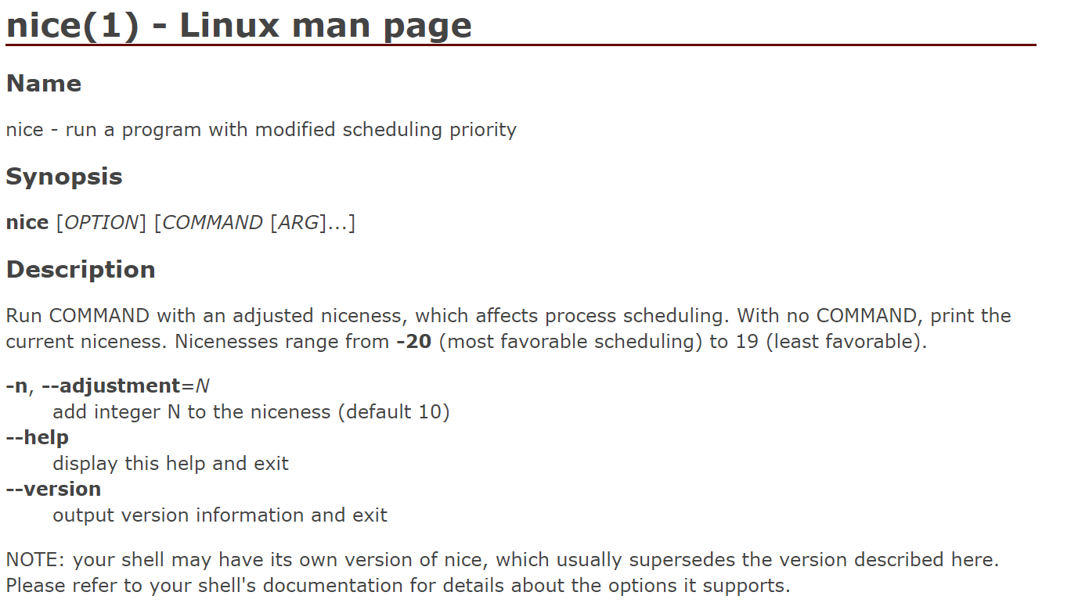
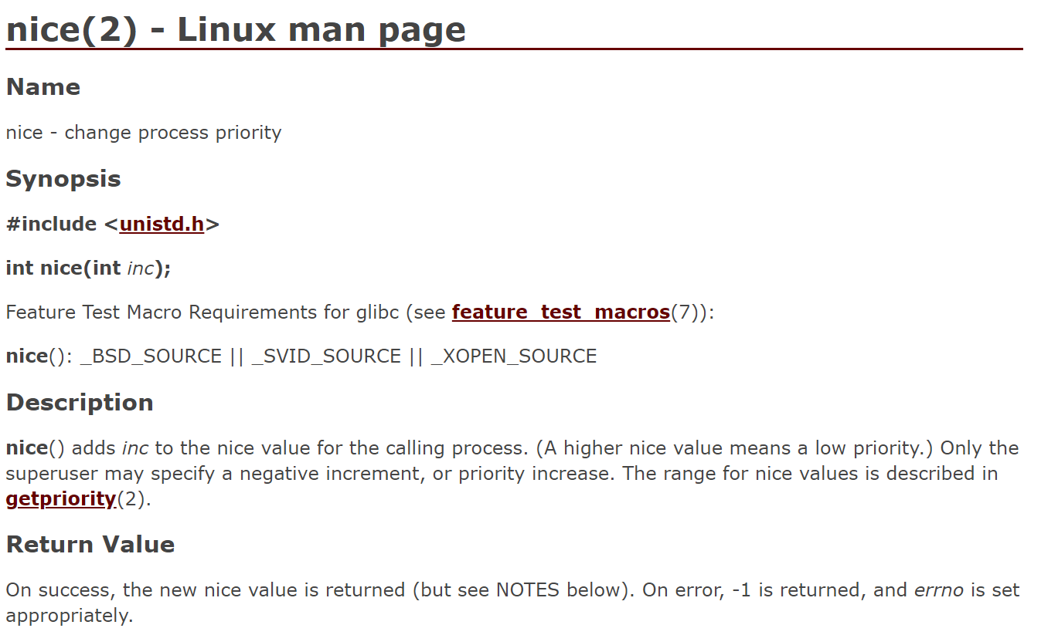
It’s Nice To Be Nice

Slide 17
Task Priorities in CFS
/*
* Nice levels are multiplicative, with a gentle 10% change for every
* nice level changed. I.e. when a CPU-bound task goes from nice 0 to
* nice 1, it will get ~10% less CPU time than another CPU-bound task
* that remained on nice 0.
*
* The "10% effect" is relative and cumulative: from _any_ nice level,
* if you go up 1 level, it's -10% CPU usage, if you go down 1 level
* it's +10% CPU usage. (to achieve that we use a multiplier of 1.25.
* If a task goes up by ~10% and another task goes down by ~10% then
* the relative distance between them is ~25%.)
*/
static const int prio_to_weight[40] = {
/* -20 */ 88761, 71755, 56483, 46273, 36291,
/* -15 */ 29154, 23254, 18705, 14949, 11916,
/* -10 */ 9548, 7620, 6100, 4904, 3906,
/* -5 */ 3121, 2501, 1991, 1586, 1277,
/* 0 */ 1024, 820, 655, 526, 423,
/* 5 */ 335, 272, 215, 172, 137,
/* 10 */ 110, 87, 70, 56, 45,
/* 15 */ 36, 29, 23, 18, 15,
};
Notes:
Note that there is an entry in the array for each possible nice value.
[Ref: http://stackoverflow.com/questions/19181834/what-is-the-concept-of-vruntime-in-cfs]

Slide 18
Task Priorities in CFS
CFS incorporates nice values by scaling a task’s elapsed runtime
The end result is that:
[nice=0] Virtual execution time equals physical execution time
[nice<0] Virtual execution time less than physical execution time
[nice>0] Virtual execution time greater than physical execution time
curr->vruntime is used as a task’s key in the RB tree
delta_exec = now – curr->exec_start;
delta_exec_weighed = delta_exec *
(NICE_0_LOAD / t->load.weight);
curr->vruntime += delta_exec_weighted;

Slide 19
Making Scheduling Efficient
Linux scheduler (circa v2.4)
The runqueue wasn’t sorted!
Newly-runnable processes added to the end: O(1)
Finding the best process to run required linear scan: O(n)
O(n) scheduling was kinda tolerable on a single-core machine, but generated a lot of lock contention on multi-core machines
t
1
Global runnable queue
t
2
t
3
…
Single spinlock
t
4
Scheduler logic

Slide 20
Linux scheduler now: CFS
Uses a red-black tree per core, to avoid cross-core lock contention
However, cross-core load balancing is needed to ensure:
All cores are highly-utilized
All of the high-priority tasks don’t end up on a small number of cores
Scheduler logic
Scheduler logic
Scheduler logic
Scheduler logic

Slide 21
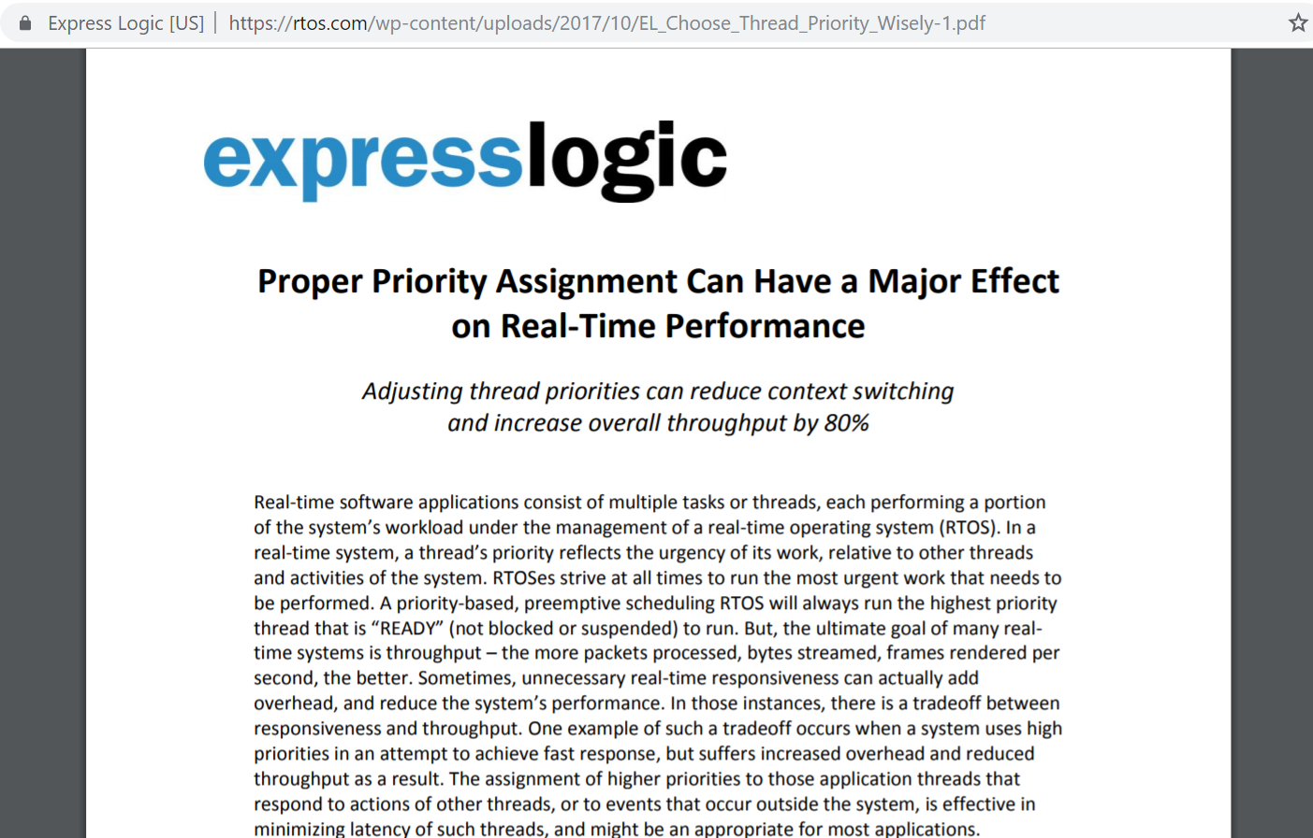
Which Priorities Should I Assign To My Tasks?
Notes:
[Ref: https://rtos.com/wp-content/uploads/2017/10/EL_Choose_Thread_Priority_Wisely-1.pdf]

Slide 22
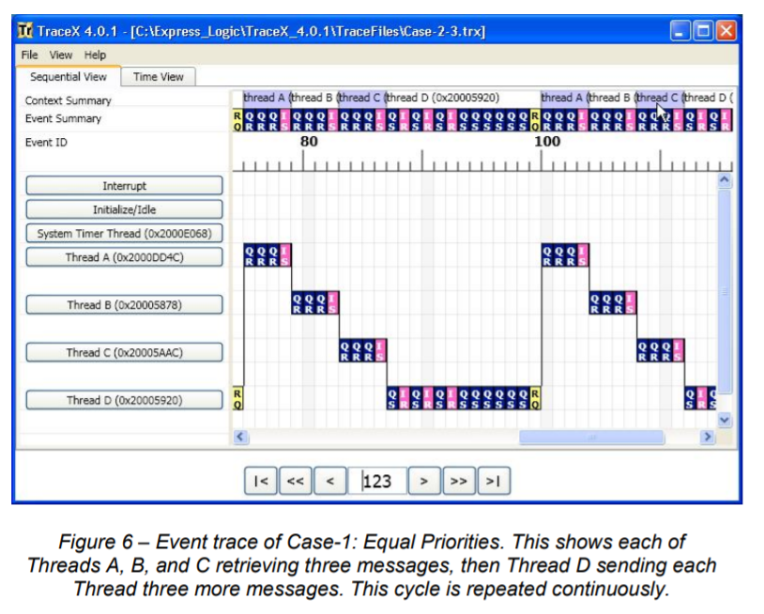
Suppose that there is one CPU and four threads (A, B, C, and D)
Threads A, B, and C are message receivers, repeatedly blocking until a message from Thread D arrives
Thread D repeatedly:
Sends a message to A, B, C
Yields
If each thread has the same priority . . .

Slide 23
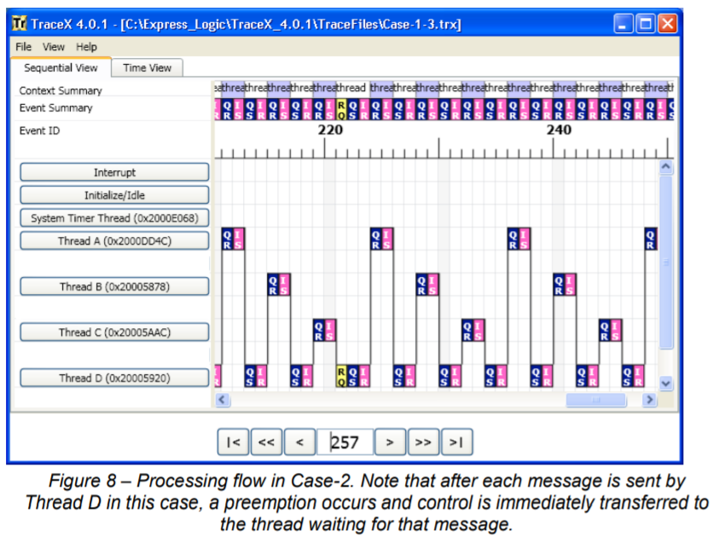
Suppose that there is one CPU and four threads (A, B, C, and D)
Threads A, B, and C are message receivers, repeatedly blocking until a message from Thread D arrives
Thread D repeatedly:
Sends a message to A, B, C
Yields
Pri(A) > Pri(B) > Pri(C) > Pri(D)
Look at all the context switches!
Notes:
[Note that the timeline starts with the partially cut-off box in the lower-left, showing that D sends a message to A. Once that happens, A is now ready to run, and since Pri(A) > Pri(D), the scheduler runs A. The A thread runs and then blocks on a message receive. Thread D then gets to run, sending a message to B. Since Pri(B) > Pri(D), the scheduler then runs B, etc.]

Slide 24
Outline
Introduction to Scheduling
Linux’s CFS Scheduler
Cache Consistency and CPU Affinity

Slide 25
What Happens After A Write Leaves A Store Buffer?

Slide 26
x86: Store Buffers, Multiple Cores, and LOCK Prefixes
A recap of what we’ve learned
A core issues writes in FIFO program order to the local store buffer
During a read, a core checks its store buffer before L*/RAM
An mfence:
Forces earlier program-order memory operations to complete before allowing subsequent ones to complete
Flushes the store buffer
A LOCK’d instruction:
Prevents other cores from reading/writing L*/RAM and reading from local store buffers
Flushes the store buffer
More generally, a store is only released from the store buffer if all prior program-order memory operations have completed
Store
buffer
(FIFO)
Store
buffer
(FIFO)
LOCK prefix lock
(hardware-maintained)
L1 i-cache
L1 d-cache
L1 i-cache
L1 d-cache
L2 cache
L2 cache
L3 cache
RAM
Notes:
[Ref: https://www.cl.cam.ac.uk/~pes20/weakmemory/cacm.pdf]

Slide 27
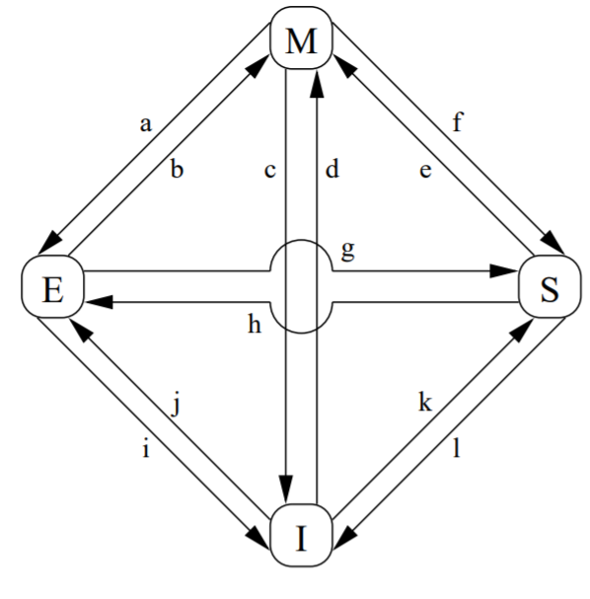
The MESI Protocol
At any given moment, a line in a CPU’s cache can be:
Invalid: The line does not hold valid data
Shared: The line is valid and . . .
May also reside in the caches of other CPUs
Cannot be modified without consulting the other caches
Reflects the content of RAM, and thus can be evicted without requiring a write to RAM
Exclusive: The line is valid and . . .
Only exists in the local cache
Can be updated without consulting other caches
Reflects the content of RAM, and thus can be evicted without requiring a write to RAM
Modified: The line is valid and . . .
Only exists in the local cache
Has been updated by the local CPU
Does not reflect the content of RAM, so eviction requires an update to RAM (or a transfer of the line to another cache)
Notes:
[Ref: CMU’s 15-418 Lecture 10 on cache coherence: https://www.cs.cmu.edu/afs/cs/academic/class/15418-s12/www/lectures/10_coherence.pdf
“Memory Barriers: a Hardware View for Software Hackers” by McKenney http://www.rdrop.com/users/paulmck/scalability/paper/whymb.2010.07.23a.pdf
The first reference has a better explanation of the read/write behavior that causes transitions between the various states. The second reference provides a better idea of the cache coherence messages that are sent; the second reference also provides a more comprehensive introduction to the memory hierarchy (e.g., not only MESI, but store buffers and memory barriers). The diagram in the slide above is taken from the second reference.]

Slide 28
The MESI Protocol
Imagine a dual-core system in which each core has a single cache line . . .
Address
Address
Data
State
Data
State
Invalid
Invalid
Invalid
Invalid
Invalid
Invalid
RAM
Data: d₀
Address: x

Slide 29
The MESI Protocol
Read x
Address
Address
Data
State
Data
State
Invalid
Invalid
d₀
x
Invalid
Invalid
Invalid
Invalid
Exclusive
Hey, other cache, do you have x’s data?
RAM
Nope, try RAM!
Data: d₀
(j) Invalid to exclusive: The right core reads data that wasn’t already in any cache
Here’s x’s data!
Hey RAM, gimme x’s data!
Address: x
The right core can now read x without generating any cross-cache traffic.

Slide 30
The MESI Protocol
Read x
Address
Address
Data
State
Data
State
d₀
x
Shared
d₀
x
Shared
Invalid
Invalid
Invalid
Exclusive
Hey, other cache, do you have x’s data?
Yeah, here it is!
RAM
Data: d₀
[Left CPU]
(k) Invalid to shared: CPU reads data that wasn’t in the local cache (but was in the other CPU’s cache)
[Right CPU]
(g) Exclusive to shared: The right CPU lost its exclusive access to the data
Both cores can now read x without generating cross-cache coherence traffic.
Address: x

Slide 31
The MESI Protocol
Write x
Address
Address
Data
State
Data
State
d₁
x
Shared
x
Shared
d₀
d₀
Invalid
Invalid
Modified
Invalid
Invalidation complete!
RAM
Invalidate x
Data: d₀
[Left CPU]
(e) Shared to modified: The left CPU’s update to x caused this transition . . .
[Right CPU]
(l) Shared to invalid: . . . and forced the right CPU to drop the cache line.
Address: x
The data in RAM is now stale!

Slide 32
The MESI Protocol
Read y
Address
Address
Data
State
Data
State
d₀
y
d₁
x
Modified
Invalid
Invalid
Invalid
Exclusive
Hey RAM, gimme y’s data!
Hey, other cache, do you have y’s data?
RAM
Nope, try RAM!
Data: d₀
Data: d₁
Here’s y’s data!
x’s cache line is evicted, to make space for y’s cache
line!
Address: x
The data in RAM is now stale!
x’s data in RAM is now fresh!

Slide 33
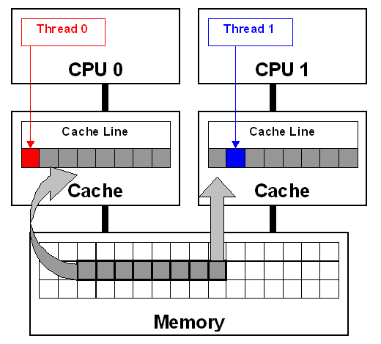
Notes:
[Ref: https://software.intel.com/content/www/us/en/develop/articles/avoiding-and-identifying-false-sharing-among-threads.html]

Slide 34
The Costs of Cache Coherency
Cache maintenance traffic increases the latency of memory operations
Ideally, if you run different threads from one address space on multiple cores, each thread works on different cache lines
Each line will transition to “exclusive” (read) or “modified” (write) on the first cache miss
After that, no additional coherence traffic is needed for reads or writes to the line—note that a transition from “exclusive” to “modified” on a write requires no coherence traffic, since no other cache has the line
Ideally, a thread would only be scheduled upon a single core in a multicore system
This way, all of the thread’s memory data could hopefully stay in the same core’s L1/2 cache!
Notes:
[Ref: https://stackoverflow.com/questions/7373033/overhead-of-spin-loop-in-terms-of-cache-coherence]

Slide 35
CPU Affinity in Linux
struct task_struct{
volatile long state; //TASK_RUNNING,
//TASK_ZOMBIE,
//etc.
void *stack; //Kernel stack
int exit_code;
struct mm_struct *mm;//Address space info
unsigned long cpus_allowed;
//Bitmask representing which
//cpus the task can run on
//...other stuff...
};
Notes:
Here’s the task_struct that Linux uses. In Linux, the word “task” means “kernel-level thread.”

