Slide 1
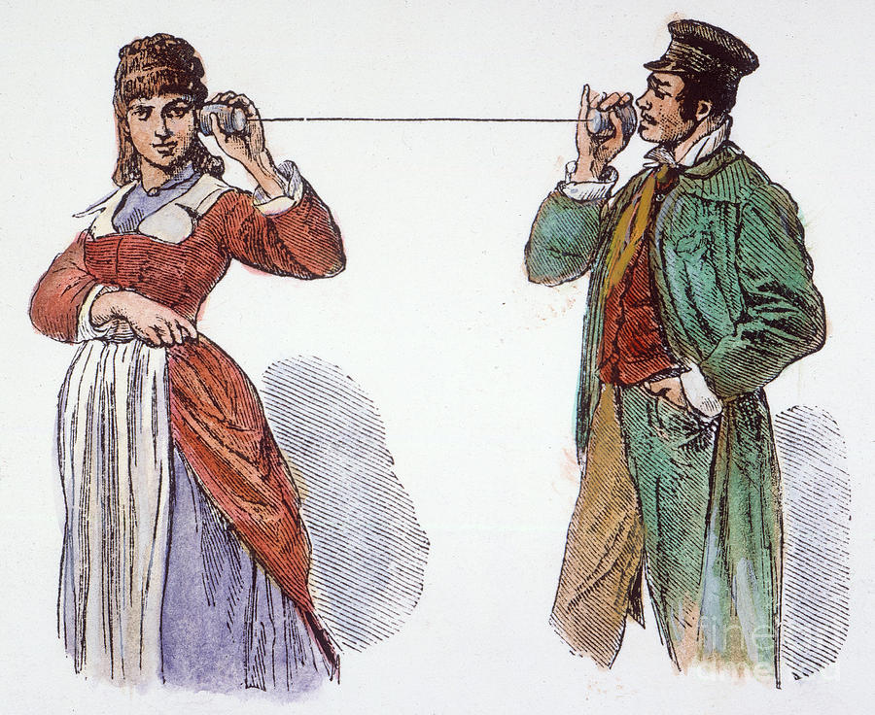
Networking
CS 161: Lecture 19
4/12/21

Slide 2
Network Cards and the Internet
A network card exchanges data between machines connected by a shared physical media
Ex: IEEE 802.11 protocol handles Wi-fi (i.e., radio) exchanges
Ex: IEEE 802.3 protocol handles Ethernet (i.e., wired) exchanges
Each network card has a unique identifier called a MAC address
00:0a:95:9d:68:16
bc:a2:3e:91:c8:da
f0:2d:08:7d:d5:92
Dst: f0:2d:08:7d:d5:92
Src: 00:0a:95:9d:68:16
Frame len: 1430
Data: <bytes>
Checksum: 2fbd0925
Ethernet frame
Ethernet switch

Slide 3
Network Cards and the Internet
The Internet™© consists of protocols that are layered above single-hop, point-to-point protocols like Ethernet
Example: The IP protocol connects machines across multiple hops
An Ethernet frame’s data is an IP packet
IP packet’s header has a source IP address and destination IP address
The “gateway” on a LAN knows how to forward IP packets destined for external hosts
00:0a:95:9d:68:16
bc:a2:3e:91:c8:da
f0:2d:08:7d:d5:92
Dst: f0:2d:08:7d:d5:92
Src: 00:0a:95:9d:68:16
Frame len: 1430
Data: <bytes>
Checksum: 2fbd0925
Ethernet frame
Ethernet switch

Slide 4
Dst: 172.217.3.110
172.217.3.110
25:98:a0:b7:9c:ac
Src: 50.235.189.28
Packet len: 1412
Data: <bytes>
Checksum: 9b77a14b
IP packet
The Internet™©
50.235.189.28
50.235.189.29
50.235.189.30
00:0a:95:9d:68:16
bc:a2:3e:91:c8:da
f0:2d:08:7d:d5:92
Dst: f0:2d:08:7d:d5:92
Gateway
Src: 00:0a:95:9d:68:16
Frame len: 1430
Data: <bytes>
Checksum: 2fbd0925
Ethernet frame
Ethernet switch

Slide 5
The OSI Network Stack
Ex: HTTP,
SSH, POP
Application
Application-specific data
Layer 4: Transport
Do we care about streams? Packet drops, duplications, or reordering?
Ex: TCP,
UDP
Layer 3: Network
How are packets exchanged between hosts separated by many hops?
Ex: IP
Layer 2: Link
How are frames transmitted between hosts on the same physical medium?
Ex: WiFi,
Ethernet
Layer 1: Physical
How are 0s and 1s encoded in the physical medium?
Notes:
POP is a protocol that allows an email client to download emails from an email server; SMTP is the common protocol that is used by a client to *submit* an email to an email server.

Slide 6
Today’s lecture: How does the kernel . . .
Receive an arriving Ethernet frame from a NIC
Send an outgoing Ethernet frame to the NIC
. . . ?
Notes:
[In the networking community, “packet” is often used as a very generic term for a piece of data exchanged between two machines. So, you’ll often hear phrases like “Ethernet packet” when, strictly speaking, the correct phrase is “Ethernet *frame*”.]

Slide 7
Outline
The OSI Model
NIC Basics
Ring Buffers
DMA
IOMMUs
NIC Optimizations
Interrupt handler splitting
Interrupt coalescing
DPDK

Slide 8
Network Cards: Ring Buffers
NICs typically use the ring abstraction to exchange packets with the OS
A ring is a circular buffer of packet descriptors
NIC expects OS to:
Allocate an RX (“receive”) ring and TX (“transmit”) ring in RAM
Configure NIC with the memory locations of the rings
If a NIC supports multiple RX rings and TX rings, then multiple CPUs can simultaneously receive and send packets
RX ring
Head
Tail
Notes:
[Ref: http://lettieri.iet.unipi.it/virtualization/2018/20161124-io-paravirtualization-tour.pdf
https://pdos.csail.mit.edu/6.828/2018/labs/lab6/
]

Slide 9
Pointer to packet buffer
Buffer len
bufContainsPkt?
Other stuff
Owned by OS
Owned by NIC
Owned by OS
RX ring
Head
Tail
Memory-mapped register pointing to first descriptor that NIC can use to store packet
Incremented by NIC upon copying packet to descriptor’s buffer
Memory-mapped register pointing to first descriptor that NIC cannot use to store packet
Incremented by OS once software-level packet handling completes

Slide 10
When a new packet arrives, the NIC uses DMA to:
Read the descriptor at Head to find the associated buffer
Write the buffer with the new packet’s data
Set the descriptor’s bufContainsPkt? to 1
Then, the NIC:
Increments the memory-mapped register Head
Discards local copy of packet and raises an interrupt
OS will eventually increment Tail to position of packet
System RAM
Empty buf
RX ring
bcp:0
bcp:1
Head
Tail
Packet
On-NIC RAM
Packet
Notes:
[Remember that the RX ring lives in system RAM. This is why the NIC has to use DMA to read and write ring metadata that’s pointed to by `Head`.]

Slide 11
If NIC increments Head and discovers that Head==Tail . . .
There are no available buffers to DMA incoming packets into!
NIC will drop packets until the OS allocates more buffers and pokes the NIC by incrementing Tail
Owned by OS
Owned by NIC
RX ring
Tail
Head

Slide 12
If OS increments Tail and discovers that Head==(Tail+1)%N . . .
The OS has processed all of the packets!
OS will wait for the NIC to raise an interrupt to indicate that new packets have arrived
Owned by OS
Owned by NIC
RX ring
Head
Tail
Points to the first descriptor that NIC cannot use to store packet
Notes:
[So, there will always be at least one descriptor slot that is unused.]

Slide 13
How Does TX Work?

Slide 14
Pointer to packet buffer
Buffer len
pktSent?
Other stuff
Owned by OS
Owned by NIC
Owned by OS
TX ring
Head
Tail
Memory-mapped register pointing to first descriptor whose packet should be transmitted by NIC
Incremented by NIC upon sending a packet
Memory-mapped register pointing to first descriptor that does not correspond to a packet to send
Incremented by OS once a packet to send has been placed in RAM

Slide 15
Initially, there are no packets to send
When the OS receives a packet to send, the OS:
Writes the descriptor at Tail to point to the packet buffer
Sets the descriptor’s pktSent? to 0
Increments Tail
The write to the memory-mapped register Tail pokes the NIC, informing it of a packet to transmit
System RAM
Packet
TX ring
ps?: 0
Tail
Head
On-NIC RAM

Slide 16
The NIC uses DMA to:
Read the descriptor at Head and discover the buffer location
Read the buffer into on-NIC RAM
Set the packetSent? flag to 1
The NIC then increments Head and raises an interrupt to inform OS of transmitted packet
System RAM
Packet
Packet
TX ring
ps?:1
ps?: 0
Tail
Head
On-NIC RAM
Notes:
[As with the RX scenario, if Head==Tail, that means that there are no more descriptors for the NIC to process. In contrast, if Head==(Tail+1)%N, then the NIC is backlogged, and the OS must wait before asking the NIC to handle another packet.]

Slide 17
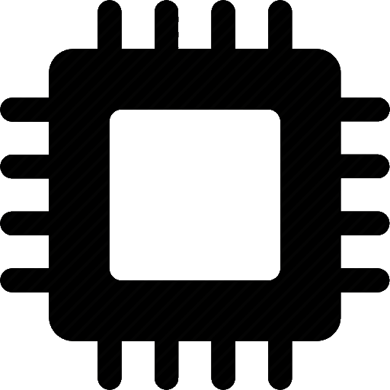
IOMMUs
Modern computers place DMA-capable devices behind an IO-specific MMU
A device generates memory references that target a “device physical” address space
The IOMMU maps device physical RAM to general-purpose physical RAM
The IOMMU has a TLB and a page table pointer
The page table (which lives in general-purpose physical RAM) is controlled by the OS on the general-purpose CPUs
IOMMUs enable cool stuff like:
Preventing a faulty device (or device driver) from DMA’ing arbitrary memory
Enabling legacy 32-bit devices to access more than 4 GB of general-purpose physical RAM
Safely allowing a device to DMA directly to/from user-level buffers (thereby avoiding data copying between user buffers and kernel buffers!)
%cr3
TLB
%cr3
TLB
MMU
MMU
Root complex
RAM
%rt
TLB
IOMMU
PCIe
RID
PCIe
RID
PCIe device
PCIe device
Notes:
The `%rt` register is the “root table” register. It points to the base of the page table that is used by the IOMMU.
[As mention on page 20 of the reference below, “The IOMMU provides no direct indication to an I/O device of a failed translation when processing an untranslated posted request. This is in contrast to the page fault mechanism employed by CPU’s MMU.”]
[Ref: Sections 2 and 3 of “Bypassing IOMMU Protection against I/O Attacks” by Morgan et al (https://hal.archives-ouvertes.fr/hal-01419962/document)]
[Ref: https://www.amd.com/system/files/TechDocs/48882_IOMMU.pdf //Sections 1 and 2.2 are most relevant
http://www.cs.technion.ac.il/~dan/papers/riommu-asplos-2015.pdf //Section 2.3
https://compas.cs.stonybrook.edu/~nhonarmand/courses/sp17/cse506/slides/hw_io_virtualization.pdf
]

Slide 18
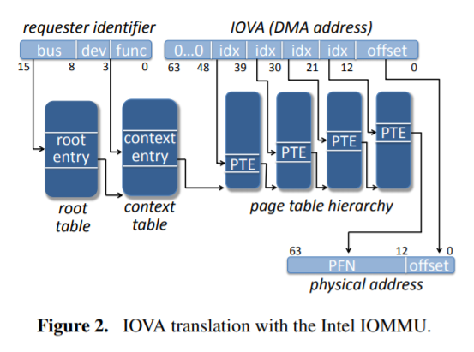
Notes:
The basic idea is that the %rt register points to a page table who last entry is a pointer to another page table. The IOMMU uses a device’s RID to traverse the root page table and determine which device-specific page table should be used to translate memory addresses for the device.

Slide 19
Outline
The OSI Model
NIC Basics
Ring Buffers
DMA
IOMMUs
NIC Optimizations
Interrupt handler splitting
Interrupt coalescing
DPDK

Slide 20
Keeping Machines Responsive
In commodity OSes, an interrupt handler often disables interrupts during some/all parts of execution
Ex: To avoid grabbing a lock, being interrupted, and then deadlocking with another interrupt handler that wants to grab the lock
Ex: To avoid a device driver having to handle recursively-nested interrupts
Disabling interrupts makes a machine unresponsive to interrupts
So, an interrupt handler should be fast (to keep the machine responsive) . . .
. . . but a handler may have a lot of work to do!
Process₀
Process₁
Process₂
Could we let interrupt handlers sleep?
In most OSes, an interrupt handler:
Runs on a per-CPU stack
Lacks a process context that can be scheduled
So, interrupt handlers can’t sleep!
CPU₀ stack
CPU₁ stack
User stack
Kernel stack
Notes:
[Aside: Remember that Chickadee does not handle interrupts on the per-cpu stack; see k-exception.S and proc::exception(). At the very beginning of the exception-handling path, the hardware has vomited some state onto the per-cpu stack, but Chickadee immediately copies this state to the kernel stack for the currently-running process, and then calls proc::exception() (where the “this” pointer corresponds to the struct proc for the user-mode process that was running when the exception occurred.]
[Ref: https://notes.shichao.io/lkd/ch7/#interrupt-context
https://0xax.gitbooks.io/linux-insides/content/Interrupts/linux-interrupts-9.html
https://stackoverflow.com/questions/1053572/why-kernel-code-thread-executing-in-interrupt-context-cannot-sleep
https://www.kernel.org/doc/Documentation/x86/kernel-stacks]

Slide 21
Splitting an Interrupt Handler
Top half: Performs the minimal amount of work needed to allow the system to make forward progress
Ex: Wake up tasks that are blocked on the device
Ex: Acknowledge interrupt receipt by writing to a memory-mapped device register
Bottom half: Handles the remaining work
Ex: Copy a fetched disk block from a kernel buffer to a user buffer
Ex: Allow the kernel’s network stack to process a received packet
Notes:
[Ref: https://0xax.gitbooks.io/linux-insides/content/Interrupts/linux-interrupts-9.html
https://notes.shichao.io/lkd/ch7/]

Slide 22
Linux: Splitting an Interrupt Handler
Per-cpu “softirq” threads implement bottom halves
Linux defines 10 types of bottom halves, each of which has a handler function
Each CPU has 10-bit bitmask indicating the bottom halves that need to run
enum { HI_SOFTIRQ=0, TIMER_SOFTIRQ,
NET_TX_SOFTIRQ, NET_RX_SOFTIRQ,
BLOCK_SOFTIRQ, BLOCK_IOPOLL_SOFTIRQ,
TASKLET_SOFTIRQ, SCHED_SOFTIRQ,
HRTIMER_SOFTIRQ, RCU_SOFTIRQ,
NR_SOFTIRQS };
A top-half interrupt handler:
Sets the appropriate bit in the bitmask
If necessary, prepares a work item (e.g., “new packet arrived”) for local softirq thread
Wakes up the local softirq thread
The softirq thread iterates over bitmask, and for each set bit:
Executes the relevant bottom-half handler on the work queue items
Clears the relevant bits in the bitmask
Notes:
[The “-e” option passed to `ps` instructs `ps` to display info for every process.]
[Aside: Linux defines 10 softirq types . . . but then why does the enum have 11 entries? The reason is that the last one (“NR_SOFTIRQS”) is a dummy one whose value is only useful to define how many “real” softirqs are defined.]
[Ref: https://www.privateinternetaccess.com/blog/2016/01/linux-networking-stack-from-the-ground-up-part-3/
https://0xax.gitbooks.io/linux-insides/content/Interrupts/linux-interrupts-9.html
https://notes.shichao.io/lkd/ch7/
https://elixir.bootlin.com/linux/v4.3/source/include/linux/interrupt.h#L406
]

Slide 23
How Quickly Do Frames Arrive?
Assume a NIC receives the smallest possible Ethernet frames (84 bytes)
Desktop machine: 1 Gbps NIC
1,488,096 frames/sec
A frame every 672 nanoseconds
Datacenter server: 100 Gbps NIC
148,809,600 frames/sec
A frame every 6.72 nanoseconds
A 3 GHz CPU has a 0.33 nanosecond cycle length
If interrupts fire to often, a machine spends all of its time running interrupt handlers!
Interrupt Storm
Notes:
A nanosecond is a billionth of a second!
[Ref: https://en.wikipedia.org/wiki/Ethernet_frame
https://networkengineering.stackexchange.com/a/34191
https://www.cisco.com/c/en/us/about/security-center/network-performance-metrics.html]

Slide 24
Interrupt Coalescing
To avoid storms, limit how frequently the NIC can generate interrupts
Trade off: Higher packet throughput and lower CPU usage for higher packet latency
On Linux, use ethtool to read/write a NIC’s coalescing params like:
rx-usecs=X: Maximum delay time between arrival of packet and RX interrupt
rx-frames=Y: Maximum number of frames to receive before RX interrupt is fired
adaptive-rx=yes/no: Instruct the NIC driver to monitor network traffic and
Generate interrupts aggressively when traffic volume is low
Coalesce interrupts when traffic volume is high
Notes:
[Ref: https://blog.packagecloud.io/eng/2016/10/11/monitoring-tuning-linux-networking-stack-receiving-data-illustrated/
https://serverfault.com/questions/241421/napi-vs-adaptive-interrupts]

Slide 25
Optimizations: Recap
DMA: Allows NIC to read/write packet data without help from the CPU
Splitting interrupt handlers: Minimizes the time that a machine is unresponsive to interrupts
Interrupt coalescing: Reduces context-switching overheads at the cost of higher packet latency

Slide 26
I WANT EVEN MORE OPTIMIZATION

Slide 27
Kernel-managed Networking
Good: Kernel-provided abstractions make programming easier and safer
The socket interface:
Hides the quirks of each NICs
Hides the packet-level details of network protocols
Process-based memory isolation prevents different programs from tampering with each other’s network data
Bad: Accessing the network via system calls imposes overhead
Context switching (syscalls+interrupts) into and out of the kernel
TLB pollution
Cache pollution
Kernel instructions needed to save and restore state
Data copying between user-level buffers and kernel DMA buffers
Scheduling latency: bottom halves don’t run immediately!
Notes:
[Ref: “A Look at Intel’s Dataplane Development Kit” by D. Scholz: https://pdfs.semanticscholar.org/e6d9/e0b89795005d7d5d4b0464bf7271ddd02ac0.pdf]

Slide 28
SR-IOV: Extending PCIe to Virtualize NICs
In SR-IOV, a NIC “function”:
Exports a traditional NIC interface to software
Has a unique:
MAC address
PCIe requestor ID
[And some memory-mapped registers are unique as well]
Shares low-level NIC hardware resources with other functions
Each device exports multiple “virtual functions” and a single “physical” function
The physical function is used by privileged software to configure virtual functions
A single physical NIC
exports four NIC interfaces!
PF
RID
VF₀
RID
VF₁
RID
RID
VF₂
SR-IOV NIC
L2 switch
Physical port
Physical Medium
Notes:
As described by https://docs.microsoft.com/en-us/windows-hardware/drivers/network/overview-of-single-root-i-o-virtualization--sr-iov-, “Each PF and VF is assigned a unique PCI Express Requester ID (RID) that allows an I/O memory management unit (IOMMU) to differentiate between different traffic streams and apply memory and interrupt translations between the PF and VFs.”]
[As described by [4], “Each NIC switch contains the following components:
-One external, or physical, port that provides network connectivity to the external physical network.
-One internal port that provides the PCI Express (PCIe) Physical Function (PF) on the network adapter with access to the external physical network. An internal port is known as a virtual port (VPort). The PF always has a VPort that is created and assigned to it. This VPort is known as the default VPort, and is referenced by the DEFAULT_VPORT_ID identifier.
-One or more VPorts that provide a PCIe Virtual Function (VF) on the network adapter with access to the external physical network.”]
[As mentioned by https://www.netdevconf.org/1.1/proceedings/slides/duyck-sr-iov-openstack.pdf, SR-IOV is “still usable without an IOMMU”]
[Ref: https://docs.microsoft.com/en-us/windows-hardware/drivers/network/overview-of-single-root-i-o-virtualization--sr-iov-
"SR-IOV Networking in Xen: Architecture, Design and Implementation" by Dong et al.
[1] http://citeseerx.ist.psu.edu/viewdoc/download?doi=10.1.1.217.5569&rep=rep1&type=pdf //Section 3
[2] https://docs.microsoft.com/en-us/windows-hardware/drivers/network/overview-of-single-root-i-o-virtualization--sr-iov-
[3] https://docs.microsoft.com/en-us/windows-hardware/drivers/network/sr-iov-architecture
[4] https://docs.microsoft.com/en-us/windows-hardware/drivers/network/nic-switches
[5] https://www.metaswitch.com/blog/accelerating-the-nfv-data-plane
[6] https://www.intel.com/content/dam/www/public/us/en/documents/technology-briefs/sr-iov-nfv-tech-brief.pdf //Up to and including Section 1.1.1.1
[7] https://www.slideshare.net/heut2008/enable-dpdk-and-sriov-for-containerized-virtual-network-functions-with-zun
[8] https://doc.dpdk.org/guides/nics/intel_vf.html
]

Slide 29
DPDK
OS+normal
DPDK
DPDK
DPDK
programs
app 0
app 1
app 2
Kernel gives each core:
A virtual function (VF)
A DMA region that’s accessible by VF
A pthread pinned to the core (to avoid TLB/cache thrashing caused by thread migration)
Each thread:
Uses spin-polling on RX ring descriptors to detect packet arrival; no interrupts!
Writes memory-mapped TX registers to tell VF that outgoing packets are ready
RID-indexed IOMMU prevents VF from accessing arbitrary RAM
%cr3
TLB
%cr3
TLB
%cr3
TLB
%cr3
TLB
MMU
MMU
MMU
MMU
RAM
%rt
TLB
IOMMU
PF
RID
VF₀
RID
VF₁
RID
VF₂
RID
SR-IOV NIC
L2 switch
Physical port
Physical Medium
Notes:
Note that both sending and receiving packets use the ring buffer mechanisms that were discussed earlier in lecture. However, user-level code manipulates the queue pointers directly; furthermore, on the receive path, the user-level code employs polling (not interrupts!) to determine when new packets have arrived. For example, to determine when a network packet has arrived, a thread can spin on the descriptor pointed to by the head register of the RX queue, waiting for the bufContainsPkt? bit to be set to 1 by the NIC.
As described by https://doc.dpdk.org/guides/prog_guide/env_abstraction_layer.html, “DPDK usually pins one pthread per core to avoid the overhead of task switching. This allows for significant performance gains, but lacks flexibility . . . for further flexibility, it is useful to set pthread affinity not only to a CPU but to a CPU set.” DPDK pins threads by marking CPUs as isolated (i.e., off-limits to the general-purpose CPU scheduler) at boot time (see https://doc.dpdk.org/guides/linux_gsg/nic_perf_intel_platform.html and https://www.linuxtopia.org/online_books/linux_kernel/kernel_configuration/re46.html) and at runtime, forcing DPDK threads onto particular cores using CPU affinity syscalls.]
[Ref: See the notes at the end of this slide deck.]

Slide 30
Pointer to packet buffer
Buffer len
bufContainsPkt?
Other stuff
Owned by NIC
RX ring
Head
Tail
Memory-mapped register pointing to first descriptor that NIC can use to store packet
Incremented by NIC upon copying packet to descriptor’s buffer
Memory-mapped register pointing to first descriptor that NIC cannot use to store packet
Incremented by OS once software-level packet handling completes

Slide 31
DPDK
OS+normal
DPDK
DPDK
DPDK
programs
app 0
app 1
app 2
Kernel gives each core:
A virtual function (VF)
A DMA region that’s accessible by VF
A pthread pinned to the code (to avoid TLB/cache thrashing caused by thread migration)
OS allows each thread to access memory-mapped registers belonging to its VF, so each thread:
Uses spin-polling on RX ring descriptors to detect packet arrival; no interrupts!
Writes memory-mapped TX Tail register to tell VF that outgoing packets are ready
RID-indexed IOMMU prevents VF from accessing arbitrary RAM
%cr3
TLB
%cr3
TLB
%cr3
TLB
%cr3
TLB
MMU
MMU
MMU
MMU
RAM
%rt
TLB
IOMMU
PF
RID
VF₀
RID
VF₁
RID
VF₂
RID
SR-IOV NIC
L2 switch
Physical port
Physical Medium

Slide 32
DPDK
OS+normal
DPDK
DPDK
DPDK
programs
app 0
app 1
app 2
Other tricks:
Use huge pages (2 MB or 1 GB) for packet buffer memory to reduce performance degradation caused by TLB misses
Use cache-aligned data structures
Use lockless data structures whenever possible
DPDK can improve packet-handling latency and throughput by an order of magnitude!
%cr3
TLB
%cr3
TLB
%cr3
TLB
%cr3
TLB
MMU
MMU
MMU
MMU
RAM
%rt
TLB
IOMMU
PF
RID
VF₀
RID
VF₁
RID
VF₂
RID
SR-IOV NIC
L2 switch
Physical port
Physical Medium

