Slide 1
CS 161: Lecture 4 2/3/2021

Slide 2
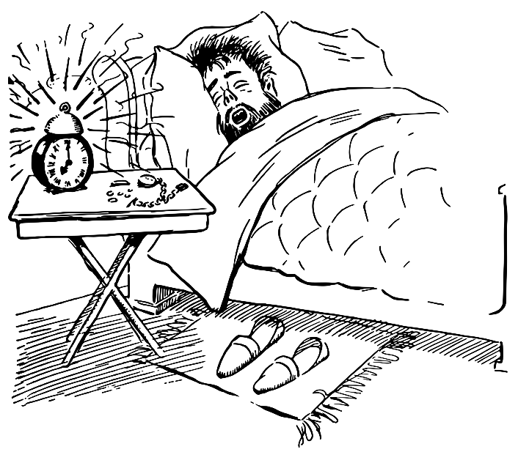
Vectoring Control To The Kernel
[Ignoring kernel threads,] kernel code only executes in response to external stimuli
Asynchronous interrupts (e.g., timer interrupt, NIC interrupt because a packet arrived))
Synchronous exceptions (e.g., dividing by zero, dereferencing a null pointer, attempting to write a read-only page)
Synchronous traps (e.g., system calls via syscall, debugging traps via int3)
During boot, the kernel must configure the processor to invoke the appropriate kernel code when exceptions, traps, and interrupts occur

Slide 3
Interrupts, Exceptions, and Non-syscall Traps
//Chickadee’s x86-64.h: Listing the IDT numbers
#define INT_DE 0 // Divide error (#DE)
#define INT_DB 1 // Debug (#DB)
#define INT_NM 2 // Non-maskable interrupt (#NM)
#define INT_BP 3 // Breakpoint (#BP)
#define INT_OF 4 // Overflow (#OF)
#define INT_UD 6 // Invalid opcode (#UD)
#define INT_DF 8 // Double fault (#DF)
#define INT_TS 10 // Invalid TSS (#TS)
#define INT_NP 11 // Segment not present (#NP)
#define INT_SS 12 // Stack fault (#SS)
#define INT_GP 13 // General protection (#GP)
#define INT_PF 14 // Page fault (#PF)
#define INT_AC 17 // Alignment check (#AC)
#define INT_MC 18 // Machine check (#MC)
Notes:
The breakpoint exception happens when code executes the int3 instruction. For example, when gdb wants to set a breakpoint in a program being debugged, gdb overwrites the first byte of the instruction to breakpoint with an int3 instruction. When the code being debugged tries to execute the instruction to break on, the code will generate a breakpoint exception. The OS can then vector control to gdb (who registered interest in the program using the ptrace() system call). [For more details on how all of this works, see http://www.alexonlinux.com/how-debugger-works/.]

Slide 4
Program to debug
...
cmpq %r8, %r9
jz 0x6000
subq %r10, %r11
addq %rax, %rbx
movq 8(%r9), %r12
breakpoint
int3
Remember that I overwrote subq!
...
gdb
Notes:
gdb needs to remember the part of the instruction that it overwrote so that gdb can successfully resume execution of the program after the human developer has inspected the program state at the breakpoint. In other words, gdb needs to replace the `int3` with whatever used to be there (in this case, `subq`).
[Yes, that is the real gdb logo. As described by https://www.gnu.org/software/gdb/mascot/, “the archer fish is known to shoot down bugs from low hanging plants by spitting water at them.”]

Slide 5
Interrupts, Exceptions, and Non-syscall Traps
//Chickadee’s x86-64.h: Listing the IDT numbers
#define INT_DE 0 // Divide error (#DE)
#define INT_DB 1 // Debug (#DB)
#define INT_NM 2 // Non-maskable interrupt (#NM)
#define INT_BP 3 // Breakpoint (#BP)
#define INT_OF 4 // Overflow (#OF)
#define INT_UD 6 // Invalid opcode (#UD)
#define INT_DF 8 // Double fault (#DF)
#define INT_TS 10 // Invalid TSS (#TS)
#define INT_NP 11 // Segment not present (#NP)
#define INT_SS 12 // Stack fault (#SS)
#define INT_GP 13 // General protection (#GP)
#define INT_PF 14 // Page fault (#PF)
#define INT_AC 17 // Alignment check (#AC)
#define INT_MC 18 // Machine check (#MC)
Notes:
The processor generates the invalid (i.e., undefined) opcode exception when the decode stage cannot successfully decode the instruction bits provided by the fetch stage.

Slide 6
Decode: 10011001…
+
Conditions?
//If the bits from fetch are
//invalid, CPU throws #UD
Next sequential IP
Sign-extended imm
Instr
Read reg0 idx
size
+
Read reg1 idx
Opcode
Write reg idx
Write reg data
Addr
IP
Current instruction register
ID/EX
EX/MEM
MEM/WB
Memory
Read data 0
Instr
Read data 1
ALU
Registers
?
RdData
Memory
Sign extend
imm to 64-bit
?
Addr
Write reg idx
WrData

Slide 7
Interrupts, Exceptions, and Non-syscall Traps
//Chickadee’s x86-64.h: Listing the IDT numbers
#define INT_DE 0 // Divide error (#DE)
#define INT_DB 1 // Debug (#DB)
#define INT_NM 2 // Non-maskable interrupt (#NM)
#define INT_BP 3 // Breakpoint (#BP)
#define INT_OF 4 // Overflow (#OF)
#define INT_UD 6 // Invalid opcode (#UD)
#define INT_DF 8 // Double fault (#DF)
#define INT_TS 10 // Invalid TSS (#TS)
#define INT_NP 11 // Segment not present (#NP)
#define INT_SS 12 // Stack fault (#SS)
#define INT_GP 13 // General protection (#GP)
#define INT_PF 14 // Page fault (#PF)
#define INT_AC 17 // Alignment check (#AC)
#define INT_MC 18 // Machine check (#MC)
Notes:
A page fault when a memory access is problematic in some way, e.g., because a write was attempted on a read-only page.

Slide 8
The Lifecycle of a Memory Reference on x86
Virtual address
TLB lookup
No
Yes
TLB hit?
HW walks the page table
Check protection bits
No
Yes
Yes
No
Access ok?
Found PTE for virt frame?
HW updates TLB
HW raises a page fault
HW raises a page fault
Calculate phys addr, send to L1/L2/L3/RAM

Slide 9
Interrupt number
Interrupt handler code: in virtual memory
16
x
Code
Virtual address
+
Other stuff
IST
WHICH STACK WILL THE INTERRUPT HANDLER USE?
Virtual address
Interrupt-Descriptor-Table Register (IDTR)
Interrupt Descriptor
Table (IDT): in virtual memory

Slide 10
Interrupt number
Interrupt handler code: in virtual memory
16
x
Code
Virtual address
+
Other stuff
IST
Task state segment (TSS): in virtual memory
Virtual address
Interrupt-Descriptor-Table Register (IDTR)
Interrupt Descriptor
Table (IDT): in virtual memory
TSS
TSS Descriptor
Virtual addr (base of TSS)
Other stuff
Virtual address
Selector
Base addr of TSS (cached from TSS descriptor)
Global-Descriptor-Table Register (GDTR)
Global Descriptor Table (GDT): in virtual memory
Task register (TR)
Notes:
[Quoth Section 2.4.4 of the Intel Software Developer Systems Programming Manual (Vol 3A): “The task register holds the 16-bit segment selector, base address (32 bits in protected mode; 64 bits in IA-32e mode), segment limit, and descriptor attributes for the TSS of the current task. The selector references the TSS descriptor in the GDT. The base address specifies the linear address of byte 0 of the TSS; the segment limit specifies the number of bytes in the TSS.”
Quoth Section 7.2.4, “The task register has a visible part (that can be read and changed by software) and an invisible part (maintained by the processor and is inaccessible by software). The segment selector in the visible portion points to a TSS descriptor in the GDT. The processor uses the invisible portion of the task register to cache the segment descriptor for the TSS. Caching these values in a register makes execution of the task more efficient” (mickens: i.e., when an interrupt occurs, the processor can directly calculate the memory addresses of fields in the TSS, instead of having to first load the base address of the TSS from the TSS descriptor).]
[Another useful (and more readable) reference is Section 8.9 of the AMD64 Architecture Programmer’s Manual (Vol 2): https://www.amd.com/system/files/TechDocs/24593.pdf]

Slide 11
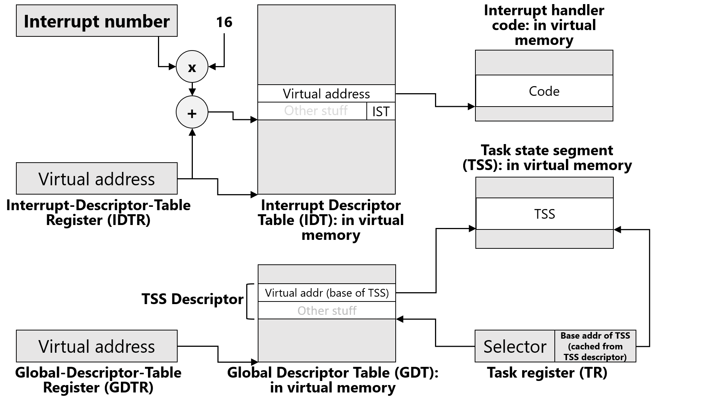
//Chickadee’s k-init.cc
void cpustate::init_cpu_hardware() {
//...stuff...
memset(&taskstate_, 0, sizeof(taskstate_));
taskstate_.ts_rsp[0] = (uintptr_t) this + CPUSTACK_SIZE;
//^^^The Ring 0 stack that the CPU initially uses when
//when executing most exception-handling code; see
//k-exception.S::exception_entry.
taskstate_.ts_ist[1] = (uintptr_t) this + CPUALTSTACK_SIZE;
//^^^Used to handle a small set of exceptions.
//...other stuff...
Interrupt-handler %rsp for IST 1
Interrupt-handler %rsp for IST 2
. . .
Interrupt-handler %rsp for IST 7
Chickadee uses the alternate stack for:
INT_DB: Debugging interrupt as controlled by debug registers %dr0—7
INT_NM: Non-maskable interrupt (e.g., RAM error or another unrecoverable hardware error)
INT_MC: Machine-check interrupt (unrecoverable hardware errors)
When these interrupts fire, the hardware might be sufficiently messed up that the regular interrupt-handler stack is corrupted!
IST 0: Default interrupt-handler %rsp
Notes:
Note that, to create the interrupt stacks, we’re using the same trick that we used to create the kernel stacks! For the kernel stacks, we allocate extra space for each struct proc, and then placed a kernel stack at the top. To create the two interrupt stacks, we allocate extra space for a struct cpustate, and then put the two interrupt stacks at the top of the cpustate. Note that taskstate_.ts_rsp[0] is the stack that the CPU initially uses after switching to ring 0 code upon an exception; see k-exception.S::exception_entry to see how, at the beginning of the exception-handling path, Chickadee immediately makes %rsp point to the appropriate kernel stack for the interrupted task, copying the registers pushed by the hardware onto the CPU stack, making copies on the kernel stack.
The algorithm used by the hardware to determine which stack to use is complex; see Sections 8.9.3, 8.9.4, and 12.2.5 of https://www.amd.com/system/files/TechDocs/24593.pdf. The basic idea is that a TSS contains a bunch of stacks:
-three of them to use as a CPU’s exception time stack when handling the exception with ring 0, 1, or 2 code respectively; and
-seven alternate IST stacks to use as desired (if at all) by the kernel.
The IST field in IDT descriptor for an exception determines which stack the hardware will switch to upon receiving an exception. If the IST field is 0, the hardware switches to the default stack for the ring level being switched to. Since Chickadee runs at ring 0, the default ring 0 stack is used. However, if the IST field is between 1 and 7 inclusive, the hardware switches to the appropriate IST stack. The slide above doesn’t explicitly show all three default stacks for rings 0—2. Instead, the slide above just shows the default stack for ring 0, labelling it as IST 0 (even though, technically speaking, there are three IST 0 stacks, one for each ring level; however, Chickadee and other commodity Oses only use ring 0 for privileged code, so no harm, no foul).
For more information about the debugging interrupt INT_DB, see https://en.wikipedia.org/wiki/X86_debug_register. As that page says, “On the x86 architecture, a debug register is a register used by a processor for program debugging. There are six debug registers, named DR0...DR7 [which] allow programmers to selectively enable various debug conditions associated with a set of four debug addresses . . . The debug registers are privileged resources; the MOV instructions that access them can only be executed at privilege level zero . . . Each of these registers contains the linear [i.e., post-segmentation-translation, pre-paging-translation] address associated with one of four breakpoint conditions. Each breakpoint condition is further defined by bits in DR7 . . . [for example] Bits 16-17 (corresponding to DR0), 20-21 (DR1), 24-25 (DR2), 28-29 (DR3), define when breakpoints trigger. Each breakpoint has a two-bit entry that specifies whether they break on execution (00b), data write (01b), data read or write (11b).”
For more information about non-maskable interrupts, see https://wiki.osdev.org/Non_Maskable_Interrupt. As that page states, “NMI occur for RAM errors and unrecoverable hardware problems . . . The short version of this story is that there's only really 2 reasons for an NMI. The first reason is a hardware failure. The second reason is a "watchdog timer", which can be used to detect when the kernel itself locks up (and is sometimes also used for more accurate profiling as it allows EIP to be sampled even when IRQs are disabled).”

Slide 12
Interrupt number
Interrupt handler code: in virtual memory
16
x
Code
Virtual address
+
Other stuff
IST
Interrupt-handler %rsp for IST 1
Task state segment (TSS): in virtual memory
Interrupt-handler %rsp for IST 2
Virtual address
. . .
Interrupt-Descriptor-Table Register (IDTR)
Interrupt Descriptor
Table (IDT): in virtual memory
TSS
Interrupt-handler %rsp for IST 7
TSS Descriptor
Virtual addr (base of TSS)
Other stuff
IST 0: Default interrupt-handler %rsp
Virtual address
Selector
Base addr of TSS (cached from TSS descriptor)
Global-Descriptor-Table Register (GDTR)
Global Descriptor Table (GDT): in virtual memory
Task register (TR)

Slide 13
The hardware automatically disables interrupts before executing an interrupt handler!
Notes:
[Ref: Section 6.8.1 of Volume 3A of the Intel Developer’s Manual.]

Slide 14
// Exception entry point
exception_entry:
/* On entry, the stack looks like this:
+-----------------------+ <- %rsp
| reg_intno, reg_swapgs | 0(%rsp)
| reg_errcode | 8(%rsp)
| %rip | 16(%rsp)
| %cs | 24(%rsp)
| %rflags | 32(%rsp)
| %rsp | 40(%rsp)
| %ss | 48(%rsp)
... ...
This data should be stored on the current kernel task stack.
It’s already there if the exception happened in kernel mode
(because the hardware doesn’t switch stacks in this case!).
Otherwise, we must move it there. */
// Exception happened in user mode if `(%cs & 3) != 0`.
testb $3, 24(%rsp)
jz exception_entry_finish
orl $1, 4(%rsp) // tell resume to swapgs
// change %rsp to the top of the kernel task stack
swapgs //%gs.base is now the address of this cpu’s cpustate
movq %gs:(8), %rsp // mov cpustate::proc* current, %rsp
addq $PROCSTACK_SIZE, %rsp
// copy data from CPU stack to kernel task stack
pushq %gs:(CPUSTACK_SIZE - 8) // %ss
pushq %gs:(CPUSTACK_SIZE - 16) // %rsp
pushq %gs:(CPUSTACK_SIZE - 24) // %rflags
pushq %gs:(CPUSTACK_SIZE - 32) // %cs
pushq %gs:(CPUSTACK_SIZE - 40) // %rip
pushq %gs:(CPUSTACK_SIZE - 48) // error code
pushq %gs:(CPUSTACK_SIZE - 56) // interrupt number
exception_entry_finish:
// complete `struct regstate`
push %gs
push %fs
pushq %r15
//...push the other general-purpose registers,
//with the final one being...
pushq %rax
// call `proc::exception(regstate*)`
// load current `proc` from the current cpustate,
// which is accessible via `%gs`
movq %gs:(8), %rdi
// the second argument, `regstate`, is the current `%rsp`
movq %rsp, %rsi
call _ZN4proc9exceptionEP8regstate
Notes:
Remember that, when the CPU executes in privileged mode, the %gs base should point to the per-CPU data structure.
[Note that Eddie and I draw stacks growing in different directions!]

Slide 15
Suppose that proc::exception() looked like this . . .
void proc::exception(regstate* regs) {
// Immediately return to the
// interrupted context
}
KERNEL OUT

Slide 16
restore_and_iret:
testb $1, 140(%rsp) // Does `reg_swapgs & 1` and sets
// the status flags (e.g., ZF set
// if the & results in a 0)
jz 1f // If & was a 0, we’re resuming
// a kernel-mode context.
// If we’re here, we’re resuming a user-mode context;
// check whether the process is runnable
movq %gs:(8), %rdi //cpustate::proc* current
cmpl $PROC_RUNNABLE, 24(%rdi) //proc::pstate_
jne panic_nonrunnable
1: // restore `regstate` registers
popq %rax
popq %rcx
popq %rdx
popq %rbx
popq %rbp
popq %rsi
popq %rdi
popq %r8
popq %r9
popq %r10
popq %r11
popq %r12
popq %r13
popq %r14
popq %r15
pop %fs
// We’ve restored almost all of the interrupted
// context’s general-purpose registers. At this
// point, the stack contains:
// %ss
// %rsp
// %rflags
// %cs
// %rip
// Error code
// Interrupt number, reg_swapgs
// %rsp --> %gs
// We must `swapgs` if required, i.e., if we’re
// returning to user-mode.
testb $1, 12(%rsp) // `reg_swapgs & 1`
jnz 1f
// Returning to kernel mode
addq $24, %rsp // Pops off %gs, interrupt number,
// reg_swapgs, error code
iretq // Pop the remaining five items from
// the stack, resetting %rip and %rsp
1: // Returning to user mode
cli // Prevent interrupts after `swapgs`
swapgs
pop %gs
addq $16, %rsp // Pop interrupt number, reg_swapgs,
// error code
iretq // Pop the remaining five items from
// the stack, resetting %rip and %rsp
Notes:
[Remember that the interrupt number and reg_swapgs are 4 bytes each on the stack.]

Slide 17
void proc::exception(regstate* regs) {
switch (regs->reg_intno) {
// This case returns to the interrupted
// process immediately.
case INT_IRQ + IRQ_KEYBOARD:
keyboardstate::get().handle_interrupt();
break;
// WHAT IS HAPPENING HERE
case INT_IRQ + IRQ_TIMER: {
cpustate* cpu = this_cpu();
if (cpu->cpuindex_ == 0) {
++ticks;
kdisplay_ontick();
}
lapicstate::get().ack();
regs_ = regs;
yield_noreturn();
break; /* will not be reached */
}
Notes:
Note that, in the code that handles the timer interrupt, we set proc::regs_!

Slide 18
// k-exception.S
// proc::yield_noreturn()
.globl _ZN4proc14yield_noreturnEv
_ZN4proc14yield_noreturnEv:
// Switch to cpustack and invoke the scheduler
// (in other words, invoke the function
// cpustate::schedule(proc* yielding_from))
// We’re currently in proc::yield_noreturn().
// so the first argument %rdi is a `this`
// representing the current process.
movq %rdi, %rsi //%rsi is `yielding_from`
movq %gs:(0), %rdi //%rdi is `this` pointer:
//points to cpustate!
leaq CPUSTACK_SIZE(%rdi), %rsp //cpustack is at
//the top of the allocated
//space for cpustate
jmp _ZN8cpustate8scheduleEP4proc
Notes:
The `lea` instruction (“load effective address”) calculates the memory address that is CPUSTACK_SIZE bytes away from the address in %rdi. However, the instruction doesn’t actually read or write memory at that address.
The function has “noreturn” in its name because it doesn’t return to the caller! Instead, we switch to a totally different stack (i.e., the cpustack) and then start executing code on that stack.

Slide 19
// A simplified version of the real schedule().
void cpustate::schedule(proc* yielding_from) {
// Find the next process to run.
runq_lock_.lock_noirq();
if (yielding_from->pstate_ == proc::ps_runnable) {
runq_.push_back(yielding_from);
}
current_ = runq_.pop_front();
runq_lock_.unlock_noirq();
// Run `current_`.
set_pagetable(current_->pagetable_);
current_->resume(); // Does not return.
}
Notes:
Note that cpustate::schedule() needs to run with interrupts disabled because cpustate::schedule() uses the CPU stack. If interrupts were enabled, then an incoming interrupt would clobber the stack area that cpustate::schedule() was using! The hardware would push stuff onto the stack; that stack area will be actively used by cpustate::schedule()---remember that proc::yield_noreturn() sets %rsp to the very top of the struct cpustate, meaning that cpustate::schedule()’s stack will start at the very start of the CPU’s stack.
[This also explains why proc::yield() (which eventually calls proc::yield_noreturn(), which eventually calls cpustate::schedule()) must ensure that interrupts are disabled.
// proc::yield()
.globl _ZN4proc5yieldEv
_ZN4proc5yieldEv:
// only save callee-saved registers and rflags
pushfq
pushq %r15
pushq %r14
pushq %r13
pushq %r12
pushq %rbx
pushq %rbp
// check if interrupts are disabled
testq $EFLAGS_IF, 48(%rsp)
jnz 1f
// if interrupts are disabled, momentarily enable them.
// This bounds interrupt delay to the time it takes a
// single kernel task to yield.
// Note that `sti; cli` would not work! `sti` only enables
// external, maskable interrupts at the end of the *next*
// instruction. A no-op instruction is required.
sti
movq (%rsp), %rax // any delayed interrupts will happen here
1: // disable interrupts, store yieldstate pointer
cli
movq %rsp, 16(%rdi)
// jump to `proc::yield_noreturn`
jmp _ZN4proc14yield_noreturnEv
// proc::yield_noreturn()
.globl _ZN4proc14yield_noreturnEv
_ZN4proc14yield_noreturnEv:
// switch to cpustack
movq %rdi, %rsi
movq %gs:(0), %rdi
leaq CPUSTACK_SIZE(%rdi), %rsp
// jump to scheduler
jmp _ZN8cpustate8scheduleEP4proc
]

Slide 20
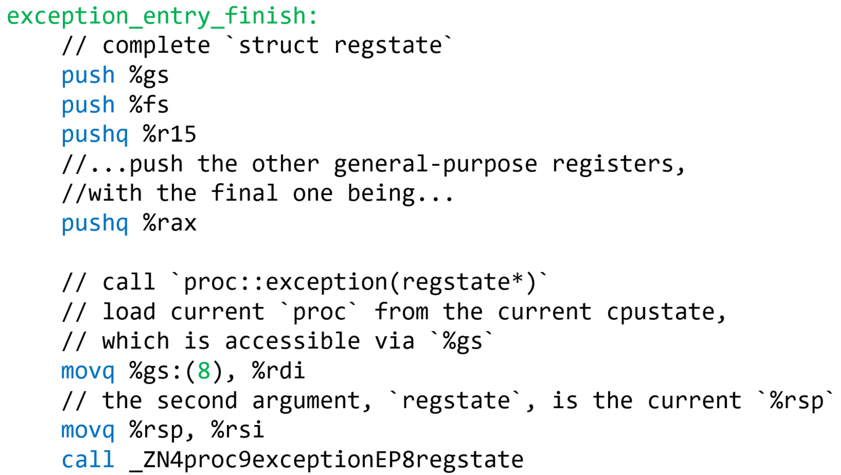
// proc::resume()
.globl _ZN4proc6resumeEv
_ZN4proc6resumeEv:
// Do we have yieldstate? (in other words, is
// `this->yields_ != nullptr`)?
movq 16(%rdi), %rax
testq %rax, %rax
jnz resume_yieldstate
resume_regstate: // No yieldstate: jump to the regstate!
// Restore %rsp, clear regstate, pop regs.
movq 8(%rdi), %rsp // %rdi is `this` (i.e., a proc),
// so 8(%rdi) is proc::regstate* regs_;
// %rsp now points to the regstate that
// holds the interrupted process’s
// registers! The regstate was pushed
// on the process’s kernel stack by
// k-exception.S::exception_entry.
movq $0, 8(%rdi) // Now proc::regs_ is nullptr.
jmp restore_and_iret

Slide 21
We’ve seen restore_and_iret already, when we imagined that proc::exception() returned immediately!

Slide 22
restore_and_iret:
testb $1, 140(%rsp) // Does `reg_swapgs & 1` and sets
// the status flags (e.g., ZF set
// if the & results in a 0)
jz 1f // If & was a 0, we’re resuming
// a kernel-mode context.
// If we’re here, we’re resuming a user-mode context;
// check whether the process is runnable
movq %gs:(8), %rdi //cpustate::proc* current
cmpl $PROC_RUNNABLE, 24(%rdi) //proc::pstate_
jne panic_nonrunnable
1: // restore `regstate` registers
popq %rax
popq %rcx
popq %rdx
popq %rbx
popq %rbp
popq %rsi
popq %rdi
popq %r8
popq %r9
popq %r10
popq %r11
popq %r12
popq %r13
popq %r14
popq %r15
pop %fs
// We’ve restored almost all of the interrupted
// context’s general-purpose registers. At this
// point, the stack contains:
// %ss
// %rsp
// %rflags
// %cs
// %rip
// Error code
// Interrupt number, reg_swapgs
// %rsp --> %gs
// We must `swapgs` if required, i.e., if we’re
// returning to user-mode.
testb $1, 12(%rsp) // `reg_swapgs & 1`
jnz 1f
// Returning to kernel mode
addq $24, %rsp // Pops off %gs, interrupt number,
// reg_swapgs, error code
iretq // Pop the remaining five items from
// the stack, resetting %rip and %rsp
1: // Returning to user mode
cli // Prevent interrupts after `swapgs`
swapgs
pop %gs
addq $16, %rsp // Pop interrupt number, reg_swapgs,
// error code
iretq // Pop the remaining five items from
// the stack, resetting %rip and %rsp
Notes:
[Remember that the interrupt number and reg_swapgs are 4 bytes each on the stack.]

Slide 23
proc* p = knew<proc>();
p->regs_ = reinterpret_cast<regstate*>(reinterpret_cast<uintptr_t>(p)
+ PROCSTACK_SIZE)) - 1);
p->regs_->reg_swapgs = 1;
p->regs_->reg_rip = /*Address of the new process’ entry point*/
void* stkpg = kalloc(PAGESIZE);
vmiter(p, MEMSIZE_VIRTUAL - PAGESIZE).map(stkpg, PTE_PWU);
p->regs_->reg_rsp = MEMSIZE_VIRTUAL;

Slide 24
<see previous slide>
So, proc::regs_ can be nullptr!
Ex: User-level code does a getpid() system call, where the kernel handles the request and then immediately returns to user-mode

Slide 25
Exercise for the reader: proc::yields_
A process can voluntarily yield the CPU while executing in kernel mode
proc::yields_ will point to kernel-level context state on the kernel-level stack!
When the process is resumed, it must restart from the appropriate location in kernel-level code
uintptr_t proc::syscall(regstate* regs){
switch (regs->reg_rax) {
case SYS_STUPID: {
int x = 42;
yield();
int y = 88;
return x + y;
}
}
}
At some point later, the process will return to user-mode
Ex: Via the syscall path (because a process invoked a yielding system call, e.g., that needs to wait for a slow IO device)
Ex: Via the exception path return_and_iret (e.g., because the interrupted/excepted process does a yield() while handling the interrupt/exception, e.g., handling a page fault for a swapped-out page)
Take a look at proc::yield() and proc::resume()!

Slide 26
Q: Is amd64 the same as x86_64/x64/intel64? A: Yes! Q: Is amd64 the same as IA-64? A: No! IA-64 refers to a totally different ISA called the Itanium.

