Slide 1
Virtual Memory
CS 161: Lecture 3
1/29/2024

Slide 2
Virtual Addresses
Virtual addresses are the addresses that programs manipulate
Roughly speaking, a process’ address space ranges from . . .
Byte 0 to byte (2³²-1) on a 32-bit system (e.g., x86-32, PowerPC-32)
Byte 0 to byte (2⁶⁴-1) on a 64-bit system (e.g., x86-64, RISC-V-64, ARMv8-A)
void main(){
int x = 42;
void* ptr = malloc(64);
printf(“&x: %p\n”, (void*)&x); //0x0000’7ffd’754e’adbc
printf(“&ptr: %p\n”, (void*)&ptr); //0x0000’7ffd’754e’adc0
printf(“ptr: %p\n”, (void*)ptr); //0x0000’5557’e367’d260
printf(“main: %p\n”, (void*)main); //0x0000’5557’e2b8’3155
}
Notes:
[Note that, if you run the sample program above, you will almost certainly get different outputs than what the slide is showing. In other words, you’ll see that the various pieces of program state live in different places in virtual memory. The reason is that the OS is using a technique called ASLR (address space layout randomization) to determine, at program launch time, where exactly the stack, heap, code, and data should be located within the virtual address space.]
[Aside: RISC-V comes in 32-bit, 64-bit, and 128-bit flavors. PowerPC and MIPS also support a 64-bit mode.]

Slide 3
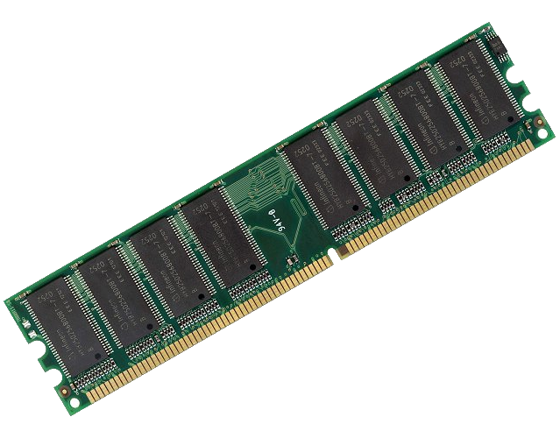
How Do We Map Virtual Addresses to Physical Addresses?
64-bit virtual address
space (16 exabytes)
FFFF’FFFF’FFFF’FFFF
Physical RAM
(e.g., 8 GB)
An exabyte is a billion GBs!
1’FFFF’FFFF
0’0000’0000
0000’0000’0000’0000

Slide 4
Memory-mapping Units (MMUs)
MMU: A piece of hardware (only configurable by privileged code) that translates virtual addresses to physical addresses
Virtual addresses are the addresses that are generated by a running program
Physical addresses are what a processor presents to the actual RAM
//Code in address space
subq %rax, %rbx
addq %rcx, %rdx
movq 8(%r12), %r13
Physical
RAM
PhysAddr: 0xd089’5cb0
MMU
VirtAddr: 0000’4d0a’fc42’9280

Slide 5
Memory-mapping Units (MMUs)
MMU: A piece of hardware (only configurable by privileged code) that translates virtual addresses to physical addresses
Virtual addresses are the addresses that are generated by a running program
Physical addresses are what a processor presents to the actual RAM
//Code in address space
subq %rax, %rbx
addq %rcx, %rdx
movq 8(%r12), %r13
b (“byte”): one byte
w (“word”): two bytes
l (“long”): four bytes
q (“quad word”): eight bytes
VirtAddr: 0000’4d0a’fc42’9280

Slide 6
Memory-mapping Units (MMUs)
Using indirection via the MMU:
A virtual address space can be larger than physical RAM (and vice versa)
At any moment, some/none/all of a virtual address space can be mapped into physical RAM
After a context switch to a new address space, the OS can lazily bring in the non-resident memory regions as the address space’s code tries to access those regions
Virtual address
space 1
Physical RAM
Virtual address
space 1
Swap device

Slide 7
Memory-mapping Units (MMUs)
Isolation properties
Protection by default: the OS maps the same virtual address in two different processes to different physical addresses
Sharing when appropriate: a single region of physical RAM can map to multiple virtual address spaces (in possibly different virtual-memory locations!)
Virtual address
Virtual address
space 1
space 1
Physical RAM
Physical RAM
Virtual address
Virtual address
space 2
space 2

Slide 8
Outline
The structure of a virtual address space
Supporting virtual memory using paging
Fast translation using TLBs
Notes:
[We didn’t have enough time to discuss TLBs in class, but the associated concepts are pretty straightforward, so students can look at the slides after lecture.]

Slide 9
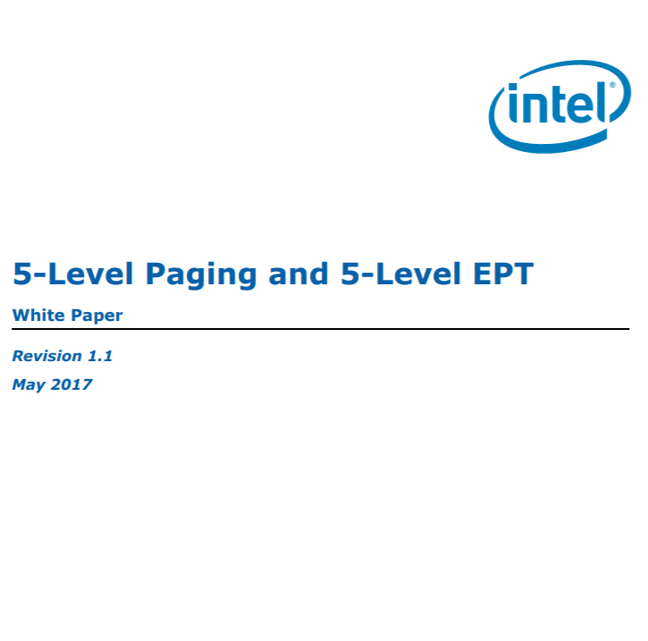
x86-64: Virtual Address Spaces
Until very recently, x86-64 chips only use 48 bits of an address
Bits 48—63 must be copies of bit 47
Kernel code+data lives in “high canonical” memory
User code+data lives in “low canonical” memory
The most recent Intel chips extend addresses to 57 bits!
Virtual address space
FFFF’FFFF’FFFF’FFFF
Kernel static data
High canonical
(kernel-only access)
Kernel code
Kernel heap+stacks
FFFF’8000’0000’0000
Physical memory map
Empty gap
0000’7FFF’FFFF’FFFF
Stack
Low canonical
(kernel+user access)
Heap
Static data
0000’0000’0000’0000
Code
Notes:
Why does the diagram say “kernel stacks” plural? Well, the way that Chickadee (and Linux) works is that, when a new process is allocated, that process gets a user-mode stack and a kernel-mode stack. The kernel-mode stack is empty when the user-mode code is executing, but when the kernel needs to handle a syscall on behalf of the process, the kernel code uses the kernel-mode stack of the process. [In Chickadee, a process’ kernel stack is the top half of the process’ struct proc; the struct proc is allocate an entire memory page, even though the members of the struct require much less space, so the remaining bytes in the page can be used for the kernel stack.]
[Refs: [1] https://en.wikipedia.org/wiki/X86-64#Virtual_address_space_details
[2] https://www.kernel.org/doc/Documentation/x86/x86_64/mm.txt
[3] https://www.kernel.org/doc/Documentation/x86/kernel-stacks
[4] https://jasoncc.github.io/kernel/jasonc-mm-x86.html
[5] https://notes.shichao.io/lkd/ch12/]

Slide 10
x86-64: Virtual Address Spaces
Each process gets its own address space
The kernel is mapped into the same place in each address space
Content in low canonical memory is mostly unique (i.e., per-process)
Why can’t user-level code tamper with kernel state?
The CPU’s current privilege level (CPL) indicates whether the code that is running right now is kernel code or user code
MMU prevents unprivileged code from touching privileged memory
The CPL flips upon user/kernel transitions (e.g., system calls)
Virtual address space
FFFF’FFFF’FFFF’FFFF
void main(){
int x = 42;
void* ptr = malloc(64);
printf(“&x: %p\n”, (void*)&x); //0x0000’7ffd’754e’adbc
printf(“&ptr: %p\n”, (void*)&ptr); //0x0000’7ffd’754e’adc0
printf(“ptr: %p\n”, (void*)ptr); //0x0000’5557’e367’d260
printf(“main: %p\n”, (void*)main); //0x0000’5557’e2b8’3155
}
Kernel static data
High canonical
(kernel-only access)
Kernel code
Kernel heap+stacks
FFFF’8000’0000’0000
Physical memory map
Empty gap
0000’7FFF’FFFF’FFFF
Stack
Low canonical
(kernel+user access)
Heap
Static data
0000’0000’0000’0000
Code
Notes:
Why is the content in the bottom half of an address space only “mostly” unique? Here’s one example: suppose that you launch two different instances of a web server, so that you have two separate processes. Each process will have the same contents in its code region. However, the stacks and the heaps will be different, because each process has its own set of dynamic state that is created in response to client requests.

Slide 11
x86-64: Virtual Address Spaces
Typically much smaller than the virtual address space!
Virtual address space
FFFF’FFFF’FFFF’FFFF
Kernel static data
Physical RAM
High canonical
(kernel-only access)
Kernel code
MAX_PHYS
Kernel heap+stacks
FFFF’8000’0000’0000
Physical memory map
Empty gap
0000’7FFF’FFFF’FFFF
Stack
Low canonical
(kernel+user access)
0
Heap
Direct linear translation:
Physical address P ↔ 0xFFFF'8000'0000'0000+P
Static data
0000’0000’0000’0000
Code
High canonical address

Slide 12
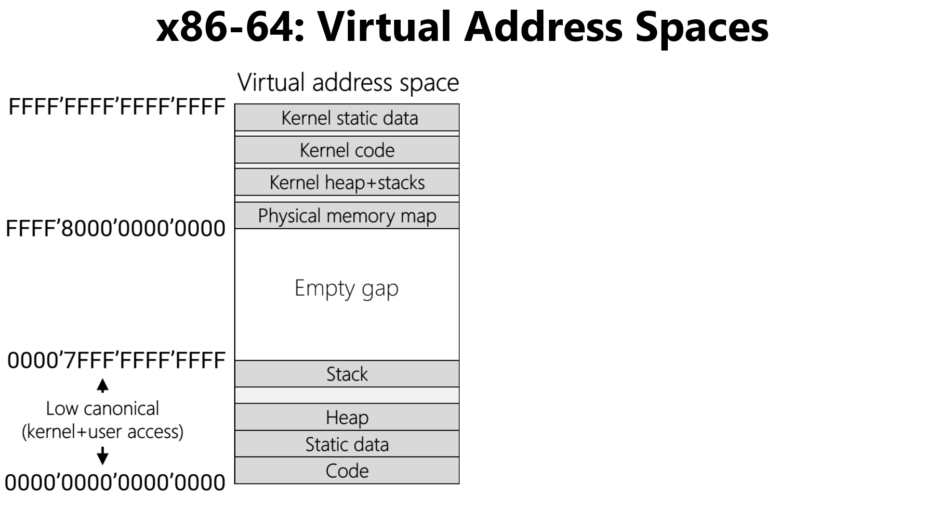
Typically much smaller than the virtual address space!
Highest 2GB
Physical RAM
MAX_PHYS
0x7FFF'FFFF
Lowest 2GB
0
Direct linear translation:
Physical address P (0≤P≤0x7FFF'FFFF) ↔
0xFFFF'FFFF'8000'0000+P
Notes:
The code and static data of the kernel are often collectively referred to as the “kernel text.”

Slide 13
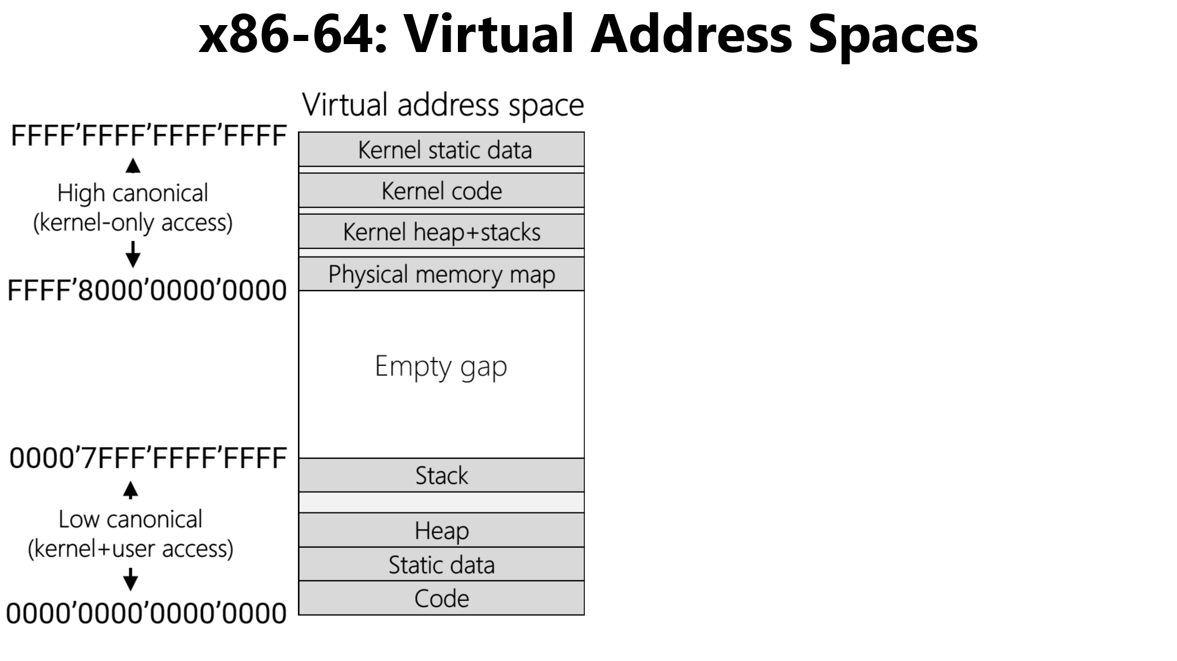
Typically much smaller than the virtual address space!
Physical RAM
MAX_PHYS
Wherever kernel text actually stops
Kernel text
0
No simple correspondence between user-mode virtual addresses and the underlying physical addresses: the miracle of paging!
Notes:
Note that the actual size of the kernel text will typically be less than 2 GB in practice. In other words, it’s unlikely that an OS will have 2 GB of code and static data. So, in practice, the user-related content (e.g., like user-mode stacks) may be mapped into physical region beneath the 2GB barrier.

Slide 14
Outline
The structure of a virtual address space
Supporting virtual memory using paging
Fast translation using TLBs

Slide 15
Paging
Virtual address
Divide virtual address space and the physical RAM into fixed-sized chunks called pages
Make each page small (e.g., 4 KB)
Good: Can allocate virtual address space with fine granularity
Good: Only need to bring the specific pages that process needs into physical RAM
Possibly concerning: Bookkeeping overhead—a single address space contains many pages!
Virtual Page Number
Offset
Virtual address
space of V pages
Physical RAM
V bits
O bits
with P pages
X
MMU
Y
Y
P bits
Not present in RAM
(e.g., swapped to disk)
Physical Page Number
Offset
Z
MMU
Z
X
Physical address
Notes:
Why would a virtual page be swapped to disk? Well, there may be a lot of processes that are running; if so, that means that a lot of processes will want to put their virtual pages in RAM. If all of the pages can’t fit at once, then some of those pages need to be stored on disk, where they can be retrieved later.
Note that a virtual page may also be absent in RAM for another reason---the associated process hasn’t allocated that page. For example, the heap grows when a program calls malloc() or new. When a process initially starts, the process hasn’t allocated any heap memory, so the associated parts of the virtual address space are not associated with actual virtual pages.

Slide 16
Paging
Virtual address
Make each page big (e.g., 1 GB)
Good: Minimizes bookkeeping overhead (i.e., number of VPN->PPN mappings)
Good/bad: Only appropriate for applications that manage huge pieces of contiguous memory (e.g., databases)
Bad: A huge page is painful to swap to/from disk—it’s like writing or writing a 1 GB file!
x86-64 supports multiple page sizes
4 KB
2 MB
1 GB
A single address space may contain
pages of different sizes
Virtual Page Number
Offset
V bits
O bits
MMU
P bits
Physical Page Number
Offset
Physical address

Slide 17
Case study: x86-64
L4
L3
L2
L1
Offset
47
39
38
30
29
21
20
12
11
0
Holds the physical address of a 4 KB-aligned PML4
Highest-order bits not useful for address translations!
%cr3
Notes:
“PML4” stands for “Page Map Level 4.”
[Reference: https://wiki.osdev.org/CPU_Registers_x86-64#CR3
Section 4.5 of “Intel® 64 and IA-32 Architectures Software Developer’s Manual
Volume 3 (3A, 3B, 3C & 3D): System Programming Guide
https://software.intel.com/sites/default/files/managed/2b/80/5-level_paging_white_paper.pdf
https://os.phil-opp.com/paging-introduction/
https://wiki.osdev.org/Page_Tables#Long_mode_.2864-bit.29_page_map]

Slide 18
Case study: x86-64
L4
L3
L2
L1
Offset
47
39
38
30
29
21
20
12
11
0
A 4 KB-aligned PDP has 512 8-byte entries
A 4 KB-aligned PML4 has 512 8-byte entries
%cr3
9 bits
Bookkeeping stuff
PDPTE
9 bits
Page directory pointer
PML4E
PML4E
4KB-aligned PDPTE physAddr
64 bits
Page map level 4
63
48
47
12
11
0

Slide 19
Case study: x86-64
L4
L3
L2
L1
Offset
47
39
38
30
29
21
20
12
11
0
A 4 KB-aligned PDP has 512 8-byte entries
9 bits
PDE
%cr3
9 bits
Page directory
Bookkeeping stuff
PDPTE
9 bits
Page directory pointer
A 4 KB-aligned PD has 512 8-byte entries
PML4E
PDPTE
4KB-aligned PDE physAddr
64 bits
Page map level 4
63
48
47
12
11
0

Slide 20
Case study: x86-64
L4
L3
L2
L1
Offset
47
39
38
30
29
21
20
12
11
0
9 bits
PDE
%cr3
9 bits
Page directory
Bookkeeping stuff
PDPTE
9 bits
Page directory pointer
A 4 KB-aligned PD has 512 8-byte entries
PML4E
PDE
4KB-aligned PTE physAddr
64 bits
Page map level 4
63
48
47
12
11
0

Slide 21
Case study: x86-64
L4
L3
L2
L1
Offset
47
39
38
30
29
21
20
12
11
0
PhysAddr
12 bits
4KB page
9 bits
PTE
9 bits
Page table
PDE
User-mode accessible?
%cr3
Writeable?
9 bits
Page directory
A 4 KB-aligned PT has 512 8-byte entries
PDPTE
Present?
9 bits
Page directory pointer
PML4E
PTE
4KB-aligned physFrame addr
64 bits
Page map level 4
63
48
47
12
11
3
2
1
0
Notes:
[Quoth Eddie’s 2018 lecture notes: “Question: Why does each index get 9 bits? Answer: Because the size of one page is 2^12 bytes, and each page table page entry is an address which has 2^3 bytes. 212/23 = 2^9 entries per page. We want to be able to index into any given entry, which means we need 9 bits.”]

Slide 22
Why so many levels?
Virtual address spaces are sparse!
Ex: Most processes don’t have gigabytes of code
Ex: Most processes don’t have gigabytes of stack frames
Multi-level tables: only materialize entries for live parts of address space
Ex: A single PML4E covers 512 GB
If none of those addresses are in use, just set the PML4E.present bit to 0!
Don’t need to create PDP/PD/PT tables for the subtree
User-mode accessible?
Writeable?
Bookkeeping stuff
Present?
Bookkeeping stuff
PML4E
PML4E
4KB-aligned PDPTE physAddr
4KB-aligned PDPTE physAddr
47
63
47
63
48
48
12
12
11
11
3
1
0
2
0

Slide 23
Case study: x86-64 using 1 GB pages
L4
L3
Offset in 1 GB page
47
39
38
30
29
0
A 4 KB-aligned PDP has 512 8-byte entries
A 4 KB-aligned PML4 has 512 8-byte entries
%cr3
9 bits
Bookkeeping stuff
PDPTE
9 bits
Page directory pointer
PML4E
PML4E
4KB-aligned PDPTE physAddr
64 bits
Page map level 4
63
48
47
12
11
0

Slide 24
Case study: x86-64 using 1 GB pages
L4
L3
Offset in 1 GB page
47
39
38
30
29
0
A 4 KB-aligned PDP has 512 8-byte entries
PS (“Page size”) bit set to 1, indicating a 1 GB page
%cr3
9 bits
Bookkeeping stuff
PDPTE
9 bits
Page directory pointer
PML4E
PDPTE
1GB-aligned huge page physAddr
64 bits
Page map level 4
63
48
47
12
11
7
0

Slide 25
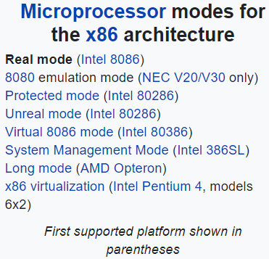
Chickadee’s Early Boot
“Booting a processor” means “configuring a processor once it’s been turned on”
Booting a processor is a delicate dance, particularly on x86!
Chickadee’s k-init.cc contains important code related to booting
init_hardware()
init_early_memory()
//Create the boot-
//time page tables
//and tell CPU to
//enable paging
init_interrupts()
//Ensure that CPU
//invokes kernel to
//handle timers,
//syscalls, etc.
init_other_processors()
//On a multi-core machine,
//ask the other cores to
//come online!

Slide 26
[511]
[510]
. . .
Bottom 512 GB
. . .
[0]
L3 pagetable (ps=1GB)
[511]
init_early_memory()
//Create the boot-
//time page tables
//and tell CPU to
//enable paging
[511]
. . .
Physical memory map
. . .
. . .
%cr3
[256]
[0]
L3 pagetable (ps=1GB)
Physical RAM
64 bits
[0]
L4 pagetable
Notes:
[Note that there are hex 1’0000’0000’0000= 262,144 GB total bytes of allowable virtual memory---half of that belongs to low-canonical memory in 0000’0000’0000’0000--0000’7FFF’FFFF’FFFF, and the other half belongs to high canonical memory in FFFF’8000’0000’0000--FFFF’FFFF’FFFF’FFFF. If an L3 pagetable has ps=1 GB, then each L3 pagetable can cover 512 GB. So, if an L4 table has 512 entries, and each entry points to an L3 page table covering 512 GB of memory, then a single L4 can cover 512 * 512 GB = 262,144 GB of memory!]

Slide 27
//x86-64.h
typedef uint64_t x86_64_pageentry_t;
typedef struct x86_64_pagetable {
x86_64_pageentry_t entry[1 << PAGEINDEXBITS];
} x86_64_pagetable;
//k-init.cc
x86_64_pagetable early_pagetable[3];
[511]
[510]
. . .
early_pagetable[2]
Bottom 512 GB
. . .
[0]
L3 pagetable (ps=1GB)
[511]
[511]
. . .
Physical memory map
. . .
. . .
%cr3
[256]
[0]
L3 pagetable (ps=1GB)
Physical RAM
64 bits
[0]
early_pagetable[1]
L4 pagetable
early_pagetable[0]
Notes:
[Aside: Chickadee's MEMSIZE_PHYSICAL is set to 0x200000 == 2MB. However, qemu is what determines the upper limit on how much memory is actually available on the emulated machine that Chickadee runs atop. By default, qemu provides 128 MB of emulated physical memory---see the discussion of the qemu -m option at https://wiki.gentoo.org/wiki/QEMU/Options. Chickadee uses the qemu default, so MEMSIZE_PHYSICAL == 0x200000 == 2MB < 128MB is saying that Chickadee actually only manages 2MB of a possible 128MB of emulated physical RAM.]

Slide 28
//x86-64.h
typedef uint64_t x86_64_pageentry_t;
typedef struct x86_64_pagetable {
x86_64_pageentry_t entry[1 << PAGEINDEXBITS];
} x86_64_pagetable;
//k-init.cc
x86_64_pagetable early_pagetable[3];
[511]
[510]
. . .
early_pagetable[2]
Bottom 512 GB
. . .
void init_early_memory() {
//...some code, and then...
//First level-3 page table maps first
//512GiB of physical memory (low
//canonical and high canonical)
for (uintptr_t p = 0; p < 512; ++p) {
early_pagetable[1].entry[p] = (p << 30) |
PTE_P | PTE_W | PTE_PS;
}
//Second level-3 page table maps its
//last 2 slots to the first 2GiB of
//of physical memory (kernel text)
early_pagetable[2].entry[510] =
early_pagetable[1].entry[0];
early_pagetable[2].entry[511] =
early_pagetable[1].entry[1];
wrcr3(ktext2pa(early_pagetable));
}
[0]
L3 pagetable (ps=1GB)
[511]
[511]
. . .
Physical memory map
. . .
. . .
%cr3
[256]
[0]
L3 pagetable (ps=1GB)
Physical RAM
64 bits
[0]
early_pagetable[1]
L4 pagetable
early_pagetable[0]
Notes:
Note that, in the excerpt of init_early_memory() that I show above, I don’t show the code that initializes the first, middle, and last entry of the L4 page table. That initialization happens in the “//…some code, and then…” part of the snippet.
[That initialization code looks like this:
// level-4 page table:
// - entry 0 maps first 512GiB of low canonical addresses
// - entry 256 maps first 512GiB of high canonical addresses
// - entry 511 maps last 2GiB of high canonical addresses (kernel text)
early_pagetable->entry[0] = ktext2pa(&early_pagetable[1]) | PTE_P | PTE_W;
early_pagetable->entry[256] = early_pagetable->entry[0];
early_pagetable->entry[511] = ktext2pa(&early_pagetable[2]) | PTE_P | PTE_W;
Here’s the definition of ktext2pa():
inline uint64_t ktext2pa(uint64_t ka) {
assert(ka >= KTEXT_BASE);
return ka - KTEXT_BASE;
}
So, ktext2pa() is just doing a direct linear translation of a kernel text virtual address (which is assumed to be in the topmost part of high canonical memory) to a physical address at the bottom of physical RAM. Remember that kernel text (i..e, kernel code and kernel static data) is mapped to the bottom of physical RAM.
]

Slide 29
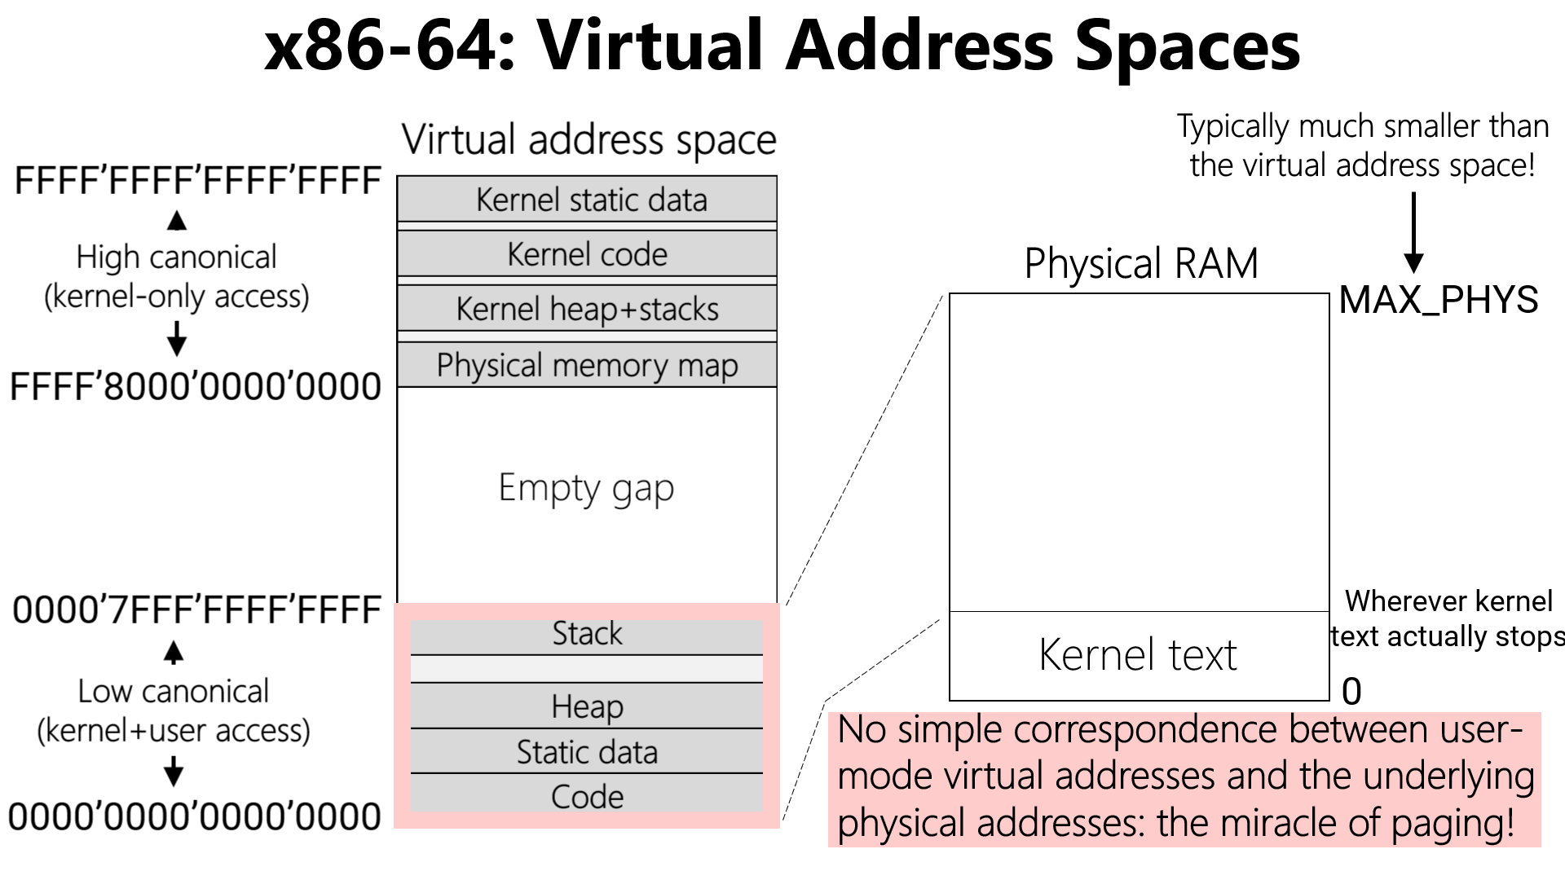
Chickadee: Page Tables
During boot, Chickadee creates a physical memory map in high canonical addresses *and* low canonical addresses
However, post-boot, low-canonical addresses are for user-mode content, not a memory map!

Slide 30
//x86-64.h
typedef uint64_t x86_64_pageentry_t;
typedef struct x86_64_pagetable {
x86_64_pageentry_t entry[1 << PAGEINDEXBITS];
} x86_64_pagetable;
//k-init.cc
x86_64_pagetable early_pagetable[3];
[511]
[510]
. . .
early_pagetable[2]
Bottom 512 GB
. . .
[0]
L3 pagetable (ps=1GB)
[511]
[511]
. . .
Physical memory map
. . .
. . .
%cr3
[256]
[0]
L3 pagetable (ps=1GB)
Physical RAM
64 bits
[0]
early_pagetable[1]
L4 pagetable
early_pagetable[0]

Slide 31
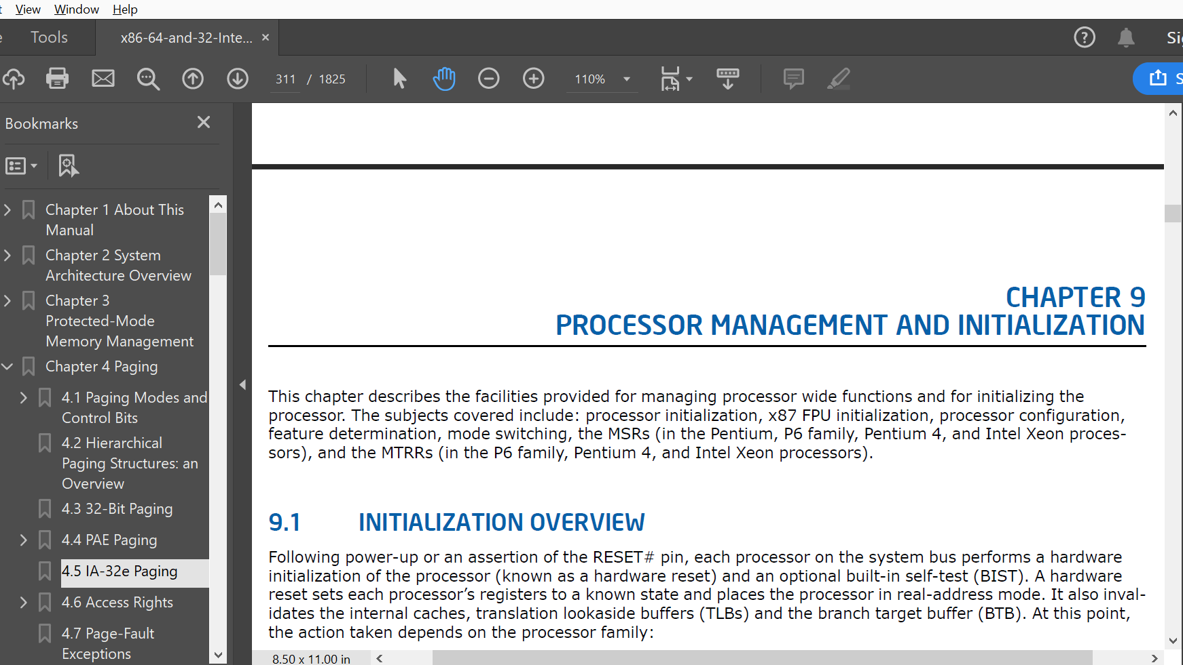
Chickadee: Page Tables
During boot, Chickadee creates a physical memory map in high canonical addresses *and* low canonical addresses
However, post-boot, low-canonical addresses are for user-mode content, not a memory map!
The boot-time kernel only needs the low-canonical memory map to assist with x86 configuration horrors
At a more detailed level, I DON’T WANT TO TALK ABOUT LOW-LEVEL X86 CONFIGURATION HORROR
However, early_pagetable will become important in pset2!

Slide 32
Outline
The structure of a virtual address space
Supporting virtual memory using paging
Fast translation using TLBs

Slide 33
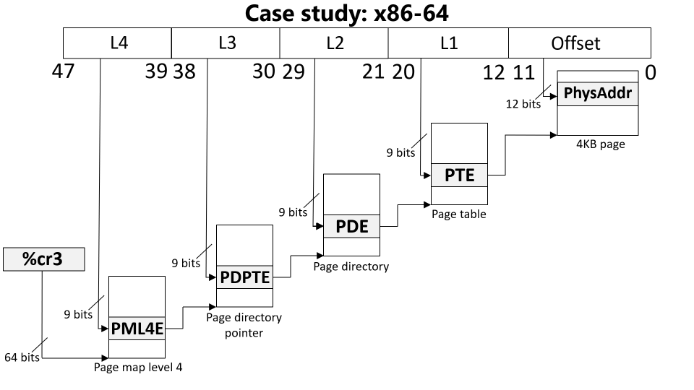
Paging: The Good and the Bad
Good: A virtual address space can be bigger/smaller than physical memory
Bad: Each virtual memory access now requires five physical memory accesses
x86-64 physical memory accesses
Load entry from page map level 4
Load entry from page directory pointer
Load entry from page directory
Load entry from page table
Generate the “real” memory access

Slide 34
Does 5x overhead sound like a lot?
IT IS INDEED A LOT.

Slide 35
Translation Lookaside Buffers (TLBs)
Idea: Cache some PTEs (i.e., V->P translations) in a small hardware buffer
If virtual address has an entry in TLB, don’t need to go to physical memory to fetch a PTE!
If virtual address misses in TLB, we must walk the page table to fetch a PTE
Key/value store: key is high bits of virt addr, value is phys frame number
TLB
TLB
L1 i-cache
L1 d-cache
L1 i-cache
L1 d-cache
L2 cache
L2 cache
L3 cache
RAM

Slide 36
Translation Lookaside Buffers (TLBs)
Idea: Cache some PTEs (i.e., V->P translations) in a small hardware buffer
If virtual address has an entry in TLB, don’t need to go to physical memory to fetch a PTE!
If virtual address misses in TLB, we must walk the page table to fetch a PTE
TLBs are effective because programs exhibit locality
Temporal locality
When a process accesses virtual address x, it will likely access x again in the future
Ex: a function’s local variable that lives on the stack
Spatial locality
When the process accesses something at memory location x, the process will likely access other memory locations close to x
Ex: reading elements from an array on the heap
Notes:
Temporal locality means that a TLB entry that has recently been accessed will be accessed again in the near future.
Spatial locality means that, when we access a virtual address x, and we create a TLB entry for the associated page, the TLB entry will likely be useful for other virtual addresses that the program accesses. Remember that a TLB entry covers an entire page of spatially contiguous addresses! For machines that have a lot of physical RAM, you might want a single TLB entry to cover a much larger region than 4 KB. x64 supports this idea using “superpages.” When a process’s page table uses superpages, each PTE and TLB entry covers 2 MB or 1 GB instead of 4 KB.

Slide 37
The Lifecycle of a Memory Reference on x86
Virtual address
TLB lookup
No
Yes
TLB hit?
HW walks the page table
Check protection bits
No
Yes
Yes
No
Access ok?
Found PTE for virt frame?
HW updates TLB
HW raises a page fault
HW raises a page fault
Calculate phys addr, send to L1/L2/L3/RAM
Notes:
Note that the protection bits state things like “is this page writable?” and “is this page accessible to user-mode processes?”
If there’s a TLB miss, the hardware walks the page table. If the hardware doesn’t find a valid PTE, i.e., if the PTE for the virtual address is not set to “present,” then the hardware raises a fault. Note that a fault could be raised for one of two reasons: the virtual address may reside in an unallocated part of the virtual address space (e.g., in the hole between the stack and the heap). Alternatively, the virtual address may reside in an allocated page of the address space, but that page is not in physical memory.

Slide 38
The Lifecycle of a Memory Reference on x86
Virtual address
Before raising page fault exception, HW sets %cr2 to faulting address, and pushes an error code onto stack
TLB lookup
-Ex: User process tried to read a nnon-present page
-Ex: User process tried to write aa present but read-only page
No
Yes
TLB hit?
HW walks the page table
Check protection bits
No
Yes
Yes
No
Access ok?
Found PTE for virt frame?
HW updates TLB
HW raises a page fault
HW raises a page fault
Calculate phys addr, send to L1/L2/L3/RAM

