Slide 1
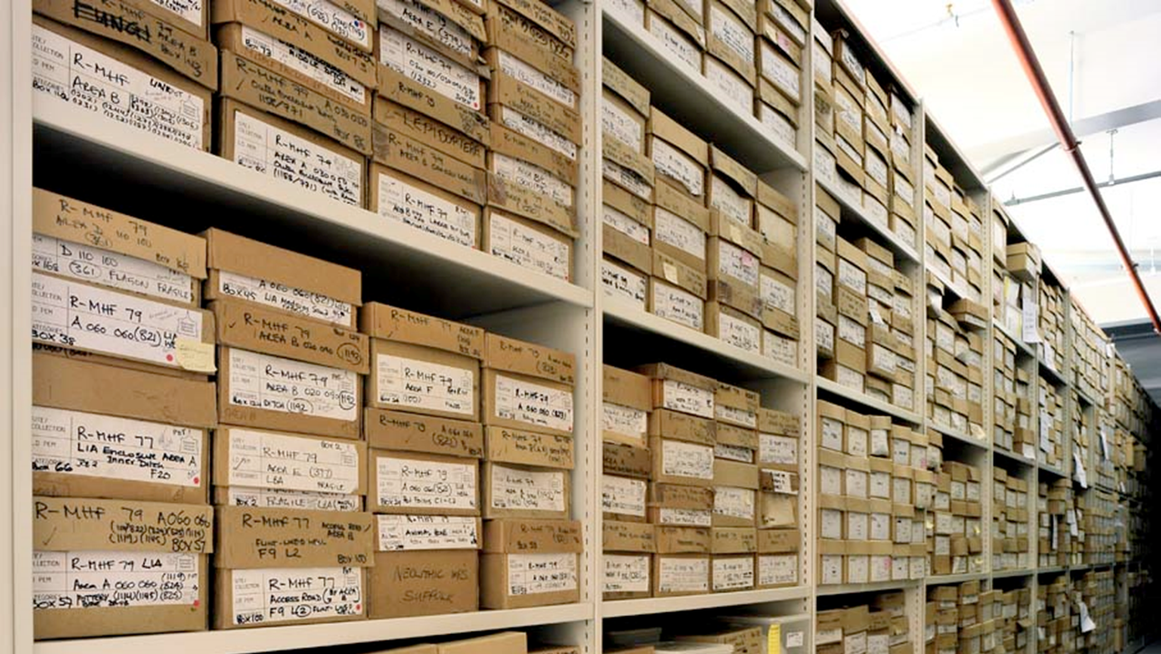
Intro to Storage Devices and File Systems
CS 1610: Lecture 10
3/5/2025

Slide 2
Why Do File Systems Exist?
A storage device is a big, linear array of bytes
Most applications want a higher-level storage abstraction:
  String names for application data (e.g., /home/david/data.txt) instead of “the bytes between offsets 12,802 and 12,837”
  Automatic management of storage blocks as files are created and deleted
  Performance optimizations like:
    Caching of recently read/written data
    Prefetching of preexisting data that is likely to be read in the future
  Some notion of reliability in the presence of application crashes, OS crashes, and unexpected power failures

Slide 3
Outline
Hard Drives vs. SSDs
Organizing Data on a Storage Device
Shingled Hard Drives

Slide 4
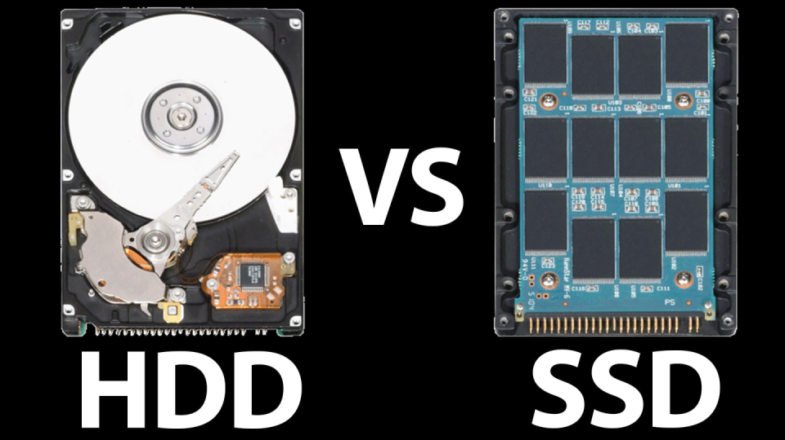
Notes:
[In the picture of the SSD, you’ll see a bunch of black rectangles. Each rectangle is a separate piece of Flash memory, connected to a bus. This means that, like hard drives, SSDs also have internal “geometries” that affect access speeds! For a high-level overview of SSD geometries, see https://www.cactus-tech.com/resources/blog/details/solid-state-drive-primer-8-controller-architecture-channels-and-banks.]

Slide 5
R/W heads
Spindle
Platter
Notes:
Note that the platters are double-sided, i.e., they store data on both sides. Also note that, in commodity hard drives, all of the read/write heads move together, in unison; however, fancier drives can have sets of independently-moving heads. See here: https://www.extremetech.com/computing/260946-seagates-new-multi-actuator-technology-double-hard-drive-speeds

Slide 6
Track
Cylinder
Sector (4KB)
Cylinder
group
Notes:
A sector is the smallest unit of reading and writing. For example, if a disk has a sector size of 4 KB, and you want to read 3 bytes, then you have to read the entire 4 KB sector that contains the 3 bytes. In fact, you might have to read TWO sectors if the bytes that you want to read span two adjacent sectors!
Operating systems typically assume that (1) a write to a single sector is atomic, but (2) a write that spans multiple sectors is not (in the sense that, if the OS tells the hard disk to write N sectors, then, in the presence of random power failures, the hard disk only guarantees that, for any sectors that are actually written before the power fails, those sectors will be atomically (i.e., completely) written. This topic will become important in the next lecture when we talk about file system reliability! [For an interesting and gory discussion of write atomicity, see https://stackoverflow.com/a/61832882.]
[For a long time, hard disks used a sector size of 512. However, modern disks now use a sector size of 4K. Ref: https://en.wikipedia.org/wiki/Advanced_Format]

Slide 7
Accessing Data on a Hard Disk: Mechanical Latencies
Seek time: Moving the disk head to the right track
  Laptop/desktop drives have average seek times of 8—15ms
  High-end server drives have average seek times of 4ms
Rotational latency: Moving the target sector under the disk head
  Dependent on the revolutions-per-minute (RPM) of the drive
  RPMs between 5400—7200 typical for laptop and desktop drives; server drives can go up to 15,000
  So, average rotational latencies are 5.56—4.17 ms for laptop/desktop drives, 2 ms for high-end server drive
If you want to read or write an entire cylinder, you just have to pay the seek cost, and then you can read/write the cylinder as the disk rotates

Slide 8
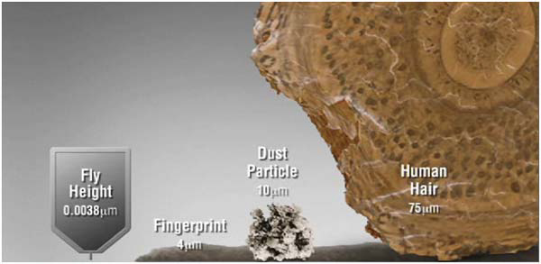
The Disk Is Sealed To Prevent Tragedies
[Courtesy of our friends at Seagate]

Slide 9
Solid-state Storage Devices (SSDs)
An SSD contains blocks made of pages
  A page is a few KB in size (e.g., 4 KB)
  A block contains several pages, is usually 128 KB or 256 KB
. . .
Page
0
1
2
3
4
5
6
7
8
9
10
11
Block
0
1
2
To write a single page, YOU MUST ERASE THE ENTIRE BLOCK FIRST
A block will fail after a certain number of erases (~1000 for slowest-but-highest-density flash, ~100,000 for fastest-but-lowest-density flash)
Notes:
By “erase,” I mean “set all of the bits to 1.”
[For a discussion of the physics, see [1] and [2].]
[Ref: [1] https://arstechnica.com/information-technology/2012/06/inside-the-ssd-revolution-how-solid-state-disks-really-work/2/
[2] https://arstechnica.com/information-technology/2012/06/inside-the-ssd-revolution-how-solid-state-disks-really-work/3/
]

Slide 10
Latency of SSD Operations
Read a page: Retrieve contents of entire page (e.g., 4 KB)
  Cost is 25—75 microseconds
  Cost is roughly independent of page number, prior request offsets
Erase a block: Resets each page in the block to all 1s
  Cost is 1.5—4.5 milliseconds
  Much more expensive than reading!
  Allows each page to be written
Program (i.e., write) a page: Change selected 1s to 0s
  Cost is 200—1400 microseconds
  Faster than erasing a block, but slower than reading a page
Hard disk: 4—15ms avg. seek latency
2—6ms avg. rotational latency
Notes:
[1 microsecond is a thousandth of a millisecond.]
[See [1] for a nice discussion of this topic. As [1] says, “While SSDs can read and write to individual pages, they cannot overwrite pages. A freshly erased, blank page of NAND flash has no charges stored in any of its floating gates; it stores all 1s. 1s can be turned into 0s at the page level, but it's a one-way process (turning 0s back into 1s is a potentially dangerous operation because it uses high voltages). It's difficult to confine the effect only to the cells that need to be altered; the high voltages can cause changes to adjacent cells. This can be prevented with tunneling inhibition—you apply a very large amount of voltage to all the surrounding cells so that their electrons don't tunnel away along with the targeted cells—but this results in no small amount of stress on the cells being erased. Consequently, in order to avoid corruption and damage, SSDs are only erased in increments of entire blocks, since energy-intensive tunneling inhibition isn't necessary when you're whacking a whole bunch of cells at the same time. (There's a Mafia joke in here somewhere, I'm sure of it.) . . . The fact that you can read and write in pages but only erase in blocks leads to some odd behavior when compared to traditional storage. A magnetic hard disk can always write wherever it likes and update data "in-place." Flash storage can't. It can (essentially) only write to empty, freshly erased pages. The most obviously bad side effect of this kind of scheme is that, unless the SSD has an available erased page ready and waiting for data, it can't immediately perform a write. If it has no erased pages, it will have to find a block with unused (but not yet erased) pages, erase the entire block, then write the block's old contents out along with the new page.
This means that the SSD can get slower and slower as it ages. When you pull your shiny new SSD out of the box and plug it in, it's full of erased pages. As you begin copying files to it, it begins busily writing out those files in pages, very quickly, making you happy you purchased it. Hooray! SSDs don't overwrite data, though, so as you change files and delete files and copy new files in, the changed and deleted files aren't actually changed or deleted—the SSD controller leaves them right where they are and writes in the changes and the new files in fresh pages.”
As [2] states, “Over-provisioning [means] stuffing more NAND into a drive than it says on the box. Over-provisioning is done on most consumer SSDs today and on all enterprise SSDs, with the amount varying depending on the type and model of drive. Consumer SSDs that list "120 GB" of capacity generally have 128GB of actual NAND inside, for example; over-provisioning in the enterprise space is generally much larger, with some drives having as much as 100% additional capacity inside. Over-provisioning provides some breathing room so that there can potentially be free pages available to receive writes even if the drive is nearing capacity; additionally, in the event that some cells wear out prematurely or go bad, over-provisioning means that those bad cells can be permanently marked as unusable without a visible decrease in the drive's capacity.
When Windows or OS X or your Linux distro of choice ‘deletes’ a file, it simply adds a note in the file system saying that the clusters that make up that file are free for use again. Unfortunately for an SSD, none of that information is visible down at the level the SSD operates—the drive doesn't know what operating system or file system is in use. All it understands are pages and blocks, not clusters and files. Deleting files doesn't free up that file's pages to be ignored by garbage collection, which can lead to the unfortunate circumstance where a drive's garbage collection routines are gathering and moving pages that contain "data" that the file system has deleted, and so cannot access anyway. [The SSD’s “trim” command] lets the operating system pass a note down to the SSD saying that a set of pages taken up by a deleted file can be considered stale, and don't have to be relocated along with good data.”]
[Ref: [1] https://arstechnica.com/information-technology/2012/06/inside-the-ssd-revolution-how-solid-state-disks-really-work/3/
[2] https://arstechnica.com/information-technology/2012/06/inside-the-ssd-revolution-how-solid-state-disks-really-work/4/
]

Slide 11
Block
Page
10011110
00100010
01101101
11010011
To write the first page, we must first erase the entire block.
11111111
11111111
11111111
11111111
Now we can write the first page . . .
. . . but what if we needed the data in the other three pages?
00110011
11111111
11111111
11111111

Slide 12
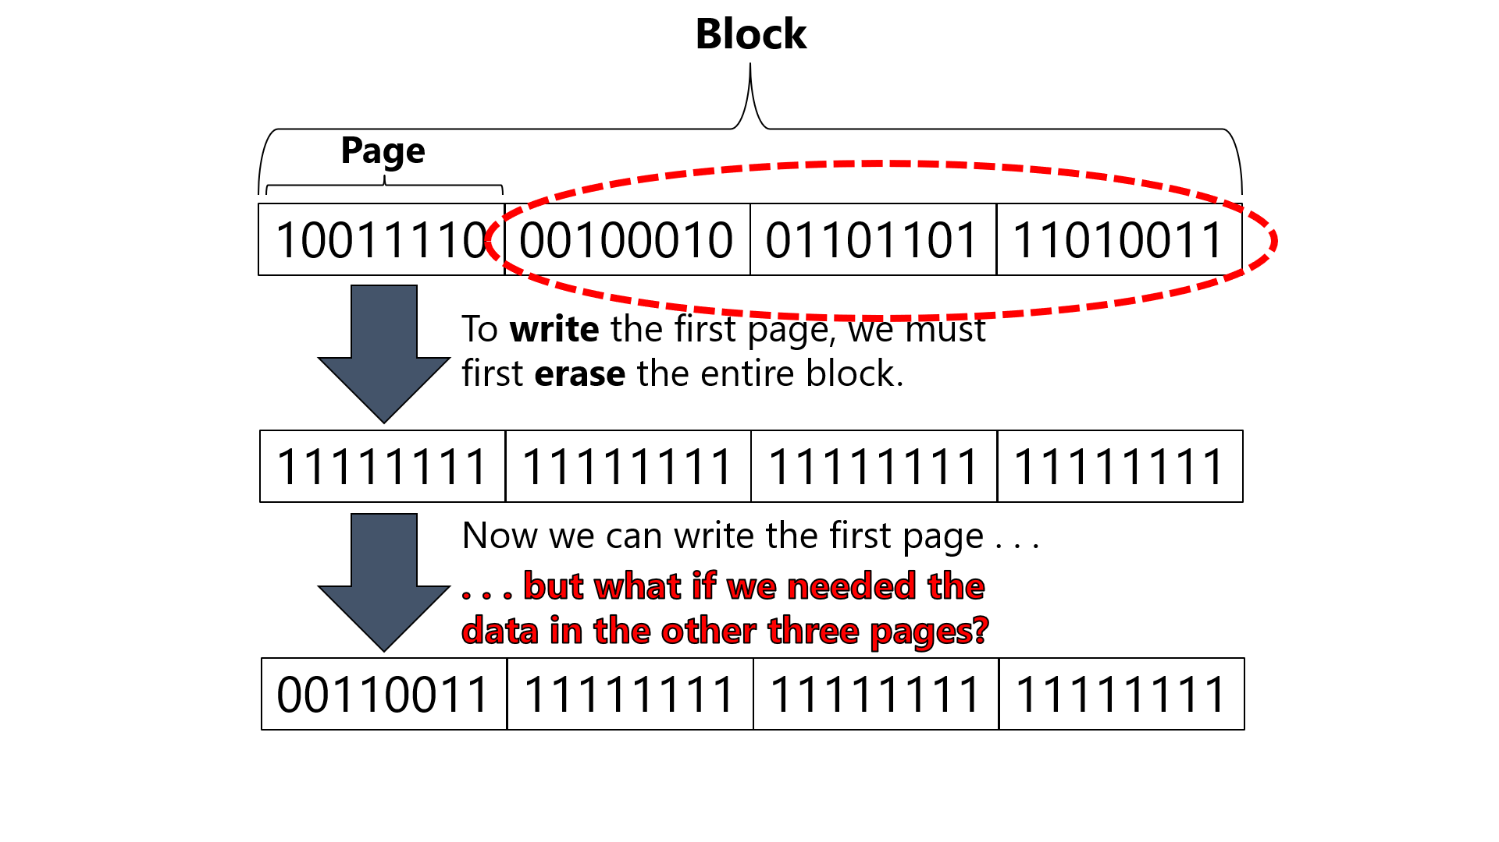
Flash Translation Layer (FTL)
Goal 1: Translate reads/writes of logical pages into reads/erases/programs of physical pages+blocks
  Allows SSDs to export the simple “block interface” that hard disks export
Goal 2: Reduce write amplification (i.e., the amount of extra copying needed to deal with block-level erases and garbage collection)
Goal 3: Implement wear leveling (i.e., distribute writes equally to all blocks, to avoid rapid failures of “hot” blocks)
The FTL is usually implemented by the SSD hardware

Slide 13
FTL Approach #1: Direct Mapping
Have a 1-1 correspondence between logical pages and physical pages
Logical
pages
Physical
pages
Block
Block
Block
Reading a logical page is straightforward
Writing a logical page is trickier:
  Read the entire physical block into memory
  Update the relevant page in the in-memory block
  Erase the entire physical block
  Program the entire physical block using the new block value

Slide 14

Sadness #1: Write amplification
  Writing a single page requires reading and writing an entire block
Sadness #2: Poor reliability
  If the same logical block is repeatedly written, its physical block will quickly fail
  Particularly unfortunate for logical metadata blocks

Slide 15
FTL Approach #2: Log-based mapping
Basic idea: Treat the physical blocks like a log
  Send data in logical-page-to-write to the physical page at the end of the log
  Maintain a mapping between logical pages and the corresponding physical pages in the SSD
As logical blocks are deallocated or overwritten, the associated physical blocks must be garbage collected!
Logical
0
1
2
3
4
5
6
7
8
9
10
11
pages
. . .
Physical
pages
0
1
2
3
4
5
6
7
8
9
10
11
Block
0
1
2

Slide 16
Logical-to-physical map
Log head
Uninitialized
. . .
Valid
Page
0
1
2
3
4
5
6
7
8
9
10
11
Block
0
1
2

Slide 17
write(page=92, data=w0)
Logical-to-physical map
92 --> 0
erase(block0)
program(page0, w0)
logHead++
Log head
Log head
Uninitialized
w0
. . .
1*
1*
1*
1*
Valid
Page
0
1
2
3
4
5
6
7
8
9
10
11
Block
0
1
2
Notes:
Remember that we cannot write to a page without erasing a block first!

Slide 18
write(page=92, data=w0)
Logical-to-physical map
92 --> 0
17 --> 1
erase(block0)
program(page0, w0)
logHead++
write(page=17, data=w1)
program(page1, w1)
logHead++
Log head
Log head
Uninitialized
w0
w1
1*
1*
. . .
1*
Valid
Page
0
1
2
3
4
5
6
7
8
9
10
11
Block
0
1
2

Slide 19
write(page=92, data=w0)
Logical-to-physical map
92 --> 0
17 --> 1
erase(block0)
program(page0, w0)
logHead++
write(page=17, data=w1)
Advantages w.r.t. direct mapping
Avoids expensive read-modify-write behavior: don’t need to erase then program entire block to write a single page
Better wear levelling: writes get spread across physical pages, even if there is spatial locality in writes at logical level
program(page1, w1)
logHead++
Log head
Uninitialized
w0
w1
1*
1*
. . .
Valid
Page
0
1
2
3
4
5
6
7
8
9
10
11
Block
0
1
2

Slide 20
write(page=92, data=w4)
Logical-to-physical map
92 --> 0
17 --> 1
33 --> 2
68 --> 3
erase(block1)
92 --> 4
program(page4, w4)
logHead++
Garbage version of logical page 92!
Log head
Log head
Uninitialized
w0
w1
w4
. . .
w2
w3
1*
1*
1*
1*
Valid
Page
0
1
2
3
4
5
6
7
8
9
10
11
Block
0
1
2

Slide 21
At some point, FTL must:
Logical-to-physical map
92 --> 0
17 --> 1
33 --> 2
68 --> 3
  Read all pages in physical block 0
92 --> 4
  Write out the second, third, and fourth pages to the end of the log
  Update logical-to-physical map
Garbage version of logical page 92!
Log head
Uninitialized
w0
w1
w2
w3
w4
1*
1*
1*
. . .
Valid
Page
0
1
2
3
4
5
6
7
8
9
10
11
Block
0
1
2

Slide 22

Trash Day Is The Worst Day
Garbage collection requires extra reads+writes
Overprovisioning makes GC less painful
  SSD exposes a logical page space that is smaller than the physical page space
  By keeping extra, “hidden” pages around, the SSD tries to defer GC to a background task (thus removing GC from critical path of a write)
SSD will occasionally shuffle live (i.e., non-garbage) blocks that never get overwritten
  Enforces wear levelling
Notes:
The garbage collection traffic is “extra” because it doesn’t correspond to an IO that was directly issued by an application---instead, the garbage collection traffic is pure bookkeeping overhead.

Slide 23
SSDs versus Hard Drives (Throughput)
[Source: “Flash-based SSDs” chapter of “Operating Systems: Three Easy Pieces” by the Arpaci-Dusseaus]
Random
Sequential
Reads
Writes
Reads
Writes
(MB/s)
(MB/s)
(MB/s)
(MB/s)
Device
Samsung 840 Pro SSD
103 287 421 384
Seagate 600 SSD
84 252 424 374
Intel 335 SSD
39 222 344 354
Seagate Savio 15K.3 HD
2 2 223 223
SSD random writes are faster than SSD random reads: the SSD can batch writes (acknowledging software quickly) and then issue the writes in one burst, but a read can’t complete until the data has actually been fetched.
Hard drives have terrible random IO performance! The disk head must incur a seek penalty and rotational delay for most IOs :-(.
Dollars per storage bit: Hard drives are an order-of-magnitude cheaper!
[SSD: ~$0.50/GB HD: ~$0.035/GB]
Sequential IO is faster than random IO on SSDs, even though SSDs have no mechanical latencies!
For sequential IOs, disks are more competitive.
Notes:
There are three interesting trends to note:
1) Hard drives have terrible performance for random reads and writes. The reason is that, for random workloads, the disk head is moving all around, incurring a bunch of seek latencies and rotational delays. In contrast, an SSD only has to pay electronic latencies. But, as we see from this chart, a file system for SSDs would also benefit from converting random IOs to sequential ones, because SSDs also have a performance disparity between random and sequential IO.
2) A second interesting trend is that, for SSDs, random writes are faster than random reads. This is because the SSD can batch a bunch of writes, and then write them in one burst to the end of the log. The SSD can’t play those kinds of tricks with reads. Also note that, like a hard disk, an SSD also has a “geometry.” Internally, the SSD groups a bunch of blocks together. Consecutively accessing pages in that group are faster than consecutively accessing pages across many different groups. [For a high-level overview of SSD geometries, see https://www.cactus-tech.com/resources/blog/details/solid-state-drive-primer-8-controller-architecture-channels-and-banks]
3) We see another interesting trend by looking at the sequential numbers. For sequential reads and writes, the performance difference between SSDs and hard drives is much smaller. So, if you’re designing a machine, and you know that the machine will only be running applications with sequential workloads, then maybe you should put a hard disk in the machine instead of an SSD. You’ll get a lot more storage capacity for the same amount of dollars, and your sequential performance will be pretty reasonable. In terms of dollar per storage bit, ******* there’s a 10x differences between hard drives and SSDs. In other words, for a given amount of money, you can buy a hard disk that has ten times more storage than an SSD with the same dollar cost. So, SSDs have roughly twice as fast sequential throughput, but roughly a tenth of the storage capacity of a hard disk.
Why are SSD random IOs are slower than SSD sequential IOs? One reason is that the log-structured design of most FTLs make random IOs slow. Random writes are slower due to less-efficient garbage collection (because compaction can’t free entire segments at a time, but instead must pluck out live pages and write them out to new segments); random reads are slower because different pages from different blocks must be read, as opposed to reading the entire contents of entire multi-page blocks. Also note that, even though SSDs are purely electronic (and thus don’t have mechanical geometries in the same way that hard drives do), an SSD may nonetheless have circuit-level geometries arising from the ways that individual SSD storage banks are wired to the SSD’s IO bus. Those circuit-level geometries can make certain IO patterns faster—in particular, SSD developers are motivated to make sequential IOs faster than random ones so that software-level file systems which were originally designed for hard disks (and their performance profile of “slow random IOs but fast sequential IOs”) can leverage preexisting data allocation strategies on SSDs and enjoy the same benefits, e.g., from laying out a particular file’s data sequentially as opposed to scattering the data across the storage device. So, this is why, even though consumer-facing devices all use SSDs now, it’s still interesting to know a bit about magnetic hard disks, because the affordances of those disks still influence how SSDs and file systems are designed.
[Ref: https://pages.cs.wisc.edu/~remzi/OSTEP/file-ssd.pdf]

Slide 24

Read Latencies for a Cache Line’s Worth of Data
On Intel and AMD x86-64 chips, a cache line is typically 64 bytes
L1 i-cache
L1 d-cache
L1 i-cache
L1 d-cache
L2 cache
L2 cache
L3 cache
RAM
Persistent storage (e.g., SSD)

Slide 25
Read Latencies for a Cache Line’s Worth of Data
On Intel and AMD x86-64 chips, a cache line is typically 64 bytes
How long does it take to read a cache line’s worth of data from the following sources?
  L1 cache: ~0.5 ns
  RAM: ~100 ns
  SSD: ~150,000 ns or 150 μs
  Hard drive: ~15,000,000 ns or 15 ms (seek+rotational latency)
The in-RAM buffer cache and the L* caches can reduce access latencies by orders of magnitude!
Notes:
[Ref: https://gist.github.com/jboner/2841832]

Slide 26
Outline
Hard Drives vs. SSDs
Organizing Data on a Storage Device
Shingled Hard Drives

Slide 27

Linux’s Storage Stack: A High-level View
Application code
libc
User
Kernel
VFS + Concrete FS
How does the OS map file data and directory data to storage blocks?
Page cache
Block IO scheduler
IO request queue
Device driver X
Device driver Y
Storage device X
Storage device Y

Slide 28
Files and Directories
A file is a named, linear region of bytes that can grow and shrink
  Associated with metadata like:
    a user-visible name (e.g., /home/bob/README.md)
    a size in bytes
    access permissions (read/write/execute)
    statistics like last modification time
    a seek position if open
  File also has a low-level name (e.g., Linux inode number) that the file system uses to locate the file data on a storage device
  File systems are typically agnostic about the contents of the file (i.e., applications decide how to interpret file bytes)
A directory is a container for other files and directories
  Typically contains pairs of <user-visible-name, low-level-name>
  Nested directories create trees (e.g., /home/todd/photos/koala.jpg)

Slide 29
Files as Linked Lists (FAT: MSDOS, SSD memory cards)
Advantages
  Easy to shrink and grow files
  Low internal and external fragmentation
  Calculating block offsets for sequential IO is easy
Disadvantages
  Sequential IO requires a lot of seeks
  Random IO is difficult—where does the target sector live?
  Must store pointer information at the end of each block
=
Notes:
[Ref: https://technet.microsoft.com/en-us/library/cc938438.aspx
http://www.ntfs.com/fat-allocation.htm]

Slide 30
Files as Hybrid Indices (FFS, ext2, ext3)
Top-level index contains direct pointers, indirect pointers, doubly-indirect pointers, etc.
Advantages:
  Efficient for small files: don’t need to materialize indirect blocks
  There is still a maximum file size, but it’s really big
  Low internal and external fragmentation
Disadvantages:
  Reading or writing a single data block may require multiple disk accesses to fetch indirection info
  Even if indirection info is cached, reading or writing adjacent blocks may require extra seeks if those blocks are not physically adjacent on disk
Notes:
[Note that the main difference between ext2 and ext3 is that ext3 adds journaling support.]
[Mention that ext4 uses an extent-based scheme (philosophically similar to the “File as Collection of Extents” model), instead of indirection nonsense. An extent-based model is more efficient for large files, since only the base and bounds of the extent must be stored, instead of a list of individual data blocks.
http://www.ibm.com/developerworks/library/l-anatomy-ext4/
https://www.dfrws.org/sites/default/files/session-files/paper-an_analysis_of_ext4_for_digital_forensics.pdf]

Slide 31
Files as Collections of Extents (IBM OS360, ext4)
Advantages:
  If extents are large, then sequential IO almost as fast as with a single extent
  Random IO almost as efficient as with single extent (offset calculations a little trickier)
  Metadata is small
Challenges:
  How large should a file’s initial extents be?
  What happens if a file needs to grow or shrink?
  External fragmentation not as bad, but depending on design, may have internal fragmentation inside each extent
Contiguous
blocks
. . .
. . .
Notes:
External fragmentation isn’t as bad because the file system doesn’t have to find a single contiguous region to hold the entire file.
[Ref: http://www.ibm.com/developerworks/library/l-anatomy-ext4/
https://www.dfrws.org/sites/default/files/session-files/paper-an_analysis_of_ext4_for_digital_forensics.pdf]

Slide 32
Free Space Management
Fixed-sized blocks: File systems typically use a bitmap to indicate which blocks are in use
  Allocation metadata is very compact
  Finding a single free block is straightforward . . .
  . . . but finding a *contiguous* region of N free blocks is tedious without auxiliary data structures
Extents: File system can implement “on-disk malloc”
  File system breaks the disk into discrete-sized extents (e.g., 4KB, 8KB, 12KB,…,4MB), or arbitrarily-sized extents sorted by size
  File system maintains a list of unallocated extents
  To allocate an extent for a request of size N bytes, file system uses a policy (e.g., best-fit, worst-fit, first-fit, etc., each of which has trade-offs between internal fragmentation, external fragmentation, and speed of finding a match)

Slide 33
Outline
Hard Drives vs. SSDs
Organizing Data on a Storage Device
Shingled Hard Drives

Slide 34
Adding More Storage Capacity To Disks
A disk head has two components: a read head and a write head
Standard approach: perpendicular magnetic recording
  Write head sets the magnetic polarity of a bit “up” or “down”
  Read head retrieves the polarity of a bit
  Each track is separated by a guard band
Track
Reader
Writer
Guard
band
Track
You could try to increase capacity by making write heads smaller . . .
  . . . but smaller write field isn’t strong enough to flip bits :-(
Notes:
[References: http://www.storagereview.com/what_is_shingled_magnetic_recording_smr/
http://blog.schmorp.de/data/smr/fast15-paper-aghayev.pdf
https://lwn.net/Articles/591782/
http://blog.hgst.com/youve-just-crossed-over-intothe-smr-zone/
https://en.wikipedia.org/wiki/Magnetic_storage
https://en.wikipedia.org/wiki/Perpendicular_recording]

Slide 35
Shingled Magnetic Recording
Idea: Overlap tracks!
  Good: Increases capacity
  Bad: Writes to track i overwrite part of track i-1 and i+1
    Data from track i-1 can still be read
    However, if you write new data to track i-1, you invalidate track i’s data :-(
    So . . . write the disk sequentially and then never update?
Reader
Track i-1
Writer
Reader
Track i
Writer
Reader
Track i+1
Writer

Slide 36
Shingled Magnetic Recording
Use a group of shingled tracks as a “sequential write regions”
Separate regions with a guard track that supports traditional random reads and writes
Shingled
Tracks
Guard
Track
Shingled
Tracks

Slide 37
SMR: Enforcing Sequential Writes
Use a log-based storage layout + “shingle translation layer”
Log head: Next logical write is mapped to this physical block
SeqWr
region
Who manages the “shingle translation layer”?
  Could be done by the drive firmware or by the file system
  We’ll discuss log-based file systems in more detail later!
Garbage collection may cause crazy performance jitter, which makes some people angry; poor random IO performance may also inspire anger

Slide 38
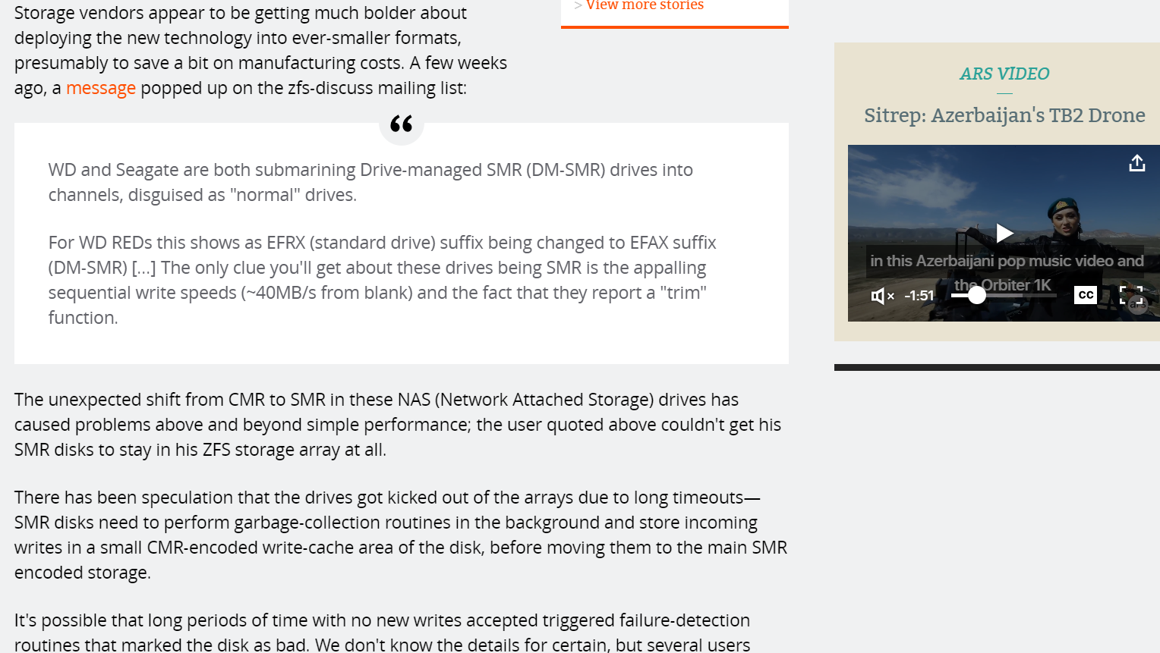
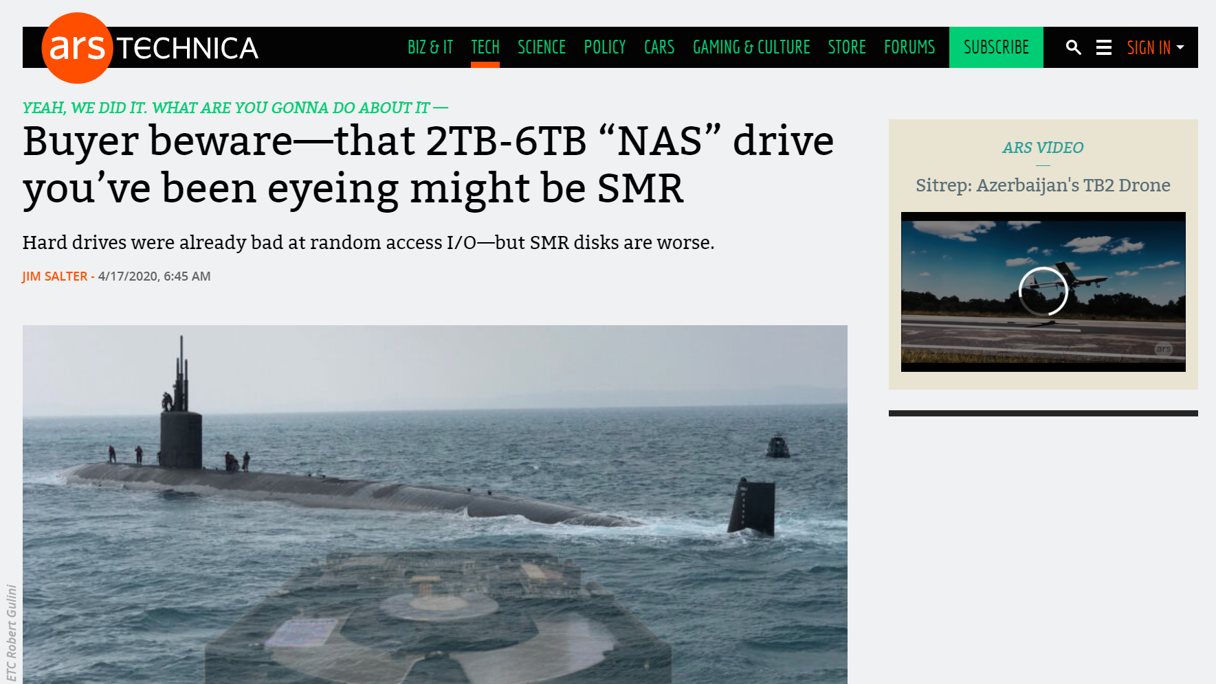
Notes:
[Ref: https://arstechnica.com/gadgets/2020/04/caveat-emptor-smr-disks-are-being-submarined-into-unexpected-channels/]

