Slide 1

DAC, MAC, and iOS
CS 1610: Lecture 15
3/31/2025

Slide 2
Outline
Discretionary Access Control in Unix
Apple’s Darwin Kernel
  Architecture
  Mandatory Access Control
iOS Security
  Sandboxing
  Enforcing App Signatures

Slide 3

Unix: From Whence OSes Came
†
The UNIX OS was a massive influence on subsequent OS development
  UNIX development first started at Bell Labs in 1969
  Various derivatives have spread through the computing industry, with the term “UN*x” often used to collectively describe the derivatives
UNIX was characterized by:
  Portability: Unlike prior OSes, UNIX was written almost entirely in C, with assembly code only used for machine-specific code
  Simplicity: The kernel and each user-visible system utility (e.g., ls, cat, kill) were designed to provide simple, well-specified functionality that could be aggregated to perform more complex tasks (e.g., via pipes and shell scripting and the fact that almost everything is a file)
†But not Windows LOL
Notes:
[According to the infallible Wikipedia [1], “In 1970, the [Bell Labs OS] group coined the name Unics for Uniplexed Information and Computing Service as a pun on Multics, which stood for Multiplexed Information and Computer Services. Brian Kernighan takes credit for the idea, but adds that ‘no one can remember’ the origin of the final spelling Unix.^{[15]} Dennis Ritchie,^{[10]} Doug McIlroy,^{[1]} and Peter G. Neumann^{[16]} also credit Kernighan.]
[Ref: [1] https://en.wikipedia.org/wiki/Unix]

Slide 4
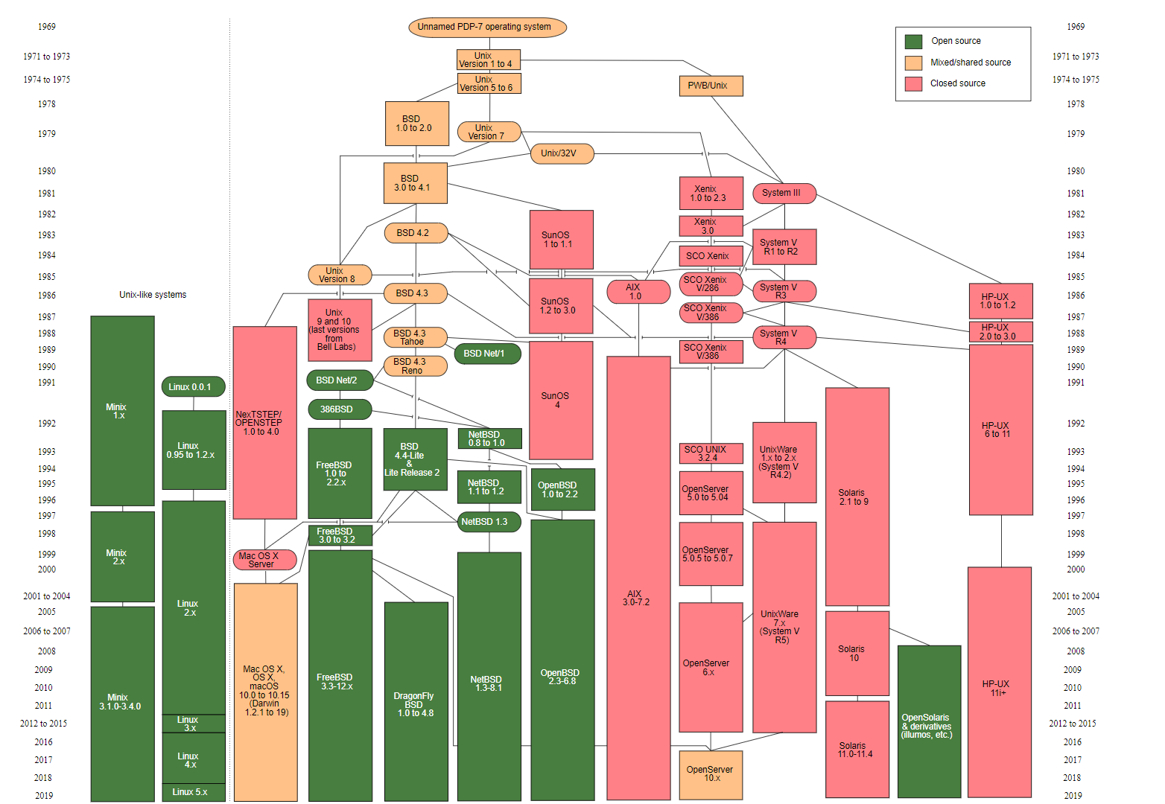
Notes:
[Ref: https://en.wikipedia.org/wiki/Unix]

Slide 5
User Ids and Group Ids in Un*x
Each user gets a 32-bit user id (uid), with uid 0 belonging to root (i.e., the “superuser”)
The system administrator can also place a user in a group (as identified by a group id (gid))
The kernel tags each process with the uid and gid of the user who launched the binary
  A newly-created file gets the uid and gid of the creating process
  The user who owns the file can set read, write, and execute bits for the user, the user’s group, and “the world” (i.e., everyone else)
  For directories:
    x: Enables traversing of the directory to:
      Access files in the directory (subject to the permissions of those files)
      Use the directory as the current directory (e.g., cd /some/dir)
    r: Enables listing of the directory contents (e.g., ls –l /some/dir)
    w: Enables the creation, deletion, or renaming of files within the directory (e.g., rm /some/dir/file.txt), but only if you also have x permission
Notes:
[The interactions between file permissions and directory permissions are subtle. I highly recommend that you read this article for more details: https://www.hackinglinuxexposed.com/articles/20030424.html. As the article says:
“*Read (r)The ability to read the names of files stored in this directory.
*Write (w)The ability to rename files in the directory, create new files, or delete existing files, if you also have Execute permissions. If you don't have execute perms, then write perms are meaningless.
*Execute (x)The ability to cd into this directory, and access the files in this directory.
How a directory functions is one of the most frequently misunderstood file permission issues. Here are a few examples that should make it easier to understand.
# "Full Access". Reegen can list, create, delete, rename, delete,
# and stat any files in dir.
# Access to file contents is subject to the permissions
# of the file itself.
# New files can be created, any file can be deleted, regardless of
# file permissions.
drwx------ 1 reegen reegen 4096 Jan 01 2003 dir
# Reegen can do everything in the "Full Access" list except create,
# delete, or rename files in this directory.
dr-x------ 1 reegen reegen 4096 Jan 01 2003 dir
# Reegen can do everything in the "Full Access" list except list the
# filenames in this directory. If she suspects there is a file
# named "program" she can list it, but cannot do an 'ls'
# of the directory itself. She can access any file (file
# permissions permitting) if she knows it's name. She can
# create new files, or rename/delete existing ones.
d-wx------ 1 reegen reegen 4096 Jan 01 2003 dir
# Reegen cannot create or delete any files in this directory.
# She can access any file (permissions permitting) if she
# knows it's name already.
d--x------ 1 reegen reegen 4096 Jan 01 2003 dir
. . . Many people don't realize that write access means the ability to create or delete files, and that the permissions of the file itself is totally irrelevant. This does make sense if you think about it. When you add files, what are you doing? You're putting a new entry into the directory listing - it is the directory that is changing, so that's why you need write permission to the directory. It's the same situation with deleting - the directory (list of files) is being changed, so if you have write access, you can do so regardless of the permissions of the file itself.”]

Slide 6
# "Full Access". Reegen can list, create, delete, rename, delete,
# and stat any files in dir.
# Access to file contents is subject to the permissions
# of the file itself.
# New files can be created, any file can be deleted, regardless of
# file permissions.
drwx------ 1 reegen reegen 4096 Jan 01 2003 dir
# Reegen can do everything in the "Full Access" list except create,
# delete, or rename files in this directory.
dr-x------ 1 reegen reegen 4096 Jan 01 2003 dir
# Reegen can do everything in the "Full Access" list except list the
# filenames in this directory. If she suspects there is a file
# named "program" she can ‘ls’ it, but cannot do an 'ls'
# of the directory itself. She can access any file (file
# permissions permitting) if she knows it's name. She can
# create new files, or rename/delete existing ones.
d-wx------ 1 reegen reegen 4096 Jan 01 2003 dir
# Reegen cannot create or delete any files in this directory.
# She can access any file (permissions permitting) if she
# knows it's name already, but she cannot list the contents
# of the directory.
d--x------ 1 reegen reegen 4096 Jan 01 2003 dir

Slide 7
User Ids and Group Ids in Un*x
The chmod(const char *pathname, mode_t mode) system call changes the permission bits on a file
In Un*x systems, devices are files and have permission bits (with the “execute” bits ignored by the kernel)
  Ex: A raw storage device like /dev/sda
  Ex: A terminal like /dev/tty, which represents the terminal for the current process
In addition to the nine r/w/x permission bits, a file has a setuid bit
  When the kernel exec()s a setuid=1 binary, the kernel sets the effective uid of the process to be the uid of the executable file’s owner (instead of the uid of the process who invoked exec())
  The kernel implements permission checks by looking at a process’s effective uid (which may be different from the real uid)
  Ex: The passwd program allows users to change their password
    The program must be able to modify the root-owned /etc/shadow file which stores passwords
    Thus, /usr/bin/passwd is owned by root and has setuid=1
The setuid(uid_t uid) system call, invocable only by root-owned processes, sets the effective uid of the calling process
Notes:
[A file also has a setgid bit, but this bit is rarely used in practice.]
[As explained by https://docstore.mik.ua/orelly/linux/run/ch06_03.htm, “When using ls -l to list device files in /dev, you'll see something like the following:
brw-rw---- 1 root disk 3, 0 May 19 1994 /dev/had
This is /dev/hda, which corresponds to the first IDE drive. First of all, note that the first letter of the permissions field is b, which means this is a block device file. (Recall that normal files have a - in this first column, directories a d, and so on.) Device files are denoted either by b, for block devices, or c, for character devices. A block device is usually a peripheral such as a hard drive: data is read and written to the device as entire blocks (where the block size is determined by the device; it may not be 1024 bytes as we usually call "blocks" under Linux), and the device may be accessed randomly. In contrast, character devices are usually read or written sequentially, and I/O may be done as single bytes. An example of a character device is a serial port. Also, note that the size field in the ls -l listing is replaced by two numbers, separated by a comma. The first value is the major device number and the second is the minor device number. When a device file is accessed by a program, the kernel receives the I/O request in terms of the major and minor numbers of the device. The major number generally specifies a particular driver within the kernel, and the minor number specifies a particular device handled by that driver. For example, all serial port devices have the same major number, but different minor numbers. The kernel uses the major number to redirect an I/O request to the appropriate driver, and the driver uses the minor number to figure out which specific device to access.”]

Slide 8
Logging Into a Un*x Virtual Terminal
vt1
vt2
. . .
vtN
fork()
uid:0
uid:0
uid:0
uid:0
init
init
init
. . .
init
exec()
exec()
exec()
uid:0
uid:0
uid:0
getty
getty
getty
Prompts for the user’s name, then passes it to login
exec()
uid:0
login
uid:userId
Prompts for the user’s password, and verifies it by reading /etc/shadow; if the password is right, login does setuid(userId) and then . . .
exec()
uid:userId
bash
Notes:
“In the Linux console and other platforms, usually the first six virtual consoles provide a text terminal with a login prompt to a Unix shell. The graphical X Window System traditionally starts in the seventh virtual console (tty7), although this is configuration dependent. In Linux, the user switches between them by pressing the Alt key combined with a function key – for example Alt + F1 to access the virtual console number 1. Alt + ← changes to the previous virtual console and Alt + → to the next virtual console.” [Ref: https://en.wikipedia.org/wiki/Virtual_console]
`getty` passes the user name to `login` via the `exec()` arguments.
When a user logs out of their shell, `init` notices that the process has died. `init` then `fork()`s itself again and spawns a new `getty` process for the associated terminal.
[Ref: https://en.wikipedia.org/wiki/Virtual_console
https://tldp.org/LDP/sag/html/login-via-terminal.html
https://en.wikipedia.org/wiki/Getty_(Unix)
https://man7.org/linux/man-pages/man1/login.1.html
https://github.com/shadow-maint/shadow/blob/master/src/login.c#L1251
//The login utility is part of a Linux package called `shadow`. The line of source code
//above shows where the login program drops its root privileges.
]

Slide 9
Outline
Discretionary Access Control in Unix
Apple’s Darwin Kernel
  Architecture
  Mandatory Access Control
iOS Security
  Sandboxing
  Enforcing App Signatures
Notes:
[For an older but still relevant overview of Darwin, see https://fahrplan.events.ccc.de/congress/2007/Fahrplan/attachments/986_inside_the_mac_osx_kernel.pdf.]
Note that MacOS was formerly called “OS X.” The older name is sometimes still seen in technical documentation from Apple and others. Apple did the rebranding to provide a consistent nomenclature across different Apple devices (e.g., “iOS” for iPhones, “MacOS” for Macintosh laptops and desktops, and “WatchOS” for Apple watches). For more information about the rebranding, see https://www.wired.com/2016/06/apple-os-x-dead-long-live-macos/.

Slide 10
Monolithic Kernels vs. Microkernels
Applications
User
Applications
VFS
Kernel
Linux server
Device drivers
File system
User
File system
IPC
Kernel
Virtual Memory
Virtual Memory
Device drivers
Scheduler
IPC
Scheduler
Hardware
Hardware
Traditional OS
Microkernel OS
Microkernels are nice from the modularity perspective
  Different pieces of kernel functionality can be placed in different user-mode “server” processes
  Each server process can export a clean API via IPC
Microkernels are bad from the performance perspective
  IPC between processes requires context switches into and out of the microkernel
  In a monolithic kernel, cross-component interactions are just function calls
Notes:
A microkernel tries to minimize the amount of OS code that runs in privileged mode. In a microkernel, the lowest-level OS functionality is implemented by the privileged microkernel. Other OS functionality is implemented by user-mode “server” processes.
In a monolithic OS, cross-component interactions are just function calls because the two components live in the same address space!

Slide 11

The Darwin Kernel
User-mode applications
The Darwin kernel is used by both iOS and MacOS
  Darwin layers BSD code atop a Mach microkernel
  The BSD code+data and the Mach code+data live in the same address space, allowing cross-component interactions to just be function calls
The core Darwin kernel is open-source (see the XNU project)
However, Apple uses closed-source for:
  The MacOS/iOS daemons and GUI
  The MacOS/iOS kernel extensions
MacOS and iOS share some (but not all) daemons and extensions
MacOS/iOS daemons
User
BSD layer
(System calls, process model, security model, file systems, networking)
MacOS/iOS kernel extensions
Kernel
IOKit (device drivers)
Darwin kernel
Virtual memory + page swapping
Scheduler
IPC
Mach
Hardware
MacOS/iOS machine
IS THIS
A GOOD IDEA?
Notes:
Mach provides low-level functionality like virtual memory + page swapping, multicore-aware scheduling, and IPC. BSD implements higher-level functionality like the BSD system call interface, the Unix process model (e.g., pids, pthreads, signals), networking, file systems, and the Unix security model (e.g., UIDs and GIDs).
As Apple says, “in OS X, Mach is linked with other kernel components into a single kernel address space. This is primarily for performance; it is much faster to make a direct call between linked components than it is to send messages or do remote procedure calls (RPC) between separate tasks. This modular structure results in a more robust and extensible system than a monolithic kernel would allow, without the performance penalty of a pure microkernel. Thus in OS X, Mach is not primarily a communication hub between clients and servers. Instead, its value consists of its abstractions, its extensibility, and its flexibility. In particular, Mach provides
object-based APIs with communication channels (for example, ports) as object references
highly parallel execution, including preemptively scheduled threads and support for SMP
a flexible scheduling framework, with support for real-time usage
a complete set of IPC primitives, including messaging, RPC, synchronization, and notification
support for large virtual address spaces, shared memory regions, and memory objects backed by persistent store”
[Ref: https://developer.apple.com/library/archive/documentation/Darwin/Conceptual/KernelProgramming/Mach/Mach.html#//apple_ref/doc/uid/TP30000905-CH209-TPXREF101]
IOKit is a kernel component that makes it easier to write device drivers. IOKit provides a variety of helpful features; for example, it:
-abstracts Mach’s low-level interrupt handling support;
-provides a C++ class hierarchy representing broad classes of devices, such that developers can create their own subclasses to implement drivers for specific devices;
-assists the process of handling plug-and-play devices that are automatically discovered and configured by the kernel upon being dynamically added to a system (e.g., USB drives, webcams).
For more details, see https://developer.apple.com/library/archive/documentation/DeviceDrivers/Conceptual/IOKitFundamentals/Features/Features.html, as well as Chapter 19 of [3].
As Chapter 18 of [3] states, kernel extensions “runs in kernel mode, and therefore has full access to kernel space. The developer can use any function that the kernel defines as exportable and even functions that are defined private— although the latter usually involve some form of hacking or reverse engineering. Global kernel variables and structures may also be queried and even set, making kexts highly popular for all sorts of kernel-level development. Profiling, system call hooking, and other functionality can be achieved in kernel mode . . . Apple seems to have no desire whatsoever to open up the [iOS] kernel development space to anyone but its own cadre. As a system, iOS is hardened in both user and kernel mode to discourage any type of modification. So, although kexts are used extensively to provide support for the various i-Devices, they are “fused” into the kernel cache by Apple when the iOS is built for each device (although kexts do load on the fly, from the kernelcache).” But! And importantly! Apple is migrating towards a new mechanism for handling Mac OS kernel extensions, wherein extensions reside in user-space, so that a buggy or subverting extension doesn’t have the ability to ruin all of privileged memory. For details, see https://www.zdnet.com/article/apple-deprecating-macos-kernel-extensions-kexts-is-a-great-win-for-security/ and https://developer.apple.com/documentation/systemextensions.
[Ref: [1] https://developer.apple.com/library/archive/documentation/Darwin/Conceptual/KernelProgramming/Architecture/Architecture.html
[2] https://github.com/apple/darwin-xnu
[3] http://newosxbook.com/MOXiI.pdf
]

Slide 12
Mach Abstractions
Mach represents computations using threads and tasks
  A thread represents a schedulable entity (and thus has register state and a stack)
  A task represents a set of resources used by one or more threads
    Ex: Address space
    Ex: Port namespace
  A task is simpler than a Unix process, and does not store information like a uid, gid, or file descriptors
Mach threads communicate using messages sent to ports
  A port has one receiver, but potentially multiple senders
  To receive a message sent to a port, a thread must possess a “receive right” for that port
  To send a message to a port, a thread needs a “send right” for that port
Mach also provides cross-thread synchronization primitives (e.g., spinlocks, semaphores)
Notes:
Conceptually speaking, a Mach port is like a unidirectional Unix pipe. However, a Unix byte represents a stream of bytes that are uninterpreted by the kernel; in contrast, Mach ports are used to exchange discrete messages.
As described by Chapter 11 of http://newosxbook.com/MOXiI.pdf, “every BSD process has an underlying Mach task object associated with it.”
[As [4] says, “Note that Apple's version of Mach as used in XNU/Darwin is subtly different than both OSF Mach and GNU Mach.” So, when looking up documentation about Mach, always defer to an Apple-specific source.]
A common Mach idiom is to assign some kind of management responsibility to a particular task, such that the only way that other tasks can interact with the resources being managed is to send a Mach IPC message to the management task's port. In a purist Mach implementation, the kernel supports very few system calls (compared to a monolithic kernel). Basically, the Mach kernel defines system calls to allow (1) new tasks/threads to be created/destroyed, (2) threads to send and receive messages, (3) threads to synchronize (e.g., via mutexes), and (4) threads to allocate/deallocate memory. That's it! So, a device driver task that manages a hard disk might communicate with the disk directly using memory-mapped IO. Other tasks (e.g., belonging to a file system) that want to exchange data with the disk must do so by exchanging messages with the device driver's Mach ports. Tasks that want to talk to the file system do so by exchanging messages with the file system task's Mach ports. In this example, the resources being "protected by port rights" are the storage device and the file system.
[Ref: [1] https://developer.apple.com/library/archive/documentation/Darwin/Conceptual/KernelProgramming/Mach/Mach.html#//apple_ref/doc/uid/TP30000905-CH209-TPXREF101
[2] https://www.gnu.org/software/hurd/microkernel/mach/task.html
[3] https://www.gnu.org/software/hurd/microkernel/mach/port.html
[4] https://docs.darlinghq.org/internals/macos-specifics/mach-ports.html
]

Slide 13
Mach Ports and Port Rights
(as implemented by Darwin’s Mach kernel)
In Darwin, a BSD-level kernel-visible thread is backed by a Mach-level thread, with BSD-level file descriptors backed by Mach-level ports
  In Un*x, file descriptors are inherited across fork()
  In Darwin’s Mach kernel, a task’s port rights are mostly reset after fork() or exec(), with the task automatically inheriting a few default port rights, e.g.,
    A send right to the task’s “task port”
      The receive right is owned by the kernel
      Sending to the port allows the sender to manipulate the task associated with the port, e.g., to map/unmap virtual memory, read/write that memory, manage threads, or kill the entire task
    A send right to the “bootstrap port”
      The receive right is owned by the bootstrap server (e.g., the launchd process on Darwin)
      A thread sends a message to the bootstrap port to:
        Publicize a local receive port using a reverse DNS name (e.g., com.foo.game.topScores)
        Request a send right to the port associated with a reverse DNS name
    Receive rights to the “exception ports”
      The send rights are owned by the kernel
      The kernel sends messages to these ports to indicate errors like segmentation faults
The mach_reply_port() system call allows a task to create a new port for which the task has a receive right
Notes:
[As [1] states, “It would make a lot of sense to make Mach port inheritable across fork() and exec() like file descriptors are (and that is the way it work on the Hurd), but on Darwin, they're not. A task starts with a fresh port right namespace after either fork() or exec(), except for a few special ports that are inherited . . . [[1] then describes the task port, bootstrap port, etc.]
[As Chapter 11 of [3] states, “In Mach, exceptions are handled via the primary facility of the kernel: message passing. An exception is little more than a message, which is raised (that is, with msg_send()) by the faulting thread or task, and caught (that is, with msg_recv()) by a handler. The handler can then process the exception, and either clear the exception (that is, mark the exception as handled, and continue) or decide to terminate the thread.
Unlike other models, wherein the exception handler runs in the context of the faulting thread, Mach runs the exception handler in a separate context by making the faulting thread send a message to a predesignated exception port and wait for a reply. Each task may register an exception port, and this exception port will affect all threads of the same task. Additionally, individual threads may register their own exception ports, using thread_set_exception_ports. Usually, both the task and thread exception ports are NULL, meaning exceptions are not handled. Once created, these ports are just like any other ports in the system, and they may be forwarded to other tasks or even other hosts.
When an exception occurs, an attempt is made to raise the exception first to the thread exception port, then to the task exception port, and finally, to the host (i.e., machine-level registered default) exception port. If none of these result in KERN_SUCCESS, the entire task is terminated.”]
As [3] states, “the Mach call of task_for_pid() (bsd/vm/vm_unix.c) exists for mapping a BSD PID to the underlying Mach task port. This call used to include PID 0 (the Mach kernel_task), but now rejects this argument as invalid. The task_for_pid() call is deprecated, and in iOS also requires special entitlements (and therefore requires code-signing the binary, and root permissions for a process not owned by you). This is for (obvious) security reasons: Getting the task port of an arbitrary PID opens a Pandora’s box of mischief and malice, enabling (among other things) one to read and modify that task’s memory image . . . Obtaining
the kernel_task’s port (for PID 0) is tantamount to omnipotence, which is why jailbreakers patch the call and re-enable PID 0.” For more information about `task_for_pid()` and its importance in jailbreaking, see https://www.theiphonewiki.com/wiki/Tfp0_patch].
[Ref: [1] https://docs.darlinghq.org/internals/macos-specifics/mach-ports.html#where-to-get-ports
[2] https://www.gnu.org/software/hurd/gnumach-doc/Port-Creation.html
[3] http://newosxbook.com/MOXiI.pdf
]

Slide 14
//Receiver (slightly simplified)
void main(){
//Create a new port.
mach_port_t port;
mach_port_allocate(mach_task_self(),
MACH_PORT_RIGHT_RECEIVE,
&port);
//Make the port discoverable by other tasks.
bootstrap_register(bootstrap_port,
“com.widgets.receiver”,
port);
//Wait for a message.
struct{
mach_msg_header_t header;
char text[10];
int number;
} msg;
mach_msg(&msg.header, MACH_RCV_MSG,
sizeof(msg), port);
message.some_text[9] = `\0`;
printf("Text: %s, number: %d\n", msg.text,
msg.number);
}
//Sender (slightly simplified)
void main(){
//Lookup the receiver port.
mach_port_t port;
bootstrap_look_up(bootstrap_port,
“com.widgets.receiver”,
&port);
//Construct the message.
struct{
mach_msg_header_t header;
char text[10];
int number;
} msg;
msg.header.msgh_remote_port = port;
strncpy(msg.text, "Hello",
sizeof(msg.some_text));
msg.number = 42;
//Send the message.
mach_msg(&msg.header, MACH_SEND_MSG);
printf("Message sent!\n");
}
Notes:
[Note that, in the example above, the receiver creates the port using `mach_port_allocate()`, not the `mach_reply_port()` system call mentioned on the last slide. As [2] states,
”— Function: mach_port_t mach_reply_port ()
The mach_reply_port system call creates a reply port in the calling task. mach_reply_port creates a port, giving the calling task the receive right for the port. The call returns the name of the new receive right. This is very much like creating a receive right with the mach_port_allocate call, with two differences. First, mach_reply_port is a system call and not an RPC (which requires a reply port). Second, the port created by mach_reply_port may be optimized for use as a reply port.“]
[Ref: [1] https://docs.darlinghq.org/internals/macos-specifics/mach-ports.html#where-to-get-ports
[2] https://www.gnu.org/software/hurd/gnumach-doc/Port-Creation.html
]
[This example depicts a simplified version on the example from https://docs.darlinghq.org/internals/macos-specifics/mach-ports.html#where-to-get-ports.]

Slide 15
Darwin: Port Rights as Capabilities
A task can only get a send or receive right for a port by:
  Creating the port itself, or
  Receiving a port right from another task or the kernel
    In Darwin, the primary way of receiving access to another task’s port is via the bootstrap server
    A task can also use IPC to pass the rights for a local port to another task
Port rights act as security capabilities
  Having access to a port grants access to the corresponding object/ functionality
  Not having access to a port means that a task has no way to directly access the corresponding object/functionality
Notes:
[As [1] says, “The only way for a task to get a port right for a port is to either create that port, or have some other task (or the kernel) send it the right. In this way, Mach ports are capabilities (as in capability-based security [https://en.wikipedia.org/wiki/Capability-based_security]). Among other things, that means that for Mach programs (including the kernel itself) which allow other tasks to ask it to perform operations by sending messages to a port the program listens on, it's idiomatic not to explicitly check if the sender has any specific "permissions" to perform this task; just having a send right to the port is considered enough of a permission. For example, you can manipulate any task (with calls like vm_write() and thread_create()) as long as you can get its task port; it doesn't matter if you're root or not and so on (and indeed, UIDs and other Unix security measures don't exist on the Mach level).]
[Ref: [1] https://docs.darlinghq.org/internals/macos-specifics/mach-ports.html#where-to-get-ports
[2] https://developer.apple.com/library/archive/documentation/Darwin/Conceptual/KernelProgramming/Mach/Mach.html
]

Slide 16
Darwin: BSD atop Mach
Processes and kernel-visible threads
  Each BSD-level kernel-visible thread maps to a Mach thread
  The Mach scheduler schedules Mach threads, but is agnostic about how a thread might map to higher-level BSD state
Memory
  Mach tags each task with a list of vm_map_entry objects, each of which represents a contiguous chunk of virtual memory (similar to a Linux VMA)
  Mach associates each vm_map_entry with a Mach port owned by a pager task
    The default pager (implemented by Mach) swaps anonymous pages between RAM and disk
    The vnode pager (implemented by BSD) swaps file-backed pages between RAM and disk
    The device pager (implemented by IOKit) handles memory-mapped devices
  Mach provides kalloc() and kfree() to allow itself (and the BSD layer) to dynamically allocate memory
//Mach-level definition of a thread
struct thread{
struct waitq *waitq; //wait queue
//this thread is enqueued on
int state;
#define TH_WAIT 0x01 //Queued for waiting
#define TH_SUSP 0x02 //Stopped
#define TH_RUN 0x04 //Running or on runq
#define TH_TERMINATE 0x10 //Halted due to
//termination
//Other thread states. . .
//Other struct field definitions. . .
#ifdef MACH_BSD
void* uthread; //Points to BSD-level
//kernel thread info
#endif
};
//Mach-level definition of a task
struct task {
vm_map_t map; //Address space info
queue_head_t threads; //Threads in
//this task
struct ipc_port* itk_bootstrap; //A
//send right
//Other stuff. . .
#ifdef MACH_BSD
void* bsd_info; //Points to BSD-level
//process info
#endif
};
Notes:
Remember that the bootstrap server allows a Mach thread to request a send right to the port associated with a reverse DNS name
As [4] says, “Mach provides a rich abstraction of tasks and threads, but is still incomplete and leaves much to be desired. A BSD process can be uniquely mapped to a Mach task, but it contains more than the basic scheduling and statistics information the Mach task offers. Most notably, BSD processes contain file descriptors and signal handlers. Processes also support the complex genealogy linking them with their parents, siblings, and children. BSD maintains these features of a process and many more by means of a struct proc, which is yet another mammoth structure, defined in bsd/sys/proc_internal.h . . . Processes serve as containers, but the actual execution units of a binary are threads. Mach provides the thread primitive, but — yet again — it is insufficient for the requirements of higher level operating systems. A richer, more standardized API therefore needs to be provided by XNU. BSD thread objects are defined as instances of a struct uthread, which is defi ned in bsd/sys/ user.h . . . the underlying Mach microkernel is what actually implements the primitives for the massive process and thread structures. Every Mach task contains a bsd_info pointer to its corresponding BSD proc structure, and likewise, Mach threads contain a uthread field pointing to the corresponding struct uthread. These pointers are void, so Mach functions need not know the specifics of the BSD structures. Similarly, the BSD process points back to its corresponding task using a task field (again, a void *), and a BSD thread (uthread) points to the corresponding Mach thread using a vc_thread * field.”
[For more information about Mach scheduling, see Chapter 11 of [4]. For more information about Mach’s implementation of virtual memory, see Chapter 12 of [4]. For discussion about Darwin’s BSD layer, see Chapter 13 of [4].]
[Ref: [1] http://beefchunk.com/documentation/macosx-programming/DarwinMachKernel.pdf
[2] https://github.com/apple/darwin-xnu/blob/main/osfmk/kern/thread.h //Contains the current implementation of `struct thread`; this
//code was used for the slide above. Note that the MOXii.pdf
//book also has a code listing for `struct thread`, but that book
//is old :-D.
[3] https://github.com/apple/darwin-xnu/blob/main/osfmk/kern/task.h
[4] http://newosxbook.com/MOXiI.pdf
]

Slide 17
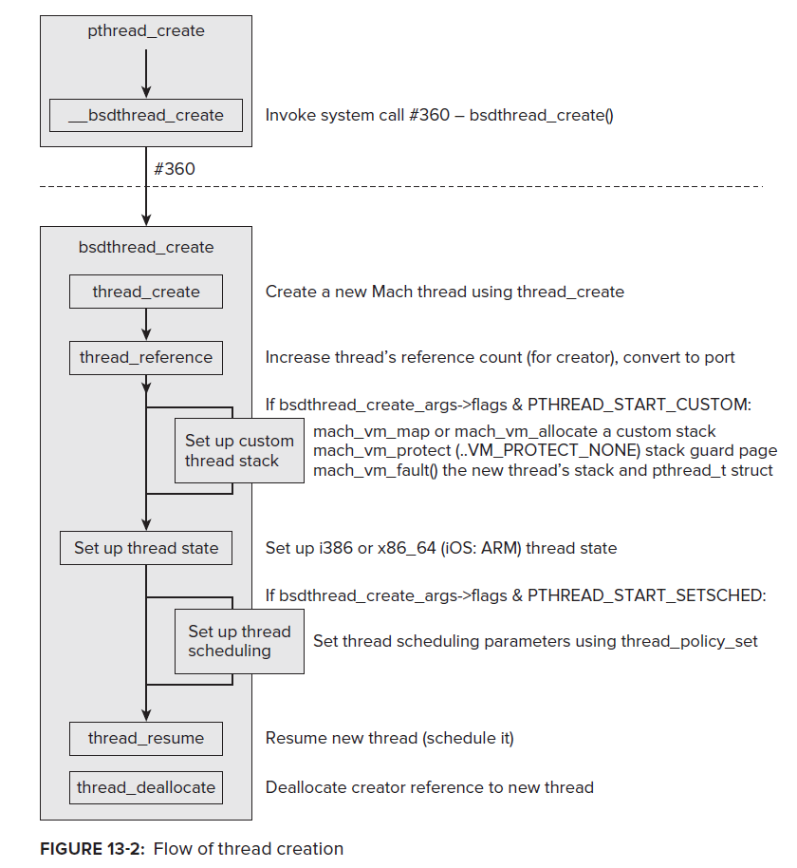
Notes:
[Ref: Chapter 13 of http://newosxbook.com/MOXiI.pdf.]

Slide 18
Darwin: BSD atop Mach
Processes and kernel-visible threads
  Each BSD-level kernel-visible thread maps to a Mach thread
  The Mach scheduler schedules Mach threads, but is agnostic about how a thread might map to higher-level BSD state
Memory
  Mach tags each task with a list of vm_map_entry objects, each of which represents a contiguous chunk of virtual memory (similar to a Linux VMA)
  Mach associates each vm_map_entry with a Mach port owned by a pager task
    The “default pager” (implemented by Mach) swaps anonymous pages between RAM and disk
    The “vnode pager” (implemented by BSD) swaps file-backed pages between RAM and disk
    The “device pager” (implemented by IOKit) handles memory-mapped devices
  Mach provides kalloc() and kfree() to allow itself (and the BSD layer) to dynamically allocate memory
struct vm_map_entry {
struct vm_map_links links; //Links to
//the other vm_map_entries that
//belong to the task
unsigned int
is_shared:1, //Is this memory
//shared with other
//vm_map_entries?
protection:3, //r/w/x perms
//. . . other bitfields . . .
__unused:2;
//. . . other stuff . . .
};
Notes:
[Ref: https://github.com/apple/darwin-xnu/blob/main/osfmk/vm/vm_map.h
https://github.com/apple/darwin-xnu/blob/main/osfmk/mach/vm_prot.h
]

Slide 19

Darwin System Calls
Darwin has two different sets of system calls!
  On 32-bit machines, negative syscall numbers indicate Mach system calls, whereas positive numbers indicate BSD system calls (which may internally invoke Mach system calls)
  On 64-bit machines, all system call numbers are positive, with the most significant byte indicating whether a Mach or BSD system call is being requested
On x86 hardware, the user invokes both kinds of system calls using the System V AMD64 ABI used by Linux and Chickadee
  The system call number is placed in %rax, with arguments placed in %rdi, %rsi, %rdx, %r10, %r8, and %r9
  The syscall instruction is used to context switch to the kernel
Notes:
[As described by [1], “Since there are basically two kernels in XNU - Mach with its message passing API and BSD with the POSIX API - there are two kinds of syscalls. While both use a single int 0x80/sysenter/sc entry point, negative syscall numbers will be routed to Mach, while positive ones go to BSD. Note that, just like on Windows NT, applications may not use int 0x80/sysenter/sc directly, as this is a private interface. Instead, applications must call through libSystem, which is the equivalent of libc on OS X.”]
[As described by [2], “In order to combine Mach and BSD into one kernel (xnu), syscall numbers are divided into different tables . . . Positive syscall numbers (smaller than 0x6000) are treated as FreeBSD syscalls. In this case the sysent table is offset and the appropriate function pointer is used. [In contrast,] in the case of a negative syscall number, the mach trap table is indexed and used.” [2] claims that on x86 machines, “the `int 0x81` (cd 81) instruction is used to call Mach traps. The `sysenter` instruction is used for the BSD syscalls.” However, note that, on recent version of MacOS, `syscall` is used to handle both Mach traps and BSD syscalls—see pages 278—279 of [4]. Page 283 of [4] also describes the following: “In 32-bit architectures, the UNIX system calls are positive, whereas the Mach traps are negative. In 64-bit, all call types are positive, but the most significant byte contains the value of SYSCALL_CLASS from the preceding table.” ]
[As [3] states, “Mach messaging and Mach interprocess communication (IPC) are relatively low-level ways of communicating between two Mach tasks (processes), as well as between a Mach task and the kernel. These form the basis for most communication outside of BSD and the I/O Kit . . . The BSD syscall API is an API for calling kernel functions from user space. It is used extensively when writing file systems and networking protocols, in ways that are very subsystem-dependent. Developers are strongly discouraged from using the syscall API outside of file-system and network extensions.”]
[Ref: [1] https://fahrplan.events.ccc.de/congress/2007/Fahrplan/attachments/986_inside_the_mac_osx_kernel.pdf
[2] https://web.archive.org/web/20170315204400/http://www.uninformed.org/?v=4&a=3&t=pdf
[3] https://developer.apple.com/library/archive/documentation/Darwin/Conceptual/KernelProgramming/boundaries/boundaries.html#//apple_ref/doc/uid/TP30000905-CH217-BABCEGBF
[4] http://newosxbook.com/MOXiI.pdf
]

Slide 20
Outline
Discretionary Access Control in Unix
Apple’s Darwin Kernel
  Architecture
  Mandatory Access Control
iOS Security
  Sandboxing
  Enforcing App Signatures

Slide 21
Mandatory Access Control (MAC)
Discretionary access control (DAC) allows users to configure security policies (e.g., via Un*x uids, gids, and r/w/x bits)
Mandatory access control (MAC) enforces policies that are:
  Set by a central administrator or by the OS designers
  Cannot be modified by users
MAC was initially popularized by military computing systems
MAC is now supported by many commodity OSes
  Ex: SELinux (originally developed by the NSA and later open-sourced) enables MAC for Linux deployments, and is used by Android to restrict all processes (even ones owned by root!)
  Ex: Darwin uses the BSD MAC framework to restrict what iOS/MacOS apps can do
Notes:
[Ref: https://en.wikipedia.org/wiki/Security-Enhanced_Linux
https://source.android.com/security/selinux
]

Slide 22
Darwin’s MAC Framework
To handle a BSD system call or Mach system call, Darwin must execute a series of kernel operations on vnodes, process structures, etc.
The MAC framework associates an introspection point with each of the most important operations
  A kernel extension can register a function that the MAC framework should invoke when an introspection point is hit
  If the function returns false, the MAC framework will prevent the associated kernel operation from occurring
//A kernel extension registers a `struct mac_policy_ops` with the MAC framework.
struct mac_policy_ops {
mpo_vnode_check_create_t *mpo_vnode_check_create;
mpo_vnode_check_read_t *mpo_vnode_check_read;
mpo_vnode_check_signature_t *mpo_vnode_check_signature;
//...more vnode operations...
mpo_socket_check_bind_t *mpo_socket_check_bind;
mpo_socket_check_connect_t *mpo_socket_check_connect;
mpo_socket_check_create_t *mpo_socket_check_create;
//...more socket operations...
Notes:
A `struct mac_policy_ops` defines a bunch of function pointers, one for each possible MAC introspection point.
[Ref: https://github.com/apple/darwin-xnu/blob/main/security/mac_policy.h
//Defines `struct mac_policy_ops`.
]

Slide 23
Darwin’s MAC Framework
To handle a BSD system call or Mach system call, Darwin must execute a series of kernel operations on vnodes, process structures, etc.
The MAC framework associates an introspection point with each of the most important operations
  A kernel extension can register a function that the MAC framework should invoke when an introspection point is hit
  If the function returns false, the MAC framework will prevent the associated kernel operation from occurring
//File table vnode read routine.
static int vn_read(struct fileproc *fp, struct uio *uio,
int flags, vfs_context_t ctx){
//...some stuff, then...
if (read_len < 0 || read_len > INT_MAX) {
return EINVAL;
}
#if CONFIG_MACF
//Invoke the mpo_vnode_check_read() functions
//registered by interested kernel extensions.
error = mac_vnode_check_read(ctx,/*...*/);
if (error) {
(void)vnode_put(vp);
return error;
}
#endif
//Complete the read request. More code follows...
}
//A kernel extension registers a `struct mac_policy_ops` with the MAC framework.
struct mac_policy_ops {
mpo_vnode_check_create_t *mpo_vnode_check_create;
mpo_vnode_check_read_t *mpo_vnode_check_read;
mpo_vnode_check_signature_t *mpo_vnode_check_signature;
//...more vnode operations...
mpo_socket_check_bind_t *mpo_socket_check_bind;
mpo_socket_check_connect_t *mpo_socket_check_connect;
mpo_socket_check_create_t *mpo_socket_check_create;
//...more socket operations...
Notes:
[Ref: https://github.com/apple/darwin-xnu/blob/main/bsd/vfs/vfs_vnops.c
//Defines `vn_read()`
]

Slide 24
Outline
Discretionary Access Control in Unix
Apple’s Darwin Kernel
  Architecture
  Mandatory Access Control
iOS Security
  Sandboxing
  Enforcing App Signatures

Slide 25
iOS Entitlements
An iOS entitlement is a permission to perform a certain high-level activity like accessing the camera or sending network traffic
An entitlement is an abstraction for:
  A set of system calls that an app would like to issue
  A set of arguments that the app would like to pass to those system calls
When a developer creates an app in Xcode, she specifies the entitlements that her app requires

Slide 26
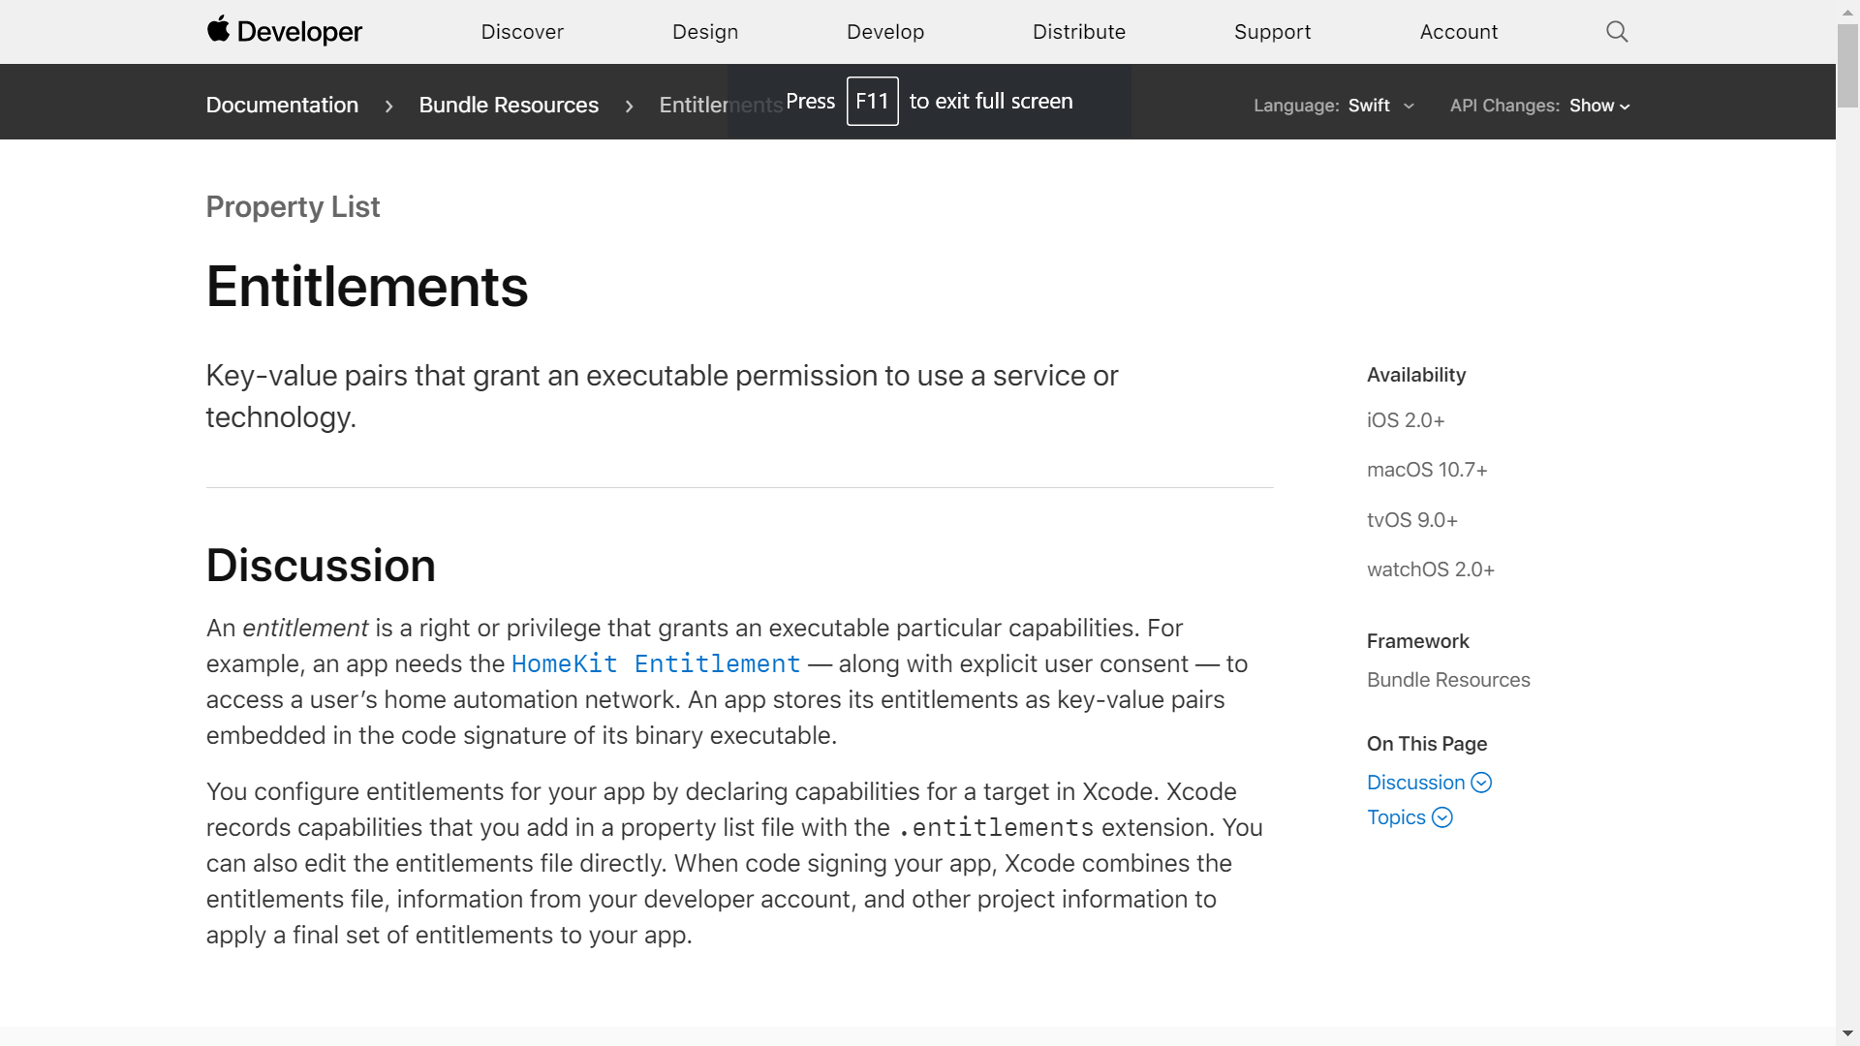
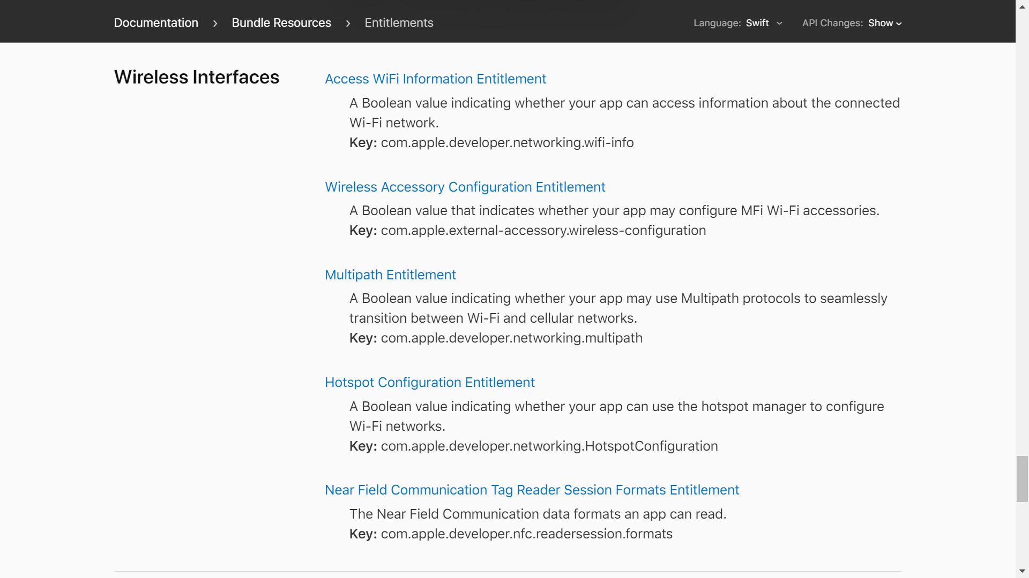
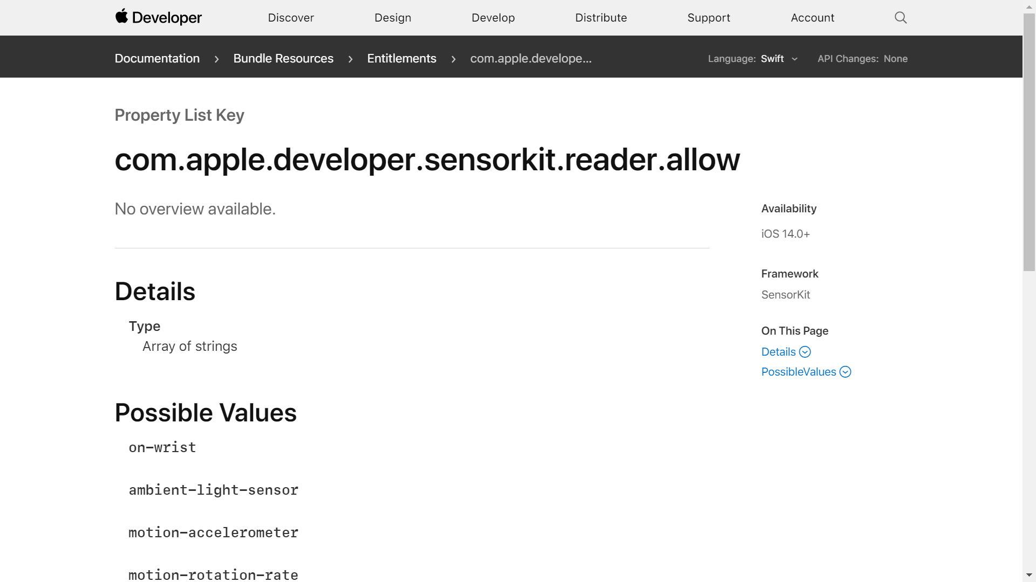
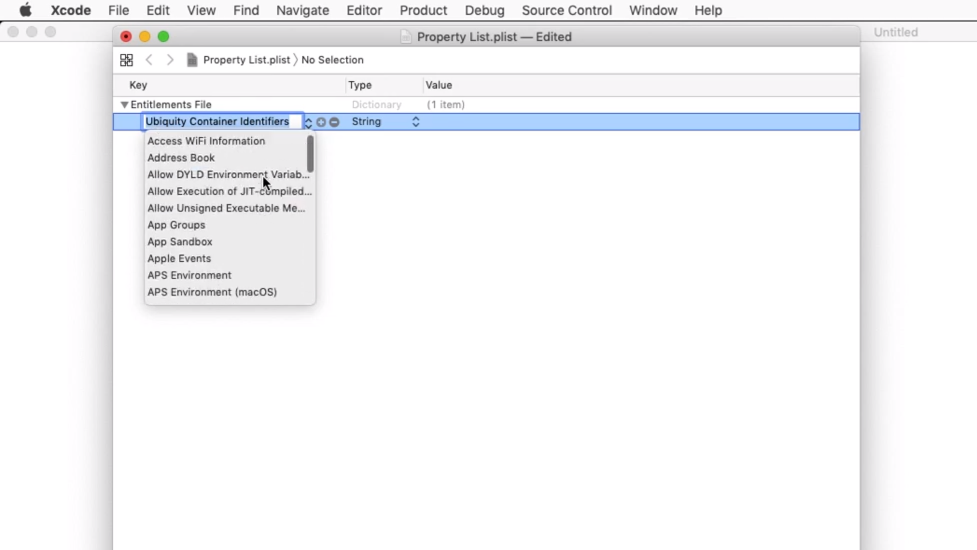
Notes:
[Aside: In the Xcode entitlement drop-down, you’ll see an entitlement called “App Sandbox.” Note that sandboxing is mandatory for iOS apps; in other words, iOS only runs sandboxed apps. Furthermore, those apps must be downloaded via the official iOS app store (unless your phone is jailbroken). MacOS is more flexible, supporting three different models for installing apps.
Apps that are installed via the official MacOS store are reviewed by Apple and are sandboxed.
Apps that are merely “notarized” are scanned for malware by Apple, but get to choose whether they are sandboxed or not by specifying the sandbox entitlement.
Non-MacOS-store, non-notarized apps can be procured from arbitrary third-party servers (e.g., via a developer’s web site). These kinds of apps are not sandboxed.]
]
[Ref: https://developer.apple.com/documentation/bundleresources/entitlements]

Slide 27

The App Review
Does the app contain inappropriate images?
Does the app drain the battery too quickly?
Does the app contain malware?
Does the app ask for “too many” entitlements?
Apple
Apple Developer Program
4
App Store
App Review
[Alice’s app +
entitlements]
[Apple]
5
[Alice->9e26]
[Apple]
[Alice’s app + entitlements]
[Alice]
[Apple->0fd9]
[Apple]
Name->Alice
Public key->9e26
Alice’s signed
app
2
Apple’s certificate
Alice’s registration request
Alice’s certificate
1
3
[Alice->9e26]
[Apple]
Alice’s certificate
Alice’s app +
Apple’s certificate
(signed by Apple)
Alice the developer
Notes:
Apple only allows registered developers to deploy apps that will be listed in the App Store. When Apple receives a certificate from Apple in Step 2, the certificate allows Alice to later prove that she is a registered developer, since that certificate is signed by Apple.
[Note that the app review checks for more than just four things. For the full list, see https://developer.apple.com/app-store/review/guidelines/.]

Slide 28
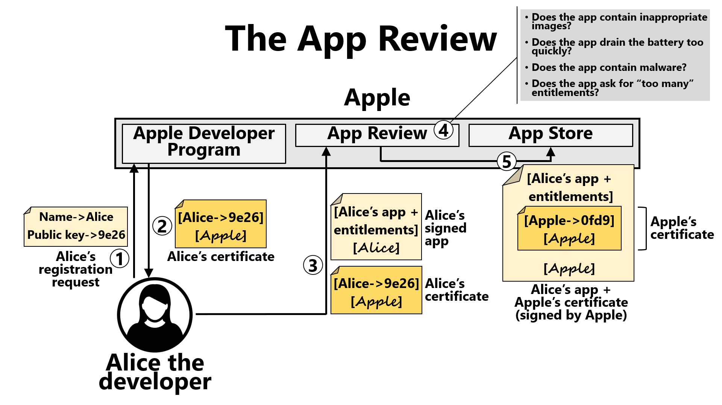
Signature Checking
Apple only wants Apple-blessed (i.e., reviewed) apps to run on iPhones!
  So, iPhones only run third-party apps if they were signed by Apple
  Signatures are checked by the AppleMobileFileIntegrity kernel extension when the vnode_check_signature MAC hook is hit during exec() or the loading of a dynamic library
Sandboxing
An app’s signature is read-only, and covers the code, static data, and entitlement list (preventing modification to any of those components)
When an app makes a system call, a MAC hook from the Sandbox kernel extension checks the app’s entitlements to ensure that the system call is allowable
Notes:
[Technical gore: `vnode_check_signature()` is called by `mac_vnode_check_signature()`, which is called by `ubc_cs_blob_add()`. “UBC” stands for “unified buffer cache”; as described by https://flylib.com/books/en/3.126.1.93/1/, “The UBC's job is to cache file-backed and anonymous memory in physical memory . . . resident pages are evicted using an LRU-like page replacement policy. Recently used pages, say, corresponding to a file that was recently read, or memory that was recently allocated, are likely to be found in the buffer cache.” The call chain for `ubc_cs_blob_add()` looks like this:
ubc_cs_blob_add() <-- load_code_signature() <-- parse_machfile() <-----load_machfile()
\--load_dylinker()
The two functions to the right are called during `exec_mach_imgact()` (basically, Mach’s version of `exec()`) and during the loading of dynamic libraries, respectively. If you’re interested in looking at the actual implementations of these functions, take a look at the Darwin source code (https://github.com/apple/darwin-xnu).]

Slide 29
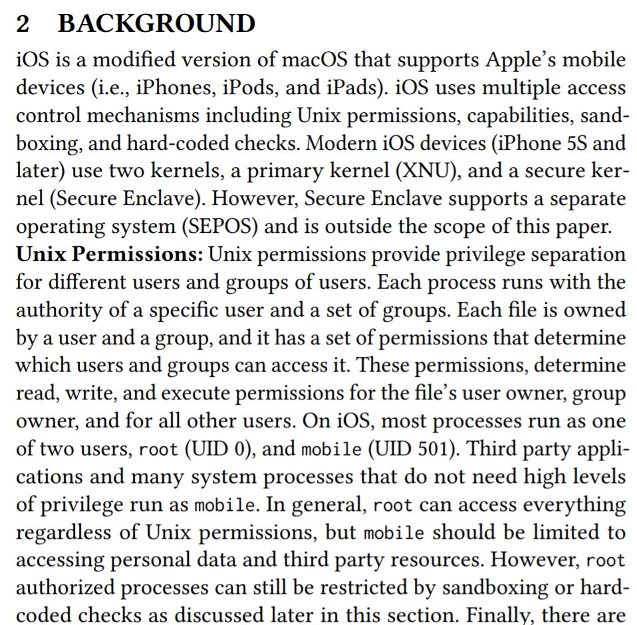

What About UIDs on iOS and MacOS?
Notes:
[Ref: https://enck.org/pubs/deshotels-asiaccs18.pdf]

Slide 30
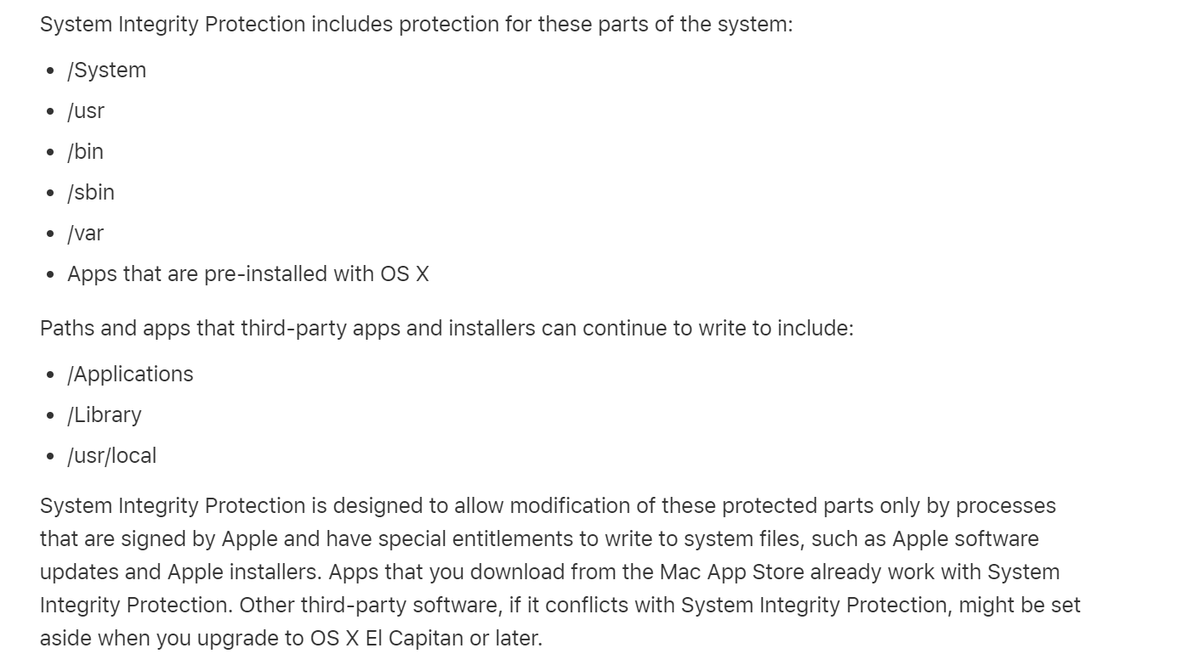
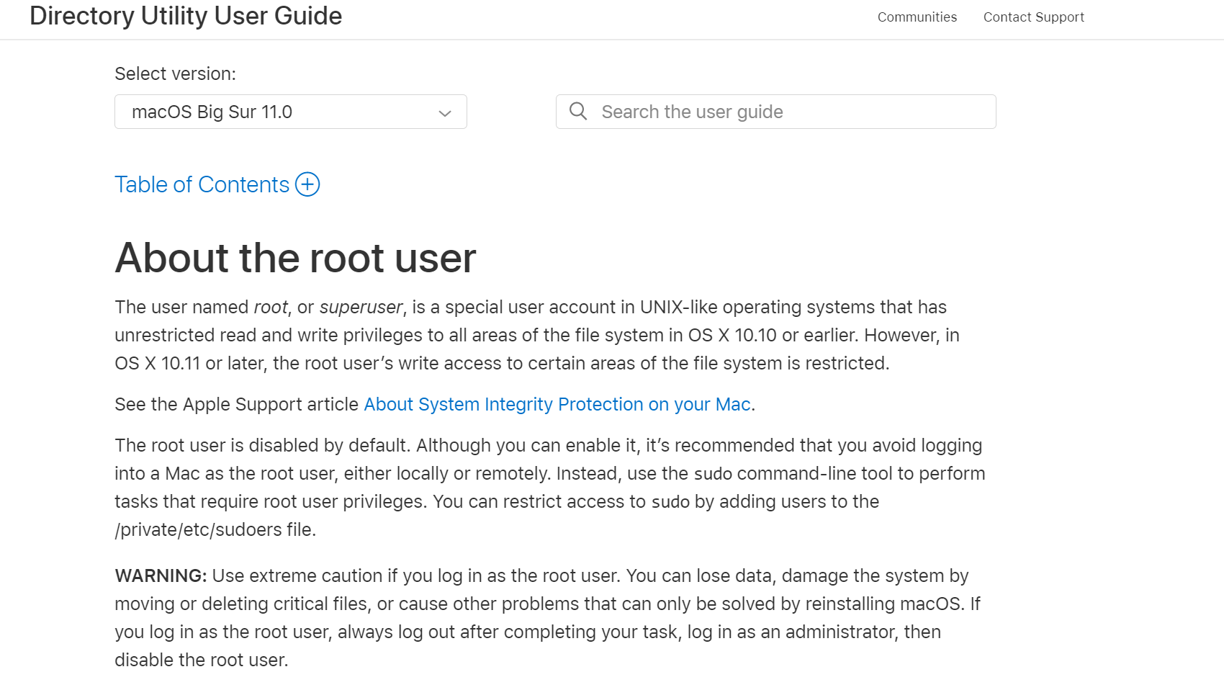
Notes:
MacOS supports multiple UIDs for multiple users. However, on recent versions of MacOS, the Unix-level root account is disabled by default! Note, however, that the concept of a root-privileged PROCESS still exists; so, for example, you can still use the `sudo` command to execute processes with root privileged. But even if you do this, there are certain parts of the file system that root-privileged processes cannot access.
[Ref: https://support.apple.com/guide/directory-utility/about-the-root-user-dirub32398f1/mac
https://support.apple.com/en-us/HT204899
]

