Slide 1

Multitasking and Preemption
CS 1610: Lecture 3
2/3/2025

Slide 2
Multitasking
A user-level execution context consists of:
  A virtual address space (pointed to by %cr3)
  The next instruction to execute (pointed to by %rip)
  A stack (pointed to by %rsp)
  Other register state (e.g., %rax, %rbx, %r8)
Multitasking allows multiple contexts to run atop a single processor
  Divide time into slices
  At the beginning of a slice, pick a task (i.e., a context) to run
  Run the task until:
    It voluntarily yields the CPU
    It is interrupted (e.g., because its time slice expires) and must involuntarily release the CPU

Slide 3

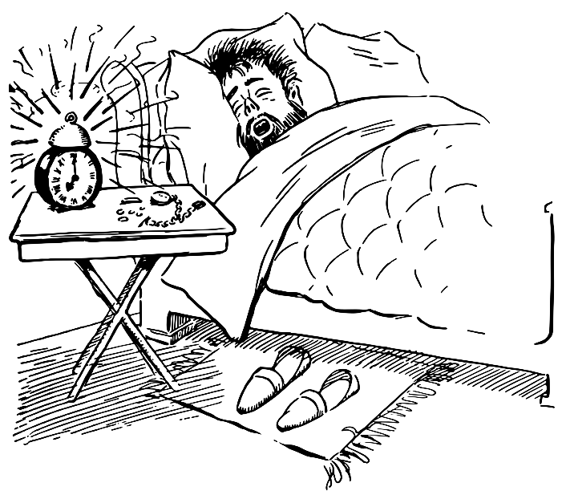
Vectoring Control To The Kernel
Kernel code only executes in response to external stimuli
  Asynchronous interrupts (e.g., timer interrupt, NIC interrupt (because a packet arrived))
  Synchronous exceptions (e.g., dividing by zero, dereferencing a null pointer, attempting to write a read-only page)
  Synchronous traps (e.g., system calls via syscall, debugging traps via int3)
During boot, the kernel must configure the processor to invoke the appropriate kernel code when exceptions, traps, and interrupts occur
Partially a lie: Kernel threads!
Notes:
[The int3 instruction is one byte long (0xcc) intended for use by debuggers. To create a breakpoint at a particular instruction, the debugger overwrites the first byte of that instruction with int3’s opcode. When the CPU executes the int3, the CPU will trap to the OS, who can then vector control to the debugger. The debugger can then inspect the paused target program, replace the int3 opcode with the real first byte of the instruction, and then restart the target program. Refs: https://en.wikipedia.org/wiki/INT_(x86_instruction)#INT3 https://blog.packagecloud.io/eng/2016/03/14/how-does-ltrace-work/]

Slide 4
Handling A System Call
Part 0: Descriptor tables and the swapgs instruction
Part I: Invoking the Kernel’s System Call Handler
Part II: Completing the Context Switch
Part III: Executing Kernel Code
Part IV: Returning to User-mode

Slide 5
x86: Descriptor Tables
An OS assigns to %cr3 to configure how a core handles virtual memory
An OS sets up descriptor tables to configure other processor behavior (e.g., interrupt handling)
  Each table is located somewhere in kernel memory (and thus is only configurable by privileged code)
  Each table contains multiple entries called descriptors
For example, each core of a multicore processor has:
  A Global Descriptor Table Register (%gdtr)
  A Global Descriptor Table (GDT) that is:
    Located in kernel memory
    Pointed to by %gdtr (a register that is only accessible by privileged code)
Descriptor
Configuration metadata
Virtual address
Global Descriptor Table Register (%gdtr)
Global Descriptor Table (GDT): in virtual memory

Slide 6
x86: Descriptor Tables
Segment register
Visible
Hidden descriptor
Special registers called segment registers index into descriptor tables
  The x86 specification associates each segment register with a particular descriptor table
  Ex: %fs is associated with the GDT
A segment register consists of:
  A visible part called the segment selector
  A hidden part which contains the metadata from the selected descriptor
When software assigns to the visible part of a segment register:
  Hardware automatically loads the hidden part of the segment via a fetch from a descriptor table
  Afterwards, the hardware consults the hidden part as appropriate, avoiding the need to repeatedly fetch the metadata from the in-memory table
  So, a segment register is like a tiny cache for a descriptor table
Selector
Configuration metadata
Used as index
Load triggered by write to segment register’s selector
Descriptor
Configuration metadata
Virtual address
Global Descriptor Table Register (%gdtr)
Global Descriptor Table (GDT): in virtual memory
Notes:
By “visible,” we mean “directly accessible by software.” By “hidden,” we mean “cannot be directly read or written by software.” Normal registers like %rax or %cr3 are entirely visible—in other words, the entire contents of the register can be read or written by software. [Or course, %cr3 can only be read or written by *privileged* software, but still, the entire contents of %cr3 are visible :-D.]

Slide 7
x86-64: The %fs and %gs Segment Registers
Accessible by user code and privileged code
Associated with the GDT descriptor table
Visible part: Contains a segment selector that can be directly read or written via normal register instructions like mov and push, e.g., push %gs
Hidden part: Contains the base address that’s used in base+offset address calculations like mov %fs:(28), %rax
%fs or %gs register
Visible
Hidden descriptor
GDT Selector
Base address

Slide 8
Only privileged code can assign to a descriptor table pointer register like %gdtr . . .
Segment register
Visible
Hidden descriptor
Selector
Configuration metadata
. . . and descriptor tables like the GDT live in kernel memory . . .
Used as index
Load triggered by write to segment register’s selector
. . . so how can user code do anything interesting with %fs and %gs?
Descriptor
Configuration metadata
Virtual address
Global Descriptor Table Register (%gdtr)
Global Descriptor Table (GDT): in virtual memory
Notes:
Even though user code can read and write the *selectors* associated with %fs and %gs, user code is unable to manipulate %gdtr, and is unable to manipulate the global descriptor table (since that table lives in kernel memory).

Slide 9
x86-64: Updating the %fs and %gs Bases
Kernel-level code can read and write segment bases by:
  Setting up the appropriate descriptor in a descriptor table and then assigning to the visible %fs or %gs selector (e.g., mov $0x4, %gs)
  Directly reading or writing the model-specific registers %MSR_IA32_GS_BASE and %MSR_IA32_FS_BASE
  [For %gs only] calling swapgs (to be discussed soon!)
User-level code can update the hidden bases by:
  Asking the OS to update the hidden part (e.g., on Linux, calling arch_prctl(ARCH_SET_FS, addr))
  Using the wrfsbase or wrgsbase instructions to write a value in a general-purpose register to %fs base or %gs base; however, the kernel must explicitly configure the processor to allow user code to invoke these instructions
The visible and hidden parts of %fs and %gs must be properly saved and restored during context switches!
//Chickadee’s k-init.cc::cpustate::init_cpu_hardware()
//Load descriptor table pointers like %gdtr
asm volatile("lgdt %0; ltr %1; lidt %2"
:
: "m" (gdt.limit),
"r" ((uint16_t) SEGSEL_TASKSTATE),
"m" (idt.limit)
: "memory", "cc");
//Initialize segments, including `%gs`, which
//points at this cpustate
asm volatile("movw %%ax, %%fs; movw %%ax, %%gs"
: : "a" ((uint16_t) SEGSEL_KERN_DATA));
wrmsr(MSR_IA32_GS_BASE, reinterpret_cast<uint64_t>(this));
Notes:
As the AMD programmer’s manual says (and as quoted by [1]), “There are two methods to update the contents of the FS.base and GS.base hidden descriptor fields. The first is available exclusively to privileged software (CPL = 0). The FS.base and GS.base hidden descriptor-register fields are mapped to MSRs. Privileged software can load a 64-bit base address in canonical form into FS.base or GS.base using a single WRMSR instruction. The FS.base MSR address is C000_0100h while the GS.base MSR address is C000_0101h.
The second method of updating the FS and GS base fields is available to software running at any privilege level (when supported by the implementation and enabled by setting CR4[FSGSBASE]). The WRFSBASE and WRGSBASE instructions copy the contents of a GPR [i.e., general-purpose register] to the FS.base and GS.base fields respectively.”
[Note that Chickadee uses constants like MSR_IA32_GS_BASE, but Linux uses names that omit the “IA32” part, e.g., MSR_GS_BASE.]
[Ref: [1] https://stackoverflow.com/questions/11497563/detail-about-msr-gs-base-in-linux-x86-64/11497742#11497742
[2] https://chao-tic.github.io/blog/2018/12/25/tls
[3] http://man7.org/linux/man-pages/man2/arch_prctl.2.html
[4] https://www.felixcloutier.com/x86/wrfsbase:wrgsbase
[5] https://linuxreviews.org/The_Linux_kernel_will_not_get_support_for_the_fsgsbase_instructions_from_Intel_any_time_soon
[6] https://twitter.com/intel80x86/status/1066088744254693381
]

Slide 10

The Magical Journey of Understanding x86 Segment Registers
CS 1610 students
Professor Mickens

Slide 11
Example: Using %fs to Implement User-level Stack Canaries

Slide 12

Ret addr_{i}
A call instruction executes.
%rbp
Saved %rbp_{i}
%rsp
//Other stuff in
//stack frame i
Ret addr_{i+1}
Stack canary
Notes:
A stack canary is a known location in the stack that contains a known value. Canaries help detect corruptions of the stack; if, at the end of a function’s execution, the stack canary has an unexpected value, this means that your code has somehow trampled the canary (and likely other in-memory data)! You’ll implement a form of stack canaries in pset1.

Slide 13
%rbp
Ret addr_{i}
Save the old breakpointer on the stack.
Saved %rbp_{i}
Make space for the local variables.
//Other stuff in
//stack frame i
%rsp
Ret addr_{i+1}
Copy the known-good canary value onto the stack.
Saved %rbp_{i+1}
//Stuff in stack
//frame ixcxxcc
Canary_{i+1}
Zero out the known-good value from %rax; paranoia!
//Function preamble
push %rbp
mov %rsp, %rbp
sub 0x410, %rsp
mov %fs:(0x28), %rax
mov %rax, -0x8(%rbp)
xor %rax, %rax
Stack canary

Slide 14
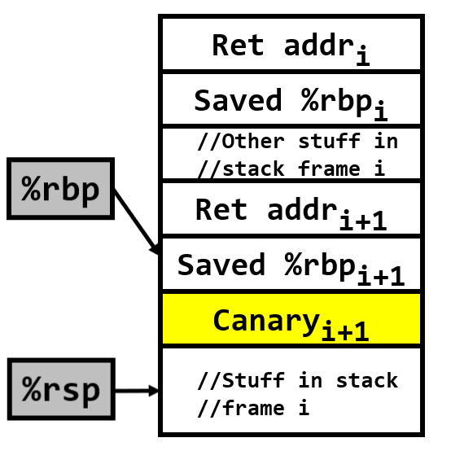
Move the canary value from the stack into %rax.
If the stack canary and the known-good value are equal, %rax will be 0!
Respond to the canary check.
//Function preamble
push %rbp
mov %rsp, %rbp
sub 0x410, %rsp
mov %fs:(0x28), %rax
mov %rax, -0x8(%rbp)
xor %rax, %rax
//Function epilogue
mov -0x8(%rbp), %rax
xor %fs:(0x28), %rax
je codeToDoFuncReturn
call __stack_chk_fail
Stack canary
Notes:
The `je` instruction jumps if the zero flag ZF is set to 1.
[Ref: http://www.unixwiz.net/techtips/x86-jumps.html]

Slide 15
x86-64: Leveraging %gs For Kernel Fun
An OS needs to store a per-CPU data structure that is only accessible by the kernel
Each core has its own %IA32_KERNEL_GS_BASE register
  %IA32_KERNEL_GS_BASE can only be accessed when the CPU is in privileged mode
  swapgs exchanges %IA32_KERNEL_GS_BASE and the base address in %gs (but doesn’t change the selector in %gs!)
When the CPU executes in privileged mode, the %gs base points to the per-CPU data structure
The kernel executes swapgs . . .
  . . . when handling a system call, interrupt, or exception, during the context switch away from an unprivileged process
  . . . as part of resuming an unprivileged process
Notes:
Note that %IA32_KERNEL_GS_BASE is a normal register, not a segment register! As described by the lengthily-titled "Intel 64 and IA-32 Architectures Software Developer’s Manual, Volume 3C: System Programming Guide, Part 3“ (https://www.intel.com/content/dam/www/public/us/en/documents/manuals/64-ia-32-architectures-software-developer-vol-3c-part-3-manual.pdf), “The SWAPGS instruction . . . swaps the contents of two specific MSRs (IA32_GS_BASE and IA32_KERNEL_GS_BASE). The IA32_GS_BASE MSR shadows [mickens: i.e., is an alias for] the base address portion of the GS descriptor register; the IA32_KERNEL_GS_BASE MSR holds the base address of the GS segment used by the kernel (typically it houses kernel structures).” %IA32_GS_BASE is an alias for just the base (i.e., hidden) part of %gs.
[For additional details about how segmentation-based address translation, see “AMD64 Architecture Programmer’s Manual Volume 2: System Programming” https://www.amd.com/system/files/TechDocs/24593.pdf. For more information about swapgs, see https://wiki.osdev.org/SWAPGS.]

Slide 16

//Chickadee’s kernel.hh
struct __attribute__((aligned(4096))) cpustate {
cpustate* self_; //Points to this cpustate
proc* current_; //The currently-executing
//process
uint64_t syscall_scratch_; //We’ll see this in
//use later
int cpuindex_; //Which of the N cpus am I?
//Stores which processes are ready to
//execute on this cpu
list<proc, &proc::runq_links_> runq_;
spinlock runq_lock_;
//...Other stuff...
};
Force compiler to align each struct on 4KB boundary
Notes:
[Ref: https://gcc.gnu.org/onlinedocs/gcc-3.3/gcc/Type-Attributes.html
https://commons.wikimedia.org/wiki/File:GNU_Compiler_Collection_logo.svg]

Slide 17
//Chickadee’s kernel.hh
struct __attribute__((aligned(4096))) cpustate {
cpustate* self_; //Points to this cpustate
proc* current_; //The currently-executing
//process
uint64_t syscall_scratch_; //We’ll see this in
//use later
int cpuindex_; //Which of the N cpus am I?
//Stores which processes are ready to
//execute on this cpu
list<proc, &proc::runq_links_> runq_;
spinlock runq_lock_;
//...Other stuff...
};
//Chickadee’s kernel.hh
struct __attribute__((aligned(4096))) proc {
pid_t id_; // process ID
//...Other stuff...
};
During kernel execution . . .
%gs.base

Slide 18
Handling A System Call
Part 0: Descriptor tables and the swapgs instruction
Part I: Invoking the Kernel’s System Call Handler
Part II: Completing the Context Switch
Part III: Executing Kernel Code
Part IV: Returning to User-mode

Slide 19
Part I: Invoking the Kernel’s System Call Handler
The syscall instruction (invoked by user code) does several things
  It saves the address of the instruction after syscall in %rcx
  Then, it sets %rip to the value stored in the model-specific-register %IA32_LSTAR
  Next, syscall stores the old %rflags value in %r11
x86 chips use MSRs to configure low-level hardware behavior
MSRs are accessed via the privileged instructions rdmsr and wrmsr
void cpustate::init_cpu_hardware() {
//...Some stuff, then...
wrmsr(MSR_IA32_LSTAR, reinterpret_cast<uint64_t>(syscall_entry));
//syscall_entry points to assembly code in k-exception.S
//that eventually calls struct proc::syscall(regstate* reg)
wrmsr(MSR_IA32_FMASK, EFLAGS_IF | /*other flags*/); //Has the effect
//of forcing the syscall instruction to disable interrupts!
Notes:
[Ref: https://www.felixcloutier.com/x86/syscall
https://wiki.osdev.org/Model_Specific_Registers
https://lwn.net/Articles/604287/
Section 3.4.3 of “Intel 64 and IA-32 Architectures Software Developer’s Manual (Volume 1)”]

Slide 20
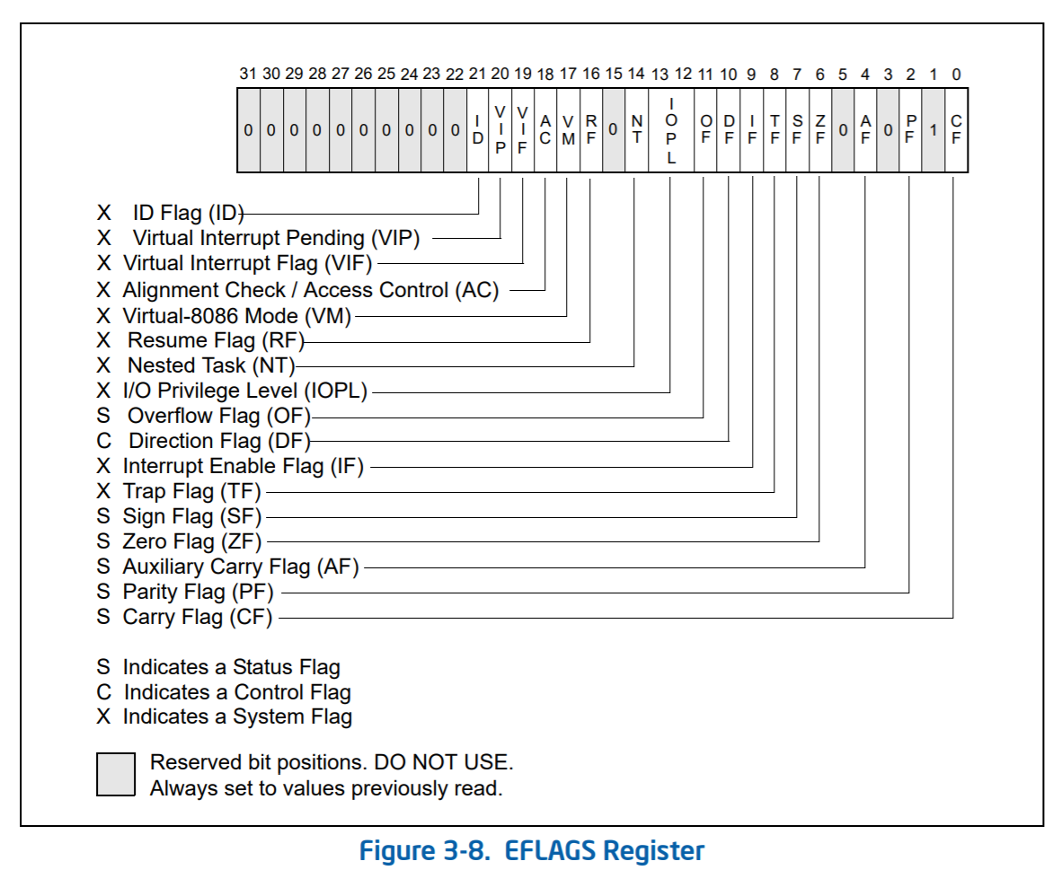
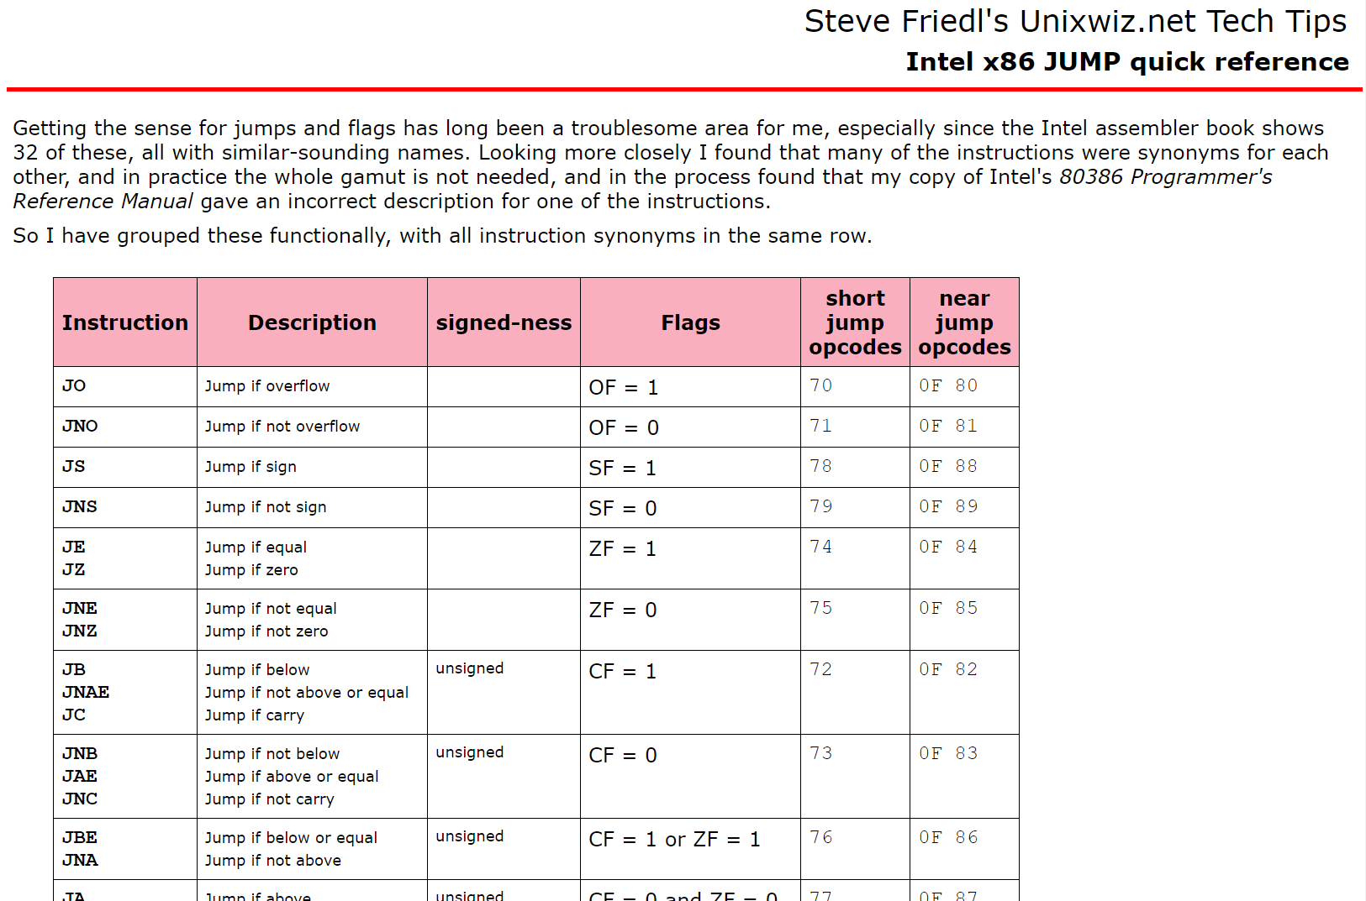
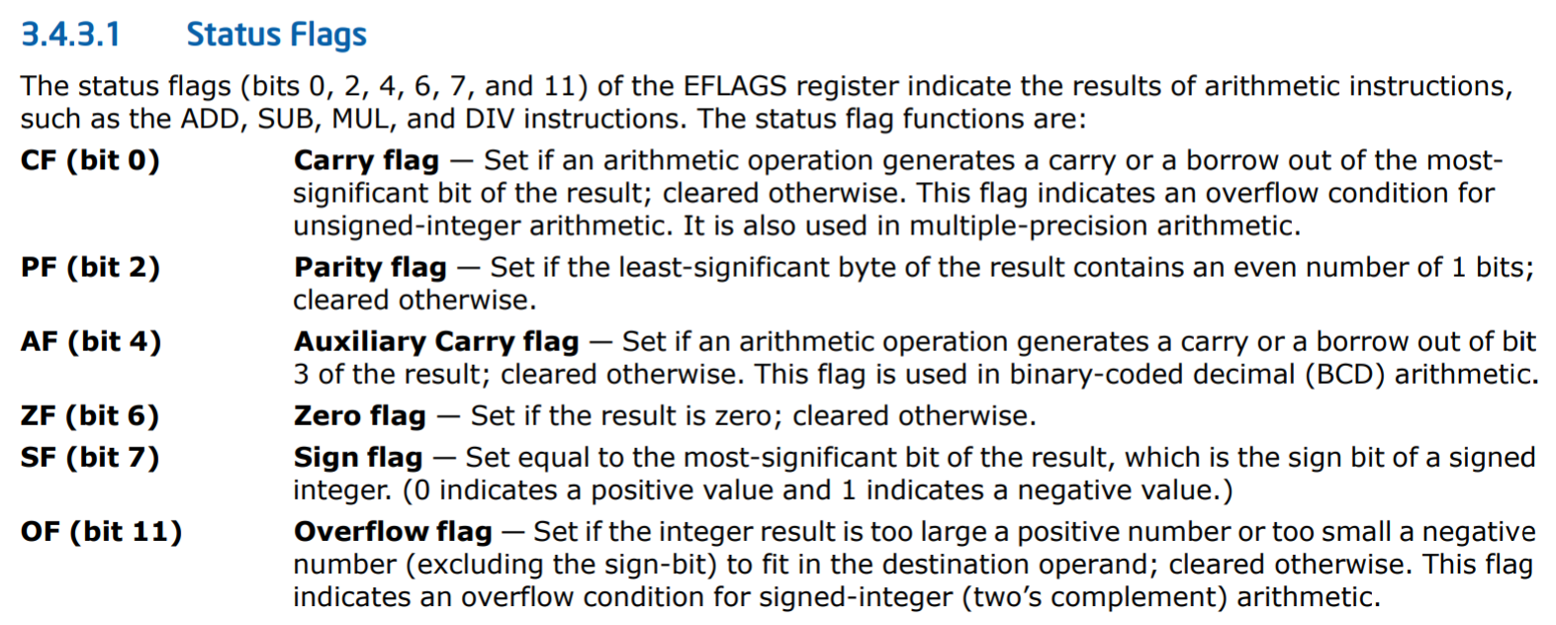
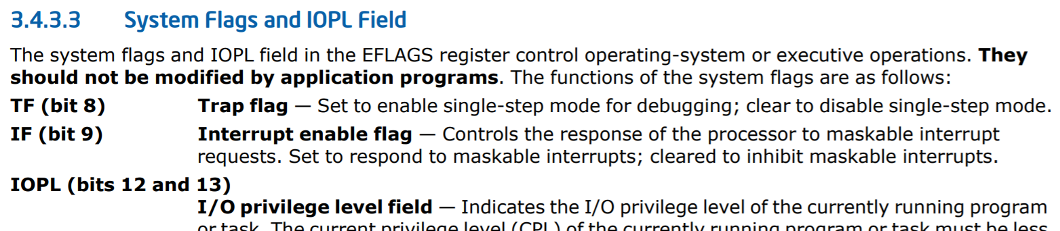
Notes:
[Note that %rflags is just the x86-64 version of the x86-32 %eflags register--%rflags has equivalent bit offsets as %eflags. As Intel’s manual states, “the upper 32 bits of RFLAGS register is reserved. The lower 32 bits of RFLAGS is the same as EFLAGS.”]
[The TF (trap flag) bit is what debuggers like gdb use to single-step through a program. If the TF bit is set, then the CPU will raise a debugging interrupt after executing a single instruction. The OS can then inform the debugger, who can examine the suspended program whose instruction caused the debugging interrupt.]
[http://www.unixwiz.net/techtips/x86-jumps.html]

Slide 21
Part I: Invoking the Kernel’s System Call Handler
The syscall instruction (invoked by user code) does several things
  It saves the address of the instruction after syscall in %rcx
  Then, it sets %rip to the value stored in the model-specific-register %IA32_LSTAR
  Next, syscall stores the old %rflags value in %r11
  syscall then clears the bits in %rflags that are set to 1 in the %IA32_FMASK MSR
  The CPU’s privilege level is set to 0 (i.e., supervisor-mode)
The kernel’s syscall handler assumes that user code:
  Put the system call number in %rax
  Passed arguments via %rdi, %rsi, %rdx, %r10, %r8, and %r9
void cpustate::init_cpu_hardware() {
//...Some stuff, then...
wrmsr(MSR_IA32_LSTAR, reinterpret_cast<uint64_t>(syscall_entry));
//syscall_entry points to assembly code in k-exception.S
//that eventually call struct proc::syscall(regstate* reg)
wrmsr(MSR_IA32_FMASK, EFLAGS_IF | /*other flags*/); //Has the effect
//of forcing the syscall instruction to disable interrupts!
Notes:
[Note that the System V ABI passes function arguments via these registers:
%rdi, %rsi, %rdx, %rcx, %r8, %r9
However, the syscall instruction clobbers %rcx (to store the address of the instruction after the syscall instruction) and %rll (to save the old %rflags value)! So, user code passes system call arguments using these registers:
%rdi, %rsi, %rdx, %r10, %r8, %r9
In other words, relative to the standard System V calling convention, a syscall invoker passes arguments via %r10 instead of the clobbered %rcx.]
[Ref: https://www.felixcloutier.com/x86/syscall
https://wiki.osdev.org/Model_Specific_Registers
https://lwn.net/Articles/604287/
https://blog.packagecloud.io/eng/2016/04/05/the-definitive-guide-to-linux-system-calls/#64-bit-fast-system-calls //Although note that, in the latest version of the kernel, the location of the entry point has been moved—it’s now in arch/x86/entry/entry_64.S, not arch/x86/kernel/entry_64.S as it was at the time of the blog post. To look at the entry point assembly in the Linux v5.5 kernel (a more recent one), see here: https://github.com/torvalds/linux/blob/c79f46a282390e0f5b306007bf7b11a46d529538/arch/x86/entry/entry_64.S#L107
Section 3.4.3 of “Intel 64 and IA-32 Architectures Software Developer’s Manual (Volume 1)”]

Slide 22
Handling A System Call
Part 0: Descriptor tables and the swapgs instruction
Part I: Invoking the Kernel’s System Call Handler
Part II: Completing the Context Switch
Part III: Executing Kernel Code
Part IV: Returning to User-mode

Slide 23


After the syscall instruction finishes . . .
The privilege bit is set to “supervisor mode”
Interrupts are off
The first instruction of the kernel’s syscall handler is about to execute
OH GOD
%CR3 HASN’T CHANGED
This is ok! The kernel is mapped into the address space of every process.

Slide 24
Virtual address space
FFFF’FFFF’FFFF’FFFF
Kernel static data
High canonical
(kernel-only access)
Kernel code
Kernel heap+stacks
FFFF’8000’0000’0000
Physical memory map
This is ok! The kernel is mapped into the address space of every process.
Empty gap
0000’7FFF’FFFF’FFFF
Stack
Low canonical
(kernel+user access)
Heap
Static data
0000’0000’0000’0000
Code

Slide 25

After the syscall instruction finishes . . .
The privilege bit is set to “supervisor mode”
Interrupts are off
The first instruction of the kernel’s syscall handler is about to execute
WHAT STACK
IS THE KERNEL
GOING TO USE?
%rsp still points to the user-level stack! Placing kernel stack data in user memory seems distasteful.

Slide 26
Part II: Completing the Context Switch
Most OSes allocate a unique kernel stack for each thread in a process
  Ex: A process with two threads gets two kernel stacks
  When a thread executes in user-level, its kernel stack is empty
  When the OS executes a system call on a thread’s behalf, the OS uses the thread’s kernel stack to store OS function state
Most OSes “over-allocate” space for a struct proc, and then place the associated kernel stack at the top of the allocated space
//Chickadee’s kernel.hh
struct __attribute__((aligned(4096))) proc {
pid_t id_; // process ID
//...Other stuff...
};
Stack frame 0
Available for use by the kernel stack
Stack frame 1
4KB of allocated space
//...Other
//stuff...
Space actually used by struct proc fields
id_
struct proc

Slide 27
Most OSes allocate a unique kernel stack for thread in a process
  Ex: A process with two threads gets two kernel stacks
  When a thread executes in user-level, its kernel stack is empty
  When the OS executes a system call on a thread’s behalf, the OS uses the thread’s kernel stack to store function state
Most OSes “over-allocate” space for a struct proc, and then place the associated kernel stack at the top of the allocated space
//Chickadee's kernel.cc
void start_initial_process(pid_t pid,
const char* name) {
//Look up process image in initfs
int mindex = memfile::initfs_lookup(name,
memfile::required);
x86_64_pagetable* pt = knew_pagetable();
assert(mindex >= 0 && pt);
//Load code and data into pagetable
memfile_loader ld(mindex, pt);
int r = proc::load(ld);
assert(r >= 0);
//Allocate process, initialize registers
proc* p = knew<proc>();
p->id_ = pid;
p->init_user(pt);
p->regs_->reg_rip = ld.entry_rip_;
// . . . other stuff . . .
}
Stack frame 0
Available for use by the kernel stack
Stack frame 1
4KB of allocated space
//...Other
//stuff...
Space actually used by struct proc fields
//knew allocates full 4K page!
id_
struct proc

Slide 28
Part II: Completing the Context Switch
Immediately before the first instruction of the kernel’s syscall handler executes . . .
  Address of the instruction after syscall is in %rcx
  The old %rflags value is in %r11
  The system call number is in %rax
  The system call arguments are in %rdi, %rsi, %rdx, %r10, %r8, and %r9
The kernel’s syscall handler needs to:
  Switch %rsp to point to the appropriate kernel stack
  Save the other user-mode register state
  Invoke the kernel code that actually performs the requested system call

Slide 29
// struct regstate
// A complete set of x86-64 general-purpose registers, plus some
// special-purpose registers. The order and contents are defined to make
// it more convenient to use important x86-64 instructions.
typedef struct regstate {
// General-purpose registers
uint64_t reg_rax;
uint64_t reg_rcx;
uint64_t reg_rdx;
uint64_t reg_rbx;
uint64_t reg_rbp;
uint64_t reg_rsi;
uint64_t reg_rdi;
uint64_t reg_r8;
uint64_t reg_r9;
uint64_t reg_r10;
uint64_t reg_r11;
uint64_t reg_r12;
uint64_t reg_r13;
uint64_t reg_r14;
// . . . other regs . . .
Initially empty
kernel stack
Available for use by the kernel stack
//k-exception.S::syscall_entry
.globl syscall_entry
syscall_entry:
swapgs //%gs.base now points to the
//per-CPU struct cpustate
//(defined in kernel.hh)
movq %rsp, %gs:(16) //Save user %rsp in scratch
//space
movq %gs:(8), %rsp //Set %rsp to the struct proc
//for the process which just
//invoked the system call
//(%gs:(8) is the field
//cpustate::proc* current_)
addq $PROCSTACK_SIZE, %rsp //Now %rsp points to the
//appropriate kernel stack!
//Push the five registers onto the stack that the hardware
//would have automatically pushed if an exception instead of
//a syscall had happened. This allows Chickadee to have a
//single data structure (namely, struct regstate) that
//represents the kernel stack after a syscall, exception,
//*or* trap occurs.
pushq $(SEGSEL_APP_DATA + 3) //%ss
pushq %gs:(16) //User %rsp at syscall time;
//(cpustate:syscall_scratch_)
pushq %r11 //%rflags
pushq $(SEGSEL_APP_CODE + 3) //%cs
pushq %rcx //User %rip that immediately
//follows the syscall instr
subq $8, %rsp //Error code not generated by
//syscall (but generated by
//hardware upon exception
//or interrupt)
pushq $-1 //reg_swapgs, reg_intno;
//also irrelevant for syscall
//instruction
pushq %gs
pushq %fs
pushq %r15 // callee saved
pushq %r14 // callee saved
pushq %r13 // callee saved
pushq %r12 // callee saved
subq $8, %rsp //%r11 clobbered by `syscall`
pushq %r10
pushq %r9
pushq %r8
pushq %rdi
pushq %rsi
pushq %rbp // callee saved
pushq %rbx // callee saved
pushq %rdx
subq $8, %rsp //%rcx clobbered by `syscall`
pushq %rax
1: testb $1, panicking //Loop if panicking
jne 1b
//Call struct proc::syscall(regstate*)
// Remember that in the System V ABI, %rdi stores
// the first function call argument, and %rsi
// stores the second argument. The first argument
// will store the `this` pointer, and the second
// argument will be a regstate*.
movq %gs:(8), %rdi //Remember that %gs points to
//the struct cpustate for this
//cpu; so, %gs:(8) corresponds
//to cpustate::proc* current.
movq %rsp, %rsi //We’ve pushed the contents of
//a regstate onto the stack!
//Note that no callee-saved registers (%rbp, %rbx, %r12,
//%r13, %r14, %r15) have been modified up to this point!
call _ZN4proc7syscallEP8regstate
4KB of allocated space
//...Other
//stuff...
Space actually used by struct proc fields
id_
struct proc
//Chickadee’s kernel.hh
struct __attribute__((aligned(4096))) cpustate {
cpustate* self_; //Points to this cpustate
proc* current_; //The currently-executing
//process
uint64_t syscall_scratch_;
int index_; //Which of the N cpus am I?
//Stores which processes are ready to
//execute on this cpu
list<proc, &proc::runq_links_> runq_;
spinlock runq_lock_;
//...Other stuff...
};
Notes:
What does it mean that %r11 and %rcx are “clobbered” by the kernel? Well, remember from the previous slide that, immediately before the first instruction of the kernel’s syscall handler executes:
-the address of the instruction after syscall is in %rcx
-the old %rflags value is in %r11
The user-level code that invokes the syscall instruction knows that the syscall instruction will overwrite %rcx and %r11, so if user code cared about those values, it would have saved those values before invoking the syscall instruction.

Slide 30
Handling A System Call
Part 0: Descriptor tables and the swapgs instruction
Part I: Invoking the Kernel’s System Call Handler
Part II: Completing the Context Switch
Part III: Executing Kernel Code
Part IV: Returning to User-mode

Slide 31
uintptr_t proc::syscall(regstate* regs) {
switch (regs->reg_rax) {
case SYSCALL_GETPID:
return id_;
case SYSCALL_PAGE_ALLOC: {
uintptr_t addr = regs->reg_rdi;
if (addr >= VA_LOWEND || addr & 0xFFF) {
return -1;
}
void* pg = kalloc(PAGESIZE);
if (!pg ||
vmiter(this, addr).try_map(ka2pa(pg), PTE_PWU) < 0) {
return -1;
}
return 0;
}
//...Other syscalls...

Slide 32
Handling A System Call
Part 0: Descriptor tables and the swapgs instruction
Part I: Invoking the Kernel’s System Call Handler
Part II: Completing the Context Switch
Part III: Executing Kernel Code
Part IV: Returning to User-mode

Slide 33
//When proc::syscall() returns, %rax holds the return value.
//Note that, from the perspective of the user-level code
//that invoked the syscall instruction, k-exception.S did
//not modify the callee-saved registers (%rbp, %rbx, %r12,
//%r13, %r14, %r15), which is why the next instruction is
//fine . . .
addq $(8 * 15), %rsp //Just (TOS->)%fs, %gs, %rip, %cs,
//%rflags, %rsp, and %ss remain on
//the stack.
pop %fs //Restore user-mode %fs
cli //Prevent interrupts after swapgs!
swapgs //%gs base now contains the user-mode
//value; IA32_KERNEL_GS_BASE now points to
//the cpustate.
pop %gs //Restore user-mode %gs
iretq //Pops %rip, %cs, %rflags, %rsp, and %ss off
//the stack into the associated registers;
//sets privilege bit to “user”; enables interrupts.
Notes:
Why do we want to disable interrupts before we call swapgs? Suppose that we call swapgs (so that %gs base now contains the user-level value), and then an interrupt happens before iretq is invoked. The exception_entry code in k-exception.S will check whether we're in kernel mode, determine that the answer is yes, and then *not* do a swapgs! However, the %gs base is the user-level value! Chaos will ensue, because the kernel will think that it's accessing the local cpustate, but is really accessing whatever memory happens to be pointed to by the user-level value of %gs base.
You might wonder why we can’t just do “pop %gs” instead of “swapgs; pop%gs”. Note that just doing “pop %gs” would restore the user-mode state of %gs, but would overwrite the kernel-mode %gs base! Doing the “swapgs” first ensures that the kernel-mode %gs base gets stored in IA32_KERNEL_GS_BASE, where it needs to be so that, during the next entry into the kernel, the kernel can do a “swapgs” and restore the kernel-mode %gs base.
[The handling of the callee-saved registers is subtle. Why doesn’t the return to user-mode path in k-exception.S need to restore any of the registers that were pushed on the stack? As described by https://read.seas.harvard.edu/cs161/2021/doc/contexts/,
"Voluntary context switches, such as system calls, don’t need to
save state in the same comprehensive way as involuntary context
switches. A calling convention can be established that lets the
kernel cut corners. Chickadee system calls are treated like
function calls: the kernel only guarantees that it will save
and restore the callee-saved registers, which are %rbp, %rbx,
and %r12-%r15."
However, note that the syscall entry point in k-exception.S doesn't clobber any of the callee-saved registers! The entry point calls proc::syscall(), and *that* function will automagically save any callee-saved registers at the beginning of execution, and restore them upon returning to k-exception.S. At that point, all of the callee-saved registers have the values that they had immediately before the invocation of the syscall instruction by user-level code!]

