Slide 1

CS 1610: Lecture 4
2/5/2025

Slide 2
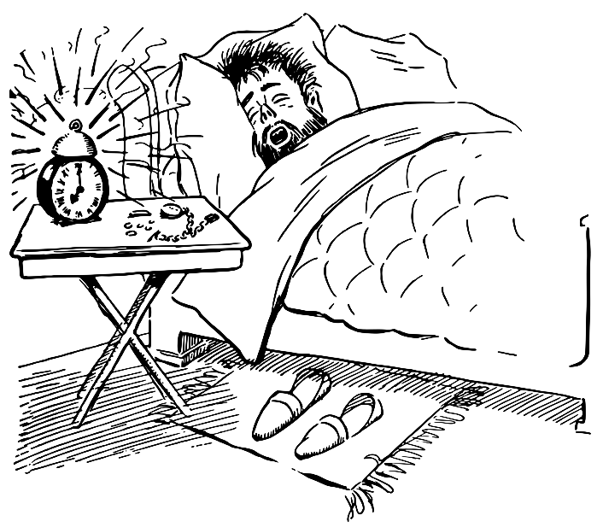
Vectoring Control To The Kernel
[Ignoring kernel threads,] kernel code only executes in response to external stimuli
  Asynchronous interrupts (e.g., timer interrupt, NIC interrupt because a packet arrived))
  Synchronous exceptions (e.g., dividing by zero, dereferencing a null pointer, attempting to write a read-only page)
  Synchronous traps (e.g., system calls via syscall, debugging traps via int3)
During boot, the kernel must configure the processor to invoke the appropriate kernel code when exceptions, traps, and interrupts occur

Slide 3
Interrupts, Exceptions, and Non-syscall Traps
//Chickadee’s x86-64.h: Listing the IDT numbers
#define INT_DE 0 // Divide error (#DE)
#define INT_DB 1 // Debug (#DB)
#define INT_NM 2 // Non-maskable interrupt (#NM)
#define INT_BP 3 // Breakpoint (#BP)
#define INT_OF 4 // Overflow (#OF)
#define INT_UD 6 // Invalid opcode (#UD)
#define INT_DF 8 // Double fault (#DF)
#define INT_TS 10 // Invalid TSS (#TS)
#define INT_NP 11 // Segment not present (#NP)
#define INT_SS 12 // Stack fault (#SS)
#define INT_GP 13 // General protection (#GP)
#define INT_PF 14 // Page fault (#PF)
#define INT_AC 17 // Alignment check (#AC)
#define INT_MC 18 // Machine check (#MC)
Notes:
The breakpoint exception happens when code executes the int3 instruction. For example, when gdb wants to set a breakpoint in a program being debugged, gdb overwrites the first byte of the instruction to breakpoint with an int3 instruction. When the code being debugged tries to execute the instruction to break on, the code will generate a breakpoint exception. The OS can then vector control to gdb (who registered interest in the program using the ptrace() system call). [For more details on how all of this works, see http://www.alexonlinux.com/how-debugger-works/.]

Slide 4

Program to debug
...
cmpq %r8, %r9
jz 0x6000
subq %r10, %r11
addq %rax, %rbx
movq 8(%r9), %r12
breakpoint
int3
Remember that I overwrote subq!
...
gdb
Notes:
gdb needs to remember the part of the instruction that it overwrote so that gdb can successfully resume execution of the program after the human developer has inspected the program state at the breakpoint. In other words, gdb needs to replace the `int3` with whatever used to be there (in this case, `subq`).
[Yes, that is the real gdb logo. As described by https://www.gnu.org/software/gdb/mascot/, “the archer fish is known to shoot down bugs from low hanging plants by spitting water at them.”]

Slide 5
Interrupts, Exceptions, and Non-syscall Traps
//Chickadee’s x86-64.h: Listing the IDT numbers
#define INT_DE 0 // Divide error (#DE)
#define INT_DB 1 // Debug (#DB)
#define INT_NM 2 // Non-maskable interrupt (#NM)
#define INT_BP 3 // Breakpoint (#BP)
#define INT_OF 4 // Overflow (#OF)
#define INT_UD 6 // Invalid opcode (#UD)
#define INT_DF 8 // Double fault (#DF)
#define INT_TS 10 // Invalid TSS (#TS)
#define INT_NP 11 // Segment not present (#NP)
#define INT_SS 12 // Stack fault (#SS)
#define INT_GP 13 // General protection (#GP)
#define INT_PF 14 // Page fault (#PF)
#define INT_AC 17 // Alignment check (#AC)
#define INT_MC 18 // Machine check (#MC)
Notes:
The processor generates the invalid (i.e., undefined) opcode exception when the decode stage cannot successfully decode the instruction bits provided by the fetch stage.

Slide 6
Decode: 10011001…
+
//If the bits in the current
//instruction register are
//invalid, CPU throws #UD
Next sequential IP
Conditions?
Sign-extended imm
Instr
Read reg0 idx
size
+
Read reg1 idx
Opcode
Write reg idx
Write reg data
Addr
IP
Current instruction register
ID/EX
EX/MEM
MEM/WB
Memory
Read data 0
Instr
Read data 1
ALU
Registers
?
RdData
Memory
Sign extend
imm to 64-bit
?
Addr
Write reg idx
WrData

Slide 7
Interrupts, Exceptions, and Non-syscall Traps
//Chickadee’s x86-64.h: Listing the IDT numbers
#define INT_DE 0 // Divide error (#DE)
#define INT_DB 1 // Debug (#DB)
#define INT_NM 2 // Non-maskable interrupt (#NM)
#define INT_BP 3 // Breakpoint (#BP)
#define INT_OF 4 // Overflow (#OF)
#define INT_UD 6 // Invalid opcode (#UD)
#define INT_DF 8 // Double fault (#DF)
#define INT_TS 10 // Invalid TSS (#TS)
#define INT_NP 11 // Segment not present (#NP)
#define INT_SS 12 // Stack fault (#SS)
#define INT_GP 13 // General protection (#GP)
#define INT_PF 14 // Page fault (#PF)
#define INT_AC 17 // Alignment check (#AC)
#define INT_MC 18 // Machine check (#MC)
Notes:
A page fault when a memory access is problematic in some way, e.g., because a write was attempted on a read-only page.

Slide 8
The Lifecycle of a Memory Reference on x86
Virtual address
TLB lookup
No
Yes
TLB hit?
HW walks the page table
Check protection bits
No
Yes
Yes
No
Access ok?
Found PTE for virt frame?
HW updates TLB
HW raises a page fault
HW raises a page fault
Calculate phys addr, send to L1/L2/L3/RAM

Slide 9
Interrupts, Exceptions, and Non-syscall Traps
//Chickadee’s kernel.hh: Hardware-generated interrupts
#define INT_IRQ 32 // Base value for any hardware-
// generated interrupt
#define IRQ_TIMER 0 // Timer went off
#define IRQ_KEYBOARD 1 // User hit a key
//Chickadee’s x86-64.h: Listing the IDT numbers
#define INT_DE 0 // Divide error (#DE)
#define INT_DB 1 // Debug (#DB)
#define INT_NM 2 // Non-maskable interrupt (#NM)
#define INT_BP 3 // Breakpoint (#BP)
#define INT_OF 4 // Overflow (#OF)
#define INT_UD 6 // Invalid opcode (#UD)
#define INT_DF 8 // Double fault (#DF)
#define INT_TS 10 // Invalid TSS (#TS)
#define INT_NP 11 // Segment not present (#NP)
#define INT_SS 12 // Stack fault (#SS)
#define INT_GP 13 // General protection (#GP)
#define INT_PF 14 // Page fault (#PF)
#define INT_AC 17 // Alignment check (#AC)
#define INT_MC 18 // Machine check (#MC)
void proc::exception(regstate* regs) {
switch (regs->reg_intno) {
// This case returns to the interrupted
// process immediately.
case INT_IRQ + IRQ_KEYBOARD:
keyboardstate::get().handle_interrupt();
break;

Slide 10
Which Stack Should the Kernel Use to Handle Interrupts and Exceptions?
//k-exception.S::syscall_entry
.globl syscall_entry
syscall_entry:
swapgs //%gs.base now points to the
//per-CPU struct cpustate
//(defined in kernel.hh)
movq %rsp, %gs:(16) //Save user %rsp in scratch
//space
movq %gs:(8), %rsp //Set %rsp to the struct proc
//for the process which just
//invoked the system call
//(%gs:(8) is the field
//cpustate::proc* current_)
addq $PROCSTACK_SIZE, %rsp //Now %rsp points to the
//appropriate kernel stack!
Let’s first consider how system calls work
  A system call asks the kernel to perform work on behalf of a particular process
  So, most OSes (including Chickadee) use a per-process kernel stack to handle system calls
  Chickadee’s k-exception.S::syscall_entry immediately switches to that stack!
Stack frame 0
Available for use by the kernel stack
Stack frame 1
4KB of allocated space
//...Other
//stuff...
Space actually used by struct proc fields
id_
struct proc
Synchronous exceptions/traps are generated by the currently-running process (e.g., divide-by-zero, invalid decode, page fault, debugging trap)
Asynchronous interrupts may not be related to the currently-running process (e.g., interrupts raised by IO devices like disks and NICs)
The kernel’s exception/trap-handling code should run on the kernel stack for the triggering process
ZOMG WHAT SHOULD WE DO

Slide 11

First, we must look at x86 configuration gore!
x86 documentation

Slide 12

Interrupt number
Interrupt handler code: in virtual memory
16
x
Code
Virtual address
+
Other stuff
IST
WHICH STACK WILL THE INTERRUPT HANDLER USE?
Virtual address
Interrupt-Descriptor-Table Register (IDTR)
Interrupt Descriptor
Table (IDT): in virtual memory

Slide 13
Interrupt number
Interrupt handler code: in virtual memory
16
x
Code
Virtual address
+
Other stuff
IST
Task state segment (TSS): in virtual memory
Virtual address
Interrupt-Descriptor-Table Register (IDTR)
Interrupt Descriptor
Table (IDT): in virtual memory
TSS
TSS Descriptor
Virtual addr (base of TSS)
Other stuff
Virtual address
Selector
Base addr of TSS (cached from TSS descriptor)
Global-Descriptor-Table Register (GDTR)
Global Descriptor Table (GDT): in virtual memory
Task register (TR)
Notes:
[Quoth Section 2.4.4 of the Intel Software Developer Systems Programming Manual (Vol 3A): “The task register holds the 16-bit segment selector, base address (32 bits in protected mode; 64 bits in IA-32e mode), segment limit, and descriptor attributes for the TSS of the current task. The selector references the TSS descriptor in the GDT. The base address specifies the linear address of byte 0 of the TSS; the segment limit specifies the number of bytes in the TSS.”
Quoth Section 7.2.4, “The task register has a visible part (that can be read and changed by software) and an invisible part (maintained by the processor and is inaccessible by software). The segment selector in the visible portion points to a TSS descriptor in the GDT. The processor uses the invisible portion of the task register to cache the segment descriptor for the TSS. Caching these values in a register makes execution of the task more efficient” (mickens: i.e., when an interrupt occurs, the processor can directly calculate the memory addresses of fields in the TSS, instead of having to first load the base address of the TSS from the TSS descriptor).]
[Another useful reference is Section 8.9 of the AMD64 Architecture Programmer’s Manual (Vol 2): https://www.amd.com/content/dam/amd/en/documents/processor-tech-docs/programmer-references/24593.pdf]

Slide 14
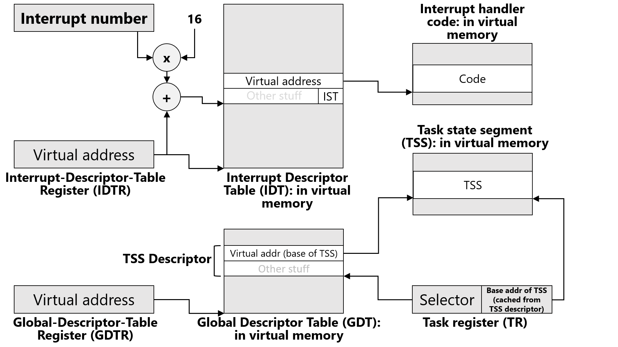
//Chickadee’s k-init.cc
void cpustate::init_cpu_hardware() {
//...stuff...
memset(&taskstate_, 0, sizeof(taskstate_));
taskstate_.ts_rsp[0] = (uintptr_t) this + CPUSTACK_SIZE;
//^^^The Ring 0 stack that the CPU initially uses when
//when executing most exception-handling code; see
//k-exception.S::exception_entry.
taskstate_.ts_ist[1] = (uintptr_t) this + CPUALTSTACK_SIZE;
//^^^Used to handle a small set of exceptions.
//...other stuff...
Interrupt-handler %rsp for IST 1
Interrupt-handler %rsp for IST 2
. . .
Interrupt-handler %rsp for IST 7
CPU stack
Chickadee uses the alternate stack for:
  INT_DB: Debugging interrupt as controlled by debug registers %dr0—7
  INT_NM: Non-maskable interrupt (e.g., RAM error or another unrecoverable hardware error)
  INT_MC: Machine-check interrupt (unrecoverable hardware errors)
When these interrupts fire, the hardware might be sufficiently messed up that the regular interrupt-handler stack is corrupted!
CPU alternative stack
4KB of allocated space
IST 0: Default interrupt-handler %rsp
//...Other
//stuff...
Space actually used by struct cpustate fields
current_
struct cpustate
Notes:
To create the interrupt stacks, we’re using the same trick that we used to create the kernel stacks! For the kernel stacks, we allocate extra space for each struct proc, and then placed a kernel stack at the top. To create the two interrupt stacks, we allocate extra space for a struct cpustate, and then put the two interrupt stacks at the top of the cpustate. Note that taskstate_.ts_rsp[0] is the stack that the CPU initially uses after switching to ring 0 code upon an exception; see k-exception.S::exception_entry to see how, at the beginning of the exception-handling path, Chickadee immediately makes %rsp point to the appropriate kernel stack for the interrupted task, copying the registers pushed by the hardware onto the CPU stack, making copies on the kernel stack.
For more information about the debugging interrupt INT_DB, see https://en.wikipedia.org/wiki/X86_debug_register. As that page says, “On the x86 architecture, a debug register is a register used by a processor for program debugging. There are six debug registers, named DR0...DR7 [which] allow programmers to selectively enable various debug conditions associated with a set of four debug addresses . . . The debug registers are privileged resources; the MOV instructions that access them can only be executed at privilege level zero . . . Each of these registers contains the linear [i.e., post-segmentation-translation, pre-paging-translation] address associated with one of four breakpoint conditions. Each breakpoint condition is further defined by bits in DR7 . . . [for example] Bits 16-17 (corresponding to DR0), 20-21 (DR1), 24-25 (DR2), 28-29 (DR3), define when breakpoints trigger. Each breakpoint has a two-bit entry that specifies whether they break on execution (00b), data write (01b), data read or write (11b).”
For more information about non-maskable interrupts, see https://wiki.osdev.org/Non_Maskable_Interrupt. As that page states, “NMI occur for RAM errors and unrecoverable hardware problems . . . The short version of this story is that there's only really 2 reasons for an NMI. The first reason is a hardware failure. The second reason is a ‘watchdog timer,’ which can be used to detect when the kernel itself locks up (and is sometimes also used for more accurate profiling as it allows EIP to be sampled even when IRQs are disabled).”
[Aside: The full algorithm used by the x86 hardware to determine which stack to use is confusing; see Sections 8.9.3, 8.9.4, and 12.2.5 of “AMD64 Architecture
Programmer’s Manual, Volume 2: System Programming” (https://www.amd.com/content/dam/amd/en/documents/processor-tech-docs/programmer-references/24593.pdf). The basic idea is that a TSS contains a bunch of stacks:
-three of them to use as a CPU’s exception time stack when handling the exception with ring 0, 1, or 2 code respectively; and
-seven alternate IST stacks to use as desired (if at all) by the kernel.
The IST field in IDT descriptor for an exception determines which stack the hardware will switch to upon receiving an exception. If the IST field is 0, the hardware switches to the default stack for the ring level being switched to. Since Chickadee runs at ring 0, the default ring 0 stack is used. However, if the IST field is between 1 and 7 inclusive, the hardware switches to the appropriate IST stack. The slide above doesn’t explicitly show all three default stacks for rings 0—2. Instead, the slide above just shows the default stack for ring 0, labelling it as IST 0 (even though, technically speaking, there are three IST 0 stacks, one for each ring level; however, Chickadee and other commodity Oses only use ring 0 for privileged code, so no harm, no foul).]

Slide 15
Interrupt handler code: in virtual memory
Interrupt number
Summary: When user-level code is running and an interrupt/exception occurs, the CPU must set %rip and %rsp for the kernel’s handling code, and flip the CPU’s privilege bit.
16
x
Code
Virtual address
+
Other stuff
IST
Interrupt-handler %rsp for IST 1
Task state segment (TSS): in virtual memory
Interrupt-handler %rsp for IST 2
Virtual address
. . .
Interrupt-Descriptor-Table Register (IDTR)
Interrupt Descriptor
Table (IDT): in virtual memory
TSS
Interrupt-handler %rsp for IST 7
TSS Descriptor
Virtual addr (base of TSS)
Other stuff
IST 0: Default interrupt-handler %rsp
Virtual address
Selector
Base addr of TSS (cached from TSS descriptor)
Global-Descriptor-Table Register (GDTR)
Global Descriptor Table (GDT): in virtual memory
Task register (TR)
Notes:
So, let’s review what happens when user-level code is executing and an interrupt occurs. The CPU uses the interrupt number, multiplied by 16, to index into the interrupt descriptor table that’s pointed to by %idtr; the CPU looks at the descriptor, pulls out the virtual address of the kernel code which handles the interrupt, and then sets %rip to that virtual address. To determine which stack should be used by that kernel code, the CPU looks at the IST field in the IDT descriptor. The IST field is used to select an %rsp value from the task state segment that is pointed to by the task register. The CPU then flips the privilege bit and starts executing the kernel’s interrupt handler.

Slide 16
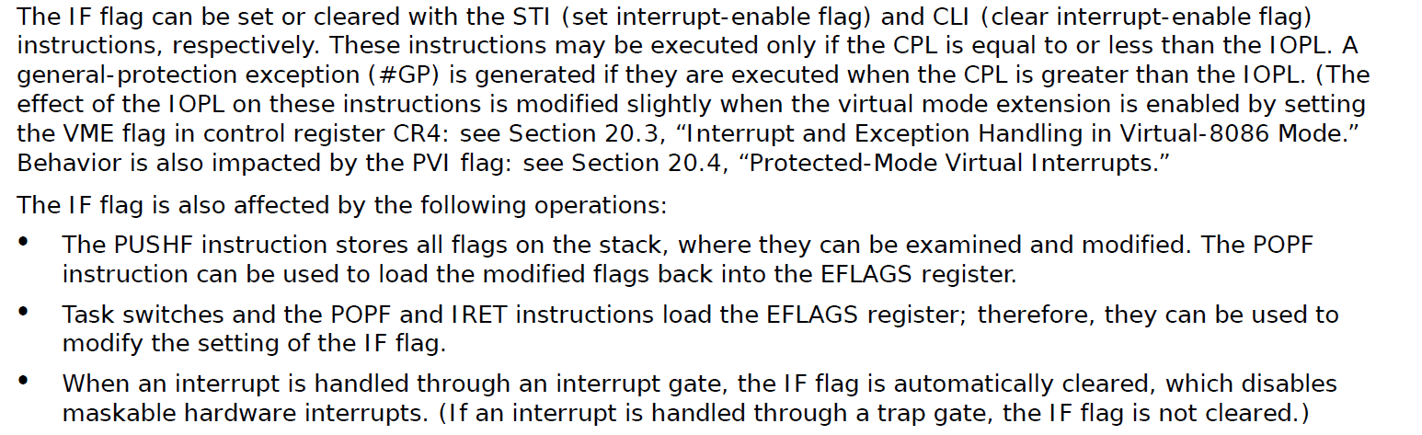
The hardware automatically disables interrupts before executing the kernel’s interrupt handler!
Notes:
[Ref: Section 6.8.1 of Volume 3A of the Intel Developer’s Manual (https://www.intel.com/content/dam/www/public/us/en/documents/manuals/64-ia-32-architectures-software-developer-vol-3a-part-1-manual.pdf)]

Slide 17
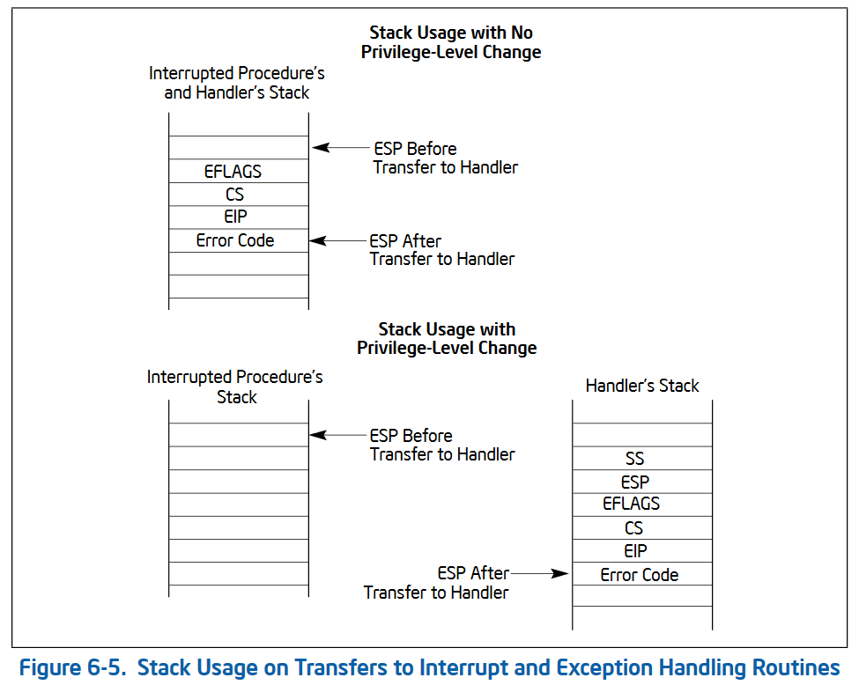
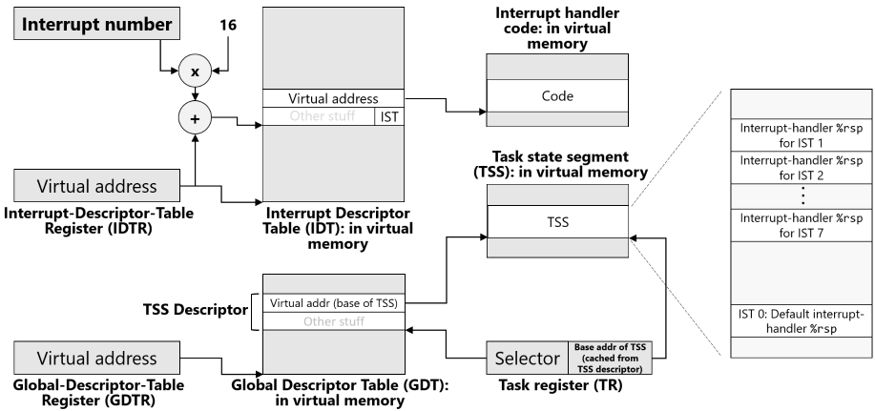
The hardware also pushes some registers onto the stack!
The hardware picks the new stack using this stuff
Notes:
[Ref: Section 6.4.1 of “Intel 64 and IA-32 Architectures Software Developer’s Manual, Volume 1: Basic Architecture Manual” (https://www.intel.com/content/dam/www/public/us/en/documents/manuals/64-ia-32-architectures-software-developer-vol-1-manual.pdf)]

Slide 18

// Exception entry point
exception_entry:
/* On entry, the stack looks like this:
+-----------------------+ <- %rsp
| reg_intno, reg_swapgs | 0(%rsp)
| reg_errcode | 8(%rsp)
| %rip | 16(%rsp)
| %cs | 24(%rsp)
| %rflags | 32(%rsp)
| %rsp | 40(%rsp)
| %ss | 48(%rsp)
... ...
This data should be stored on the current kernel task stack.
It’s already there if the exception happened in kernel mode
(because the hardware doesn’t switch stacks in this case!).
Otherwise, we must move it there. */
// Exception happened in user mode if `(%cs & 3) != 0`.
testb $3, 24(%rsp) // does a bitwise and
jz exception_entry_finish // jump if exception happened in
// kernel mode
orl $1, 4(%rsp) // exception happened in user mode; tell
// k-exception.S::restore_and_iret to
// do swapgs before returning to user mode
// change %rsp to the kernel task stack
swapgs //%gs.base is now the address of this cpu’s cpustate
movq %gs:(8), %rsp // mov cpustate::proc* current_, %rsp
addq $PROCSTACK_SIZE, %rsp
// copy data from CPU stack to kernel task stack
pushq %gs:(CPUSTACK_SIZE - 8) // %ss
pushq %gs:(CPUSTACK_SIZE - 16) // %rsp
pushq %gs:(CPUSTACK_SIZE - 24) // %rflags
pushq %gs:(CPUSTACK_SIZE - 32) // %cs
pushq %gs:(CPUSTACK_SIZE - 40) // %rip
pushq %gs:(CPUSTACK_SIZE - 48) // error code
pushq %gs:(CPUSTACK_SIZE - 56) // interrupt number
exception_entry_finish:
// complete `struct regstate`
push %gs
push %fs
pushq %r15
//...push the other general-purpose registers,
//with the final one being...
pushq %rax
// call `proc::exception(regstate*)`
// load current `proc` from the current cpustate,
// which is accessible via `%gs`
movq %gs:(8), %rdi
// the second argument, `regstate`, is the current `%rsp`
movq %rsp, %rsi
call _ZN4proc9exceptionEP8regstate
Design decision: To the greatest extent possible, Chickadee should use a per-process kernel stack for all kernel code: exception handling, syscall handling, and interrupt handling!
Notes:
Remember that, when the CPU executes in privileged mode, the %gs base should point to the per-CPU data structure.
[Note that Eddie and I draw stacks growing in different directions!]

Slide 19


Suppose that proc::exception() looked like this . . .
void proc::exception(regstate* regs) {
return;
// Immediately return to the
// interrupted context
}
KERNEL OUT

Slide 20
restore_and_iret:
testb $1, 140(%rsp) // Does `reg_swapgs & 1` and sets
// the status flags (e.g., ZF set
// if the & results in a 0)
jz 1f // If & was a 0, we’re resuming
// a kernel-mode context.
// If we’re here, we’re resuming a user-mode context;
// check whether the process is runnable
movq %gs:(8), %rdi //cpustate::proc* current
cmpl $PROC_RUNNABLE, 24(%rdi) //proc::pstate_
jne panic_nonrunnable
1: // restore `regstate` registers
popq %rax
popq %rcx
popq %rdx
popq %rbx
popq %rbp
popq %rsi
popq %rdi
popq %r8
popq %r9
popq %r10
popq %r11
popq %r12
popq %r13
popq %r14
popq %r15
pop %fs
// We’ve restored almost all of the interrupted
// context’s general-purpose registers. At this
// point, the stack contains:
// %ss
// %rsp
// %rflags
// %cs
// %rip
// Error code
// Interrupt number, reg_swapgs
// %rsp --> %gs
// We must `swapgs` if required, i.e., if we’re
// returning to user-mode.
testb $1, 12(%rsp) // `reg_swapgs & 1`
jnz 1f // Jump if returning to user-mode
// Returning to kernel mode
addq $24, %rsp // Pops off %gs, interrupt number,
// reg_swapgs, error code
iretq // Pop the remaining five items from
// the stack, resetting %rip and %rsp
1: // Returning to user mode
cli // Prevent interrupts after `swapgs`
swapgs
pop %gs
addq $16, %rsp // Pop interrupt number, reg_swapgs,
// error code
iretq // Pop the remaining five items from
// the stack, resetting %rip and %rsp
Notes:
[Remember that the interrupt number and reg_swapgs are 4 bytes each on the stack.]
[Recall from Lecture 3: Why do we want to disable interrupts before we call swapgs? Suppose that we call swapgs (so that %gs base now contains the user-level value), and then an interrupt happens before iretq is invoked. The exception_entry code in k-exception.S will check whether we're in kernel mode, determine that the answer is yes, and then *not* do a swapgs! However, the %gs base is the user-level value! Chaos will ensue, because the kernel will think that it's accessing the local cpustate, but is really accessing whatever memory happens to be pointed to by the user-level value of %gs base.]
You might wonder why we can’t just do “pop %gs” instead of “swapgs; pop%gs”. Note that just doing “pop %gs” would restore the user-mode state of %gs, but would overwrite the kernel-mode %gs base! Doing the “swapgs” first ensures that the kernel-mode %gs base gets stored in KERNEL_GS_BASE, where it needs to be so that, during the next entry into the kernel, the kernel can do a “swapgs” and restore the kernel-mode %gs base.
[The handling of the callee-saved registers is subtle. Why doesn’t the return to user-mode path in k-exception.S need to restore any of the registers that were pushed on the stack. As described by https://read.seas.harvard.edu/cs161/2021/doc/contexts/,
"Voluntary context switches, such as system calls, don’t need to
save state in the same comprehensive way as involuntary context
switches. A calling convention can be established that lets the
kernel cut corners. Chickadee system calls are treated like
function calls: the kernel only guarantees that it will save
and restore the callee-saved registers, which are %rbp, %rbx,
and %r12-%r15."
However, note that the syscall entry point in k-exception.S doesn't clobber any of the callee-saved registers! The entry point calls proc::syscall(), and *that* function will automagically save any callee-saved registers at the beginning of execution, and restore them upon returning to k-exception.S. At that point, all of the callee-saved registers have the values that they had immediately before the invocation of the syscall instruction by user-level code!]

Slide 21

What does proc::exception() really look like?

Slide 22
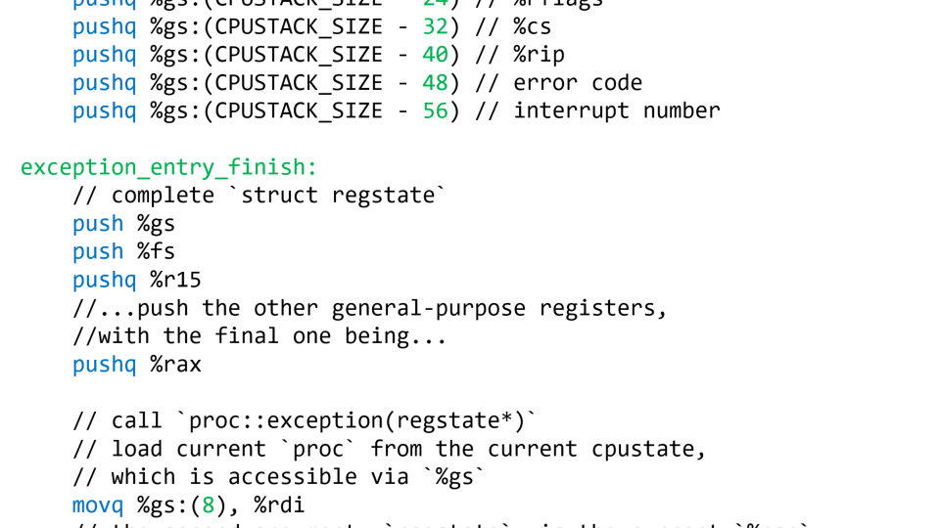
regs_ is a member variable of struct proc
regs points to saved context state on the stack
Stack frame 0
Available for use by the kernel stack
4KB of allocated space
//...Other
//stuff...
Space actually used by struct proc fields
regstate* regs_
void proc::exception(regstate* regs) {
switch (regs->reg_intno) {
// This case returns to the interrupted
// process immediately.
case INT_IRQ + IRQ_KEYBOARD:
keyboardstate::get().handle_interrupt();
break;
// WHAT IS HAPPENING HERE
case INT_IRQ + IRQ_TIMER: {
cpustate* cpu = this_cpu();
if (cpu->cpuindex_ == 0) {
tick(); //Called once every tick (0.01
//sec, 1/HZ) by CPU 0. Updates
//the `ticks` counter and
//performs other periodic
//maintenance tasks.
}
lapicstate::get().ack();
regs_ = regs; //this->regs_ = regs on stack
yield_noreturn();
break; /* will not be reached */
}
pid_t id_
struct proc
Notes:
Note that, in the code that handles the timer interrupt, we set proc::regs_! The proc::regs_ value, if non-null, points to the register state for an interrupted user-mode execution context. Recall that this state was pushed onto the proc’s kernel stack by k-exception.S.

Slide 23
// k-exception.S
// proc::yield_noreturn()
.globl _ZN4proc14yield_noreturnEv
_ZN4proc14yield_noreturnEv:
// Switch to cpustack and invoke the scheduler
// (in other words, invoke the function
// cpustate::schedule()).
// Recall that %gs.base points to the
// cpustate for this cpu.
movq %gs:(0), %rdi //%rdi will be the
//`this` pointer for
//cpustate::schedule()!
leaq CPUSTACK_SIZE(%rdi), %rsp //cpustack is at
//the top of the allocated
//space for cpustate
jmp _ZN8cpustate8scheduleEv
Notes:
The `lea` instruction (“load effective address”) calculates the memory address that is CPUSTACK_SIZE bytes away from the address in %rdi. However, the instruction doesn’t actually read or write anything at that address.
The function has “noreturn” in its name because it doesn’t return to the caller! Instead, we switch to a totally different stack (i.e., the cpustack) and then start executing code on that stack.

Slide 24
// A simplified version of the real schedule(). Note that
// this code uses the per-cpu stack, not a per-process
// kernel stack!
void cpustate::schedule() {
proc* prev = current_;
// Find the next process to run.
runq_lock_.lock_noirq();
if (prev->pstate_ == proc::ps_runnable) {
runq_.push_back(prev);
}
current_ = runq_.empty() ? idle_task_ :
runq_.pop_front();
runq_lock_.unlock_noirq();
// Run `current_`.
set_pagetable(current_->pagetable_);
current_->resume(); // Does not return.
}
Notes:
Note that cpustate::schedule() needs to run with interrupts disabled because cpustate::schedule() uses the CPU stack. If interrupts were enabled, then an incoming interrupt would clobber the stack area that cpustate::schedule() was using! The hardware would push stuff onto the stack; that stack area will be actively used by cpustate::schedule()---remember that proc::yield_noreturn() sets %rsp to the very top of the struct cpustate, meaning that cpustate::schedule()’s stack will start at the very start of the CPU’s stack.
lock() saves the current interrupt state, then disables interrupts and tries to grab the lock; unlock() releases the lock and then restores the old interrupt state. lock_irq() and unlock_irq() don’t fiddle save or restore the interrupt state.
[This also explains why proc::yield() (which eventually calls proc::yield_noreturn(), which eventually calls cpustate::schedule()) must ensure that interrupts are disabled.
// proc::yield()
.globl _ZN4proc5yieldEv
_ZN4proc5yieldEv:
// only save callee-saved registers and rflags
pushfq
pushq %r15
pushq %r14
pushq %r13
pushq %r12
pushq %rbx
pushq %rbp
// check if interrupts are disabled
testq $EFLAGS_IF, 48(%rsp)
jnz 1f
// if interrupts are disabled, momentarily enable them.
// This bounds interrupt delay to the time it takes a
// single kernel task to yield.
// Note that `sti; cli` would not work! `sti` only enables
// external, maskable interrupts at the end of the *next*
// instruction. A no-op instruction is required.
sti
movq (%rsp), %rax // any delayed interrupts will happen here
1: // disable interrupts, store yieldstate pointer
cli
movq %rsp, 16(%rdi)
// jump to `proc::yield_noreturn`
jmp _ZN4proc14yield_noreturnEv
// proc::yield_noreturn()
.globl _ZN4proc14yield_noreturnEv
_ZN4proc14yield_noreturnEv:
// switch to cpustack
movq %gs:(0), %rdi
leaq CPUSTACK_SIZE(%rdi), %rsp
// jump to scheduler
jmp _ZN8cpustate8scheduleEv
]

Slide 25
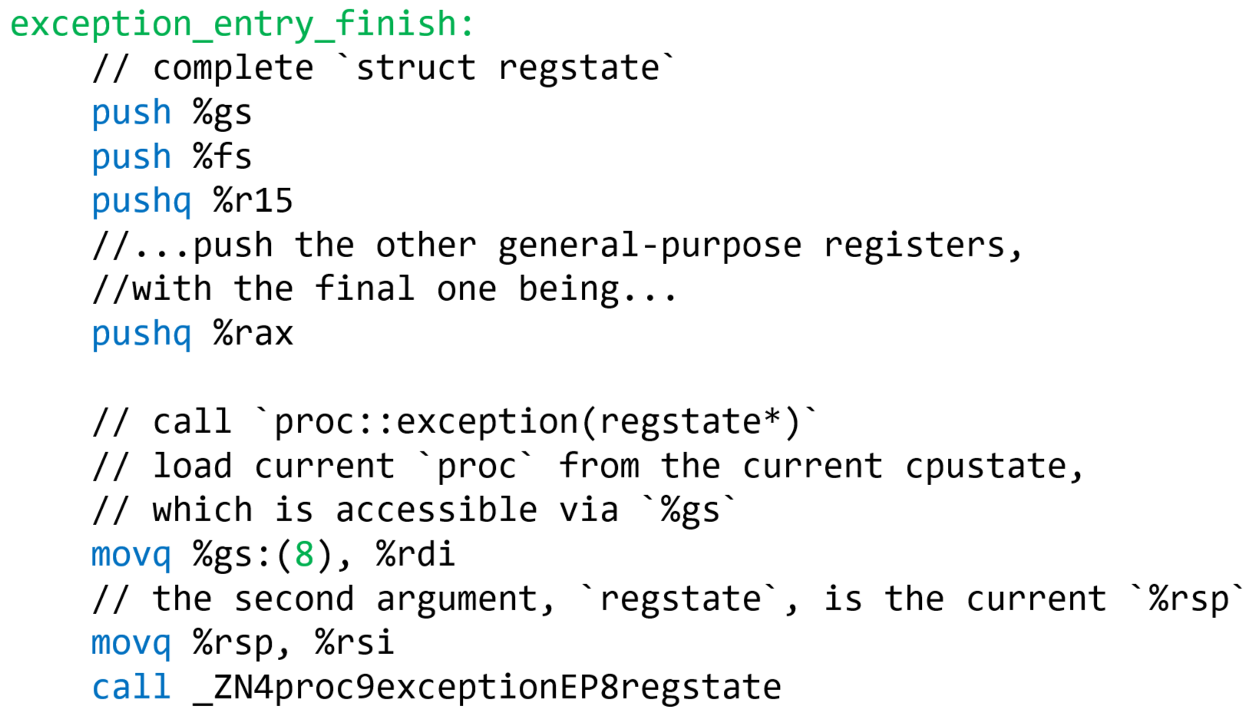
// proc::resume()
.globl _ZN4proc6resumeEv
_ZN4proc6resumeEv:
// Do we have yieldstate? (in other words, is
// `this->yields_ != nullptr`)?
movq 16(%rdi), %rax
testq %rax, %rax
jnz resume_yieldstate
resume_regstate: // No yieldstate: restore an involuntarily
// interrupted process!
// Restore %rsp, clear regstate, pop regs.
movq 8(%rdi), %rsp // %rdi is `this` (i.e., a proc),
// so 8(%rdi) is proc::regstate* regs_;
// %rsp now points to the regstate that
// holds the interrupted process’s
// registers! The regstate was pushed
// on the process’s kernel stack by
// k-exception.S::exception_entry.
movq $0, 8(%rdi) // Now proc::regs_ is nullptr.
jmp restore_and_iret
Notes:
Note that the test instruction performs bitwise & on the two operands.

Slide 26
We’ve seen restore_and_iret already, when we imagined that proc::exception() returned immediately!

Slide 27
restore_and_iret:
testb $1, 140(%rsp) // Does `reg_swapgs & 1` and sets
// the status flags (e.g., ZF set
// if the & results in a 0)
jz 1f // If & was a 0, we’re resuming
// a kernel-mode context.
// If we’re here, we’re resuming a user-mode context;
// check whether the process is runnable
movq %gs:(8), %rdi //cpustate::proc* current
cmpl $PROC_RUNNABLE, 24(%rdi) //proc::pstate_
jne panic_nonrunnable
1: // restore `regstate` registers
popq %rax
popq %rcx
popq %rdx
popq %rbx
popq %rbp
popq %rsi
popq %rdi
popq %r8
popq %r9
popq %r10
popq %r11
popq %r12
popq %r13
popq %r14
popq %r15
pop %fs
// We’ve restored almost all of the interrupted
// context’s general-purpose registers. At this
// point, the stack contains:
// %ss
// %rsp
// %rflags
// %cs
// %rip
// Error code
// Interrupt number, reg_swapgs
// %rsp --> %gs
// We must `swapgs` if required, i.e., if we’re
// returning to user-mode.
testb $1, 12(%rsp) // `reg_swapgs & 1`
jnz 1f
// Returning to kernel mode
addq $24, %rsp // Pops off %gs, interrupt number,
// reg_swapgs, error code
iretq // Pop the remaining five items from
// the stack, resetting %rip and %rsp
1: // Returning to user mode
cli // Prevent interrupts after `swapgs`
swapgs
pop %gs
addq $16, %rsp // Pop interrupt number, reg_swapgs,
// error code
iretq // Pop the remaining five items from
// the stack, resetting %rip and %rsp
Notes:
[Remember that the interrupt number and reg_swapgs are 4 bytes each on the stack.]

Slide 28

THAT WAS A LOT OF INFORMATION

Slide 29
The Mystery of proc::regs_
struct regstate
If a process has a non-null proc::regs_:
  The process has a full set of saved registers on its kernel stack that must be restored because the process was interrupted/exceptioned; or
  The process is new; the callchain kicked off by start_initial_process(pid_t pid, const char* name) has done stuff like this:
Available for use by the kernel stack
4KB of allocated space
//...Other
//stuff...
Space actually used by struct proc fields
regs_
id_
struct proc
proc* p = knew<proc>();
p->regs_ = reinterpret_cast<regstate*>(reinterpret_cast<uintptr_t>(p)
+ PROCSTACK_SIZE) - 1;
p->regs_->reg_swapgs = 1;
p->regs_->reg_rip = /*Address of the new process’ entry point*/
void* stkpg = kalloc(PAGESIZE);
vmiter(p, MEMSIZE_VIRTUAL - PAGESIZE).map(stkpg, PTE_PWU);
p->regs_->reg_rsp = MEMSIZE_VIRTUAL;
Notes:
The pointer arithmetic in this line . . .
p->regs_ = reinterpret_cast<regstate*>(reinterpret_cast<uintptr_t>(p) + PROCSTACK_SIZE)) - 1);
. . . is bit tricky. It does the following:
Cast the proc* pointer p to a uintptr.
Adding PROCSTACK_SIZE to that pointer, so that the pointer now points to the very top of the allocated struct proc.
Casting that uintptr to a regstate*, and then subtracting one from it.
The result is that p->regs_ now points to a memory region of sizeof(regstate) bytes that lives at the top of the allocated region for the struct proc.
[Note that some of the code above actually lives in proc::init_user(), which is called by start_initial_process().]

Slide 30
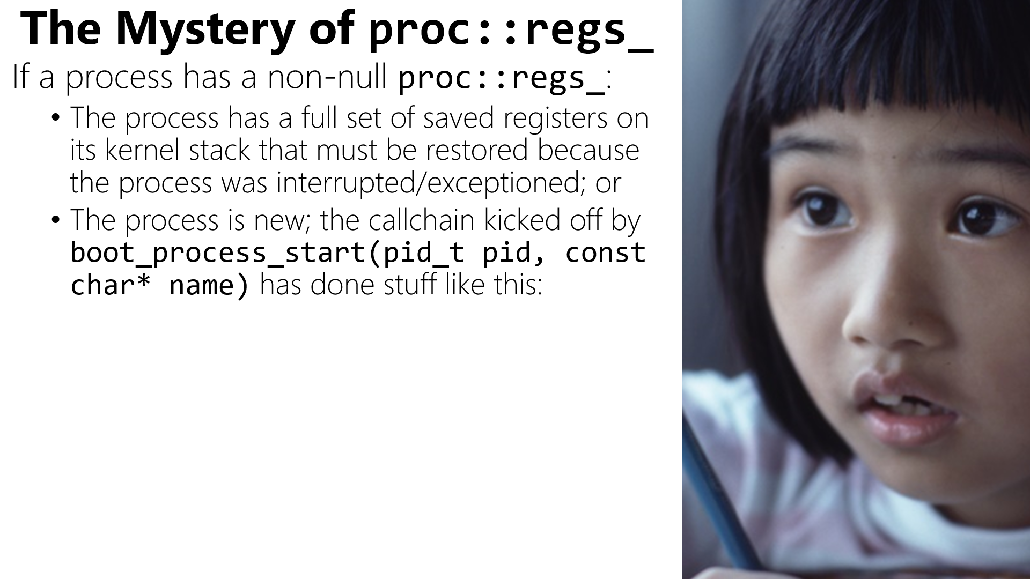
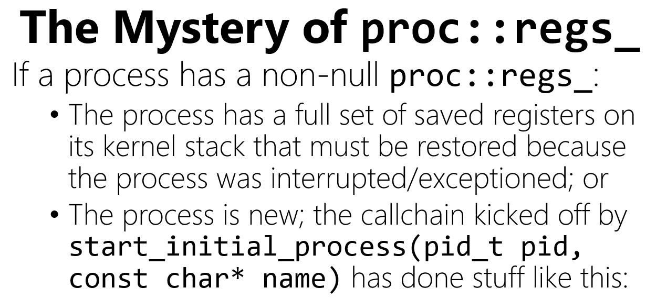
<see previous slide>
So, proc::regs_ can be nullptr!
  Ex: User-level code does a getpid() system call, where the kernel handles the request and then immediately returns to user-mode

Slide 31
Exercise for the reader: proc::yields_
A process can voluntarily yield the CPU while executing in kernel mode
  proc::yields_ will point to kernel-level context state on the kernel-level stack!
  When the process is resumed, it must restart from the appropriate location in kernel-level code
uintptr_t proc::syscall(regstate* regs){
switch (regs->reg_rax) {
case SYS_STUPID: {
int x = 42;
yield();
int y = 88;
return x + y;
}
}
}
At some point later, the process will return to user-mode
  Ex: Via the syscall path (because a process invoked a yielding system call, e.g., that needs to wait for a slow IO device)
  Ex: Via the exception path return_and_iret (e.g., because an interrupted/excepted process does a yield() while handling the interrupt/exception (e.g., handling a page fault for a swapped-out page))
Take a look at proc::yield() and proc::resume()!

Slide 32

Buddy allocation is more subtle than it seems!

Slide 33
Testing Strategies
Verify hypotheses: Don’t guess what your code is doing!
Use asserts: Obvious show-stopping bugs should be identified as soon as possible
Use binary debugging: Leverage bisection to minimize bug finding time
Use infinite loops: If you suspect that a broken kernel isn’t logging correctly, try inserting an infinite loop before the suspected bug location
Make tests repeatable: For example, use a pseudorandom number generator for guiding test behavior
Commit incrementally: Don’t check in a 17 GB God Commit and then hope that everything works, BECAUSE IT WON’T
Ensure corner cases get tested: Buddy allocation is full of them!
Notes:
For one approach for generating pseudorandom numbers, see Chickadee’s lib.cc::rand().

