Slide 1

CS 1610: Lecture 6
2/12/2025
Interrupts, Concurrency, and Synchronization

Slide 2
Your fork() should deallocate memory upon failure!
Your fork() implementation is probably a very long God function (which is probably ok in this scenario)
In OS code, goto statements are a common way to unwind from a deeply-nested failure

Slide 3
Linux’s fork() Implementation
//Different invocations of a function
//may take different branches due to
//differences in inputs/environment!
void foo(void *arg) {
if (foo(arg)) {
//...Developer-written code...
}
while (bar(arg)) {
//...Developer-written code...
}
return;
}
//Basic idea: Observe branching behavior to add
//randomness to an entropy pool!
void foo(void *arg) {
uint local_entropy = 0x52b9aeff; //Random value
//picked by
//by compiler
if (foo(arg)) {
local_entropy += 0xbb8; //Random operation
//and value picked
//by compiler
//...Developer-written code...
}
while (bar(arg)) {
local_entropy ^= 0x9a41a;//Random operation
//and value picked
//by compiler
//...Developer-written code...
}
global_entropy ^= local_entropy;
return;
}
/*
* This creates a new process as a copy of the old one,
* but does not actually start it yet.
*
* It copies the registers, and all the appropriate
* parts of the process environment (as per the clone
* flags). The actual kick-off is left to the caller.
*/
static __latent_entropy struct task_struct *copy_process(
struct pid *pid,
int trace,
int node,
struct kernel_clone_args *args){
//...stuff...
if (atomic_read(&p->real_cred->user->processes) >=
task_rlimit(p, RLIMIT_NPROC)) {
if (p->real_cred->user != INIT_USER &&
!capable(CAP_SYS_RESOURCE) &&
!capable(CAP_SYS_ADMIN))
goto bad_fork_free;
}
current->flags &= ~PF_NPROC_EXCEEDED;
retval = copy_creds(p, clone_flags);
if (retval < 0)
goto bad_fork_free;
/*
* If multiple threads are within copy_process(),
* then this check triggers too late. This doesn’t
* hurt, the check is only there to stop root fork
* bombs.
*/
retval = -EAGAIN;
if (nr_threads >= max_threads)
goto bad_fork_cleanup_count;
//...other stuff...
retval = copy_mm(clone_flags, p);
if (retval)
goto bad_fork_cleanup_signal;
retval = copy_namespaces(clone_flags, p);
if (retval)
goto bad_fork_cleanup_mm;
retval = copy_io(clone_flags, p);
if (retval)
goto bad_fork_cleanup_namespaces;
retval = copy_thread_tls(clone_flags, args->stack,
args->stack_size, p,
args->tls);
if (retval)
goto bad_fork_cleanup_io;
//Etc, and then at the end of the
//function . . .
return p; //This is a “fork succeeded”
//return path.
//If we reach any of the goto statements
//here, A SADNESS HAS OCCURRED.
bad_fork_free_pid:
if (pid != &init_struct_pid)
free_pid(pid);
bad_fork_cleanup_thread:
exit_thread(p);
bad_fork_cleanup_io:
if (p->io_context)
exit_io_context(p);
bad_fork_cleanup_mm:
if (p->mm) {
mm_clear_owner(p->mm, p);
mmput(p->mm);
}
//...etc...
}
Notes:
When a kernel boots, it may need to have a source of randomness. For example, the kernel may need to generate a random-looking cryptographic key. But what kind of source can generate random numbers during the boot process? The __latent_entropy tries to generate randomness from the kernel code that executes during boot. The hope is that, on different machines that have different hardware configurations, the kernel will execute the same code in different ways---in particular, the kernel will execute different branches. The __latent_entropy patch adds instrumentation to kernel code, randomly updating entropy variables in response to branching behavior.
[Ref: https://github.com/torvalds/linux/blob/master/kernel/fork.c
https://outflux.net/blog/archives/2016/12/12/security-things-in-linux-v4-9/
https://grsecurity.net/featureset/gcc_plugins //See the section “Adds entropy at early boot and runtime”
]

Slide 4
//Etc, and then at the end of the
//function . . .
return p; //This is a “fork succeeded”
//return path.
//If we reach any of the goto statements
//here, A SADNESS HAS OCCURRED.
bad_fork_free_pid:
if (pid != &init_struct_pid)
free_pid(pid);
bad_fork_cleanup_thread:
exit_thread(p);
bad_fork_cleanup_io:
if (p->io_context)
exit_io_context(p);
bad_fork_cleanup_mm:
if (p->mm) {
mm_clear_owner(p->mm, p);
mmput(p->mm);
}
//...etc...
return ERR_PTR(retval);
}

Slide 5

IN GENERAL, DO NOT USE GOTO STATEMENTS

Slide 6
Outline
Nested Interrupts and Exceptions
Locking: Synchronizing Kernel Code
Locking: Synchronizing User Code

Slide 7
Kernel Code Should (Almost Never) Cause Exceptions!
Exceptions are typically a sign of bugs (or debugging)
  Ex: Divide by zero
  Ex: Misaligned memory access
  Ex: Invalid opcode
  Ex: Debugging exception
A kernel should not have bugs!
So, in real OSes, exceptions can nest at most two deep
  Exception 1: A user-mode divide-by-zero or whatever
  Exception 2: A page fault exception triggered by the kernel’s handler for Exception 1; e.g., the handler tries to read a user-level page that is currently swapped out to disk
Exception
User
Kernel
Process is killed, debugged, etc.
Page fault exception
iret
During this time, there would be two Chickadee regstates on the kernel stack!
Notes:
[Note that Chickadee doesn’t actually handle page fault exceptions, so a correct Chickadee kernel will never have a doubly-nested exception. See the proc::exception() codepath for INT_PF.]
[Ref: https://www.oreilly.com/library/view/understanding-the-linux/0596005652/ch04s03.html]

Slide 8

A Potential Thing: Nested Interrupt Handlers!
An OS can allow interrupts to nest
  For example, an interrupt handler could reenable interrupts as soon as the old register state has been saved on the stack
IRQ₀
User
Kernel
iret
IRQ₁
iret
IRQ₂
iret
IRQ₃
iret
Notes:
[Remember that, on x86, interrupts that occur in kernel mode do not perform a stack switch!]

Slide 9
A Potential Thing: Nested Interrupt Handlers!
An OS can allow interrupts to nest
  For example, an interrupt handler could reenable interrupts as soon as the old register state has been saved on the stack
Advantage: Nesting interrupts can improve system responsiveness
Disadvantage: Writing correct kernel code (and debugging that code) becomes more difficult!
  If an interrupt can interrupt itself, then handler code must be reentrant
  Stack overflows become more likely
  Doing stack backtraces becomes harder
A reentrant function can safely start running, be interrupted, and have another copy of the function start running as the old copy is still paused!
Notes:
Stack backtraces become more difficult because the stack can contain a mix of normal stack frames and saved register states.

Slide 10

Linux’s Solution to Nested Interrupts
Top-half handlers
  Run with interrupts disabled
  Are fast (i.e., run small amounts of code)
  Can mark a kernel data structure to indicate that a softirq needs to run later
Bottom-half softirqs
  Run with interrupts enabled
  Do stuff that takes a medium amount of time, but does not require sleeping
  Pending softirqs are checked:
    When returning from a top-half handler
    By per-cpu ksoftirq kernel threads
Bottom-half work-queue kernel threads
  Run with interrupts enabled
  Can do computations that are slow-running or might sleep
Things that might induce a sleep
Ex: Acquiring a non-spinlock lock
Ex: Performing IO
Ex: Allocating a large amount of memory
Notes:
[Note that tasklets are another bottom-half mechanism that are built atop softirqs, and have similar properties—in particular, they run with interrupts are enabled and cannot sleep.]
[Ref: http://books.gigatux.nl/mirror/kerneldevelopment/0672327201/ch07lev1sec2.html
http://books.gigatux.nl/mirror/kerneldevelopment/0672327201/ch07lev1sec4.html]

Slide 11

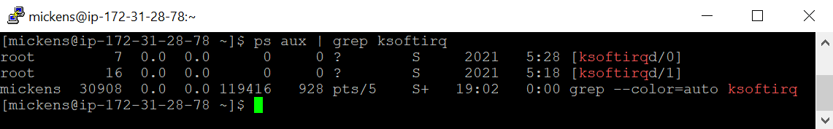
Linux’s Solution to Nested Interrupts
Virtual address space
Kernel static data
Top-half handlers
  Run with interrupts disabled
  Are fast (i.e., run small amounts of code)
  Can mark a kernel data structure to indicate that a softirq needs to run later
Bottom-half softirqs
  Run with interrupts enabled
  Do stuff that takes a medium amount of time, but does not require sleeping
  Pending softirqs are checked:
    When returning from a top-half handler
    By per-cpu ksoftirq kernel threads
Bottom-half work-queue kernel threads
  Run with interrupts enabled
  Can do computations that are slow-running or might sleep
Kernel code
K1 kernel stack
P1:Tx kernel stack
P1:Ty kernel stack
Physical memory map
P1:Tx user stack
P1:Ty user stack
Heap
Static data
Code
One user process with two kernel-visible
threads; kernel also has a kernel thread
Notes:
[Note that the softirq threads are different than the bottom-half work-queue threads. Both kinds of threads are pure kernel tasks that don’t have user-mode components. However, softirq threads are only intended to perform interrupt-handling work that does not require sleeping.]

Slide 12
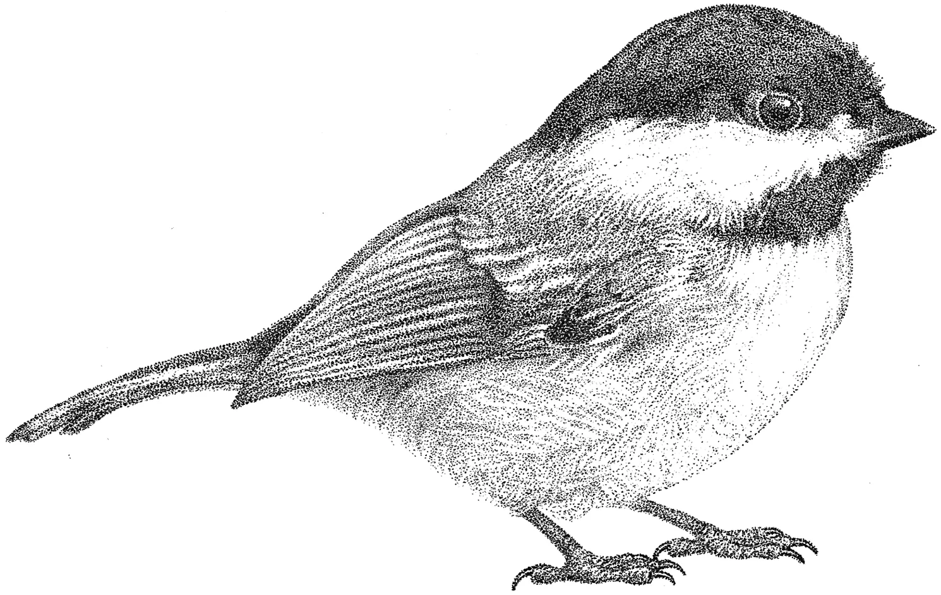
Chickadee’s proc::exception()
Timer interrupt: Suspend the currently-running process
Page fault: Mark the faulting process as broken, because stock Chickadee doesn’t swap pages between RAM and disk
regs_ = regs;
yield_noreturn();
break; //Won't be reached
pstate_ = proc::ps_faulted;
yield(); //Won’t run again because
//cpustate::schedule() will
//notice the sad pstate_
Notes:
[Note that x86 disables interrupts before transferring control to the kernel’s exception handler. As [1] says, “When accessing an exception- or interrupt-handling procedure through an interrupt gate, the processor clears the IF flag to prevent other interrupts from interfering with the current interrupt handler. A subsequent IRET instruction restores the IF flag to its value in the saved contents of the EFLAGS register on the stack.” [Note that the Intel documentation mentions that interrupts and exceptions can be handled via both “interrupt gates” and “trap gates.” Chickadee uses interrupt gates; you (i.e., a CS 161 students) don’t need to know the difference between an interrupt gate and a trap gate. However, one interesting difference is that, as [1] says, “When an interrupt is handled through an interrupt gate, the IF flag is automatically cleared, which disables maskable hardware interrupts. (If an interrupt is handled through a trap gate, the IF flag is not cleared.)”]
Ref: [1] Section 6.12.12 of Volume 3A of the Intel Software Developer Manual]

Slide 13
Chickadee’s proc::exception()
Keyboard interrupt: Read a character and then immediately return to the interrupted execution context
keyboardstate::get().handle_interrupt();
//Uses `inb` instruction to read
//a char from the keyboard
break; //Kernel goes to k-exception.S::
//restore_and_iret
Notes:
In a few lectures, when we talk about how OSes handle hardware devices, we’ll talk more about the inb instruction. For now, it suffices to say that the inb instruction allows a CPU to pull a byte of data from certain kinds of devices like keyboards.
Remember that k-exception.S::restore_and_iret pops a bunch of saved register content from the stack into actual registers, and then does an iret to return to the interrupted execution context.

Slide 14
Outline
Nested Interrupts and Exceptions
Locking: Synchronizing Kernel Code
Locking: Synchronizing User Code

Slide 15


Locking: Sacrificing Parallelism to Ensure Correctness
OSes were originally designed for single-processor machines
  Disabling interrupts was sufficient for the kernel to prevent race conditions on kernel state
//proc::exception() will invoke
//::yield_noreturn(), and the call
//chain eventually invokes
//cpustate::schedule(), which will
//try to examine the run queue.
runq_lock_.lock_noirq();
//Deadlock: will spin forever
//because the lock is already
//held by this core!
//Suppose that interrupts are enabled, and
//a kernel task wants to add a new process
//to the local run queue.
this_cpu()->runq_lock_.lock_noirq();
//Doesn’t disable interrupts!
//Timer interrupt occurs
//on the same core!
Time
Notes:
As we discussed in the last lecture, race conditions can occur even in a single-core machine if a spinlock is acquired without disabling interrupts!
[Ref: https://www.kernel.org/doc/htmldocs/kernel-locking/uniprocessor.html]

Slide 16
Locking: Sacrificing Parallelism to Ensure Correctness
OSes were originally designed for single-processor machines
  Disabling interrupts was sufficient for the kernel to prevent race conditions on kernel state
  If you compile Linux without enabling multicore support, then:
    A spinlock acquire just saves the old interrupt state and disables interrupts—there’s no spinning!
    A spinlock release just restores the old interrupt state
When Linux first added multicore support in 1996, Linux used a Big Kernel Lock that was acquired at the start of any context switch into the kernel
    Advantage: Simple, and still allowed user-level code to be parallel
    Disadvantage: Only one core could execute in the kernel at a time
Over many years, Linux (and other OSes) developed finer-grained locking strategies
Notes:
[Ref: https://stackoverflow.com/questions/3372541/spin-lock-on-non-preemtive-linux-kernels
http://halobates.de/lk09-scalability.pdf //Section 6 in particular
https://www.kernel.org/doc/htmldocs/kernel-locking/uniprocessor.html]

Slide 17

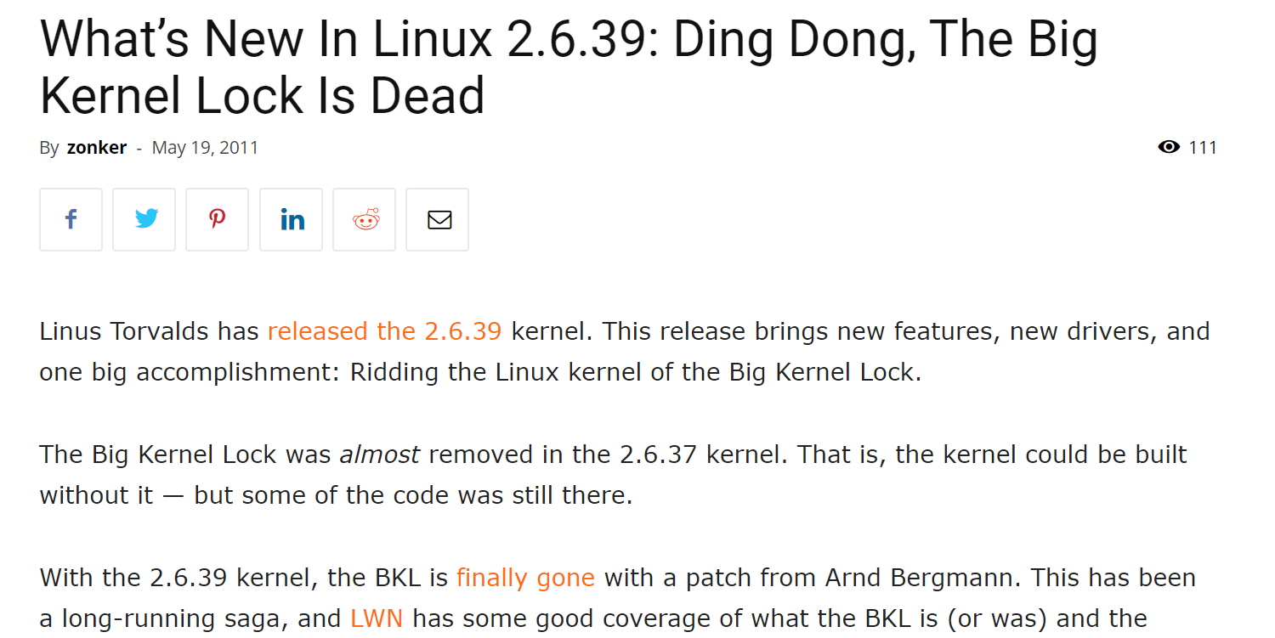

Slide 18
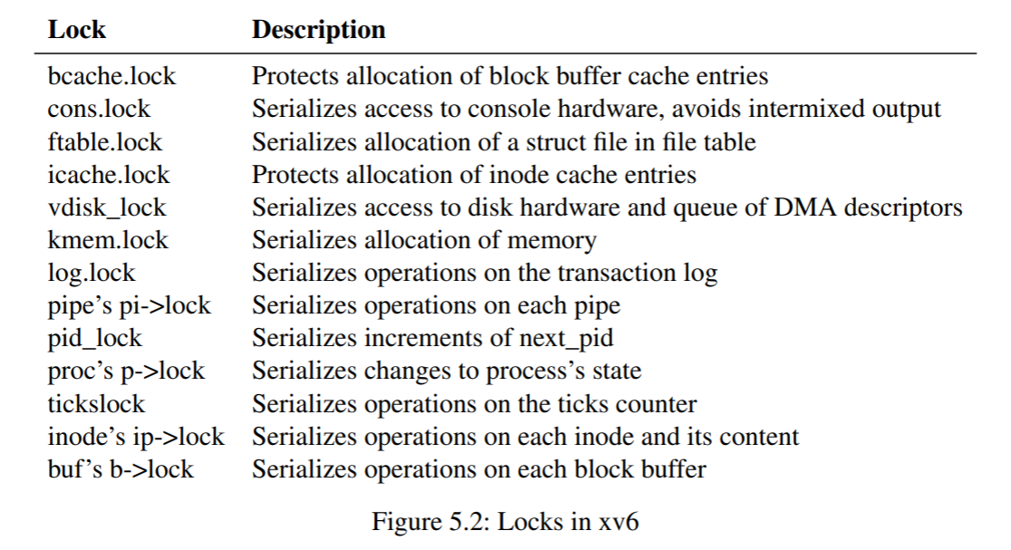
Case study: Locks in the xv6 Teaching OS
Notes:
[Ref: https://pdos.csail.mit.edu/6.828/2019/xv6/book-riscv-rev0.pdf]

Slide 19
Case study: Locks in the xv6 Teaching OS
Impact when two distinct CPUs execute fork()
  The parallel fork()s may serialize during pid allocation and memory allocation
  However, parallel fork()s can simultaneously configure page tables and copy data from parent pages to child pages

Slide 20

A (Partial) List of Chickadee Locks
ptable_lock: Protects the process table
page_lock: Protects memory allocation metadata
Per-CPU runq_lock_: Protects a CPU’s list of runnable processes
cursor_lock: Serializes console output

Slide 21
Designing a Locking Strategy
A lock is used to protect a collection of events that must be atomic
  Usually, a single function will acquire and release a lock
  However, if the event sequence to protect is complex, then locking and unlocking may occur in different functions
Atomicity reduces the difficulty of defining invariants
  Invariants are properties that must be true before and after an operation on a data structure
  Invariants may only be false in the middle of an atomic update that is protected by a lock!
Locks are typically needed when an invariant requires multiple memory locations (e.g., in a struct) to be read and written as a single atomic action—locking avoids exposing an in-flight (i.e., partial) update to a reader
Notes:
Locks are typically needed when an invariant requires atomic reading and writing of multiple memory locations. As a concrete example, consider why spinlocks disable interrupts. Even in the case of a single-core machine, kernel code can be updating a data structure, and then an interrupt can fire. If the interrupted kernel code was trying to perform an atomic operation, then it’s possible that the interrupt handler might touch the memory locations being updated by the ostensibly atomic operation! Thus, even on a single-core machine, locks are helpful for ensuring the atomicity of operations that affect multiple memory locations.
[Ref: https://pdos.csail.mit.edu/6.828/2019/xv6/book-riscv-rev0.pdf //Section 5.3]

Slide 22

Case Study: getppid()
The fork() system call allows a parent process to create a child process
The getppid() system call allows a child to get the pid of its parent
In Unix-derived systems, a special undying init process is the first process created
  init has getpid()==1 and getppid()==1
  When a parent dies, its children are reparented to init
  The reasons for init will become clearer in pset2!
2
3
4
5
6
Notes:
[Note that, in pset2, you’ll have to implement getppid()!]

Slide 23
A Possible getppid() Implementation
We could add a ppid_ field to struct proc
  Initialize it during fork()
  Set it to 1 if the parent exit()s before the child
Are we done?
  Initializing ppid_ is fast
    The parent process can directly access its own id_ and assign it to the child’s ppid_
    There are no race conditions between the parent and the child, because the child isn’t running yet!
  The getppid() system call is fast: just return the ppid_ value
  But what happens when the parent calls exit()? The parent has no pointers to its children!

Slide 24
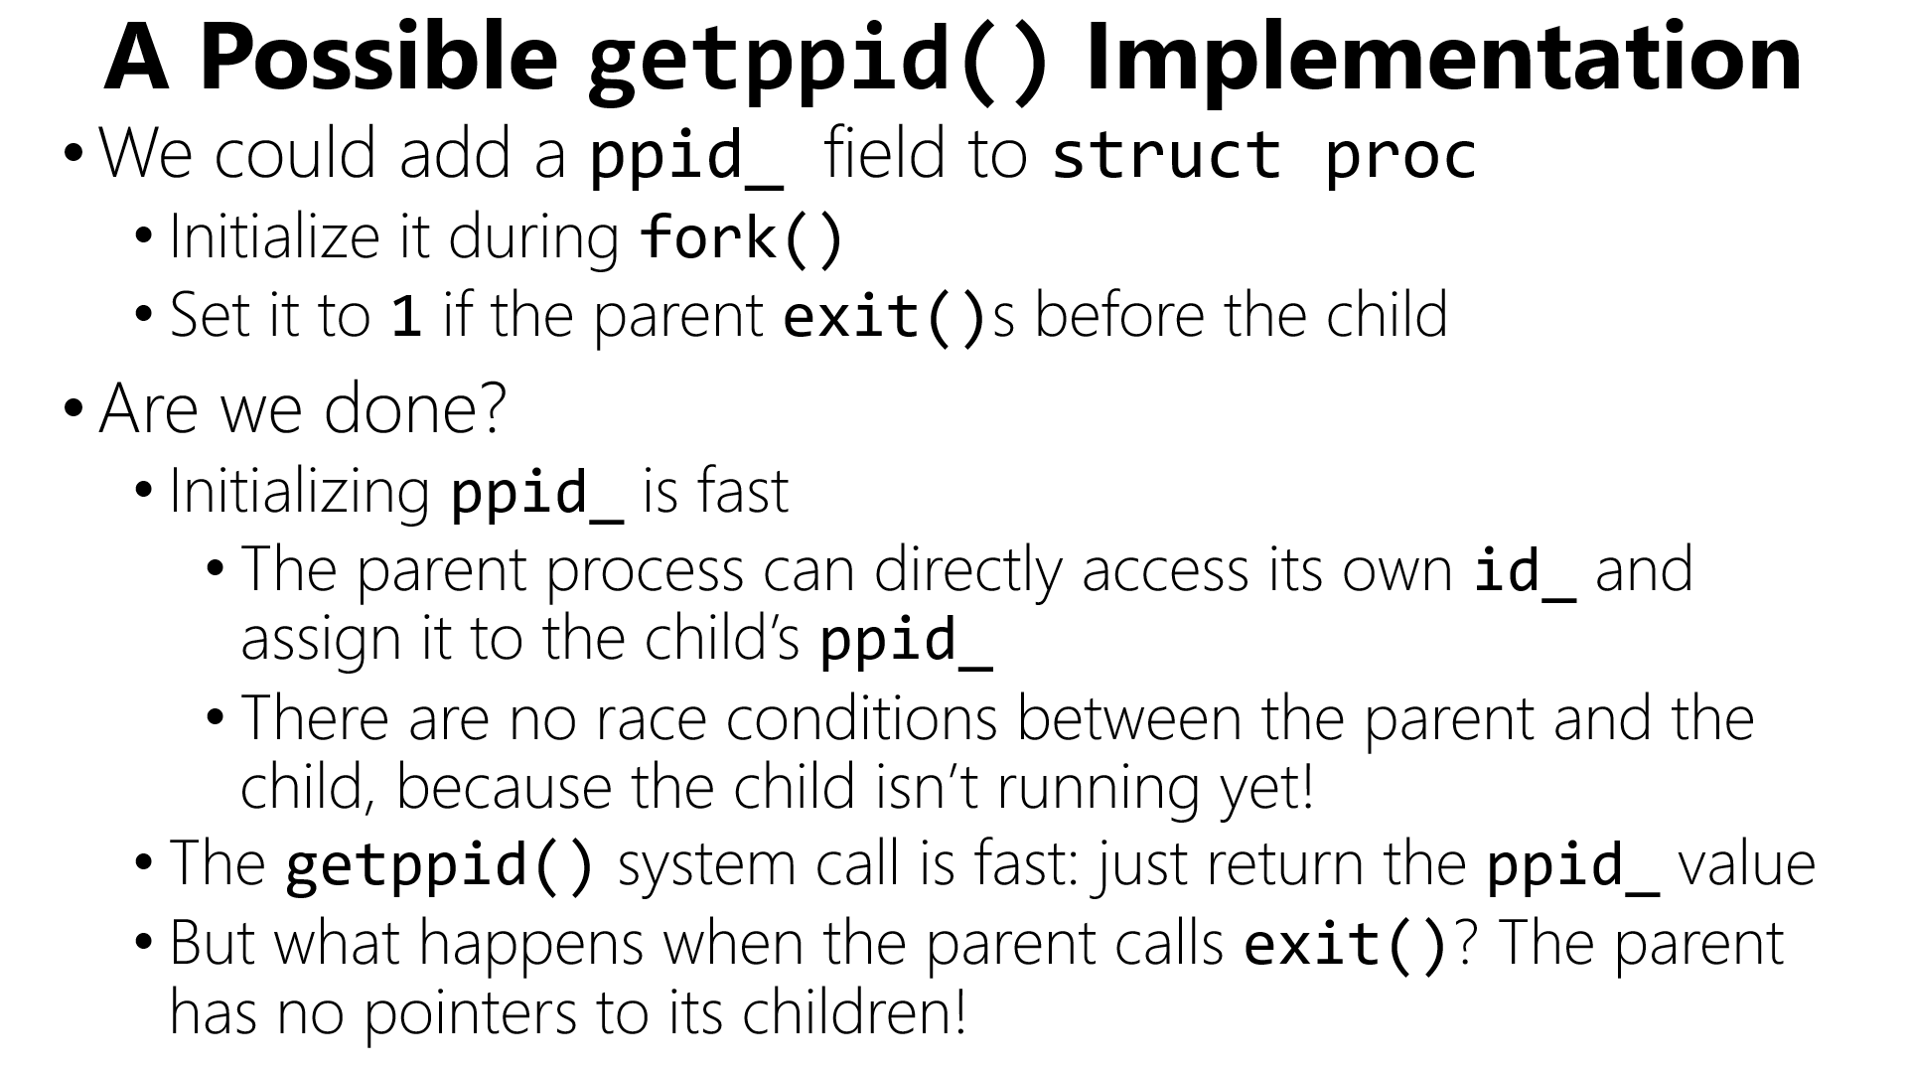


Slide 25


Problem 1: Scalability
//The exit() code must examine each child’s
//ppid_ field to determine who to reparent!
for(int i = 0; i != NPROC; ++i){
if (ptable[i] &&
(ptable[i]->ppid_ == current()->id_){
ptable[i]->ppid_ = 1;
}
}
The running
time for exit()
should be linear in the number of
children, not the total number of processes!
We need per-parent child lists!

Slide 26
Problem 2: Synchronization
How do we coordinate access to ppid_?
“If two threads simultaneously access a memory location, then both accesses must be reads, otherwise the program behavior is undefined.”
THE FUNDAMENTAL LAW OF SYNCHRONIZATION

Slide 27



Problem 2: Synchronization
How do we coordinate access to ppid_?
Core 1
Core 2
P
C
Calls exit()
//Must write
//the child’s
//ppid_!
Calls getppid()
//Must read
//the child’s
//ppid_!
Time

Slide 28
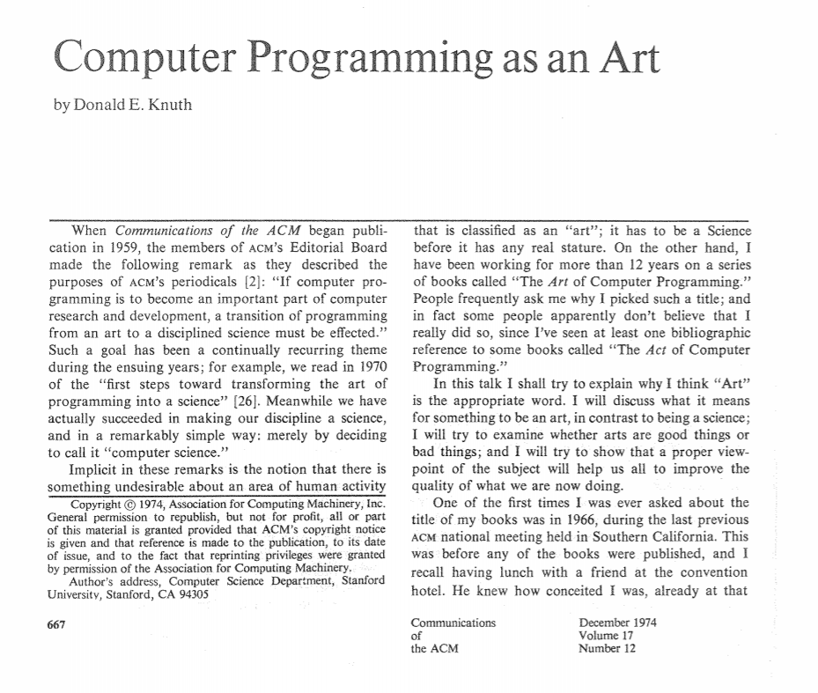
Problem 2: Synchronization
How do we coordinate access to ppid_?
“Premature optimization
is the root of all evil.”
//A possible solution: Use ptable_lock
//to protect ppid_.
uintptr_t proc::syscall(regstate* regs) {
switch (regs->reg_rax) {
case SYSCALL_GETPPID: {
spinlock_guard g(ptable_lock);
return ppid_;
}
case SYSCALL_EXIT: {
spinlock_guard g(ptable_lock);
//Find children and reparent
}
}
//Do we care that getppid() and exit()
//will contend with fork() to acquire
//ptable_lock?
Notes:
fork() has to acquire ptable_lock to find an empty ptable slot for the newly-created process!
[Ref: http://www.cs.bilkent.edu.tr/~canf/knuth1974.pdf]

Slide 29
A Different getppid() Implementation
We could protect ppid_ with a per-process ppid_lock_ instead of the global ptable_lock . . .
struct proc {
pid_t ppid_;
spinlock ppid_lock_;
//...other stuff...
}
Good: getppid() is faster (since contention on per-process lock should be lower than contention on the global ptable_lock), and we decrease the contention pressure on ptable_lock
//Reparenting code
auto irqs = ptable_lock.lock();
for (int i = 0; i != NPROC; ++i) {
if (ptable[i]) {
spinlock_guard guard(ptable[i]->ppid_lock_);
if (ptable[i]->ppid_ == current()->id_) {
ptable[i]->ppid_ = 1;
}
}
}
ptable_lock.unlock(irqs);
Bad (?): Reparenting in exit() must now grab multiple locks (a global one and up to NPROC local ones) . . . but isn’t exit() uncommon?
Notes:
Note that exit() still needs to grab ptable_lock (because the parent is examining ptable and we don’t want ptable changing as the parent iterates through it).

Slide 30

DON’T START HERE
Lesson 1: Start simple but correct

Slide 31

Before optimizing, actually measure why your program is slow!
  Too few CPUs?
  Waiting on slow IOs?
  Synchronization stalls?

Slide 32
Outline
Nested Interrupts and Exceptions
Locking: Synchronizing Kernel Code
Locking: Synchronizing User Code

Slide 33


Synchronizing User Code
So far, we’ve talked about how kernel code synchronizes with itself
  Ex: spinlock ptable_lock protects concurrent modifications to ptable
  Ex: spinlock page_lock protects concurrent modifications to memory allocation state
However, user-level code may want to synchronize itself!
  Ex: Two threads in a multithreaded process need a producer/consumer queue
  With user-level threads, there is no true concurrency
Producer
Consumer
Enqueue
Shared queue
Dequeue
  So, lock() just checks a user-level (i.e., low canonical) flag indicating whether the lock is held
    If not, set the flag to true and allow the user-level thread to keep executing
    If so, put the user-level thread on a queue
      Context switch to another (runnable) user-level thread
      When the lock is unlock()ed, dequeue a waiting user-level thread and context switch to it
bool isHeld_;
queue<uthread> waiting;

Slide 34
Synchronizing User Code
So far, we’ve talked about how kernel code synchronizes with itself
  Ex: spinlock ptable_lock protects concurrent modifications to ptable
  Ex: spinlock page_lock protects concurrent modifications to memory allocation state
However, user-level code may want to synchronize itself!
  Ex: Two threads in a multithreaded process need a producer/consumer queue
  What about kernel-visible threads?
Producer
Consumer
Enqueue
Shared queue
Dequeue
Low canonical memory
  Solution 1: lock() atomically spins on a spinlock value that lives in low-canonical memory
P1:Tx user stack
P1:Ty user stack
while (lock.test_and_set()) {
//While someone else has
//the lock . . .
}
while (lock.test_and_set()) {
//While someone else has
//the lock . . .
}
Heap
Static data
CPU0
CPU1
Code

Slide 35
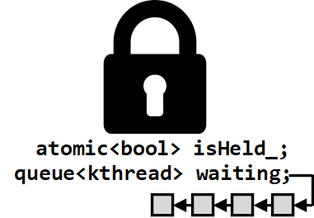
Synchronizing User Code
So far, we’ve talked about how kernel code synchronizes with itself
  Ex: spinlock ptable_lock protects concurrent modifications to ptable
  Ex: spinlock page_lock protects concurrent modifications to memory allocation state
However, user-level code may want to synchronize itself!
  Ex: Two threads in a multithreaded process need a producer/consumer queue
  What about kernel-visible threads?
Producer
Consumer
Enqueue
Shared queue
Dequeue
High canonical memory
  Solution 1: lock() atomically spins on a spinlock value that lives in low-canonical memory
  Solution 2: lock() and unlock() are system calls
    sys_lock() atomically test-and-sets a high-canonical value; may put calling thread on a kernel-level lock queue
    sys_unlock() atomically releases the lock; may transfer a thread from the lock queue to a CPU run queue
  There are other solutions (e.g., futexes)
Kernel static data
Kernel code
P1:Tx kernel stack
P1:Ty kernel stack
kalloc()’d region
Notes:
By `sys_lock()` and `sys_unlock()`, I mean the kernel-level code which implements the system calls.
Note that `sys_lock()` might be internally implemented as a spin-lock (i.e., a busy-wait in which the kernel thread repeatedly tries to acquire the lock). Alternatively, `sys_lock` might only try to spin-acquire the lock N times, and if unsuccessful after N attempts, `sys_lock` would put the kernel thread on a queue associated with the lock; the kernel thread would only be released once the necessary number of `sys_unlock()`s occur to move the thread to the front of the queue and then pop the thread off the queue.

