Slide 1
Wait queues
CS 1610: Lecture 7
2/24/2025

Slide 2
Implementing sleep(ms) Inefficiently
//kernel.hh
#define HZ 100 // # of ticks per second
//kernel.cc
std::atomic<unsigned long> ticks; // # of timer interrupts
// so far on CPU 0; it’s
// incremented when the
// timer interrupt fires
Will overflow if machine runs for a long time!

Slide 3
Implementing sleep(ms) Inefficiently
//kernel.cc
switch(regs->reg_rax) {
case SYSCALL_MSLEEP: {
unsigned long wakeup_time = ticks +
(regs->reg_rdi + 9) / (1000/HZ);
while (long(wakeup_time - ticks) > 0) {
this->yield();
}
return 0;
}
//...Other syscalls...
User-mode part of process goes to sleep, but . . .
. . . kernel-half stays runnable, repeatedly testing the exit condition and then yielding! Polling is gross.
Like wakeup_ticks > ticks, but works even if ticks or wakeup_ticks overflows!
Notes:
The +9 part ensures that we sleep for at least one timer interrupt period if a positive ms argument is used. For example, if the caller specifies a sleep duration of 1 ms, then the kernel will sleep for (1+9)/10=1 timer interrupt period; since HZ = 100, one timer interrupt period is 10 ms. If the caller specifies a sleep duration of 9 ms, then the kernel will sleep for (9+9)/10 = 1 timer interrupt period; remember that in C, integer division uses truncation towards 0. [Ref: https://stackoverflow.com/a/3602857]
The long() trick works as long as (1) the computer uses two’s complement to represent numbers, (2) the subtraction of two unsigned longs wraps around, and (3) the difference between the two is in the range of an unsigned long. Note that hardware ensures (1), and the C++ standard guarantees (2).
For example:
a = 0101 b = 0110
0101
1001
+ 1
-----
1111 = 15 unsigned = -1 signed
Remember that in two’s complement, a leading bit of 1 means the number is negative, and a leading bit of 0 means that the number is positive. For a negative number, the magnitude is determined by flipping all of the bits and then adding 1. This is why 1111 in binary is -1 signed decimal.
[Ref: https://stackoverflow.com/questions/2061245/how-to-subtract-two-unsigned-ints-with-wrap-around-or-overflow
https://en.wikipedia.org/wiki/Signed_number_representations#History
https://www.cs.cornell.edu/~tomf/notes/cps104/twoscomp.html]

Slide 4
The Challenges of Blocking
Kernel tasks often need to block until an event occurs
Ex: A certain amount of time has elapsed (as in sleep(ms))
Ex: Keyboard data arrives
Ex: A (non-spinlock) lock is released
How can the kernel create an efficient mechanism to handle arbitrary types of blocking events?
Notes:
[Note that a spinlock doesn’t have a queue because acquiring a spin lock “blocks” by just repeatedly testing the lock condition!]

Slide 5
Wait Queues to the Rescue!
Have a queue for each type of blocking event
Threads that wait for the same event will sleep on the same queue
When the event is noticed by a running thread, that thread will wake the sleepers in the relevant queue
Correctly implementing
a wait queue is tricky!
True blocking is
now possible!
Notes:
Note that I’m being a bit sloppy with terminology here. By “thread” here, I mean “a kernel-level execution context.” However, “thread” is easier to say than “kernel-level execution context” :-D. In general, when we say “thread” in this class, we mean “kernel-level execution context” unless otherwise stated.

Slide 6
Formalizing the Blocking Problem
Let x be a subset of program state
A sleeping thread blocks until f(x) is true
A running thread modifies x in a way that makes f(x) true
Sounds trivial, right?
COMPLETELY AND UTTERLY FALSE
YOU MORTAL FOOLS

Slide 7
Computes f(x) == false
Decides to sleep (but hasn’t slept yet!)
Modifies x so that f(x) is true
Looks for sleeping threads, finds none to wake up
Does other stuff
Goes to sleep, blocks forever, infinite suffering occurs
Maybe locks can help us avoid bad interleavings?

Slide 8
Sleep/wakeup: Attempt #2
x_lock.lock()
Computes f(x) == false
Decides to sleep and goes to sleep
Tries to x_lock.lock() and blocks
Sleeps forever (holding x_lock), society degenerates into chaos

Slide 9
Sleep/wakeup: Attempt #3
x_lock.lock()
Computes f(x) == false
Decides to sleep (but hasn’t slept yet!)
x_lock.unlock()
x_lock.lock()
Does stuff so f(x) is true
Finds no sleeping threads to wake
x_lock.unlock()
Goes to sleep, blocks forever, all teddy bears are destroyed
Problem: Lost wakeups
Cause: Releasing the lock and blocking aren’t atomic from the perspective of the wakeup thread!

Slide 10
Sleep/wakeup: Solution #1
x_lock.lock()
Computes f(x) == false
Decides to block (but isn’t sleeping yet!)
cond_wait(&x_cond, &x_lock)
x_lock.lock()
Does stuff so f(x) is true
cond_signal(&x_cond) wakes up sleeping thread
x_lock.unlock()
Atomically releases lock
and blocks thread; when it
returns, lock held by caller
What if the wakeup thread runs first?

Slide 11
Sleep/wakeup: Solution #1
x_lock.lock()
Computes f(x) == false
Decides to block (but isn’t sleeping yet!)
cond_wait(&x_cond, &x_lock)
with no threads to wake
x_lock.lock()
Does stuff so f(x) is true
cond_signal(&x_cond) wakes up sleeping thread
x_lock.unlock()
Computes f(x) == true
Does stuff involving x
x_lock.unlock()
Locking and cond_* semantics eliminate bad interleavings!
Notes:
Note that `x_lock` serializes the critical sections of the sleeper thread and the wakeup thread, preventing those two critical sections from executing simultaneously!

Slide 12
Case study: OS/161
Notes:
OS/161 is the teaching OS that this class used before switching to Chickadee! You can find more about OS/161 here: http://www.os161.org/.

Slide 13
Case Study: OS/161
/* Wait channel. A wchan is protected by
* an associated spinlock. */
struct wchan{
char *wc_name; //Name for this channel
struct threadlistwc_threads; //Queue of waiting
//threads for this
//channel
};

Slide 14
Case Study: OS/161
/**
* Yield the cpu to another process, and go to sleep on the
* specified wait channel whose associated spinlock is lk.
* The spinlock must be locked.
*/
void wchan_sleep(struct wchan *wc,
struct spinlock *lk){
thread_switch(S_SLEEP, wc, lk); //Similar to Chickadee’s
//proc::yield(), but also
//adds the current thread
//to wc->wc_threads and
//then releases the lock.
spinlock_acquire(lk);
}
Notes:
Note that, at the end of wchan_sleep(), the spinlock_acquire() may block if the waker hasn’t released the lock yet!
[See wchan_wakeone() in two slides—after the waker calls wchan_wakeone(), the waker needs to release the spinlock.]

Slide 15
Case Study: OS/161
/**
* Puts the current thread on the appropriate queue;
* another thread to run is selected and switched
* to. If NEWSTATE is S_SLEEP, the thread is queued
* on the wait channel wc, protected by the spinlock
* lk. Otherwise wc and lk should be NULL.
*/
void thread_switch(threadstate_t newstate,
struct wchan *wc,
struct spinlock *lk){
/* Lock the run queue. */
spinlock_acquire(&curcpu->c_runqueue_lock);
switch (newstate) {
case S_READY:
/* Enqueue the thread on the runqueue! */
thread_make_runnable(cur);
break;
case S_SLEEP:
/* Add the thread to the list in the wait
* channel, and unlock it. If the wakeup
* thread was spinning on the lock, the
* wakeup thread can grab the lock now. */
threadlist_addtail(&wc->wc_threads, cur);
spinlock_release(lk);
break;
/* ...Other code...
* Scheduler eventually dequeues a thread
* from the runqueue and runs it.
*/
From the perspective of an external wakeup thread, the current thread has atomically released the lock and blocked!
Notes:
The S_SLEEP case is subtle—it does the atomic releasing of the lock and putting the holder to sleep. The code may not look like its atomic, since the two lines of code are executing a bunch of instructions. However, the two lines of code are atomic from the perspective of an outside party who wants to acquire the wait channel lock. There’s no way for a lost wakeup to occur, because the wakeup thread cannot grab the lock and send the wakeup without the sleeper already being asleep and moving to the wait queue.

Slide 16
Case Study: OS/161
/**
* Wake up one thread sleeping on a wait channel.
* The associated spinlock should be locked.
*/
void wchan_wakeone(struct wchan *wc, struct spinlock *lk) {
struct thread *target = threadlist_remhead(&wc->wc_threads);
if (target == NULL) {
/* Nobody was sleeping. */
return;
}
/* Add the thread to a runqueue. */
thread_make_runnable(target);
}
/**
* Yield the cpu to another process, and go to
* sleep, on the specified wait channel whose
* associated spinlock is lk. The spinlock must
* be locked.
*/
void wchan_sleep(struct wchan *wc,
struct spinlock *lk){
thread_switch(S_SLEEP, wc, lk);
spinlock_acquire(lk);
}
Sleeping thread wakes up and runs the code after thread_switch() . . .
Notes:
[The function wchan_wakeall() looks like this:
void wchan_wakeall(struct wchan *wc, struct spinlock *lk)
{
struct thread *target;
struct threadlist list;
KASSERT(spinlock_do_i_hold(lk));
threadlist_init(&list);
/*
* Grab all the threads from the channel, moving them to a
* private list.
*/
while ((target = threadlist_remhead(&wc->wc_threads)) != NULL) {
threadlist_addtail(&list, target);
}
while ((target = threadlist_remhead(&list)) != NULL) {
thread_make_runnable(target, false);
}
threadlist_cleanup(&list);
}
]

Slide 17
Condition variables in OS/161
//The sleeper thread
x_lock->lock()
while (f(x) != true) {
wchan_sleep(wc, x_lock);
//Atomically block and
//release the lock via
//thread_switch(S_SLEEP,
//wc, x_lock); upon
//return, grab x_lock.
}
do_stuff(x);
x_lock->unlock();
//The waker thread
x_lock->lock()
make_fx_true(x);
wchan_wakeone(wc, x_lock);
x_lock->unlock();
Notes:
[Remember that wchan_wakeone() looks like this . . .
/**
* Wake up one thread sleeping on a wait channel.
* The associated spinlock should be locked.
*/
void wchan_wakeone(struct wchan *wc, struct spinlock *lk) {
struct thread *target = threadlist_remhead(&wc->wc_threads);
if (target == NULL) {
/* Nobody was sleeping. */
return;
}
/* Add the thread to a runqueue. */
thread_make_runnable(target);
}
. . . And that wchan_sleep() looks like this:
void wchan_sleep(struct wchan *wc,
struct spinlock *lk){
thread_switch(S_SLEEP, wc, lk);
spinlock_acquire(lk);
}
]

Slide 18
What Do Other OSes Do?
FreeBSD and xv6 implement blocking in a similar way to OS/161
Scheduler must be aware of wait queue abstractions
Linux and Chickadee employ a different wait queue design
Goal: Loosen the binding between the scheduler and the condition/wait abstraction
Idea: Maintain wait queues outside of the scheduler

Slide 19
Chickadee-style wait queues are more complicated than OS/161’s approach!

Slide 20
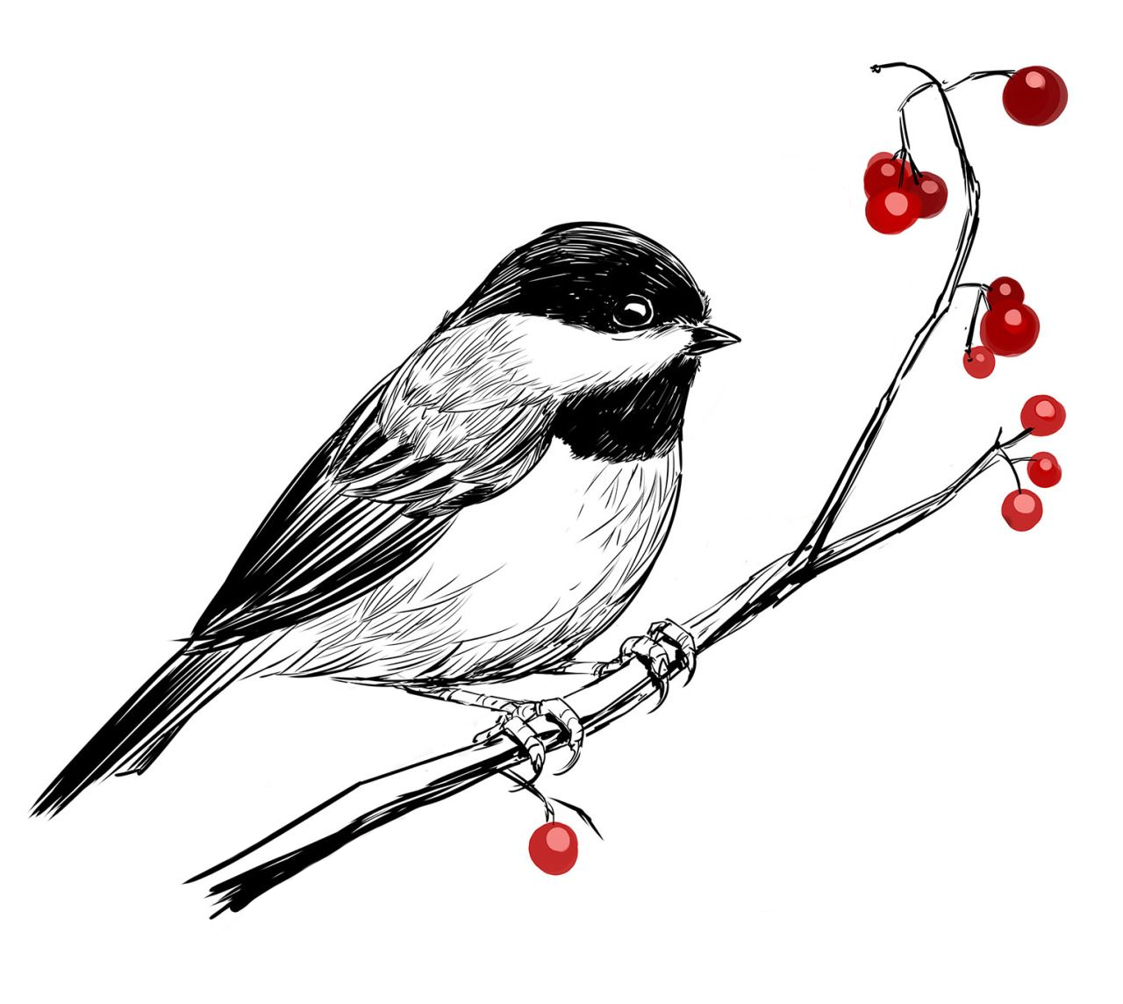
Chickadee Wait Queues
//The wakeup thread
void wt_func() {
spinlock_guard guard(x_lock);
//Code that makes f(x) true,
//and then . . .
wq.notify_all(); //Wake up
//blocked processes by
//calling p->unblock()
//on each one
}
//Simplified proc::unblock().
void proc::unblock() {
pstate_ = ps_runnable;
cpus[runq_cpu_].reenqueue(this);
//Only enqueues if the proc has
//!runq_links_.is_linked()
}
//The sleeper thread
waiter w;
auto irqs = x_lock.lock();
while (true) {
w.prepare(waitq);
if (f(x)) {
break;
}
x_lock.unlock(irqs);
w.maybe_block();
irqs = x_lock.lock();
}
w.clear();
//Compute using x
x_lock.unlock(irqs);
Grab the lock that protects x, because we’re about to check whether f(x) is true.
Notes:
cpustate::reenqueue() doesn’t add a proc to a runqueue if the proc is already in a runqueue; in other words, for the proc, runq_links_.is_linked() must return false.
[Ref: https://read.seas.harvard.edu/cs1610/2025/doc/wait-queues/]

Slide 21
Chickadee Wait Queues
Add the current process to the wait queue, and set
current()->pstate_ to proc::ps_blocked, but don’t actually block yet! Then, see if we need to block. If not (because f(x) is true), break out of the loop with x_lock still held.
//The sleeper thread
waiter w;
auto irqs = x_lock.lock();
while (true) {
w.prepare(waitq);
if (f(x)) {
break;
}
x_lock.unlock(irqs);
w.maybe_block();
irqs = x_lock.lock();
}
w.clear();
//Compute using x
x_lock.unlock(irqs);
Notes:
Note that, after calling `w.prepare(waitq)`, the process’s `pstate_` is `ps_blocked` even though the associated kernel task is running. That’s OK according to the Chickadee synchronization invariants: see https://read.seas.harvard.edu/cs1610/2025/doc/synchronization-invariants/.]
[In the highlighted code on the left, we see the fact that the wait queue is maintained outside of the scheduling code---it’s maintained by the sleeping thread and the wake-up thread.]

Slide 22
Chickadee Wait Queues
//The sleeper thread
waiter w;
auto irqs = x_lock.lock();
while (true) {
w.prepare(waitq);
if (f(x)) {
break;
}
x_lock.unlock(irqs);
w.maybe_block();
irqs = x_lock.lock();
}
w.clear();
//Compute using x
x_lock.unlock(irqs);
Remove the current process from the wait queue. If the process’s pstate_ == proc::ps_blocked, set the pstate_ to proc::ps_runnable.
Then, compute using x and finally, release the lock.
Notes:
[Recall that `p_` is an instance variable of the waiter, and corresponds to the `struct proc` associated with the waiter.]

Slide 23
Now imagine that we didn’t break out of the loop . . .

Slide 24
Chickadee Wait Queues
f(x) was false, so we must block. Recall that w.prepare(waitq) set
pstate_ == proc::ps_blocked. Release the lock (so that someone else can make f(x) true!) and call w.maybe_block(). When we wake up, acquire the lock again and see if f(x) is now true.
//The sleeper thread
waiter w;
auto irqs = x_lock.lock();
while (true) {
w.prepare(waitq);
if (f(x)) {
break;
}
x_lock.unlock(irqs);
w.maybe_block();
irqs = x_lock.lock();
}
w.clear();
//Compute using x
x_lock.unlock(irqs);
Notes:
Recall that w.prepare(waitq) set pstate_ == proc::ps_blocked!
[Similar to the OS/161 solution, when the sleeper releases the lock, the sleeper is already on the appropriate wait queue. Unlike the OS/161 solution, the sleeper hasn’t actually started to sleep when the lock is released.]

Slide 25
Chickadee Wait Queues
//The sleeper thread
waiter w;
auto irqs = x_lock.lock();
while (true) {
w.prepare(waitq);
if (f(x)) {
break;
}
x_lock.unlock(irqs);
w.maybe_block();
irqs = x_lock.lock();
}
w.clear();
//Compute using x
x_lock.unlock(irqs);
void waiter::maybe_block() {
//When this function is called, the caller
//doesn’t hold x_lock! So, between the caller
//releasing x_lock and the caller invoking
//maybe_block(), a waker thread may have
//grabbed x_lock, noticed that f(x) is true,
//and woken up the process p_ by calling
//p->unblock(). So, p_->pstate_ might or might
//not equal ps_blocked.
//When the function returns, p_->pstate_
//MUST NOT equal ps_blocked, and `links_`
//MUST NOT be linked.
if (p_->pstate_ == proc::ps_blocked) {
p_->yield(); //As p_ yields, a waker on
//another CPU may call p_->unblock(),
//setting p_->pstate_ to ps_runnable
//and trying to lock the CPU runqueue
//at the same time that this CPU is
//in cpustate::schedule() and trying
//to grab the runqueue lock. One core
//will win, adding p_ to the runqueue
//and unlocking; the other core will
//grab the runqueue lock, notice that
//p_->runq_links.is_linked(), and not
//re-add p_ to the runqueue.
}
spinlock_guard guard(wq_->lock_);
if (links_.is_linked()) {
wq_->q_.erase(this);
}
}
//Simplified proc::unblock().
void proc::unblock() {
pstate_ = ps_runnable;
cpus[runq_cpu_].reenqueue(this);
//Only enqueue if the proc has
//!runq_links_.is_linked()
}
Notes:
Recall that proc::yields() will store a yieldstate (basically, just a pointer to the callee-saved registers that proc::yields() must store) and then call cpustate::schedule().
Note that p->unblock() sets the pstate_ to ps_runnable and then calls cpustate::reenqueue(p); however, the latter function will not actually add p to the runqueue if p->runq_links.is_linked().

Slide 26
What Do Other OSes Do?
FreeBSD and xv6 implement blocking in a similar way to OS/161
Scheduler must be aware of wait queue abstractions
Linux and Chickadee employ a different wait queue design
Goal: Loosen the binding between the scheduler and the condition/wait abstraction
Idea: Maintain wait queues outside of the scheduler

Slide 27
Notes:
Remember that thread_switch() is similar to Chickadee’s cpustate::schedule(). In OS161’s thread switch, the wait queue and the associated spinlock have to be exposed to the scheduler.

Slide 28
Chickadee’s cpustate::schedule()
No wait-queue abstractions must be exposed to the scheduler!
//Run a process, or the current CPU’s
//idle task if no runnable process
//exists. Prefers to run a process
//that is not the most recent process.
void cpustate::schedule() {

