Slide 1

Processor Design
CS 1610: Lecture 1
1/26/2026
Notes:
HELPFUL READINGS FOR LECTURE 1
"Guide to x86-64" from Stanford's CS 107 class (https://web.stanford.edu/class/cs107/guide/x86-64.html)
"Notes on x86-64 programming" by Jean-Christophe Filliâtre (https://usr.lmf.cnrs.fr/~jcf/ens/compil/x86-64.pdf)
"Stack frame layout on x86-64" by Eli Bendersky (https://eli.thegreenplace.net/2011/09/06/stack-frame-layout-on-x86-64)
"Classic RISC Pipeline" at the Wikipedia (https://en.wikipedia.org/w/index.php?title=Classic_RISC_pipeline&oldid=1325823718)

Slide 2




Processors: From the View of a Mediocre Programmer
Instructions for currently executing programs live in RAM
IP (“instruction pointer”) register points to memory address of next instruction to fetch and execute
Arithmetic logic unit (ALU)
  The inputs are values in registers or RAM
  ALU performs operation on inputs (e.g., add, xor)
  ALU writes result to an output register or a memory address
Some instructions cause devices to perform actions
Registers
Registers versus RAM
  Registers are orders of magnitude faster for ALU to access (~0.3ns versus ~120ns)
  However, RAM is orders of magnitude larger (a few dozen registers versus GBs of RAM)
Register size defines the “-bit” part of a CPU
  Ex: A 64-bit CPU has 64-bit-large registers
  Register size affects:
    Size of ALU inputs and outputs
    How many bytes of memory can be addressed!
?
RAM
IP
ALU
Instruction to execute
Devices
Notes:
[A nanosecond is one-billionth of a second, i.e., 10^-9 seconds!]

Slide 3
Instruction Set Architectures (ISAs)
A processor’s ISA defines the instructions and registers which the processor exposes to software
  A compiler translates high-level source code (e.g., C++, Go) to the instructions for a target processor’s ISA
  The processor directly executes ISA instructions
Example ISAs
  ARMv9: 64-bit ISA used by iPhone 17
  x86-64: 64-bit ISA popular on desktop, laptops, and servers; known to cause sadness among programmers and hardware developers

Slide 4
ISAs: The Three Basic Instruction Types
Arithmetic/bitwise logic
  Ex: Multiply two register values and store the result in a third register
  Ex: Left-shift a register value by 2 bits
Data movement between registers and/or memory
  Ex: Store a register value into memory
  Ex: Load a memory value into a register
Control flow
  Ex: Unconditionally jump to a particular instruction
  Ex: Jump to an instruction if a register has a value of 0
  Ex: Call a function

Slide 5

RISC vs CISC: ISA Wars
CISC (Complex Instruction Set Computer)
  A single instruction might do many things
  Instructions are variable-size to minimize RAM usage
  CISC instructions make life easier for compiler writers, but much more difficult for hardware designers—complex instructions are hard to implement and make fast
x86 is the classic CISC ISA
//Copy %rax register’s val to %rbx
mov %rax, %rbx
//Copy *(%rsp+16) to %rbx
mov 16(%rsp), %rbx
//Copy %rbx register val to *(%rsp+8)
mov %rbx, 8(%rsp)
mov instruction: Operands can both be registers, or one register/one memory location

Slide 6

//movsb: Copy 1 byte from one
// pointer to another
//%rdi: Destination pointer
//%rsi: Source pointer
if(cpu_direction_flag == 0){
*(%rdi++) = *(rsi++);
}else{
*(%rdi--) = *(%rsi--);
}
A single hardware instruction has to do:
  a condition test
  a memory read
  a memory write
  two register increments or decrements
That’s a lot!
Notes:
Note that in movsb, the source and destination pointers are hardcoded into the instruction itself.
[For a nice discussion of why the x86 ISA is considered somewhat distasteful by modern audiences, see http://stackoverflow.com/a/2679922.]

Slide 7

RISC vs CISC: ISA Wars
RISC (Reduced Instruction Set Computer)
  Each instruction does a simple thing
  Instructions are fixed-sized (or at least easy to decode)
  Load/store architecture: all instructions but loads and stores manipulate registers
  RISC ISAs make it easier to design fast, power-efficient hardware
Ex: MIPS, ARM
//On MIPS, operands for mov instr
//can only be registers!
mov a0, a1 //Copy a0 register value
//to a1
//In fact, mov is a pseudoinstruction
//that isn’t in the ISA! Compiler
//translates the above to:
addi 0, a0, a1 //a1 = a0 + 0
RAM is cheap, power efficiency is important, and RISC makes it easier to design fast CPUs—so who cares if compilers must work a little harder to compile code?
Notes:
[Note that modern x86 processors internally translate the CISC instructions to a RISC-like form that only the processor sees; the RISC instructions are what the processor actually executes. These RISC-like instructions are called “microinstructions” or “micro-ops”.]
[Refs: https://cseweb.ucsd.edu/classes/fa12/cse141/project/pseudo.html
http://sunnyeves.blogspot.co.uk/2009/07/intel-x86-processors-cisc-or-risc-or.html]

Slide 8



Notes:
[Ref: https://www.vox.com/2016/4/20/11463818/intel-iphone-mobile-revolution
https://www.extremetech.com/computing/227816-how-intel-lost-the-mobile-market-part-2-the-rise-and-neglect-of-atom]

Slide 9
x86-64: Registers
16 general-purpose integer registers
  %rbp: break pointer
  %rsp: stack pointer
  %rax, %rbx, %rcx, %rdx, %rsi, %rdi, %r8, %r9, %r10, %r11, %r12, %r13, %r14, %r15: used for various purposes
%rip: instruction pointer (i.e., holds the address of the next instruction to execute)
  Incremented or decremented by more than one instruction during jumps, function calls/returns
Various special-purpose registers like:
  %cr3: the page table pointer
  %xmm0—%xmm15: floating point registers
Notes:
[Aside: As described in [2], “The red zone: First I'll quote the formal definition from the AMD64 ABI:
`The 128-byte area beyond the location pointed to by %rsp is considered to be reserved and shall not be modified by signal or interrupt handlers. Therefore, functions may use this area for temporary data that is not needed across function calls. In particular, leaf functions may use this area for their entire stack frame, rather than adjusting the stack pointer in the prologue and epilogue. This area is known as the red zone.’
Put simply, the red zone is an optimization. Code can assume that the 128 bytes below rsp will not be asynchronously clobbered by signals or interrupt handlers, and thus can use it for scratch data, without explicitly moving the stack pointer. The last sentence is where the optimization lays - decrementing rsp and restoring it are two instructions that can be saved when using the red zone for data.
However, keep in mind that the red zone will be clobbered by function calls, so it's usually most useful in leaf functions (functions that call no other functions).”
Also see this text from [2]: “Preserving the base pointer: The base pointer rbp (and its predecessor ebp on x86), being a stable "anchor" to the beginning of the stack frame throughout the execution of a function, is very convenient for manual assembly coding and for debugging [5]. However, some time ago it was noticed that compiler-generated code doesn't really need it (the compiler can easily keep track of offsets from rsp), and the DWARF debugging format provides means (CFI) to access stack frames without the base pointer.
This is why some compilers started omitting the base pointer for aggressive optimizations, thus shortening the function prologue and epilogue, and providing an additional register for general-purpose use (which, recall, is quite useful on x86 with its limited set of GPRs).
gcc keeps the base pointer by default on x86, but allows the optimization with the -fomit-frame-pointer compilation flag. How recommended it is to use this flag is a debated issue - you may do some googling if this interests you.
Anywho, one other "novelty" the AMD64 ABI introduced is making the base pointer explicitly optional, stating:
`The conventional use of %rbp as a frame pointer for the stack frame may be avoided by using %rsp (the stack pointer) to index into the stack frame. This technique saves two instructions in the prologue and epilogue and makes one additional general-purpose register (%rbp) available.’
gcc adheres to this recommendation and by default omits the frame pointer on x64 when compiling with optimizations. It gives an option to preserve it by providing the -fno-omit-frame-pointer flag. For clarity's sake, the stack frames showed above were produced without omitting the frame pointer.”]
[References: [1] https://usr.lmf.cnrs.fr/~jcf/ens/compil/x86-64.pdf
[2] https://eli.thegreenplace.net/2011/09/06/stack-frame-layout-on-x86-64]

Slide 10
x86-64: System V Calling Convention
Simplest case: callee arguments+retval are integers or pointers
  Caller stores first six arguments in %rdi, %rsi, %rdx, %rcx, %r8, and %r9
  Remaining arguments are passed via the stack
  Callee places return value in %rax
int64_t foo(int64_t a, int64_t b,
int64_t c, int64_t d,
int64_t e, int64_t f,
int64_t g, int64_t h){
int64_t local0 = a*b*c;
int64_t local1 = d*e*f;
return local0 - local1;
}
Caller info
h
g
return addr
saved %rbp
%rbp
local0
local1
%rsp
a
b
c
d
e
f
%rdi
%rsi
%rdx
%rcx
%r8
%r9
Notes:
System V was one of the first commercial versions of the Unix operating system. The design of Unix was extremely influential on subsequent operating systems like Linux. [Reference: https://en.wikipedia.org/wiki/UNIX_System_V]
[Note that, if a stack-passed integer argument is smaller than 64 bits, the argument is rounded up to 64-bits in size before being placed on the stack.]
[Reference: Section 3.2.3 of “System V Application Binary Interface: AMD64 Architecture Processor Supplement”:
https://raw.githubusercontent.com/wiki/hjl-tools/x86-psABI/x86-64-psABI-1.0.pdf]

Slide 11
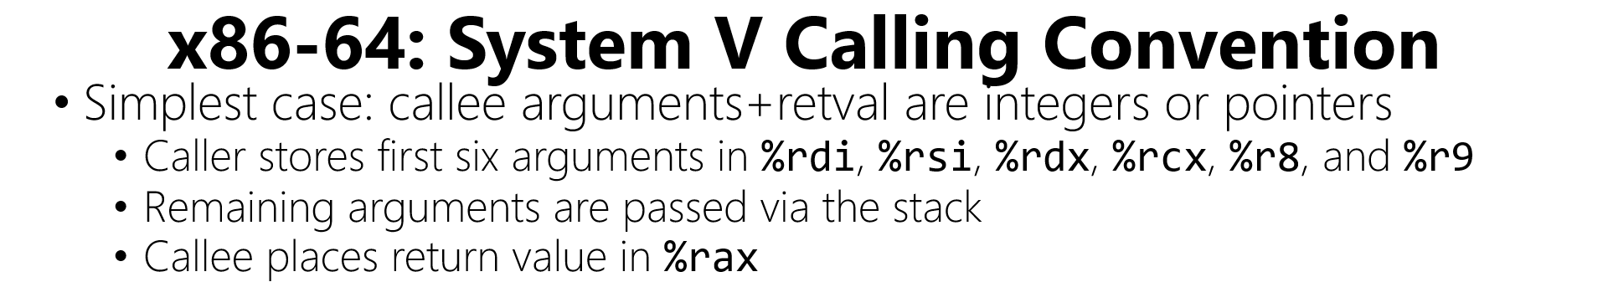
Caller-saved regs
  %rdi%, %rsi, %rdx, %rcx, %r8, %r9, %r10, %r11, %rax
  Can be overwritten by callee, so if the caller wants to preserve their value, must do so *before* invoking callee
Callee-saved regs
  %rbp, %rbx, %r12, %r13, %r14, %r15
  Assumed by caller to *not* be modified by callee, so callee must push old values on the stack *before* updating these registers
//Code at start of function.
//Save old breakpointer.
pushq %rbp
movq %rsp, %rbp
//Assume that function needs
//to overwrite callee-saved
//%rbx and %r12.
pushq %rbx
pushq %r12
//Allocate local vars.
subq $0x10, %rsp
//Rest of function . . .
int64_t foo(int64_t a, int64_t b,
int64_t c, int64_t d,
int64_t e, int64_t f,
int64_t g, int64_t h){
int64_t local0 = a*b*c;
int64_t local1 = d*e*f;
return local0 - local1;
}
Caller info
h
g
return addr
saved %rbp
%rbp
local0
local1
%rsp
a
b
c
d
e
f
%rdi
%rsi
%rdx
%rcx
%r8
%r9
Notes:
If we look at the bottom of the diagram, we see that the first six arguments for the callee are stored in %rdi, %rsi, %rdx, and so on. This is one reason why these registers are *caller* saved---the caller has to stash the old values in these registers before using the registers to pass arguments to the callee.
In the example at the end of the slide, a function saves (i.e., pushes) some callee-saved registers on the stack. Note that, when the function returns, it needs to restore those values by popping them back into the appropriate registers!

Slide 12
How can a processor efficiently execute instructions?

Slide 13

Pipelining: The Need for Speed
Vin Diesel needs more cars because VIN DIESEL
A single car must be constructed in stages
  Build the floorboard
  Build the frame
  Attach floorboard to frame
  Install engine
  I DON’T KNOW HOW CARS ARE MADE BUT YOU GET THE POINT
Q: How do you design the car factory?

Slide 14
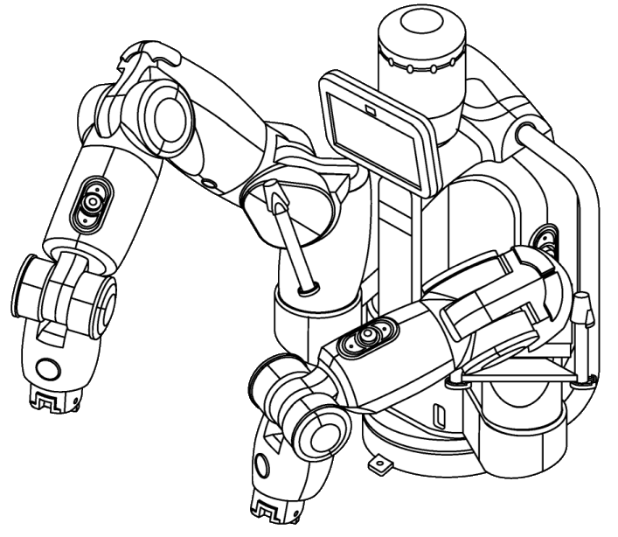
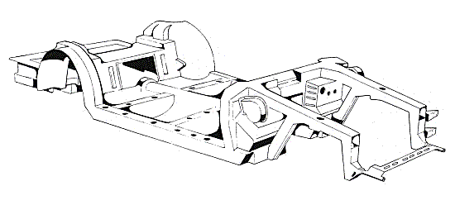
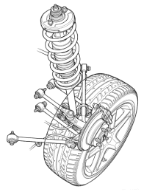

Factory Design #1
Suppose that building a car requires three tasks that must be performed in serial (i.e., the tasks cannot be overlapped)
Further suppose that each task takes the same amount of time
We can design a single, complex robot that can perform all of the tasks
The factory will build one car every three time units
t=0
t=1
t=2

Slide 15



Factory Design #2
We design three simple robots, each of which performs one task
The robots can work in parallel, performing their tasks on different cars simultaneously
Once the factory ramps up, it can make one car every time unit!
t=0
Car 0
t=1
Car 1
Car 0
The factory has ramped up: the pipeline is now full!
t=2
Car 2
Car 1
Car 0
t=3
Car 3
Car 2
Car 1

Slide 16
Pipelining a Processor
Executing an instruction requires five steps to be performed
  Fetch: Pull the next instruction from RAM into the processor
  Decode: Determine the type of the instruction and extract the operands (e.g., the register indices, the immediate value, etc.)
  Execute: If necessary, perform the arithmetic operation that is associated with the instruction
  Memory: If necessary, read or write a value from/to RAM
  Writeback: If necessary, update a register with the result of an arithmetic operation or a RAM read
To pipeline a CPU, we put each step in its own hardware stage
  This increases the production rate of instructions, as in the car example
  A processor’s clock frequency is the rate at which its pipeline completes instructions

Slide 17
Processors: From the View of a Master Programmer
+
Next sequential IP
Conditions/
%rcx
%rcx
Condition
Sign-extended imm
Instr
Read reg0 idx
size
+
Read reg1 idx
Opcode
Write reg idx
Write reg data
Addr
IP
Current instruction register
ID/EX
EX/MEM
MEM/WB
Memory
Read data 0
Instr
Read data 1
ALU
Registers
?
RdData
Memory
Sign extend
imm to 64-bit
?
Addr
Write reg idx
WrData

Slide 18
Address of instruction after addq
Fetch:addq %r8, %r9
+
Conditions/
%rcx
//IP=addr of addq instr
//Fetch addq instr, increment
//IP to next instr
Next sequential IP
%rcx
Condition
Sign-extended imm
Instr
Read reg0 idx
size
+
Read reg1 idx
Opcode
Write reg idx
Write reg data
Addr
IP
Current instruction register
ID/EX
EX/MEM
MEM/WB
Memory
Read data 0
Instr
Read data 1
ALU
Registers
?
RdData
4D 01 C1
Memory
Sign extend
imm to 64-bit
?
Addr
Write reg idx
WrData
Notes:
The instruction `addq %r8, %9` is encoded using the three bytes `4D 01 C1`.
[What does the “q” at the end of “addq” mean? See https://en.wikibooks.org/wiki/X86_Assembly/GAS_Syntax#Operation_Suffixes for the answer. Quoth that page:
“GAS assembly instructions are generally suffixed with the letters "b", "s", "w", "l", "q" or "t" to determine what size operand is being manipulated.
b = byte (8 bit).
s = single (32-bit floating point).
w = word (16 bit).
l = long (32 bit integer or 64-bit floating point).
q = quad (64 bit).”
]

Slide 19
Decode:addq %r8, %r9
+
Next sequential IP
Conditions/
%rcx
//Opcode=add
//Read reg0=%r8 Read reg1=%r9
//Write reg=%r9
%rcx
Condition
Sign-extended imm
Instr
Read reg0 idx
size
+
Read reg1 idx
Opcode
Write reg idx
Write reg data
Addr
IP
Current instruction register
ID/EX
EX/MEM
MEM/WB
Memory
Read data 0
Instr
Read data 1
ALU
Registers
?
RdData
Memory
Sign extend
imm to 64-bit
?
Addr
Write reg idx
WrData
Notes:
[For more information about decoding x86 instructions, see:
https://pyokagan.name/blog/2019-09-20-x86encoding/
]

Slide 20
Execute:addq %r8, %r9
+
Conditions/
%rcx
//Calculate read data 0 +
// read data 1
Next sequential IP
%rcx
Condition
Sign-extended imm
Instr
Read reg0 idx
size
+
Read reg1 idx
Opcode
Write reg idx
Write reg data
Addr
IP
Current instruction register
ID/EX
EX/MEM
MEM/WB
Memory
Read data 0
Instr
Read data 1
ALU
Registers
?
RdData
Memory
Sign extend
imm to 64-bit
?
Addr
Write reg idx
WrData

Slide 21
Memory:addq %r8, %r9
+
Conditions/
%rcx
//Nothing to do here; all
//operands are registers
Next sequential IP
%rcx
Condition
Sign-extended imm
Instr
Read reg0 idx
size
+
Read reg1 idx
Opcode
Write reg idx
Write reg data
Addr
IP
Current instruction register
ID/EX
EX/MEM
MEM/WB
Memory
Read data 0
Instr
Read data 1
ALU
Registers
?
RdData
Memory
Sign extend
imm to 64-bit
?
Addr
Write reg idx
WrData

Slide 22
Writeback: addq %r8, %r9
+
Conditions/
%rcx
//Update %r9 with the
//result of the add
Next sequential IP
%rcx
Condition
Sign-extended imm
Instr
Read reg0 idx
size
+
Read reg1 idx
Opcode
Write reg idx
Write reg data
Addr
IP
Current instruction register
ID/EX
EX/MEM
MEM/WB
Memory
Read data 0
Instr
Read data 1
ALU
Registers
?
RdData
Memory
Sign extend
imm to 64-bit
?
Addr
Write reg idx
WrData
Notes:
[Ref: The Wikipedia article on the classic RISC pipeline is quite good: https://en.wikipedia.org/wiki/Classic_RISC_pipeline]

Slide 23
Suppose that the next instruction is a mov . . .

Slide 24
Address of instruction after mov
Fetch:mov 8(%r10), %r11
+
Conditions/
%rcx
//IP=addr of mov instr
//Fetch mov instr and
//increment IP
Next sequential IP
%rcx
Condition
Sign-extended imm
Instr
Read reg0 idx
size
+
Read reg1 idx
Opcode
Write reg idx
Write reg data
Addr
IP
Current instruction register
ID/EX
EX/MEM
MEM/WB
Memory
Read data 0
Instr
Read data 1
ALU
Registers
?
RdData
Memory
Sign extend
imm to 64-bit
?
Addr
Write reg idx
WrData

Slide 25
Decode:mov 8(%r10), %r11
+
Conditions/
%rcx
//Opcode=mov
//Read reg0=%r10 Write reg=%r11
//Imm=8
Next sequential IP
%rcx
Condition
Sign-extended imm
Instr
Read reg0 idx
size
+
Read reg1 idx
Opcode
Write reg idx
Write reg data
Addr
IP
Current instruction register
ID/EX
EX/MEM
MEM/WB
Memory
Read data 0
Instr
Read data 1
ALU
Registers
?
RdData
Memory
Sign extend
imm to 64-bit
?
Addr
Write reg idx
WrData

Slide 26
Execute:mov 8(%r10), %r11
+
Conditions/
%rcx
//Calculate the mem addr:
// %r10 + 8
Next sequential IP
%rcx
Condition
Sign-extended imm
Instr
Read reg0 idx
size
+
Read reg1 idx
Opcode
Write reg idx
Write reg data
Addr
IP
Current instruction register
ID/EX
EX/MEM
MEM/WB
Memory
Read data 0
Instr
Read data 1
ALU
Registers
?
RdData
Memory
Sign extend
imm to 64-bit
?
Addr
Write reg idx
WrData

Slide 27
Memory:mov 8(%r10), %r11
+
Conditions/
%rcx
//Ask the memory hardware
//to fetch data at addr
Next sequential IP
%rcx
Condition
Sign-extended imm
Instr
Read reg0 idx
size
+
Read reg1 idx
Opcode
Write reg idx
Write reg data
Addr
IP
Current instruction register
ID/EX
EX/MEM
MEM/WB
Memory
Read data 0
Instr
Read data 1
ALU
Registers
?
RdData
Memory
Sign extend
imm to 64-bit
?
Addr
Write reg idx
WrData

Slide 28
Writeback:mov 8(%r10), %r11
+
//Update %r11 with the
//value from memory
Next sequential IP
Conditions/
%rcx
%rcx
Condition
Sign-extended imm
Instr
Read reg0 idx
size
+
Read reg1 idx
Opcode
Write reg idx
Write reg data
Addr
IP
Current instruction register
ID/EX
EX/MEM
MEM/WB
Memory
Read data 0
Instr
Read data 1
ALU
Registers
?
RdData
Memory
Sign extend
imm to 64-bit
?
Addr
Write reg idx
WrData

Slide 29
x86-64: Branches
Most arithmetic instructions (e.g., add, sub) set condition flags to 1 if certain conditions are true
  ZF: Result was zero
  CF: Result generated a carry-out
  SF: Result was negative (i.e., sign bit was set)
  OF: Result caused overflow
cmp and test also set flags without updating registers
  cmp %x, %y: Set flags using %y – %x
  test %x, %y: Set flags using %x & %y (i.e., using logical and)
Conditional jump instruction jXXX offset jumps to %rip+offset if the flag condition XXX is true
  Ex: jz offset jumps if ZF is set
  Ex: js offset jumps if SF is set
Note that jrcxz (“jump if %rcx is zero”) jumps if %rcx is zero
Notes:
[Note that jczx does not need to consult the ZF flag—the instruction just directly checks whether %rcx is zero.]
[References: https://web.archive.org/web/20190202155734/http://www.cs.tufts.edu/comp/181/x64_cheatsheet.pdf
https://www.felixcloutier.com/x86/jmp
https://en.wikibooks.org/wiki/X86_Assembly/Control_Flow#Jump_Instructions
]

Slide 30
Address of instruction after jrcxz
Fetch:jrcxz $0x40
+
Conditions/
%rcx
//IP=addr of jrcxz instr
//Fetch jrcxz instr and
//increment IP
Next sequential IP
%rcx
Condition
Sign-extended imm
Instr
Read reg0 idx
size
+
Read reg1 idx
Opcode
Write reg idx
Write reg data
Addr
IP
Current instruction register
ID/EX
EX/MEM
MEM/WB
Memory
Read data 0
Instr
Read data 1
ALU
Registers
?
RdData
Memory
Sign extend
imm to 64-bit
?
Addr
Write reg idx
WrData

Slide 31
Decode: jrcxz $0x40
+
Conditions/
%rcx
//If %rcx is 0, set next IP
//to IP + signExtend($0x40)
Next sequential IP
%rcx
Condition
Sign-extended imm
Instr
Read reg0 idx
size
+
Read reg1 idx
Opcode
Write reg idx
Write reg data
Addr
IP
Current instruction register
ID/EX
EX/MEM
MEM/WB
Memory
Read data 0
Instr
Read data 1
ALU
Registers
?
RdData
Did the CPU assume the branch isn’t taken and fetch the instruction after jz?
Memory
Sign extend
imm to 64-bit
?
Addr
Write reg idx
WrData

Slide 32
Execute: jrcxz $0x40
+
Conditions/
%rcx
//Does nothing
Next sequential IP
%rcx
Condition
Sign-extended imm
Instr
Read reg0 idx
size
+
Read reg1 idx
Opcode
Write reg idx
Write reg data
Addr
IP
Current instruction register
ID/EX
EX/MEM
MEM/WB
Memory
Read data 0
Instr
Read data 1
ALU
Registers
?
RdData
Memory
Sign extend
imm to 64-bit
?
Addr
Write reg idx
WrData

Slide 33
Memory: jrcxz $0x40
+
Conditions/
%rcx
//Does nothing
Next sequential IP
%rcx
Condition
Sign-extended imm
Instr
Read reg0 idx
size
+
Read reg1 idx
Opcode
Write reg idx
Write reg data
Addr
IP
Current instruction register
ID/EX
EX/MEM
MEM/WB
Memory
Read data 0
Instr
Read data 1
ALU
Registers
?
RdData
Memory
Sign extend
imm to 64-bit
?
Addr
Write reg idx
WrData

Slide 34
Writeback: jrcxz $0x40
+
Conditions/
%rcx
//Does nothing
Next sequential IP
%rcx
Condition
Sign-extended imm
Instr
Read reg0 idx
size
+
Read reg1 idx
Opcode
Write reg idx
Write reg data
Addr
IP
Current instruction register
ID/EX
EX/MEM
MEM/WB
Memory
Read data 0
Instr
Read data 1
ALU
Registers
?
RdData
Memory
Sign extend
imm to 64-bit
?
Addr
Write reg idx
WrData

Slide 35

The Problem with Branches
We don’t know if jrcxz is taken until the end of the decode stage . . .
. . . so what should the IF stage fetch immediately after the jrcxz instruction?
IF
ID
EX
MEM
WB
incq %r8
jrcxz lbl
subq %r10, %r11
addq %rax, %rbx
movq 8(%r9), %r12
t=0
incq
t=1
jrcxz
incq
lbl:
t=2
???
jrcxz
incq
We don’t know if we should branch until the end of t=2 . . .
. . . so we don’t know whether subq or movq should have been fetched until end of t=2!

Slide 36
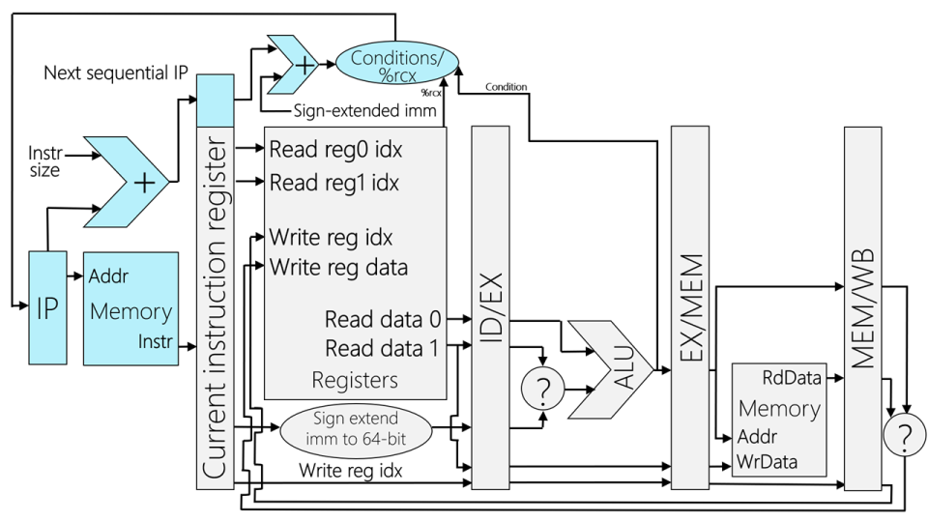
The Problem with Branches
We don’t know if jrcxz is taken until the end of the decode stage . . .
. . . so what should the IF stage fetch immediately after the jrcxz instruction?
incq %r8
jrcxz lbl
subq %r10, %r11
addq %rax, %rbx
movq 8(%r9), %r12
Address of jrcxz
lbl:
Opcode
incq

Slide 37
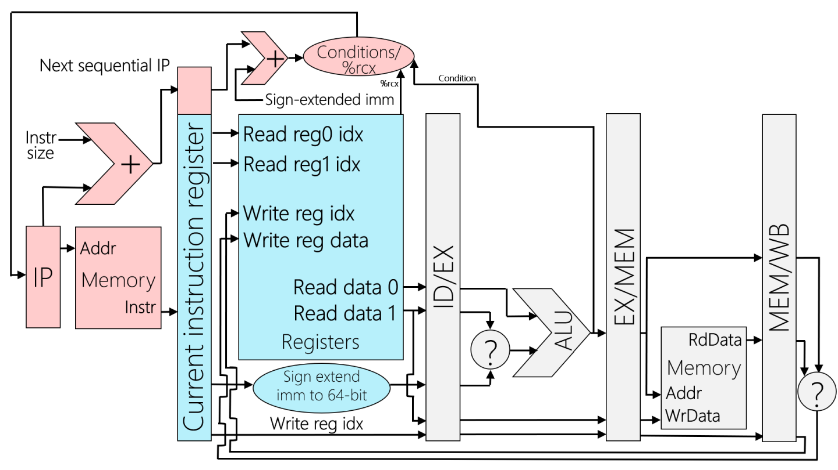
The Problem with Branches
We don’t know if jrcxz is taken until the end of the decode stage . . .
. . . so what should the IF stage fetch immediately after the jrcxz instruction?
incq %r8
jrcxz lbl
subq %r10, %r11
addq %rax, %rbx
movq 8(%r9), %r12
Address of subq
lbl:
Opcode
jrcxz
incq

Slide 38
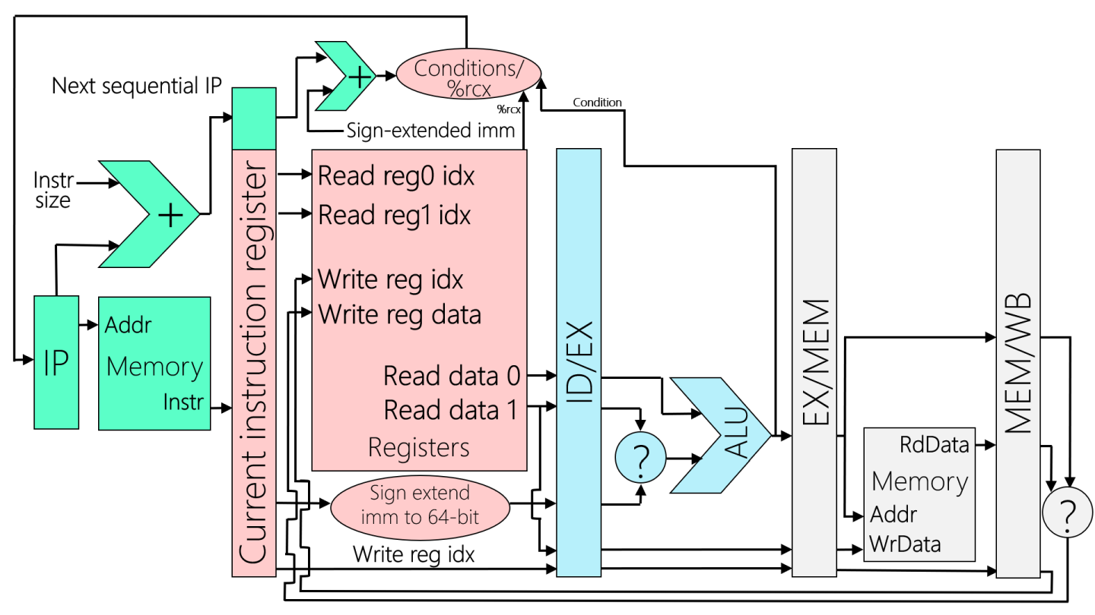
The Problem with Branches
We don’t know if jrcxz is taken until the end of the decode stage . . .
. . . so what should the IF stage fetch immediately after the jrcxz instruction?
The %rcx check may determine that the default next IP (i.e., the address of the instruction after subq) should be overridden with the address of movq!
incq %r8
jrcxz lbl
subq %r10, %r11
addq %rax, %rbx
movq 8(%r9), %r12
Address of addq
lbl:
Opcode
subq
jrcxz
incq

Slide 39
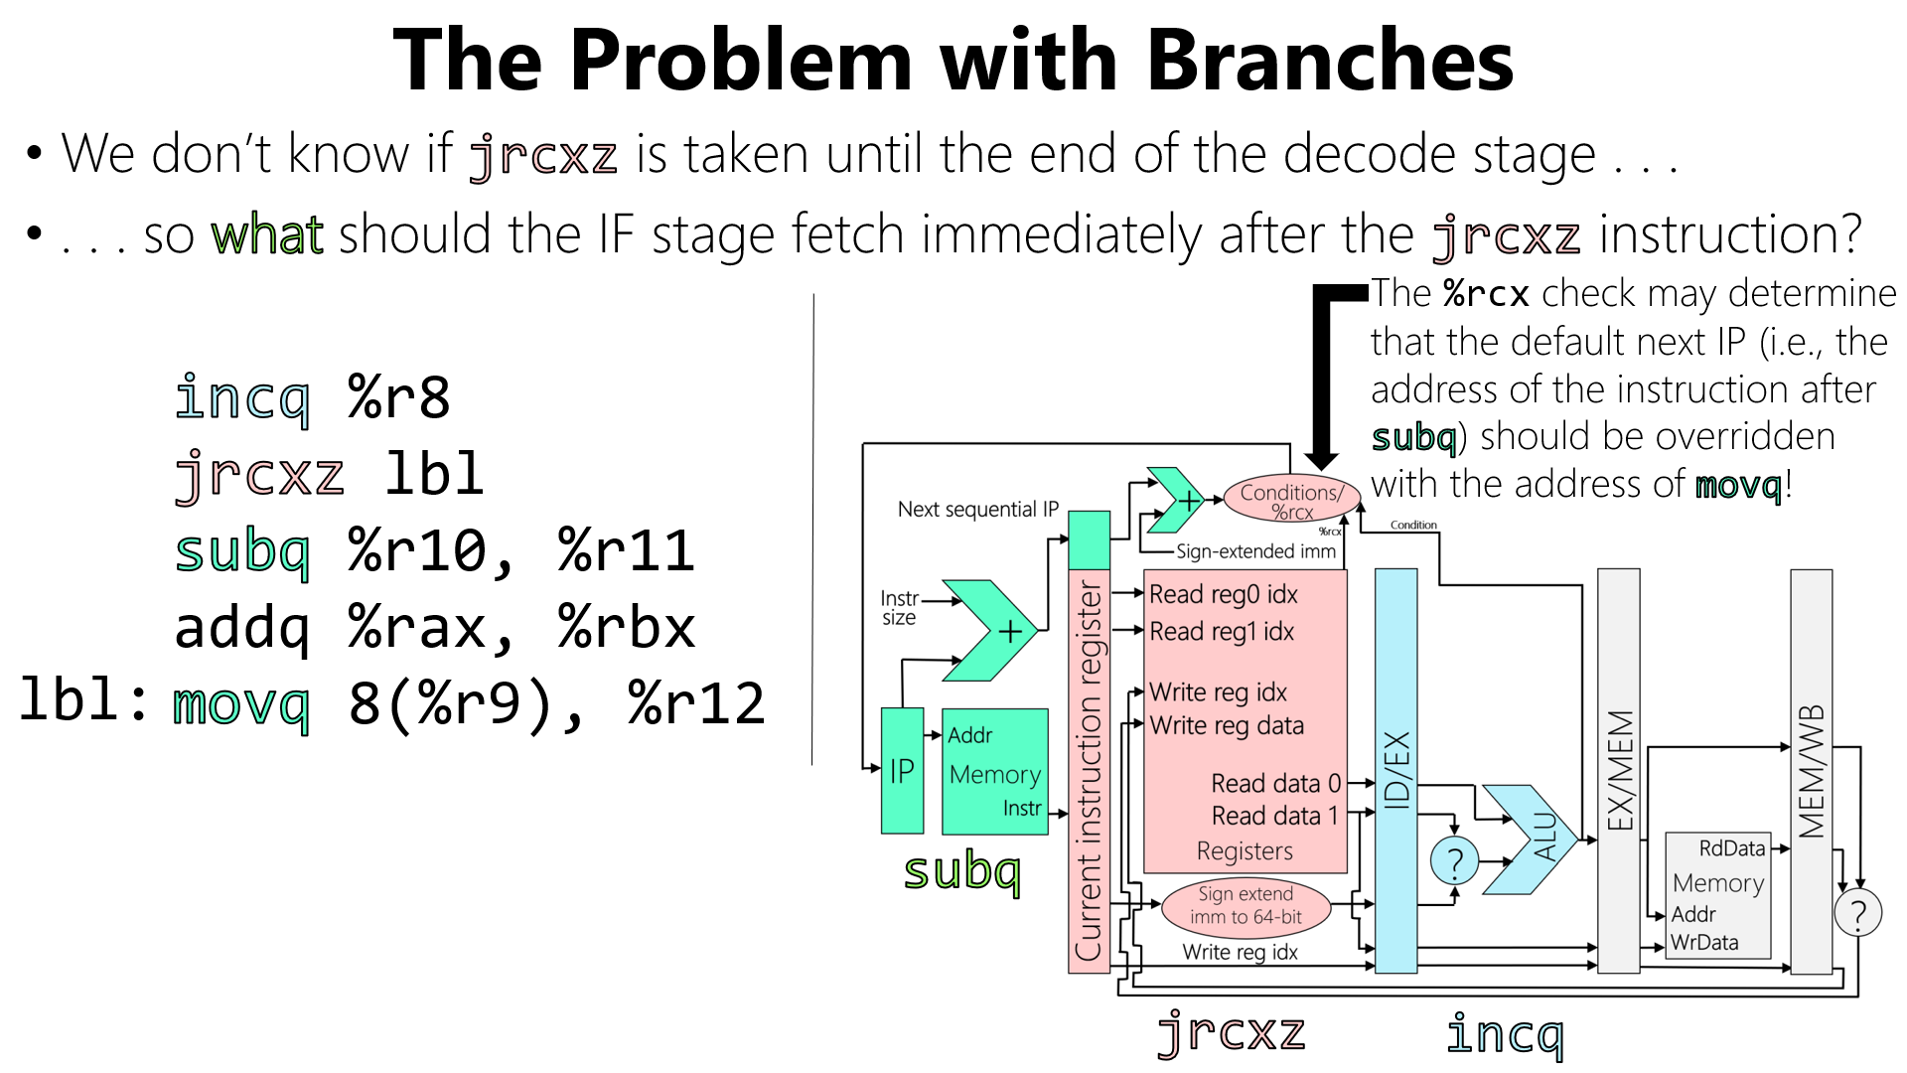

Address of addq
Opcode
If the branch is taken, we need to kill the subq!

Slide 40
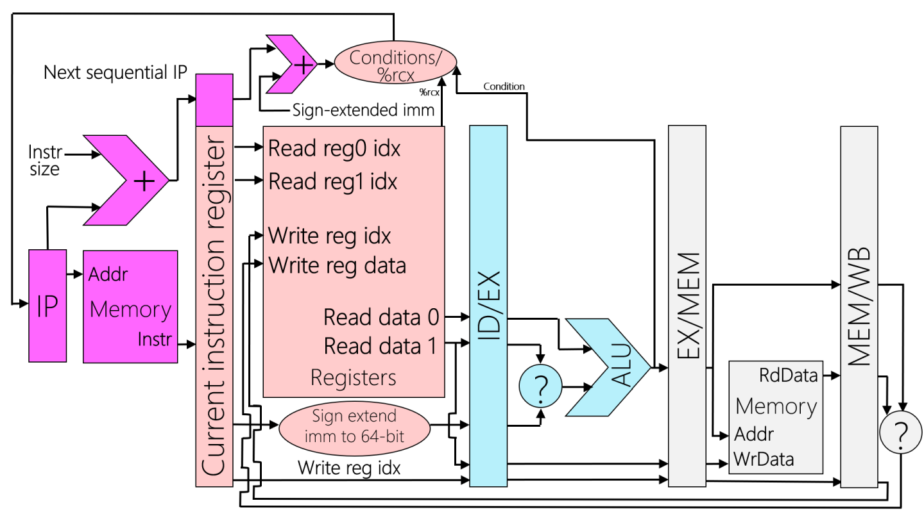
incq %r8
jrcxz lbl
subq %r10, %r11
addq %rax, %rbx
movq 8(%r9), %r12
Address of movq
Address of addq
lbl:
Opcode
nop
subq
The pipeline overwrites the subq with a nop, and then fetches the correct instruction (i.e., the movq)!
jrcxz
incq
Notes:
A “nop” instruction has no side effects---in other words, it perform “no operation.” Inserting a nop into an stream of instructions will never affects the correctness of the computation that the instructions perform. However, inserting nops does affect performance---the pipeline completes fewer *useful* instructions per unit time.
Remember that, in the binary-level representation of `jrcxz lbl`, the `lbl` part is actually an integer offset; the virtual address of the jump target (e.g., the `movq` in the example above) lives `lbl` bytes away from the virtual address of the instruction that follows the `jrcxz`. [Ref: See https://c9x.me/x86/html/file_module_x86_id_147.html for the gory details.]

Slide 41
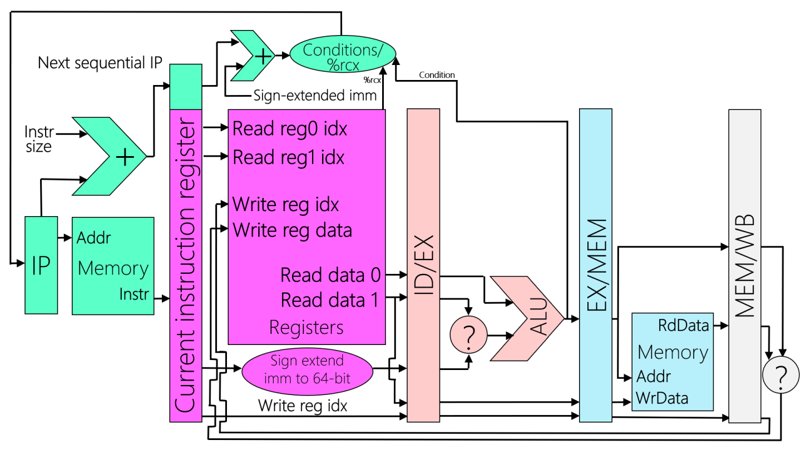
incq %r8
jrcxz lbl
subq %r10, %r11
addq %rax, %rbx
movq 8(%r9), %r12
lbl:
Opcode
movq
The pipeline overwrites the subq with a nop, and then fetches the correct instruction (i.e., the movq)!
nop
jrcxz
incq
Notes:
The pipeline-inserted nop is often called a pipeline “bubble” because it has to propagate through the entire pipeline, doing nothing at each stage besides taking up space :-D.
A modern CPU has a piece of hardware called a branch predictor. The branch predictor hardware lives in the IF stage. When the predictor sees an IP register associate with a branch, the predictor consults an on-CPU data structure that tracks the previously-observed behavior of the branch. In particular, the table predicts the target address of the branch---either the instruction immediately after the branch, or some other instruction. The output of the predictor is the next instructions that IF will fetch!
Food for thought: jrcxz is a weird kind of jump instruction; jrcxz looks at the %rcx register to determine whether to jump, whereas other kinds of x86 jumps look at the condition flags. Those condition flags are set by arithmetic/bitwise instructions in the EX stage. What does this mean for how the pipeline must handle branch mispredictions? For example, what happens if an arithmetic/bitwise instruction is immediately followed by a jump instruction that checks a condition flag?

