Slide 1

Device Interactions
Lecture 12: CS 1610
3/11/2026

Slide 2
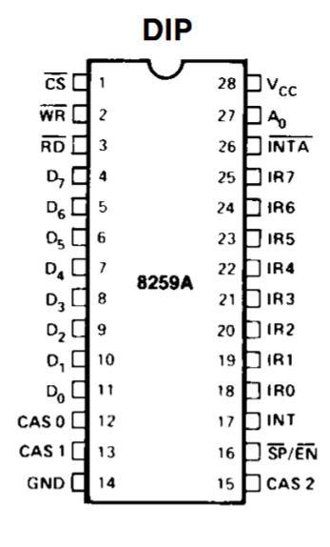
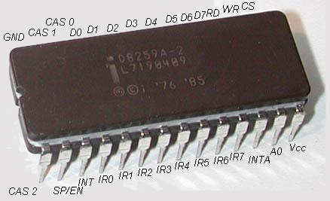
Buses and Pins
A chip is a collection of circuits that implement a specific hardware interface
A chip has pins which provide input/ output ports for electrical signals
  Two chips communicate via wires that connect their pins
  A set of logically-related communication wires (a “bus”) might only be used by two devices, or it might be shared with many devices
  A bus protocol (e.g., SATA, PCI-e) defines the electrical signals needed to send or receive data over the bus
Intel 8259 chip: Pin diagram
Physical 8259 chip
Notes:
As we’ll see later in lecture, the Intel 8259 is a programmable interrupt controller (PIC). A PIC is like a referee that sits between a CPU and multiple interrupt lines coming in from multiple devices (e.g., a storage device, a hardware timer, a network card); if multiple devices have raised an interrupt, the PIC decides the order in which the interrupts are presented to the CPU. [Ref: https://en.wikipedia.org/wiki/Intel_8259]
[8259 pin diagram taken from https://pdos.csail.mit.edu/6.828/2005/readings/hardware/8259A.pdf]
[Ref: https://learn.sparkfun.com/tutorials/integrated-circuits/all]

Slide 3
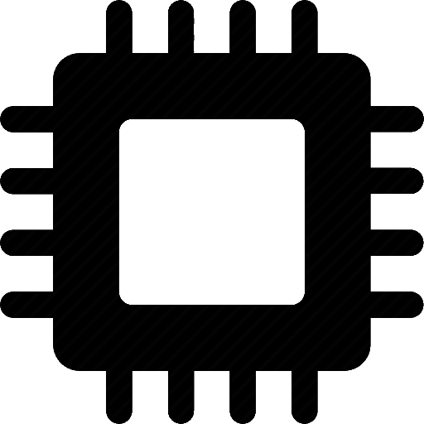
The Olden Days:
Intel’s 8259 Programmable Interrupt Controller (PIC)
The 8259 PIC was first introduced by Intel in 1976
  The PIC aggregated 8 interrupt lines from multiple devices, sending a single interrupt line to the CPU
  After executing each instruction, the CPU checks whether the interrupt line has been raised
To support 15 interrupts, Intel cascaded two PICs!
Device0
IRQ0
Device1
IRQ1
Device2
IRQ2
Device3
IRQ3
Interrupt line
8259 PIC
Device4
IRQ4
Device5
IRQ5
Device6
CPU’s interrupt pin
IRQ6
Device7
IRQ7
Notes:
[Ref: https://habr.com/en/articles/446312/
https://wiki.osdev.org/8259_PIC
https://wiki.osdev.org/Interrupts
https://pdos.csail.mit.edu/6.828/2005/readings/hardware/8259A.pdf
]

Slide 4
The Olden Days:
Intel’s 8259 Programmable Interrupt Controller (PIC)
The 8259 PIC was first introduced by Intel in 1976
  The PIC aggregated 8 interrupt lines from multiple devices, sending a single interrupt line to the CPU
  After executing each instruction, the CPU checks whether the interrupt line has been raised
To support 15 interrupts, Intel cascaded two PICs!
Examples of IRQ numbers on the primary PIC
  IRQ 0: Timer
  IRQ 1: Keyboard
  IRQ 2: Cascaded interrupt from the secondary PIC
Examples of IRQ numbers on the secondary PIC
  IRQ 12: PS/2 Mouse
  IRQ 14: ATA device (e.g., disk)
Secondary PIC
Device8
IRQ0
Primary PIC
Device9
IRQ1
Device0
IRQ0
Device10
IRQ2
Device1
IRQ1
Device11
IRQ3
8259 PIC
Device12
IRQ2
IRQ4
Device3
IRQ3
8259 PIC
Device13
IRQ5
Device4
IRQ4
Device14
IRQ6
Device5
IRQ5
Device15
IRQ7
Device6
IRQ6
Device7
IRQ7
Notes:
[Note that, in the literature about the 8259, the terms “master” and “slave” are often used instead of “primary” and “secondary.”]
[Ref: https://habr.com/en/articles/446312/
https://en.wikipedia.org/wiki/Interrupt_request_(PC_architecture)
https://wiki.osdev.org/8259_PIC
https://wiki.osdev.org/Interrupts
https://pdos.csail.mit.edu/6.828/2005/readings/hardware/8259A.pdf
]

Slide 5
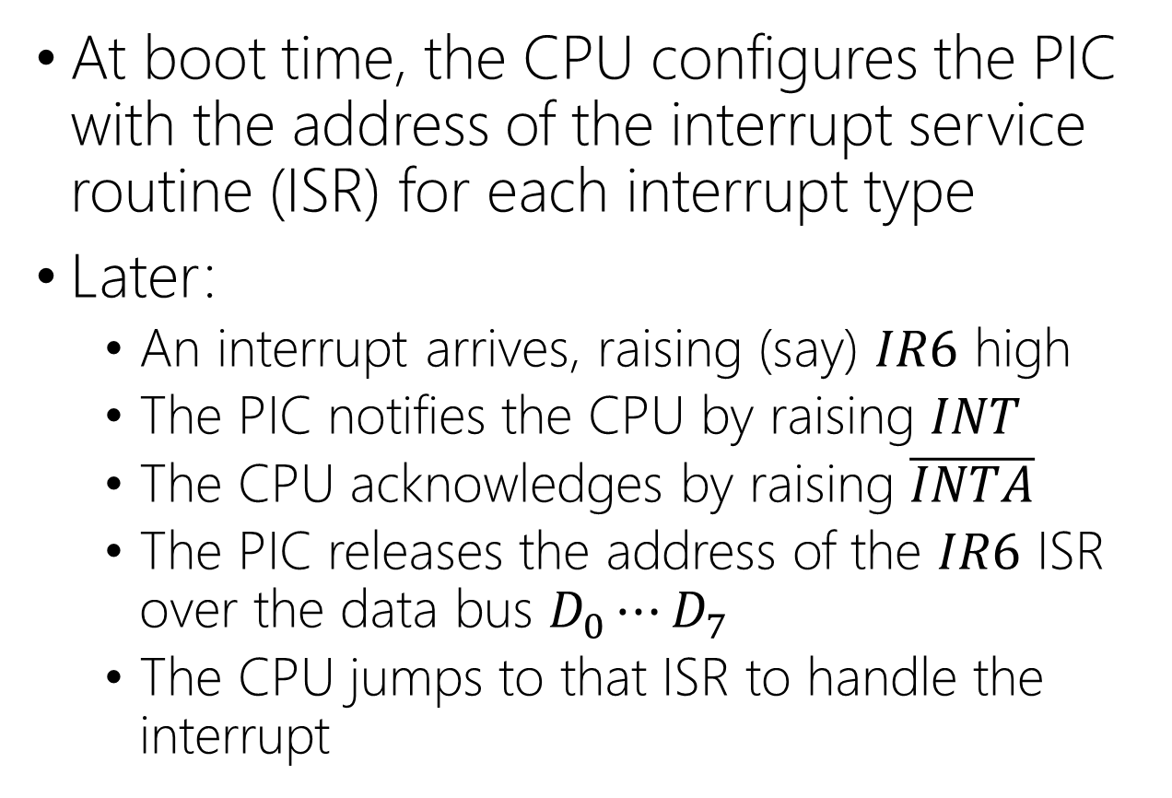
The 8259 PIC: The Interrupt Lifecycle
At boot time, the CPU configures the PIC with the address of the interrupt service routine (ISR) for each interrupt type
Later:
  An interrupt arrives, raising (say) $IR6$ high
  The PIC notifies the CPU by raising $INT$
  The CPU acknowledges by raising $\overline{INTA}$
  The PIC releases the address of the $IR6$ ISR over the data bus $D_{0}⋯D_{7}$
  The CPU jumps to that ISR to handle the interrupt
Notes:
[In a cascading PIC setup, when the secondary PIC wants to send an interrupt to the CPU, the secondary PIC raises its interrupt line. Eventually, the primary PIC will raise its acknowledgement line. The secondary PIC will send the ISR address to the primary PIC, who will then forward the ISR address to the CPU. Ref: Page 19 of [1].]
[Ref: [1] https://pdos.csail.mit.edu/6.828/2005/readings/hardware/8259A.pdf]

Slide 6


AND THEN MULTICORE ARRIVED
The PIC only has a single $INT$ line!
NO INTERRUPTS FOR YOU

Slide 7

AND THEN MANY DEVICES ARRIVED
A single PIC can only handle 8 devices; daisy chaining PICs is inefficient!

Slide 8

THE MODERN ERA
OF DEVICE COMMUNICATION

Slide 9
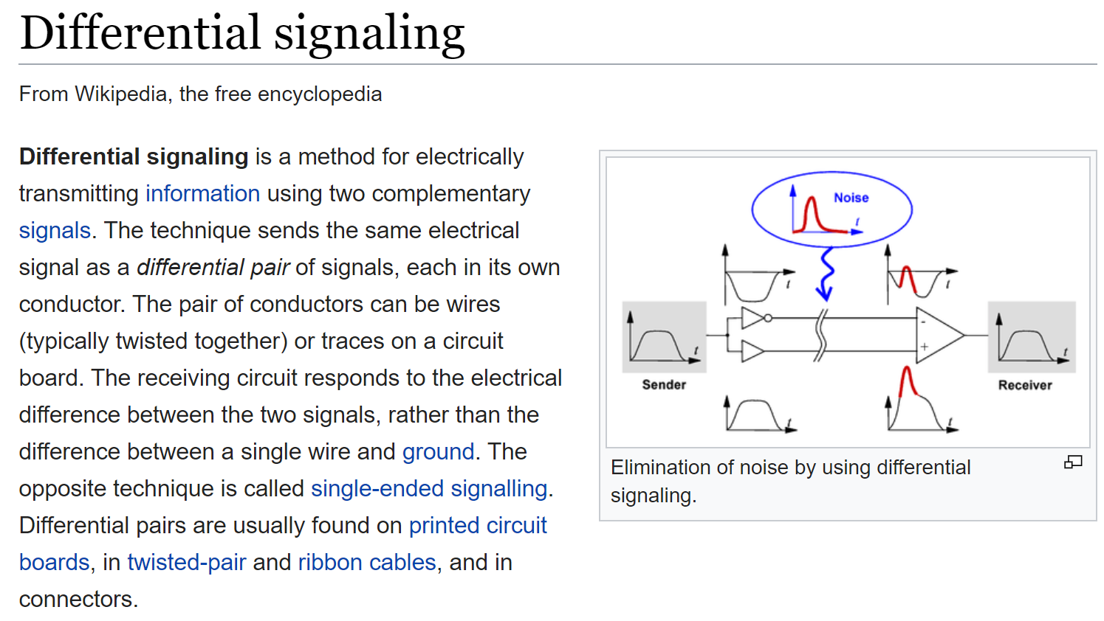
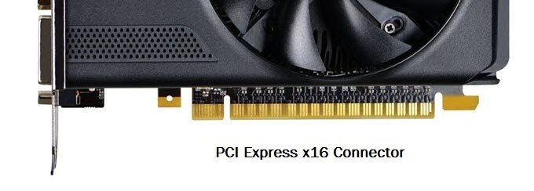
The PCI-e Subsystem
PCI-e is used by modern computers to connect CPUs, memory, and devices
A single PCI-e lane between endpoints X and Y contains four wires
  Two wires send data from X to Y, and two wires send data from Y to X
  Every PCI-e cycle, one bit of data can be sent in both directions
  Amount of simultaneous bi-directional traffic handled:
    One PCI-e 3.0 lane: 985 MB/s
    One PCI-e 5.0 lane: 3.9 GB/s
PCI-e endpoint X
PCI-e endpoint Y
A single PCI-e lane
“x16” means “16 lanes”
Notes:
[Why do you need two wires to send one bit? The reason is that PCI-e uses a technology called differential signaling to transmit a bit. Differential signaling requires two wires, with a bit being encoded as the difference in the voltage between the two wires. Ref: https://en.wikipedia.org/wiki/Differential_signaling]]
If you look at the photo of the graphics card, you can actually count the lanes!
[Ref: https://computer.howstuffworks.com/pci-express.htm
https://en.wikipedia.org/wiki/PCI_Express
https://en.wikipedia.org/wiki/PCI_Express#History_and_revisions //Reference for the PCI-e 5.0 speed;
Picture of graphics card taken from https://graphicscardhub.com/graphics-card-pcie-power-connectors/
]

Slide 10
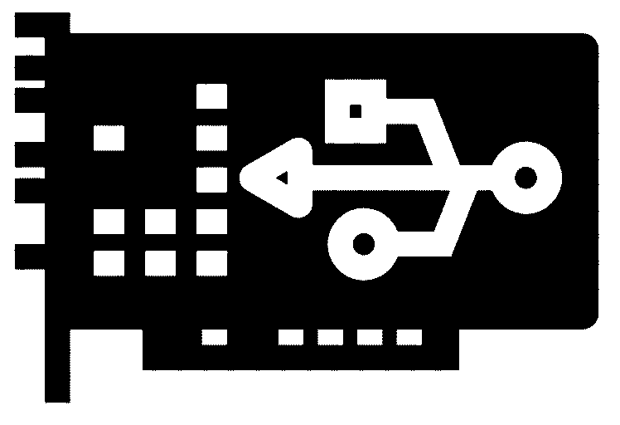
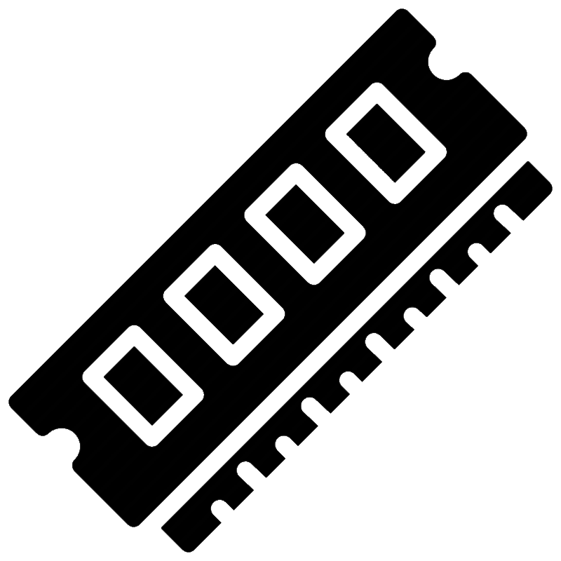
10 Gbps
PCI-e NIC
CPU package
x4
SDRAM
Root complex
Root complex
SDRAM
DMI
PCH
DMI
x4
PCI-e
port 1
(x8)
PCI-e
port 2
(x16)
PCI-e
port 3
(x16)
PCI-e
port 1
(x8)
PCI-e
port 2
(x16)
PCI-e
port 3
(x16)
RAM
RAM
PCI-e
switch
PCI-e
switch
PCI-e
switch
PCI-e
switch
x8
x16
x16
x16
x16
x8
x16
x16
x16
x16
Slot1
Slot2
Slot3
Slot4
Slot5
Slot6
Slot11
Slot10
Slot9
Slot8
Slot7
Microway’s Octoputer
(optimized for 8 GPUs)
Notes:
Note that the Octoputer has oversubscription along its PCI-e links. Oversubscription means that all devices cannot simultaneously exchange data with a CPU at full speed. For example, each of the x16 lanes coming out of a CPU are two-way oversubscripted, because each of those x16 lanes connect to a switch which talks to TWO devices, each of which has x16 lanes. Oversubscription won’t be noticed if both of those devices are rarely active at the same time.
DMI (Direct Media Interface) is just another bus protocol. At a high level, DMI is similar to PCI-e: DMI uses lanes, differential signaling, and point-to-point connections between devices.
The PCH (“Platform Controller Hub”) is an Intel-specific component for connecting various components on a chip. [Ref: https://en.wikipedia.org/wiki/Platform_Controller_Hub]
[Why do you need two wires to send one bit? The reason is that PCI-e uses a technology called differential signaling to transmit a bit. Differential signaling requires two wires, with a bit being encoded as the difference in the voltage between the two wires. Ref: https://en.wikipedia.org/wiki/Differential_signaling]]
[Ref: https://computer.howstuffworks.com/pci-express.htm
https://en.wikipedia.org/wiki/PCI_Express
https://en.wikipedia.org/wiki/PCI_Express#History_and_revisions //Reference for the PCI-e 5.0 speed;
https://pcisig.com/sites/default/files/files/PCI_Express_Basics_Background.pdf
https://www.microway.com/hpc-tech-tips/pci-express-root-complex-confusion/ //The reference for the
//diagram in the slides
https://en.wikipedia.org/wiki/Direct_Media_Interface
https://en.wikipedia.org/wiki/Synchronous_dynamic_random-access_memory
]

Slide 11
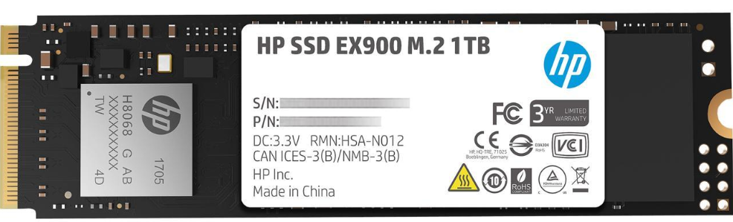
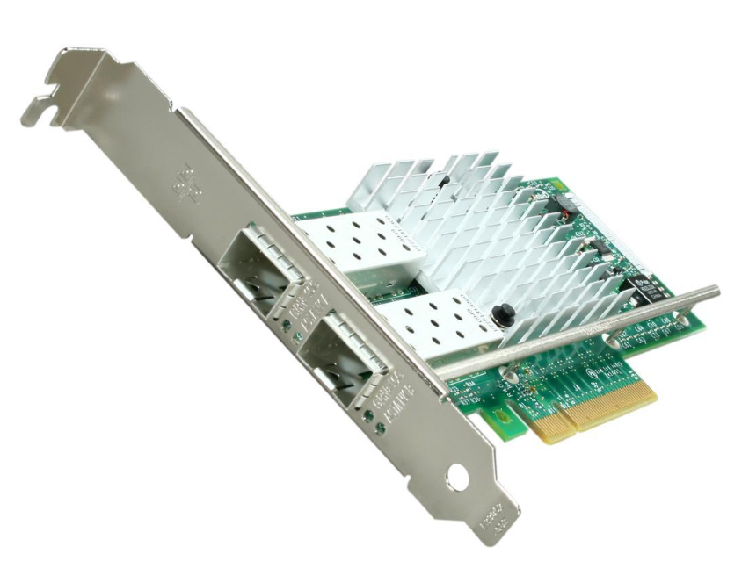
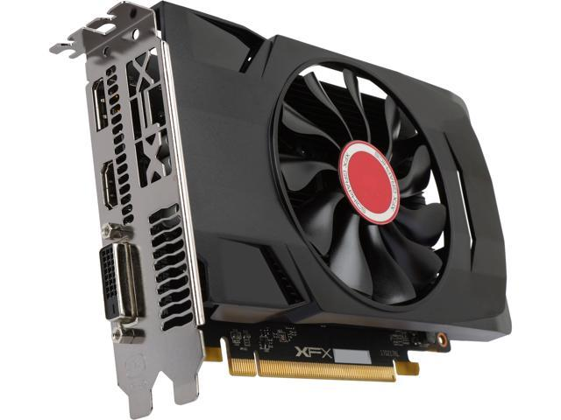
Different devices have different lane counts
Oversubscription at a switch may prevent a device from exchanging data at its full rate
10 Gbps
PCI-e NIC
CPU package
x4
SDRAM
Root complex
Root complex
SDRAM
DMI
PCH
DMI
HP EX900 SSD
(PCI-e 3.0 x4 lanes)
x4
PCI-e
port 1
(x8)
PCI-e
port 2
(x16)
PCI-e
port 3
(x16)
PCI-e
port 1
(x8)
PCI-e
port 2
(x16)
PCI-e
port 3
(x16)
RAM
RAM
PCI-e
switch
PCI-e
switch
PCI-e
switch
PCI-e
switch
Intel X520 NIC
(PCI-e 2.0 x8 lanes)
x8
x16
x16
x16
x16
x8
x16
x16
x16
x16
Radeon RX 560 GPU
(PCI-e 3.0 x16 lanes)
Slot1
Slot2
Slot3
Slot4
Slot5
Slot6
Slot11
Slot10
Slot9
Slot8
Slot7
Microway’s Octoputer
(optimized for 8 GPUs)

Slide 12
Memory-mapped PCI-e Devices
Each PCI-e device is bound to a range of memory addresses that are managed by the device (not by actual DRAM!)
The root complex translates between CPU-created memory requests and PCI-e messages
  The CPU writes to device-owned memory addresses to send commands or configure the device
  A device sends a PCI-e message to the root complex to respond to a request or proactively interrupt the CPU
Proprietary protocol
SDRAM
Root complex
PCI-e lanes
(xWhatever)
RAM
PCI-e device
Notes:
The CPU and the root complex communicate using a proprietary protocol that’s designed by the vendor of the chip. For example, on an x86 chip, Intel determines how that protocol works.

Slide 13
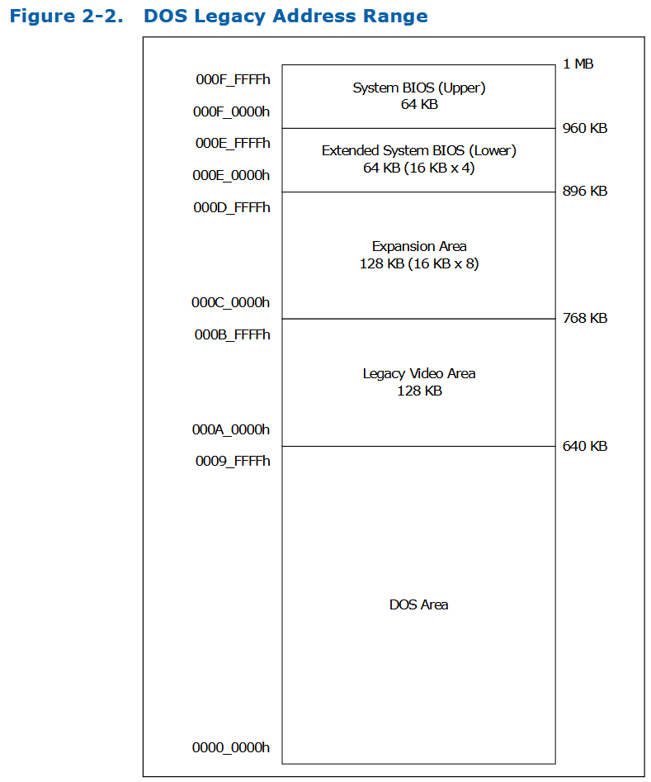
Physical Memory
Regions: Intel 10th Gen CPUs
At the bottom of physical RAM is the DOS area
  The entire OS goes here (if it fits)
  Otherwise, the first-stage OS bootloader lives here
The legacy video area is for CGA and VGA graphics
  A CPU can update the display by writing to this area
  Chickadee’s console output uses the CGA area!
The BIOS (basic input/output system) is firmware code that is stored in on-CPU flash
  When a CPU boots up, the BIOS code runs
  The BIOS detects which buses and hardware devices are connected to the CPU, and eventually loads the OS
  UEFI (Unified extensible firmware interface) is the newer specification for BIOS-like software
//Chickadee's x86-64.h
//CGA console memory-mapped I/O
#define CONSOLE_ADDR 0xB8000
Notes:
DOS was an early operating system from which the Windows OS eventually emerged. For a discussion of the MS-DOS, see https://en.wikipedia.org/wiki/MS-DOS; for a discussion of the DOS area in physical RAM, see https://en.wikipedia.org/wiki/DOS_memory_management.
[Ref for the physical memory region layout: https://www.intel.com/content/dam/www/public/us/en/documents/datasheets/10th-gen-core-families-datasheet-vol-2-datasheet.pdf]

Slide 14
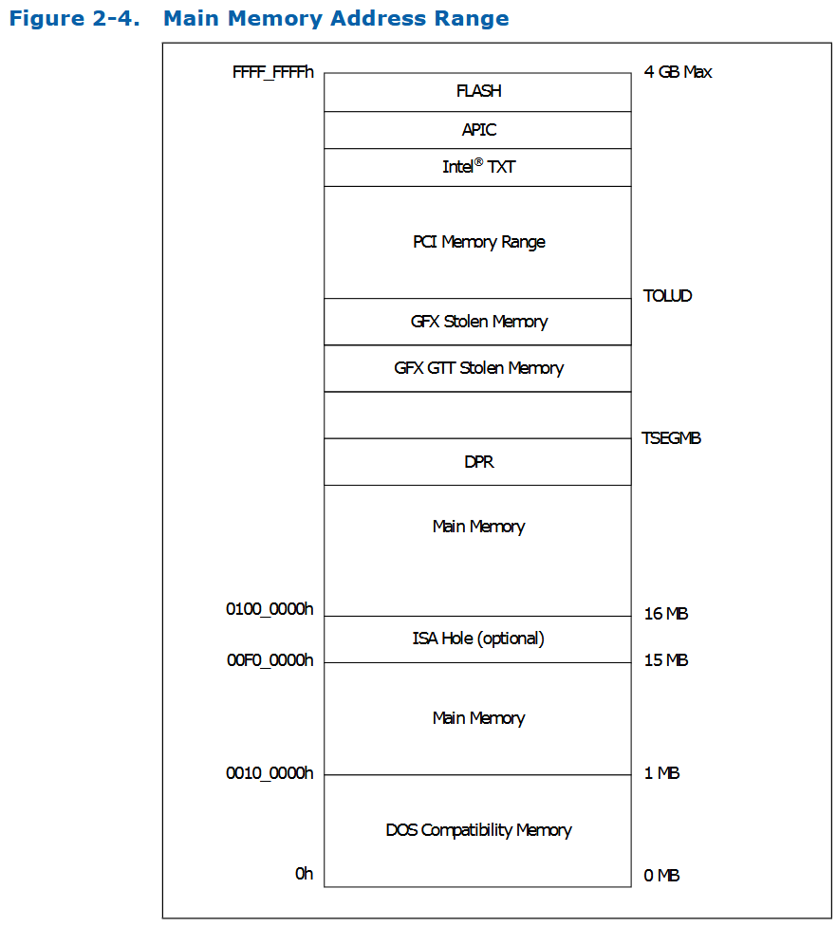
Physical Memory
Regions: Intel 10th Gen CPUs
The PCI memory range is the range of physical addresses that are dedicated to PCIe traffic!
  At boot time, each PCIe device registers for a portion of the PCI memory range
  Later, the OS communicates with a device by reading or writing to its PCI memory
As we’ll see later, the PCI memory range is also how PCIe-related interrupts are:
  Configured by the OS by writing to APICs (advanced programmable interrupt controllers)
  Raised by PCIe devices who write to the MSI interrupt region
Roughly speaking, nothing interesting happens above 4 GB of physical RAM
Notes:
[Ref for the physical memory region layout: https://www.intel.com/content/dam/www/public/us/en/documents/datasheets/10th-gen-core-families-datasheet-vol-2-datasheet.pdf]

Slide 15
Lifecycle of a read request
  The CPU sends a memory read to the root complex
  The root complex sends a PCI read request to the target device
  Later, the device sends a PCI response that’s forwarded to CPU
Proprietary protocol
SDRAM
Root complex
Indicate a memory read request
PCI-e lanes
(xWhatever)
Fmt: 0x0
Type: 0x00
Length: 0x001
RAM
Requester ID: 0x0000
Tag: 0x0c
Read request port is mapped to physical address 0xfdaff040
ReadAddress/4: 0x3f6bfc10
PCI-e device
32 bits
The root complex’s ID
Request ID (allows a pair of PCI-e endpoints
to have multiple outstanding requests)
Amount to read (units of 32 bytes)
0x3f6bfc10 * 4 = 0xfdaff040
Notes:
In this example, a “read request” means that the CPU wants to read some data from the PCI-e device.
In a TLP packet, grey fields are just ones that aren’t relevant to the slide.
The slide doesn’t explicitly show the format for the PCI response, but you can imagine what it looks like. It contains . . .
-the data to read,
-the length of the returned data
-the ID of the device which returned the data
. . . and so on and so forth.
[Aside: For an in-depth look at PCIe, check out https://resources.infosecinstitute.com/topic/system-address-map-initialization-x86x64-architecture-part-2-pci-express-based-systems/. That web page is pretty low-level, but it’s much more readable than the official PCIe spec :-D.]
[Ref: Example based on the one from here: http://xillybus.com/tutorials/pci-express-tlp-pcie-primer-tutorial-guide-1]

Slide 16
Raising Interrupts with PCI-e and APIC
APIC (Advanced Programmable Interrupt Controller) has replaced PIC
Every core on a multicore machine has a local APIC (i.e., LAPIC)
The LAPIC:
  Generates “local” interrupts like:
    Timer expiration
    Thermal sensor event
    Performance counter overflow
  Listens for device interrupts sent via the CPU/root complex interconnect
Proprietary protocol
SDRAM
Root complex
LAPIC
PCI-e lanes
(xWhatever)
RAM
PCI-e device
Notes:
[Ref: https://habr.com/en/articles/446312/
https://web.archive.org/web/20160320235754/https://www.mindshare.com/files/ebooks/PCI%20Express%20Technology%203.0.pdf //Chapter 17
https://en.wikipedia.org/wiki/Message_Signaled_Interrupts
https://www.xilinx.com/Attachment/Xilinx_Answer_58495_PCIe_Interrupt_Debugging_Guide.pdf
Chapter 10 (“Advanced Programmable Interrupt Controller”) of Volume 3 of the Intel Software Developer’s Manual
]

Slide 17
Raising Interrupts with PCI-e and APIC
A PCI-e device raises an interrupt by sending a PCI-e memory write to the root complex
  The memory range for MSI interrupts is 0xFEE00000--0xFEEFFFFF
  The kernel:
    Associates each device interrupt type with a different target address in 0xFEE00000--0xFEEFFFFF
    Configures each PCI-e device to send interrupts to the appropriate target address
Proprietary protocol
SDRAM
Root complex
LAPIC
PCI-e lanes
(xWhatever)
RAM
PCI-e device
The root complex forwards an interrupt message to the appropriate LAPIC, who triggers the appropriate interrupt on the local CPU
Notes:
“MSI” stands for “message signaled interrupts.” The Wikipedia has a good summary (https://en.wikipedia.org/wiki/Message_Signaled_Interrupts): “Traditionally, a device has an interrupt line (pin) which it asserts when it wants to signal an interrupt to the host processing environment. This traditional form of interrupt signalling is an out-of-band form of control signalling since it uses a dedicated path to send such control information, separately from the main data path. MSI replaces those dedicated interrupt lines with in-band signalling, by exchanging special messages that indicate interrupts through the main data path. In particular, MSI allows the device to write a small amount of interrupt-describing data to a special memory-mapped IO address, and the chipset then delivers the corresponding interrupt to a processor . . . PCI Express does not have separate interrupt pins at all; instead, it uses special in-band messages to allow pin assertion or deassertion to be emulated.”

Slide 18
Raising Interrupts with PCI-e and APIC
Advantages over the PIC approach
  Hardware is now simpler: there’s no need for a separate wires to handle interrupt raising and acknowledgment
  Richer interrupts: An MSI message can convey several bytes of additional information besides the mere fact that an interrupt occurred
Proprietary protocol
SDRAM
Root complex
LAPIC
PCI-e lanes
(xWhatever)
RAM
PCI-e device
Notes:
The PCI-e+APIC approach towards interrupt handling allows a single bus to handle both “normal” traffic between the CPU and a device, and interrupt traffic.

Slide 19
What Have We Learned So Far?
PIC used dedicated wires to:
  Receive interrupt notifications from devices
  Send interrupt information to CPUs
PIC is ill-suited for modern machines that have multiple cores and many devices
PCI-e is a modern bus framework that enables:
  High-speed communication between CPUs and devices
  Fast, expressive interrupts at no additional cost (because interrupts are just a special type of PCI-e message)

Slide 20
Memory-mapped IO vs. Port-mapped IO
Memory-mapped IO: CPU interacts with devices via memory reads and writes
  PCI-e devices use memory-mapped IO
  Some older devices also use memory-mapped IO, like the CGA console that Chickadee uses!
  Note that the CPU is involved in every device interaction
console = (uint16_t*) 0xB8000;
//Fixed physical address
//for CGA hardware that
//kernel has mapped to the
//virtual address 0xB8000.
console[0] = 'H' | 0xC000;
console[1] = 'i' | 0xC000;
console[2] = '!' | 0xC000;

Slide 21
Memory-mapped IO vs. Port-mapped IO
Port-mapped IO: CPU talks to devices using special instructions
  Ex: The IBM PC/AT keyboard that Chickadee uses
  Note that the CPU is involved in every device transaction
A single device can support both port-mapped IO and memory-mapped IO
  Ex: A console device
if ((inb(KEYBOARD_STATUSREG) &
KEYBOARD_STATUS_READY) == 0) {
return -1;
}
uint8_t data = inb(KEYBOARD_DATAREG);
void console_show_cursor(int cpos) {
outb(0x3D4, 14);
outb(0x3D5, cpos / 256);
outb(0x3D4, 15);
outb(0x3D5, cpos % 256);
}

Slide 22
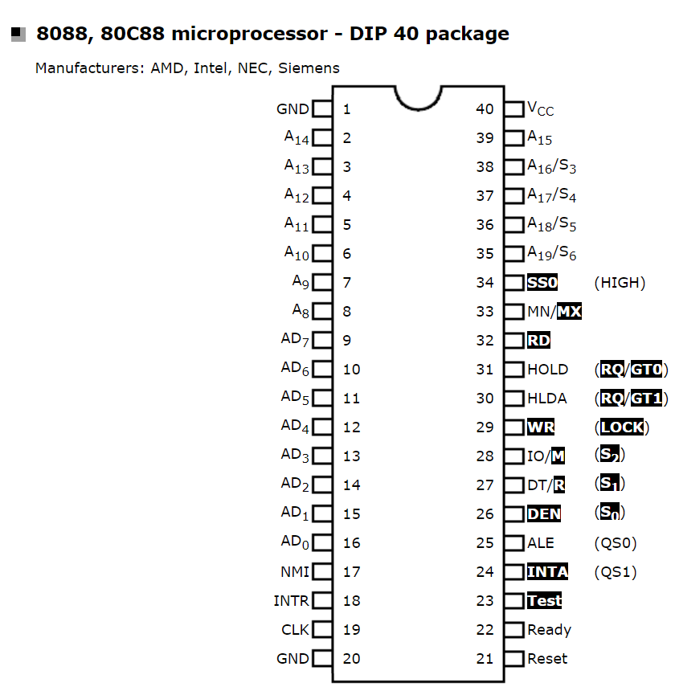


Memory-mapped IO vs. Port-mapped IO
On older machines, port-mapped devices and memory-mapped devices were attached to the same address+ data bus, with the CPU setting an “IO/M” pin to indicate whether the address+data was a port-mapped request or a memory-mapped request.
For PCI-e systems, instructions like inb and outb tell the root complex to send requests to PCI-e devices, asking those devices to use port-mapped semantics instead of memory-mapped semantics.
Proprietary protocol
SDRAM
Root complex
LAPIC
IO controller
PCI-e lane
(xWhatever)
Data bus
Address bus
RAM
Memory controller
PCI-e device
RAM
Notes:
For the system on the left, the CPU only specifies something on the address bus when requesting a read; in contrast, to specify a write, the CPU specifies both the target port or memory address, as well as the data to write via the data bus.
[Refs: https://stackoverflow.com/questions/3215878/what-are-in-out-instructions-in-x86-used-for
https://stackoverflow.com/questions/19883260/can-i-use-i-o-ports-asm-in-out-to-transfer-data-via-pci-express-on-modern
https://electronics.stackexchange.com/questions/188742/address-spaces-in-pcie
https://electronics.stackexchange.com/a/251880
https://www.cpu-world.com/info/Pinouts/8088.html
https://sysplay.github.io/books/LinuxDrivers/book/Content/Part08.html
]

Slide 23
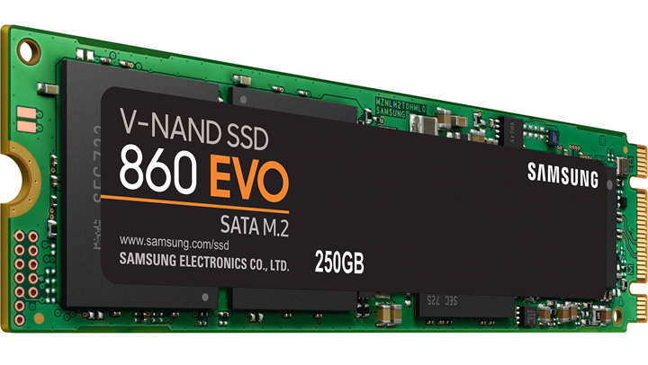
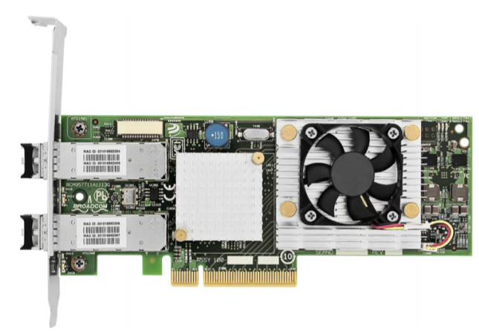
Private On-device RAM
Ex: A Samsung 860 EVO SSD has 512 MB of on-device RAM to:
  Cache recently-read data (in case software asks for it again)
  Buffer recently-written data (so that the writes can be acknowledged to software immediately)
Ex: A Broadcom NetXtreme II BCM57711 10 Gbps NIC has 148 KB of on-device RAM to buffer:
  Incoming packets that require processing by the local OS
  Outgoing packets that need to be sent over the network

Slide 24
Private On-device RAM
Given limited amounts of on-device RAM, a device would prefer to:
  Immediately dump retrieved data (e.g., a received network packet) into host RAM, so that on-device RAM can be immediately reused
  Leave data to write (e.g., a dirty disk block) in host RAM until a device is ready to copy the data into on-device buffers
Ideally, devices could transfer data to and from RAM without CPU intervention (e.g., without outb instructions or writes to memory-mapped device state)!
  This would prevent the CPU from having to devote cycles to IO management

Slide 25

OS configures a device (e.g., by writing to the device’s memory-mapped control registers), specifying where the device’s input/ output buffers are located in host RAM
Later, the device is able to autonomously read or write host RAM, then interrupts the CPU when the IO is done
Direct Memory Access
(DMA)

Slide 26
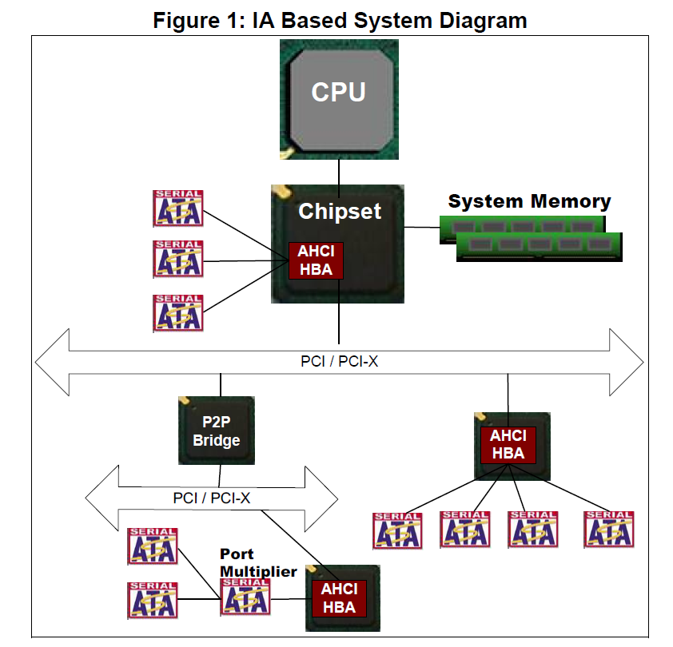
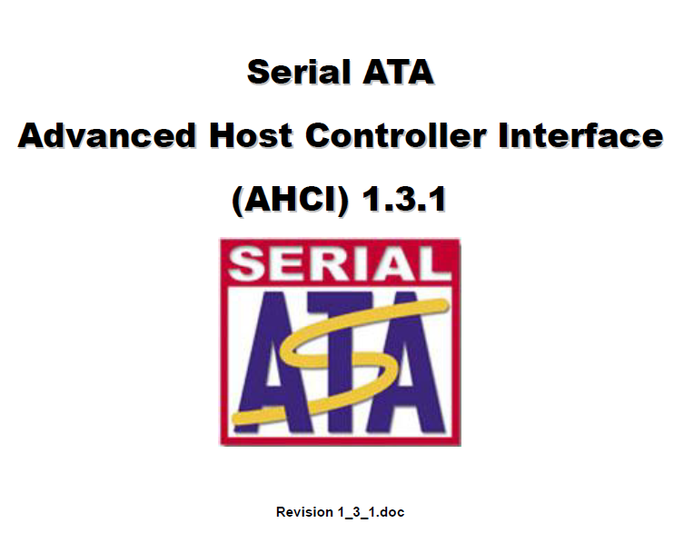
An AHCI host bus adapter (HBA) can be attached to the root complex, or to a PCI bus.
Notes:
The leaf nodes in the graph that are label “Serial ATA” are individual storage devices.

Slide 27
AHCI (Advanced Host Controller Interface):
Defining How Storage Devices Perform DMA
Once a kernel finds the AHCI bus adapter’s memory-mapped registers, the kernel configures it (e.g., to set up the memory-mapped registers associated with each storage device)
Chickadee’s k-ahci.hh calls those registers a struct regs (because the structure represents the AHCI bus adapter’s memory-mapped registers)
If you want to see how Chickadee configures those registers (and you’re masochistic), see ahcistate::ahcistate(...)

Slide 28
//A field in the knew’d
//ahicstate.
struct dmastate {
cmdheader ch[32];
cmdtable ct[32];
//...other stuff...
};
//Contains configuration data for a single
//disk; lives in the memory-mapped region
//for the host bus adapter.
struct portregs {
uint64_t cmdlist_pa; //Set by
//ahcistate::ahcistate(…) to
//ka2pa(&dma_.ch[0])
//...other stuff...
};
On my VM, the struct regs lives at physical address 0xFEBF1000!
//One of these is knew'd
//in ahcistate::find(); so,
//it lives in normal RAM.
struct ahcistate {
dmastate dma_;
volatile regs* dr_;
volatile portregs* pr_;
//...other stuff..
};
//This object (found by ahcistate::find())
//lives in the memory-mapped region for
//the host bus adapter, not normal RAM!
struct regs {
uint32_t capabilities; //Ex: Does the
//bus support NCQ? [Read-only]
//...other stuff...
portregs p[32]; //One for each of up
//to 32 disks
};
Notes:
On my VM, the struct regs lives at physical address 0xFEBF1000. Note that this address is within the yellow “PCI devices” region shown in the system address map from a few slides ago!

Slide 29
dmastate::ch[i] and dmastate::ct[i] contain information for the i-th IO request that the disk should handle
  Ex: Pointer to a DMA buffer
  Ex: Flag indicating whether the IO is a read or write
The technology that lets a storage device handle up to 32 outstanding requests concurrently is called Native Command Queueing (NCQ)
//A field in the knew’d
//ahicstate.
struct dmastate {
cmdheader ch[32];
cmdtable ct[32];
//...other stuff...
};
//Contains configuration data for a single
//disk; lives in the memory-mapped region
//for the host bus adapter.
struct portregs {
uint64_t cmdlist_pa; //Set by
//ahcistate::ahcistate(…) to
//ka2pa(&dma_.ch[0])
//...other stuff...
};
//One of these is knew'd
//in ahcistate::find(); so,
//it lives in normal RAM.
struct ahcistate {
dmastate dma_;
volatile regs* dr_;
volatile portregs* pr_;
//...other stuff..
};
//This object (found by ahcistate::find())
//lives in the memory-mapped region for
//the host bus adapter, not normal RAM!
struct regs {
uint32_t capabilities; //Ex: Does the
//bus support NCQ? [Read-only]
//...other stuff...
portregs p[32]; //One for each of up
//to 32 disks
};
Notes:
Storage throughput is improved if, at any given time, a storage device has multiple IOs that it should handle. This is particularly true for hard disks, which can decrease mechanical latencies by handling requests out of order.

Slide 30
//Tell the device about the buffer to
//use for the disk read.
dma_.ct[slot].buf[0].pa = ka2pa(buf);
dma_.ct[slot].buf[0].maxbyte = sz - 1;
dma_.ch[slot].nbuf = 1;
dma_.ch[slot].buf_byte_pos = sz;
//Configure the NCQ request.
size_t first_sector = off / sectorsize;
size_t nsectors = sz / sectorsize;
dma_.ct[slot].cfis[0] = cfis_command
| (unsigned(cmd_read_fpdma_queued) << 16)
| ((nsectors & 0xFF) << 24);
//...other config stuff...
//Ensure all previous writes have made
//it out to memory.
std::atomic_thread_fence(std::memory_order_release);
//Tell the drive which NCQ slot is used.
pr_->ncq_active_mask = 1U << slot;
//Tell the drive that a command is available.
pr_->command_mask = 1U << slot;
//The write to `command_mask` wakes up the device.
//The disk will generate an interrupt when
//the IO has completed!
Notes:
Note that, when we write to the `pr` fields, we’re writing to memory-mapped controlled registers that are owned by the device. In other words, those “memory writes” are sending commands to the device.

Slide 31

LOOK AT ALL
THE ACRONYMS
PIC: An old approach for delivering interrupts to CPUs
PCI-e: A modern bus for fast devices
LAPIC+MSI: A modern approach for delivering interrupts over PCI-e
DMA: Enables devices to directly interact with memory
AHCI: A modern standard for interacting with storage devices
NCQ: A mechanism for issuing concurrent IOs to storage

