Slide 1

Log-structured File Systems
CS 1610: Lecture 13
3/23/2026

Slide 2
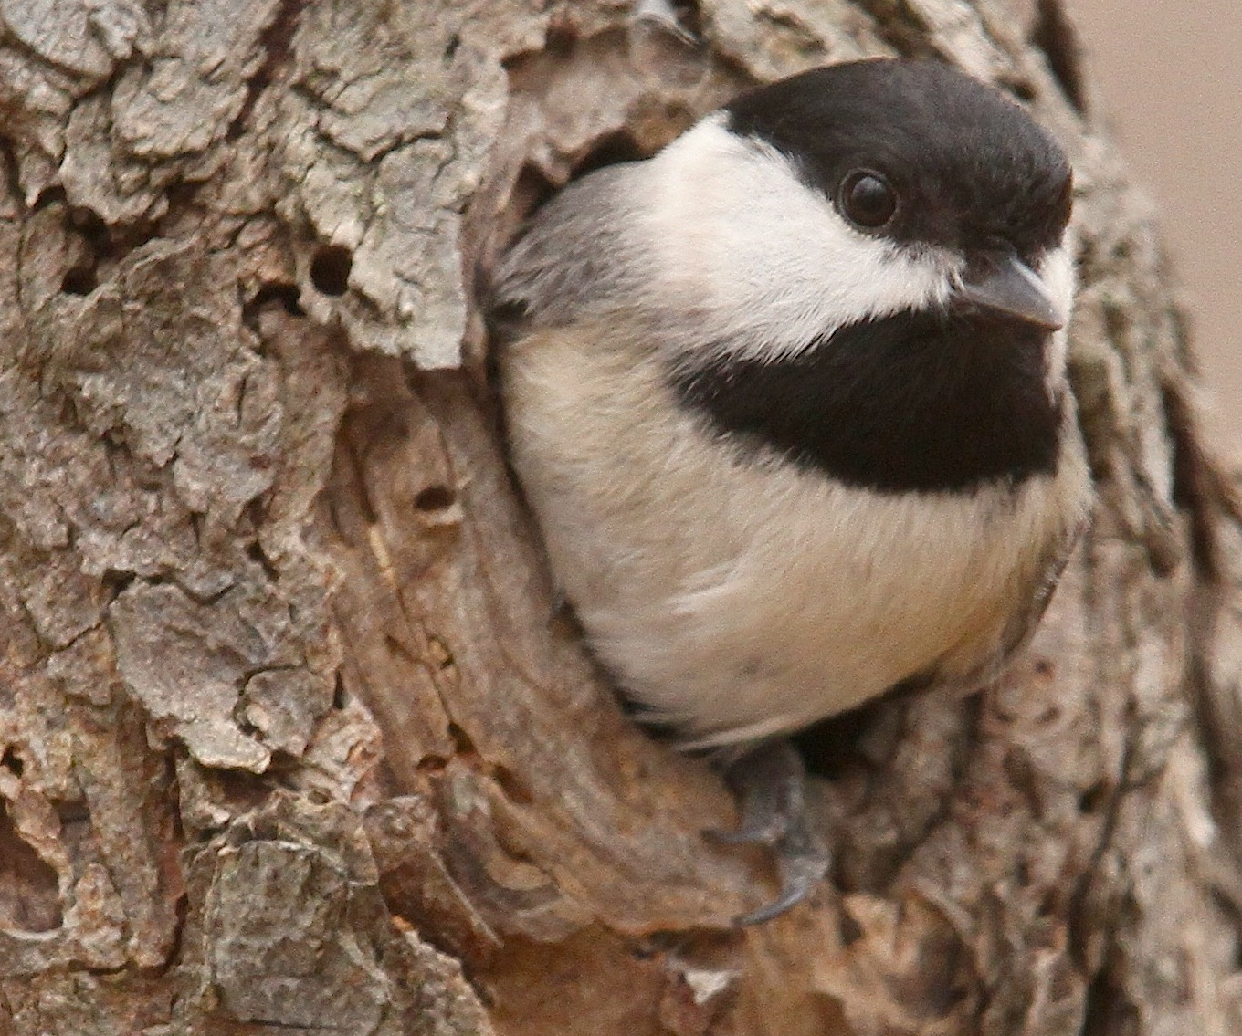
But first! Chickadee’s buffer cache!

Slide 3
Chickadee’s Buffer Cache
The goal of the buffer cache is to store recently-accessed disk blocks in RAM
Read accesses to a cached block avoid a slow disk fetch
Write accesses to a cached block update the in-memory copy, with the actual disk write happening asynchronously
A big part of pset4 involves improving Chickadee’s default buffer cache to handle writes and prefetching!

Slide 4
struct bcslot {
blocknum_t bn_; //Disk block number (unless empty).
unsigned char* buf_ = nullptr; //Memory buffer
//for the entry's
//disk block.
enum state_t {
s_empty, //The bcslot belongs to no block.
s_allocated,//The bcslot is assigned to a block,
//but no kernel task has tried to
//load it from disk yet.
s_loading, //A kernel task has issued a disk
//load for the block.
s_clean //The block has been read from disk!
};
std::atomic<int> state_ = s_empty;
spinlock lock_; //Protects most `state_` changes.
unsigned ref_ = 0; //Reference count.
//...other stuff...
};

Slide 5
struct bcslot {
blocknum_t bn_; //Disk block number (unless empty).
unsigned char* buf_ = nullptr; //Memory buffer
//for the entry's
//disk block.
enum state_t {
s_empty, //The bcslot belongs to no block.
s_allocated,//The bcslot is assigned to a block,
//but no kernel task has tried to
//load it from disk yet.
s_loading, //A kernel task has issued a disk
//load for the block.
s_clean //The block has been read from disk!
};
std::atomic<int> state_ = s_empty;
spinlock lock_; //Protects most `state_` changes.
unsigned ref_ = 0; //Reference count.
//...other stuff...
};
using bcref = ref_ptr<bcslot>;
struct bufcache {
bcslot slots_[10];
spinlock lock_; /Protects all entries’
//.bn_ and .ref_.
wait_queue read_wq_; //Used by kernel tasks
//that are waiting for
//a block to load.
bcref load(blocknum_t bn,...);
//...other stuff...
};
Notes:
The type `ref_ptr<bcslot>` represents a reference-counted pointer to a bcslot:
inline void bcslot::clear() {
assert(ref_ == 0);
state_ = s_empty;
if (buf_) {
kfree(buf_);
buf_ = nullptr;
}
}
void bcslot::decrement_reference_count() {
spinlock_guard guard(lock_); // needed in case we `clear()`
assert(ref_ != 0);
if (--ref_ == 0) {
clear();
}
}
void ref_ptr::reset(T* x = nullptr) noexcept {
if (e_) {
e_->decrement_reference_count();
}
e_ = x;
}

Slide 6
Suppose that kernel task X wants to read a block from disk . . .

Slide 7


Kernel task X
bcref bufcache::load(blocknum_t bn,
...)
Is bn in bufcache?
bufcache
read_wq_
s_empty
state_ =
bn_ =
buf_ =
ref_ =
/*invalid*/
bn wasn’t found, so let’s read it from disk!
nullptr
bcslot
0
Notes:
[Recall that bcslot::state_ is an std::atomic<int>.]

Slide 8

Kernel task X
bcref bufcache::load(blocknum_t bn,
...)
bcslot
bufcache
read_wq_
s_loading
Call bcslot::load(…), which sets state_ to s_loading, unlocks the bcslot lock, and then calls the blocking achistate::read(…)
s_allocated
s_empty
state_ =
bn_ =
buf_ =
ref_ =
/*invalid*/
bn
bn wasn’t found, so let’s read it from disk!
nullptr
bcslot
bcslot
1
0

Slide 9
Kernel task X
bcref bufcache::load(blocknum_t bn,
...)
Imagine that a second kernel task called Y wants to read the same block that X is loading . . .
Kernel task Y
bcref bufcache::load(blocknum_t bn,
...)
bcslot
bufcache
read_wq_
s_loading
An entry for bn is found! Grab the bcslot lock, release the bufcache lock, increment the ref_ count, and call the (maybe blocking) bcslot::load(…)
state_ =
bn_ =
buf_ =
ref_ =
bn
nullptr
bcslot
bcslot
1
2
Notes:
Now imagine that a second kernel task called Y wants to read the same block that X is loading . . .
When kernel task Y calls `bcslot::load()`, the call may block if the disk read for the requested block hasn’t completed yet. However, if the disk read has already completed, then `bcslot::load()` will return immediately. So, let’s take a look at how `bcslot::load()` works.

Slide 10
bool bcslot::load(...){ //Simplified code; remember that
//the bcslot’s .lock_ is held!
if (state_ == s_allocated) { //But not loaded yet!
state_ = s_loading;
lock_.unlock(irqs);
sata_disk->read(buf_, chkfs::blocksize,
bn_ * chkfs::blocksize); //Blocking!
irqs = lock_.lock();
state_ = s_clean;
bc.read_wq_.wake_all(); //Wake anyone waiting for the
//load to complete.
} else if (state_ == s_loading) {
waiter().block_until(bc.read_wq_, [&] () {
return state_ != s_loading;
}, lock_, irqs);
}
//...other stuff...
}
Kernel task X
Kernel task Y

Slide 11
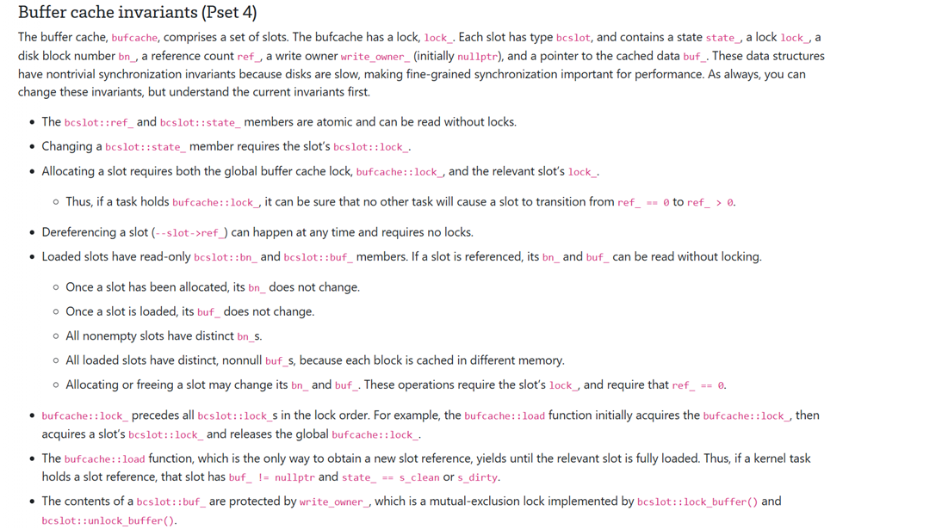

YOU NEED THIS RELIGION IN YOUR LIFE
Notes:
[Ref: https://read.seas.harvard.edu/cs1610/2026/doc/synchronization-invariants/]

Slide 12

Log-structured File Systems
In the 90s, people realized that physical RAM was getting larger
So, buffer caches were getting larger
So, once data was read from disk, reads (and writes to that data) increasingly hit in the buffer cache!
So, file system performance was largely determined by how efficiently you handled writes that had to go to disk
As physical RAM got larger, sequential IOs continued to be much faster than random IOs
Early Unix file systems (e.g., FFS,ext2) tried to avoid seeks and rotational delays by allocating related files and directories in the same block group, but related files and directories often still weren’t directly next to each other
Journaling file systems (e.g., ext3, NTFS) write sequentially to the journal, but asynchronous checkpoints still require head movements away from the journal
So, state-of-the-art file systems couldn’t write to disk at full sequential disk speed
Notes:
[Ref: http://pages.cs.wisc.edu/~remzi/OSTEP/file-lfs.pdf]

Slide 13

MAKE THE ENTIRE FILE SYSTEM A LOG
YES, JUST A LOG
Basic idea: Buffer all writes (data + metadata) using an in-memory “segment”; once the segment is full, write the segment to a log
The segment write is a sequential write, so it’s fast
We write one large segment (e.g., 4 MB) instead of a bunch of block-sized log appends to ensure that, at worst, we pay only one seek and then no rotational latencies (instead of one seek and possibly many rotational latencies)
There are no in-place writes!
Reads still require random seeks, but physical RAM is plentiful, so the hit rate in a warm buffer cache should be high
Notes:
Suppose that, instead of writing a single big segment, we issued a bunch of block-sized writes back-to-back. At worst, we’d pay one seek cost to get the disk head to the proper track. However, we might have to pay a rotational latency cost if we don’t send blocks to the disk fast enough! In other words, suppose that we write block i. Then suppose that, a little while later, we write block i+1. In the time between the two writes, the platter might have rotated away from the position where block i+1 should go.

Slide 14
Finding Inodes
ext3
In a standard file system (e.g., ext3), inodes are statically allocated during file system initialization, and live in a fixed location
With LFS, there are no in-place updates, so how do we determine the place on disk that has the *last* (i.e., most recent) version of an inode?
Data bitmap
Superblock
Inode bitmap
Block group descriptor
Inodes
Journal
Backup superblock
Block group 0
Block group 1
Another challenge in LFS: How do we find and deallocate old versions of data blocks and inodes?
LFS solves these problems using an inode map which translates inode numbers to on-disk inode locations
Data
Inode(v0)
Inode(v1)
. . .
LFS log grows this way
Block group N
Notes:
[In Chickadee, the on-disk layout looks like this:
*Superblock
*Data block bitmap
*Inode region
*Data block region
*Journal region (not used in pset4)
See https://read.seas.harvard.edu/cs1610/2026/doc/chickadeefs/for more details.]

Slide 15
Trick 1: LFS caches the entire inode map in memory
Thus, determining the on-disk location for an inode doesn’t require a disk seek
LFS does need to periodically checkpoint the in-memory imap to disk: allows recovery after a crash or reboot
High-canonical virtual memory
Disk
imap checkpoint lives in fixed on-disk region
. . .
In-memory imap
Log region stores file data and file metadata (e.g., inodes). . .
. . .
. . . but the on-disk checkpoint may point to stale inodes (which point to stale file data)!
Notes:
Note that the checkpoint is not part of the log! Instead, the checkpoint lives in a fixed place on the disk.
The in-memory imap always contains up-to-date inode information; in other words, whenever a change is made to the file system, the in-memory imap is updated immediately. However, the on-disk checkpoint of the imap is only updated periodically. So, at any given moment, the on-disk checkpoint may point to stale inodes, i.e., inodes that are no longer pointed to by the in-memory imap because those inodes have been modified and new versions have been written to disk. During crash recovery, the on-disk imap is read into memory and used to initialize the in-memory imap. Doing this will lead to a consistent file system, but data may be lost because the stale checkpoint may not reflect all pre-crash file system updates.
[Here’s the original LFS paper: https://web.stanford.edu/~ouster/cgi-bin/papers/lfs.pdf
For a higher-level overview of LFS, see here: http://pages.cs.wisc.edu/~remzi/OSTEP/file-lfs.pdf.
Several of the examples in this lecture are adapted from the second link.]

Slide 16
Trick 1: LFS caches the entire inode map in memory
Thus, determining the on-disk location for an inode doesn’t require a disk seek
LFS does need to periodically checkpoint the in-memory imap to disk: allows recovery after a crash or reboot
Trick 2: LFS breaks the on-disk imap into several chunks
When LFS writes an updated inode to the log, LFS also writes the imap chunk that is associated with the inode
Periodically (e.g., once every 30 seconds), LFS updates the checkpoint region (which lives in a fixed place!)
The on-disk checkpoint region contains pointers to the current on-disk versions of the imap chunks
During a clean shutdown, LFS flushes the entire in-memory imap to the checkpoint region
After a clean reboot, LFS reads the checkpoint region to create the in-memory imap
Checkpoint
imap[0:3]->C
1st imap piece
imap[4:7]->G
2nd imap piece
. . .
A
Data
B
Inode₁
blk[0]->A
C
imap_{0:3}
inode[1]->B
D
Data
E
Data
F
Inode₅
blk[0]->D
blk[1]->E
G
imap_{4:7}
inode[5]->F
Notes:
Breaking the imap into pieces is nice because now, when LFS needs to checkpoint the imap, the file system doesn’t have to write the entire in-memory imap to disk—instead, the file system only has to write the pieces of the checkpoint that need to be updated. For example, if only the first imap piece has been updated, then only that piece needs to be written to the relevant checkpoint region.
Note that Trick 2 means that the diagram from the previous slide is slightly inaccurate. The diagram from the previous slide showed that the on-disk checkpoint region contains direct pointers to inodes. However, Trick 2 means that the on-disk checkpoint contains direct pointers to imap chunks; in turn, an imap chunk contains direct pointers to inodes.
Keep in mind that the in-memory imap is a mapping from inode numbers to the corresponding on-disk locations for the inodes. The in-memory imap does *not* point to inode chunks on disk!

Slide 17
LFS: Directories
Checkpoint
imap[0:3]->…
imap[4:7]->E
LFS represents a directory as a file that contains <name,inode> pairs
This is the same representation used by traditional Unix file systems like ext3
However, LFS directories (like LFS inodes) are not updated in place
Ex: Creating a new file foo.txt and then adding a data block to it
Note that LFS always writes a thing that is pointed-to before a pointer to that thing
This will be useful during crash recovery!
. . .
A
Data_{file}
B
Inode₆
blk[0]->A
C
Data_{dir}
<“foo.txt”, 6>
D
Inode₄
blk[0]->C
E
imap_{4:7}
inode[4]->D
inode[6]->B
Notes:
In this example, Inode_4 is the inode for the directory, and Inode_6 is the inode for the file foo.txt.
Note that LFS writes “a thing that is pointed to” before writing “the thing which points.” For example, file data is written to the log before the inode which references that file data is written to the log. Similarly, an inode is written to the log before the chunk of the inode map which references that inode. Ordering the disk writes in this way is helpful for recovering from crashes. It ensure that, if a thing that points, e.g., an inode, is successfully recovered from the log, then the thing that is pointed to, e.g., a data block, has also been successfully recovered from the log. So, for example, a recovered inode will never point to a data block that never actually got written to the log.

Slide 18
LFS: Reading File Data For A File With Inode Number i
Assuming that the inode map is cached in memory, LFS requires the same number of disk reads as in a traditional Unix file system
Consult the in-memory inode map to determine the disk address for inode i
Read the inode into memory if it isn’t already in the buffer cache, and find the appropriate data pointer
You may need to read one or more indirect blocks
Read the data block that is referenced by the data pointer

Slide 19


Slide 20

LFS: Garbage Collection
Checkpoint
imap[0:3]->G
imap[4:7]->…
As the file system handles new writes, older parts of the log become stale
Ex: Appending a new block to a file invalidates the file’s old inode (and the associated imap chunk)
Keeping stale data could actually be useful if we wanted to implement a versioning file system!
Regardless, stale data will eventually need to be garbage collected
LFS performs garbage collecting at a segment granularity
The cleaner reads X partially invalid segments, and writes the live data to Y<X segments (each of which will only contain live data)
This approach keeps GC reads and writes sequential!
. . .
A
Data
B
Inode₁
blk[0]->A
C
imap_{0:3}
inode[1]->B
D
Data
E
Inode₁
blk[0]->A
blk[1]->D
G
imap_{0:3}
inode[1]->E
Notes:
In this example, the file used to have just one data block living at location A; the append creates a new data block living at location D.

Slide 21
LFS: How Exactly Should We Implement GC?
Scheduling garbage collection turns out to be tricky
Could only run the cleaner when free space is low
Good: No garbage collection when space is plentiful!
Bad: The disk has finite size, so eventually space will run out, and then the cleaner will have to run frequently (possibly blocking writes from normal processes until free segments are available)
Could run the cleaner at regular intervals, but then the cleaner will regularly contend with normal processes for disk bandwidth
Determining how to cluster live data in compacted segments is also tricky
Place data from the same directory in the same segment, to improve spatial locality for subsequent reads?
Place data of the same age in the same segment, to create “cold” segments that won’t need further compaction, and “hot” segments that will quickly fill up with stale data and will release a lot of free space upon compaction?

Slide 22
The LFS Wars of the 1990s
In two papers (one in 1993, one in 1995) Seltzer compared FFS to a BSD port of Sprite’s LFS, finding that:
LFS is great for workloads with:
Frequent small writes
Read patterns that are amenable to hitting in the buffer cache
Enough idle time for cleaning to run without hurting foreground tasks
LFS is not great when:
The disk is almost full (because the cleaner must read many segments just to find a little free space)
Writes are too random (because dead space will be spread evenly throughout the segments, forcing the cleaner to read many segments to free space)
Ousterhout (who wrote Sprite LFS) claimed that:
BSD LFS was poorly implemented and had performance bugs
The benchmarks used to evaluated BSD LFS were unfair (e.g., the compilation benchmark was CPU bound and doesn’t provide much insight into file system behavior; the transaction processing workload contains a pathological number of random writes)
FFS fragmentation can hurt performance just as much as LFS cleaning
Notes:
For the purpose of this lecture, you can basically think of FFS as ext3 but without journaling support.
LFS is great for frequent small writes because those small writes can be buffered into a segment, and then written to disk in a single sequential write.
[Ref: https://web.archive.org/web/20190219171617/https://www.eecs.harvard.edu/margo/papers/usenix95-lfs/supplement/ouster_critique2.html
https://dl.acm.org/doi/10.1145/268998.266700
//This is the “Improving the Performance of Log-Structured File Systems with Adaptive Methods” by Matthews et al.]

Slide 23
LFS: Crash Recovery
Remember that the on-disk checkpoint region contains pointers to all of the on-disk imap pieces
LFS updates the checkpoint region every 30 seconds
After a crash, LFS can regenerate the in-memory map by reading the checkpoint region
To ensure that the multi-sector checkpoint region is updated atomically, LFS keeps two copies of the checkpoint in two different portions of the disk
LFS alternates which location receives the current checkpoint
To detect interrupted checkpoints, LFS writes a timestamp, the pointers to the imap fragments, and then the same timestamp; the checkpoint is only valid if both timestamps match
This approach works, but during recovery, we might lose the last 30 seconds of write data

Slide 24

Summary: The File Systems That We Have Loved
Journaling file systems use write-ahead logging to make crash recovery faster
ext3 performs redo logging of physical blocks
The journal converts random writes into sequential ones, but the file system must eventually issue random writes to perform checkpoints
LFS turns the entire file system into a log
Assumes that the buffer cache will handle most reads, so making writes fast is the most important thing
The log turns all writes (random or sequential, large or small) into large sequential writes
Fast recovery
Requires garbage collection, which (depending on the workload) may eliminate the benefits from making all writes sequential

