Slide 1

The Horrors of Memory Ordering
CS 1610: Lecture 14
3/25/2026

Slide 2
The Memory Operations in a Single Thread
Typically, a developer writes a thread’s code in a high-level language (e.g., C++, Go) and relies on the compiler to translate the source code to machine instructions
The “source code order” of memory operations refers to the order of loads and stores at the source code level
void foo(int* i, int* j,
int* x, int* y,
int* out) {
int sum_ij = (*i) + (*j);
int sum_xy = (*x) + (*y);
*out = sum_ij + sum_xy;
}
0
1
2
3
4

Slide 3

SOURCE-CODE ORDER IS A LIE

Slide 4

Source-code Order Is A Lie
Source-code order: The sequence of memory reads and writes specified by a developer in a single thread’s code
Program order: The sequence that the compiler issues
Execution order: The sequence that the processor executes
These orders can differ, as long as source-code-order semantics are preserved!
Instructions in program order
F
D
EX
MEM
WB
For the simple pipeline
we discussed in Lecture 1, execution order is always in program order!

Slide 5

Source-code Order Is A Lie
Source-code order: The sequence of memory reads and writes specified by a developer in a single thread’s code
Program order: The sequence that the compiler issues
Execution order: The sequence that the processor executes
These orders can differ, as long as source-code-order semantics are preserved!
EX
MEM
Instructions in program order
F
D
WB
EX
MEM
Start-of-the-art pipelines can execute instructions out-of-order and in parallel!
Notes:
Note that, even for an out-of-order pipeline, instructions retire (i.e., graduate from the writeback stage) in order.

Slide 6
Source-code Order Is A Lie
Source-code order: The sequence of memory reads and writes specified by a developer in a single thread’s code
Program order: The sequence that the compiler issues
Execution order: The sequence that the processor executes
These orders can differ, as long as source-code-order semantics are preserved!
  Ex: Compiler optimizations may eliminate memory accesses
//No compiler optimization:
//v stored in -8(%rbp),
//p stored in -24(%rbp).
movq %rdi, -24(%rbp)
movq $0, -8(%rbp)
.L5:
cmpq $9, -8(%rbp)
ja .L4 //Exit the loop
movq -24(%rbp), %rax
movq (%rax), %rax
addq %rax, -8(%rbp)
jmp .L5
//-O2 optimization: The value pointed
//to by p is moved into a register, and
//local variable v stays in a register!
movq (%rdi), %rdx
xorl %eax, %eax
.L2:
addq %rdx, %rax
cmpq $9, %rax
jbe .L2
uint64_t foo(uint64_t* p){
uint64_t v = 0;
while (v < 10) {
v += *p; //Memory access!
}
return v;
}
Notes:
[For a quick way to disassemble snippets of compiled C++ code, go here: https://godbolt.org/]
[Ref: https://davmac.wordpress.com/2018/01/28/understanding-the-c-c-memory-model/
https://arxiv.org/pdf/1803.04432.pdf]

Slide 7

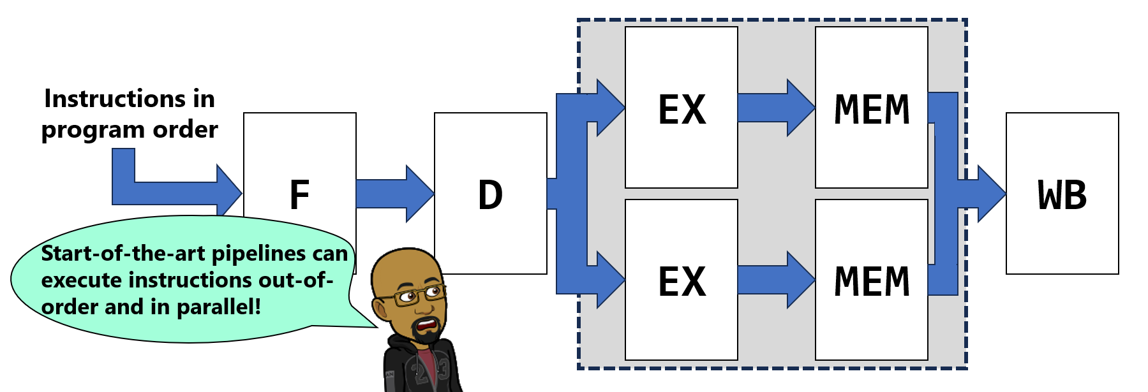
Source-code Order Is A Lie
The memory load completes; the sneak peak of %rbx is sent to EX, and instructions must retire in program order!
Fetching from the memory hierarchy is slow!
Source-code order: The sequence of memory reads and writes specified by a developer in a single thread’s code
Program order: The sequence that the compiler issues
Execution order: The sequence that the processor executes
These orders can differ, as long as source-code-order semantics are preserved!
  Ex: Even if the compiler issues instructions in source code order, the processor may execute those instructions out of order if data dependencies wouldn’t be violated
%rbx hasn’t been updated yet by mov! So, the pipeline makes a note to grab the updated value from MEM later.
Sneak peak of new %rbx
mov (%rax), %rbx
add %rbx, %rcx
sub %r9, %r10
The sub is ready to go to WB, but instructions must retire in program order!
mov (%rax), %rbx
add %rbx, %rcx
sub %r9, %r10
Must be executed in order due to the data dependency
Can be executed before, after, or between the mov+add
Notes:
[Note that, as mentioned earlier in the slide deck, even if instructions execute out-of-order, they *commit* in order. This ensures that the ISA-level effects of a program (e.g., updates to registers and memory) proceed as if the program had executed in program order. So, in the example above, the `add` and `sub` instructions may complete the EX stage of the pipeline in an arbitrary order with respect to each other; however, the `add` instruction will always commit before the `sub` instruction, because the `add` instruction comes first in program order (i.e., the order of instructions that the fetch stage of the pipeline sees).]
[Ref: https://preshing.com/20120625/memory-ordering-at-compile-time/]

Slide 8
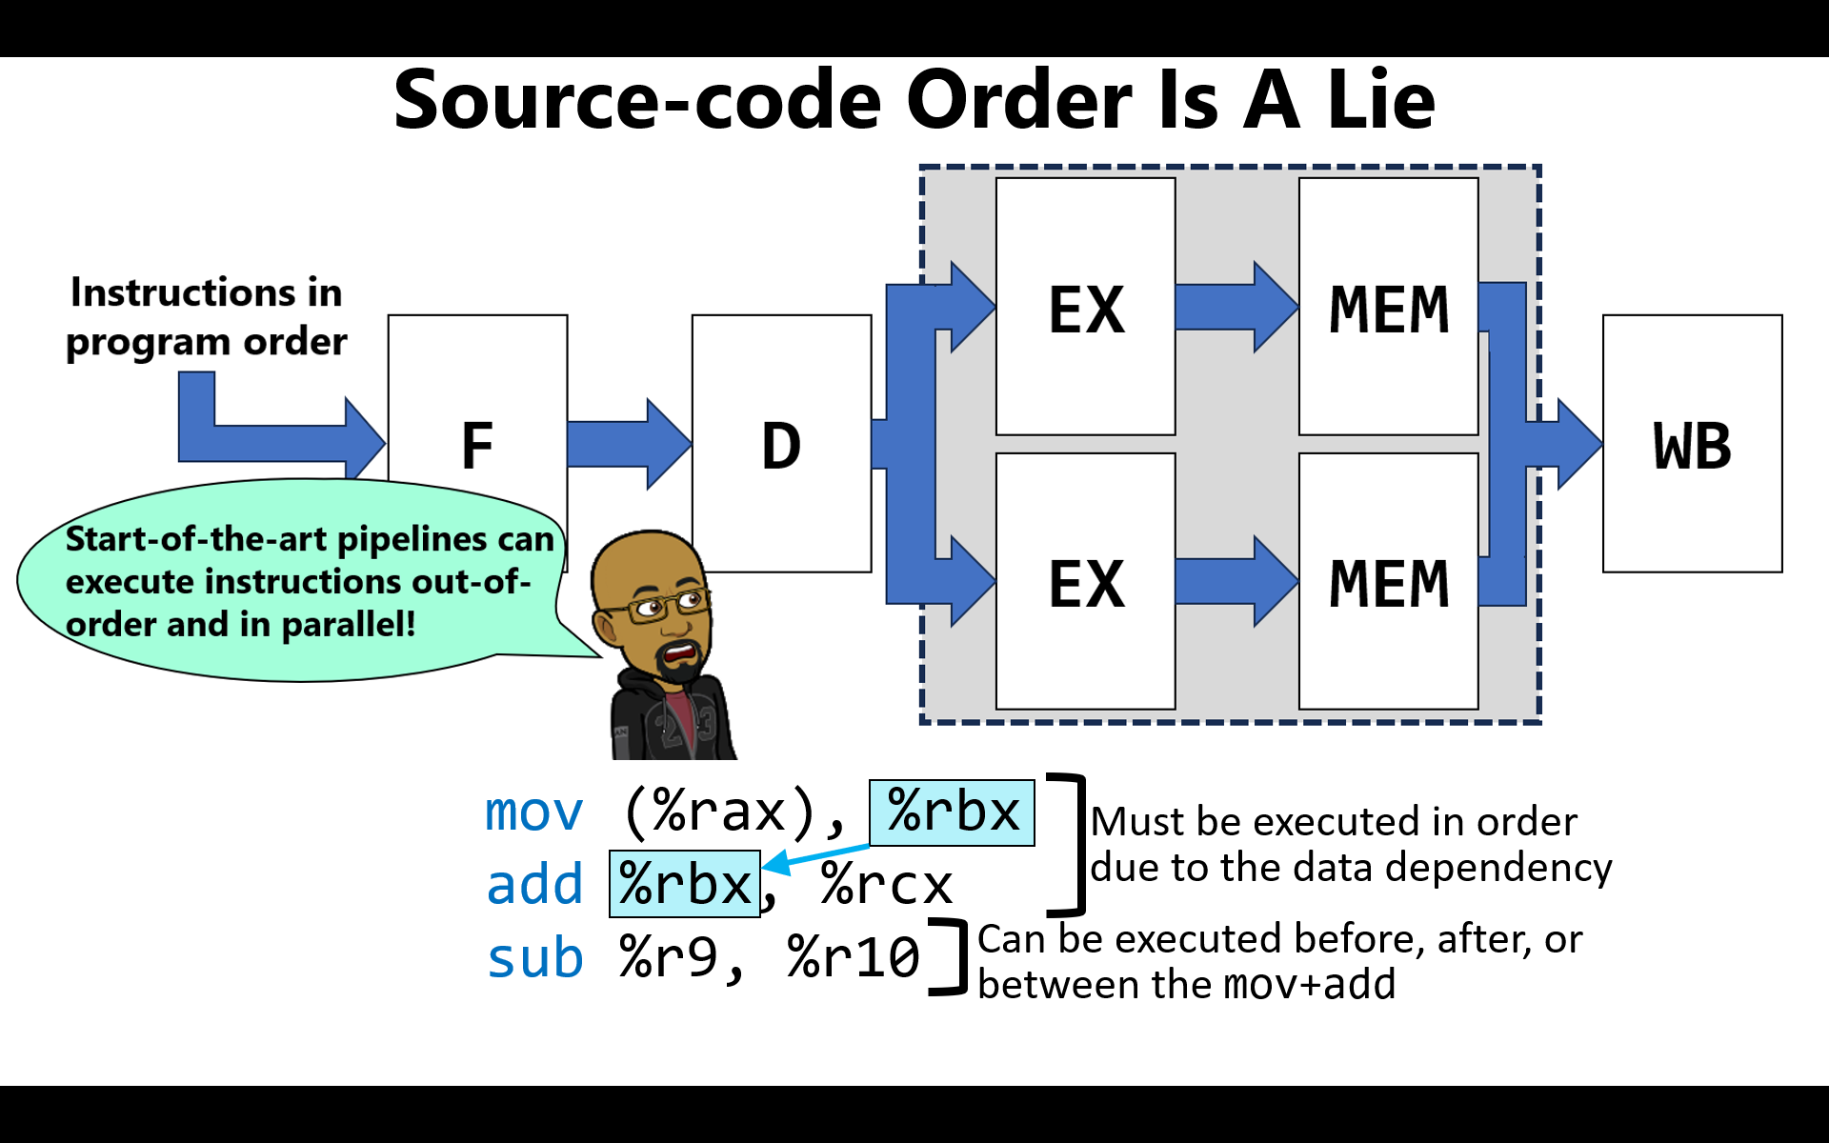
Instructions enter the pipeline in program order
Instructions exit the pipeline in program order
Instructions may go through the middle of the pipeline out-of-order
Older instructions sometimes need to provide “sneak peaks” of register updates so that newer instructions don’t stall!
Notes:
If older instructions didn’t provide “sneak peaks” of register updates to newer instructions, then the newer instructions would have to wait for older instructions to retire (i.e., finish WB) before the updated register values could be seen!

Slide 9
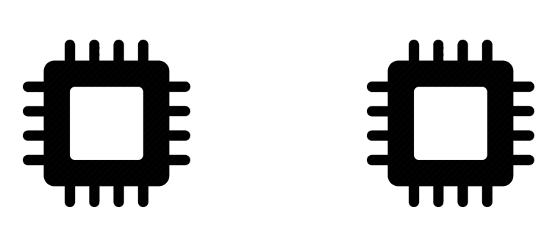
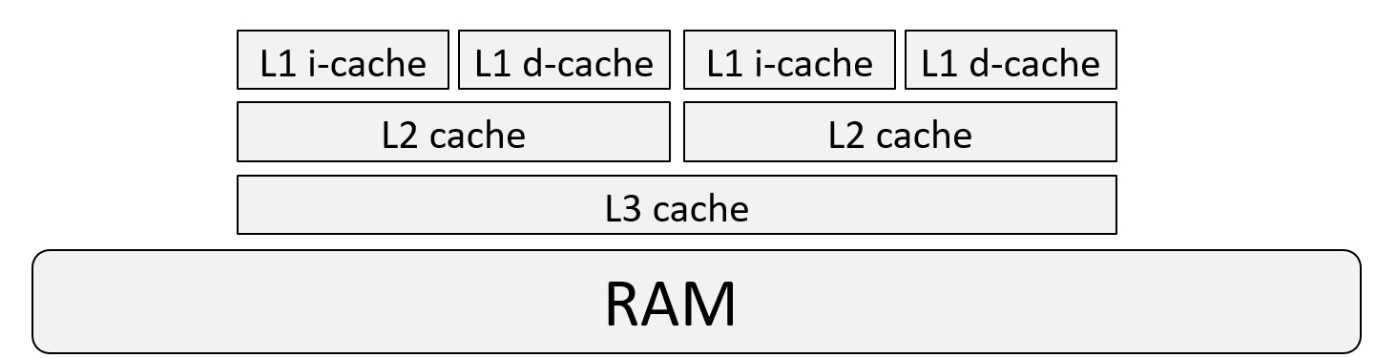

Memory Consistency on a Multicore Machine
Any sane machine ensures that a particular core perceives its own memory reads and writes to have occurred as if the execution order were program order
However, if we have two cores on the same machine, in what order does the memory hierarchy see the reads and writes of the two cores? In other words, when do a core’s memory operations leave the core and become visible to the memory hierarchy and other cores?
The answer is important for multi-core software like Chickadee!

Slide 10

What is x86’s Model for Memory Consistency?

Slide 11

x86: Store Buffers, Multiple Cores, and LOCK Prefixes
Assume an inclusive L* cache design:
Everything in a core’s L1 caches also resides in the core’s L2 cache
Everything in both cores’ L2 caches also resides in the shared L3 cache
L1 i-cache
L1 d-cache
L1 i-cache
L1 d-cache
L2 cache
L2 cache
L3 cache
RAM
Notes:
[Aside: Inclusive caches are just one possible design. An exclusive approach would have a single cache line reside in at most one of the L1/L2/L3 cache. A non-inclusive non-exclusive (NINE) approach does not strictly enforce an inclusive or exclusive policy. For more details on the various approaches, see the ever-infallible Wikipedia: https://en.wikipedia.org/wiki/Cache_inclusion_policy]

Slide 12
x86: Store Buffers, Multiple Cores, and LOCK Prefixes
Each core has a FIFO (w.r.t. program order) store buffer
  In the MEM stage, a memory write first goes in the store buffer
  At some point later, hardware propagates the write (i.e., makes it visible) to the downstream memory hierarchy (L* + RAM)
  In the MEM stage, a memory read:
    Checks the local store buffer before pulling data from memory, ensuring a core reads its own writes
    Becomes visible if the read cannot be satisfied by the store buffer
  Note that x86 execution order always propagates stores in program order, since the store buffer is FIFO w.r.t. program order!
mov $0x42,(%rax) //Suppose %rax=0xAA
mov $0x0, (%rbx) //Suppose %rbx=0xBB
mov (%rax), %r12
*(OxAA)=0x42
Store
buffer
(FIFO)
*(OxBB)=0x0
Store
buffer
(FIFO)
L1 i-cache
L1 d-cache
L1 i-cache
L1 d-cache
L2 cache
L2 cache
L3 cache
RAM
Notes:
Remember that program order corresponds to the sequence of instructions that the compiler issues; in contrast, execution order refers to the sequence that the processor executes.
[Ref: https://docs.microsoft.com/en-us/archive/msdn-magazine/2015/may/compilers-what-every-programmer-should-know-about-compiler-optimizations-part-2
https://www.cl.cam.ac.uk/~pes20/weakmemory/cacm.pdf]

Slide 13
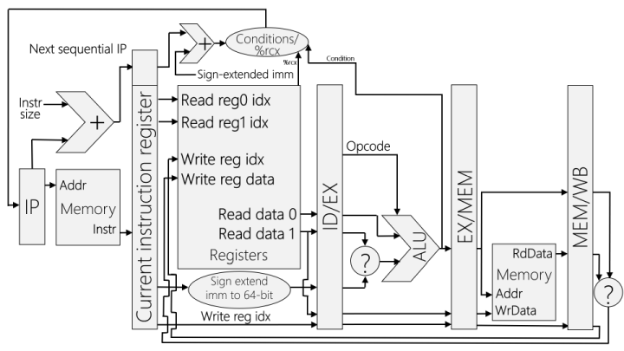
x86: Store Buffers, Multiple Cores, and LOCK Prefixes
Store buffers mean that a write made by one core may not be immediately visible to another core!
  The earliest that a store buffer entry can be flushed (i.e., made visible) is when the associated store instruction commits
  Note that modern pipelines are long (~12—20 stages), which delays commit times!
mov $0x42, (%rax)
//Writes to 0xAA
mov (%r12), %r10
//Reads from 0xAA
Read misses in the store buffer . . .
Store
buffer
(FIFO)
*(OxAA)=0x42
Store
buffer
(FIFO)
. . . so a stale value is pulled from L1/L2/L3/
RAM!
L1 i-cache
L1 d-cache
L1 i-cache
L1 d-cache
L2 cache
L2 cache
Unlike a store (which becomes visible at some point after committing), a load become visible when the MEM stage actually sends the read to the memory hierarchy (assuming the read missed in the local store buffer)
An instruction commits when it completes the writeback stage; when a store instruction commits, hardware will flush the corresponding store buffer entry eventually (but might not do so immediately!)
L3 cache
RAM
Notes:
Note that when the second core’s read misses in the store buffer, the core will search its own L1 cache, then its own L2 cache, then RAM, pulling a stale value from the memory hierarchy! The second core won’t consult the L2 and L1 cache of the first core before checking RAM. The reason is that the computer uses an inclusive cache design. Thus, if the desired memory value isn’t found in the shared L3 cache, the value couldn’t possible reside in the L2 or L1 caches of the first core. Note that the second core also won’t check the first core’s store buffer, because the writes in that buffer haven’t committed yet!]
[To see the pipeline depths of various Intel chips, see the chart at https://en.wikipedia.org/wiki/List_of_Intel_CPU_microarchitectures#x86_microarchitectures.]
[Ref: https://www.cl.cam.ac.uk/~pes20/weakmemory/cacm.pdf
https://www.cs.utexas.edu/~bornholt/post/memory-models.html#fnref:compiler]

Slide 14

x86: Store Buffers, Multiple Cores, and LOCK Prefixes
The LOCK prefix can precede instructions that perform a read-modify-write on a memory location
  Ex: LOCK inc 0x16(%rax) //Increment 0x16(%rax)
  Ex: LOCK bts (%rax), 0x2 //“Bit test and set”: Read //second bit of (%rax), //store it in the carry //flag, then set second //bit to 1
  While a core executes a LOCK instruction, other cores can’t read or write memory (and can write to but not read from the local store buffer)
  At the end of the LOCK’d instruction, the local store buffer is flushed before lock is released
struct spinlock {
std::atomic_flag f_;
void lock_noirq() {
while (f_.test_and_set()) {
pause();
}
}
//...other stuff...
};
Store
buffer
(FIFO)
Store
buffer
(FIFO)
LOCK prefix lock
(hardware-maintained)
L1 i-cache
L1 d-cache
L1 i-cache
L1 d-cache
L2 cache
L2 cache
L3 cache
RAM
Notes:
The `inc` instruction increments its argument by 1.
On x86, the C++ compiler will implement std::atomic_flag::test_and_set() using a LOCK-prefixed instruction.
[Ref: https://www.felixcloutier.com/x86/lock
https://www.felixcloutier.com/x86/xchg
Volume 3 of Intel’s software developer’s manual: See Section 8.1 (“Locked Atomic Operations”)
]

Slide 15

//Lock lives at 0xBB, and isn’t initially in L*
LOCK bts (%rax), 0x2
The LOCK prefix can precede instructions that perform a read-modify-write on a memory location
  Ex: LOCK inc 0x16(%rax) //Increment 0x16(%rax)
  Ex: LOCK bts (%rax), 0x2 //“Bit test and set”: Read //second bit of (%rax), //store it in the carry //flag, then set second //bit to 1
  While a core executes a LOCK instruction, other cores can’t read or write memory (and can write to but not read from the local store buffer)
  At the end of the LOCK’d instruction, the local store buffer is flushed before lock is released
LOCK bts (%rax), 0x2
//Can now do the read-modify-write
//on the lock!
//Blocked while other core has lock!
Store
buffer
(FIFO)
*(OxBB)=0x4
Store
buffer
(FIFO)
LOCK prefix lock
(hardware-maintained)
L1 i-cache
L1 d-cache
L1 i-cache
L1 d-cache
L2 cache
L2 cache
L3 cache
RAM
Read *(0xBB)

Slide 16
What if a set of program-order memory operations in a thread (e.g., in a critical section!) must all become visible before the next set of program-order memory operations in the thread become visible?
  All loads and stores before an mfence will become visible before all loads and stores after an mfence
  mfence also synchronously flushes the store buffer (which isn’t strictly necessary to satisfy the ordering requirements)
  Any LOCK’d instruction also orders memory operations and flushes the store buffer like mfence does
mov (%rax), %r11
mov $0x42,(%rbx) //Suppose %rbx=0xAA
//Might update store buffer (but not commit)
//before or concurrently w/prior load instr’s
//read becoming visible (if %rax!=%rbx)
mfence //Flushes second instruction’s store buffer
//entry if it’s still buffered
mov (%rcx), %r9 //Can’t be reordered upward
//[even if making
//the read visible
//earlier would not
//violate single-
//threaded data
//dependencies!]
Store
buffer
(FIFO)
*(OxAA)=0x42
Store
buffer
(FIFO)
LOCK prefix lock
(hardware-maintained)
L1 i-cache
L1 d-cache
L1 i-cache
L1 d-cache
L2 cache
L2 cache
L3 cache
RAM
Read (%rcx)
Notes:
[Remember that program order corresponds to the sequence of instructions that the compiler issues.]
If %rax equals %rbx, then the second instruction cannot happen before or concurrently with the first one because there would be a data dependency---both instructions would be touching the same address, with one touch being a read and the other being a write. In this situation, program order needs to be maintained to ensure program correctness!
[Note that, as the documentation for mfence describes (https://www.felixcloutier.com/x86/mfence), “MFENCE does not serialize the instruction stream.” On x86, a serializing instruction (as defined by Intel in Section 8.3 of https://www.intel.com/content/dam/www/public/us/en/documents/manuals/64-ia-32-architectures-software-developer-vol-3a-part-1-manual.pdf) is one that forces the processor to “to complete all modifications to flags, registers, and memory by previous instructions and to drain all buffered writes to memory before the next instruction is fetched and executed.” An example of a serializing instruction is a mov to %cr3 or a load of the GDT via the lgdt instruction. As Intel states, “Nothing can pass a serializing instruction and a serializing instruction cannot pass any other instruction.” So, the fact that mfence isn’t a serializing instruction means that an instruction that (1) follows an mfence and (2) isn’t a load or store may be reordered above the mfence.]
[As described by https://software.intel.com/en-us/forums/intel-moderncode-for-parallel-architectures/topic/537987, “From a purely architectural perspective, the MFENCE instruction does not have to directly cause the draining of the store buffers on a processor -- it simply has to prevent any subsequent memory references from being executed before the prior loads and stores have reached global visibility. Of course in practice it makes sense to have the MFENCE instruction cause the store buffers to be drained -- otherwise the processor would simply stall until some other mechanism caused the store buffers to drain. Intel's choice to make MFENCE drain the store buffers is confirmed in Section 11.10 of Volume 3 of the Intel SW Developer's Guide, where the following list of store-buffer-draining events is included:
*Generation of an Exception and/or Interrupt
*Execution of a serializing instruction (CPUID, IRET, and RSM are the only non-privileged serializing instructions)
*Execution of an I/O instruction
*Execution of a LOCK operation
*Execution of the BINIT operation (an external reset operation using the BINIT pin)
*Execution of an SFENCE instruction
*Execution of an MFENCE instruction
”]
[As described by https://preshing.com/20120515/memory-reordering-caught-in-the-act/, “Interestingly, mfence isn’t the only instruction which acts as a full memory barrier on x86/64. On these processors, any locked instruction, such as xchg, also acts as a full memory barrier – provided you don’t use SSE instructions or write-combined memory.”]

Slide 17
Case Study: A Correct x86 Spinlock
//Here’s a small implementation; the lock
//lives at (%eax).
// Free: (%eax) == 0
// Held: (%eax) == 1
acquire:
LOCK bts (%eax), 0 //Read zeroth bit of
//(%eax), store it
//in the carry flag
//CF, then set the
//zeroth bit to 1
jc acquire //Spin if CF==1
//i.e., lock was held
crit_section:
//The critical section is here
release:
LOCK btr (%eax), 0 //“Bit test+reset”:
//Read the zeroth bit
//into CF and then set
//the bit to 0
In 1999, Linux kernel developers were trying to determine the fastest (but still correct!) way to design a spinlock for a multicore x86 system
At the time, the x86 memory model was underspecified, leading to confusion
Notes:
[Note that the LOCK prefix cannot be used with a `mov` instruction; thus the use of `btr` in release.]

Slide 18
Case Study: A Correct x86 Spinlock
//Here’s a small implementation; the lock
//lives at (%eax).
// Free: (%eax) == 0
// Held: (%eax) == 1
acquire:
LOCK bts (%eax), 0 //Read zeroth bit of
//(%eax), store it
//in the carry flag
//CF, then set the
//zeroth bit to 1
jc acquire //Spin if CF==1
//i.e., lock was held
crit_section:
//The critical section is here
release:
LOCK btr (%eax), 0 //“Bit test+reset”:
//Read the zeroth bit
//into CF and then set
//the bit to 0
LOCK’d instructions have mfence semantics
So, having LOCK’d instructions at the start and end of the critical section ensure that the CPU cannot reorder the critical section’s memory instructions to be outside of the lock acquire and release!
Notes:
Recall that mfence semantics are the following: All loads and stores before an mfence will become visible before all loads and stores after an mfence. It’s important to keep a critical section’s instructions between the acquire and release of the lock. For example, suppose that process X has a critical section that writes to a piece of shared state that’s protected by the lock. We wouldn’t want the CPU to move the write PAST the lock release; if this happened, a write that should have occurred inside the critical section might occur simultaneously with the execution of the critical section by a different process Y that runs on a different processor!

Slide 19
Case Study: A Correct x86 Spinlock
//The Linux implementation: lock lives at (%eax).
// Free: (%eax) == 1
// Held: (%eax) <= 0
acquire:
LOCK dec (%eax) //Atomic decrement of the lock
//variable, setting the sign
//flag SF to 1 if (%eax) is
//now negative (i.e., < 0).
jns crit_section //"Jump if not sign": We've
//grabbed the lock if the
//lock is now 0 (i.e., SF=0),
//otherwise, the lock is held,
//so we decremented (%eax)
//to a negative value and SF=1.
spin:
cmp (%eax), 0 //Compare the lock to 0.
jle spin //If the lock is <= 0, it's
//held by someone else---spin!
jmp acquire //Otherwise, the lock is free,
//so try to get it.
crit_section:
//The critical section starts here
In 1999, Linux kernel developers were trying to determine the fastest (but still correct!) way to design a spinlock for a multicore x86 system
At the time, the x86 memory model was underspecified, leading to confusion

Slide 20
Case Study: A Correct x86 Spinlock
//The Linux implementation: lock lives at (%eax).
// Free: (%eax) == 1
// Held: (%eax) <= 0
acquire:
LOCK dec (%eax) //Atomic decrement of the lock
//variable, setting the sign
//flag SF to 1 if (%eax) is
//now negative (i.e., < 0).
jns crit_section //"Jump if not sign": We've
//grabbed the lock if the
//lock is now 0 (i.e., SF=0),
//otherwise, the lock is held,
//so we decremented (%eax)
//to a negative value and SF=1.
spin:
cmp (%eax), 0 //Compare the lock to 0.
jle spin //If the lock is <= 0, it's
//held by someone else---spin!
jmp acquire //Otherwise, the lock is free,
//so try to get it.
crit_section:
//The critical section starts here
This code exploits knowledge about the memory model of an x86 processor
  The LOCK prefix is to be avoided when possible, because it prevents other CPUs from issuing memory operations (hence the split between the acquire and spin phases)
  x86 guarantees that reads and writes to aligned 32-bit memory values are atomic
Notes:
By splitting the lock acquisition into an acquire and a spin, the spin part doesn’t require the memory bus (or the cache bus in modern Intel processors) to be locked! [Also note that the spin part is a plain read, not a read/modify/write. Since x86 guarantees that reads to an aligned 32-bit memory value are atomic, the read in the spin part will atomically fetch the value of the spinlock without the need for a bus-locking LOCK operation. However, since the spin part doesn’t actually acquire the lock, it’s possible that a core will read the lock as free in the spin part, but before getting to the acquire part, another core acquires the lock.]

Slide 21
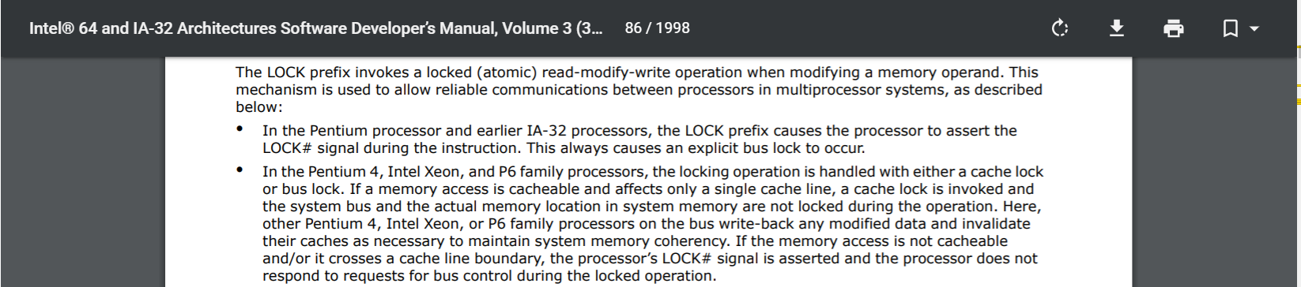
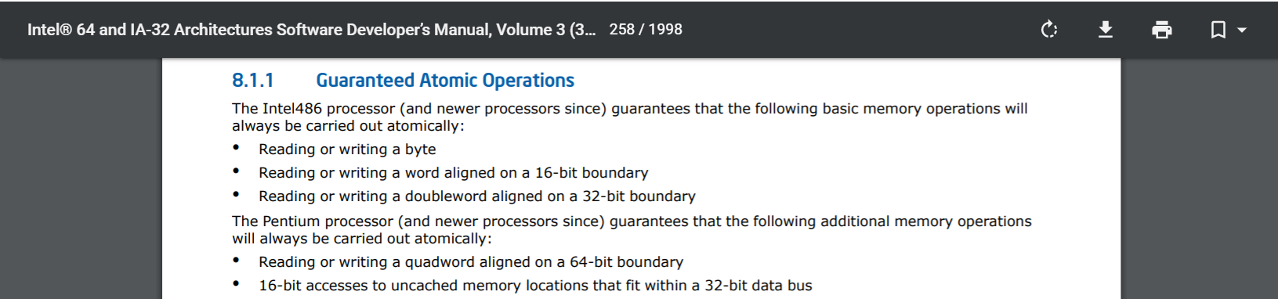
Notes:
[In the context of this class, the precise differences between a “cache lock” and a “bus lock” aren’t relevant. The basic idea is that locking the cache is less painful than locking the entire bus, but either type of locking is best to avoid if possible.]
[Ref: https://www.intel.com/content/www/us/en/architecture-and-technology/64-ia-32-architectures-software-developer-system-programming-manual-325384.html]

Slide 22
Case Study: A Correct x86 Spinlock
//The Linux implementation: lock lives at (%eax).
// Free: (%eax) == 1
// Held: (%eax) <= 0
acquire:
LOCK dec (%eax) //Atomic decrement of the lock
//variable, setting the sign
//flag SF to 1 if (%eax) is
//now negative (i.e., < 0).
jns enter //"Jump if not sign": We've
//grabbed the lock if the
//lock is now 0 (i.e., SF=0),
//otherwise, the lock is held,
//so we decremented (%eax)
//to a negative value and SF=1.
spin:
cmp (%eax), 0 //Compare the lock to 0.
jle spin //If the lock is <= 0, it's
//held by someone else---spin!
jmp acquire //Otherwise, the lock is free,
//so try to get it.
enter:
//The critical section starts here
To implement unlock, the Linux developers were unsure whether a LOCK’d implementation like . . .
LOCK xchg 1, (%eax)
. . . could be replaced by . . .
mov 1, (%eax)
. . . which avoids a painful LOCK-prefixed instruction
The concern was that, in a non-LOCK’d approach, the CPU could reorder memory operations in the critical section to be *after* the release of the lock
Notes:
[Note that xchg always has an implicit LOCK prefix, so you don’t actually need to specify it explicitly (although doing so won’t hurt anything).]
[Ref: Section 4 of “x86-TSO: A Rigorous and Usable Programmer’s Model for x86
Multiprocessors” in Communications of the ACM: [http://www.spinroot.com/spin/Doc/course/x86_tso.pdf]
https://lkml.org/lkml/1999/11/24/90
]

Slide 23

Case Study: A Correct x86 Spinlock
//The Linux implementation: lock lives at (%eax).
// Free: (%eax) == 1
// Held: (%eax) <= 0
//Imagine that we acquire the lock here using
//an acquisition implementation that has mfence
//semantics . . .
//. . . and then execute the critical section . . .
mov (%ebx), %ecx //CS1
mul %ecx, %edx //CS2: Dependency on CS1
mov %edx, 16(%ebx) //CS3: Dependency on CS2
//. . . and then release the lock like this:
release:
mov 1, (%eax) //Set lock to “free”.
//Note that this instruction is not LOCK-
//prefixed, so it does not implement an
//mfence-style memory barrier.
//CS* have no dependency on spinlock (%eax).
//Could the processor reorder (say) CS3 to
//*after* the lock release???
To implement unlock, the Linux developers were unsure whether a LOCK’d implementation like . . .
LOCK xchg 1, (%eax)
. . . could be replaced by . . .
mov 1, (%eax)
. . . which avoids a painful LOCK-prefixed instruction
The concern was that, in a non-LOCK’d approach, the CPU could reorder memory operations in the critical section to be *after* the release of the lock
Would violate the atomicity of critical sections!

Slide 24
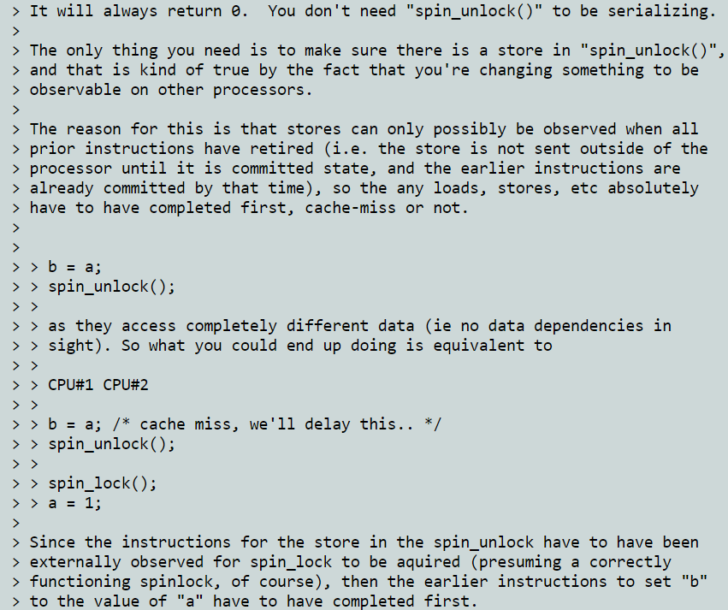
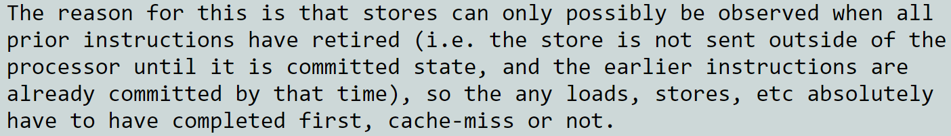
An Intel developer replied to a thread on the Linux kernel mailing list, and explained why mov 1, (%eax) is correct!
Notes:
[Ref: https://lkml.org/lkml/1999/11/24/90]

Slide 25
A store buffer entry for write instruction w can only be flushed if all instructions prior to w in program order have committed (and exited the store buffer if any are writes)!
Store
buffer
(FIFO)
*(OxAA)=0x42
Store
buffer
(FIFO)
LOCK prefix lock
(hardware-maintained)
L1 i-cache
L1 d-cache
L1 i-cache
L1 d-cache
L2 cache
L2 cache
L3 cache
RAM

Slide 26
Case Study: A Correct x86 Spinlock
//The Linux implementation: lock lives at (%eax).
// Free: (%eax) == 1
// Held: (%eax) <= 0
//Imagine that we acquire the lock here using
//an acquisition implementation that has mfence
//semantics . . .
//. . . and then execute the critical section . . .
mov (%ebx), %ecx //CT1
mul %ecx, %edx //CT2: Dependency on CT1
mov %edx, 16(%ebx) //CT3: Dependency on CT2
//. . . and then release the lock like this:
release:
mov 1, (%eax)
This is safe: If an external CPU sees the spinlock as free (i.e., sees the write to (%eax)), then all of the prior reads and writes in the local core’s critical section have become visible.
All prior writes have become visible because x86 makes writes visible in FIFO order from the store buffer.
All prior reads have become visible because, by the time a write commits (which is the earliest time that the write can become visible), all prior reads have already committed (and thus become visible: reads become visible in the MEM stage!)

Slide 27
Which Memory Operations Does x86 Reorder?
Suppose that we examine two program-order memory operations: LoadLoad, StoreStore, LoadStore, StoreLoad
x86 only does StoreLoad reordering!
  StoreStore: Two program-order memory writes become visible in program order
  LoadStore: A memory write is never made visible before a memory read that is earlier in program order
  LoadLoad: Two program-order memory reads will become visible in program order
//Won’t be reordered, even
//if the instructions have
//no dependencies.
mov 0, 8(%rax)
mov 1, 12(%rbx)
//Won’t be reordered, even
//if the instructions have
//no dependencies.
mov 8(%rax), %rcx
mov 1, 12(%rbx)
Remember: This is from the perspective of an external core!
Notes:
Remember that all of these reorderings are from the perspective of an external core that is looking at memory reads and writes issues by the local core. A local core always perceives its local reads and writes as if they proceeded in program order.
[You might think that the fact that x86 does not do StoreStore or LoadStore reordering is the reason why Linux’s spinlock release implementation is a valid one; after all, the unlocking of the spinlock is a write, and the goal is to ensure that no reads or writes BEFORE the spinlock release are reordered to be AFTER the spinlock release. However, the fact that x86 doesn’t do StoreStore or LoadStore reordering is irrelevant. Here’s a proof by counterexample: suppose that x86 *did* perform StoreStore reordering and LoadStore reordering. Linux’s spinlock release implementation would still be correct if the store to the spinlock only became visible once all prior reads and writes had committed. For example, suppose that a critical section ended like this:
mov 42, (%ebx) //A write to state x protected by the lock
mov 1, (%eax) //Unlock the lock
Suppose that x86 performed StoreStore reordering. This would allow the write to the spinlock to execute before the write to x. However, instructions *commit* in order, and write values stay in the store buffer while the associated write instructions are waiting to commit. So, even if the write to the spinlock is reorder to execute before the write to x, the write to x will commit first, and be flushed from the store buffer, before the write to the spinlock is committed and leaves the store buffer.]

Slide 28
Which Memory Operations Does x86 Reorder?
Suppose that we examine two program-order memory operations: LoadLoad, StoreStore, LoadStore, StoreLoad
x86 only does StoreLoad reordering!
  StoreStore: Two program-order memory writes become visible in program order
  LoadStore: A memory write is never made visible before a memory read that is earlier in program order
  LoadLoad: Two program-order memory reads will become visible in program order
  StoreLoad: A memory read can become visible before a memory write that is:
    Earlier in program order
    Doesn’t involve the same memory location
//Won’t be reordered, even
//if the instructions have
//no dependencies.
mov 8(%rax), %rbx
mov 16(%rcx), %r11
//Can be reordered if the
//store addr != load addr
mov %rax, 8(%rbx)
mov 16(%rcx), %r11
//*Cannot* be reordered:
//Doing so would cause the
//load to not fetch the
//appropriate value from
//the store! There’s a
//data dependency here!
mov %rax, 8(%rbx)
mov 8(%rbx), %r11

Slide 29

Which Memory Operations Does x86 Reorder?
Suppose that we examine two program-order memory operations: LoadLoad, StoreStore, LoadStore, StoreLoad
x86 only does StoreLoad reordering!
  StoreStore: Two program-order memory writes become visible in program order
  LoadStore: A memory write is never made visible before a memory read that is earlier in program order
  LoadLoad: Two program-order memory reads will become visible in program order
  StoreLoad: A memory read can become visible before a memory write that is:
    Earlier in program order
    Doesn’t involve the same memory location
Motivation
  Writes are fast to complete because they can always go in store buffers and update L*/RAM later
  Reads that don’t hit in a store buffer must always pull from L*/RAM, so try to start them as soon as possible
  Reads don’t modify ISA-level machine state, so issuing them “ahead of time” seems harmless
Notes:
So, on x86, the fact that there is StoreLoad reordering means that a load can become visible before a preceding store. With respect to critical sections, this means if you have a store that unlocks a lock, then a subsequent read of state protected by that lock might float “into” the critical section; to prevent this from happening, you need mfence-style semantics to prevent the load from becoming visible to early.
[Aside: The slide says that issuing reads “ahead of time” seems harmless, but even though reads don’t modify ISA-level machine state, they do update microarchitectural-level state—namely, the L* caches! This fact can be exploited by malicious code. For example, see the Meltdown attack: https://meltdownattack.com/meltdown.pdf]

Slide 30
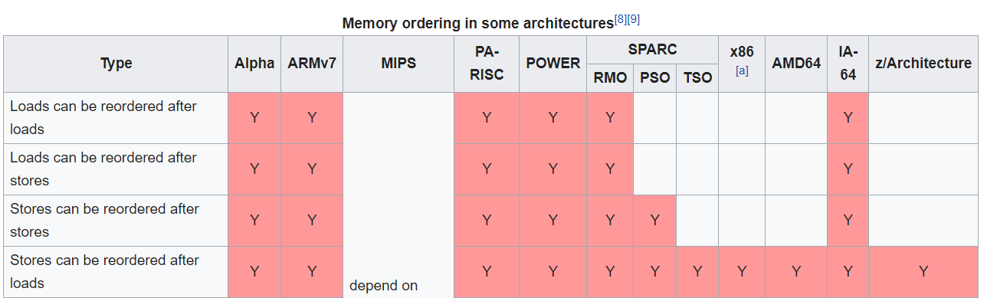


Different CPUs Have Different Memory Models!
Ex: For performance/simplicity reasons, a CPU might add store buffer entries in a FIFO manner with respect to program order, but remove them (i.e., make them visible) in non-FIFO order!
[Ref: https://en.wikipedia.org/wiki/Memory_ordering]
Notes:
Why on earth would a CPU enable reorderings? As stated by [1], “Memory order relaxations can improve performance, power efficiency and hardware complexity, [although] it makes the life of a programmer, who is implementing concurrent data structures, significantly harder.” In other words, designing a CPU that performs no memory reordering is difficult, because you have to track all various dependencies between instructions. By not tracking those dependencies, CPUs can avoid including the associated hardware; in turn, this makes the CPUs smaller, more power efficient, and easier to performance-optimize.]
[Ref: [1] https://www.arangodb.com/2021/02/cpp-memory-model-migrating-from-x86-to-arm/]

Slide 31

IMPORTANT: Visibility Reordering Can Never Break Single-threaded Program-order Semantics!
A CPU always respects single-threaded, program-order data dependencies
  Two instructions can only be reordered if they have no dependencies
  So, the CPU guarantees that, from the perspective of single-threaded program-order, all instructions perceive the results that would arise if the execution order was the program order
Reordering-induced incorrectness is only possible for cross-thread synchronization invariants that the CPU can’t see!

Slide 32
Example: AHCI Interactions
AHCI interactions involve two logical threads (the kernel and the disk)
Kernel code interacts with the disk via the disk’s memory-mapped registers
  However, the compiler is totally unaware of the disk: the compiler just sees memory reads and writes in the kernel’s source code
  So, the human developer is responsible for synchronizing activity between the kernel and the disk

Slide 33




The C++ compiler portably implements std::atomics using the appropriate local-ISA instructions!
Every non-relaxed std::atomic operation is also a compiler barrier!
//Chickadee’s k-ahci.cc: Issuing an
//NCQ operation.
//
//Tell the device about the buffer to
//use for the disk read.
dma_.ct[slot].buf[0].pa = ka2pa(buf);
dma_.ct[slot].buf[0].maxbyte = sz - 1;
dma_.ch[slot].nbuf = 1;
dma_.ch[slot].buf_byte_pos = sz;
//Configure the NCQ request.
size_t first_sector = off / sectorsize;
size_t nsectors = sz / sectorsize;
dma_.ct[slot].cfis[0] = cfis_command
| (unsigned(cmd_read_fpdma_queued) << 16)
| ((nsectors & 0xFF) << 24);
//...other config stuff...
//Ensure all previous writes have made
//it out to memory.
std::atomic_thread_fence(std::memory_order_release);
//Tell the drive which NCQ slot is used.
pr_->ncq_active_mask = 1U << slot;
//Tell the drive that a command is available.
pr_->command_mask = 1U << slot;
//The write to `command_mask` wakes up the device.
//The disk will generate an interrupt when
//the IO has completed!
How should this be implemented using my CPU’s ISA?
Do I need to worry about compiler reordering?
CS1610 student
Notes:
[As described by https://preshing.com/20120625/memory-ordering-at-compile-time/, “In the new C++11 atomic library standard, every non-relaxed atomic operation acts as a compiler barrier as well . . . the majority of function calls act as compiler barriers, whether they contain their own compiler barrier or not. This excludes inline functions, functions declared with the pure attribute, and cases where link-time code generation is used.“]
[Also note that mfence provides stronger ordering guarantees than std::atomic_thread_fence(std::memory_order_release). An mfence acts as a strict memory barrier: all operations before the mfence must execute before any operation about the mfence executes. In contrast, a std::atomic_thread_fence(std::memory_order_release) just guarantees that reads and writes above the fence will not be reordered past a post-fence write; reads below the fence may be reordered upward. Similarly, for a std::atomic_thread_fence(std::memory_order_acquire), a read that is above the fence cannot be reordered past any post-fence reads or writes; however, a write that is above the fence may be reordered beyond the fence. Preshing (https://preshing.com/20130922/acquire-and-release-fences/) defines acquire and release fences like this:
“An acquire fence prevents the memory reordering of any read which precedes it in program order with any read or write which follows it in program order.
A release fence prevents the memory reordering of any read or write which precedes it in program order with any write which follows it in program order.”
These semantics got their names from mutex scenarios. Acquiring a mutex uses acquire semantics, and releasing a lock uses release semantics; in concert, the two semantics ensure that all memory operations in the critical section are bookended by the acquire (i.e., the read-modify-write of the lock) and release (i.e., write of the lock) operations.
For more details, see here:
https://preshing.com/20120913/acquire-and-release-semantics/
https://en.cppreference.com/w/cpp/atomic/memory_order
https://www.stdthread.co.uk/forum/index.php?topic=72.0
]

Slide 34
Every non-relaxed std::atomic operation is also a compiler barrier!
On x86, invokes the xchg instruction (which automatically uses the LOCK prefix!)
  While a core executes a LOCK instruction, other cores can’t read or write memory (and can write to but not read from the local store buffer)
  At the end of the LOCK’d instruction, the local store buffer is flushed before the lock is released
  The LOCK’d Instruction also has mfence semantics: All loads and stores before the instruction will issue before all loads and stores after the instruction, ensuring that critical section instructions don’t wander before the lock acquisition!
struct spinlock{
std::atomic_flag f_;
void lock_noirq() {
while (f_.f.test_and_set()) {
pause();
}
}
bool is_locked() {
return f_.test(std::memory_order_relaxed) != 0;
}
};
Means that:
  The compiler must ensure that the load is atomic, but . . .
  The compiler and the hardware can reorder the load in any way that satisfies single-threaded data dependencies
  This is safe for is_locked() because (unlike lock_noirq()), the function isn’t being used to synchronize local critical-section memory operations with those happening on a remote core!
Notes:
is_locked() can use related memory ordering because it’s not being used to synchronize local critical-section memory operations with those being conducted by a remote core. In contrast, a local spinlock acquisition and release *does* need to synchronize with memory operations being conducted by remote cores—hence the use of stronger consistency semantics.
[For a nice discussion about relaxed versus release semantics, see https://stackoverflow.com/a/13633355.]
[As mentioned by https://www.felixcloutier.com/x86/lock#description, “The XCHG instruction always asserts the LOCK# signal regardless of the presence or absence of the LOCK prefix.”]

Slide 35
//Chickadee’s k-ahci.cc: Issuing an
//NCQ operation.
//
//Tell the device about the buffer to
//use for the disk read.
dma_.ct[slot].buf[0].pa = ka2pa(buf);
dma_.ct[slot].buf[0].maxbyte = sz - 1;
dma_.ch[slot].nbuf = 1;
dma_.ch[slot].buf_byte_pos = sz;
//Configure the NCQ request.
size_t first_sector = off / sectorsize;
size_t nsectors = sz / sectorsize;
dma_.ct[slot].cfis[0] = cfis_command
| (unsigned(cmd_read_fpdma_queued) << 16)
| ((nsectors & 0xFF) << 24);
//...other config stuff...
//Ensure all previous writes have made
//it out to memory.
std::atomic_thread_fence(std::memory_order_release);
//Tell the drive which NCQ slot is used.
pr_->ncq_active_mask = 1U << slot;
//Tell the drive that a command is available.
pr_->command_mask = 1U << slot;
//The write to `command_mask` wakes up the device.
//The disk will generate an interrupt when
//the IO has completed!
Every non-relaxed std::atomic operation is also a compiler barrier!
On x86, std::atomic_thread_fence(std::memory_order_release) is a nop! x86 already provides the desired property, namely, no StoreStore or LoadStore reordering.
The fence tells the compiler to:
  Not reorder memory operations around the fence: a compiler barrier!
  Instruct the hardware that all reads and writes before the fence should execute before all post-fence writes
Notes:
It’s possible for pre-fence reads and writes to be reordered past post-fence READS. The reason this is okay is because if the post-fence reads needed to be synchronized with pre-fence reads, the post-fence reads would need to be protected somehow, e.g., with a std::atomic_thread_fence(std::memory_order_acquire).
[Ref: https://preshing.com/20131125/acquire-and-release-fences-dont-work-the-way-youd-expect/]

Slide 36
x86: Store Buffers, Multiple Cores, and LOCK Prefixes
A recap of what we’ve learned
  A core issues writes in FIFO program order to the local store buffer
  Writes become visible (i.e., leave the store buffer) at some point after they commit
  Reads become visible upon hitting the MEM stage (but check the local store buffer before L* caches/RAM)
  An mfence:
    Forces earlier program-order memory operations to become visible before letting subsequent ones become visible
    Flushes the store buffer (i.e., makes the buffered writes visible)
  A LOCK’d instruction:
    Prevents other cores from reading/writing L*/RAM and reading from local store buffers
    Flushes the store buffer
Store
buffer
(FIFO)
Store
buffer
(FIFO)
LOCK prefix lock
(hardware-maintained)
L1 i-cache
L1 d-cache
L1 i-cache
L1 d-cache
L2 cache
L2 cache
L3 cache
RAM
Notes:
Remember that “program order” refers to the order of instructions that are issued by the compiler.
[Ref: https://www.cl.cam.ac.uk/~pes20/weakmemory/cacm.pdf]

