Slide 1

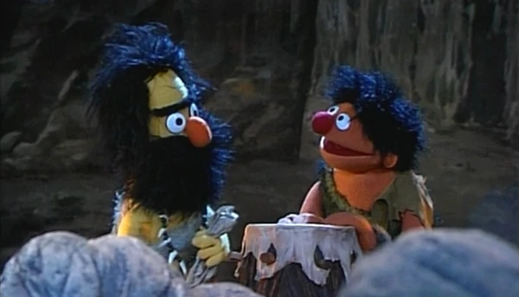
Writing Kernels in High-level Languages
Go
Java
C#
Rust
CS 1610: Lecture 16
4/1/2026
C
C++

Slide 2
Henry Cyril Paget, 5th Marquis of Anglesey
“A British peer who was notable during his short life for squandering his inheritance on a lavish social life and accumulating massive debts. Regarded as the ‘black sheep’ of the family, he was dubbed ‘the dancing marquess’ for his habit of performing ‘sinuous, snake-like dances’ and for his Butterfly Dancing.”
[Ref: https://en.wikipedia.org/wiki/Henry_Paget,_5th_Marquess_of_Anglesey]
Notes:
The photo is of Henry Cyril Paget, 5th Marquis of Anglesey: https://en.wikipedia.org/wiki/Henry_Paget,_5th_Marquess_of_Anglesey.

Slide 3

Why Write An OS In A High-level Language?
The lack of memory safety in C/C++ results in tragedies
  Buffer overflows
  Memory leaks
  Double frees
  Use-after-frees
  Pointers of type foo* actually point to bars
The lack of memory safety leads to:
  Crashes
  Security bugs
  A general inability to:
    Define correctness
    Statically guarantee it
C++ code in an OS
CS 1610 student
YOU ALREADY KNOW THE ANSWER

Slide 4

WWSCD?
Write the OS in a strongly-typed, statically-typed, garbage-collected language!
Strongly-typed and statically-typed: Go, Rust, C#, Java
    var start time.Time = time.Now() //Go developer
    //explicitly specifies the type
    end := time.Now() //Go compiler deduces type!
    fmt.Printf("%d", end.Sub(start)) //Ok
    end.FindString(“hi”) //Doesn’t compile because
    //time.Time lacks this method!
Strongly-typed and dynamically-typed: Python, JavaScript
    d = new Date(); alert(d.getTime()); //Works
    d = new RegExp(); alert(d.getTime()); //Fails
    //at runtime b/c no getTime() method found!
Weakly-typed and statically-typed: C, C++
    int* p = 7; //WHAT
    float f = (float)("hello"[18]); //WHAT
    void* vp = &f; //If you insist
    struct s* sp = (struct s*) vp; //WHAT
What would
Steve Chong do?
Notes:
[For a good discussion of the difference between weak versus strong typing, and dynamic versus static typing, see https://pythonconquerstheuniverse.wordpress.com/2009/10/03/static-vs-dynamic-typing-of-programming-languages/.
As that web page says, “In a weakly typed language, variables can be implicitly coerced to unrelated types, whereas in a strongly typed language they cannot, and an explicit conversion is required. ... Both Java and Python are strongly typed languages. [In a dynamically-typed language,] names are bound to objects at execution time by means of assignment statements, and it is possible to bind a name to objects of different types during the execution of the program. [In a statically-typed language,] once a variable name has been bound to a type (that is, declared) it can be bound (via an assignment statement) only to objects of that type; it cannot ever be bound to an object of a different type. An attempt to bind the name to an object of the wrong type will raise a type exception.”]

Slide 5
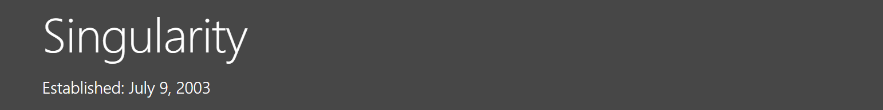
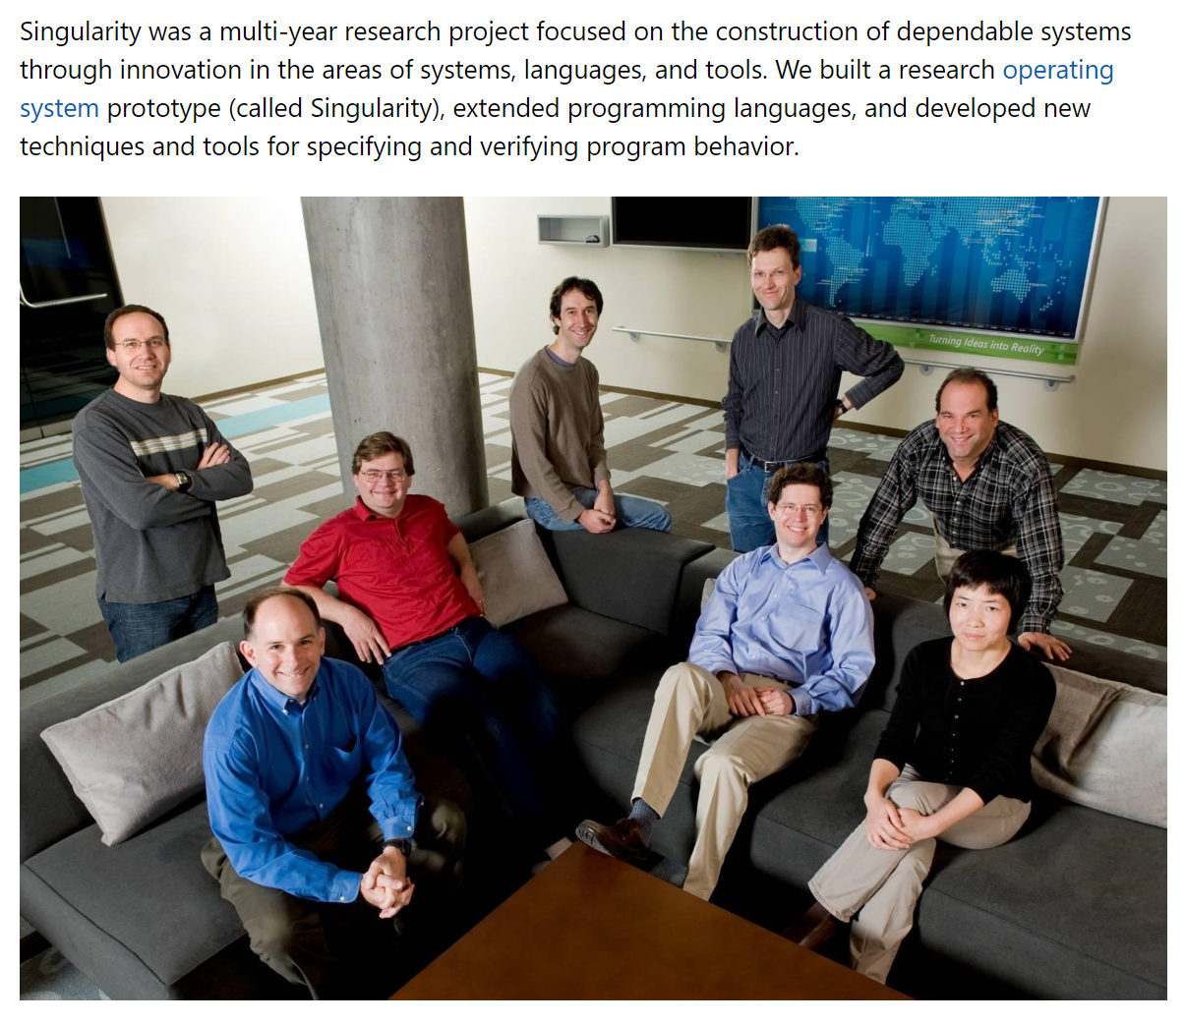

Notes:
[Ref: https://www.microsoft.com/en-us/research/project/singularity/?from=https%3A%2F%2Fresearch.microsoft.com%2Fen-us%2Fprojects%2Fsingularity]

Slide 6

Singularity: Software-Isolated Processes (SIPs)
Like a traditional process, a SIP has:
  Memory pages (code, static data, heap, stack(s))
  One or more execution threads
However, SIPs are much different than traditional processes!
  A SIP’s code is “sealed” (i.e., immutable—no JIT compilation allowed)
  A SIP cannot share writeable memory with another SIP
    Read-only pages (e.g., code) may be shared
    Cross-SIP communication must use channels (which are Singularity’s version of pipes)
    Cross-SIP memory isolation is enforced by the compiler and the managed runtime, not by hardware (i.e., page tables)—the kernel and all SIPs live in the same address space!
WHAT FOUL MAGIC IS THIS?

Slide 7
Example: Compiling Go to Native Code
main.main:
//...some stuff, then...
pushq %rbp
movq %rsp, %rbp
subq $16, %rsp
movl $12, %esi
movl $__go_tdn_main.Circle, %edi
call __go_new
movss .LC16(%rip), %xmm0
movss %xmm0, (%rax)
movss .LC17(%rip), %xmm0
movss %xmm0, 4(%rax)
movss .LC18(%rip), %xmm0
movss %xmm0, 8(%rax)
movq %rax, -8(%rbp)
movq -8(%rbp), %rax
movq %rax, %rdi
call main.getCircumference.N11_main.Circle
type Circle struct {
x float32
y float32
r float32
}
func (c Circle) getCircumference() float32 {
return 2 * 3.1415 * c.r
}
func main() {
c := Circle {1.0, 2.0, 4.0}
c.getCircumference()
}
Notes:
[The website https://godbolt.org/ allows you to compile languages like C, C++, Go, Rust, Haskell, and Python, and then inspect the bytecode or native code that results!]

Slide 8
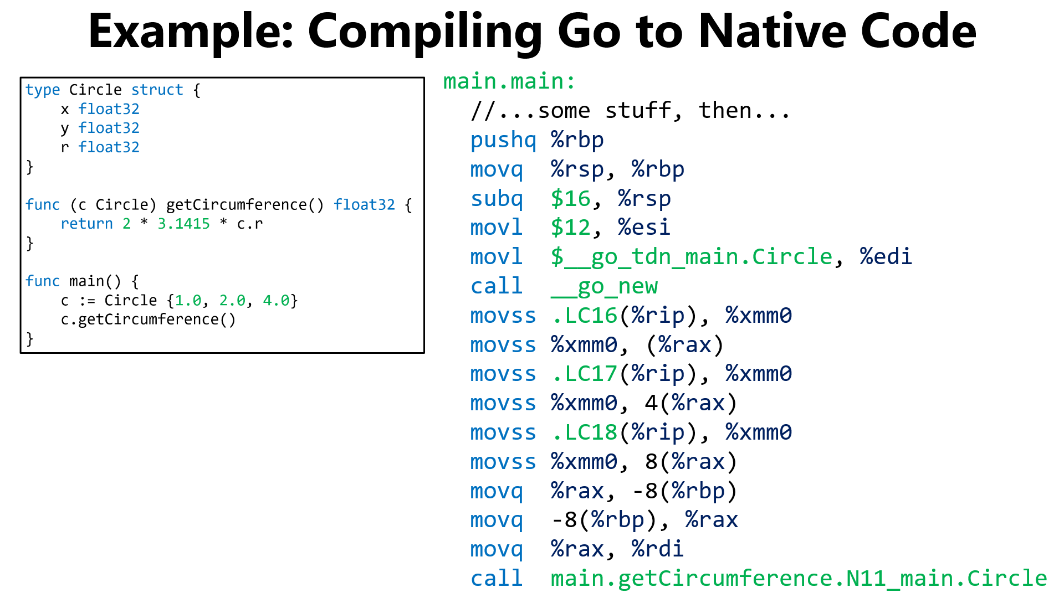
Standard function prologue

Slide 9
void *
__go_new(const struct __go_type_descriptor *td,
uintptr_t size){
return runtime_mallocgc (size,
(uintptr) td |
TypeInfo_SingleObject,
0);
}
Allocate 12 bytes of heap space for the Circle {1.0, 2.0, 4.0} and place a pointer to the new heap object in %rax
Notes:
__go_new() takes two arguments.
*The first is a type descriptor. Every struct in Go has a type descriptor which contains metadata like size of the type in bytes, the required alignment of the type (e.g., on a 32-bit boundary or a 64-bit boundary), and a pointer to a function which takes two instances of the type and returns whether the instances are equal.
*The second argument to __go_new() is the size of the requested allocation. In the example code, the requested allocation size is 12 bytes.
[Aside: It’s strange that c is allocated on the heap instead of the stack. The Go compiler uses escape analysis to determine if a locally-declared variable might become referred to by something on the heap; if so, the locally-declared variable should be allocated on the heap. However, just looking at the code in the sample program, it doesn’t seem like c should escape main()! The compiler does not introduce INCORRECTNESS in the program by allocating c on the heap, but doing so seems INEFFICIENT, since the heap allocator will have to be invoked (instead of the stack pointer just being bumped down), and eventually c will have to be garbage-collected (instead of the stack pointer just being bumped up). See here for more information about Go’s allocation strategies: https://segment.com/blog/allocation-efficiency-in-high-performance-go-services/
As described by https://golang.org/doc/faq#Pointers, “Q: How do I know whether a variable is allocated on the heap or the stack? A: From a correctness standpoint, you don't need to know. Each variable in Go exists as long as there are references to it. The storage location chosen by the implementation is irrelevant to the semantics of the language. The storage location does have an effect on writing efficient programs. When possible, the Go compilers will allocate variables that are local to a function in that function's stack frame. However, if the compiler cannot prove that the variable is not referenced after the function returns, then the compiler must allocate the variable on the garbage-collected heap to avoid dangling pointer errors. Also, if a local variable is very large, it might make more sense to store it on the heap rather than the stack. In the current compilers, if a variable has its address taken, that variable is a candidate for allocation on the heap. However, a basic escape analysis recognizes some cases when such variables will not live past the return from the function and can reside on the stack.”]
Refs: https://github.com/totalspectrum/gcc-propeller/blob/master/libgo/runtime/go-type.h //Defines __go_type_descriptor
https://github.com/totalspectrum/gcc-propeller/blob/master/libgo/runtime/go-new.c //Defines __go_new()
https://github.com/totalspectrum/gcc-propeller/blob/master/libgo/runtime/malloc.goc //Defines runtime_malloc()

Slide 10
Update the three fields of the new Circle; e.g., the memory location .LC16(%rip) holds 1.0, which is assigned to c.x that lives at (%rax)
Notes:
Each %xmmXXX register is 128 bits wide. Intel introduced these registers to perform vector instructions, i.e., instructions in which a single instruction performs the same operation on multiple sets of data. For example, a single %xmm register can hold four 32-bit floats. So, a single vector add instruction could treat two input %xmm registers as a two vectors, each of which contain 4 floating-point numbers; the instruction would add v0[i] to v1[i] and store the result in v1[i].
The movss instruction moves the lowest 32-bits of an %xmm register to a memory location.
Refs: https://en.wikipedia.org/wiki/Streaming_SIMD_Extensions#Registers
https://c9x.me/x86/html/file_module_x86_id_205.html

Slide 11

First instruction: legit
Second instruction: %RAX ALREADY HAS THE APPROPRIATE VALUE, THE COMPILER IS DRUNK

Slide 12
Invoke c.getCircumference()
Notes:
Note that a pointer to c (in %rdi) is passed as the assembly-level first argument to getCircumference(). In other words, %rdi holds the “this” pointer.

Slide 13

Go has pointers but not pointer arithmetic
  Possible: fmt.Println(“%p\n”, &someObj)
  Impossible: p = (&someObj)+1 //Doesn’t compile
  Impossible: var c *Circle = (*Circle) 0xf91d // Doesn’t c mpile //Doesn’t compile
  When a pointer is created, the compiler can statically ensure that the pointer references an object of the correct type
Array accesses are always bounds-checked
Thus, a Go process cannot use pointers to break type safety, overflow array lengths, or reference arbitrary memory in itself or another process
Singularity’s claim: since managed code can only generate safe memory references, it’s fine to place multiple, untrusted programs in the same address space!
Notes:
[Strictly speaking, Go cannot check all pointer safety at compile time. A variable that has the instance{} type (i.e., the “empty interface” type) can be used to reference any kind of value. However!---since the empty interface doesn’t define any methods on the associated value, a program cannot manipulate the value in any way. To perform any kind of manipulation to such a value, a program must first do a type coercion at runtime, e.g.,
c := someVal.(Circle) //Will cause a Go panic if someVal isn’t actually a Circle
A better way to do the type coercion is like this:
if c, ok = someVal.(Circle); ok {
doStuff() //The dynamic type check determined that someVal
//is indeed a Circle
}
So, the interface{} type is like C/C++’s void* in the sense that instance of the type can be used to refer to any value. However, the big difference is that, at runtime, a program can determine with 100% confidence whether an interface{} instance refers to some particular type of object; the 100% confidence arises because the compiler embeds type information in each value representation that can be consulted at runtime. [In Go, the use of the interface{} type is considered poor style unless you really need to use it, e.g., because you’re building a data structure like a linked list that needs to be able to hold arbitrary types of values. The introduction of generic types in Go 1.18 has gotten rid of most of the reasonable use cases for interface{}.]
Refs: https://betterprogramming.pub/a-comprehensive-guide-to-interfaces-in-go-6a945b795db
https://go.dev/tour/methods/14 // and /15 and /16
https://github.com/golang/go/issues/43651
]
[Aside: As mentioned by the first reference below, “Perhaps surprisingly, `new` is not commonly used in Go programs. In Go taking the address of a variable is always safe and never yields a dangling pointer. If the program takes the address of a variable, it will be allocated on the heap if necessary.”]
[Ref: https://github.com/golang/go/wiki/GoForCPPProgrammers
https://bluxte.net/musings/2018/04/10/go-good-bad-ugly/
https://golang.org/doc/faq#Pointers]

Slide 14


What if I need to write device drivers?
What if there are bugs in the compiler or the managed runtime?
90% of the Singularity kernel is written in Sing# (a variant of C#)
  Most of that code uses type-safe, memory-safe Sing#
  However, some code uses unsafe Sing#
    Ex: Garbage collector (48% of the unsafe code!)
    Ex: Virtual memory management
Roughly 6% of the kernel is written in assembly/C++
  Ex: Context switching
  Ex: Interrupt vectoring
  Ex: Memory-mapped device IO
SIPs are compatible with traditional page-table-based protections
This approach improves security at the cost of performance

Slide 15
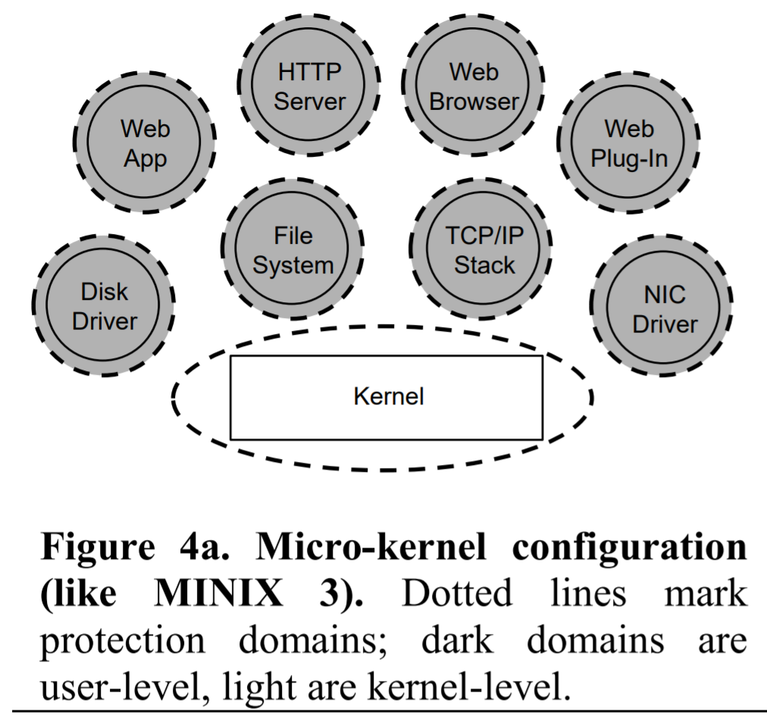
With SIP-only isolation (i.e., no page-table-based isolation), all of these SIPs live in a single address space, and run with kernel privileges!

Slide 16
The Singularity Microkernel
The Singularity microkernel is a SIP that only handles:
  SIP creation, destruction, and scheduling
  Memory management (e.g., page tables, SIP calls to mmap())
  Channel management
  Hardware access
The remaining OS functionalities (e.g., device drivers) reside in separate SIPs
Notes:
[The kernel can give a device driver direct access to a device by mapping the device’s memory-mapped registers into the driver’s address space. Also note that drivers run in Ring 0, and can issue privileged IO instruction directly.]

Slide 17
The Singularity Microkernel
The kernel provides each SIP with:
  Memory pages
  One or more execution contexts (i.e., threads)
  Access to . . .
    . . . the kernel via system calls
    . . . other SIPs via channels (accessed via system calls)
The kernel’s system call interface is versioned
  Each SIP’s manifest (i.e., configuration file) specifies the expected version for the kernel interface
  Kernel won’t load a SIP that expects a different kernel!

Slide 18
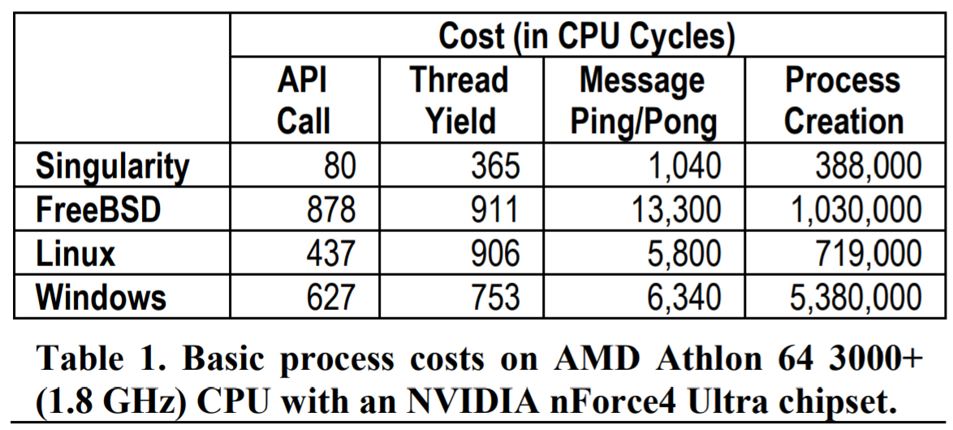
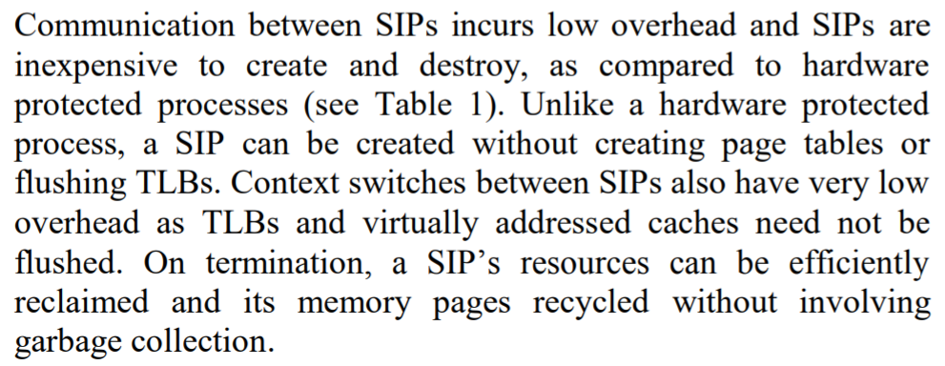
The Advantages of Software-isolated Processes
Notes:
Why can a SIP’s resources can be “efficiently reclaimed and its memory pages recycled without involving garbage collection”? The reason is that, when a SIP dies, *all* of its memory pages are now garbage---remember that two SIPs cannot share memory! So, the kernel can just deallocate all pages that belong to the SIP.

Slide 19
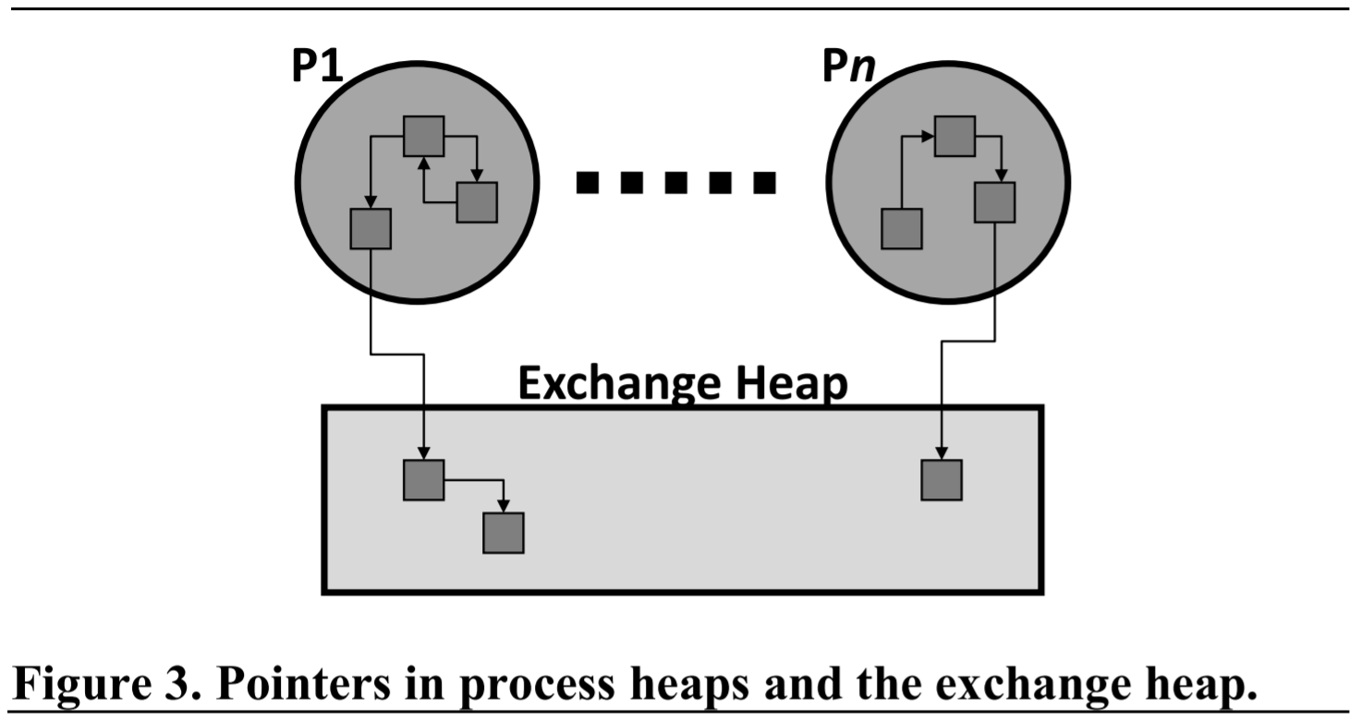
Singularity: The Exchange Heap
Singularity enforces a memory independence invariant: a pointer in SIP P1 can only point to . . .
  A location in P1’s memory
  A location owned by P1 that resides in the global exchange heap
SIPs P1 and P2 exchange data by exchanging pointers to data in the exchange heap
Sing# uses a linear type system to manage the exchange heap
  Each object o in the exchange heap can only have one pointer to it
  When P1 sends P2 a pointer p to o:
    P2 now owns o
    P1’s copy of p is now invalid—the compiler won’t compile P1’s code if P1 tries to use p after the ownership transfer
Notes:
It’s important to note that objects that don’t live in the exchange heap don’t have ownership semantics! In other words, an object in a SIP’s regular heap can be pointed to by multiple references.

Slide 20
Example: Rust’s Move Semantics
In Rust, each heap-allocated value has a single owner
The compiler enforces this invariant across assignments
let s1 = String::from("hello");
let s2 = s1;
println!("{}, world!", s1);
error[E0382]: borrow of moved value: `s1`
|
11 | let s1 = String::from("hello");
| -- move occurs because `s1` has type
| `String`, which does not implement
| the `Copy` trait
12 | let s2 = s1;
| -- value moved here
13 | println!("{}, world!", s1);
| ^^ value borrowed here
| after move
Notes:
[In Rust, variables are immutable unless you explicitly state otherwise. So, a declaration of “let x = …” creates a variable that is immutable after assignment completes. A declaration of “let mut x = …” creates a mutable variable.]
[Refs: https://godbolt.org/
https://doc.rust-lang.org/1.7.0/book/strings.html]

Slide 21

Example: Rust’s Move Semantics
In Rust, each heap-allocated value has a single owner
The compiler enforces this invariant across assignments
let s1 = String::from("hello");
let s2 = s1;
println!("{}, world!", s1);
Allocates a new String on the heap; the owner is s1
Ownership of String is transferred to s2—so, s1 isn’t valid anymore!
Trying to access s1 generates a compile-time error!

Slide 22

Q: WHY SHOULD WE
TOLERATE THIS?
A: Rust programmers
don’t have to worry
about calling free()!
Move semantics force the object graph to be a series of trees with no cycles . . .
Disallowed!

Slide 23
Q: WHY SHOULD WE
TOLERATE THIS?
A: Rust programmers
don’t have to worry
about calling free()!
Whenever a parent object goes out of scope, it’s safe to deallocate all of the reachable child objects!
if(x > 42){ //Braces create new scope
let s1 = String::from("hello");
println!("{}, world!", s1);
}
//s1 (and all heap objects reachable
//from s1) can be automatically freed
//by compiler-inserted code!
Notes:
[Rust’s linear type system has some other advantages. For example, the ownership system is more complex than presented here. A heap-allocated value (e.g., s1 in the running example) can have, at any given moment, (1) multiple read-only references, or (2) a single read/write reference. Creating a mutable reference will invalidate all other read-only references. These semantics are useful for ensuring that multiple threads can safely access a shared variable: at any given moment, one or more read-only references, or a single mutable reference. In other words, these semantics enforce multiple reader/single writer access!
Ref: https://doc.rust-lang.org/1.30.0/book/2018-edition/ch04-02-references-and-borrowing.html
https://medium.com/@GolDDranks/things-rust-doesnt-let-you-do-draft-f596a3c740a5
https://www.snoyman.com/blog/2018/10/rust-crash-course-02-basics-of-ownership
https://stackoverflow.com/questions/50251487/what-are-non-lexical-lifetimes
As the second reference says, ”There is still one general principle that affects the design decisions of Rust: all analysis should be local. No whole-program stuff. Rust programs must be type checkable function-by-function. The function signatures have to contain enough of lifetime and type information that the body can be checked. This also means that some situations where the borrow checker might seem stupid (“This function only mutates only field A, so why can’t I call also that function that mutates field B, they are different fields! It should allow that much!”), but the point is that it isn’t allowed to “peek into” functions other than the one it is currently checking. All it gets to know are the function signatures.”
The third reference gives this example . . .
struct Foobar(i32); //Foobar is a ``newtype wrapper'':
//a new data type wrapping around,
//and with the same runtime
//representation of, a signed 32-bit
//integer (i32).
fn uses_foobar(foobar: &Foobar) {
println!("I consumed a Foobar: {:?}", foobar);
}
fn main() {
let x: Foobar = Foobar(1);
let y: &Foobar = &x;
println!("Before uses_foobar");
uses_foobar(&x);
uses_foobar(y);
println!("After uses_foobar");
}
. . . and says that multiple read-only references are “allowed in Rust, because:
1. Multiple read-only references to a variable cannot result in any data races
2. The lifetime of the value outlives the references to it. In other words, in this case, x lives at least as long as y.”
]

Slide 24

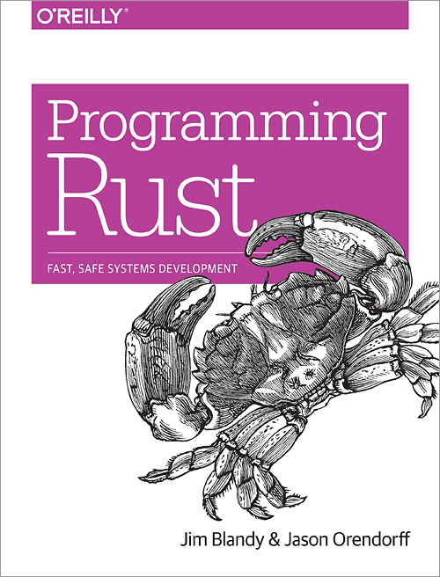
RUST IS MUCH MORE COMPLICATED THAN THIS

Slide 25
Singularity: The Exchange Heap and Linear Types
No data copying is necessary when transferring data between P1 and P2
Ownership semantics will automatically prevent cross-process races on shared data
SIPs still enjoy strong memory isolation
SIPs can be independently garbage-collected: no cross-SIP references!
  In a SIP, most objects won’t have a linear type
  For those objects, Singularity requires a traditional garbage collection—Singularity can’t rely on Rust-style garbage collection that’s triggered by a value going out of scope

Slide 26

Singularity:
Garbage Collection

Slide 27
Garbage Collection: Overview
A live heap object is one that a program can access via a chain of one or more object references
  Some live objects are directly referenced via heap roots:
    Global variables
    Local function variables on the stack
    Thread-local variables
  Other live objects are accessible by recursively following the references inside these heap roots (e.g., globalVar.x.y)
Goal: Given the set of all heap-allocated objects, determine which objects are no longer reachable (and thus can be deallocated!)

Slide 28
class Circle:
def __init__(self, x, y, r):
self.x = x
self.y = y
self.r = r
def __str__(self):
return "Circle(%d,%d,%d)" % \
(self.x, self.y, self.r)
def foo():
global globalC
localC = Circle(2, 2, 2)
print(globalC)
print(localC)
globalC = None
globalC = Circle(1, 1, 1)
if __name__ == "__main__":
foo()
foo()
Stack
Global variables
globalC
Circle(1,1,1)
Heap

Slide 29

class Circle:
def __init__(self, x, y, r):
self.x = x
self.y = y
self.r = r
def __str__(self):
return "Circle(%d,%d,%d)" % \
(self.x, self.y, self.r)
def foo():
global globalC
localC = Circle(2, 2, 2)
print(globalC)
print(localC)
globalC = None
globalC = Circle(1, 1, 1)
if __name__ == "__main__":
foo()
foo()
Stack
Global variables
localC
globalC
None
Circle(2,2,2)
Circle(1,1,1)
Heap
>
Circle(1, 1, 1)
Circle(2, 2, 2)

Slide 30
class Circle:
def __init__(self, x, y, r):
self.x = x
self.y = y
self.r = r
def __str__(self):
return "Circle(%d,%d,%d)" % \
(self.x, self.y, self.r)
def foo():
global globalC
localC = Circle(2, 2, 2)
print(globalC)
print(localC)
globalC = None
globalC = Circle(1, 1, 1)
if __name__ == "__main__":
foo()
foo()
Stack
Global variables
localC
globalC
None
Circle(2,2,2)
Circle(1,1,1)
Heap
After the first call to foo() ends, but before the second call starts . . .

Slide 31
class Circle:
def __init__(self, x, y, r):
self.x = x
self.y = y
self.r = r
def __str__(self):
return "Circle(%d,%d,%d)" % \
(self.x, self.y, self.r)
def foo():
global globalC
localC = Circle(2, 2, 2)
print(globalC)
print(localC)
globalC = None
globalC = Circle(1, 1, 1)
if __name__ == "__main__":
foo()
foo()
Stack
Global variables
localC
globalC
None
Circle(2,2,2)
Circle(2,2,2)
Circle(1,1,1)
Heap
>
None
Circle(2, 2, 2)

Slide 32
Stop-the-world
mark-and-sweep GC
Stack
Global variables
localC
globalC
Each heap object is associated with a single bit isReachable (initially 0)
Maintain a list of allocated objects
To collect garbage:
  Pause the application code
  Starting from heap roots, traverse the live object graph; for each live object, set isReachable to 1
  Traverse the list of all allocated heap objects; for an object obj . . .
    If isReachable is 0, then obj is garbage and can be deallocated
    If isReachable is 1, then obj is live; set isReachable to 0 (to prepare for the next GC)
None
Circle(2,2,2)
0
1
Circle(2,2,2)
0
Circle(1,1,1)
0
Heap
List of all allocated objects
Notes:
[Ref: https://en.wikipedia.org/wiki/Tracing_garbage_collection#Na%C3%AFve_mark-and-sweep]

Slide 33
Stop-the-world
mark-and-sweep GC
Stack
Global variables
localC
globalC
Each heap object is associated with a single bit isReachable (initially 0)
Maintain a list of allocated objects
To collect garbage:
  Pause the application code
  Starting from heap roots, traverse the live object graph; for each live object, set isReachable to 1
  Traverse the list of all allocated heap objects; for an object obj . . .
    If isReachable is 0, then obj is garbage and can be deallocated
    If isReachable is 1, then obj is live; set isReachable to 0 (to prepare for the next GC)
None
Circle(2,2,2)
0
1
Circle(2,2,2)
0
Circle(1,1,1)
0
Heap
List of all allocated objects
Notes:
[Ref: https://en.wikipedia.org/wiki/Tracing_garbage_collection#Na%C3%AFve_mark-and-sweep]

Slide 34
Singularity: Garbage Collection
Singularity enforces a memory independence invariant: a pointer in SIP P1 can only point to . . .
  A location in P1’s memory
  A location owned by P1 that resides in the global exchange heap
As a result . . .
  Each SIP can be garbage-collected independently and in parallel
  Each SIP can use a SIP-specific GC algorithm
Objects in the exchange heap use linear types, so Singularity garbage-collects them using a Rust-style approach
  A heap object and its descendants are automatically deallocated when a pointer to the object goes out of scope or is set to null

Slide 35
Singularity: Garbage Collection
Remember that the kernel is a SIP, so P1 and the kernel can only exchange pass-by-reference data via the exchange heap
Since the kernel and P1 live in the same address space, a “system call” is just a function call that doesn’t change the page table, flush the TLB, etc.!
  Singularity places the kernel’s stack records on P1’s stack!
  To allow concurrent GC’ing of P1’s state and the kernel’s state, Singularity must annotate each stack frame as belonging to P1 or the kernel
P1’s stack
userFoo()
P1’s GC only treats these local variables as heap roots
userBar()
Syscall
userBaz()
kernelQux()
Kernel’s GC only treats these local variables as heap roots
kernelQuux()
kernelCorge()

Slide 36
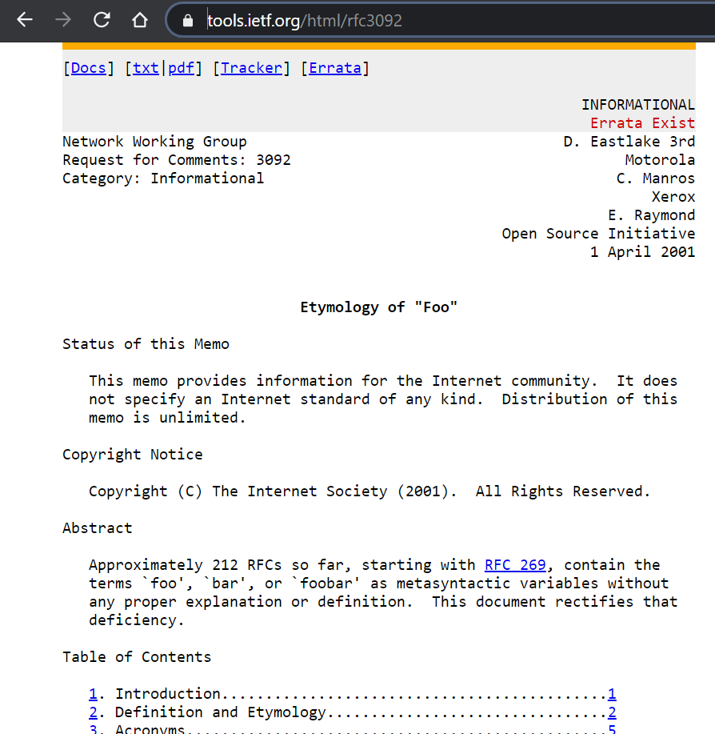

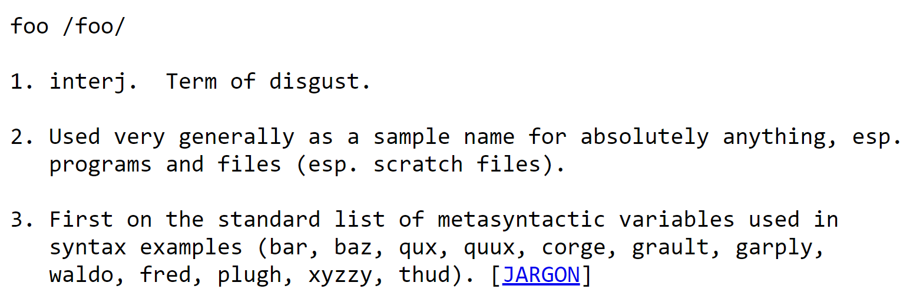
Why “foo”?
Why “bar”?
WHY “BAZ”?

