Slide 1

Scheduling and Cache Coherency
CS 1610: Lecture 17
4/6/2026

Slide 2
Outline
Introduction to Scheduling
Linux’s CFS Scheduler
Cache Consistency and CPU Affinity

Slide 3

Scheduling: Which Process Should Run Now?
Different processes have different behaviors
  IO-bound: A process mostly waits for IOs to complete
  CPU-bound: A process issues few IOs, mostly does computation
It’s often a good idea to prioritize IO-bound processes
  Allow tasks blocked on user input, network, etc. to respond quickly and initiate new (and slow!) IOs if necessary
  A process may change its behavior throughout its execution—the scheduler must notice and adjust!

Slide 4


Ex: An IO-bound disk grep, and a CPU-bound cryptographic calculation on a single-core machine
Crypto task finishes
Non-preemptive
first-come-first-serve
Crypto
CPU
screws IO-bound tasks
Waiting
Waiting on CPU :-(
Waiting
Waiting
Grep
on IO
on IO
on IO
Time
Crypto
CPU
CPU
CPU
Preempting
CPU-bound tasks
for IO-bound ones
Waiting
Waiting
Waiting
Grep
on IO
on IO
on IO
improves utilization
of CPU and IO devices
Time
Notes:
[In the first example, we look at a case of non-preemptive scheduling, meaning that, once a task is given the CPU, the task continues to run until it willingly relinquishes the CPU. In the second example, we look at an example of preemptive scheduling---in particular, preemptive scheduling in which IO-bound tasks are given priority over CPU-bound tasks.]

Slide 5
Evaluating Scheduler Algorithms
Utilization
  How often are the CPUs and IO devices kept busy?
  Note that CPUs and IO devices can simultaneously be busy (which is good!)
Fairness
  Higher-priority tasks should receive more CPU time . . .
  . . . but no task should starve
Interactive latency
  A task that mostly blocks on IO should run as soon as IO completes
  Ex: Text editor waiting on keypress
Computational overhead of the scheduler as a function of:
  The number of CPUs
  The number of runnable tasks
  The number of waiting tasks
Notes:
[Ref: “BFS vs. CFS Scheduler Comparison” by Taylor Groves, Je Knockel, Eric Schulte: https://web.archive.org/web/20150723201912/https://www.cs.unm.edu/~eschulte/classes/cs587/data/bfs-v-cfs_groves-knockel-schulte.pdf]

Slide 6




Priority-based Round-Robin
Scheduler
(priority-deque)
Priority queues
Idea: Maintain several ready queues, one for each priority level
  Each queue is FIFO
  Scheduler finds highest-priority non-empty queue and runs the first task in that queue
Good: Allows higher-priority tasks to receive more CPU time
Bad: Low-priority tasks may starve!
  Solution: Aging (the longer a task waits without getting the CPU, the higher its priority becomes)
Bad: IO-bound tasks may suffer long response times if not given high priorities
Bad: Priority inversion
Blocking
operation
Wait queues
Notes:
[Why are low-priority tasks vulnerable to starvation? The reason is that, if a steady stream of high-priority processes arrive, the lower-priority tasks will never get an opportunity to run on the CPU. Thus, the lower-priority tasks languish in their priority queues, getting “starved” of access to the CPU.]

Slide 7
Priority Inversion
Assume that a system has three tasks T1, T2, and T3
  Priority: T3 > T2 > T1
Imagine that T1 and T3 both use the same lock . . .
T3
Waiting on IO
Running
Waiting on lock
Waiting on lock
T3 is the highest
Tries to acquire lock
priority thread,
T2
Waiting on IO
Running
but it’s blocked
Ready
Running
by T2 and T1!
T1
Running
Waiting on IO
Ready
Ready
Time
Acquires lock
Notes:
[Ref: http://www.drdobbs.com/jvm/what-is-priority-inversion-and-how-do-yo/230600008
http://www.cse.chalmers.se/edu/year/2015/course/EDA222/Documents/Misc/Report_MarsPathFinder.pdf
http://research.microsoft.com/en-us/um/people/mbj/Mars_Pathfinder/Mars_Pathfinder.html
http://space.stackexchange.com/a/9181]

Slide 8

Priority Inversion
I HAZ A PRIORITY INVERSION
Assume that a system has three tasks T1, T2, and T3
  Priority: T3 > T2 > T1
Imagine that T1 and T3 both use the same lock . . .
T3
Waiting on IO
Running
Waiting on lock
Waiting on lock
T3 is the highest
Tries to acquire lock
priority thread,
T2
Waiting on IO
Running
but it’s blocked
Ready
Running
by T2 and T1!
T1
Running
Waiting on IO
Ready
Ready
Time
Acquires lock

Slide 9
Solution: Priority Inheritance
A task which owns a lock inherits the highest priority of any task that wishes to acquire the lock
T3
Waiting on IO
Running
Waiting on lock
Running
Tries to acquire lock
Acquires lock
T2
Waiting on IO
Ready
Ready
Ready
T1
Running
Waiting on IO
Running
Ready
Time
Acquires lock
Inherits T3’s priority
Releases lock, drops priority

Slide 10
Outline
Introduction to Scheduling
Linux’s CFS Scheduler
Cache Consistency and CPU Affinity

Slide 11
Linux’s “Completely Fair Scheduler” (CFS)
For now, make these simplifying assumptions:
  There is only one CPU
  All tasks have the same priority
  There are always T tasks ready to run at any moment
Basic idea: each task gets 1/T of the CPU’s resources
  CFS tries to model an “ideal CPU” that runs each task simultaneously, but at 1/T the CPU’s clock speed
  A real CPU can only run a single task at once, so a task will get “ahead” or “behind” of its 1/T allotment
    CFS tracks how long each task has actually run
    During a scheduling decision (e.g., timer interrupt), CFS picks the task with the lowest runtime so far
Notes:
[Refs:
[1] https://web.archive.org/web/20150301135846/https://criticalblue.com/news/wp-content/uploads/2013/12/linux_scheduler_notes_final.pdf
[2] http://www.ibm.com/developerworks/library/l-completely-fair-scheduler/
[3] https://web.archive.org/web/20120711234506/http://kerneltrap.org/node/8059
[4] https://www.kernel.org/doc/Documentation/scheduler/sched-design-CFS.txt
[5] https://web.archive.org/web/20120711234506/http://kerneltrap.org/node/8059
[6] https://web.archive.org/web/20150723201912/https://www.cs.unm.edu/~eschulte/classes/cs587/data/bfs-v-cfs_groves-knockel-schulte.pdf
]

Slide 12
Red-black
10
binary trees
3
13
0
7
15
5
8
Self-balancing: Insertions and deletions ensure that the longest tree path is at most twice the length of any other path
Guaranteed logarithmic: All insertions, deletions, and searches run in O(log N) time
Notes:
[The rules of red-black trees, as described by the infallible Wikipedia:
1. Each node is either red or black.
2. The root is black.
3. All leaves (NIL) are black.
4. If a node is red, then both its children are black.
5. Every path from a given node to any of its descendant NIL nodes contains the same number of black nodes.
Ref: https://en.wikipedia.org/wiki/Red%E2%80%93black_tree]

Slide 13
t
3
23
CFS scheduler
t
t
5
0
Associate each task with its elapsed runtime (nanosecond granularity)
For each core, keep runnable tasks in a red-black tree, with an insertion key of elapsed runtime
  A newly-created task is tagged with the minimal runtime in the tree
Next task to run is just the left-most task in tree!
7
37
t
1
5
15
42
t
t
2
4
Scheduler picks this task to run, removes it from tree
Notes:
A newly-created task is tagged with the minimal runtime in the tree. By doing this, we ensure two things: first, we ensure that the task will get a CPU burst very soon in the future. However, we also ensure that the task doesn’t then hog the CPU for a long time---soon, the other task with the minimal runtime will get to run.

Slide 14
t
3
23
t
t
5
0
7
37
t
1
15
42
t
4
Timer interrupt fires, scheduler runs
Now, t₂ no longer has the smallest elapsed runtime
So, scheduler reinserts t₂ into the tree and runs t₀!
5
Runs for 20 time units
25
t
t
2
2

Slide 15
Classic CFS Example
Suppose there are two tasks:
  Video rendering application (CPU-intensive, long-running, non-interactive)
  Word processor (interactive, only uses CPU for bursts)
Both tasks start with an elapsed runtime of 0
  Video rendering task quickly accumulates runtime . . .
  . . . but word processor’s runtime stays low (task is mainly blocked on IO)
So, whenever word processor receives keyboard/mouse input and wakes up, it will be the left-most task, and immediately get scheduled

Slide 16

Making Scheduling Efficient
Linux scheduler (circa v2.4)
The runqueue wasn’t sorted!
  Newly-runnable processes added to the end: O(1)
  Finding the best process to run required linear scan: O(n)
O(n) scheduling was kinda tolerable on a single-core machine, but generated a lot of lock contention on multi-core machines
t
1
Global runnable queue
t
2
t
3
…
Single spinlock
t
4
Scheduler logic
Notes:
[In general, each core gets its own timer interrupt. However, Linux does allow a sys admin to configure a machine so that specific interrupts are only handled by a subset of cores.
http://sameerseth-tcp-ip.blogspot.com/2010/09/kernel-ticks-jiffies-and-high.html
http://lxr.free-electrons.com/source/kernel/timer.c?v=3.4
https://cs.uwaterloo.ca/~brecht/servers/apic/SMP-affinity.txt
]
[References: http://www.tldp.org/LDP/lki/lki-2.html
http://fxr.watson.org/fxr/source/kernel/sched.c?v=linux-2.4.22
http://www.linuxjournal.com/article/7178]

Slide 17
Linux scheduler now: CFS
Uses a red-black tree per core, to avoid cross-core lock contention
However, cross-core load balancing is needed to ensure:
  All cores are highly-utilized
  All of the high-priority tasks don’t end up on a small number of cores
Scheduler logic
Scheduler logic
Scheduler logic
Scheduler logic
Notes:
Note that load-balancing tasks across the red-black trees is tricky to implement efficiently. The reason is that moving a task from one tree to another requires the acquisition of locks on the associated trees. The entire point of using per-core scheduling structures is to avoid the acquisition of non-local locks!

Slide 18
Outline
Introduction to Scheduling
Linux’s CFS Scheduler
Cache Consistency and CPU Affinity

Slide 19
What Happens When A Memory Read or Memory Write Becomes Visible (i.e., Is Revealed to the Memory Hierarchy)?

Slide 20

x86: Store Buffers, Multiple Cores, and LOCK Prefixes
A recap of what we’ve learned
  A core issues writes in FIFO program order to the local store buffer
  Writes become visible (i.e., leave the store buffer) at some point after they commit
  Reads become visible upon hitting the MEM stage (but check the local store buffer before L* caches/RAM)
  An mfence:
    Forces earlier program-order memory operations to become visible before letting subsequent ones become visible
    Flushes the store buffer (i.e., makes the buffered writes visible)
  A LOCK’d instruction:
    Prevents other cores from reading/writing L*/RAM and reading from local store buffers
    Flushes the store buffer
Store
buffer
(FIFO)
Store
buffer
(FIFO)
LOCK prefix lock
(hardware-maintained)
L1 i-cache
L1 d-cache
L1 i-cache
L1 d-cache
L2 cache
L2 cache
L3 cache
RAM
Notes:
Remember that “program order” refers to the order of instructions that are issued by the compiler.
[Ref: https://www.cl.cam.ac.uk/~pes20/weakmemory/cacm.pdf]

Slide 21
Imagine that each CPU only had a private, single-layer cache . . .
The memory hierarchy is still inclusive: RAM contains everything in both the left cache and the right cache
But what should happen when:
  A visible read misses in the local cache?
  A write becomes visible (i.e., leaves the local store buffer)?
Store
buffer
(FIFO)
Store
buffer
(FIFO)
LOCK prefix lock
(hardware-maintained)
L1 i-cache
L1 d-cache
L1 i-cache
L1 d-cache
Left cache
Right cache
L2 cache
L2 cache
L3 cache
RAM

Slide 22
Imagine that each CPU only had a private, single-layer cache . . .
Write-through caches with cache line invalidation
Read x
Read x
The memory hierarchy is still inclusive: RAM contains everything in both the left cache and the right cache
But what should happen when:
  A visible read misses in the local cache?
  A write becomes visible (i.e., leaves the local store buffer)?
Store
buffer
(FIFO)
Store
buffer
(FIFO)
LOCK prefix lock
(hardware-maintained)
Left cache
Right cache
Data: d₀
Data: d₀
RAM
Data: d₀
Address: x
Notes:
[In Lecture 14, we talked about memory ordering, discussing how a core’s memory stores have to commit in program order, but may become visible to external cores in a different order. We discussed how x86 does not do StoreStore reordering (meaning that a core’s writes become visible in program order), but other processor types do perform StoreStore reordering (such that a core’s writes may become visible in non-program-order). Cache coherence protocols describe what happens when a core’s writes become visible.]
[See Slide 16 of https://www.cs.cmu.edu/afs/cs/academic/class/15418-s12/www/lectures/10_coherence.pdf.]

Slide 23
Imagine that each CPU only had a private, single-layer cache . . .
Write-through caches with cache line invalidation
Read x
Write x
The memory hierarchy is still inclusive: RAM contains everything in both the left cache and the right cache
But what should happen when:
  A visible read misses in the local cache?
  A write becomes visible (i.e., leaves the local store buffer)?
Store
buffer
(FIFO)
Store
buffer
(FIFO)
LOCK prefix lock
(hardware-maintained)
Invalidate x
Left cache
Right cache
Data: d₁
Data: d₁
Data: d₀
Data: d₀
RAM
Data: d₁
Data: d₀
Address: x

Slide 24
Good
Hardware is simple
Once a write to location x leaves a store buffer, all caches will see the same (i.e., a coherent) value in x
Write-through caches with cache line invalidation
Bad
Store
buffer
(FIFO)
Store
buffer
(FIFO)
Every update to the local cache requires a synchronous write to RAM!
  For memory reads, cache hits absorb bus traffic that would have gone to RAM . . .
  . . . but all memory writes (regardless of whether they hit in the cache) send bus traffic to RAM!
LOCK prefix lock
(hardware-maintained)
Left cache
Right cache
Data: d₁
Data: d₁
Data: d₀
Data: d₀
RAM
Data: d₁
Data: d₀
Address: x
Notes:
The memory bus has an upper limit on how much traffic it can handle. So, bus bandwidth is a precious resource.

Slide 25

MESI Protocol: Write-back Caches with Cache Line Invalidation
High-level goals:
  Provide all cores with a coherent view of visible writes (i.e., writes that have left a store buffer)
  For visible writes, allow cache hits to reduce traffic on the memory bus
  During a visible read miss in the local cache, allow the cache line to be pulled from another cache if resident (thereby avoiding a RAM read)
When Core X writes a cache line:
  We don’t immediately update RAM: This allows us to eliminate a synchronous bus message!
  We do tell caches belonging to other cores that their local copies of the cache line should be invalidated
  We asynchronously update RAM (e.g., when the cache line is evicted to RAM)
Notes:
[Note that, because we only write cache lines to RAM asynchronously, we allow the cache to potentially absorb multiple writes to the same cache line before we finally evict that line to RAM!]

Slide 26
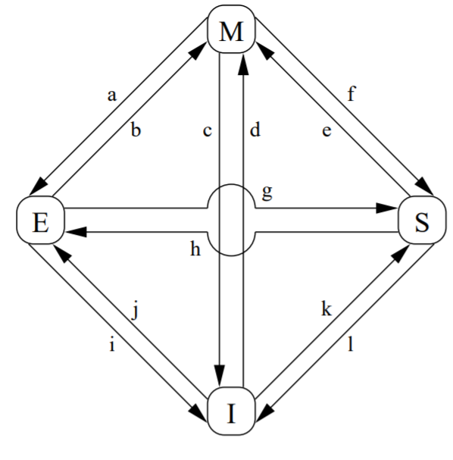
The MESI Protocol
At any given moment, a line in a CPU’s cache can be:
Invalid: The line does not hold valid data
Shared: The line is valid and . . .
  May also reside in the caches of other CPUs
  Cannot be modified without consulting the other caches
  Reflects the content of RAM, and thus can be evicted without requiring a write to RAM
Exclusive: The line is valid and . . .
  Only exists in the local cache
  Can be updated without consulting other caches
  Reflects the content of RAM, and thus can be evicted without requiring a write to RAM
Modified: The line is valid and . . .
  Only exists in the local cache
  Has been updated by the local CPU
  Does not reflect the content of RAM, so eviction requires an update to RAM (or a transfer of the line to another cache)
Notes:
[Ref: CMU’s 15-418 Lecture 10 on cache coherence: https://www.cs.cmu.edu/afs/cs/academic/class/15418-s12/www/lectures/10_coherence.pdf
“Memory Barriers: a Hardware View for Software Hackers” by McKenney http://www.rdrop.com/users/paulmck/scalability/paper/whymb.2010.07.23a.pdf
The first reference has a better explanation of the read/write behavior that causes transitions between the various states. The second reference provides a better idea of the cache coherence messages that are sent; the second reference also provides a more comprehensive introduction to the memory hierarchy (e.g., not only MESI, but store buffers and memory barriers). The diagram in the slide above is taken from the second reference.]

Slide 27
The MESI Protocol
Imagine a dual-core system in which each core’s private cache has a single cache line . . .
Address
Address
Data
State
Data
State
Invalid
Invalid
Invalid
Invalid
Invalid
Invalid
RAM
Data: d₀
Address: x

Slide 28
The MESI Protocol
Read x
Address
Address
Data
State
Data
State
Invalid
Invalid
d₀
x
Invalid
Invalid
Invalid
Invalid
Exclusive
Hey, other cache, do you have x’s data?
RAM
Nope, try RAM!
Data: d₀
(j) Invalid to exclusive: The right core reads data that wasn’t already in any cache
Here’s x’s data!
Hey RAM, gimme x’s data!
Address: x
The right core can now read x without generating any cross-cache traffic.

Slide 29
The MESI Protocol
Read x
Address
Address
Data
State
Data
State
d₀
x
Shared
d₀
x
Shared
Invalid
Invalid
Invalid
Exclusive
Hey, other cache, do you have x’s data?
Yeah, here it is!
RAM
Data: d₀
[Left CPU]
(k) Invalid to shared: CPU reads data that wasn’t in the local cache (but was in the other CPU’s cache)
[Right CPU]
(g) Exclusive to shared: The right CPU lost its exclusive access to the data
Both cores can now read x without generating cross-cache coherence traffic.
Address: x

Slide 30
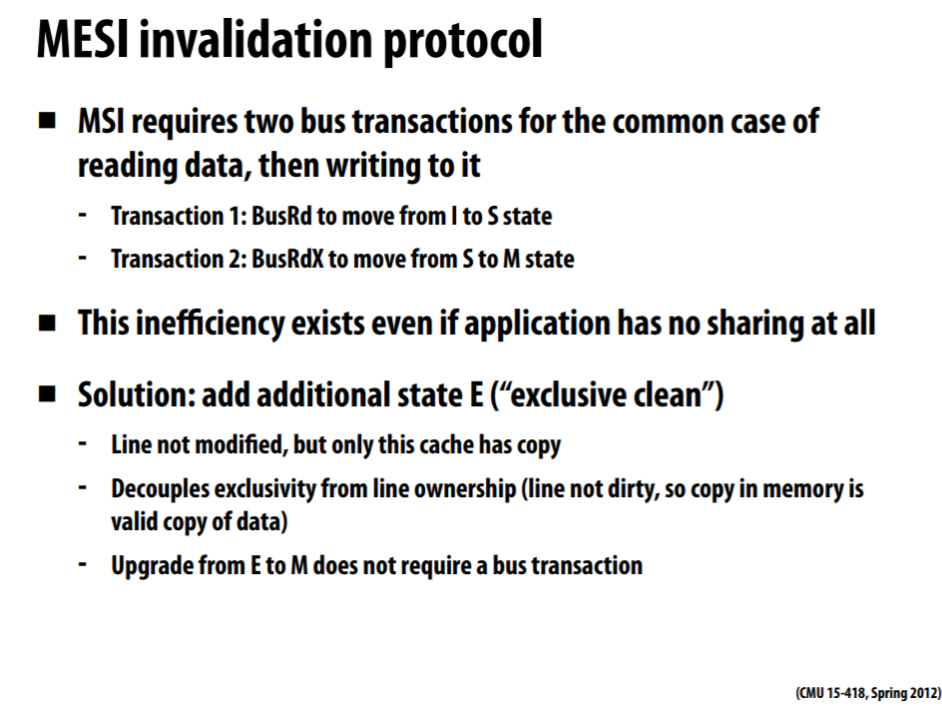
Notes:
In case you’re interested about why the “exclusive” state in MESI is helpful . . .
[Ref: https://www.cs.cmu.edu/afs/cs/academic/class/15418-s12/www/lectures/10_coherence.pdf]

Slide 31
The MESI Protocol
Write x
Address
Address
Data
State
Data
State
d₁
x
Shared
x
Shared
d₀
d₀
Invalid
Invalid
Modified
Invalid
Invalidation complete!
RAM
Invalidate x
Data: d₀
[Left CPU]
(e) Shared to modified: The left CPU’s update to x caused this transition . . .
[Right CPU]
(l) Shared to invalid: . . . and forced the right CPU to drop the cache line.
Address: x
The data in RAM is now stale!

Slide 32
The MESI Protocol
Read y
Address
Address
Data
State
Data
State
d₂
y
d₁
x
Modified
Invalid
Invalid
Invalid
Exclusive
Hey RAM, gimme y’s data!
Hey, other cache, do you have y’s data?
RAM
Nope, try RAM!
Data: d₂
Data: d₀
Data: d₁
Here’s y’s data!
x’s cache line is evicted, to make space for y’s cache
line!
Address: y
Address: x
The data in RAM is now stale!
x’s data in RAM is now fresh!

Slide 33
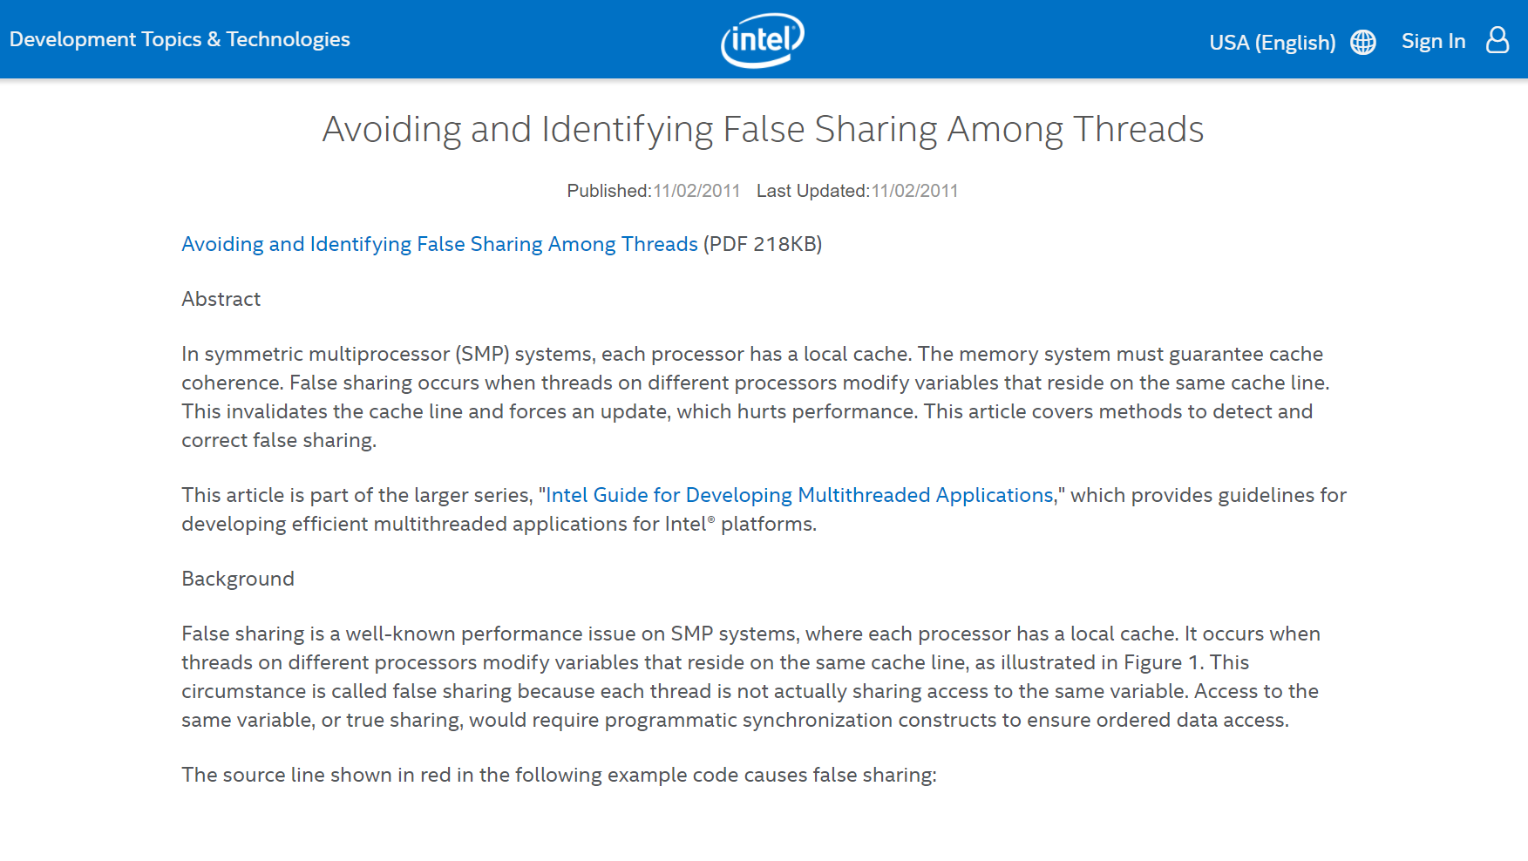
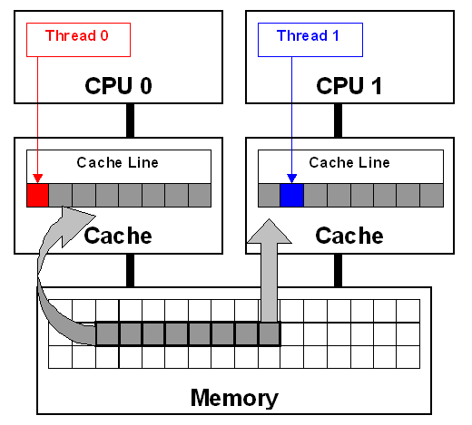
Notes:
[Ref: https://web.archive.org/web/20200511113246/https://software.intel.com/content/www/us/en/develop/articles/avoiding-and-identifying-false-sharing-among-threads.html]

Slide 34
The Costs of Cache Coherency
Cache maintenance traffic increases the latency of memory operations
Ideally, if you run different threads from one address space on multiple cores, each thread works on different cache lines
  Each line will transition to “exclusive” (read) or “modified” (write) on the first cache miss
  After that, a core generates no additional coherence traffic for reads or writes to the line
  Note that a transition from “exclusive” to “modified” on a write requires no coherence traffic, since no other cache has the line
Ideally, a thread would only be scheduled upon a single core in a multicore system
  This way, all of the thread’s memory data could hopefully stay in the same core’s L1/2 cache!
Notes:
[Ref: https://stackoverflow.com/questions/7373033/overhead-of-spin-loop-in-terms-of-cache-coherence]

Slide 35
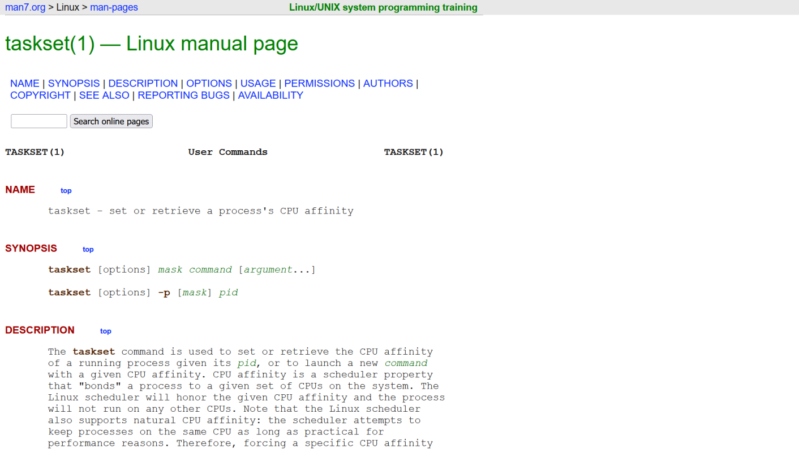
CPU Affinity in Linux
struct task_struct{
volatile long state; //TASK_RUNNING,
//TASK_ZOMBIE,
//etc.
void *stack; //Kernel stack
int exit_code;
struct mm_struct *mm;//Address space info
unsigned long cpus_allowed;
//Bitmask representing which
//cpus the task can run on
//...other stuff...
};
Notes:
Here’s the task_struct that Linux uses. In Linux, the word “task” means “kernel-level thread.”

