Slide 1


Virtualization
CS 1610: Lecture 18
4/13/2026
Notes:
[Ref: https://web.archive.org/web/20180525151921/https://saferwall.com/blog/virtualization-internals-part-1-intro-to-virtualization]

Slide 2
The Challenge
How can we take an OS and user-mode processes, and trick them into thinking that they’re running on bare metal?
VM₀
VM₁
Guest processes
Guest processes
Guest OS
Guest OS
Virtual hardware interface
Hypervisor
Real hardware interface
Hardware
Also called a VMM
(“virtual machine monitor”)

Slide 3
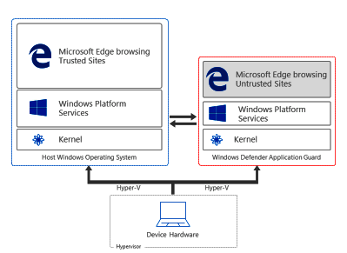
Why Is Virtualization Useful?
Security: Isolation between VMs is useful if VMs don’t trust each other, and/or host doesn’t trust VMs
Ex: In Windows 10 Enterprise, navigating to an untrusted website will open the web browser inside of a Hyper-V VM
“When an employee browses to a site that is not recognized or trusted by the network administrator, Application Guard steps in to isolate the potential threat . . . Application Guard creates a new instance of Windows at the hardware layer, with an entirely separate copy of the kernel and the minimum Windows Platform Services required to run Microsoft Edge. The underlying hardware enforces that this separate copy of Windows has no access to the user’s normal operating environment.”
Notes:
[Note: Some of the Application Guard documentation refers to Hyper-V “containers,” but, as described in Reference [3], those “containers” are not Docker-style containers---they’re actually VMs.]
[Ref: [1] https://docs.microsoft.com/en-us/windows/security/threat-protection/windows-defender-application-guard/wd-app-guard-overview
[2] http://www.miru.ch/demystifying-windows-defender-application-guard/
[3] https://docs.microsoft.com/en-us/virtualization/windowscontainers/manage-containers/hyperv-container
//In particular, see https://docs.microsoft.com/en-us/virtualization/windowscontainers/manage-containers/hyperv-container
//for a discussion of the “containers” that Windows 10 Enterprise uses.
//However, note that Application Guard was deprecated in Windows 11---see https://learn.microsoft.com/en-us/windows/security/application-security/application-isolation/microsoft-defender-application-guard/md-app-guard-overview
[4] https://www.itprotoday.com/windows-8/differences-between-windows-containers-and-hyper-v-containers-windows-server-2016
]

Slide 4
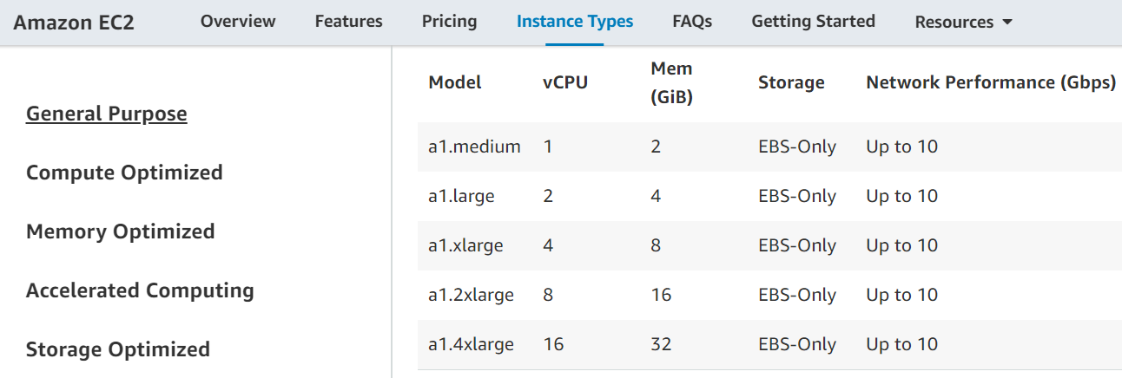
Why Is Virtualization Useful?
Server consolidation: VMs make it easy for the owner of a physical machine to rent that machine to others
Cram a bunch of somewhat-busy server apps onto a single physical machine
Cheaper than allocating a separate physical server per app
Ex: A multi-tenant datacenter like Amazon’s EC2 runs code from multiple parties on a single physical server

Slide 5
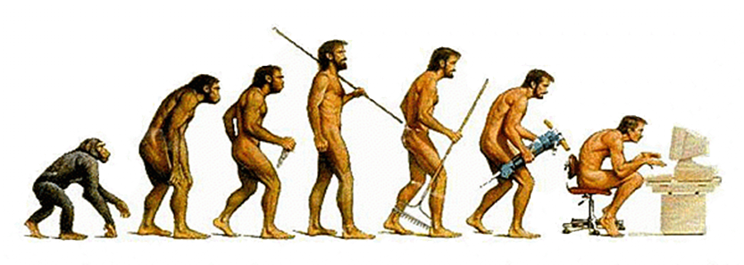
How Can We Implement Virtualization?
Hosted Interpretation
Popek-Goldberg VMMs
Dynamic Binary Translation
Hardware-assisted Virtualization

Slide 6
Hosted Interpretation
Run the VMM as a regular user application atop a host OS
VMM maintains a software-level representation of physical hardware
VMM steps through the instructions in the code of the VM, updating the virtual hardware as necessary
while(1){
curr_instr = fetch(virtHw.PC);
switch(curr_instr){
case ADD:
int sum = virtHw.regs[curr_instr.reg0] +
virtHw.regs[curr_instr.reg1];
virtHw.regs[curr_instr.reg0] = sum;
break;
case SUB:
//...etc...
Hosted interpretation used by Bochs (x86) and Gemulator (Atari)
Notes:
[Ref: http://bochs.sourceforge.net/Virtualization_Without_Hardware_Final.pdf]

Slide 7
Hosted Interpretation
Good: Easy to interpose on sensitive operations
The guest OS will want to read and write sensitive registers (e.g., %gs, %cr3), send commands to IO devices (e.g., inb), etc.
The interpreter can handle sensitive operations according to a policy
Ex: All VM disk IO is redirected to backing files in the host OS
Ex: VM cannot access the network at all, or can only access a predefined set of remote IP addresses
Good: Provides “complete” isolation (no guest instruction is directly executed on host hardware)
Good: Virtual ISA can be different than the physical ISA
Bad: Accurately emulating a modern processor is difficult
Bad: Interpretation is slow! [Ex: Bochs is 2x—3x slower than direct execution]

Slide 8
What If We Assume That The Virtual ISA Is The Same As The Physical ISA?

Slide 9
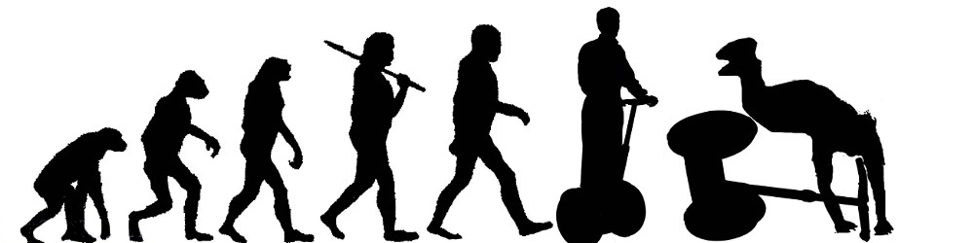
How Can We Implement Virtualization?
Hosted Interpretation
Popek-Goldberg VMMs
Dynamic Binary Translation
Hardware-assisted virtualization

Slide 10
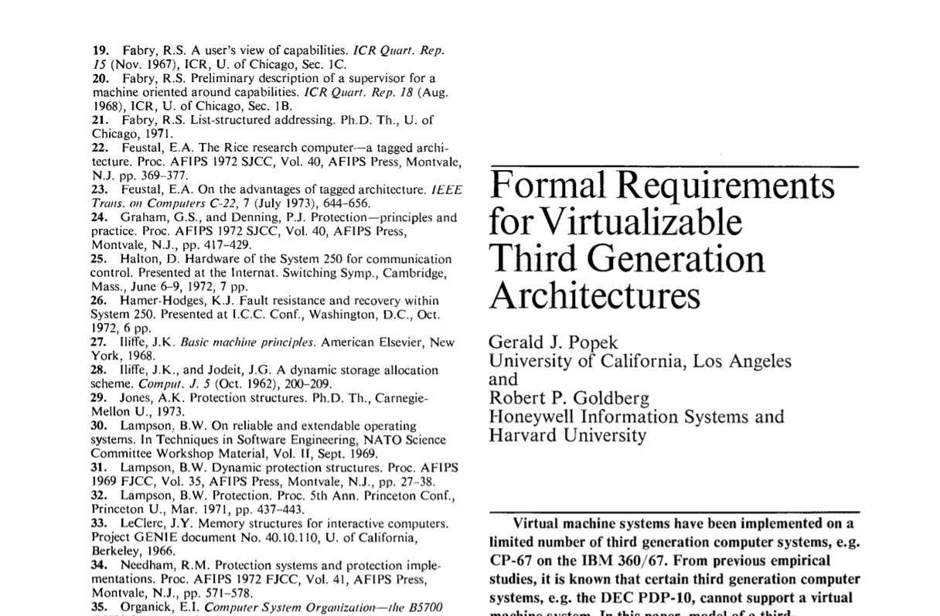
Popek and Goldberg: Terminology
Privileged instructions cause a trap if the processor isn’t in privileged mode
Sensitive instructions access low-level machine state (e.g., page tables, IO devices, privilege bits) that should be managed by control software (i.e., an OS or a VMM)
Safe instructions are not sensitive
A VMM is a control program that is:
Efficient: All safe guest instructions run directly on hardware
Omnipotent: Only the VMM can manipulate sensitive state
Undetectable: A guest cannot determine that it is running atop a VMM
invlpg: Invalidate a tlb entry
mov %crXXX: Write to a control register
inb: Read a byte of data from an input port
Notes:
[Aside: The precise definition of a “third-generation computer” isn’t important with respect to the pedagogical goals of the lecture. Basically, a third-generation computer (1) has distinct “user” and “supervisor” modes, with user mode only having access to a subset of the instructions and trapping upon executing a supervisor-privileged instruction; (2) the machine uses a base+virt_addr model to generate physical addresses; (3) there are no interrupts or IO instructions. Only the first requirement is actually a strong one. The latter two make the paper’s formal argument easier to prove. See here for more details: https://pdfs.semanticscholar.org/d800/009a27fbc8da40095f9ab59ef72441c654bb.pdf]

Slide 11
Does x86 support Popek-Goldberg virtualization?

Slide 12
Observation 1: Only Ring 0 can invoke privileged instructions. Rings 1, 2, and 3 trap when invoking privileged instructions.
Observation 2: An x86 PTE only has a single bit to indicate user/supervisor! The MMU maps Rings 0, 1, and 2 to “supervisor,” and Ring 3 to “user.”
Least
privileged
Ring 3
Ring 2
The Normal x86 Setup
Ring 1
User-mode accessible?
User apps
Intel originally thought that device drivers could be “isolated” here
However, “isolated” drivers in Rings 1 or 2 can still access ring 0 memory pages, so isolation is weak in practice without additional segment-based protection (but segment support was dropped in x86-64)
Also, many non-x86 chips only define two privilege levels, so portable OSes shouldn’t leverage Rings 1 and 2
Ring 3
Writeable?
Ring 0
Nothing
Ring 2
Present?
Nothing
Ring 1
PTE
4KB-aligned physFrame addr
OS
Ring 0
63
48
47
12
11
3
2
1
0
Most
x86 Rings
x86
privileged
Notes:
On x86, an example of a privileged instruction is the instruction is a mov operation to %cr3. Only Ring 0 code should be able to change the value of %cr3 and therefore change the active address space. Another example of a privileged instruction is the LIDT instruction. This instruction allows code to set the register which points to the interrupt descriptor table.
[As described by ”Bringing Virtualization to the x86 Architecture with the Original VMware Workstation” [http://www.cs.columbia.edu/~cdall/candidacy/pdf/Bugnion2012.pdf] (Section 6.2.1) an x86-32 can place the VMM in ring 0, the guest OS in ring 1, and the guest apps in ring 3, such that:
*the VMM and the guest OS are protected from each other using segments (so that, even though the x86 MMU treats privilege levels 0--2 as supervisor w.r.t. to the u/s bit in page tables, the guest OS cannot access VMM memory);
*the guest OS and the guest apps are protected from each other (because page protections will prevent the ring 3 guest apps from accessing ring 1 guest OS pages).
However, x86-64 does not support segmentation! So, the guest OS has to be placed in Ring 3, to prevent the guest OS from being able to access hypervisor memory.]
[Aside: Are port-mapped IO instructions privileged? Because x86 is terrible, the answer is obviously “it depends.” As described by https://sites.google.com/site/masumzh/articles/x86-architecture-basics/x86-architecture-basics, the %rflags register has an “IO privilege level (IOPL) flag (2 bits). A task or program (T1) can access IO ports if its current privilege level (CPL) is less than or equal to IOPL. A program or task may get access privilege to a port via the IO bitmap. The POPF (POPF: 16 bit, POPFD: 32 bit or POPFQ: 64-bit architecture) instruction pops the top of the stack into the privileged FLAGS register, as a result of which the IOPL and the IF flags can be modified. The IOPL can only be modified by the POPF and IRET instructions when CPL is 0. A program can modify the IF flag, only if its CPL is less than or equal to the IOPL.”].
[Ref: https://www.virtualbox.org/manual/ch10.html#hwvirt //Section 10.5 describes how, when VirtualBox uses software virtualization,
//it puts the guest OS in Ring 1. This is nice because the guest OS will trap
//when executing privileged instructions, but not all sensitive instructions
//are privileged, so VirtualBox must perform dynamic binary translation.
“Intel Virtualization Technology” by Uhlig et al. http://citeseerx.ist.psu.edu/viewdoc/download?doi=10.1.1.459.3814&rep=rep1&type=pdf
//A great discussion of the challenges of virtualizing x86
http://stackoverflow.com/questions/3425085/the-difference-between-call-gate-interrupt-gate-trap-gate //Info about call gates w.r.t. traps
]

Slide 13
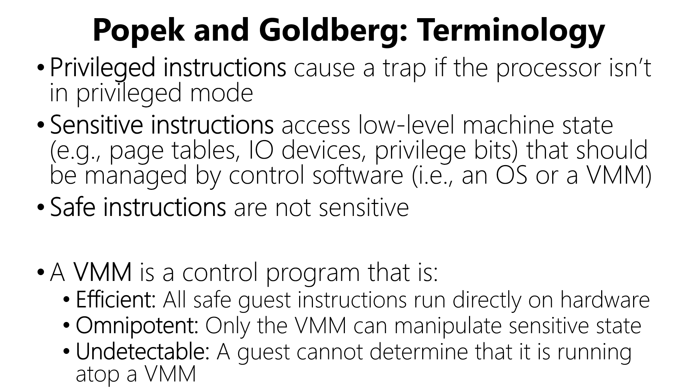
Guest apps
Ring 3
Guest OS
VMM
Ring 0
x86
Guest app executes syscall to read from keyboard
Hardware generates trap which is handled by VMM
VMM vectors control to guest OS’s interrupt handler
Guest OS tries to execute inb to read a key from the keyboard
Hardware traps to VMM
VMM executes real inb
Theorem: A virtual machine monitor can be constructed for architectures in which every sensitive instruction is privileged.
Notes:
Why is the syscall instruction sensitive? It’s sensitive because it manipulates low-level machine state—most importantly, the instruction flips the privilege bit! Similarly, instructions like iret are also sensitive because they flip the privilege bit.

Slide 14

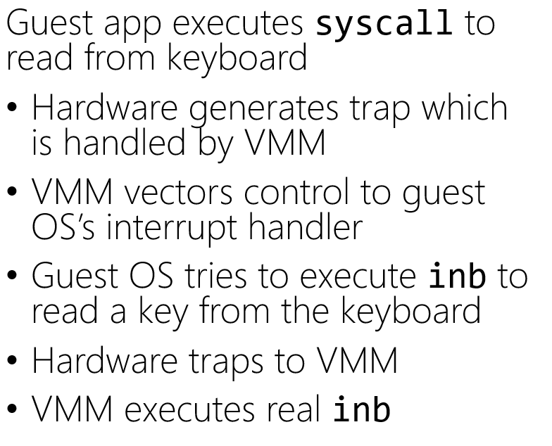
The guest OS does an iret/sysexit, thinking that the privilege level will flip from 0 to 3 . . . but both the guest OS and the guest apps run at 3!
Guest apps
Ring 3
Guest OS
VMM
Ring 0
x86
To provide isolation between the guest OS and guest apps, the VMM must do gross bookkeeping during “context switches” between the guest OS and guest apps!
VMM places result where the guest OS expects it to be
VMM vectors control back to the guest OS
Guest OS does some processing and then does an iret/sysexit
Hardware traps to VMM
VMM returns to user-mode

Slide 15
The guest OS does an iret/sysexit, thinking that the privilege level will flip from 0 to 3 . . . but both the guest OS and the guest apps run at 3!
Guest apps
Ring 3
Guest OS
VMM
Ring 0
x86
The VMM must detect a context switch from the guest OS to the guest user-level, and unmap guest OS state from the virtual address space! Afterwards, just VMM state is mapped into Ring 0 memory, and guest app state is mapped into Ring 3 memory.
Kernel static data
Kernel code
Kernel heap+stacks
All of this is in Ring 3!
Physical memory map
Empty gap
Stack
Heap
Static data
Code
Notes:
Here’s an example of the complex bookkeeping: most guest OSes place the kernel at the top of a virtual address space. In other words, the kernel is mapped into every process’s address space. In a normal scenario, this is safe because the page table entries for kernel memory are marked as “supervisor access only.” However, in the virtualization setup that I’ve described in this slide, both kernel memory and user-level memory are mapped into Ring 3 (i.e., unprivileged) memory! So, if a hypervisor wants to provide isolation between user-level guest code and kernel-level guest code, the hypervisor has to ensure that, when the guest OS writes to %cr3, the hypervisor actually UNMAPS the kernel code from the real page table that the hardware sees.
[Aside: Section 6.2.1 of Bugnion2012 discusses the page table problem in the context of x86-64 (which lacks segmentation support). Quoth the paper: “We did evaluate alternatives that relied on paging rather than segmentation . . . Unfortunately, the design alternatives all had two major downsides: first, the x86 architecture defined only one single protection bit at the page level (pte.us). Since we require three levels of protection (VMM, guest kernel, guest applications), the VMM would need to maintain two distinct page tables: one for guest applications and VMM, the other for guest kernel (running at %cpl=3!) and VMM. Second, and probably most critically, binary translators always need a low-overhead and secure mechanism to access their own supporting data structures from within translated code. Without hardware segment limit checking, we would lose the opportunity to use hardware-based segmentation and instead would have had to build a software fault isolation framework.” Remember that the VMM needs to isolate the VMM from the guest OS and the guest apps, and the guest OS from the guest apps. On x86-32, this was done by placing the VMM at Ring 0, the guest OS at Ring 1, and the guest apps at Ring 3. The paging hardware only differentiates between “user” (Ring 3) and “supervisor” (Rings 0, 1, and 2), so paging can only protect the VMM and the guest OS from guest apps. However, segments can prevent Ring 1 guest OS code from accessing Ring 0 VMM code.]

Slide 16
There’s another challenge . . .

Slide 17

Theorem: A virtual machine monitor can be constructed for architectures in which every sensitive instruction is privileged.
For many years, x86 had sensitive instructions that weren’t privileged!

Slide 18
The x86 push instruction was not PG-virtualizable!
push can push a register value onto the top of the stack
%cs register contains (among other things) 2 bits that represent the current privilege level (i.e., the current ring)
A guest OS running in Ring 3 could push %cs and see that the privilege level isn’t Ring 0!
To be virtualizable, push should cause a trap when invoked from Ring 3, allowing the VMM to push a fake %cs value which indicates that the guest OS is running in Ring 0
Notes:
[References: “Analysis of the Intel Pentium’s Ability To Support A Secure Virtual Machine Monitor” http://www.cse.psu.edu/~buu1/teaching/spring06/papers/analysis-pentium.pdf
https://pdos.csail.mit.edu/6.828/2005/lec/l17.html]

Slide 19
The x86 pushf/popf instructions weren’t PG-virtualizable!
pushf/popf read/write the %eflags register using the value on the top of the stack
Bit 9 of %eflags enables interrupts
In Ring 0, popf can set bit 9, but in Ring 3, CPU silently ignores popf!
To be virtualizable, pushf/popf should cause traps in Ring 3
Allows VMM to detect when guest OS wants to changes its interrupt level (meaning that the VMM should change which interrupts it forwards to the guest OS)
x86 had 17 non-PG-virtualizable instructions!

Slide 20

How Can We Implement Virtualization?
Hosted Interpretation
Popek-Goldberg VMMs
Dynamic Binary Translation
Hardware-assisted virtualization

Slide 21
Dynamic Translation
mov 32(%rbp), %rbx
sub %rbx, %rcx
push %rcx
popf //Sensitive instruction,
//but not privileged!
//Won’t trap when called
//in Ring 3.
Suppose that:
VMM runs in Ring 0
Guest OS and guest apps run in Ring 3
Allow guest user-level programs to run directly atop hardware . . .
. . . but the VMM rewrites the guest OS’s binary on-the-fly!
Translate sensitive-but-unprivileged instructions into ones that trap to the VMM
Translation starts when the VMM initially loads the guest OS binary
Translator handles a few instructions at a time (no bigger than a basic block)
VMM caches frequently-used translations to amortize translation costs
Original guest OS code
mov 32(%rbp), %rbx
sub %rbx, %rcx
push %rcx
int3
//A special one-byte
//instruction that traps.
//Normally leveraged by
//debuggers to trigger
//breakpoints!
Translated guest OS code
Notes:
[Refs: https://en.wikipedia.org/wiki/INT_(x86_instruction)#INT3
“Bringing Virtualization to the x86 Architecture with the Original VMware Workstation” http://www.cs.columbia.edu/~cdall/candidacy/pdf/Bugnion2012.pdf
“A Comparison of Software and Hardware Techniques for x86 Virtualization” https://www.vmware.com/pdf/asplos235_adams.pdf
https://www.anandtech.com/show/2480/5]

Slide 22
Emo kid is still sad!
Dynamic binary translation is complicated and hard to get right!

Slide 23
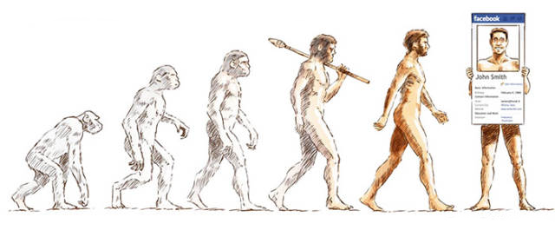
How Can We Implement Virtualization?
Hosted Interpretation
Popek-Goldberg VMMs
Dynamic Binary Translation
Hardware-assisted virtualization
Notes:
[For a nice medium-level overview of VT-x and KVM, see the “KVM” section of https://sites.cs.ucsb.edu/~rich/class/old.cs290/notes/Virtualization/virtualization.html.]

Slide 24
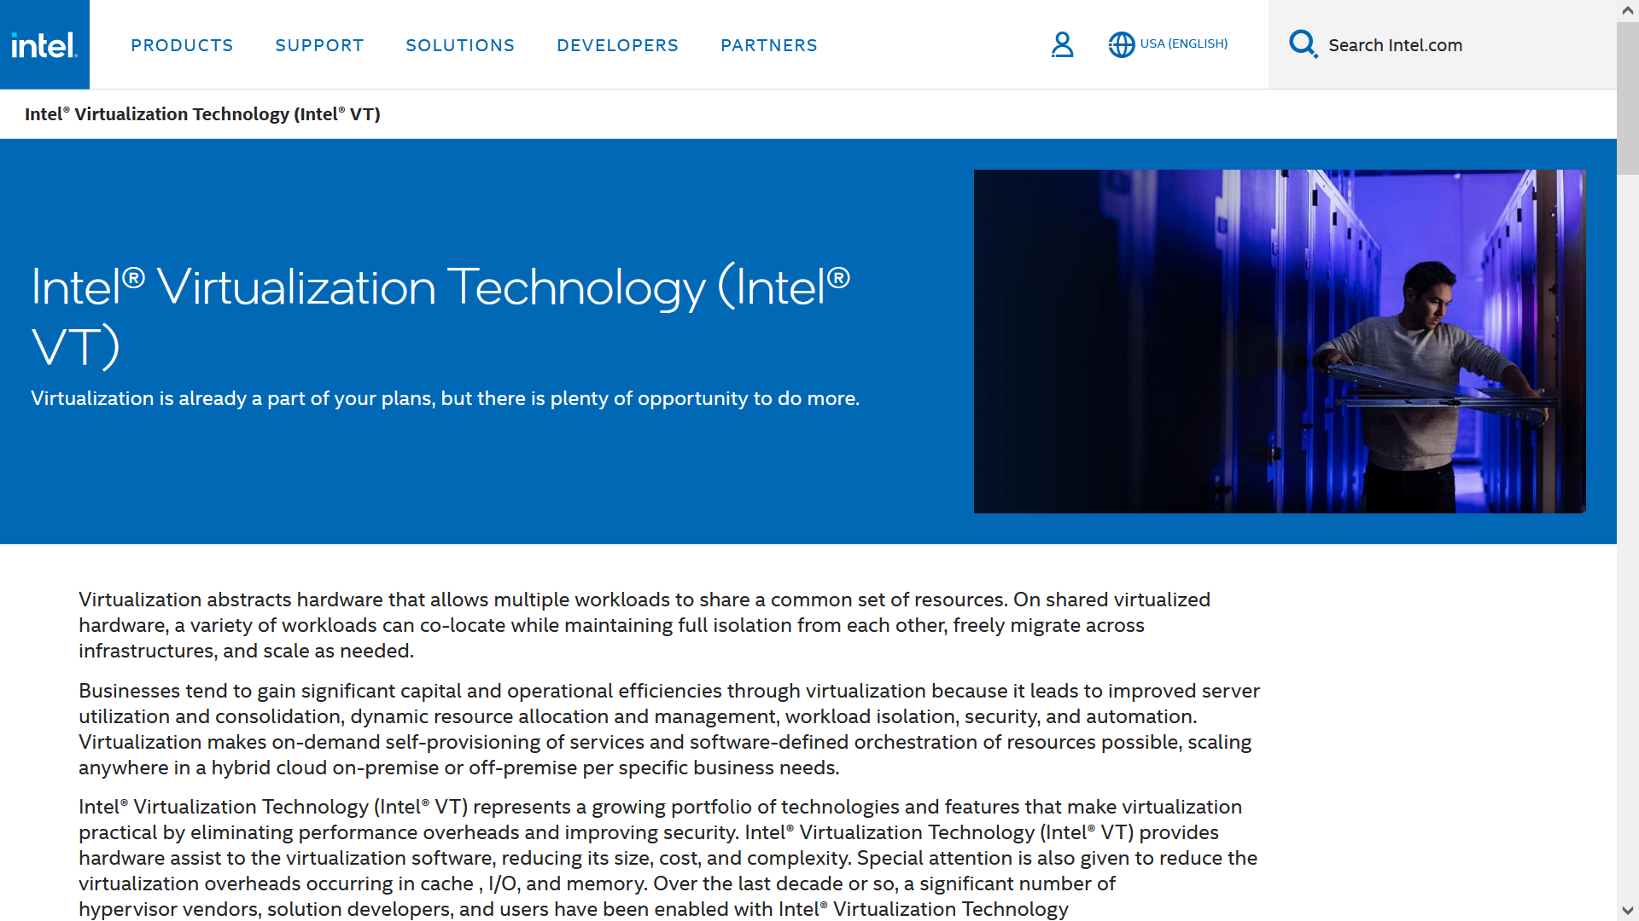

Slide 25
Intel VT-x: Sensitive Instructions
VT-x makes all sensitive instructions privileged!
VT-x also creates a new privilege bit, orthogonal to rings, to support virtualization
Root mode: Hypervisor code is running
Non-root mode: VM code is running
In non-root mode:
Sensitive instructions invoked by Ring 0 (i.e., the guest OS) will trap to Ring 0 root code (i.e., privileged hypervisor code)
Sensitive instructions invoked by Rings 1—3 will trap to Ring 0 non-root mode (i.e., the guest OS), so that the guest OS can handle the misbehaving guest application
In root mode, sensitive instructions executed by Rings 1—3 code will trap to Ring 0 root code (i.e., privileged hypervisor code)
A syscall instruction traps to Ring 0 code but doesn’t change the virtualization mode
Notes:
[Remember that, on an older (i.e., non-VT-x) x86 chip, if code in Ring 1—3 tries to execute a privileged instruction, it will trap to Ring 0. VT-x preserves these semantics for root mode code. However, if non-root code is running, then regardless of the code’s ring, the code will trap to root Ring 0 upon trying to execute a privileged instruction; furthermore, VT-x ensures that all sensitive instructions are privileged.]
[This slide implies that all non-root Ring 0 sensitive instructions must always trap to the hypervisor. However, in reality, VT-x provides more flexibility. Some instructions (e.g., VM-manipulation instructions like vmlaunch) always trap to the hypervisor. Others (like the port-mapped IO instructions inb and outb) can either trap to the hypervisor, or be handled as normal by the VM; the hypervisor chooses the desired behavior when configuring the VM’s VMCS entry. We’ll talk about VMCSes in a few slides; for now, it suffices to say that a VMCS is a region of memory, only accessible by the hypervisor, which stores configuration information about a VM. For more details about how instructions in non-root mode trap to the hypervisor, see Section 25.1 of https://www.intel.com/content/dam/www/public/us/en/documents/manuals/64-ia-32-architectures-software-developer-vol-3c-part-3-manual.pdf. For example, that documentation describes how a hypervisor might (or might) configure a VM to trap to the hypervisor upon trying to read/write %cr3. A hypervisor might be interested in guest-level modifications to %cr3, because a hypervisor might be interested in knowing when guest-level context switches are occurring.]
[As the slide above states, in non-root mode, sensitive instructions invoked by Rings 1—3 will trap to Ring 0 non-root mode (i.e., the guest OS), so that the guest OS can handle the misbehaving guest application. As Section 25.1.1 of https://www.intel.com/content/dam/www/public/us/en/documents/manuals/64-ia-32-architectures-software-developer-vol-3c-part-3-manual.pdf states, “Certain exceptions have priority over VM exits [i.e., traps to the hypervisor]. These include invalid-opcode exceptions [and] faults based on privilege level [e.g., Ring 3 code trying to invoke a sensitive instruction] . . . For example, execution of RDMSR with CPL = 3 generates a general-protection exception and not a VM exit [i.e., a trap to the hypervisor].”

Slide 26
Intel VT-x: Forcing Non-root Ring 1—3 System Calls to Trap to the VMM
VT-x does not explicitly provide a configuration bit which forces non-root Ring 1—3 invocations of syscall/sysenter to trap to the VMM
However, such traps can be enforced using creativity :-D
syscall/sysret
These two instructions are enabled by the SCE flag in %efer (“Extended Feature Enable Register”)
Hypervisor can disable the flag, telling VT-x to trap to the hypervisor when non-root code tries to perform a syscall or sysret
sysenter/sysexit
These instructions rely on model-specific registers like %SYSENTER_EIP_MSR
The hypervisor configures VT-x to trap to the hypervisor when non-root code reads or writes an MSR
Writes: Hypervisor saves the value that non-root code wants to write, but actually updates the real MSR with an invalid value like 0x0
Reads: Hypervisor returns the saved value
When non-root code tries to do a sysenter/sysexit, the invalid values in the MSRs will cause a general protection fault which will trap to the hypervisor
Notes:
[As explained by the paper “Nitro: Hardware-based System Call Tracing for Virtual Machines” by Pfoh et al. (http://citeseerx.ist.psu.edu/viewdoc/download?doi=10.1.1.637.8184&rep=rep1&type=pdf), “As it turns out, trapping to the hypervisor on the event of a system call is not supported [by VT-x] . . . [We handle] SYSCALL-based System Calls [like this:] System calls [may] be implemented using the SYSCALL instruction and its analogue counterpart SYSRET. Both of these rely on a set of MSRs, namely STAR MSR, CSTAR MSR, and LSTAR MSR. Exactly which of these registers is used depends on whether the guest OS is running in legacy, long, or compatibility mode. Additionally, this mechanism can effectively be turned on and off by setting and unsetting the SCE flag in the Extended Feature Enable Register (EFER). Making use of either SYSCALL or SYSRET with the SCE flag not set results in an invalid opcode exception. Forcing this mechanism to cause a system interrupt is then a matter of unsetting the SCE flag and setting the hypervisor to trap all invalid opcode exceptions, which is natively supported by the virtualization extensions. Once control has passed to the hypervisor, we must once again differentiate between natural exceptions and those caused by our introspection. This is achieved by looking at the violating instruction and if this instruction is not either SYSCALL or SYSRET, we inject an invalid opcode exception into the guest OS and return control to it . . . In addition to emulating the SYSCALL instruction, Nitro must be capable of handling exceptions caused by the SYSRET instruction and emulating this instruction as well. This is due to the fact that the changes made to the EFER affect the SYSRET instruction in the same manner that they affect the SYSCALL instruction. Thus, use of the SYSRET instruction will also cause an invalid opcode exception and must be handled accordingly.
[To handle] SYSENTER-based System Calls[, we do the following:] Similar to SYSCALL and SYSRET, the SYSENTER and SYSEXIT pair of instructions also rely on a set of MSRs, namely SYSENTER CS MSR, SYSENTER ESP MSR, and SYSENTER EIP MSR. The values in each of these MSRs are copied into specific system registers upon a call to SYSENTER . . . [The] value of the SYSENTER CS MSR is copied into the CS register when SYSENTER is executed and an attempt to load the CS register with a null value results in a general protection exception. Hence, causing a system interrupt is a matter of saving the current value of the SYSENTER CS MSR register in the hypervisor and loading it with a null value. This will cause each SYSENTER operation to attempt to load a null value into the CS register, thus causing a system interrupt that the hypervisor can trap. [Note that a hypervisor can detect when the guest OS reads or writes MSRs: See the “Use MSR bitmaps” entry in Table 24-6 of the “VM-Execution Controls” discussion at https://rayanfam.com/topics/hypervisor-from-scratch-part-5/.] Once the hypervisor has trapped a general protection exception, differentiating between natural and forced exceptions is once more a matter of checking the current instruction at the time of the exception . . . As with the SYSCALL/SYSRET-based system call mechanism, the change that we make to the guest in order to induce a system interrupt also affects the
SYSEXIT instruction.“]
[Note that non-root Ring 0 code shouldn’t be invoking the syscall/sysenter instructions :-D.]

Slide 27
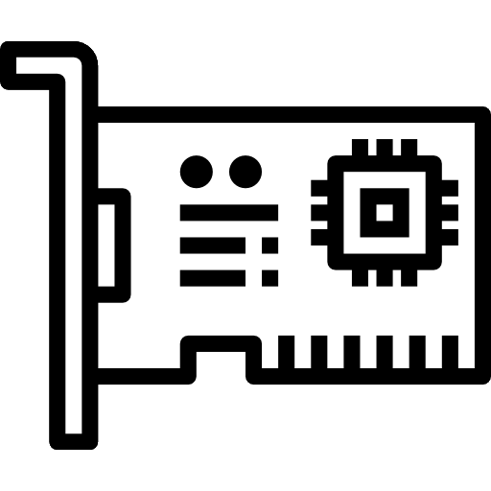
VM 1
VM 2
Suppose that a user process in VM2 invokes a system call that uses outb to configure a virtual NIC . . .
User apps
Ring 3
User apps
Ring 3
Guest process executes syscall
Guest OS executes outb
Hypervisor asks the device emulator to translate the guest outb instruction into the necessary commands for the physical NIC
Device emulator sends commands to the hypervisor’s device driver
Hypervisor’s device driver communicates with the physical NIC (e.g., using outb or memory-mapped IO)
Hypervisor resumes the VM, allowing the guest OS to run again
Guest OS returns to the guest process
Nothing
Ring 2
Nothing
Ring 2
Non-root
1
Non-root
7
Nothing
Ring 1
Nothing
Ring 1
Guest OS
Ring 0
Guest OS
Ring 0
User apps (e.g., device emulators)
Ring 3
6
2
Nothing
Ring 2
Root
3
Nothing
Ring 1
4
Hypervisor
Ring 0
5
Physical NIC

Slide 28
VM 1
VM 2
User apps
Ring 3
User apps
Ring 3
Nothing
Ring 2
Nothing
Ring 2
Non-root
Non-root
Nothing
Ring 1
Nothing
Ring 1
Guest OS
Ring 0
Guest OS
Ring 0
User apps (e.g., device emulators)
Ring 3
QEMU device emulator
Nothing
Ring 2
Root
Nothing
Ring 1
Hypervisor
Ring 0
Linux with the KVM kernel module
Notes:
The KVM (“Kernel Virtual Machine”) kernel extension allows the Linux kernel to act as a hypervisor using VT-x extensions!

Slide 29
Intel VT-x: Interrupts and Exceptions
When configuring a VM, the hypervisor decides if interrupts (e.g., timer interrupts, SSD interrupts) that occur during VM execution are vectored to:
Hypervisor code (via the hypervisor’s IDT)
Guest OS code (via the VM’s IDT)
Similarly, the hypervisor configures the CPU to send exceptions to the hypervisor IDT or the VM IDT
Notes:
[What happens if (1) the hypervisor handles a particular interrupt type (say, the NIC interrupt that is raised when a network packet arrives), and (2) such an interrupt arrives, the hypervisor processes it, and then wishes to interrupt to the guest OS, but (3) the guest OS has marked interrupts as disabled by setting the appropriate RFLAGS bit to 0 (e.g., via the cli instruction)? In these cases, the hardware will suspend the VM when the interrupt arrives from the physical device, invoke the hypervisor’s interrupt handler. The hypervisor can then configure VT-x to suspend the VM when the VM marks itself as interruptible again (e.g., via sti). At that point, the hypervisor will regain control and can inject the appropriate interrupt into the VM. As described by [1], the launching of a VM will “load processor state from the guest-state area of the VMCS [i.e., the memory region that the hypervisor uses to store saved register state for a VM] . . . In addition to loading guest state, VM entry can be optionally configured for event injection. The CPU effects this injection using the guest IDT to deliver an event (exception or interrupt) specified by the VMM, just as if it had actually occurred immediately after VM entry.”]
[As we’ll see in a few slides (“Intel VT-x: Launching and Suspending VMs”), when a VM is running, the hypervisor’s register state (including interrupt vectoring register state like %idtr) are stored in a memory location that is known to the VT-x hardware. So, when a VM is running and an interrupt occurs that should be handled by the hypervisor, the VT-x hardware knows how to restore the hypervisor’s register state (including special registers like %idtr) and then vector control to the appropriate hypervisor-level interrupt handler.]
[1] “Intel ® Virtualization Technology: Hardware Support for Efficient Processor Virtualization” by Neiger et al.: https://course.ece.cmu.edu/~ece845/docs/vt-overview-itj06.pdf
[Also see Table 24-5 of https://www.intel.com/content/dam/www/public/us/en/documents/manuals/64-ia-32-architectures-software-developer-vol-3c-part-3-manual.pdf, which describes the part of the VMCS that configures interrupt-handling behavior. Also see Section 24.6.3, which discusses the VMCS’ exception bitmap which determines whether exceptions are delivered to the VM or the hypervisor. Section 25.2 is also helpful.]

Slide 30
Intel VT-x: Virtualizing the MMU
Goals
Allow a guest OS to believe that it controls the virtual-to-physical mapping
Enable a hypervisor to actually control:
Which guest pages live in real RAM
Where those pages live in real RAM
Memory types when a VM is running
Guest virtual memory: Visible to VM code
Guest physical memory: What the guest OS maps guest virtual memory to using %cr3
Host physical memory: What the hypervisor maps guest physical memory to using %ept

Slide 31
Intel VT-x: Extended Page Tables
When a VM is running:
%cr3 is set by the guest OS
Controls the mapping from guest virtual addresses to guest physical addresses
Each page table entry contains a guest physical address
%ept is controlled by the hypervisor (and is invisible to the guest OS)
Translates guest physical addresses to host physical addresses
Each page table entry contains a host physical address
During a TLB miss, the MMU:
Uses the extended page table to translate the guest physical address in %cr3 to a host physical address (i.e., the host physical location of the top-level page table)
Walks the page table pointed to by %cr3, using the %ept page table to translate the guest physical address in each level of the table to the corresponding host physical address

Slide 32
Page tables: x86-64
L4
L3
L2
L1
Offset
47
39
38
30
29
21
20
12
11
0
PhysAddr
12 bits
4KB page
9 bits
PTE
9 bits
Page table
PDE
User-mode accessible?
%cr3
Writeable?
9 bits
Page directory
PDPTE
Present?
Execute disable?
Guest physical address!
9 bits
Page directory pointer
PML4E
PTE
4KB-aligned physFrame addr
64 bits
Page map level 4
63
48
47
12
11
3
2
1
0
Notes:
Note that “execute disable” bits are present in all of the page table entries, not just the L1 entry. To execute an instruction on a particular page, the execute-disable bits in *all* of the relevant entries must be set to 0.
[Ref: Section 4.5 of "Intel® 64 and IA-32 Architectures Software Developer’s Manual Volume 3 (3A, 3B, 3C & 3D): System Programming Guide“
https://en.wikipedia.org/wiki/NX_bit
]

Slide 33
Intel VT-x: Extended Page Tables
When a VM is running:
%cr3 is set by the guest OS
Controls the mapping from guest virtual addresses to guest physical addresses
Each page table entry contains a guest physical address
%ept is controlled by the hypervisor (and is invisible to the guest OS)
Translates guest physical addresses to host physical addresses
Each page table entry contains a host physical address
During a TLB miss, the MMU:
Uses the extended page table to translate the guest physical address in %cr3 to a host physical address (i.e., the host physical location of the top-level page table)
Walks the page table pointed to by %cr3, using the %ept page table to translate the guest physical address in each level of the table to the corresponding host physical address

Slide 34
Page tables: x86-64
L4
L3
L2
L1
Offset
47
39
38
30
29
21
20
12
11
0
PhysAddr
12 bits
4KB page
Walk the %ept to translate to a host physical address
9 bits
PTE
Walk the %ept to translate to a host physical address
9 bits
Page table
PDE
%cr3
Walk the %ept to translate to a host physical address
9 bits
Page directory
PDPTE
Walk the %ept to translate to a host physical address
9 bits
Page directory pointer
PML4E
64 bits
Walk the %ept to translate to a host physical address
Page map level 4

Slide 35
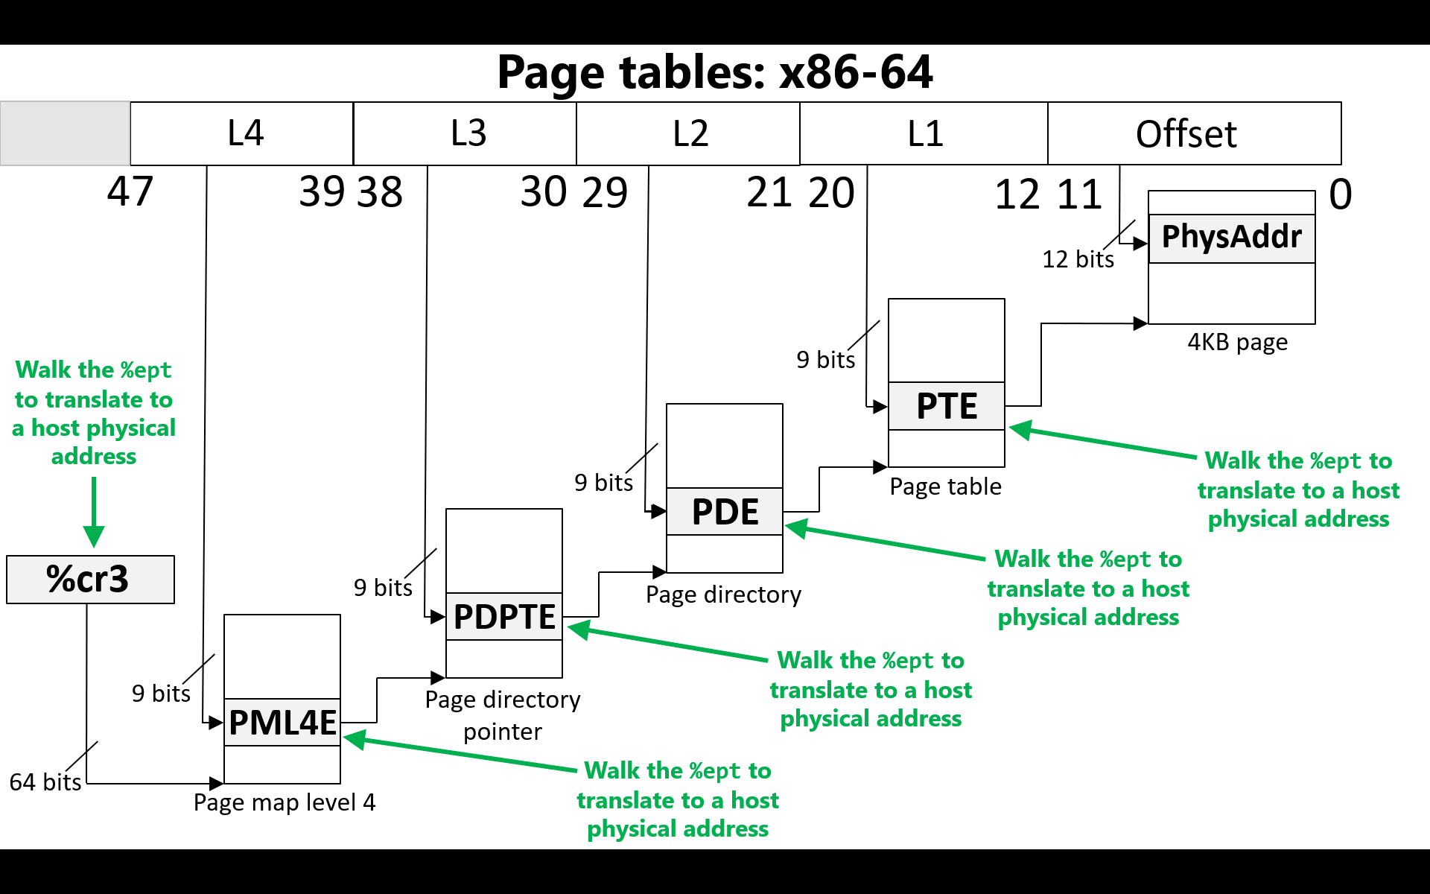

Look at all of the additional memory accesses!
Notes:
We’re doing a five page table walks instead of just one! A regular x86-64 page walk has 4 memory accesses, but an EPT page walk has 24 memory accesses. Luckily, VT-x processors maintain caches for various intermediate mappings.

Slide 36
Intel VT-x: Launching and Suspending VMs
VMM launches a VM by:
Configuring the VM’s VMCS page in memory
Setting a core’s VMCS pointer to point to the VMCS page
Calling vmlaunch/vmresume, which context switches to a VM by copying the VM’s register state from the VMCS page into the CPU’s registers
A VM relinquishes control to the VMM:
By voluntarily invoking vmexit or vmcall
By invoking a sensitive instruction
When an interrupt occurs
In all cases, the VM’s register state (including special registers like %cr3 and %idtr) is saved in the VM’s VMCS page
During a mode switch, hardware automatically and atomically saves register state!
VMM->VM: The VM’s register state is loaded from the VMCS onto the CPU, and the VMM’s state is saved in the VMCS
VM->VMM: The VMM’s register state is loaded from the VMCS onto the CPU, and the VM’s state is saved in the VMCS
Notes:
[As described by Intel’s documentation [3], “There is no software-visible bit whose setting indicates whether a logical processor is in VMX non-root operation. This fact may allow a VMM to prevent guest software from determining that it is running in a virtual machine. Because VMX operation places restrictions even on software running with current privilege level (CPL) 0, guest software can run at the privilege level for which it was originally designed. This capability may simplify the development of a VMM . . . A VMM could use a different VMCS for each virtual machine that it supports. For a virtual machine with multiple logical processors (virtual processors), the VMM could use a different VMCS for each virtual processor.“]
[As described in Section 24.4 of Reference [3], strictly speaking, a VMCS does not store *all* of the register state for a swapped-out VM. Instead, it only stores %rip, %rsp, the segment registers (e.g., %cs and %gs), and some other control registers like %cr3 and %idtr. The hypervisor is responsible for saving the rest of the VM’s registers.]
[Ref: [1] https://cseweb.ucsd.edu/~jfisherogden/hardwareVirt.pdf
[2] Chapter 4 of “Hardware and Software Support for Virtualization" by Bugnion, Nieh, and Tsafrir. hw-sw-virtualization.pdf
[3] https://www.intel.com/content/dam/www/public/us/en/documents/manuals/64-ia-32-architectures-software-developer-vol-3c-part-3-manual.pdf
]

Slide 37
VM 1
VM 2
User apps
Ring 3
User apps
Ring 3
Nothing
Ring 2
Nothing
Ring 2
Non-root
Non-root
Nothing
Ring 1
Nothing
Ring 1
OS
Ring 0
OS
Ring 0
User apps
Ring 3
Nothing
Ring 2
Root
Nothing
Ring 1
VMM
Ring 0

Slide 38
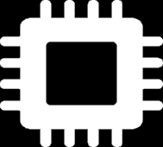
VM 1
VM 2
VMM-controlled “extended” page table!
User apps
Ring 3
User apps
Ring 3
VMM pages
VMM
Nothing
Ring 2
Nothing
Ring 2
VM₁
Non-root
Non-root
VM₂ pages
Nothing
Ring 1
Nothing
Ring 1
%ept
OS
Ring 0
OS
Ring 0
VM₁ pages
%cr3
%vmcsPointer
User apps
Ring 3
VMCS₂
[VM₁ state]
Nothing
Ring 2
Root
VMCS₁
Nothing
Ring 1
vmptrld
[VM₀ state]
[VMM state]
vmlaunch
VMM
Ring 0
RAM
Notes:
[Note that a VM-level page fault only traps to the VMM if the page fault is induced by the EPT part of the page walk! In other words, if an address translation hits an unmapped region in the guest %cr3’s page table, the page fault is handled by the guest OS. However, if an address translation hits an unmapped region in the EPT’s page table, then the fault is sent to the VMM.]
[Aside: Even if non-root mode has disabled interrupts, the arrival of an interrupt will cause a trap to the VMM if non-root code is running. See page 56 of the reference below.]
[Ref: Chapter 4 of “Hardware and Software Support for Virtualization" by Bugnion, Nieh, and Tsafrir. hw-sw-virtualization.pdf

Slide 39
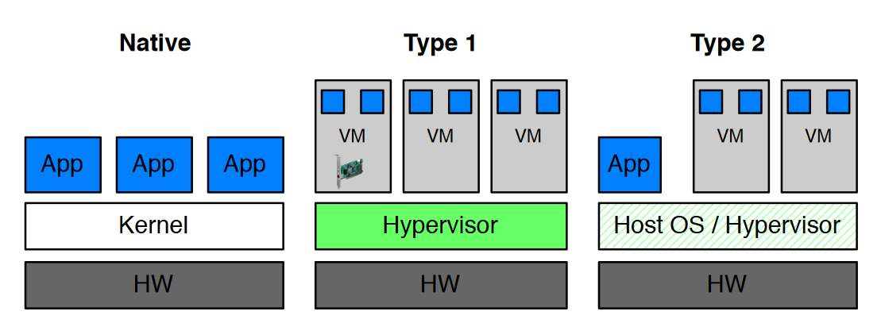
Type 1 vs. Type 2 Hypervisors
Type 1 hypervisors run directly atop the hardware
Type 2 hypervisors are implemented as part of a host OS
Type 2 hypervisors can reuse OS code that would otherwise be a pain to recreate/port in the hypervisor
Device drivers are an important example of such code: Type 2 hypervisors can just borrow the OS’s device drivers!
For both kinds of hypervisors, minimizing the number of context switches between VMs and hypervisors is key to good performance
Notes:
[Ref: http://www.cs.columbia.edu/~cdall/pubs/isca2016-dall.pdf //”ARM Virtualization: Performance and Architectural Implications” by Dall et al.
//Section 2 in particular.
]

Slide 40
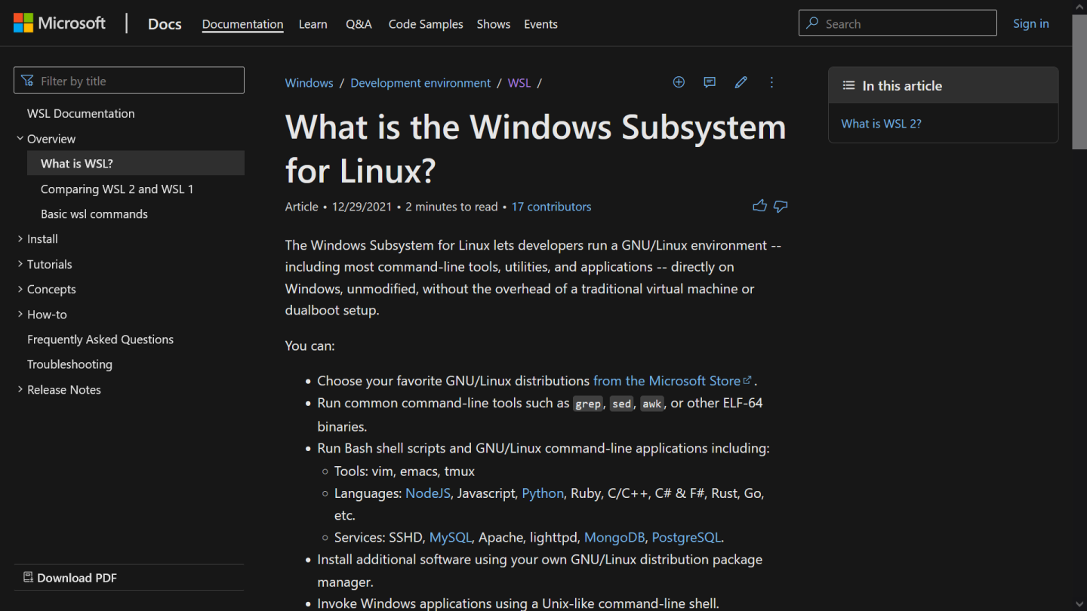
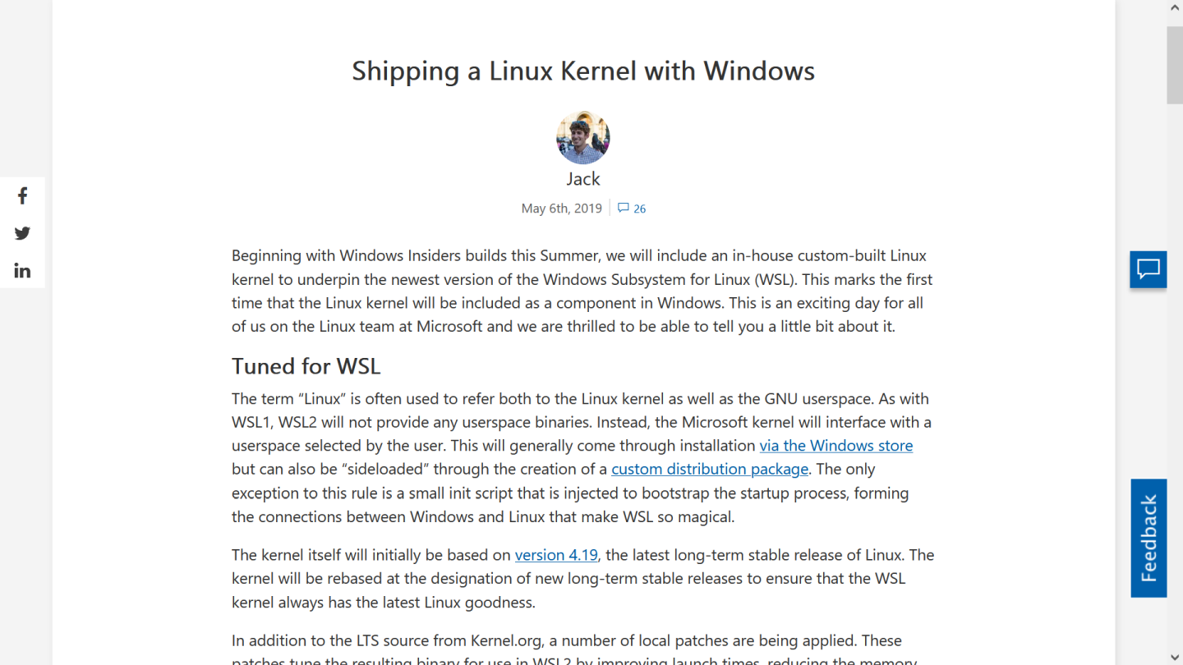
Windows Subsystem for Linux (WSL)
Notes:
[As described by [2], the first version of WSL used system call translation to map Linux system calls to Windows system calls. As [2] state, “Both the Linux kernel and Windows NT kernel expose several hundred syscalls to user mode, but they have different semantics and are generally not directly compatible. For example, the Linux kernel includes things like fork, open, and kill while the Windows NT kernel has the comparable NtCreateProcess, NtOpenFile, and NtTerminateProcess.
The Windows Subsystem for Linux includes kernel mode drivers (lxss.sys and lxcore.sys) that are responsible for handling Linux system call requests in coordination with the Windows NT kernel. The drivers do not contain code from the Linux kernel but are instead a clean room implementation of Linux-compatible kernel interfaces. On native Linux, when a syscall is made from a user mode executable it is handled by the Linux kernel. On WSL, when a syscall is made from the same executable the Windows NT kernel forwards the request to lxcore.sys. Where possible, lxcore.sys translates the Linux syscall to the equivalent Windows NT call which in turn does the heavy lifting. Where there is no reasonable mapping the Windows kernel mode driver must service the request directly.
As an example, the Linux fork() syscall has no direct equivalent call documented for Windows. When a fork system call is made to the Windows Subsystem for Linux, lxcore.sys does some of the initial work to prepare for copying the process. It then calls internal Windows NT kernel APIs to create the process with the correct semantics, and completes copying additional data for the new process.”]
[As [1] states, WSL v2 uses virtualization to provide Linux support on Windows. In particular, Microsoft created a custom Linux kernel that is run atop the Hyper-V hypervisor; Linux apps run atop that custom Linux kernel.]
[Ref: [1] https://devblogs.microsoft.com/commandline/shipping-a-linux-kernel-with-windows/ //Described WSL v2
[2] https://docs.microsoft.com/en-us/archive/blogs/wsl/windows-subsystem-for-linux-overview //Describes WSL v1
[3] https://github.com/microsoft/WSL2-Linux-Kernel //The repo for the WSL-specific Linux kernel that Microsoft created
]

