Slide 1
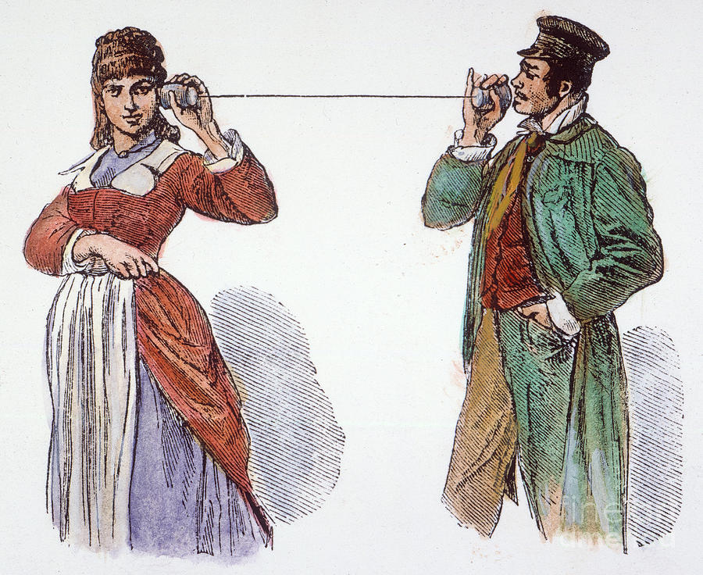
Networking
CS 1610: Lecture 19
4/15/2026

Slide 2

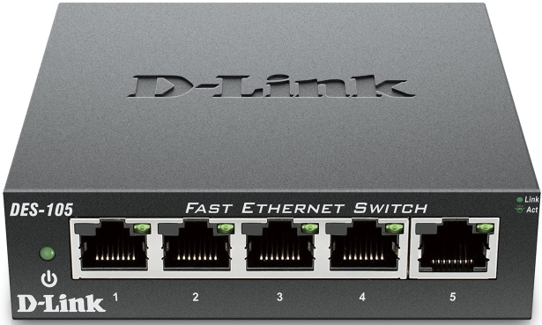
Network Cards and the Internet
A network card exchanges data between machines connected by a shared physical media
  Ex: IEEE 802.11 protocol handles Wi-fi (i.e., radio) exchanges
  Ex: IEEE 802.3 protocol handles Ethernet (i.e., wired) exchanges
Each network card has a unique identifier called a MAC address
00:0a:95:9d:68:16
bc:a2:3e:91:c8:da
f0:2d:08:7d:d5:92
Dst: f0:2d:08:7d:d5:92
Src: 00:0a:95:9d:68:16
Frame len: 1430
Data: <bytes>
Checksum: 2fbd0925
Ethernet frame
Ethernet switch

Slide 3
Network Cards and the Internet
The Internet™© consists of protocols that are layered above single-hop, point-to-point protocols like Ethernet
Example: The IP protocol connects machines across multiple hops
  An Ethernet frame’s data is an IP packet
  IP packet’s header has a source IP address and destination IP address
  The “gateway” on a LAN knows how to forward IP packets destined for external hosts
00:0a:95:9d:68:16
bc:a2:3e:91:c8:da
f0:2d:08:7d:d5:92
Dst: f0:2d:08:7d:d5:92
Src: 00:0a:95:9d:68:16
Frame len: 1430
Data: <bytes>
Checksum: 2fbd0925
Ethernet frame
Ethernet switch

Slide 4

Dst: 172.217.3.110
172.217.3.110
25:98:a0:b7:9c:ac
Src: 50.235.189.28
Packet len: 1412
Data: <bytes>
Checksum: 9b77a14b
IP packet
The Internet™©
50.235.189.28
50.235.189.29
50.235.189.30
00:0a:95:9d:68:16
bc:a2:3e:91:c8:da
f0:2d:08:7d:d5:92
Dst: f0:2d:08:7d:d5:92
Gateway
Src: 00:0a:95:9d:68:16
Frame len: 1430
Data: <bytes>
Checksum: 2fbd0925
Ethernet frame
Ethernet switch

Slide 5
The OSI Network Stack
Ex: HTTP,
SSH, POP
Application
Application-specific data
Layer 4: Transport
Do we care about streams? Packet drops, duplications, or reordering?
Ex: TCP,
UDP
Layer 3: Network
How are packets exchanged between hosts separated by many hops?
Ex: IP
Layer 2: Link
How are frames transmitted between hosts on the same physical medium?
Ex: WiFi,
Ethernet
Layer 1: Physical
How are 0s and 1s encoded in the physical medium?
Notes:
“OSI” stands for “open systems interconnection.” The OSI model provides a conceptual framework for understanding various aspects of network data exchange.
POP is a protocol that allows an email client to download emails from an email server; SMTP is the common protocol that is used by a client to *submit* an email to an email server.

Slide 6
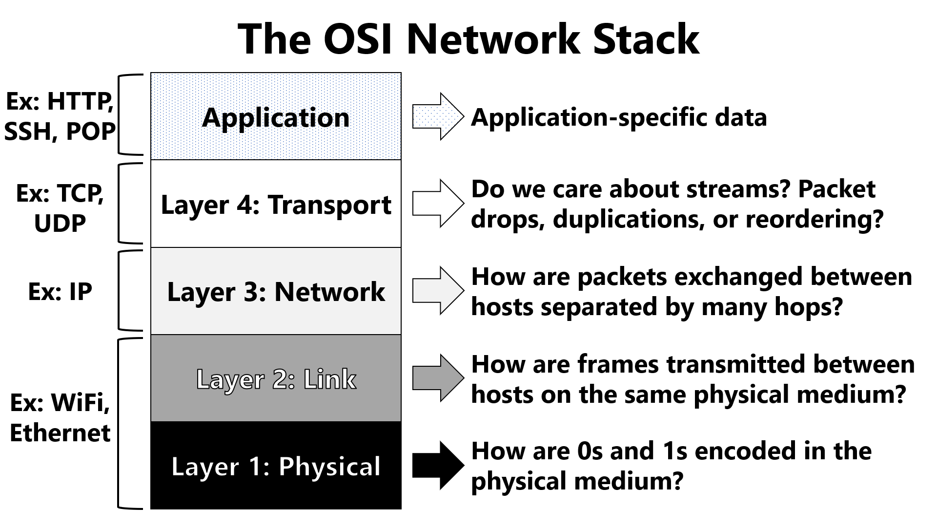
Kernel code implements these layers!

Slide 7
Outline
The OSI Model
NIC Basics
  Ring Buffers
  DMA
  IOMMUs
NIC Optimizations
  Interrupt handler splitting
  Interrupt coalescing
  DPDK

Slide 8
Network Cards: Ring Buffers
NICs typically use the ring abstraction to exchange packets with the OS
  A ring is a circular buffer of packet descriptors (much like a file system’s buffer cache is a collection of buffer descriptors)
  NIC expects the OS to:
    Allocate an RX (“receive”) ring and TX (“transmit”) ring in RAM
    Configure the NIC with the memory locations of the rings
If a NIC supports multiple RX rings and TX rings, then multiple CPUs can simultaneously receive and send packets
RX ring
Head
Tail
Notes:
[Ref: https://web.archive.org/web/20230804072231/https://lettieri.iet.unipi.it/virtualization/2018/20161124-io-paravirtualization-tour.pdf
https://pdos.csail.mit.edu/6.828/2018/labs/lab6/
]

Slide 9
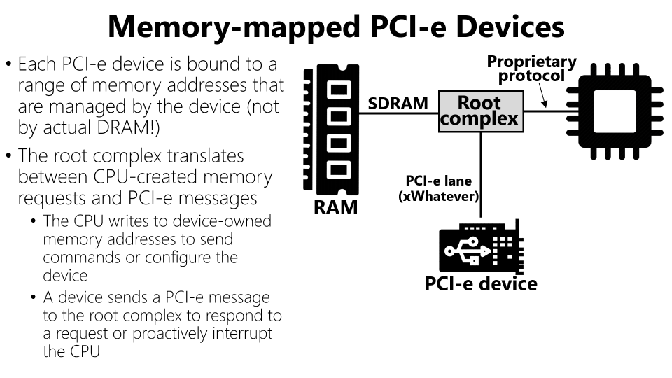
Pointer to packet buffer
Buffer len
bufContainsPkt?
Other stuff
Owned by OS
Owned by NIC
Owned by OS
RX ring
Head
Tail
Memory-mapped register pointing to the first descriptor that NIC can use to store a packet
Incremented by NIC upon copying a received packet to the descriptor’s buffer
Memory-mapped register pointing to the first descriptor that NIC cannot use to a store packet
Incremented by OS once software-level packet handling completes
Notes:
[Ref: http://lettieri.iet.unipi.it/virtualization/2018/20161124-io-paravirtualization-tour.pdf]

Slide 10
When a new packet arrives, the NIC uses DMA to:
  Read the descriptor pointed to by Head to find the buffer address
  Write the received packet’s data to the buffer
  Set the descriptor’s bufContainsPkt? to 1
Then, the NIC:
  Increments the memory-mapped register Head
  Discards local copy of packet and raises an interrupt
OS will eventually increment Tail to the position of packet
System RAM
Empty buf
RX ring
bcp:0
bcp:1
Head
Tail
Packet
On-NIC RAM
Packet
Notes:
[Remember that the RX ring lives in system RAM. This is why the NIC has to use DMA to read and write ring metadata that’s pointed to by `Head`. However, the memory-mapped register which contains `Head` dos not live in system RAM, because it’s a memory-mapped register. Instead, the register is managed by the NIC itself; for example, it might be implemented as an actual register inside the NIC, or as a special memory location in the on-NIC RAM.]
[Ref: http://lettieri.iet.unipi.it/virtualization/2018/20161124-io-paravirtualization-tour.pdf]

Slide 11
If NIC increments Head and discovers that Head==Tail . . .
  There are no available buffers to DMA incoming packets into!
  NIC will drop incoming packets until the OS processes some packets and pokes the NIC by incrementing Tail
Owned by OS
Owned by NIC
RX ring
Tail
Head
Notes:
We say that the OS “pokes” the NIC by incrementing `Tail`, because writing to `Tail` will send a PCI-e message to the NIC (since `Tail` is a memory-mapped register); the message will inform the NIC that the NIC now has at least one slot that can hold an incoming packet.

Slide 12
If OS increments Tail and discovers that Head==(Tail+1)%N . . .
  The OS has processed all of the packets!
  OS will wait for the NIC to raise an interrupt to indicate that new packets have arrived
Owned by OS
Owned by NIC
RX ring
Head
Tail
Points to the first descriptor that NIC cannot use to store packet
Notes:
[So, there will always be at least one descriptor slot that is unused.]

Slide 13
How Does TX Work?

Slide 14
Pointer to packet buffer
Buffer len
pktSent?
Other stuff
Owned by OS
Owned by NIC
Owned by OS
TX ring
Head
Tail
Memory-mapped register pointing to the first descriptor whose packet should be transmitted by NIC
Incremented by NIC upon sending a packet
Memory-mapped register pointing to the first descriptor that does not correspond to a packet to send
Incremented by OS once a packet to send has been copied into the descriptor’s buffer

Slide 15
Initially, there are no packets to send
When the OS receives a packet to send, the OS:
  Writes the descriptor at Tail to point to the packet buffer
  Sets the descriptor’s pktSent? to 0
  Increments Tail
The write to the memory-mapped register Tail pokes the NIC, informing it of a packet to transmit
System RAM
Packet
TX ring
ps?: 0
Tail
Head
On-NIC RAM

Slide 16
The NIC uses DMA to:
  Read the descriptor pointed to by Head to find the buffer address
  Read the buffer into on-NIC RAM
  Set the packetSent? flag to 1 (once the packet is sent)
The NIC then increments Head and raises an interrupt to inform the OS of the packet transmission
System RAM
Packet
Packet
TX ring
ps?:1
ps?: 0
Tail
Head
On-NIC RAM
Notes:
[As with the RX scenario, if Head==Tail, that means that there are no more descriptors for the NIC to process. In contrast, if Head==(Tail+1)%N, then the NIC is backlogged, and the OS must wait before asking the NIC to handle another packet.]
[As a preview of coming attractions later in the slide deck, the NIC can be configured to not generate interrupts when a packet is sent or received. In this mode, software needs to poll the NIC to determine when packets have been sent or received. For example, with respect to the TX ring, the OS can spin on the head register, waiting for the NIC to update it.]
[Ref: https://blog.packagecloud.io/eng/2017/02/06/monitoring-tuning-linux-networking-stack-sending-data/]

Slide 17
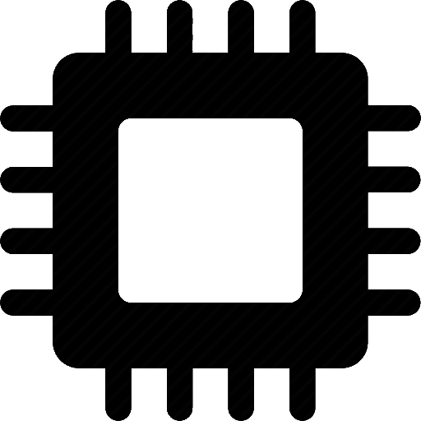
IOMMUs
Modern computers place DMA-capable devices behind an IO-specific MMU
  A device generates memory references that target a “device physical” address space
  The IOMMU maps device physical RAM to general-purpose physical RAM
    The IOMMU has a TLB and a page table pointer
    The page table (which lives in general-purpose physical RAM) is controlled by the OS on the general-purpose CPUs
IOMMUs enable cool stuff like:
  Preventing a faulty device (or device driver) from DMA’ing arbitrary memory
  Enabling legacy 32-bit devices to access more than 4 GB of general-purpose physical RAM
  Safely allowing a device to DMA directly to/from user-level buffers (thereby avoiding data copying between user buffers and kernel buffers!)
%cr3
TLB
%cr3
TLB
MMU
MMU
Root complex
RAM
%rt
TLB
IOMMU
PCIe
RID
PCIe
RID
PCIe device
PCIe device
Notes:
The `%rt` register is the “root table” register. It points to the base of the page table that is used by the IOMMU.
[Aside: As mentioned on page 20 of the reference below, “The IOMMU provides no direct indication to an I/O device of a failed translation when processing an untranslated posted request. This is in contrast to the page fault mechanism employed by CPU’s MMU.”]
[Ref: Sections 2 and 3 of “Bypassing IOMMU Protection against I/O Attacks” by Morgan et al (https://hal.archives-ouvertes.fr/hal-01419962/document)]
[Ref: https://www.amd.com/system/files/TechDocs/48882_IOMMU.pdf //Sections 1 and 2.2 are most relevant
http://www.cs.technion.ac.il/~dan/papers/riommu-asplos-2015.pdf //Section 2.3
https://compas.cs.stonybrook.edu/~nhonarmand/courses/sp17/cse506/slides/hw_io_virtualization.pdf
]

Slide 18
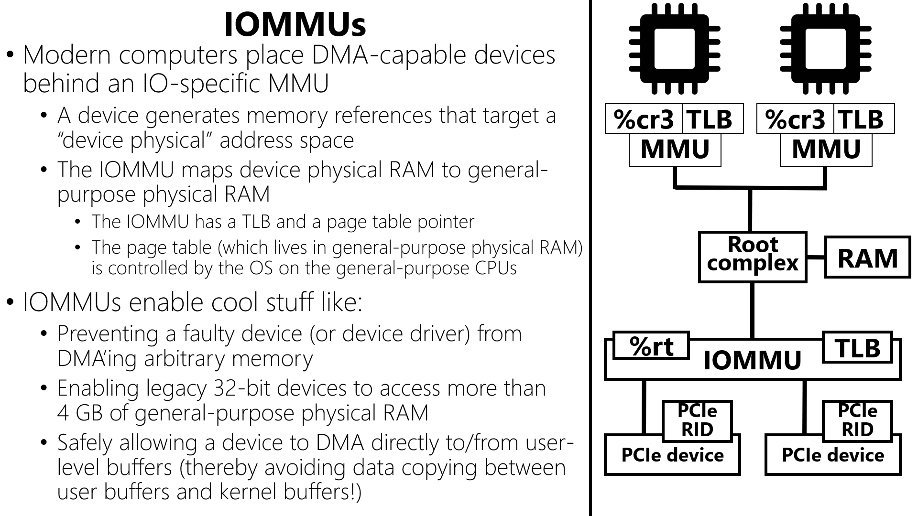
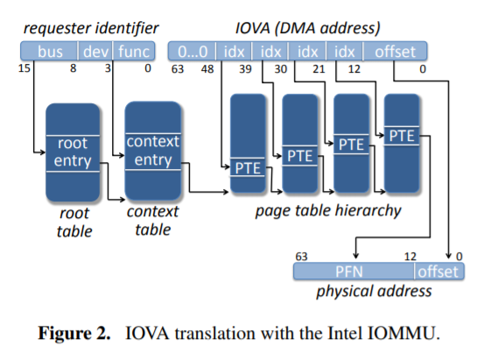
Notes:
The basic idea is that the %rt register points to a page table who last entry is a pointer to another page table. The IOMMU uses a device’s RID to traverse the root page table and determine which device-specific page table should be used to translate memory addresses for the device.

Slide 19
Outline
The OSI Model
NIC Basics
  Ring Buffers
  DMA
  IOMMUs
NIC Optimizations
  Interrupt handler splitting
  Interrupt coalescing
  DPDK

Slide 20
Keeping Machines Responsive
In commodity OSes, an interrupt handler often disables interrupts during some/all parts of execution
  Ex: To avoid grabbing lock x, being interrupted, and then deadlocking with another interrupt handler that wants to grab x
  Ex: To avoid a device driver having to handle recursively-nested interrupts
Disabling interrupts makes a machine unresponsive to interrupts
  So, an interrupt handler should be fast (to keep the machine responsive) . . .
  . . . but a handler may have a lot of work to do!
Process₀
Process₁
Process₂
Could we let interrupt handlers sleep?
  In most OSes, an interrupt handler:
    Runs on a per-CPU stack
    Lacks a process context that can be scheduled
  So, interrupt handlers can’t sleep!
CPU₀ stack
CPU₁ stack
User stack
Kernel stack
Notes:
[Recall that, in x86, the per-core task register points to a task state segment (TSS); the TSS contains pointers to the stacks that the hardware will use when executing interrupt handling code. Ref: https://wiki.osdev.org/Task_State_Segment and https://en.wikipedia.org/wiki/Task_state_segment]
[In theory, it is definitely possible to allocate a new stack per interrupt and then the associated handler to sleep. However, this design is kinda ugly---a simpler approach is to have a set of dedicated threads handle the heavyweight part of interrupt handling.
Also recall that Chickadee does not handle interrupts on the per-cpu stack; see k-exception.S and proc::exception(). At the very beginning of the exception-handling path, the hardware has vomited some state onto the per-cpu stack, but Chickadee immediately copies this state to the kernel stack for the currently-running process, and then calls proc::exception() (where the “this” pointer corresponds to the struct proc for the user-mode process that was running when the exception occurred.]
[Ref: https://notes.shichao.io/lkd/ch7/#interrupt-context
https://0xax.gitbooks.io/linux-insides/content/Interrupts/linux-interrupts-9.html
https://stackoverflow.com/questions/1053572/why-kernel-code-thread-executing-in-interrupt-context-cannot-sleep
https://www.kernel.org/doc/Documentation/x86/kernel-stacks]

Slide 21
Splitting an Interrupt Handler
Top half: Performs the minimal amount of work needed to allow the system to make forward progress
  Ex: Wake up tasks that are blocked on the device
  Ex: Acknowledge interrupt receipt by writing to a memory-mapped device register
Bottom half: Handles the remaining work
  Ex: Copy a fetched disk block from a kernel buffer to a user buffer
  Ex: Allow the kernel’s network stack to process a received packet
Notes:
[Ref: https://0xax.gitbooks.io/linux-insides/content/Interrupts/linux-interrupts-9.html
https://notes.shichao.io/lkd/ch7/]

Slide 22
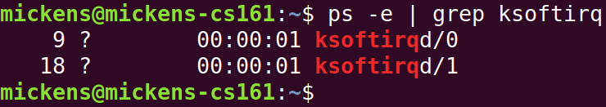
Linux: Splitting an Interrupt Handler
Per-cpu “softirq” threads implement bottom halves
Linux defines 10 types of bottom halves, each of which has a handler function
Each CPU has 10-bit bitmask indicating the bottom halves that need to run
enum { HI_SOFTIRQ=0, TIMER_SOFTIRQ,
NET_TX_SOFTIRQ, NET_RX_SOFTIRQ,
BLOCK_SOFTIRQ, BLOCK_IOPOLL_SOFTIRQ,
TASKLET_SOFTIRQ, SCHED_SOFTIRQ,
HRTIMER_SOFTIRQ, RCU_SOFTIRQ,
NR_SOFTIRQS };
  A top-half interrupt handler:
    Sets the appropriate bit in the bitmask
    If necessary, prepares a work item (e.g., “new packet arrived”) for local softirq thread
    Wakes up the local softirq thread
  The softirq thread iterates over bitmask, and for each set bit:
    Executes the relevant bottom-half handler on the work queue items
    Clears the relevant bits in the bitmask
Notes:
[The “-e” option passed to `ps` instructs `ps` to display info for every process.]
[Aside: Linux defines 10 softirq types . . . but then why does the enum have 11 entries? The reason is that the last one (“NR_SOFTIRQS”) is a dummy one whose value is only useful to define how many “real” softirqs are defined.]
[Ref: https://www.privateinternetaccess.com/blog/2016/01/linux-networking-stack-from-the-ground-up-part-3/
https://0xax.gitbooks.io/linux-insides/content/Interrupts/linux-interrupts-9.html
https://notes.shichao.io/lkd/ch7/
https://elixir.bootlin.com/linux/v4.3/source/include/linux/interrupt.h#L406
]

Slide 23

How Quickly Do Frames Arrive?
Assume a NIC receives the smallest possible Ethernet frames (84 bytes)
  Desktop machine: 1 Gbps NIC
    1,488,096 frames/sec
    A frame every 672 nanoseconds
  Datacenter server: 100 Gbps NIC
    148,809,600 frames/sec
    A frame every 6.72 nanoseconds
A 3 GHz CPU has a 0.33 nanosecond cycle length
If interrupts fire too often, a machine spends all of its time running interrupt handlers!
Interrupt Storm
Notes:
A nanosecond is a billionth of a second!
[Aside: NICs measure throughputs in decimal units, not binary ones. For example, a 1 Gbps adapter can handle a million bits per second, not 2*30 bits per second. Irritating!]
[Ref: https://en.wikipedia.org/wiki/Ethernet_frame
https://networkengineering.stackexchange.com/a/34191
https://www.cisco.com/c/en/us/about/security-center/network-performance-metrics.html]

Slide 24
Interrupt Coalescing
To avoid storms, limit how frequently the NIC can generate interrupts
  Trade off: Higher packet throughput and lower CPU usage for higher packet latency
On Linux, use ethtool to read/write a NIC’s coalescing params like:
  rx-usecs=X: Maximum delay time between arrival of packet and RX interrupt
  rx-frames=Y: Maximum number of frames to receive before RX interrupt is fired
  adaptive-rx=yes/no: Instruct the NIC driver to monitor network traffic and
    Generate interrupts aggressively when traffic volume is low
    Coalesce interrupts when traffic volume is high
Notes:
[Ref: https://blog.packagecloud.io/eng/2016/10/11/monitoring-tuning-linux-networking-stack-receiving-data-illustrated/
https://serverfault.com/questions/241421/napi-vs-adaptive-interrupts]

Slide 25
Optimizations: Recap
DMA: Allows NIC to read/write packet data without help from the CPU
Splitting interrupt handlers: Minimizes the time that a machine is unresponsive to interrupts
Interrupt coalescing: Reduces context-switching overheads at the cost of higher packet latency

Slide 26

I WANT
EVEN MORE OPTIMIZATION

Slide 27
Kernel-managed Networking
Good: Kernel-provided abstractions make programming easier and safer
  The socket interface:
    Hides the quirks of each NICs
    Hides the packet-level details of network protocols
  Process-based memory isolation prevents different programs from tampering with each other’s network data
Bad: Interacting with NICs via system calls and interrupts will incur various overheads
  Context switching (syscalls+interrupts) into and out of the kernel
    TLB pollution
    Cache pollution
    Kernel instructions needed to save and restore state
  Data copying between user-level buffers and kernel DMA buffers
  Scheduling latency: bottom halves don’t run immediately!
Notes:
[Ref: “A Look at Intel’s Dataplane Development Kit” by D. Scholz: https://pdfs.semanticscholar.org/e6d9/e0b89795005d7d5d4b0464bf7271ddd02ac0.pdf]

Slide 28

Can you totally remove the kernel from the network code path?
YOU CAN DO THIS
^
almost

Slide 29


Slide 30
SR-IOV: Extending PCIe to Virtualize NICs
In SR-IOV, a NIC “function”:
  Exports a traditional NIC interface to software
  Has a unique:
    MAC address
    PCIe requestor ID
    Memory-mapped registers
  Shares low-level NIC hardware resources with other functions
Each SR-IOV NIC exports multiple “virtual functions” and a single “physical” function
  The physical function is used by privileged software to configure virtual functions
A single physical NIC
exports four NIC interfaces!
PF
RID
VF₀
RID
VF₁
RID
RID
VF₂
SR-IOV NIC
L2 switch
Physical port
Physical Medium
Notes:
As described by https://docs.microsoft.com/en-us/windows-hardware/drivers/network/overview-of-single-root-i-o-virtualization--sr-iov-, “Each PF and VF is assigned a unique PCI Express Requester ID (RID) that allows an I/O memory management unit (IOMMU) to differentiate between different traffic streams and apply memory and interrupt translations between the PF and VFs.”]
[Lecturer note: As described by [4], “Each NIC switch contains the following components:
-One external, or physical, port that provides network connectivity to the external physical network.
-One internal port that provides the PCI Express (PCIe) Physical Function (PF) on the network adapter with access to the external physical network. An internal port is known as a virtual port (VPort). The PF always has a VPort that is created and assigned to it. This VPort is known as the default VPort, and is referenced by the DEFAULT_VPORT_ID identifier.
-One or more VPorts that provide a PCIe Virtual Function (VF) on the network adapter with access to the external physical network.”]
[Aside: As mentioned by https://www.netdevconf.org/1.1/proceedings/slides/duyck-sr-iov-openstack.pdf, SR-IOV is “still usable without an IOMMU”]
[Aside: “SR-IOV” stands for “single-root IO virtualization.” Roughly speaking, the “root” refers to a PCI bus---there’s only one PCI controller that needs to manage access to PCI devices. In “multi-root” IO virtualization, there are multiple roots because, for example, multiple servers (each of which have their own PCI roots) want to create a hierarchy of shared PCI devices.]
[Ref: https://docs.microsoft.com/en-us/windows-hardware/drivers/network/overview-of-single-root-i-o-virtualization--sr-iov-
"SR-IOV Networking in Xen: Architecture, Design and Implementation" by Dong et al.
[1] http://citeseerx.ist.psu.edu/viewdoc/download?doi=10.1.1.217.5569&rep=rep1&type=pdf //Section 3
[2] https://docs.microsoft.com/en-us/windows-hardware/drivers/network/overview-of-single-root-i-o-virtualization--sr-iov-
[3] https://docs.microsoft.com/en-us/windows-hardware/drivers/network/sr-iov-architecture
[4] https://docs.microsoft.com/en-us/windows-hardware/drivers/network/nic-switches
[5] https://www.metaswitch.com/blog/accelerating-the-nfv-data-plane
[6] https://www.intel.com/content/dam/www/public/us/en/documents/technology-briefs/sr-iov-nfv-tech-brief.pdf //Up to and including Section 1.1.1.1
[7] https://www.slideshare.net/heut2008/enable-dpdk-and-sriov-for-containerized-virtual-network-functions-with-zun
[8] https://doc.dpdk.org/guides/nics/intel_vf.html
]

Slide 31

DPDK
OS+normal
DPDK
DPDK
DPDK
programs
app 0
app 1
app 2
Kernel gives each core:
  A virtual function (VF)
  A DMA region that’s accessible by the VF
  A pthread pinned to the core (to avoid TLB/cache thrashing caused by thread migration)
Each thread:
  Uses spin-polling on RX ring descriptors to detect packet arrival; no interrupts!
  Writes memory-mapped TX registers to tell VF that outgoing packets are ready
RID-indexed IOMMU prevents VF from accessing arbitrary RAM
%cr3
TLB
%cr3
TLB
%cr3
TLB
%cr3
TLB
MMU
MMU
MMU
MMU
RAM
%rt
TLB
IOMMU
PF
RID
VF₀
RID
VF₁
RID
VF₂
RID
SR-IOV NIC
L2 switch
Physical port
Physical Medium
Notes:
Note that both sending and receiving packets use the ring buffer mechanisms that were discussed earlier in lecture. However, user-level code manipulates the queue pointers directly; furthermore, on the receive path, the user-level code employs polling (not interrupts!) to determine when new packets have arrived. For example, to determine when a network packet has arrived, a thread can spin on the descriptor pointed to by the head register of the RX queue, waiting for the bufContainsPkt? bit to be set to 1 by the NIC.
As described by https://doc.dpdk.org/guides/prog_guide/env_abstraction_layer.html, “DPDK usually pins one pthread per core to avoid the overhead of task switching. This allows for significant performance gains, but lacks flexibility . . . for further flexibility, it is useful to set pthread affinity not only to a CPU but to a CPU set.” DPDK pins threads by marking CPUs as isolated (i.e., off-limits to the general-purpose CPU scheduler) at boot time (see https://doc.dpdk.org/guides/linux_gsg/nic_perf_intel_platform.html and https://www.linuxtopia.org/online_books/linux_kernel/kernel_configuration/re46.html) and at runtime, forcing DPDK threads onto particular cores using CPU affinity syscalls.]
Also note that SR-IOV NICs are helpful for reducing IO-related virtualization overhead! The hypervisor can assign a VF to each VM, such that the guest OS in the VM can directly manipulate the memory-mapped registers associated with the VM—no traps to the hypervisor will be needed!
[Modern chips typically give each core a TLB and MMU. See Figure 2 from the paper ”ASLR on the Line: Practical Cache Attacks on the MMU”: https://www.cs.vu.nl/~giuffrida/papers/anc-ndss-2017.pdf].
[Ref: See the notes at the end of this slide deck.]

Slide 32

Pointer to packet buffer
Buffer len
bufContainsPkt?
Other stuff
Owned by NIC
RX ring
Head
Tail
Memory-mapped register pointing to first descriptor that NIC can use to store packet
Incremented by NIC upon copying packet to descriptor’s buffer
Memory-mapped register pointing to first descriptor that NIC cannot use to store packet
Incremented by OS once software-level packet handling completes

Slide 33
DPDK
OS+normal
DPDK
DPDK
DPDK
programs
app 0
app 1
app 2
Kernel gives each core:
  A virtual function (VF)
  A DMA region that’s accessible by the VF
  A pthread pinned to the code (to avoid TLB/cache thrashing caused by thread migration)
OS allows each thread to access memory-mapped registers belonging to its VF, so each thread:
  Uses spin-polling on RX ring descriptors to detect packet arrival; no interrupts!
  Writes memory-mapped TX Tail register to tell VF that outgoing packets are ready
RID-indexed IOMMU restricts VF to accessing just its DMA region in RAM
%cr3
TLB
%cr3
TLB
%cr3
TLB
%cr3
TLB
MMU
MMU
MMU
MMU
RAM
%rt
TLB
IOMMU
PF
RID
VF₀
RID
VF₁
RID
VF₂
RID
SR-IOV NIC
L2 switch
Physical port
Physical Medium

Slide 34

DPDK
OS+normal
DPDK
DPDK
DPDK
programs
app 0
app 1
app 2
Other tricks:
  Use huge pages (2 MB or 1 GB) for packet buffer memory to reduce performance degradation caused by TLB misses
  Use cache-aligned data structures to avoid cache ping-pongs
  Use lock-free data structures when possible
DPDK can improve packet-handling latency and throughput by an order of magnitude!
%cr3
TLB
%cr3
TLB
%cr3
TLB
%cr3
TLB
MMU
MMU
MMU
MMU
RAM
%rt
TLB
IOMMU
PF
RID
VF₀
RID
VF₁
RID
VF₂
RID
SR-IOV NIC
L2 switch
Polling is only a good idea
FOR NETWORK-INTENSIVE APPLICATIONS
Physical port
Physical Medium
Notes:
DPDK can provide impressive performance boosts for network-intensive applications. However, DPDK uses polling to determine when new packets have arrived; this approach wastes CPU cycles if the arrival rate is low! In these situations, a DPDK thread will spend most of its time spinning on a core, not doing useful work.

