Slide 1

Virtual Memory
CS 1610: Lecture 2
1/28/2026

Slide 2
Virtual Addresses
Virtual addresses are the addresses that programs manipulate
Roughly speaking, a process’s address space ranges from . . .
  Byte 0 to byte (2³²-1) on a 32-bit system (e.g., x86-32, PowerPC-32)
  Byte 0 to byte (2⁶⁴-1) on a 64-bit system (e.g., x86-64, RISC-V-64, ARMv8-A)
void main(){
int x = 42;
void* ptr = malloc(64);
printf(“&x: %p\n”, (void*)&x); //0x0000’7ffd’754e’adbc
printf(“&ptr: %p\n”, (void*)&ptr); //0x0000’7ffd’754e’adc0
printf(“ptr: %p\n”, (void*)ptr); //0x0000’5557’e367’d260
printf(“main: %p\n”, (void*)main); //0x0000’5557’e2b8’3155
}
Notes:
[Note that, if you run the sample program above, you will almost certainly get different outputs than what the slide is showing. In other words, you’ll see that the various pieces of program state live in different places in virtual memory. The reason is that the OS is using a technique called ASLR (address space layout randomization) to determine, at program launch time, where exactly the stack, heap, code, and data should be located within the virtual address space. We’ll cover ASLR in a few weeks from now!]
[RISC-V comes in 32-bit, 64-bit, and 128-bit flavors. PowerPC and MIPS also support a 64-bit mode.]

Slide 3

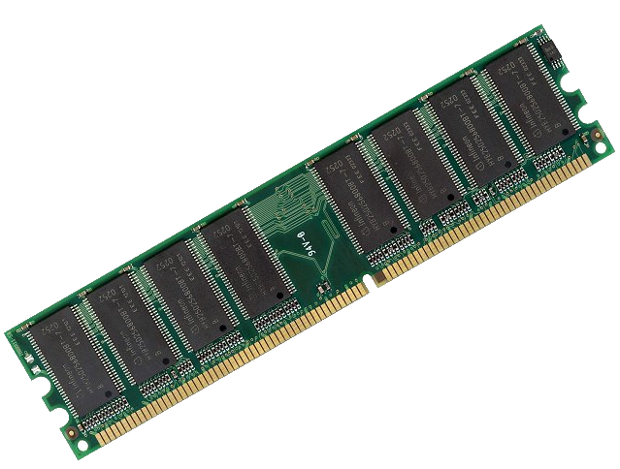
How Do We Map
Virtual Addresses to
Physical Addresses?
64-bit virtual address
space (16 exabytes)
FFFF’FFFF’FFFF’FFFF
Physical RAM
(e.g., 8 GB)
An exabyte is a billion GBs!
1’FFFF’FFFF
0’0000’0000
0000’0000’0000’0000

Slide 4
Memory-mapping Units (MMUs)
MMU: A piece of hardware (only configurable by privileged code) that translates virtual addresses to physical addresses
  Virtual addresses are the addresses that executing code generates
  Physical addresses are what a processor presents to the actual RAM
//Code in address space
subq %rax, %rbx
addq %rcx, %rdx
movq 8(%r12), %r13
Physical
RAM
PhysAddr: 0xd089’5cb0
MMU
VirtAddr: 0000’4d0a’fc42’9280

Slide 5
Memory-mapping Units (MMUs)
MMU: A piece of hardware (only configurable by privileged code) that translates virtual addresses to physical addresses
  Virtual addresses are the addresses that executing code generates
  Physical addresses are what a processor presents to the actual RAM
//Code in address space
subq %rax, %rbx
addq %rcx, %rdx
movq 8(%r12), %r13
Physical
RAM
PhysAddr: 0xd089’5cb0
MMU
b (“byte”): one byte
w (“word”): two bytes
l (“long”): four bytes
q (“quad word”): eight bytes
VirtAddr: 0000’4d0a’fc42’9280

Slide 6
Memory-mapping Units (MMUs)
Using indirection via the MMU:
  A virtual address space can be larger than physical RAM (and vice versa)
  At any moment, some/none/all of a virtual address space can be mapped into physical RAM
  After a context switch to a new address space, we can lazily bring in the non-resident memory regions, as the address space’s code tries to access those regions
Virtual address
space 1
Physical RAM
Virtual address
space 2
Swap device

Slide 7
Memory-mapping Units (MMUs)
Isolation properties
  Protection by default: the hardware maps the same virtual address in two different processes to different physical addresses
  Sharing when appropriate: a single region of physical RAM can map to multiple virtual address spaces (in possibly different virtual-memory locations!)
Virtual address
Virtual address
space 1
space 1
Physical RAM
Physical RAM
Virtual address
Virtual address
space 2
space 2

Slide 8




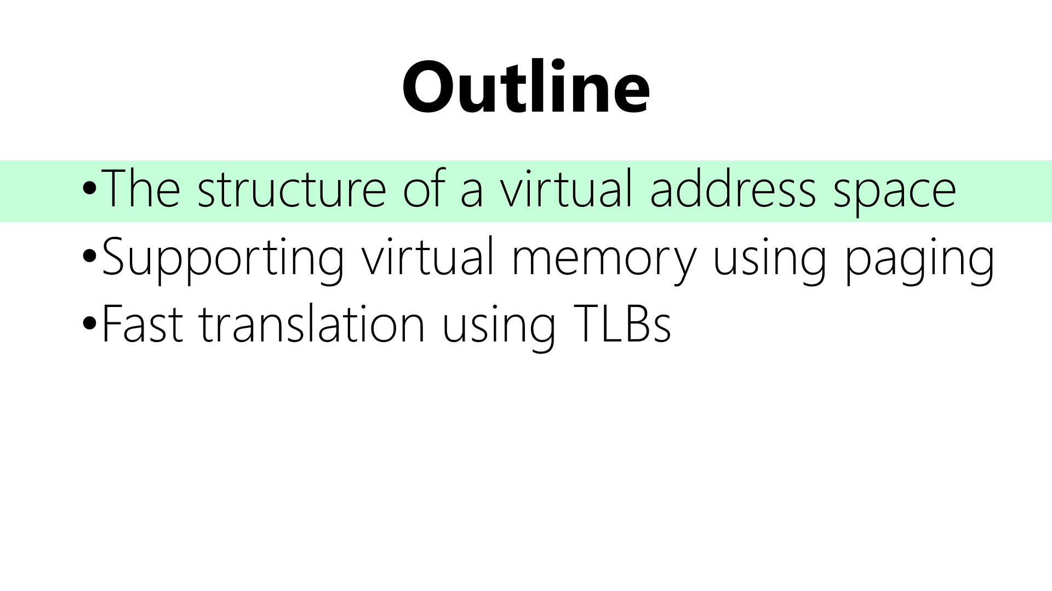

Slide 9
x86-64: Virtual Address Spaces
Until very recently, x86-64 chips only used 48 bits of an address
  Bits 48—63 must be copies of bit 47
  Kernel code+data lives in “high canonical” memory
  User code+data lives in “low canonical” memory
Virtual address space
FFFF’FFFF’FFFF’FFFF
Kernel static data
High canonical
(kernel-only access)
Kernel code
Kernel heap+stacks
FFFF’8000’0000’0000
Physical memory map
Empty gap
0000’7FFF’FFFF’FFFF
Stack
Low canonical
(kernel+user access)
Heap
Static data
0000’0000’0000’0000
Code
Notes:
Why does the diagram say “kernel stacks” plural? Well, the way that Chickadee (and Linux) works is that, when a new process is allocated, that process gets a user-mode stack and a kernel-mode stack. The kernel-mode stack is empty when the user-mode code is executing, but when the kernel needs to handle a syscall on behalf of the process, the kernel code uses the kernel-mode stack of the process. [In Chickadee, a process’ kernel stack is the top half of the process’ `struct proc`; the `struct proc` is allocated an entire memory page, even though the members of the struct require much less space, so the remaining bytes in the page can be used for the kernel stack.]
As described by https://read.seas.harvard.edu/cs1610/2025/doc/memory-layout/, “Kernel code and kernel global data uses the highest 2GB of virtual addresses, 0xFFFF'FFFF'8000'0000–0xFFFF'FFFF'FFFF'FFFF. These kernel text addresses correspond to physical addresses 0–0x7FFF'FFFF by linear transformation: physical address P maps to kernel text address 0xFFFF'FFFF'8000'0000 + P . . . Since the kernel assumes that all physical addresses are accessible via high canonical memory, the Chickadee kernel could access up to 0x7FFF'8000'0000 = 2^48 – 2^31 bytes of physical memory.”
[Aside: In Linux, the per-process stacks are not used to handle interrupts. Instead, Linux creates a special, per-CPU stack that is used to handle interrupts destined for that CPU. As described by [5], “Early in the 2.6 kernel series, an option was introduced to move to single-page kernel stacks, where each process is given only a single page (4KB on 32-bit architectures and 8KB on 64-bit architectures). This was done for two reasons:
*It results in a page with less memory consumption per process.
*As uptime increases, it becomes increasingly hard to find two physically contiguous unallocated pages. Physical memory becomes fragmented, and the resulting VM pressure from allocating a single new process is expensive.
There is one more complication. Each process’s entire call chain has to fit in its kernel stack. Historically, however, interrupt handlers also used the kernel stack of the process they interrupted, thus they too had to fit. This was efficient and simple, but it placed even tighter constraints on the already meager kernel stack. When the stack moved to only a single page, interrupt handlers no longer fit. To rectify this problem, the kernel developers implemented a new feature: interrupt stacks. Interrupt stacks provide a single per-processor stack used for interrupt handlers. With this option, interrupt handlers no longer share the kernel stack of the interrupted process. Instead, they use their own stacks. This consumes only a single page per processor.”
Chickadee also has per-CPU stacks, although they are used only briefly, at the beginning of interrupt/syscall dispatch, and when the kernel’s scheduling logic is switching between two tasks. See https://read.seas.harvard.edu/cs161-18/doc/contexts/, which says (among other things): “Chickadee can suspend kernel tasks. For instance, a Chickadee system call implementation can voluntarily or involuntarily give up control to another task, picking up later right where it left off. To make this work, each kernel task context has its own kernel stack. When the processor is running a kernel task, the %rsp register points into the corresponding stack. Just like any stack, a kernel task stack holds local variables. It also holds a snapshot of the task’s registers when the task is suspended [.] CPU contexts are used when switching from one kernel task to another. Each CPU has its own CPU context; while kernel tasks can switch among CPUs, a CPU context is pinned to a single CPU. CPU contexts are not suspendable, and each CPU context has its own stack. The only kernel functions that run in CPU context are entry points from user context (exception_entry, alt_exception_entry) and cpustate::schedule.
Kernel stacks are collocated on memory pages that contain other data structures. The page of memory containing a kernel task stack also holds a `struct proc`, and the page of memory containing a CPU context stack also holds a `struct cpustate`. These structures are located in the beginnings of their pages (starting at the first address of the page), whereas the kernel stacks are located at the ends of the pages and grow down. Kernel functions shouldn’t use too many local variables or recursively call other functions too deeply, or stack data is liable to crash into and destroy the `cpustate` and/or `proc`.”
cpu.cc::schedule()]
[Aside: In industrial-strength kernels like Linux, the kernel memory region has a lot of stuff in it; see Ref [2] for more details.]
[Refs: [1] https://en.wikipedia.org/wiki/X86-64#Virtual_address_space_details
[2] https://www.kernel.org/doc/Documentation/x86/x86_64/mm.txt
[3] https://www.kernel.org/doc/Documentation/x86/kernel-stacks
[4] https://jasoncc.github.io/kernel/jasonc-mm-x86.html
[5] https://web.archive.org/web/20180926010033/https://notes.shichao.io/lkd/ch12/
]

Slide 10
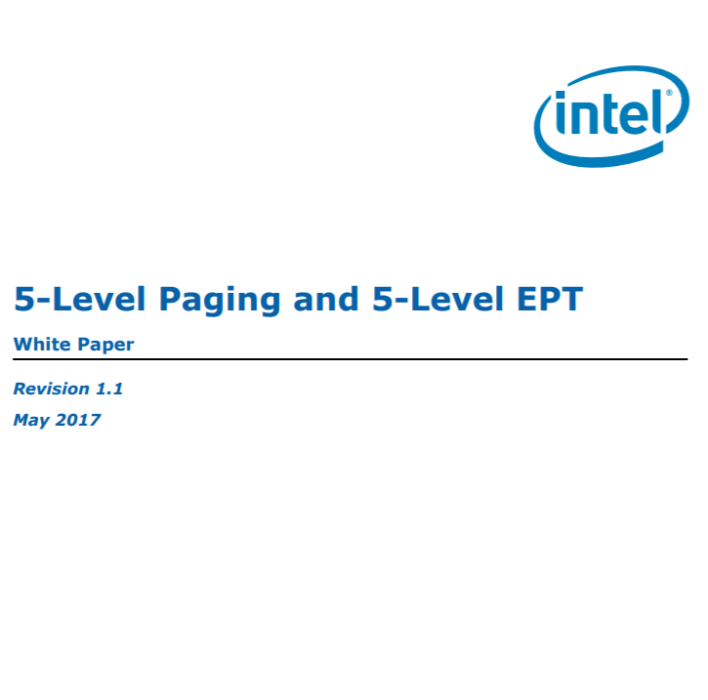
x86-64: Virtual Address Spaces
Until very recently, x86-64 chips only used 48 bits of an address
  Bits 48—63 must be copies of bit 47
  Kernel code+data lives in “high canonical” memory
  User code+data lives in “low canonical” memory
The most recent Intel chips extend addresses to 57 bits!
Virtual address space
FFFF’FFFF’FFFF’FFFF
Kernel static data
High canonical
(kernel-only access)
Kernel code
Kernel heap+stacks
FFFF’8000’0000’0000
Physical memory map
Empty gap
0000’7FFF’FFFF’FFFF
Stack
Low canonical
(kernel+user access)
Heap
Static data
0000’0000’0000’0000
Code

Slide 11
x86-64: Virtual Address Spaces
Each process gets its own address space
  The kernel is mapped into the same place in each address space
  Content in low canonical memory is mostly unique (i.e., per-process)
Why can’t user-level code tamper with kernel state?
  The CPU has a privilege bit: indicates whether currently-executing code is kernel code
  MMU prevents unprivileged code from touching privileged memory
  Privilege bit flips upon user/kernel transitions (e.g., system calls)
Virtual address space
FFFF’FFFF’FFFF’FFFF
void main(){
int x = 42;
void* ptr = malloc(64);
printf(“&x: %p\n”, (void*)&x); //0x0000’7ffd’754e’adbc
printf(“&ptr: %p\n”, (void*)&ptr); //0x0000’7ffd’754e’adc0
printf(“ptr: %p\n”, (void*)ptr); //0x0000’5557’e367’d260
printf(“main: %p\n”, (void*)main); //0x0000’5557’e2b8’3155
}
Kernel static data
High canonical
(kernel-only access)
Kernel code
Kernel heap+stacks
FFFF’8000’0000’0000
Physical memory map
Empty gap
0000’7FFF’FFFF’FFFF
Stack
Low canonical
(kernel+user access)
Heap
Static data
0000’0000’0000’0000
Code
Notes:
Why is the content in the bottom half of an address space only “mostly” unique? Here’s one example: suppose that you launch two different instances of a web server, so that you have two separate processes. Each process will have the same contents in its code region. However, the stacks and the heaps will be different, because each process has its own set of dynamic state that is created in response to client requests.
[Aside: Why is the address of main() so high, given that the program has so little code (meaning that there shouldn’t be a lot of other code between virtual address 0 and the start of main())? The reason is address space layout randomization! See https://en.wikipedia.org/wiki/Address_space_layout_randomization.]

Slide 12
x86-64: Virtual Address Spaces
Typically much smaller than the virtual address space!
Virtual address space
FFFF’FFFF’FFFF’FFFF
Kernel static data
Physical RAM
High canonical
(kernel-only access)
Kernel code
MAX_PHYS
Kernel heap+stacks
FFFF’8000’0000’0000
Physical memory map
Empty gap
0000’7FFF’FFFF’FFFF
Stack
Low canonical
(kernel+user access)
0
Heap
Direct linear translation:
Physical address P ↔ 0xFFFF'8000'0000'0000+P
Static data
0000’0000’0000’0000
Code
High canonical address
Notes:
The reason why a physical memory map is feasible is that virtual memory is much, much bigger than physical memory! So, it’s possible to map all of physical memory into virtual memory, and still have room in virtual memory for other stuff. [Of course, the “other stuff” may not actually be present in physical memory—as explained a few slides ago, the “other stuff” may be swapped out to a local storage device!]

Slide 13
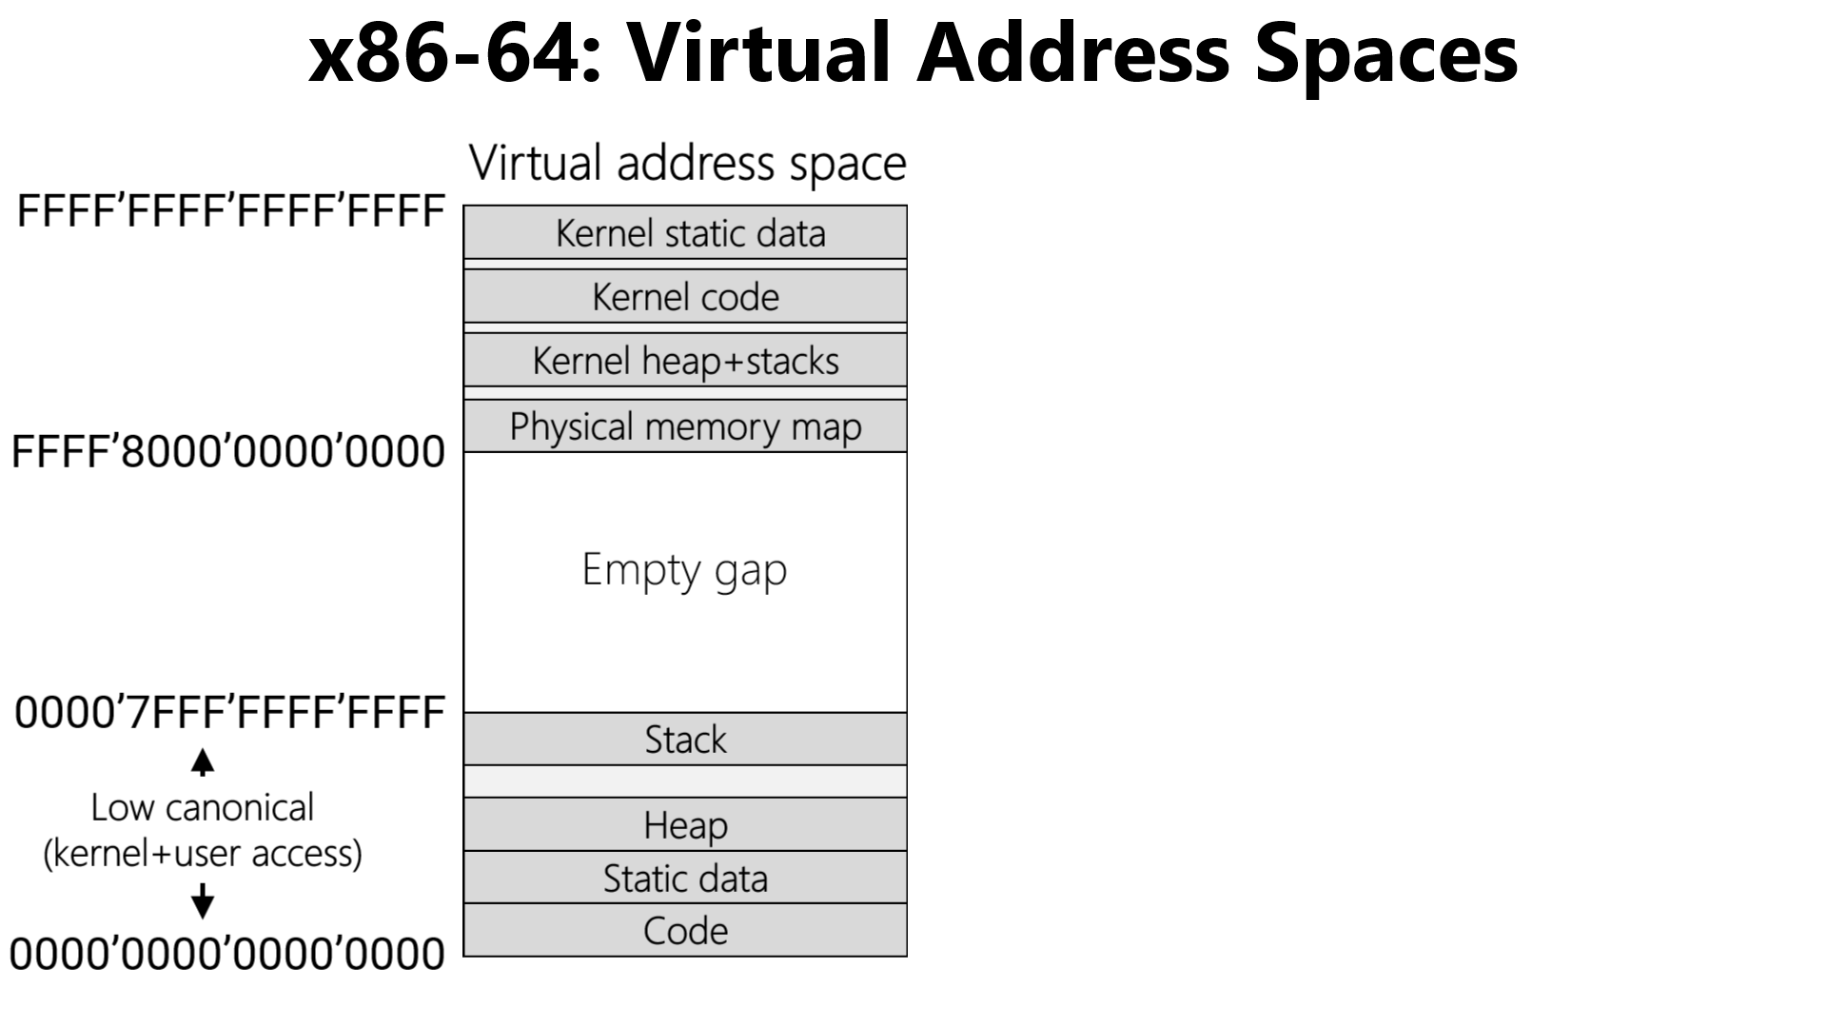
Typically much smaller than the virtual address space!
Highest 2GB
Physical RAM
MAX_PHYS
0x7FFF'FFFF
Lowest 2GB
0
Direct linear translation:
Physical address P (0≤P≤0x7FFF'FFFF) ↔
0xFFFF'FFFF'8000'0000+P
Notes:
The code and static data of the kernel are often collectively referred to as the “kernel text.”

Slide 14
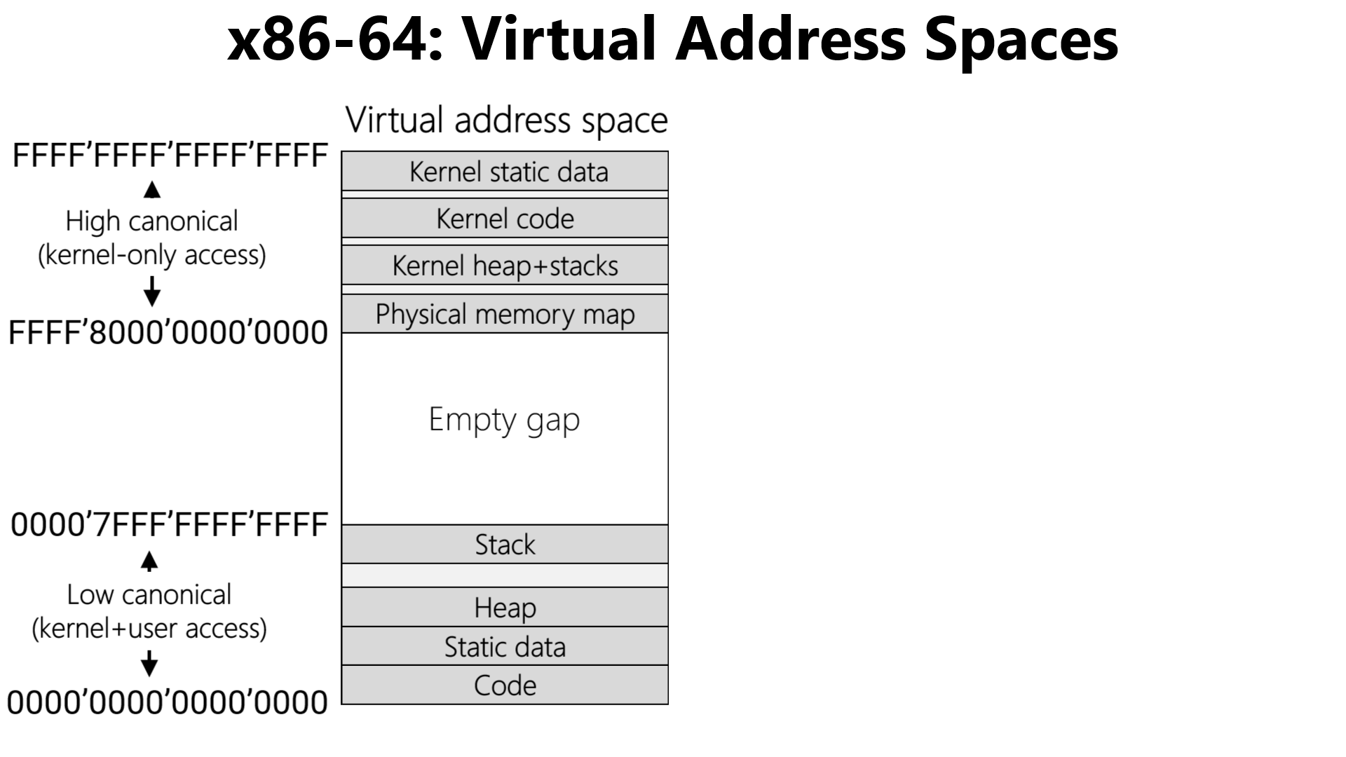
Typically much smaller than the virtual address space!
Physical RAM
MAX_PHYS
Wherever kernel text actually stops
Kernel text
0
No simple correspondence between user-mode virtual addresses and the underlying physical addresses: the miracle of paging!
Notes:
Note that the actual size of the kernel text will typically be less than 2 GB in practice. In other words, it’s unlikely that an OS will have 2 GB of code and static data. So, in practice, the user-related content (e.g., like user-mode stacks) may be mapped into physical region beneath the 2GB barrier.

Slide 15
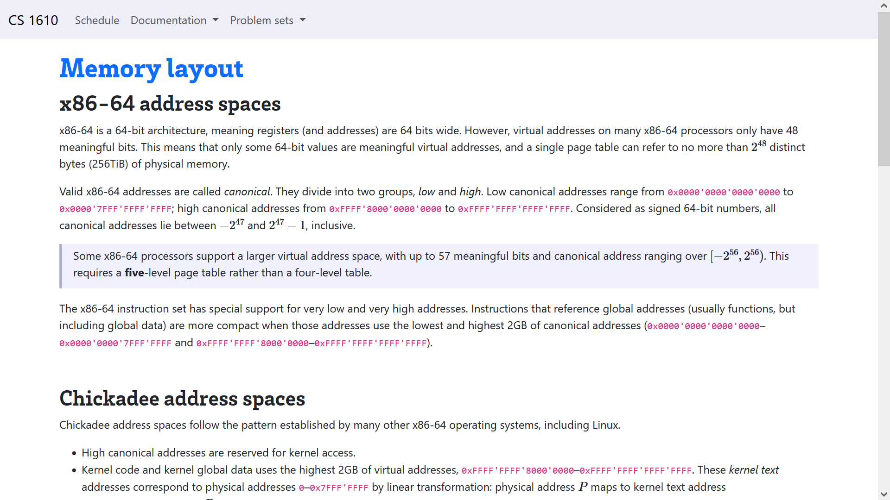
Notes:
For another overview of the memory layout on x86-64 machines, see the documentation on the course website at:
https://read.seas.harvard.edu/cs1610/2026/doc/memory-layout/

Slide 16
Outline
The structure of a virtual address space
Supporting virtual memory using paging
Fast translation using TLBs

Slide 17
Paging
Virtual address
Divide virtual address space and the physical RAM into fixed-sized chunks called pages
Make each page small (e.g., 4 KB)
  Good: Can allocate virtual address space with fine granularity
  Good: Only need to bring the specific pages that process needs into physical RAM
  Possibly concerning: Bookkeeping overhead—a single address space contains many pages!
Virtual Page Number
Offset
Virtual address
space of 2^V pages
Physical RAM
V bits
O bits
with 2^P pages
X
MMU
Y
Y
Not present in RAM
(e.g., swapped to disk, or not valid)
P bits
Physical Page Number
Offset
Z
MMU
Z
X
Physical address
Notes:
Why would a virtual page be swapped to disk? Well, there may be a lot of processes that are running; if so, that means that a lot of processes will want to put their virtual pages in RAM. If all of the pages can’t fit at once, then some of those pages need to be stored on disk, where they can be retrieved later.
Note that a virtual page may also be absent in RAM for another reason---the associated process hasn’t allocated that page. For example, the heap grows when a program calls malloc() or new. When a process initially starts, the process hasn’t allocated any heap memory, so the associated parts of the virtual address space are not associated with actual virtual pages.

Slide 18
Paging
Virtual address
Make each page big (e.g., 1 GB)
  Good: Minimizes bookkeeping overhead (i.e., number of VPN->PPN mappings)
  Good/bad: Only appropriate for applications that manage huge pieces of contiguous memory (e.g., databases)
  Bad: A huge page is painful to swap to/from disk—it’s like writing or writing a 1 GB file!
x86-64 supports multiple page sizes
  4 KB
  2 MB
  1 GB
A single address space may contain
pages of different sizes
Virtual Page Number
Offset
V bits
O bits
MMU
P bits
Physical Page Number
Offset
Physical address

Slide 19
Case study: x86-64
L4
L3
L2
L1
Offset
47
39
38
30
29
21
20
12
11
0
Holds the physical address of a 4 KB-aligned PML4
Highest-order bits not useful for address translations!
%cr3
Notes:
[Reference: Section 4.5 of “Intel® 64 and IA-32 Architectures Software Developer’s Manual
Volume 3 (3A, 3B, 3C & 3D): System Programming Guide”
https://www.intel.com/content/www/us/en/content-details/671442/5-level-paging-and-5-level-ept-white-paper.html
https://os.phil-opp.com/paging-introduction/
https://wiki.osdev.org/Page_Tables#Long_mode_.2864-bit.29_page_map]

Slide 20
Case study: x86-64
L4
L3
L2
L1
Offset
47
39
38
30
29
21
20
12
11
0
A 4 KB-aligned PDP has 512 8-byte entries
A 4 KB-aligned PML4 has 512 8-byte entries
%cr3
9 bits
Bookkeeping stuff
PDPTE
9 bits
Page directory pointer
PML4E
PML4E
4KB-aligned PDPT physAddr
64 bits
Page map level 4
63
48
47
12
11
0

Slide 21
Case study: x86-64
L4
L3
L2
L1
Offset
47
39
38
30
29
21
20
12
11
0
A 4 KB-aligned PDP has 512 8-byte entries
9 bits
PDE
%cr3
9 bits
Page directory
Bookkeeping stuff
PDPTE
9 bits
Page directory pointer
A 4 KB-aligned PD has 512 8-byte entries
PML4E
PDPTE
4KB-aligned PD physAddr
64 bits
Page map level 4
63
48
47
12
11
0

Slide 22
Case study: x86-64
L4
L3
L2
L1
Offset
47
39
38
30
29
21
20
12
11
0
9 bits
PDE
%cr3
9 bits
Page directory
Bookkeeping stuff
PDPTE
9 bits
Page directory pointer
A 4 KB-aligned PD has 512 8-byte entries
PML4E
PDE
4KB-aligned PT physAddr
64 bits
Page map level 4
63
48
47
12
11
0

Slide 23
Case study: x86-64
L4
L3
L2
L1
Offset
47
39
38
30
29
21
20
12
11
0
PhysAddr
12 bits
4KB page
9 bits
PTE
9 bits
Page table
PDE
User-mode accessible?
%cr3
Writeable?
9 bits
Page directory
A 4 KB-aligned PT has 512 8-byte entries
PDPTE
Present?
9 bits
Page directory pointer
PML4E
PTE
4KB-aligned physFrame addr
64 bits
Page map level 4
63
48
47
12
11
3
2
1
0
Notes:
[Quoth Eddie’s 2018 lecture notes: “Question: Why does each index get 9 bits? Answer: Because the size of one page is 2^12 bytes, and each page table page entry is an address which has 2^3 bytes. 212/23 = 2^9 entries per page. We want to be able to index into any given entry, which means we need 9 bits.”]

Slide 24

Why so many levels?
Virtual address spaces are sparse!
  Ex: Most processes don’t have gigabytes of code
  Ex: Most processes don’t have gigabytes of stack frames
Multi-level tables: only materialize entries for live parts of address space
  Ex: A single PML4E covers 512 GB
  If none of those addresses are in use, just set the PML4E.present bit to 0!
  Don’t need to create PDPT/PD/PT tables for the subtree
User-mode accessible?
Writeable?
Bookkeeping stuff
Present?
Bookkeeping stuff
PML4E
PML4E
4KB-aligned PDPTE physAddr
4KB-aligned PDPTE physAddr
47
63
47
63
48
48
12
12
11
11
3
1
0
2
0

Slide 25
Case study: x86-64 using 1 GB pages
L4
L3
Offset in 1 GB page
47
39
38
30
29
0
A 4 KB-aligned PDP has 512 8-byte entries
A 4 KB-aligned PML4 has 512 8-byte entries
%cr3
9 bits
Bookkeeping stuff
PDPTE
9 bits
Page directory pointer
PML4E
PML4E
4KB-aligned PDPTE physAddr
64 bits
Page map level 4
63
48
47
12
11
0

Slide 26
Case study: x86-64 using 1 GB pages
L4
L3
Offset in 1 GB page
47
39
38
30
29
0
A 4 KB-aligned PDP has 512 8-byte entries
PS (“Page size”) bit set to 1, indicating a 1 GB page
%cr3
9 bits
Bookkeeping stuff
PDPTE
9 bits
Page directory pointer
PML4E
PDPTE
1GB-aligned huge page physAddr
64 bits
Page map level 4
63
48
47
12
11
7
0

Slide 27



The Horrors of Early Boot
Early boot
CS 1610 students
Professor Mickens

Slide 28
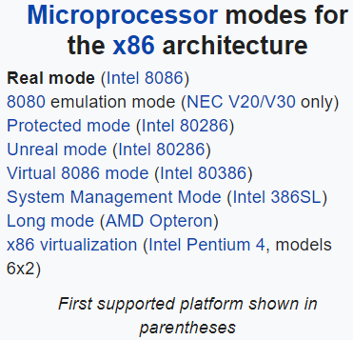
Chickadee’s Early Boot
“Booting a processor” means “configuring a processor once it’s been turned on”
Booting a processor is a delicate dance, particularly on x86!
Chickadee’s k-init.cc contains important code related to booting
init_hardware()
init_early_memory()
//Create the boot-
//time page tables
//and tell CPU to
//enable paging
init_interrupts()
//Ensure that CPU
//invokes kernel to
//handle timers,
//syscalls, etc.
init_other_processors()
//On a multi-core machine,
//ask the other cores to
//come online!
Notes:
[Quoth the Wikipedia [1], “Real mode, also called real address mode, is an operating mode of all x86-compatible CPUs. The mode gets its name from the fact that addresses in real mode always correspond to real locations in memory. Real mode is characterized by a 20-bit segmented memory address space (giving exactly 1 MiB of addressable memory) and unlimited direct software access to all addressable memory, I/O addresses and peripheral hardware. Real mode provides no support for memory protection, multitasking, or code privilege levels. Before the release of the 80286, which introduced protected mode, real mode was the only available mode for x86 CPUs;[1] and for backward compatibility, all x86 CPUs start in real mode when reset.”
Further quoth the Wikipedia [2], “In the x86-64 computer architecture, long mode is the mode where a 64-bit operating system can access 64-bit instructions and registers. 64-bit programs are run in a sub-mode called 64-bit mode, while 32-bit programs and 16-bit protected mode programs are executed in a sub-mode called compatibility mode.”]
[Ref: [1] https://en.wikipedia.org/wiki/Real_mode
[2] https://en.wikipedia.org/wiki/Long_mode
]

Slide 29
[511]
[510]
. . .
Bottom 512 GB
. . .
[0]
L3 pagetable (ps=1GB)
[511]
init_early_memory()
//When the kernel invokes this
//function, the kernel text
//lives at the bottom of
//physical memory, but the
//CPU hasn’t turned on support
//for virtual paging yet!
//This function enables paging
//and sets up the page table
//shown to the right . . .
[511]
. . .
Physical memory map
. . .
. . .
%cr3
[256]
[0]
L3 pagetable (ps=1GB)
Physical RAM
64 bits
[0]
L4 pagetable
Notes:
[Note that there are hex 1’0000’0000’0000= 262,144 GB total bytes of allowable virtual memory---half of that belongs to low-canonical memory in 0000’0000’0000’0000--0000’7FFF’FFFF’FFFF, and the other half belongs to high canonical memory in FFFF’8000’0000’0000--FFFF’FFFF’FFFF’FFFF. If an L3 pagetable has ps=1 GB, then each L3 pagetable can cover 512 GB. So, if an L4 table has 512 entries, and each entry points to an L3 page table covering 512 GB of memory, then a single L4 can cover 512 * 512 GB = 262,144 GB of memory!]

Slide 30
//x86-64.h
typedef uint64_t x86_64_pageentry_t;
typedef struct x86_64_pagetable {
x86_64_pageentry_t entry[1 << PAGEINDEXBITS];
} x86_64_pagetable;
//k-init.cc
x86_64_pagetable early_pagetable[3];
[511]
[510]
. . .
early_pagetable[2]
Bottom 512 GB
. . .
[0]
L3 pagetable (ps=1GB)
[511]
[511]
. . .
Physical memory map
. . .
. . .
%cr3
[256]
[0]
L3 pagetable (ps=1GB)
Physical RAM
64 bits
[0]
early_pagetable[1]
L4 pagetable
early_pagetable[0]
Notes:
[Chickadee's MEMSIZE_PHYSICAL is set to 0x200000 == 2MB. However, qemu is what determines the upper limit on how much memory is actually available on the emulated machine that Chickadee runs atop. By default, qemu provides 128 MB of emulated physical memory---see the discussion of the qemu -m option at https://wiki.gentoo.org/wiki/QEMU/Options. Chickadee uses the qemu default, so MEMSIZE_PHYSICAL == 0x200000 == 2MB < 128MB is saying that Chickadee actually only manages 2MB of a possible 128MB of emulated physical RAM.]
[Note that PAGEINDEXBITS is defined thusly:
#define PAGEINDEXBITS 9
This makes sense, because each level in a page table tree is indexed using 9 bits of a virtual address.]

Slide 31
//x86-64.h
typedef uint64_t x86_64_pageentry_t;
typedef struct x86_64_pagetable {
x86_64_pageentry_t entry[1 << PAGEINDEXBITS];
} x86_64_pagetable;
//k-init.cc
x86_64_pagetable early_pagetable[3];
[511]
[510]
. . .
void init_early_memory() {
memset(early_pagetable, 0, ...); //Zero fill
early_pagetable->entry[0] =
ktext2pa(&early_pagetable[1]) | PTE_P | PTE_W;
early_pagetable->entry[256] =
early_pagetable->entry[0];
early_pagetable->entry[511] =
ktext2pa(&early_pagetable[2]) | PTE_P | PTE_W;
//First level-3 page table maps first 512GiB of
//physical memory
for (uintptr_t p = 0; p < 512; ++p) {
early_pagetable[1].entry[p] = (p << 30) |
PTE_P | PTE_W | PTE_PS;
}
//Second level-3 page table maps its last 2
//slots to the first 2GiB of physical memory
// (kernel text)
early_pagetable[2].entry[510] =
early_pagetable[1].entry[0];
early_pagetable[2].entry[511] =
early_pagetable[1].entry[1];
wrcr3(ktext2pa(early_pagetable));
}
early_pagetable[2]
Bottom 512 GB
. . .
[0]
L3 pagetable (ps=1GB)
[511]
[511]
. . .
Physical memory map
. . .
. . .
%cr3
[256]
[0]
L3 pagetable (ps=1GB)
Physical RAM
64 bits
[0]
early_pagetable[1]
L4 pagetable
early_pagetable[0]
Notes:
[Here’s the definition of ktext2pa():
inline uint64_t ktext2pa(uint64_t ka) {
assert(ka >= KTEXT_BASE);
return ka - KTEXT_BASE;
}
So, ktext2pa() is just doing a direct linear translation of a kernel text virtual address (which is assumed to be in the topmost part of high canonical memory) to a physical address at the bottom of physical RAM. Remember that kernel text (i..e, kernel code and kernel static data) is mapped to the bottom of physical RAM.]

Slide 32
[511]
The net effect of all of this is that:
  The bottom of low canonical virtual memory is a physical memory map
  The bottom of high canonical virtual memory is a physical memory map
  The top of high canonical virtual memory points to the bottom 2 GB of physical memory (where the booting sequence has put the kernel text)
[510]
. . .
early_pagetable[2]
Bottom 512 GB
. . .
[0]
L3 pagetable (ps=1GB)
[511]
[511]
. . .
Physical memory map
. . .
. . .
%cr3
[256]
[0]
L3 pagetable (ps=1GB)
Physical RAM
64 bits
[0]
early_pagetable[1]
L4 pagetable
early_pagetable[0]

Slide 33
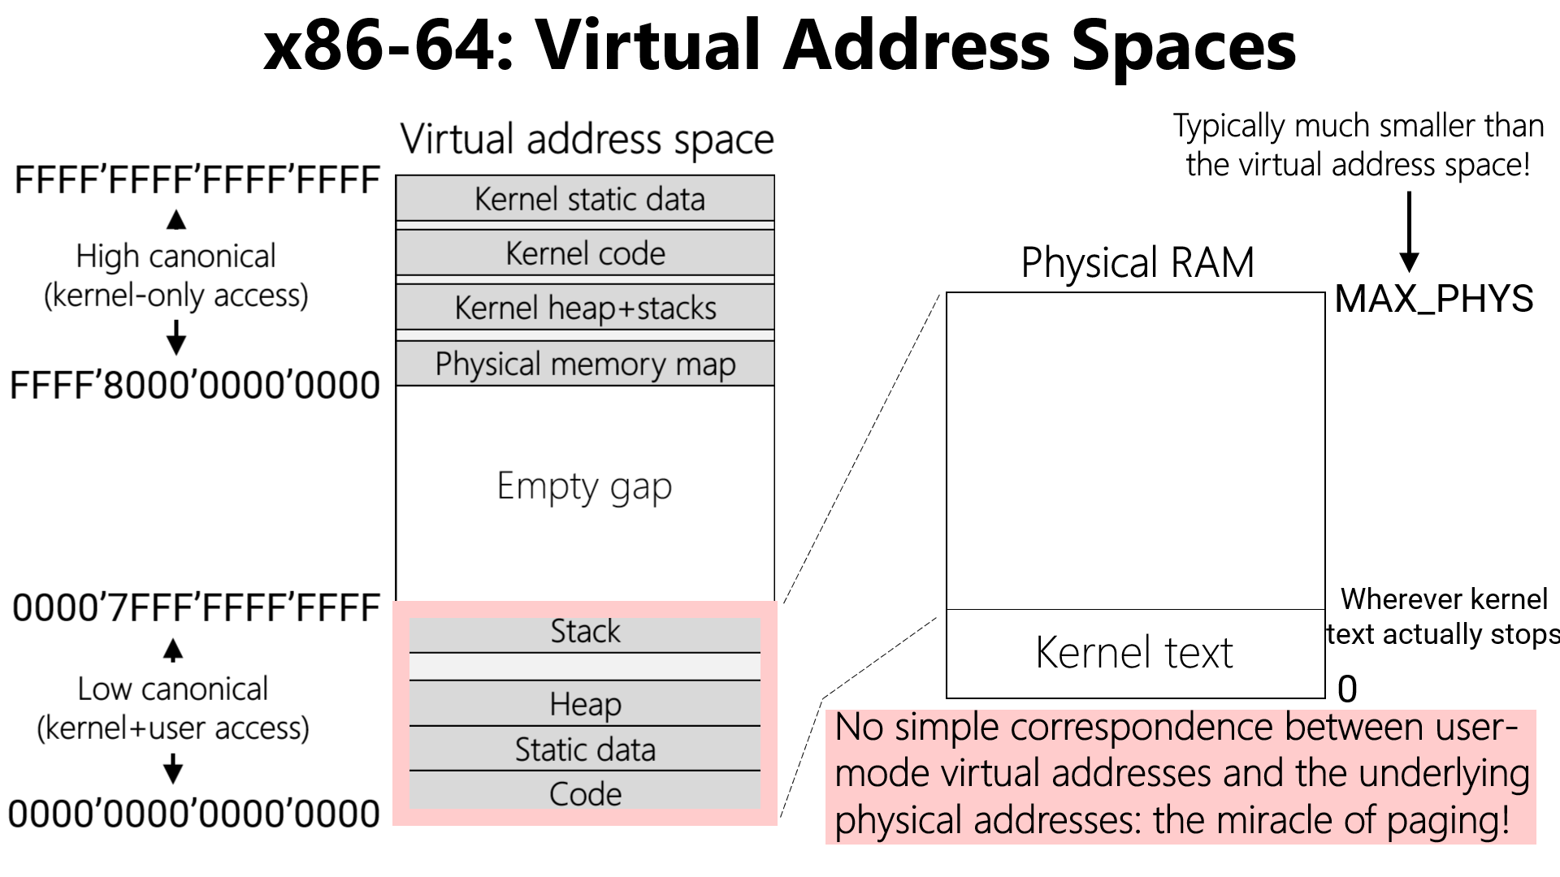

Chickadee: Page Tables
During boot, Chickadee creates a physical memory map in high canonical addresses *and* low canonical addresses
However, post-boot, low-canonical addresses are for user-mode content, not a memory map!

Slide 34

//x86-64.h
typedef uint64_t x86_64_pageentry_t;
typedef struct x86_64_pagetable {
x86_64_pageentry_t entry[1 << PAGEINDEXBITS];
} x86_64_pagetable;
//k-init.cc
x86_64_pagetable early_pagetable[3];
[511]
[510]
. . .
early_pagetable[2]
Bottom 512 GB
. . .
[0]
L3 pagetable (ps=1GB)
[511]
[511]
. . .
Physical memory map
. . .
. . .
%cr3
[256]
[0]
L3 pagetable (ps=1GB)
Physical RAM
64 bits
[0]
early_pagetable[1]
L4 pagetable
early_pagetable[0]

Slide 35
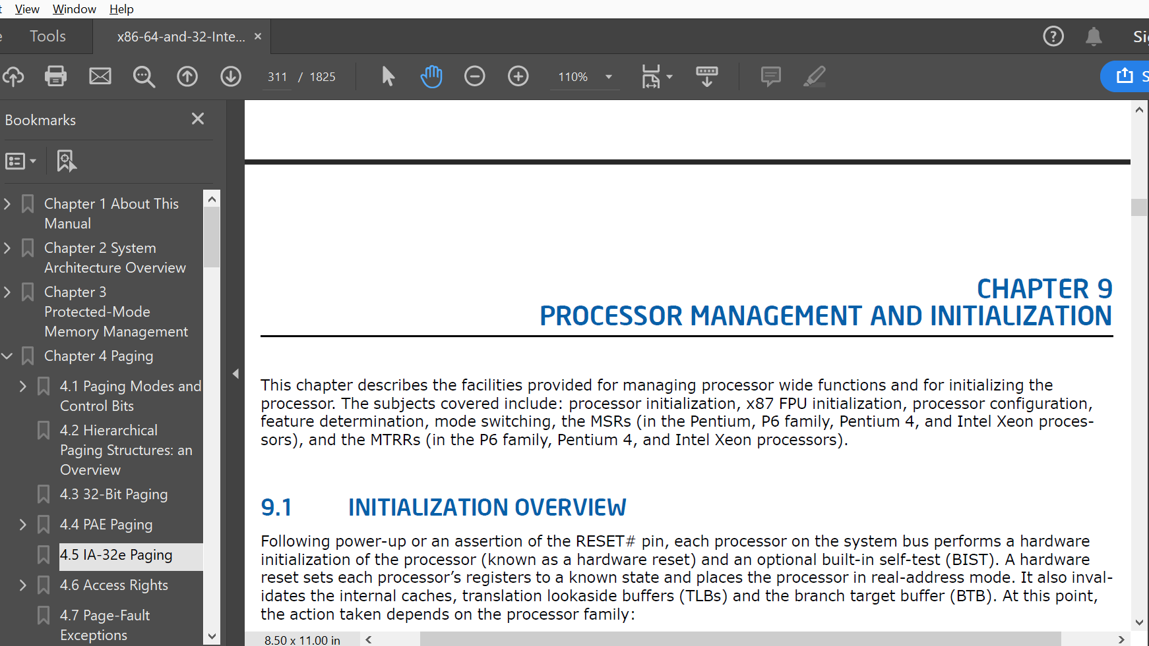


Chickadee: Page Tables
During boot, Chickadee creates a physical memory map in high canonical addresses *and* low canonical addresses
However, post-boot, low-canonical addresses are for user-mode content, not a memory map!
  The boot-time kernel only needs the low-canonical memory map to assist with x86 configuration horrors
  At a more detailed level, I DON’T WANT TO TALK ABOUT LOW-LEVEL X86 CONFIGURATION HORROR
  However, early_pagetable will become important in pset2!

Slide 36
Outline
The structure of a virtual address space
Supporting virtual memory using paging
Fast translation using TLBs

Slide 37
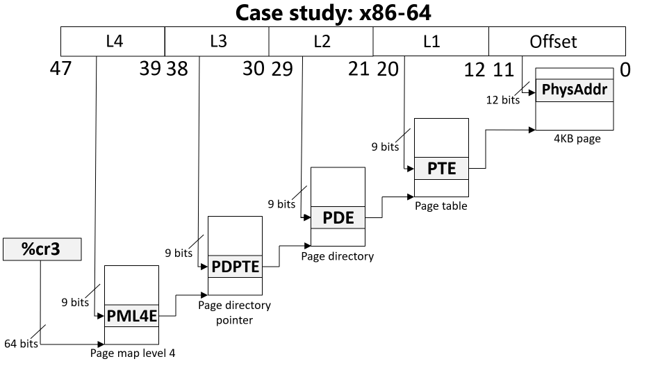
Paging: The Good and the Bad
Good: A virtual address space can be bigger/smaller than physical memory
Bad: Each virtual memory access now requires five physical memory accesses
x86-64 physical memory accesses
Load entry from page map level 4
Load entry from page directory pointer
Load entry from page directory
Load entry from page table
Generate the “real” memory access

Slide 38

Translation Lookaside Buffers (TLBs)
Idea: Cache some PTEs (i.e., V->P translations) in a small hardware buffer
  If virtual address has an entry in TLB, don’t need to go to physical memory to fetch a PTE!
  If virtual address misses in TLB, we must walk the page table to fetch a PTE
Key/value store: key is high bits of virt addr, value is phys frame number
TLB
TLB
L1 i-cache
L1 d-cache
L1 i-cache
L1 d-cache
L2 cache
L2 cache
L3 cache
RAM

Slide 39
Translation Lookaside Buffers (TLBs)
Idea: Cache some PTEs (i.e., V->P translations) in a small hardware buffer
  If virtual address has an entry in TLB, don’t need to go to physical memory to fetch a PTE!
  If virtual address misses in TLB, we must walk the page table to fetch a PTE
TLBs are effective because programs exhibit locality
  Temporal locality
    When a process accesses virtual address x, it will likely access x again in the future
    Ex: a function’s local variable that lives on the stack
  Spatial locality
    When the process accesses something at memory location x, the process will likely access other memory locations close to x
    Ex: reading elements from an array on the heap
Notes:
Temporal locality means that a TLB entry that has recently been accessed will be accessed again in the near future.
Spatial locality means that, when we access a virtual address x, and we create a TLB entry for the associated page, the TLB entry will likely be useful for other virtual addresses that the program accesses. Remember that a TLB entry covers an entire page of spatially contiguous addresses! For machines that have a lot of physical RAM, you might want a single TLB entry to cover a much larger region than 4 KB. x64 supports this idea using “superpages.” When a process’s page table uses superpages, each PTE and TLB entry covers 2 MB or 1 GB instead of 4 KB. [For a reference on superpages, see Section 4.5 (“IA-32E Paging”) of “Intel® 64 and IA-32 Architectures Software Developer’s Manual Volume 3 (3A, 3B, 3C & 3D): System Programming Guide.”]

Slide 40
The Lifecycle of a Memory Reference on x86
Virtual address
TLB lookup
No
Yes
TLB hit?
HW walks the page table
Check protection bits
No
Yes
Yes
No
Access ok?
Found PTE for virt frame?
HW updates TLB
HW raises a page fault
HW raises a page fault
Calculate phys addr, send to L1/L2/L3/RAM
Notes:
Note that the protection bits state things like “is this page writable?” and “is this page accessible to user-mode processes?”
If there’s a TLB miss, the hardware walks the page table. If the hardware doesn’t find a valid PTE, i.e., if the PTE for the virtual address is not set to “present,” then the hardware raises a fault. Note that a fault could be raised for one of two reasons: the virtual address may reside in an unallocated part of the virtual address space (e.g., in the hole between the stack and the heap). Alternatively, the virtual address may reside in an allocated page of the address space, but that page is not in physical memory.
[References: https://www.ece.umd.edu/~blj/papers/micro18-4.pdf
http://www.scs.stanford.edu/06au-cs240/notes/l7.pdf
http://wiki.osdev.org/Paging
https://en.wikipedia.org/wiki/Control_register#CR2
https://users.ece.cmu.edu/~jhoe/course/ece447/handouts/L21.pdf
https://users.ece.cmu.edu/~jhoe/course/ece447/handouts/L22.pdf]

Slide 41
The Lifecycle of a Memory Reference on x86
Virtual address
Before raising page fault exception, HW sets %cr2 to faulting address, and pushes an error code onto stack
TLB lookup
-Ex: User process tried to read a nnon-present page
-Ex: User process tried to write aa present but read-only page
No
Yes
TLB hit?
HW walks the page table
Check protection bits
No
Yes
Yes
No
Access ok?
Found PTE for virt frame?
HW updates TLB
HW raises a page fault
HW raises a page fault
Calculate phys addr, send to L1/L2/L3/RAM
Notes:
[References: http://wiki.osdev.org/Paging
https://en.wikipedia.org/wiki/Control_register#CR2
https://users.ece.cmu.edu/~jhoe/course/ece447/handouts/L21.pdf
https://users.ece.cmu.edu/~jhoe/course/ece447/handouts/L22.pdf]

