Slide 1

Embedded EthiCS
CS 1610
4/22/2026

Slide 2
Linux Patches
When a kernel developer wants to patch the kernel (e.g., to fix a bug or improve performance), she has to:
Generate a diff relative to the current kernel source
Write an English-level description of the patch, explaining the “user-visible impact” and quantifying “optimizations and trade-offs”
Find the maintainers for the associated kernel subsystem, and email the patch to those maintainers
Notes:
[Ref: https://www.kernel.org/doc/html/v7.0/process/submitting-patches.html]

Slide 3
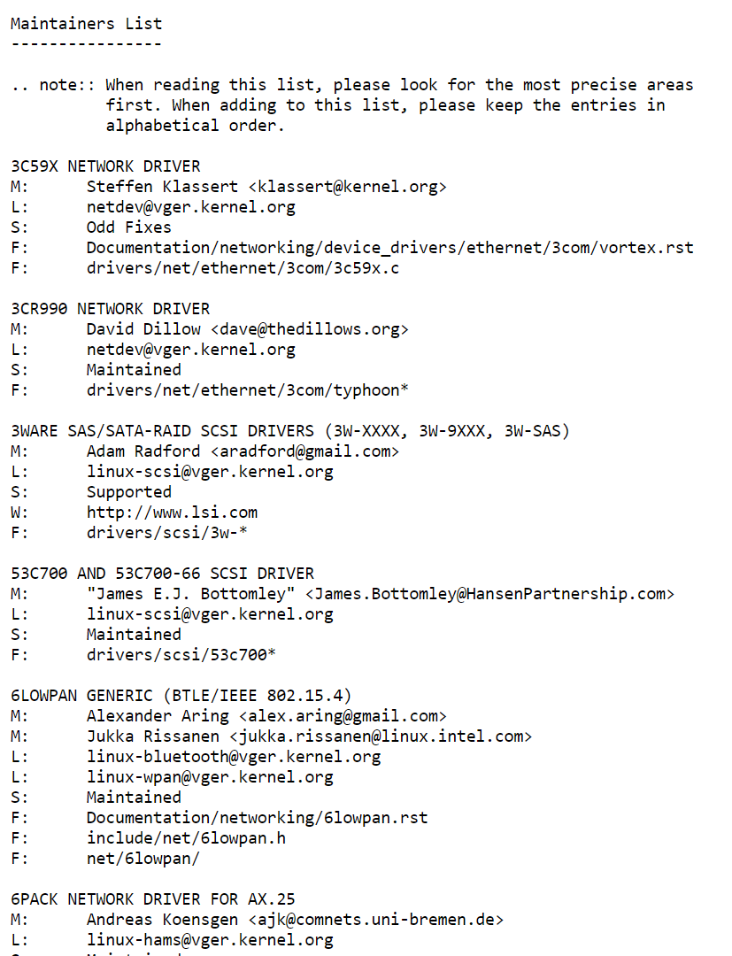
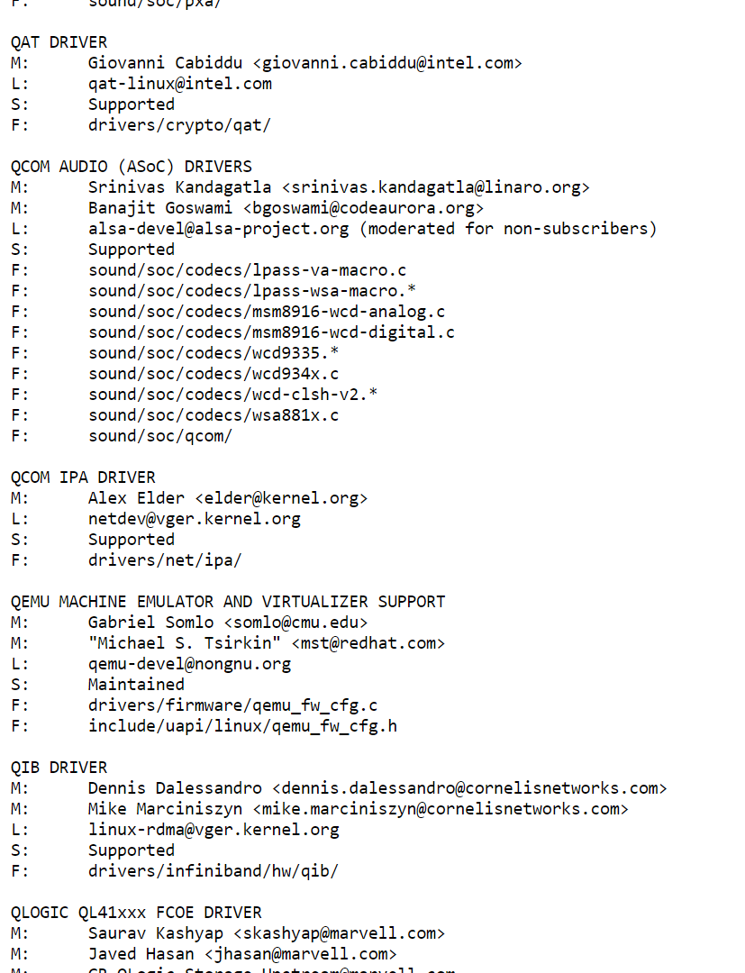
Notes:
“M” indicates who patches should be mailed to. “L” indicates the mailing list that is associated with a kernel subsystem.
[Ref: https://www.kernel.org/doc/linux/MAINTAINERS]

Slide 4
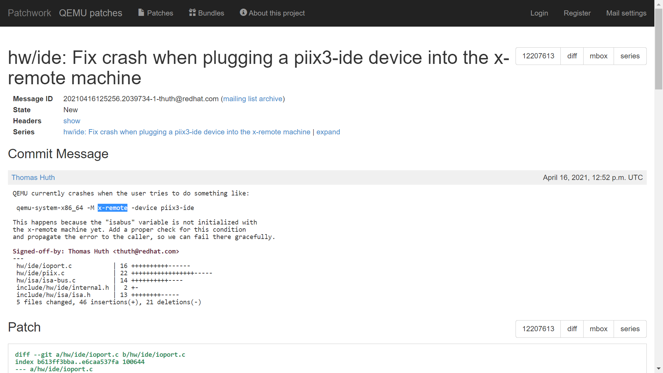
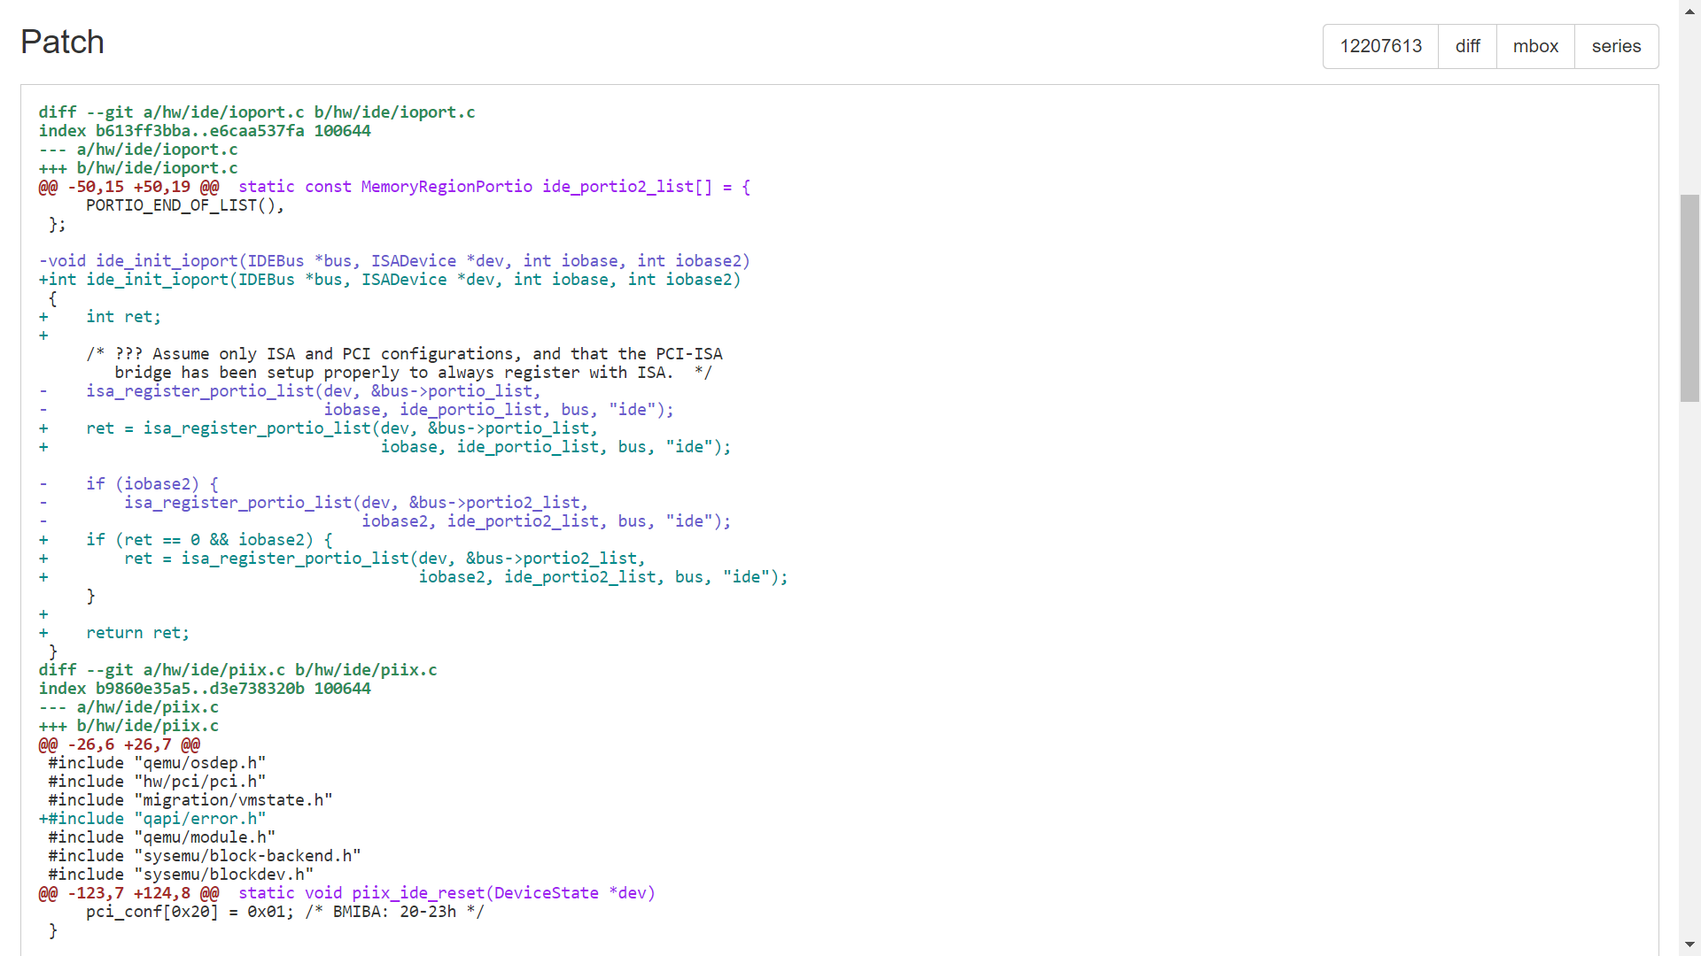
Notes:
[Ref: https://patchwork.kernel.org/project/qemu-devel/patch/20210416125256.2039734-1-thuth@redhat.com/]

Slide 5
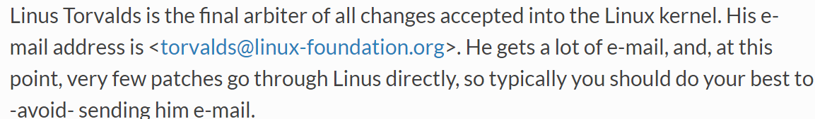
Linux Patches
When a kernel developer wants to patch the kernel (e.g., to fix a bug or improve performance), she has to:
Generate a diff relative to the current kernel source
Write an English-level description of the patch, explaining the “user-visible impact” and quantifying “optimizations and trade-offs”
Find the maintainers for the associated kernel subsystem, and email the patch to those maintainers
The maintainers then test the patch and may or may not merge it into the kernel
Notes:
[Ref: https://www.kernel.org/doc/html/v7.0/process/submitting-patches.html]

Slide 6
How Do We Determine Whether a Patch is “Worth Merging”?

Slide 7
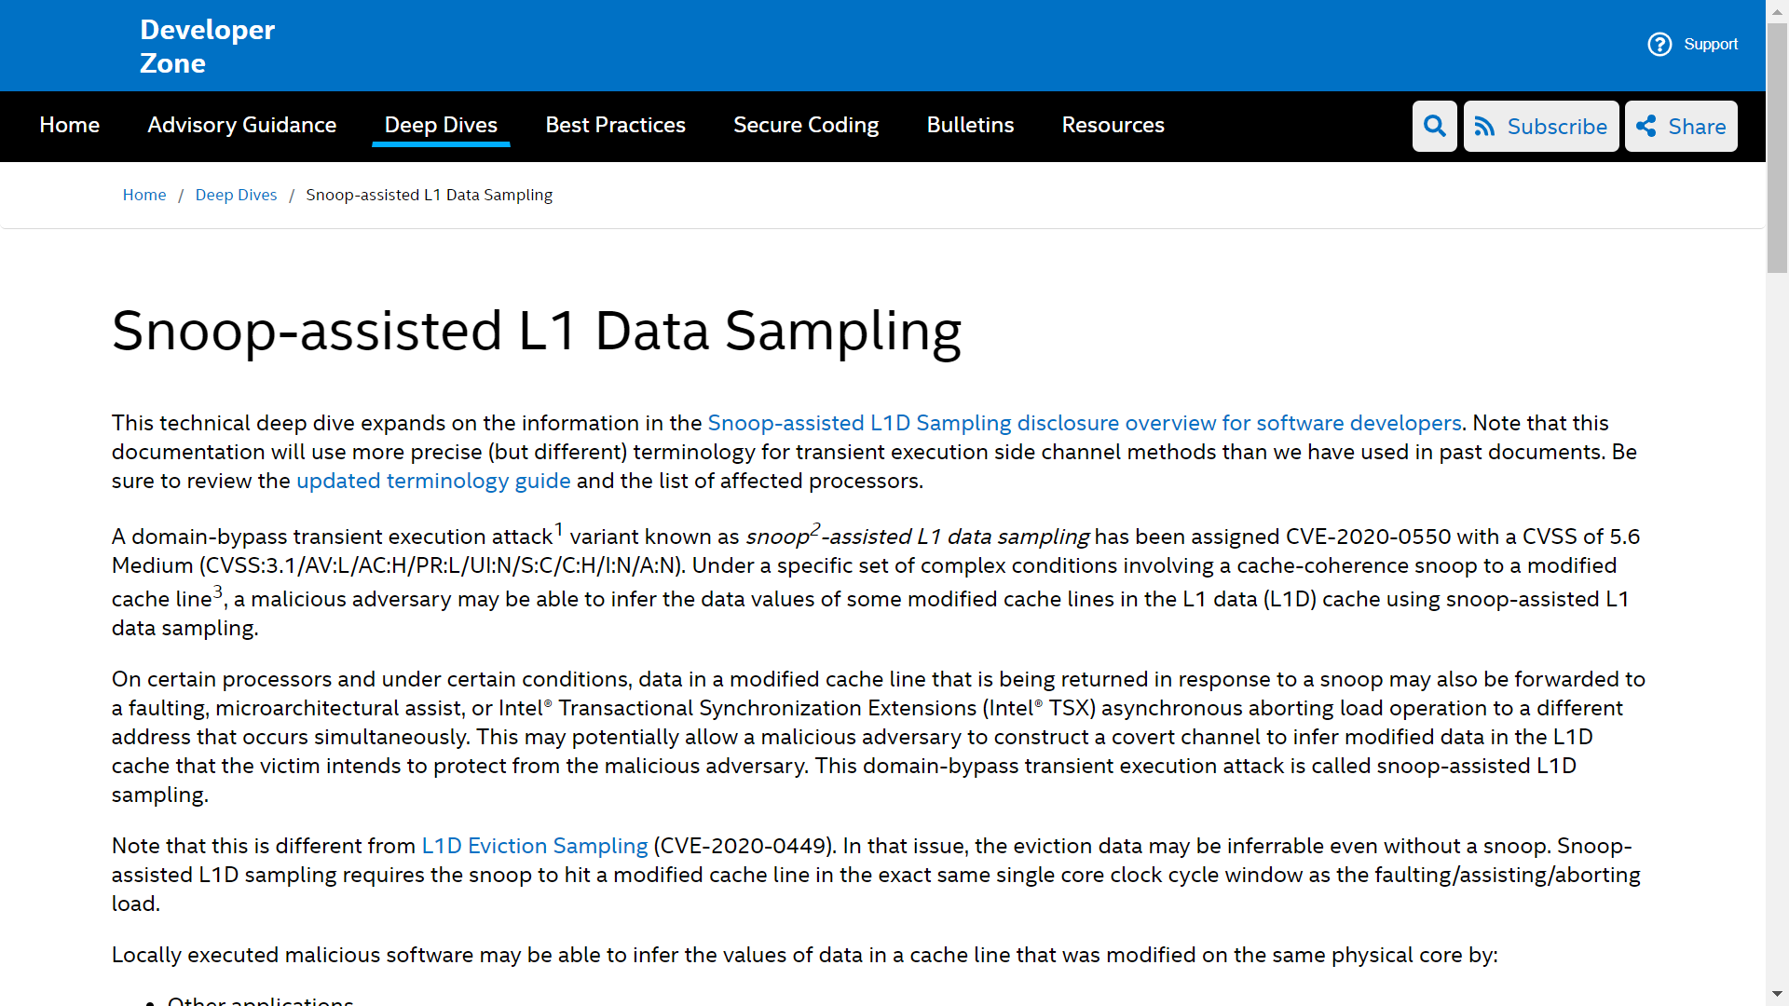
Notes:
[For a high-level overview of the attack, see Ref [1]. For a more detailed analysis, see Ref [2]. The second reference refers to the attacker leveraging “transient execution”; to understand what that term means, see Ref [3]. The next few slides in this deck simplify the discussion of the snooping attack, eliding exactly how the attacker uses transient execution to inappropriately observe data.]
[Ref: [1] https://www.zdnet.com/article/intel-cpus-vulnerable-to-new-snoop-attack/
[2] https://www.intel.com/content/www/us/en/developer/articles/technical/software-security-guidance/technical-documentation/snoop-assisted-l1-data-sampling.html
[3] https://software.intel.com/security-software-guidance/best-practices/refined-speculative-execution-terminology
]

Slide 8
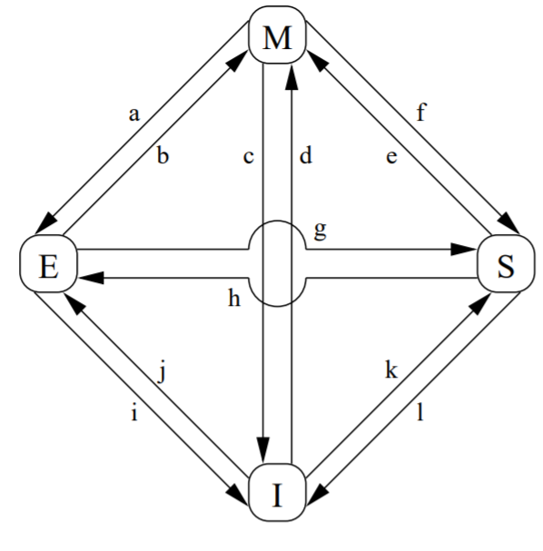


The MESI Protocol
T0:A_{Victim}
Address
Address
Data
State
Data
State
Invalid
Invalid
Invalid
d₁
x
Modified
RAM
Data: d₀
Address: x
Suppose that the core on the right has a modified cache line that belongs to kernel-visible thread T0 in address space A_{Victim}.

Slide 9
The MESI Protocol
T0:A_{Evil}
T0:A_{Victim}
Address
Address
Data
State
Data
State
Invalid
Invalid
Invalid
d₁
x
Modified
RAM
Data: d₀
Address: x
Now suppose that the core on the right starts running a malicious thread from a different address space.
T0:A_{Evil} should not be able to read the cache line from A_{Victim}—the address spaces are different!

Slide 10
The MESI Protocol
Read x
T1:A_{Victim}
T0:A_{Evil}
Address
Address
Data
State
Data
State
d₁
x
Shared
d₁
x
Shared
Invalid
Invalid
Invalid
Modified
Hey, other cache, do you have x’s data?
Yeah, here it is!
RAM
Data: d₀
[Left CPU]
(k) Invalid to shared: CPU reads data that wasn’t in the local cache (but was in the other CPU’s cache)
[Right CPU]
(g) Modified to shared: The right CPU lost its exclusive access to the data
Address: x
Now suppose a new thread from the victim address space runs on the left core, and tries to read the cache line . . .

Slide 11
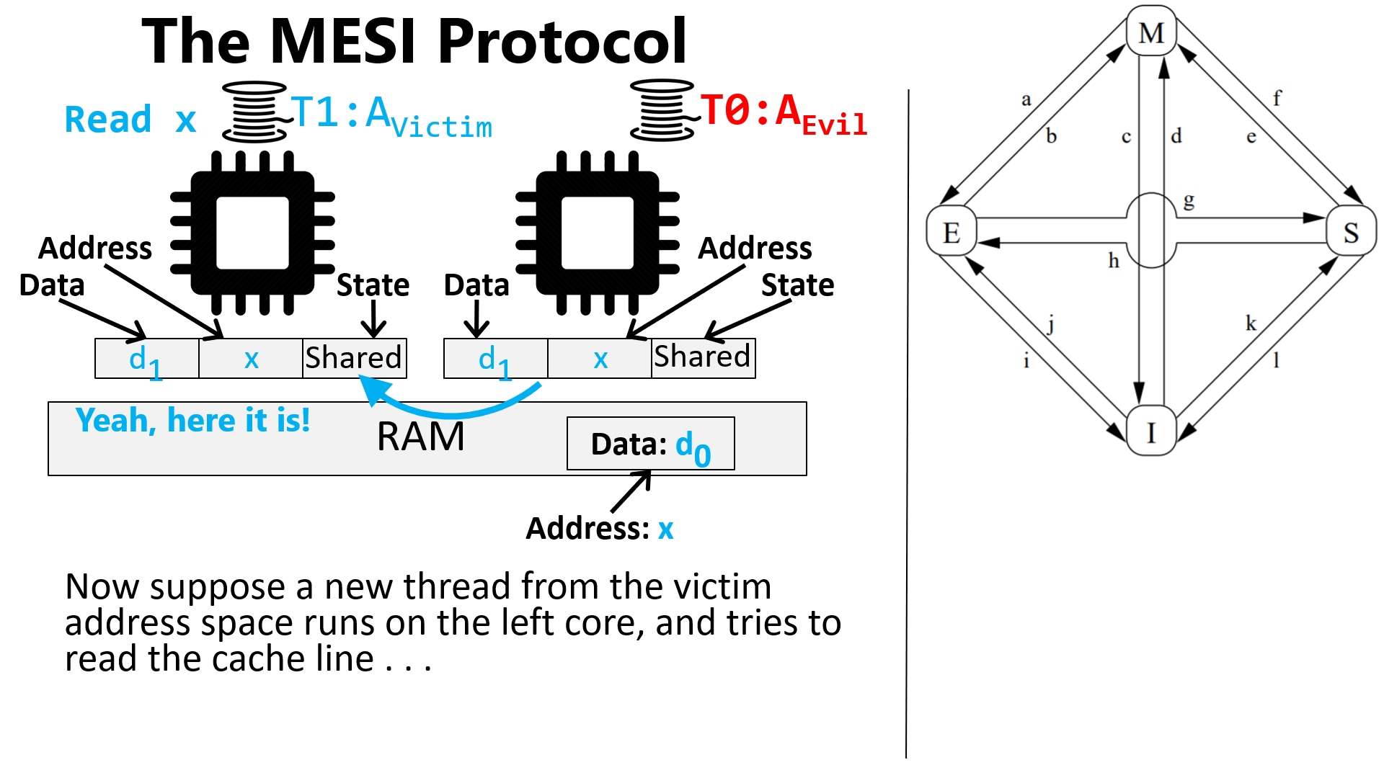
Intel chips had a hardware bug that allowed T0:A_{Evil} to “snoop” on the cache message sent from the right core to the left one, allowing T0:A_{Evil} to read the cache line from A_{Victim}!

Slide 12
Patching Linux to Stop the Attack
An Amazon engineer wrote a kernel patch to address the snooping attack
The patch added a new system call which marked the calling process as wanting to prevent the snooping attack
When Linux context-switched away from such a process, the kernel would force the CPU to flush the cache
T0:A_{Victim}
Address
Address
Data
State
Data
State
Invalid
Invalid
Invalid
d₁
x
Modified
RAM
Data: d₀
Address: x

Slide 13
Patching Linux to Stop the Attack
An Amazon engineer wrote a kernel patch to address the snooping attack
The patch added a new system call which marked the calling process as wanting to prevent the snooping attack
When Linux context-switched away from such a process, the kernel would force the CPU to flush the cache
T0:A_{Evil}
T0:A_{Victim}
Address
Address
Data
State
Data
State
Invalid
x
Invalid
d₁
Invalid
Invalid
Invalid
Invalid
d₁
Modified
RAM
Data: d₀
Address: x

Slide 14
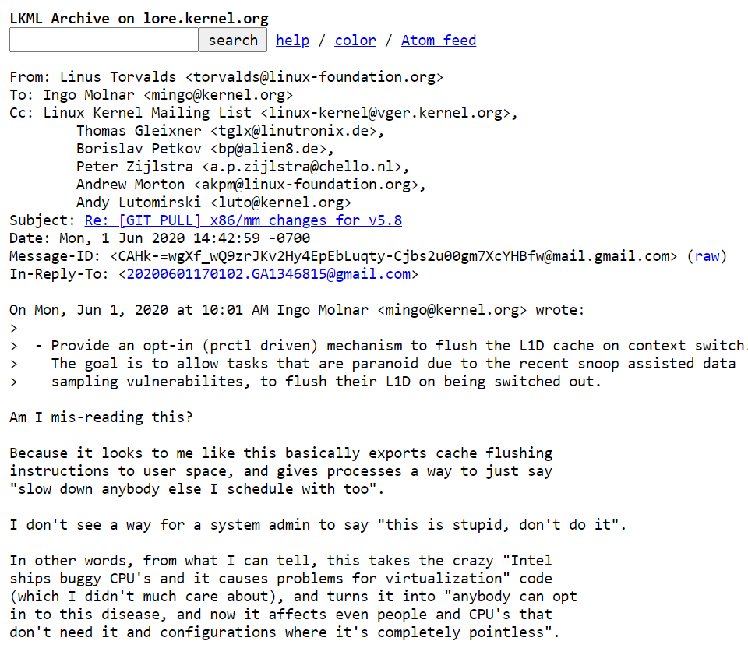

Linus
Notes:
[Ref: https://lore.kernel.org/lkml/CAHk-=wgXf_wQ9zrJKv2Hy4EpEbLuqty-Cjbs2u00gm7XcYHBfw@mail.gmail.com/]

Slide 15

Linus was trying to do a cost-benefit analysis.

