Slide 1

GPUs
CS 1610: Lecture 22
4/27/2026

Slide 2
Outline
Trends in Hardware Design
The GPU Programming Model
Types of GPUs
Case study: Intel’s Iris GPU

Slide 3
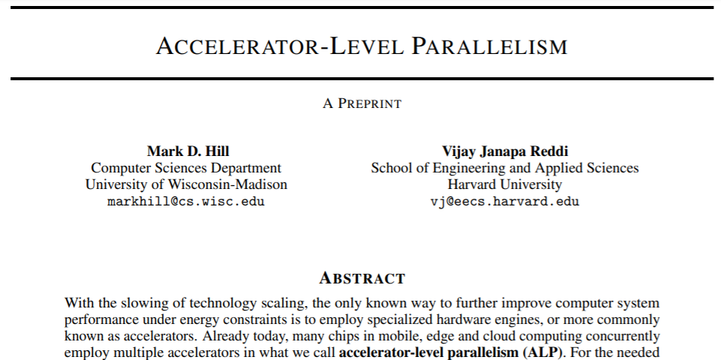
Trends in Hardware Design
Bit-level parallelism: Increasing the size of instruction arguments (e.g., 32 bits → 64 bits)
Instruction-level parallelism: In a single thread, allow unrelated instructions to execute in parallel
Thread-level parallelism: Giving multiple cores to a single machine
Data-level parallelism: Concurrently performing the same operation on multiple pieces of data (e.g., GPUs!)
mov (%rax), %rbx
add %rbx, %rcx
sub %r9, %r10
Must be executed in order due to the data dependency
Can be executed before, after, or between the mov+add
Notes:
[Ref: “Accelerator-level Parallelism” by Hill and Reddi (https://arxiv.org/pdf/1907.02064.pdf)
https://www.eetasia.com/18083002-a-look-at-apples-vertical-integration/
]

Slide 4
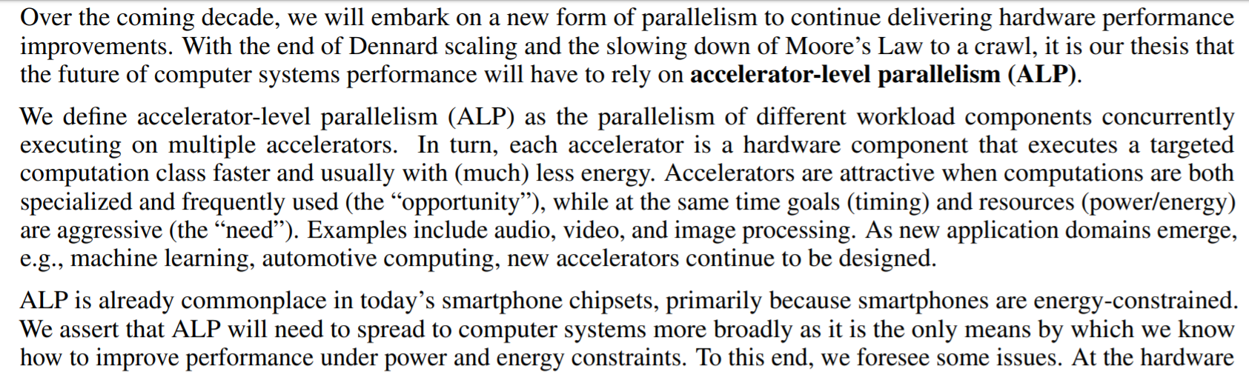

ALLOW ME TO READ SOME PAPER TEXT TO YOU
Notes:
[Ref: “Accelerator-level Parallelism” by Hill and Reddi (https://arxiv.org/pdf/1907.02064.pdf)]

Slide 5
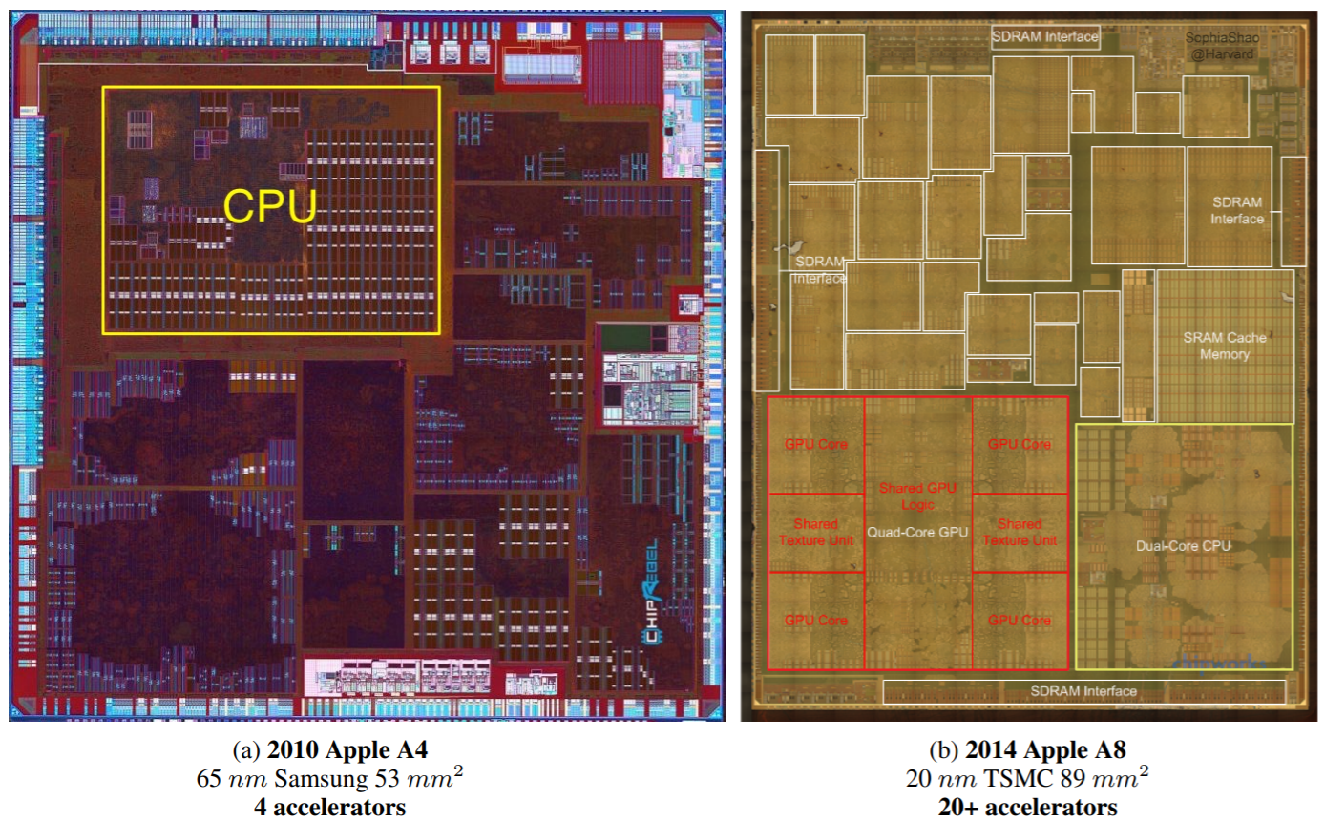
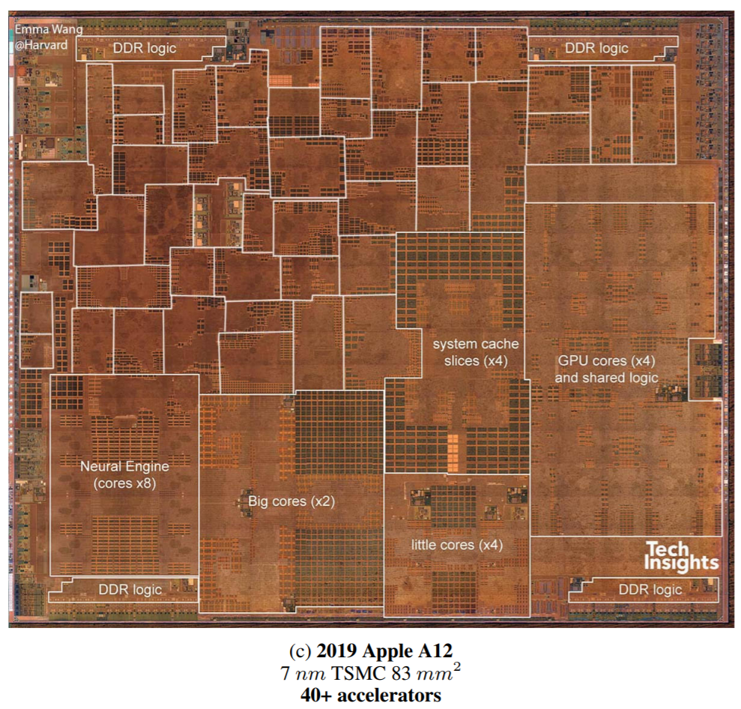
Integrated Design Is What Makes The iPhone Skinny!
Notes:
[Ref: “Accelerator-level Parallelism” by Hill and Reddi (https://arxiv.org/pdf/1907.02064.pdf)]

Slide 6

Steve Jobs in 2007, during the launch of the first iPhone
Helped to invent object-oriented programming and window-based GUIs!
Notes:
[Ref: https://www.youtube.com/watch?v=XAfTXYa36f4]

Slide 7
Outline
Trends in Hardware Design
The GPU Programming Model
Types of GPUs
Case study: Intel’s Iris GPU

Slide 8
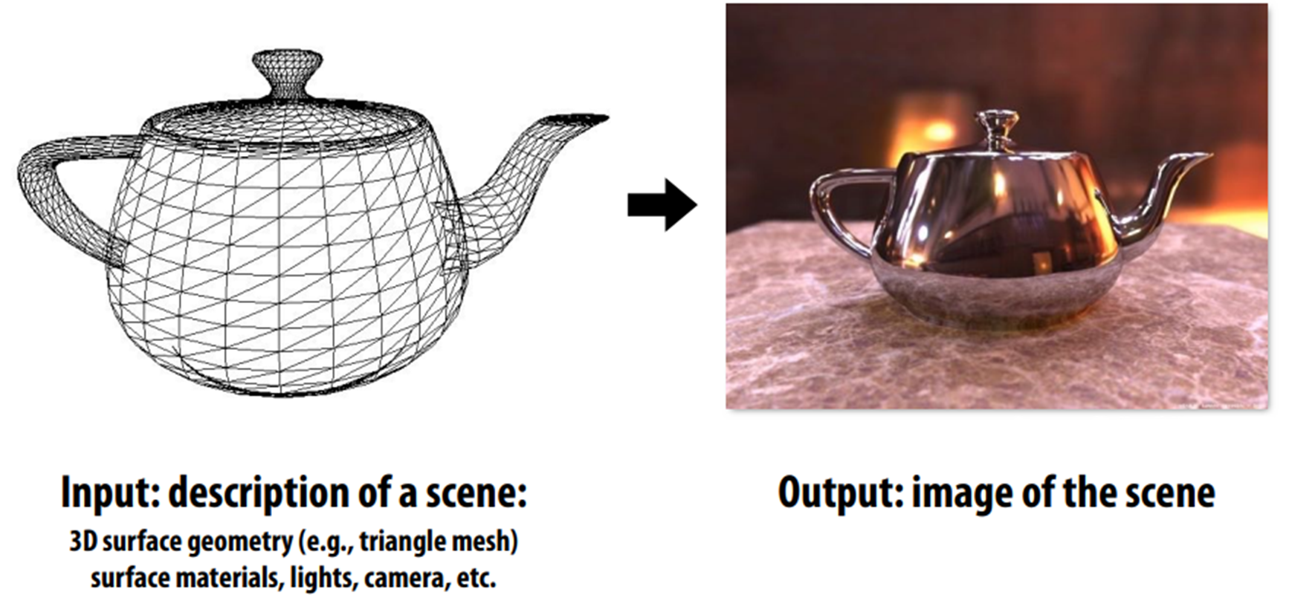
The Original Goal of a GPU
Notes:
[Ref for images above: https://gfxcourses.stanford.edu/cs149/fall25content/media/gpuarch/07_gpuarch.pdf
The slide deck from the link above gives a really nice overview of GPUs---I recommend at least skimming the whole deck!
]

Slide 9


CPUs, GPUs, and Displays: Division of Labor
The CPU is responsible for:
  Receiving the data which determines the next frame to display to the user
    Ex: Key presses and mouse clicks from the user
    Ex: Network inputs from network-connected game players
    Ex: Behaviors from simulated players in a game
    Ex: Physics-based models of where various program objects should live
  Analyzing that data to determine the wire meshes, camera locations, and other visual assets needed to render the next frame
  Sending the visual assets and the associated math kernels to the GPU for actual rendering
The GPU is responsible for:
  Performing the rendering math
  Updating a framebuffer that contains the pixels to show to the user
The display is responsible for:
  Reading pixel data from the GPU’s framebuffer
  Displaying the pixel data to the user
If these activities aren’t synchronized, tearing will occur!
Notes:
[Ref: https://www.reddit.com/r/hardware/comments/13oxeyy/understanding_the_different_roles_of_your_cpu_and/
https://www.ituonline.com/tech-definitions/what-is-frame-buffer/
]

Slide 10
Overview of GPU Architecture
GPU hardware is specialized for highly-parallel, computationally-bound applications with simple control flows
The CPU offloads graphics computations to the GPU, and runs general-purpose code in parallel as the GPU works
ALU
ALU
Control
ALU
ALU
Cache
DRAM
DRAM
CPU
GPU
Implements fancy stuff like out-of-order execution and branch prediction
Doesn’t implement fancy stuff like out-of-order execution or branch prediction
CPU
Launch GPU threads
Threads complete
Launch GPU threads
Threads complete
GPU
Notes:
The colored diagrams show the relative amount of die area (i.e., the relative number of transistors) that are allocated to various pieces of functionality. [“Control” refers to circuitry that coordinates the overall operation of the chip, e.g., to handle branch prediction and out-of-order execution.]
[Ref: https://web.cs.ucdavis.edu/~amenta/f15/amenta-cuda.pdf
https://www.usenix.org/system/files/conference/nsdi17/nsdi17-go.pdf //Section 2 (“Background”)
https://en.wikipedia.org/wiki/Single_instruction,_multiple_threads
]

Slide 11
Maximizing Parallelization: SIMD vs. SIMT
SIMD (“single instruction, multiple data”) increases the number of calculations that are performed by one instruction
Starting in 2006, Intel has added a variety of SIMD instructions to accelerate scientific, multimedia, and cryptographic workloads
  %xmm0—%xmm15 are 128-bit registers for use by SIMD instructions
  An %xmm register is treated differently by different SIMD instructions, e.g., as
    Two 64-bit floats
    Four 32-bit floats
    Eight 16-bit shorts
    Sixteen 8-bit bytes
  Example: vector addition
//C code
vec_out.w = v1.w + v2.w;
vec_out.x = v1.x + v2.x;
vec_out.y = v1.y + v2.y;
vec_out.z = v1.z + v2.z;
movaps (v1), %xmm0 //%xmm0 = v1.z | v1.y |
// v1.x | v1.w
addps (v2), %xmm0 //%xmm0 = v1.z+v2.z |
// v1.y+v2.y |
// v1.x+v2.x |
// v1.w+v2.w
movaps %xmm0, (vec_out)
Notes:
`movaps` stands for “move aligned packed single precision” floating-point values. `addps` stands for “add packed single precision” floating-point values.
[Ref: https://en.wikipedia.org/wiki/Streaming_SIMD_Extensions
https://www.felixcloutier.com/x86/movaps
https://www.felixcloutier.com/x86/addps
]

Slide 12

Maximizing Parallelization: SIMD vs. SIMT
SIMD (“single instruction, multiple data”) increases the number of calculations that are performed by one instruction
SIMT (“single instruction, multiple threads”) is used by GPUs to increase parallelism
  Thread: A sequence of scalar (i.e., non-SIMD) instructions
  Block: A group of multiple threads where each thread:
    Contains the same instruction sequence
    Has separate registers and local variables!
    Runs on the same streaming multiprocessor (SM)
    Knows its thread id and block id
  Grid: A collection of blocks that belong to the same computational “kernel”
  Warp: A subset of threads in a block (32 on Nvidia GPUs) that simultaneously execute on the same SM
Structure of a kernel
Thread instructions
Thread
instr₀
instr₁
Block
instr₂
instr₃
instr₄
Grid
A “kernel” refers to a set of mathematical operations to perform—not to an OS kernel!
Notes:
Note that the grid layout is a convenient abstraction for graphics problems, since you can divide the screen into a grid, and then assign different threads to render different parts of the screen in parallel. The grid layout is also a convenient abstraction for many kinds of problems in machine learning, where training a model can be decomposed into a bunch of parallel tasks.
[Ref: https://nyu-cds.github.io/python-gpu/02-cuda/
http://15418.courses.cs.cmu.edu/spring2017content/lectures/05_gpuarch/05_gpuarch_slides.pdf //Saved as gpu-arch.pdf
https://www.cis.upenn.edu/~devietti/classes/cis601-spring2016/hipeac-2015.updated.pdf //Saved as gpu-arch3.pdf
https://en.wikipedia.org/wiki/Thread_block_(CUDA_programming)
https://en.wikipedia.org/wiki/Thread_block_(CUDA_programming)#Warps
]

Slide 13



SM scheduler logic
Warp queue
Inside a streaming multiprocessor
Each thread has its own register set (e.g., up to 255 on an Nvidia GPU)
Fetch
Registers
Thread instructions
Decode
Thread
instr₀
Execute
instr₁
Warp0
Warp1
Block
instr₂
At least one thread misses: entire warp is suspended!
D-Cache
instr₃
All threads in warp hit in D-cache: all proceed to Writeback
instr₄
Warp0
Grid
Warp2
All data arrives
Writeback
One GPU: MANY THOUSANDS of registers!
Notes:
In this example, a warp has three threads, but as mentioned in the last slide, a real warp has 32 threads in it!
Note that all of the threads in a warp have to exit the pipeline at the same time—this is why the threads are said to be in a warp. However, suppose that, while going through the D-cache stage, one or more threads suffer from a miss; in other words, one or more threads has to block until data can be fetched from RAM and pulled into the D-cache. If this happens, then the SM has to suspend the *entire* warp, only resuming the warp when all of the D-cache results have arrived. [As http://www.cs.fsu.edu/~yuw/pubs/2015-ICS-Yu.pdf states:
“Within the lock-step execution model, a warp becomes ready when all of its demanded data is available; warps that have missing data, regardless of the data size, are excluded for execution. This execution model of GPU expects that all cache blocks of each divergent load instruction are cached as a unit when there is locality. However, conventional cache management is unaware of the GPU execution model and the collective nature of divergent memory blocks. As a result, some blocks of a divergent instruction can be evicted while others are still cached, resulting in a varying number of cache misses for individual loads.”]
When a particular warp is suspended, the SM can execute other warps.
Each thread gets its own private register set. On Nvidia GPUs, a thread can get have up to 255 registers in its set. Since a single GPU runs hundreds or thousands of threads simultaneously, this means that a single GPU will have many thousands of registers, e.g., hundreds of thousands of registers! This contrasts with a CPU, which only has maybe 16 or 32 general-purpose registers. [For the specs about Nvidia GPUs, see the documentation about “Maximum number of 32-bit registers per thread” here: https://docs.nvidia.com/cuda/cuda-c-programming-guide/index.html#features-and-technical-specifications__technical-specifications-per-compute-capability.]
Note that, in this SM, the execute stage has enough ALUs to execute every instruction in a warp in parallel! [In a real-life SM, there may not be enough ALUs so that each thread in a warp gets a dedicated one—see the Intel Iris architecture discussed later in the slide deck.]
[Ref: https://www.archive.ece.cmu.edu/~ece740/f13/lib/exe/fetch.php?media=onur-740-fall13-module5.1.3-simd-and-gpus-part3-vliw-dae-systolic.pdf]

Slide 14
SM scheduler logic
Warp queue
Inside a streaming multiprocessor
Each thread has its own register set (e.g., up to 255 on an Nvidia GPU)
Fetch
This part is similar to a traditional SIMD pipeline
  However, there are multiple threads executing the same instruction on different inputs, not one instruction operating on multiple inputs
  In SIMT, what happens if . . .
    The instruction to execute is a branch, and
    Different threads evaluate the branch condition differently?
Registers
Decode
Execute
At least one thread misses: entire warp is suspended!
D-Cache
All threads in warp hit in D-cache: all proceed to Writeback
Warp0
Warp2
All data arrives
Writeback
Notes:
You might wonder why you would use a SIMT approach instead of a SIMD approach if both allow multiple computations to be executed at once. The reason is that the SIMT approach allows for those computations to be executed simultaneously by multiple THREADS, each of which has its own register state and (as we explain in the next slide) its own ability to take different branches in different directions. Thus, the SIMT model is a richer one than the SIMD model in which there’s a single thread with a single register context.

Slide 15

There Is A (Janky) Solution!
UGGGGGHGHHHHHHHHHHGHGHKJ
All threads in a warp execute the branch test at the same time
  The “test succeeds” threads then execute the if-path while the other threads in the warp are idle
  Afterwards, the “test fails” threads execute the else-path while the other threads in the warp are idle
So, the two execution paths execute serially!
in[] = {4,8,12}; //1D
//global input array
1: i = in[threadIdx.x];
//Thread offset in
//the 1D input data
2: if(i < 10)
3: r = 0;
else
4: r = 1;
5: out[threadIdx.x] = r;
SM execution of the warp
1
T0
T1
T2
2
T0
T1
T2
3
T0
T1
T2
4
T0
T1
T2
5
T0
T1
T2
Notes:
Note that the “number:” stuff wouldn’t appear in the actual source code: those annotations just provide line numbers for the example. Also note that, in this example, `in` and `out` are global variables that are visible to all threads; in contrast, `i` and `r` are thread-local variables.
[Ref: https://cvw.cac.cornell.edu/GPU/thread_div
https://www.cis.upenn.edu/~devietti/classes/cis601-spring2016/hipeac-2015.updated.pdf //Slide 20, which
//is the basis for the example above
https://devblogs.nvidia.com/easy-introduction-cuda-c-and-c/
https://cs.calvin.edu/courses/cs/374/CUDA/CUDA-Thread-Indexing-Cheatsheet.pdf
]

Slide 16

TRY TO AVOID BRANCHES IN GPU CODE
OR MAKE SURE THAT
ALL THREADS IN A WARP WILL BRANCH IN THE
SAME DIRECTION!
Notes:
Branches hurt performance because they prevent the SIMD pipeline inside each SM from being fully utilized every clock cycles!
The way that you’d ensure that all threads in a warp branch in the same direction is by making sure that you the dimensions of warps, blocks, and grids are such that each warp’s threads will take the same branch directions, even if threads in different warps will take different directions.

Slide 17
Thread-Accessible Memory (Nvidia-style External GPU)
Global memory
  Visible to all threads in the application
  Persists for as long as the application runs
Local memory
  Only visible to a thread
  Only persists for the lifetime of the thread
  Bytes are actually stored in global memory! [In other words, local memory semantics are provided by the compiler]
Shared memory
  Visible to all threads in a block
  Only persists for the lifetime of the block
  Bytes typically live in per-SM RAM (e.g., 64 KB)
  Allows threads in the block to communicate with each other
Developers annotate variables (e.g., as __shared__) and the compiler (e.g., the CUDA compiler for Nvidia GPUs) is responsible for generating the right kind of memory accesses to variables
GPU
Global memory
Fetch
Fetch
Decode
Decode
Shared memory
Shared memory
D-Cache
D-Cache
Writeback
Writeback
SM
SM
Notes:
[As described by [5], “Global memory is a 49-bit virtual address space that [is] visible to all threads in the GPU . . . Local memory is private storage for an executing thread and is not visible outside of that thread. It is intended for thread-local data like thread stacks and register spills. Local memory addresses are translated to global virtual addresses . . . Local memory has the same latency as global memory . . . Shared memory is located on chip, so it has much higher bandwidth and much lower latency than either local or global memory.”]
[Nvidia uses the term “CUDA core” to refer to an SM. In Nvidia terminology, an “SM” contains multiple CUDA cores (say, 32), the associated registers, as well as shared memory and the scheduler logic which dispatches warps to CUDA cores. For more details, see https://medium.com/@smallfishbigsea/basic-concepts-in-gpu-computing-3388710e9239.]
[Ref: [1] https://jhui.github.io/2017/03/06/CUDA/
[2] https://www.microway.com/hpc-tech-tips/gpu-memory-types-performance-comparison/
[3] https://developer.download.nvidia.com/CUDA/training/register_spilling.pdf
[4] https://www.cis.upenn.edu/~devietti/classes/cis601-spring2016/hipeac-2015.updated.pdf //gpu-arch3.pdf;
//see slides 29, 30, and 38.
[5] https://docs.nvidia.com/nsight-compute/ProfilingGuide/index.html
]

Slide 18
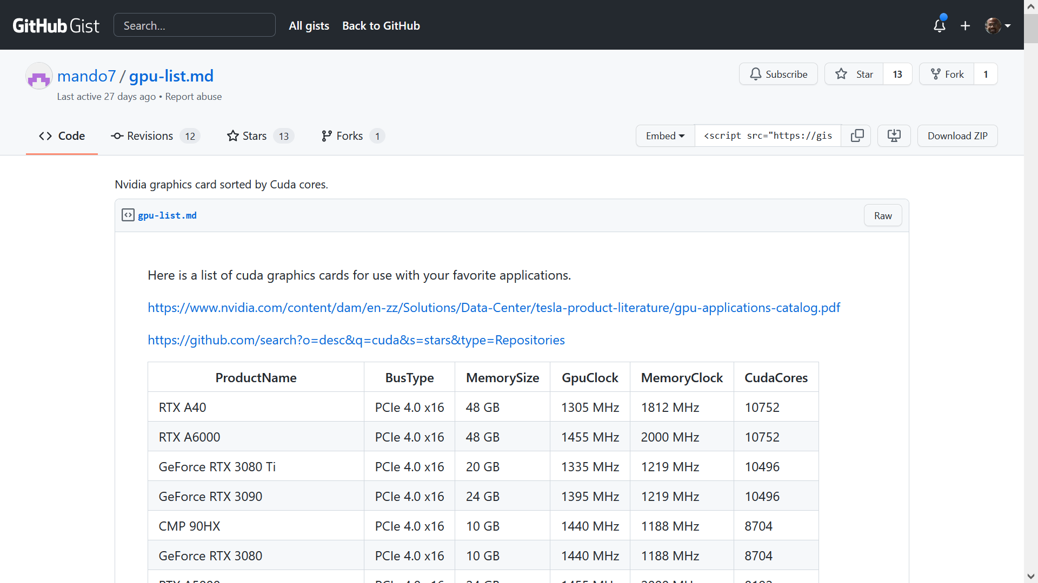

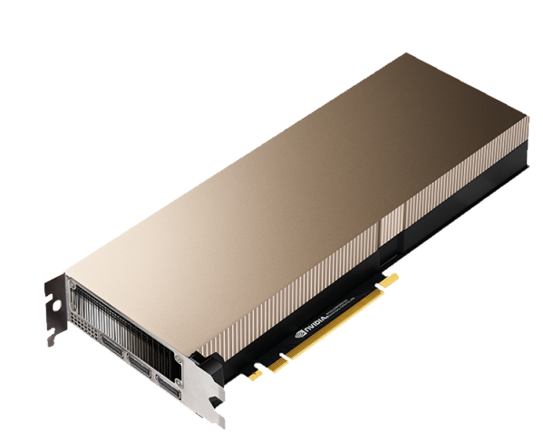
PCIe v4.0 x16: 32 GB/s host->GPU and GPU->host
A single nVidia CUDA core has a warp width of 32!
Notes:
See the comment on the previous slide about Nvidia terminology—for example, a “CUDA core” is Nvidia’s term for an SM.
[Note that the RTX A40 (and all of the top GPUs listed above) are top-of-the-line GPUs that target datacenter environments, render farms, and other hard-core scenarios. In contrast, the more modest GTX 1080 only has 2560 CUDA cores (as opposed to the 10752 of the RTX A40) and only 8 GB of RAM (as opposed to the 48 GB of the RTX A40).]
Note that modern Nvidia GPUs have a warp width of 32 threads. [See the nVidia documentation about “Warp size” athttps://docs.nvidia.com/cuda/cuda-c-programming-guide/index.html#features-and-technical-specifications__technical-specifications-per-compute-capability. !!!Check this number next year :-D.]
[Ref: https://gist.github.com/mando7/d2c4464a5991f5787e9752e5950608fb
https://en.wikipedia.org/wiki/PCI_Express#History_and_revisions //Provides PCIe bandwidths. Remember that
//a PCIe lane is a full-duplex connection. So, for the RTX A40, there is 32 GB/s of memory
//bandwidth from the host RAM to the GPU, and 32 GB/s of bandwidth from host RAM to
//the GPU.
]

Slide 19
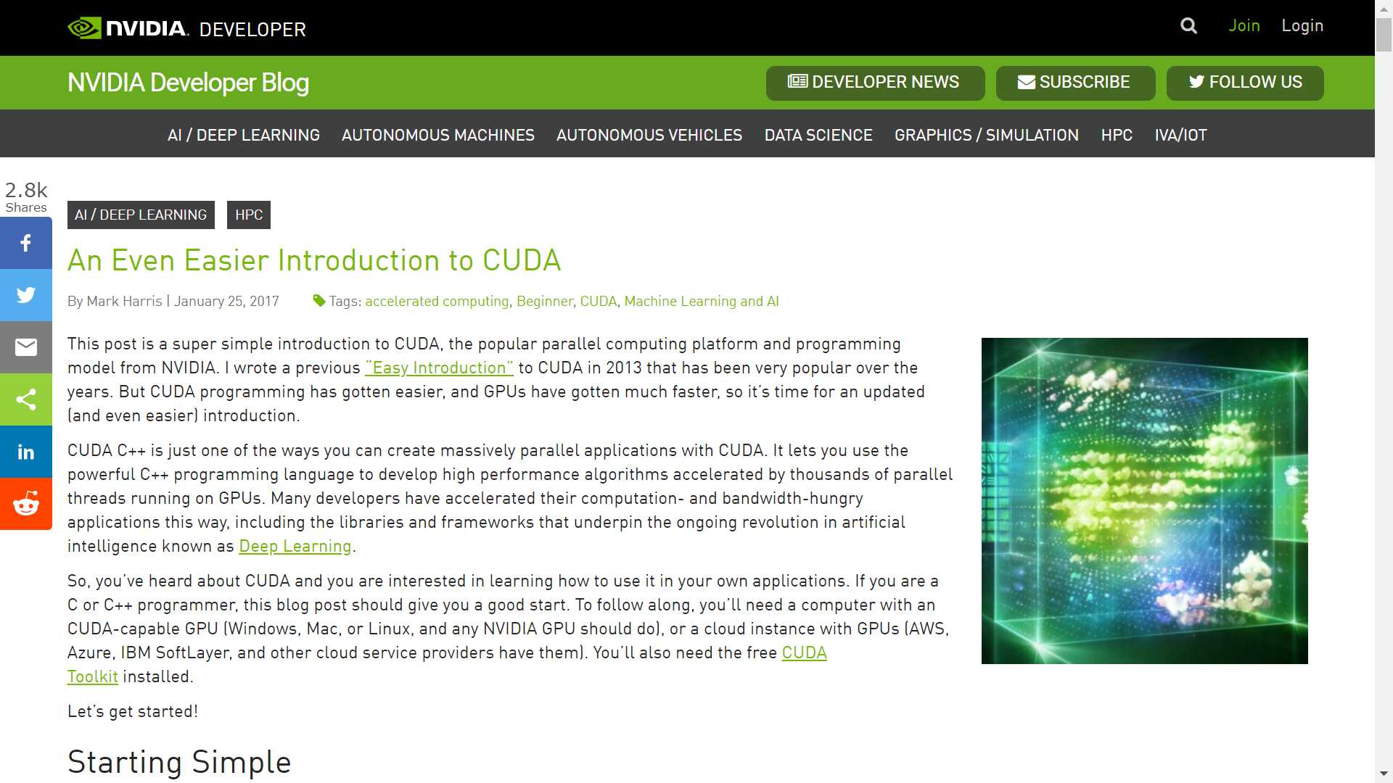
Notes:
[Ref: https://devblogs.nvidia.com/even-easier-introduction-cuda/]

Slide 20
Goal: Do a Vector-Addition of Two Large Arrays

Slide 21
Version 1: Regular C++ Code
//Vector-add two arrays.
void add(int n, float *x, float *y){
for (int i = 0; i < n; i++)
y[i] = x[i] + y[i];
}
int main(){
int N = 1<<20; // 1M elements
float *x = new float[N];
float *y = new float[N];
//Initialize the arrays.
for (int i = 0; i < N; i++) {
x[i] = 1.0f;
y[i] = 2.0f;
}
//Run kernel.
add(N, x, y);
delete [] x;
delete [] y;
return 0;
}

Slide 22
Version 2: CUDA (1 block with 256 threads)
//Vector-add two arrays.
__global__ //Tells CUDA that add()
//is a kernel that runs
//on a GPU, and can be
//invoked by a CPU.
void add(int n, float *x, float *y){
int index = threadIdx.x; //Index of the
//current thread in the 1D block.
int stride = blockDim.x; //Total number
//of threads in the 1D block.
for (int i = index; i < n; i += stride)
y[i] = x[i] + y[i];
}
int main(){
int N = 1<<20; // 1M elements
//Allocate "unified memory" that's
//accessible from both CPU and GPU.
float *x, *y;
cudaMallocManaged(&x, N*sizeof(float));
cudaMallocManaged(&y, N*sizeof(float));
//Initialize the arrays.
for (int i = 0; i < N; i++) {
x[i] = 1.0f; y[i] = 2.0f;
}
//Run kernel (1 block with 256 threads)
add<<<1, 256>>>(N, x, y);
//Wait for GPU to finish.
cudaDeviceSynchronize();
cudaFree(x); cudaFree(y); return 0;
}
Thread
One-dimensional block

Slide 23
Version 3: CUDA (4096 blocks, each with 256 threads)
//Vector-add two arrays.
__global__ //Tells CUDA that add()
//is a kernel that runs
//on a GPU, and can be
//invoked by a CPU.
void add(int n, float *x, float *y){
int index = (blockIdx.x * blockDim.x) +
threadIdx.x;
//(myBlockId * threadsInBlock) +
//(myThreadIdInBlock)
int stride = blockDim.x * gridDim.x;
//threadsInBlock * blocksInGrid
for (int i = index; i < n; i += stride)
y[i] = x[i] + y[i];
}
int main(){
int N = 1<<20; // 1M elements
//Allocate "unified memory" that's
//accessible from both CPU and GPU.
float *x, *y;
cudaMallocManaged(&x, N*sizeof(float));
cudaMallocManaged(&y, N*sizeof(float));
//Initialize the arrays.
for (int i = 0; i < N; i++) {
x[i] = 1.0f; y[i] = 2.0f;
}
//Run kernel (4096 blocks, 256 threads
//each)
add<<<4096, 256>>>(N, x, y);
//Wait for GPU to finish.
cudaDeviceSynchronize();
cudaFree(x); cudaFree(y); return 0;
}
Thread
Block
One-dimensional grid

Slide 24
Performance Results (Laptop GeForce GT 750M)
Version 1 (regular C++ code): Hundreds of milliseconds
Version 2 (CUDA: 1 block, 256 threads per block): 3.2 ms
Version 3 (CUDA: 4096 blocks, 256 threads per block): 0.68 ms

Slide 25
Outline
Trends in Hardware Design
The GPU programming model
Types of GPUs
Case study: Intel’s Iris GPU

Slide 26



Memory-mapped PCI-e Devices
10 Gbps
PCI-e NIC
CPU package
Each PCI-e device is bound to a range of memory addresses that are managed by the device (not by actual RAM)
x4
SDRAM
Root complex
Root complex
SDRAM
DMI
PCH
DMI
x4
PCI-e
port 1
(x8)
PCI-e
port 2
(x16)
PCI-e
port 3
(x16)
PCI-e
port 1
(x8)
PCI-e
port 2
(x16)
PCI-e
port 3
(x16)
RAM
RAM
PCI-e
switch
PCI-e
switch
PCI-e
switch
PCI-e
switch
The root complex translates between CPU-created memory requests and PCI-e messages
  The CPU writes to device-owned memory addresses to send commands or configure the device
  A device sends a PCI-e message to the root complex to respond to a request or proactively interrupt the CPU
x8
x16
x16
x16
x16
x8
x16
x16
x16
x16
Slot1
Slot2
Slot3
Slot4
Slot5
Slot6
Slot11
Slot10
Slot9
Slot8
Slot7
Microway’s Octoputer
(optimized for 8 GPUs)

Slide 27
Integrated vs Discrete GPUs
An integrated GPU:
  Lives on the same package that contains the CPUs
  Communicates with the CPUs via an on-chip bus (e.g., an AGP, PCI-e, or proprietary bus that connects directly to a root complex)
A discrete GPU:
  Is a separate piece of silicon
  Communicates with the CPUs via an external bus (e.g., PCI-e lanes which connect to CPUs via a root complex)
Integrated GPUs:
  Require less space and consume less energy (due to co-design with the rest of the chip)
  Are financially cheaper
  Have worse compute performance—a discrete GPU has more space for more compute elements, and often has its own RAM and caching hierarchy
  Can access host RAM directly, avoiding copies between host RAM and GPU RAM

Slide 28
Outline
Trends in Hardware Design
The GPU programming model
Types of GPUs
Case study: Intel’s Iris GPU

Slide 29
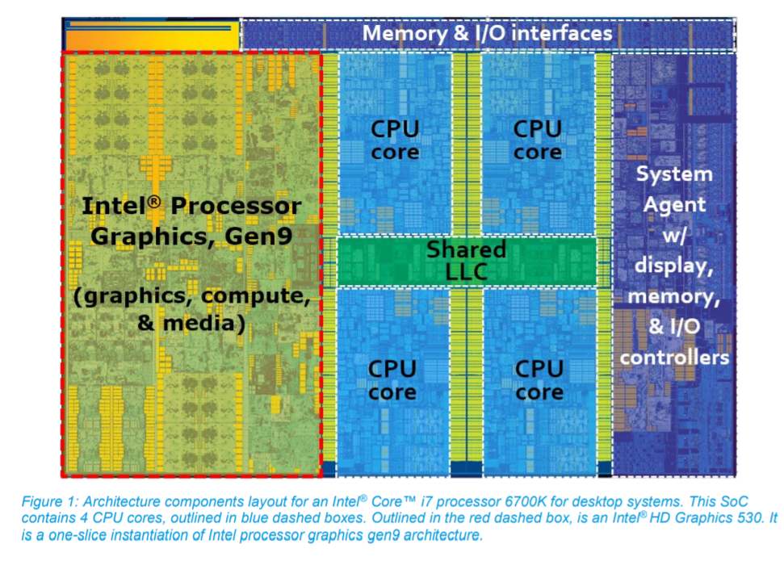
Case Study: Intel’s Iris Integrated GPU
Notes:
[Ref: https://software.intel.com/sites/default/files/managed/c5/9a/The-Compute-Architecture-of-Intel-Processor-Graphics-Gen9-v1d0.pdf]

Slide 30

Case Study: Intel’s Iris Integrated GPU
L1-i
L3 cache shard
L2
SDRAM
L1-d
Root complex
Ring bus
(proprietary protocol)
PCI-e lanes
(xWhatever)
RAM
L3 cache shard
L1-i
L2
L1-d
PCI-e device
“System on a Chip”
(SoC)
Notes:
The Iris is not a smartphone GPU—instead, it’s intended for laptops and desktops.
As described by Intel, in a SoC, “each on-die core is allocated a slice of cache, and that cache slice is connected as a unique agent on the ring. However, all of the slices work together as a single cache, albeit a shared and distributed cache. An address hashing scheme routes data requests to the cache slice assigned to its address. This distributed LLC is also shared with Intel processor graphics. For both CPU cores and for Intel processor graphics, LLC seeks to reduce apparent latency to system DRAM and to provide higher effective bandwidth.”
[Ref: See https://github.com/Igalia/intel-osrc-gfx-prm/tree/master/011_kbl_-_2016-2017 for the chapters in the Iris Programmer’s Reference Manual.
Also see Figure 2 of https://software.intel.com/sites/default/files/managed/c5/9a/The-Compute-Architecture-of-Intel-Processor-Graphics-Gen9-v1d0.pdf
See https://software.intel.com/sites/default/files/managed/db/88/The-Architecture-of-Intel-Processor-Graphics-Gen11_R1new.pdf; Figure 7 is
particularly relevant for the diagram above, since it depicts each core’s private L1 and L2 caches.
https://www.anandtech.com/show/3922/intels-sandy-bridge-architecture-exposed/4
]

Slide 31
Case Study: Intel’s Iris Integrated GPU
L1-i
L3 cache shard
L2
SDRAM
L1-d
Root complex
Ring bus
(proprietary protocol)
PCI-e lanes
(xWhatever)
RAM
L3 cache shard
L1-i
L2
L1-d
PCI-e device
CPU sends commands to GPU (via MMIO registers), and GPU sends interrupts to CPU, via the ring, without leaving the SoC!
“System on a Chip”
(SoC)

Slide 32
Case Study: Intel’s Iris Integrated GPU
L1-i
L3 cache shard
L2
SDRAM
L1-d
Root complex
Ring bus
(proprietary protocol)
PCI-e lanes
(xWhatever)
RAM
L3 cache shard
L1-i
L2
L1-d
PCI-e device
GPU can access host RAM directly, without having to copy graphics buffers between on-GPU RAM and host RAM!
“System on a Chip”
(SoC)

Slide 33

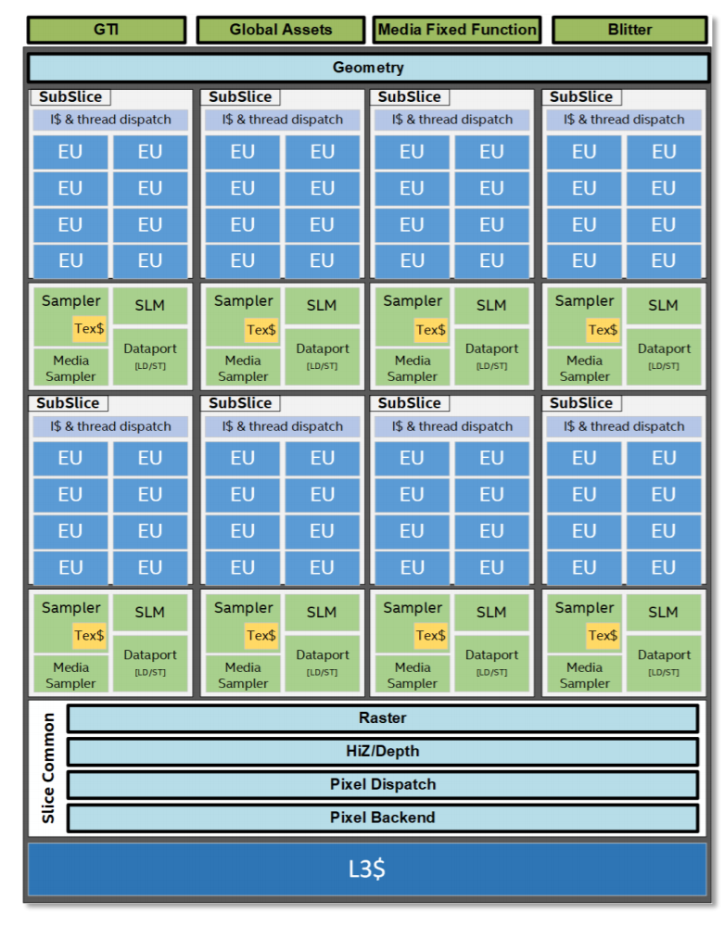
An EU (“Execution Unit”) is an SM
  Each EU simultaneously runs instructions from four threads (i.e., the warp width is four)
  Each SIMD ALU in an EU can issue:
    Four 32-bit operations per cycle, or
    Eight 16-bit operations per cycle
Each sub-slice contains:
  Eight EUs
  A scheduler which assigns warps to EUs
  SLM (“Shared Local Memory”): 64 KB
The GPU has:
  Eight sub-slices (and thus 64 total EUs)
  A private L1/L2/L3 cache
  Global thread memory lives in normal system RAM, and the GPU shares the normal L3 cache with the CPUs
GTI (“Graphics Technology Interface”) is the bus interface that connects the GPU to the rest of the SoC
GTX TITAN Z:
5760 SMs
Intel Iris:
64 SMs
Notes:
The GPU has a private L1/L2/L3 caching layer. The GPU also shares the “normal” L3 cache with the CPUs on the SOC. So, from the perspective of the GPU, the “normal” L3 cache is like an L4 cache that sits in front of the GPU’s private L1/L2/L3 cache.

Slide 34
Summary
SM scheduler logic
Warp queue
Challenges in semiconductor physics mean that future performance gains will likely require specialized hardware accelerators
GPUs accelerate highly-parallel, compute-bound workloads
  SM (“streaming multiprocessors”) execute the same instruction from multiple threads on different data
  Branches are handled by serializing the taken and not-taken paths
  If one or more threads in a warp stall on memory, the entire warp is suspended until the memory data is ready
Integrated GPUs have different strengths and weaknesses than external GPUs
Each thread has its own register set (e.g., up to 255 on an Nvidia GPU)
Fetch
Registers
Decode
Execute
At least one thread misses: entire warp is suspended!
D-Cache
All threads in warp hit in D-cache: all proceed to Writeback
Warp0
Warp2
All data arrives
Writeback

