Slide 1

Security
CS 1610: Lecture 21
4/24/2026

Slide 2

Outline
A remote attacker can take over your machine!
Intel’s Management Engine
Intel’s Implementation of sysret

Slide 3
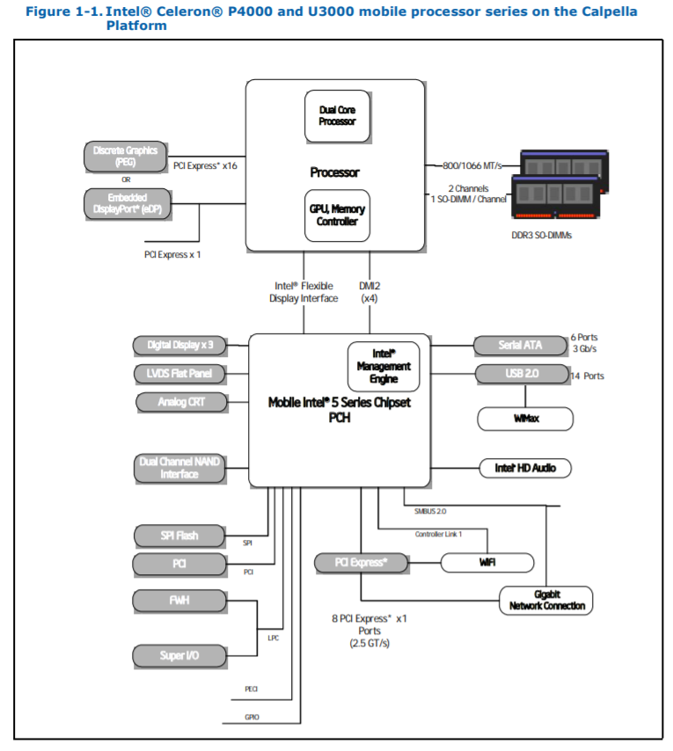
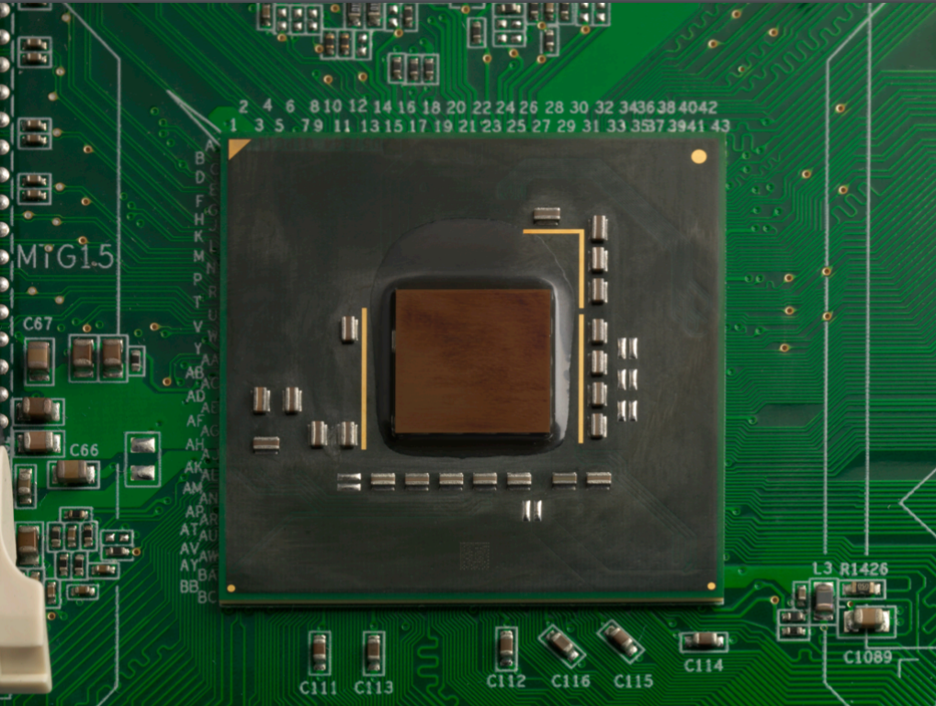
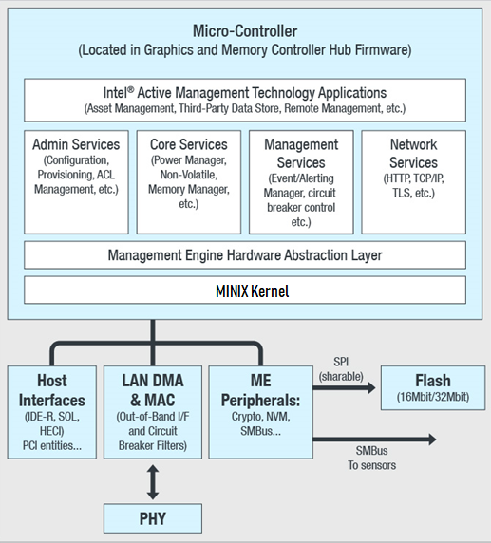
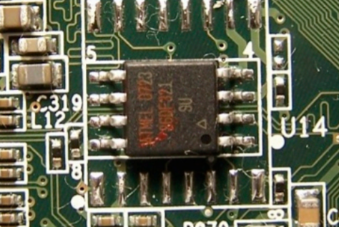
Intel Chips Post-2006
The Management Engine (ME) is an x86-32 processor that’s co-located with a machine’s normal x86-64 cores
  ME core runs MINIX OS and a web server
  If a machine is plugged into a wall socket, then the ME core is always running, even if the rest of the hardware is turned off or sleeping
  ME core has DMA privileges for all of host physical RAM: even a hypervisor cannot restrict what the ME does!
  ME core can:
    Send and receive Ethernet packets that the host OS never sees
    Prevent the host OS from seeing packets
Example ME Core:
Intel Q35
Example Flash chip used to store ME code
Notes:
[As [7] states, the management engine “remains functional during most hardware failures because it is an entire embedded computer featuring its own execution core, bootstrap ROM, and internal RAM. The ME can be used for troubleshooting effectively thanks to an array of abilities that include overriding the CPU’s boot vector and a DMA engine that can access the computer’s DRAM . . . When the ME is powered up [shortly after the computer is turned on], it starts executing the code in its boot ROM [and then] loads its firmware from flash memory, which contains the ME’s operating system and applications. After the Intel ME loads its software, it sets up some of the motherboard’s hardware, such as the PCH bus clocks, and then it kicks off the CPU’s bootstrap sequence.”]
[Aside: The Intel Celeron is an older processor that was released in 2010 [Ref: https://en.wikichip.org/wiki/intel/celeron/p4500]. Many functions of the PCH have now been migrated directly into the SoC. As described by https://en.wikipedia.org/wiki/Platform_Controller_Hub#Phase-out, “Beginning with ultra-low-power Broadwells and continuing with mobile Skylake processors, Intel incorporated the clock, PCI controller, and southbridge IO controllers into the CPU package, eliminating the PCH for a system on a chip (SOC) design. Rather than DMI, these SOCs directly expose PCIe lanes, as well as SATA, USB, and HDA lines from integrated controllers, and SPI/I²C/UART/GPIO lines for sensors.” However, I can’t find any diagrams that depict the location of the ME in such an architecture.]
[Aside: As [1] says, “Due to the signature verification, developing free replacement firmware for the ME is basically impossible. The only entity capable of replacing the ME firmware is Intel.”]
[Ref: [1] https://web.archive.org/web/20190512112725/https://files.bitkeks.eu/docs/intelme-report.pdf //”Intel Management Engine (Hauptseminar Technischer Datenschutz)“ by Dominik Pataky
[2] https://invisiblethingslab.com/resources/bh09usa/Ring%20-3%20Rootkits.pdf
[3] https://mirrors.dotsrc.org/cdn.media.ccc.de/congress/2017/slides-pdf/34c3-8782-intel_me_myths_and_reality.pdf
[4] https://libreboot.org/faq.html#intel
[5] Ref: https://web.archive.org/web/20140211075753/http://www.intel.com/content/dam/www/public/us/en/documents/datasheets/celeron-mobile-p4000-u3000-datasheet.pdf //See page 10
[6] https://blog.invisiblethings.org/papers/2015/x86_harmful.pdf //”Intel x86 considered harmful” by Rutkowska
[7] https://eprint.iacr.org/2016/086.pdf //Section 2.9.2
]

Slide 4

NooOoOOOOOoOOoOooOOOOOOOoooOOOOOOOOOooooOOoOoOOoOOOOOOoOoooOOOoooooooooOoOOOOooOoOOoooOooOooOooOoOoOOoo

Slide 5
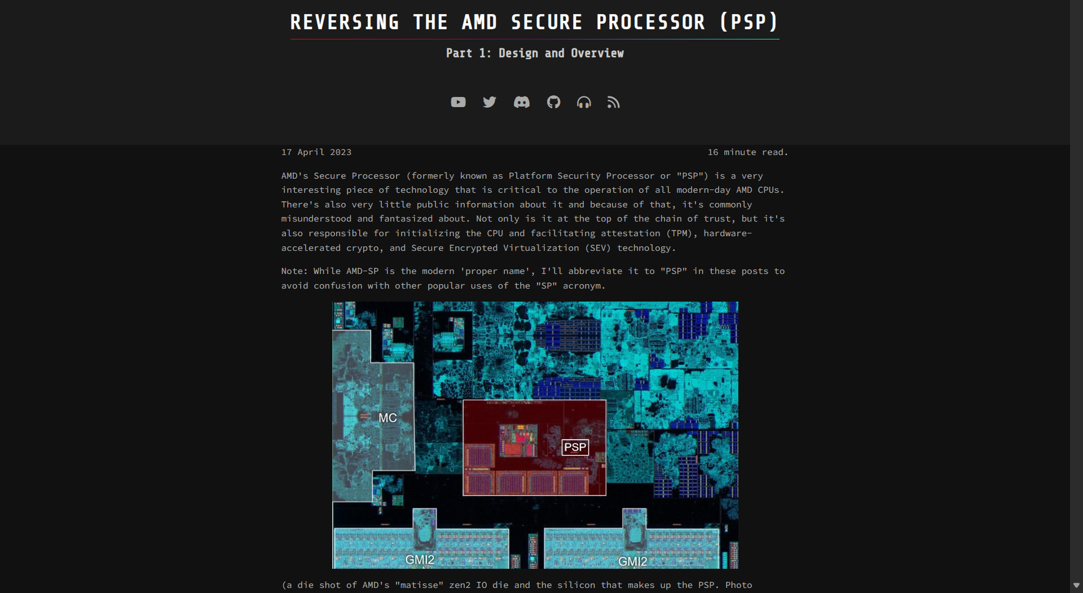
AMD Chips Have An Equivalent:
The Platform Security Processor (now known as the “Secure Processor”)
Notes:
AMD’s equivalent of the management engine is called the “Secure Processor.” [It used to be called the “Platform Security Processor.”]
[Ref: https://en.wikipedia.org/wiki/AMD_Platform_Security_Processor
https://dayzerosec.com/blog/2023/04/17/reversing-the-amd-secure-processor-psp.html
https://www.theregister.com/2018/01/06/amd_cpu_psp_flaw/
]

Slide 6
Intel’s Active Management Technology (AMT)
AMT enables remote administration of a machine
  The AMT software runs on the ME
    Listens for HTTP requests on TCP port 16992
    Listens for HTTPS requests on TCP port 16993
  Using AMT, a remote administrator can do stuff like:
    Reboot/power down/power up a machine
    Enumerate local hardware resources (e.g., processors, IO devices)
    Install packet filters to log/drop packets before the host OS can send/receive them
  AMT log data is stored in persistent on-ME memory
Let’s hope that AMT’s login method is secure LOLOLOLOL
Notes:
[Ref: https://en.wikipedia.org/wiki/Intel_Active_Management_Technology
https://www.symantec.com/connect/articles/why-must-intel-amt-be-configured-and-what-required
https://www.blackhat.com/docs/us-17/thursday/us-17-Evdokimov-Intel-AMT-Stealth-Breakthrough-wp.pdf]

Slide 7
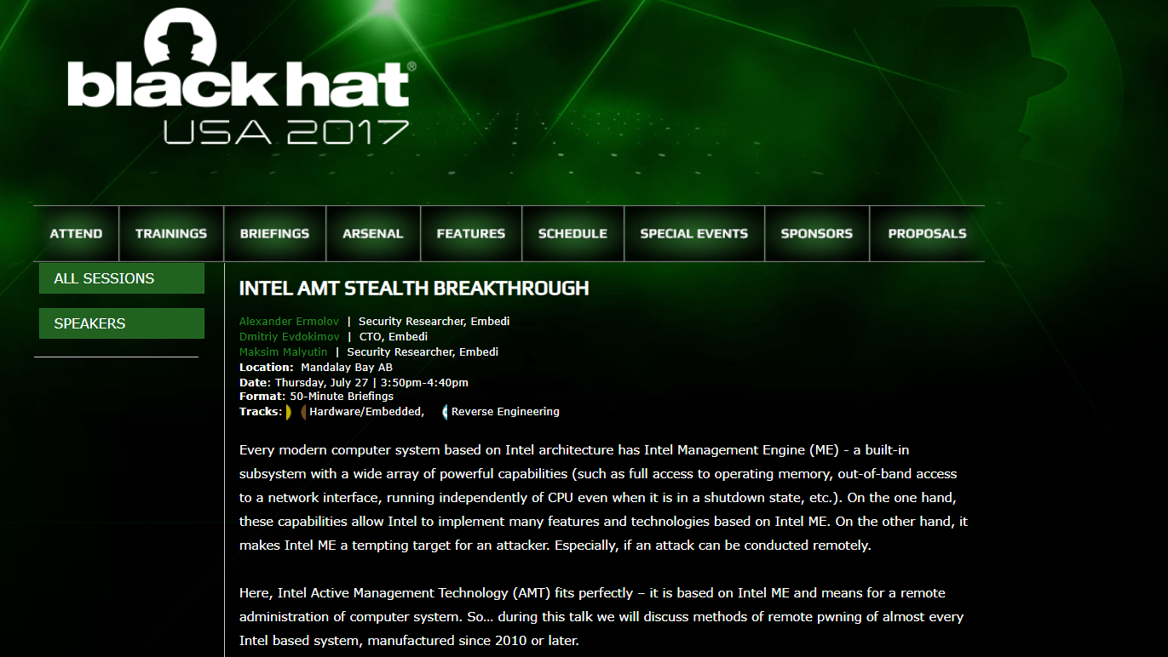
Notes:
Some of the images in the next few slides are taken from a Black Hat presentation from 2017.
[Ref: https://www.tenable.com/blog/rediscovering-the-intel-amt-vulnerability
https://www.blackhat.com/docs/us-17/thursday/us-17-Evdokimov-Intel-AMT-Stealth-Breakthrough-wp.pdf
]

Slide 8


The terms are inspired by old cowboy movies, where the villains wore black hats and the heroes wore white hats
  White hats: Security researchers who actively try to help society (e.g., by informing companies of vulnerabilities before disclosing those vulnerabilities)
  Grey hats: Hackers with more complicated motives (e.g., hacktivism by Anonymous)
  Black hats: The people who create ransomware, send phishing emails, etc. for selfish criminal gain

Slide 9
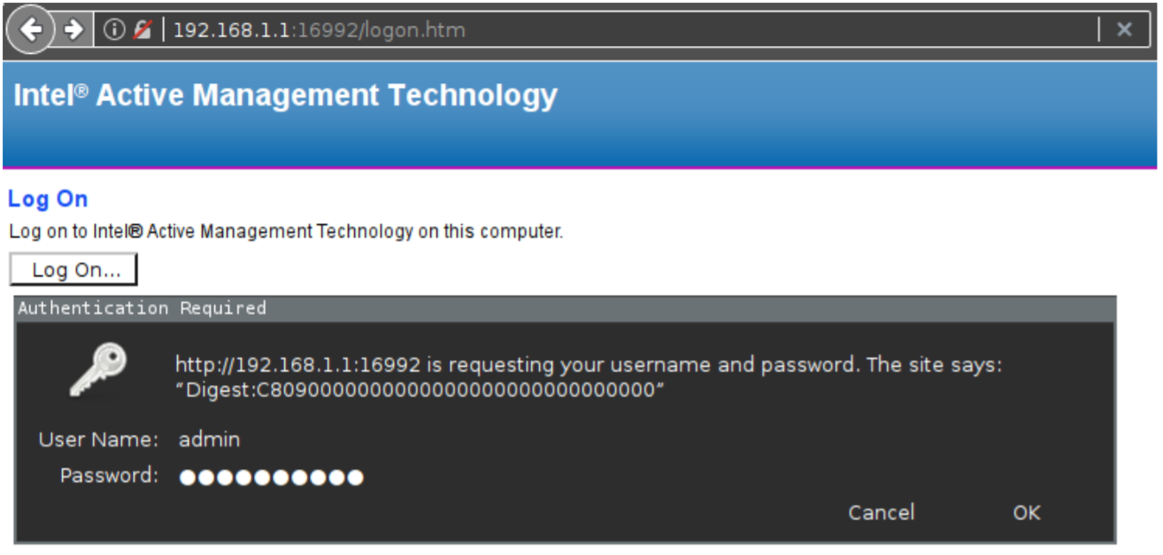


AMT: Logon Process
HTTP GET /logon.htm
[HTML, CSS, JS for logon page]
HTTP GET /index.htm
Authorization: [logon info]
Admin
machine
AMT-enabled
server

Slide 10
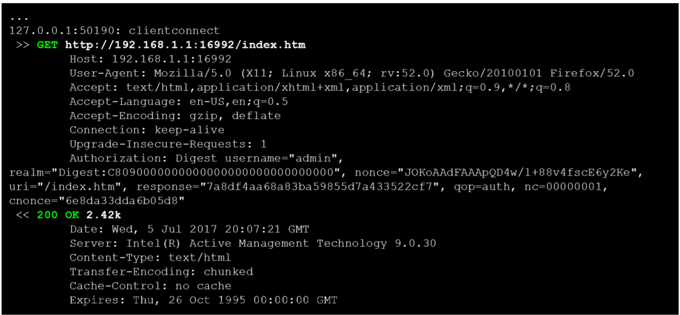
AMT: Logon Process
Notes:
[Ref: https://en.wikipedia.org/wiki/Digest_access_authentication
https://tools.ietf.org/html/rfc2617
]

Slide 11
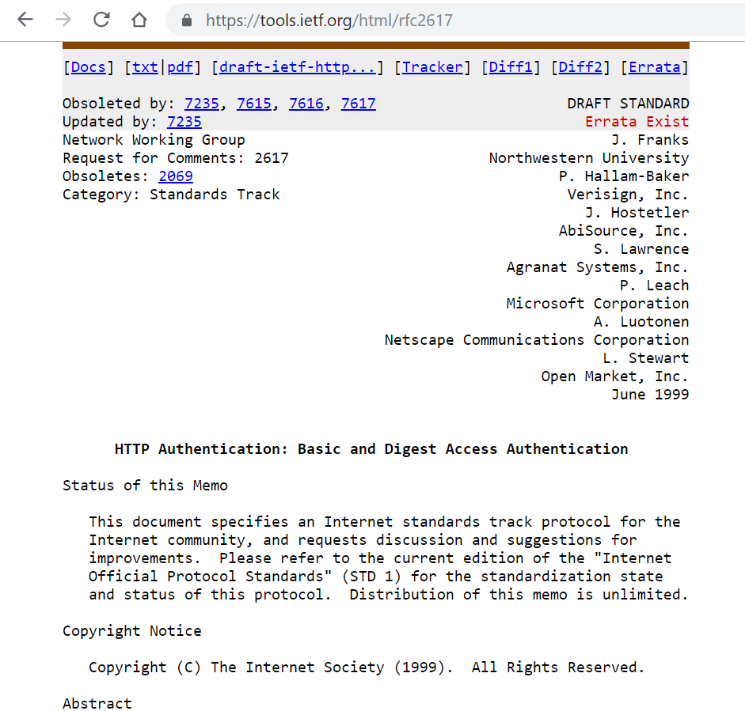

AMT: Logon Process
HTTP GET /index.htm
Authorization: [logon info]
Authorization: Digest
username="admin",
realm="Digest:C80900000000000000",
nonce="JOKoAAdFAAApQD4w/l+88v4fscE6y2Ke",
uri="/index.htm",
response="7a8df4aa68a83ba59855d7a433522cf7",
qop="auth", nc=00000001,
cnonce="6e8da33dda6b05d8"
Admin
machine
AMT-enabled
server
Security goals: Prevent a network eavesdropper from (1) learning the admin password or (2) replaying a successful authentication response
Notes:
As described by the RFC, “realms allow the protected resources on a server to be partitioned into a set of protection spaces, each with its own authentication scheme and/or authorization database.”
[Ref: https://en.wikipedia.org/wiki/Digest_access_authentication
https://tools.ietf.org/html/rfc2617
]

Slide 12
HTTP Digest Authentication
Hidden from the network; only computed locally by AMT host and admin host
HA1 = hash(username || realm || password)
HA2 = hash(method || URI)
response = hash(HA1 || serverNonce ||
clientNonceCount ||
clientNonce ||
HA2)
Incremented by the client after every auth request
A nonce is a random number
Property 3: Assuming that nonces are refreshed during each authentication exchange, a network eavesdropper cannot replay an old successful authentication response.
Property 1: The raw password submission isn’t revealed to the network, but the AMT machine can still determine whether the submitted password is the right one.
Property 2: Assuming that the hash function is difficult to invert, a network eavesdropper can’t derive password from response.
Notes:
The “method” refers to the HTTP method in the request, e.g., “GET” or “POST.” “URI” refers to the URL contained in the HTTP request.
It’s particularly important that HA1 is never revealed to the network, because if the network attacker can see HA1, then the attacker can successfully masquerade as the admin user!
[Aside: Strictly speaking, the `qop` field is also included in the hash computation for `response`. As RFC 2617 says, the field is optional; “if present, it is a quoted string of one or more tokens indicating the "quality of protection" values supported by the server. The value "auth" indicates authentication; the value "auth-int" indicates authentication with integrity protection.”]

Slide 13
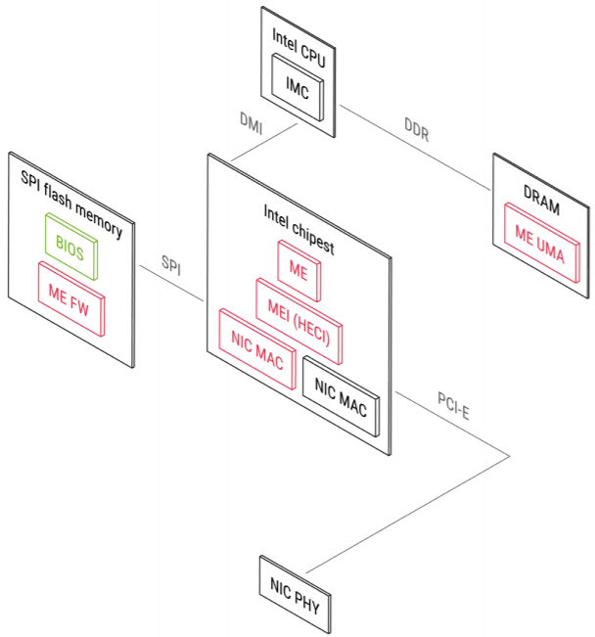
Does Intel’s implementation of HTTP Digest Authentication have security flaws?
Firmware is low-level software provided by a hardware vendor
  Stored in on-device non-volatile memory like flash
  May be read-only or updatable
BIOS (“Basic Input/Output System”) or UEFI (“Unified Extensible Firmware Interface”) firmware:
  Coordinates the early boot process
    Ex: Enumerating+testing hardware devices
    Ex: Pulling the OS boot loader from storage into memory
  Provides post-boot services to the OS
    Ex: Reading/writing the time and timezone of the hardware clock
    Ex: Storing or retrieving small amounts of data in non-volatile RAM (e.g., to build event logs that persist across machine reboots)
Let’s reverse-engineer the ME firmware!
ME firmware
Interface allowing the ME and CPU to communicate
A DRAM area that belongs to the ME; inaccessible to the normal CPU
Notes:
Flash memory is the technology used by SSDs.
[Ref: https://en.wikipedia.org/wiki/Firmware
https://en.wikipedia.org/wiki/BIOS
https://en.wikipedia.org/wiki/Unified_Extensible_Firmware_Interface
https://www.kernel.org/doc/Documentation/mtd/intel-spi.txt
]

Slide 14
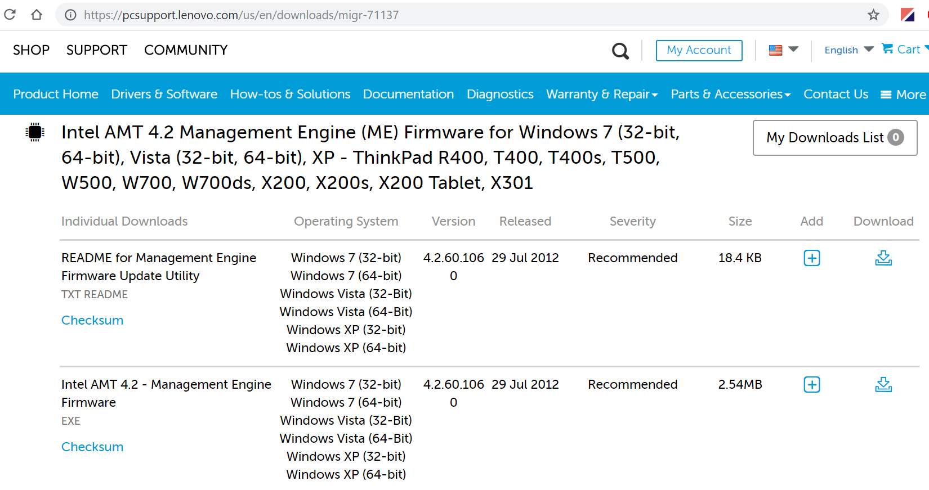
Download the firmware . . .

Slide 15
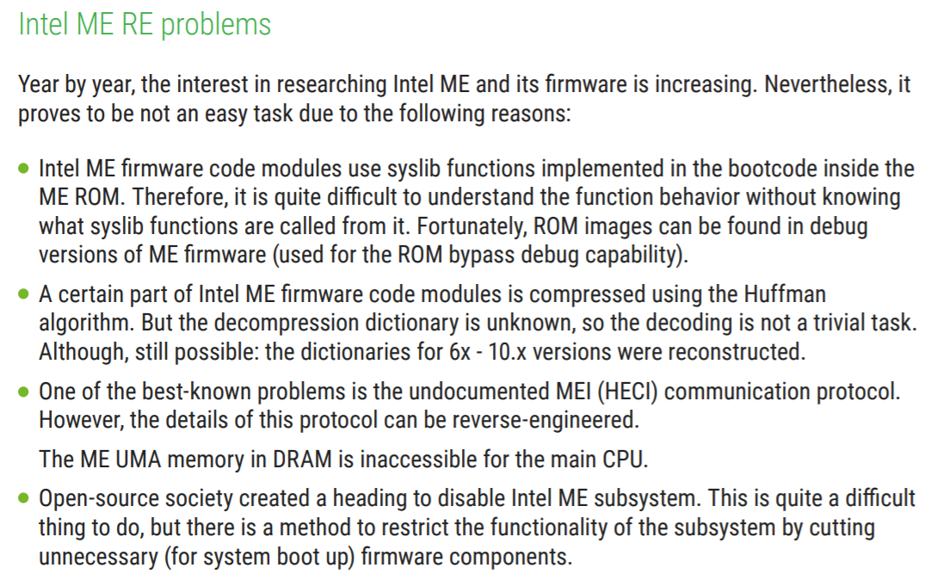
. . . then decompress it . . .

Slide 16
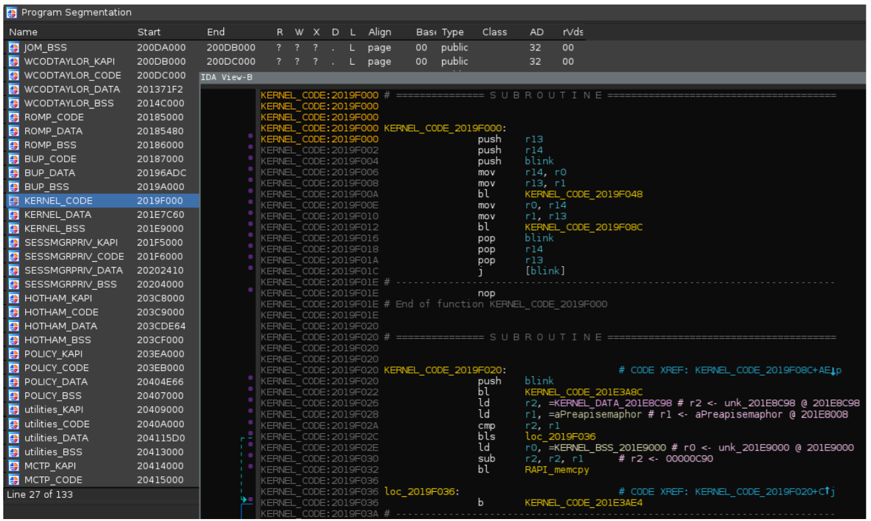
. . . then disassemble the binary!

Slide 17
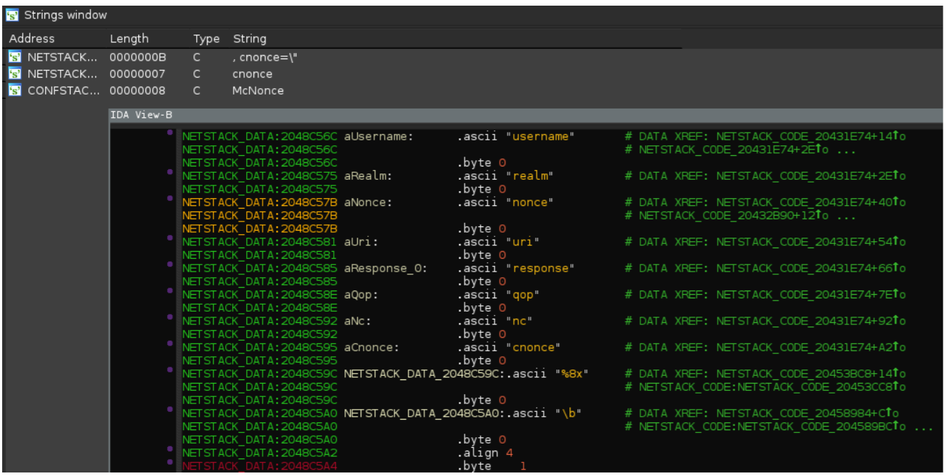
But how do we figure out where the authentication code is implemented?
Grep for static protocol strings like “cnonce,” then see which code references those strings!

Slide 18
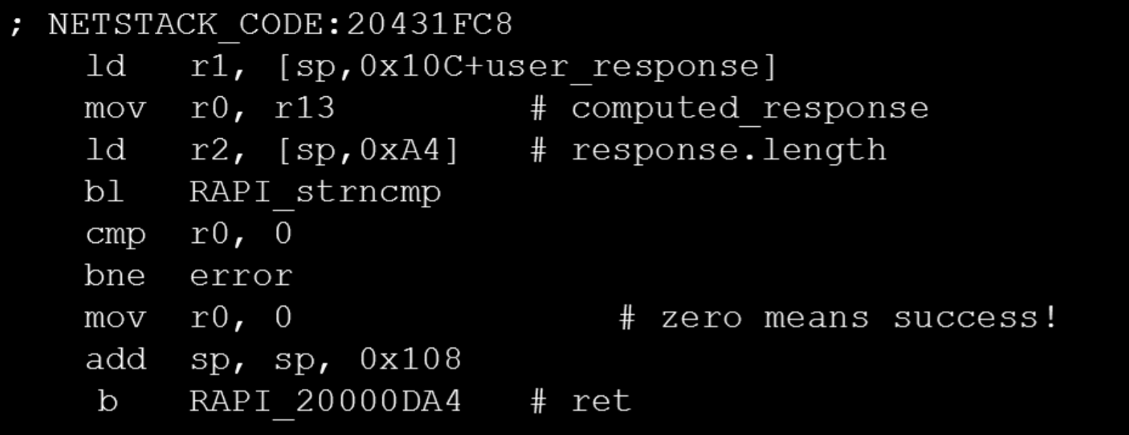
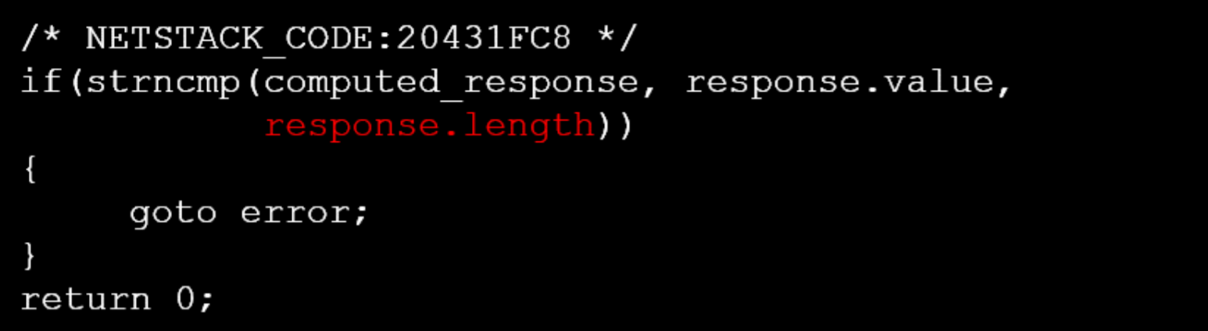
After some investigation, we find the AMT code that compares the client-submitted authentication value to one computed by AMT.
[Note: These instructions are for a 32-bit ARC RISC CPU—the machine being analyzed was made before Intel switched the ME to a 32-bit x86 core.]
Converting the assembly into source code, we see that AMT is performing the strncmp() using a client-controlled value to determine the number of characters to compare!
strncmp() always says that strings are equal if n is 0!

Slide 19
AMT: Logon Process
HTTP GET /index.htm
Authorization: [logon info]
Authorization: Digest
username="admin",
realm="Digest:C80900000000000000",
nonce="JOKoAAdFAAApQD4w/l+88v4fscE6y2Ke",
uri="/index.htm",
response="7a8df4aa68a83ba59855d7a433522cf7",
qop="auth", nc=00000001,
cnonce="6e8da33dda6b05d8"
Admin
response=“”,
machine
AMT-enabled
server
AMT will accept the admin logon as valid!

Slide 20
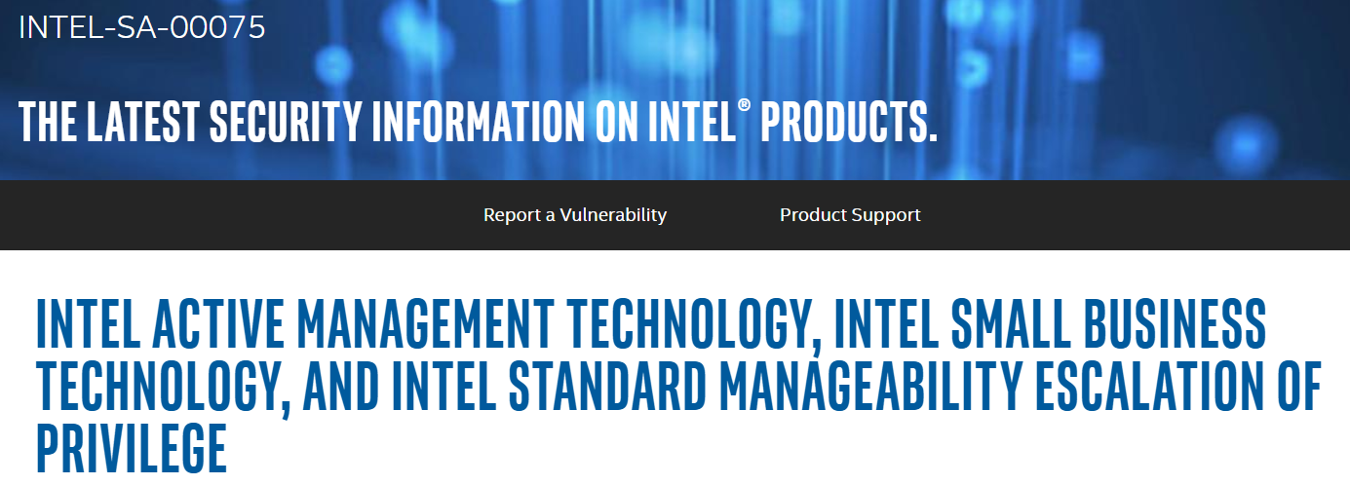
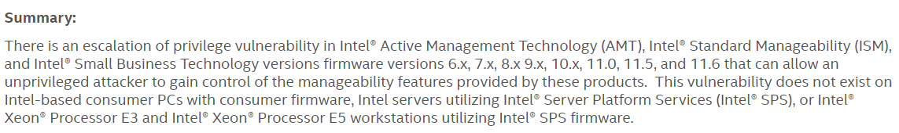
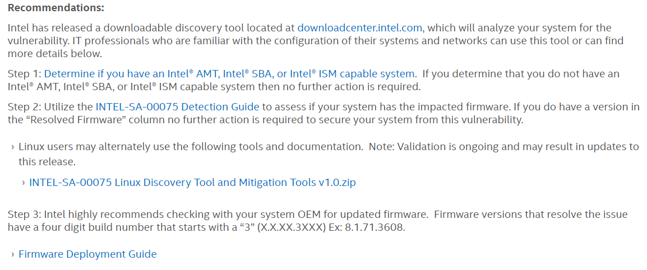
Notes:
[Ref: https://www.intel.com/content/www/us/en/security-center/advisory/intel-sa-00075.html]

Slide 21

Notes:
[Aside: In this class, we’ve only talked about the x86 security rings 0—3, with 0 being for kernel code, 3 being for user-level code, and 2 and 3 being unused in commodity systems. However, security professionals sometimes talk of Intel chips as having rings -3 through 3. Rings 0—3 are the rings I mentioned at the beginning of this paragraph. Ring -1 is the hypervisor, as implemented by the Intel VT-x technology that we discussed earlier in the semester. Ring -3 is the Management Engine (which we discussed in today’s lecture). Ring -2 is the System Management Mode (SMM), which manages very low-level hardware details like power modes. For more details on SMM, see https://en.wikipedia.org/wiki/System_Management_Mode. For an overview of rings -3—3, see https://medium.com/swlh/negative-rings-in-intel-architecture-the-security-threats-youve-probably-never-heard-of-d725a4b6f831.]
[Ref for tweet: https://twitter.com/x0rz/status/859316660808937472]

Slide 22

Outline
Intel’s Management Engine
Intel’s Implementation of sysret
User-level code can force the kernel to panic!
Notes:
[Ref: https://www.slideshare.net/nkslides/exploiting-the-linux-kernel-via-intels-sysret-implementation
https://fail0verflow.com/blog/2012/cve-2012-0217-intel-sysret-freebsd/
https://xenproject.org/2012/06/13/the-intel-sysret-privilege-escalation/
]

Slide 23
AMD’s x64 syscall and sysret
syscall
  Uses %rcx to save the address of the instruction following syscall
  Loads OS system call handler %rip from %IA32_LSTAR MSR
  Changes the privilege level to Ring 0
  Does *not* save %rsp—if the OS will use a different %rsp, then:
    OS must save %rsp in the system call handler, and restore it before calling sysret; or
    User-mode code must save %rsp before calling syscall, and restore it in the instruction immediately following syscall
  Arguments to the system call passed in %rdi, %rsi, %rdx, %r10, %r8, %r9
sysret
  Loads %rip using the value in %rcx
  Changes the privilege level to Ring 3
  Does *not* restore %rsp
Intel defined almost-equivalent instructions (sysenter/sysexit), but later implemented syscall/sysret too due to their popularity
Notes:
[Remember that Chickadee uses iret, not sysret, to return to user-mode, even when returning from system calls as well as exceptions. iret pops %rip, %cs, %rflags, %rsp, and %ss off the stack into the associated registers; sets the privilege bit to “user”; enables interrupts.]
[Aside: syscall also “saves RFLAGS into R11 and then masks RFLAGS using the IA32_FMASK MSR (MSR address C0000084H); specifically, the processor clears in RFLAGS every bit corresponding to a bit that is set in the IA32_FMASK MSR”; see [1].]
[Aside: See [3] (slides 31—33) for a discussion of one reason why sysenter is faster than int; the reason is that sysenter effectively uses a special, dedicated register (%IA32_LSTART) to store the IDT entry for the OS’s system call handler; this way, there’s no possibility of a cache line miss for the appropriate IDT entry. Remember that the IDT lives in memory! As described in [5], syscall/sysret is also fast because it assumes that the OS only uses not paging and not also segmentation.]
[Aside: The argument-passing convention for syscall is the convention defined by the AMD64 ABI; see [4] below.]
[Ref: [1] https://www.felixcloutier.com/x86/syscall
[2] https://www.felixcloutier.com/x86/sysret
[3] https://compas.cs.stonybrook.edu/~nhonarmand/courses/sp17/cse506/slides/04-interrupts.pdf
[4] https://en.wikipedia.org/wiki/X86_calling_conventions#System_V_AMD64_ABI
[5] https://wiki.osdev.org/Sysenter#AMD:_SYSCALL.2FSYSRET
]

Slide 24
x86-64: Noncanonical Addresses and sysret
When sysret finds a noncanonical %rcx, hardware raises a general protection fault (#GP)
Note that a #GP is different than a page fault (#PF)!
  #PFs arise from errors involving page tables
    Ex: A permissions check involving readable/writeable/supervisor_only failed
    Ex: Attempt to load instruction-TLB using a non-executable PTE
  #GPs cover many kinds of errors
    Ex: Trying to execute a privileged instruction with ring > 0
Virtual address space
FFFF’FFFF’FFFF’FFFF
Kernel static data
High canonical
(kernel-only access)
Kernel code
Kernel heap+stacks
FFFF’8000’0000’0000
Physical memory map
Noncanonical
Empty gap
0000’7FFF’FFFF’FFFF
Stack
Low canonical
(kernel+user access)
Heap
Static data
Code
0000’0000’0000’0000
Notes:
Remember that sysret loads %rip using the value in %rcx.
[Ref: https://wiki.osdev.org/Exceptions#General_Protection_Fault
https://wiki.osdev.org/Exceptions#Page_Fault
https://en.wikipedia.org/wiki/NX_bit#x86
]

Slide 25
When Does The sysret #GP Happen?
AMD’s specification for sysret wasn’t explicit about whether the check for a canonical %rcx should occur before or after sysret changes the current privilege level!
Suppose that %rsp is:
  Saved by OS at the beginning of the syscall handler
  Restored by OS immediately before calling sysret
  This is what Linux and many other popular OSes do
AMD
processor
Restore old
Change the
Check for noncanonical
value of %rsp
privilege level
%rcx and maybe raise
to Ring 3
a #GP fault
OS handler
sysret
Notes:
Remember that sysret loads %rip using the value in %rcx.

Slide 26
When Does The #GP Happen?
If a #GP happens, the privilege level will be 3
Hardware will switch the privilege level to 0 and perform the standard user-mode-to-kernel mode interrupt path
  Sets %rsp to the kernel stack pointed to by the TSS in the GDT
  Push the old %ss, %rsp, %rflags, %cs, and %rip onto that stack
  Set %rip and %rflags to the appropriate value for the interrupt handler
Kernel (i.e., software-level) #GP handler will then execute
AMD
processor
Restore old
Change the
Check for noncanonical
value of %rsp
privilege level
%rcx and maybe raise
to Ring 3
a #GP fault
OS handler
sysret
Notes:
[Ref: [1] https://read.seas.harvard.edu/cs161-19/lectures/lecture3/
[2] https://www.kernel.org/doc/Documentation/x86/kernel-stacks]

Slide 27
Interrupt number
Interrupt handler code: in virtual memory
16
x
Code
Virtual address
+
Other stuff
IST
Interrupt-handler %rsp for IST 1
Task state segment (TSS): in virtual memory
Interrupt-handler %rsp for IST 2
Virtual address
. . .
Interrupt-Descriptor-Table Register (IDTR)
Interrupt Descriptor
Table (IDT): in virtual memory
TSS
Interrupt-handler %rsp for IST 7
TSS Descriptor
Virtual addr (base of TSS)
Other stuff
IST 0: Default interrupt-handler %rsp
Virtual address
Selector
Base addr of TSS (cached from TSS descriptor)
Global-Descriptor-Table Register (GDTR)
Global Descriptor Table (GDT): in virtual memory
Task register
Notes:
[This slide is from Lecture 4!]

Slide 28

What Does x86 Do?
It reverses the last two steps
in sysret!

Slide 29
When Does The sysret #GP Happen?
If a #GP happens, the privilege level will be 0
Hardware will check the #GP-time privilege level, see that it’s 0, and thus assume that %rsp already points to a kernel stack!
  So, the hardware will try to push the #GP exception state (e.g., %rflags, %rip) onto the current %rsp, as if a normal nested exception were occurring . . .
x86
processor
Restore old
Check for noncanonical
Change the
value of %rsp
%rcx and maybe raise
privilege level
a #GP fault
to Ring 3
OS handler
sysret
Notes:
[Ref: https://www.kernel.org/doc/Documentation/x86/kernel-stacks
https://cs.unc.edu/~porter/courses/cse506/f12/slides/interrupts.pdf //Slides 32—34 in particular
]

Slide 30
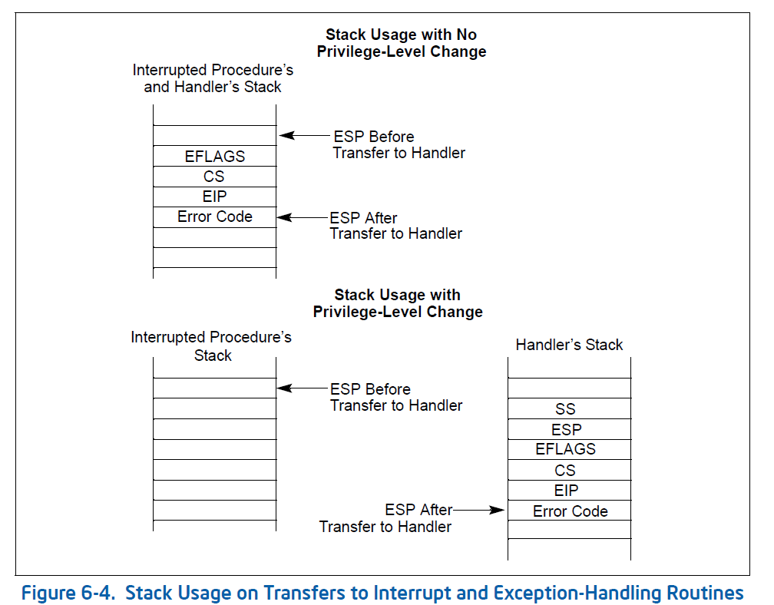
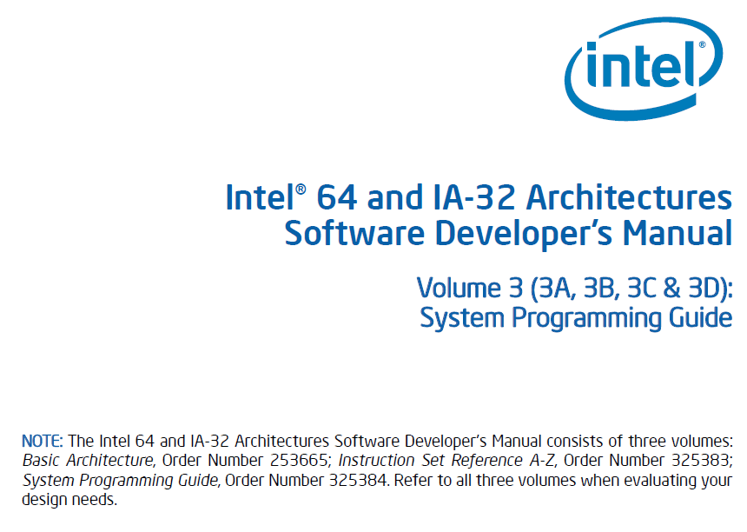

Slide 31
// Chickadee: Exception entry point
// Most exception handlers jump here.
exception_entry:
/* On entry, the stack looks like this:
+-----------------------+ <- %rsp
| reg_intno, reg_swapgs | 0(%rsp)
| reg_errcode | 8(%rsp)
| %rip | 16(%rsp)
| %cs | 24(%rsp)
| %rflags | 32(%rsp)
| %rsp | 40(%rsp)
| %ss | 48(%rsp)
... ...
This data should be stored on the current kernel task stack.
It's already there if the exception happened in kernel mode.
Otherwise, we must `swapgs` and move it there. */
// Exception happened in user mode if `(%cs & 3) != 0`.
testb $3, 24(%rsp)
jz exception_entry_finish
orl $1, 4(%rsp) // Exception happened in user-mode;
// tell resume to swapgs.
// change %rsp to the top of the kernel task stack
swapgs
movq %gs:(8), %rsp
addq $PROCSTACK_SIZE, %rsp
// copy data from CPU stack to kernel task stack
pushq %gs:(CPUSTACK_SIZE - 8) // %ss
pushq %gs:(CPUSTACK_SIZE - 16) // %rsp
pushq %gs:(CPUSTACK_SIZE - 24) // %rflags
pushq %gs:(CPUSTACK_SIZE - 32) // %cs
pushq %gs:(CPUSTACK_SIZE - 40) // %rip
pushq %gs:(CPUSTACK_SIZE - 48) // error code
pushq %gs:(CPUSTACK_SIZE - 56) // interrupt number
exception_entry_finish:
// complete `struct regstate`
pushq %gs
pushq %fs
pushq %r15
...etc...

Slide 32
When Does The #GP Happen?
If a #GP happens, the privilege level will be 0
Hardware will check the #GP-time privilege level, see that it’s 0, and thus assume that %rsp already points to a kernel stack
  So, the hardware will try to push the #GP exception state (e.g., %rflags, %rip) onto the current %rsp, as if a normal nested exception were occurring . . .
  . . . but %rsp points to the user-mode stack!
What if malicious user code sets %rcx and %rsp to noncanonical addresses before invoking syscall?
x86
processor
Restore old
Check for noncanonical
Change the
value of %rsp
%rcx and maybe raise
privilege level
a #GP fault
to Ring 3
OS handler
sysret
Notes:
[Ref: https://www.kernel.org/doc/Documentation/x86/kernel-stacks
https://cs.unc.edu/~porter/courses/cse506/f12/slides/interrupts.pdf //Slides 32—34 in particular
https://fail0verflow.com/blog/2012/cve-2012-0217-intel-sysret-freebsd/
]

Slide 33
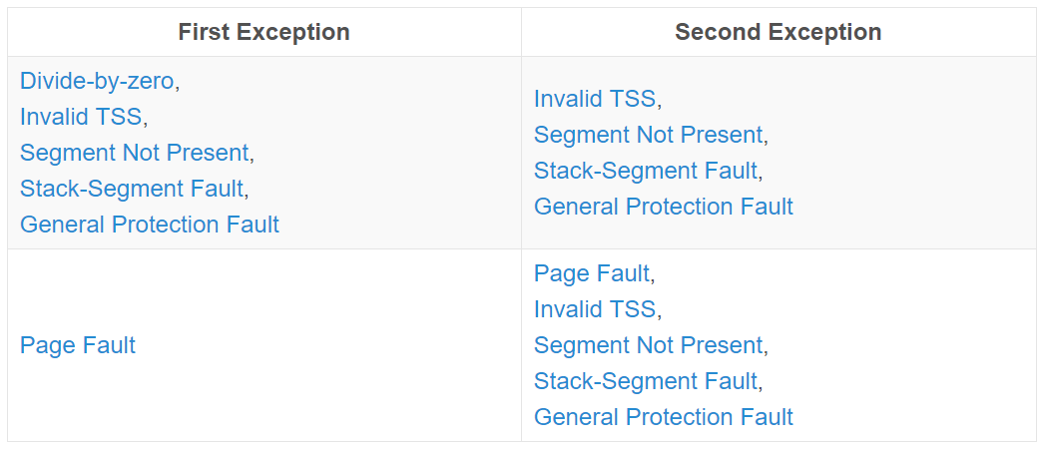
A Double-Fault Will Occur!
A double fault is a fatal condition which occurs when hardware is trying to handle an exception, and another exception is triggered
Only certain pairs of exceptions will cause a double fault
Fault 1: Caused by sysret finding a noncanonical %rcx
Fault 2: Caused by hardware responding to #GP and finding a noncanonical %rsp
Notes:
[Ref: https://os.phil-opp.com/double-fault-exceptions/ //The source for the double-fault table]

Slide 34

A Double-Fault Will Occur!
“A program-state following a double-fault exception is undefined. The program or task cannot be resumed or restarted. The only available action of the double-fault exception handler is to collect all possible context information for use in diagnostics and then close the application and/or shut down or reset the processor.”
YOU’RE SCREWED
Notes:
A double fault indicates that the machine is so messed up that recovery is effectively impossible. In our running example, recovery is impossible because the kernel has no way to determine what the right %rsp value is for the kernel. Linux’s double-fault handler just tries to dump some register state and then sit in a while(1) loop that executes nop instructions.
[Ref: Volume 3A, page 6-29 of Intel 64 and IA-32 Architectures Software Developer’s Manual, provides the quoted text about how a double-fault should induce a kernel to panic. Volume 2B, page 4-513 describes how a push instruction will cause a stack segment fault if %rsp has a noncanonical form.]
[Ref: https://os.phil-opp.com/double-fault-exceptions/
https://wiki.osdev.org/Exceptions
https://media.blackhat.com/bh-us-12/Briefings/Wojtczuk/BH_US_12_Wojtczuk_A_Stitch_In_Time_WP.pdf
https://github.com/torvalds/linux/blob/master/arch/x86/kernel/doublefault.c
]

Slide 35
Example of Evil User-mode Code
// Allocate a memory page at the upper end of low
// canonical memory.
uint64_t page_size = 4096;
uint8_t* page = (uint8_t*)((1ULL << 47) - page_size);
page = mmap(page, page_size,
PROT_READ | PROT_WRITE | PROT_EXEC,
MAP_FIXED | MAP_ANON | MAP_PRIVATE, -1, 0);
// Define the attack code: set %rsp to a noncanonical
// value, then invoke the getuid() system call (whose
// syscall_num is 24).
char evil_code[] =
"\x48\xBC\x08\x00\x00\x00\x00\x80\x00\x00" // mov 0x800000000008, %rsp
"\xb8\x18\x00\x00\x00" // mov 24, %rax
"\x0f\x05"; // syscall
size_t evil_code_bytes = 19;
// Copy the attack code to the very top of the
// low canonical region, so that the instruction
// *after* the syscall will be a noncanonical
// address!
uint8_t* code_addr = page + page_size - evil_code_bytes;
memcpy(code_addr, evil_code, evil_code_bytes);
// Execute the evil code.
void (*evil_func)(void) = evil_code;
evil_func();
Notes:
[Aside: The code in the slide will crash the machine. However, a more clever attack could actually give the attacker root privileges! The basic idea behind the more clever attack is that %rsp is controlled by the attacker—so, the attacker can set %rsp to a carefully-chosen value that will overwrite important control flow structures in the kernel. Examples of such control flow structures include kernel function pointers. Note that the structures will be overwritten by ATTACKER-CONTROLLED VALUES, since the stuff that gets pushed on the stack will be the values of attacker-controlled registers; remember that, right before the kernel calls sysret, the kernel has restored the user-mode registers. Refs [1] and [3] provide examples of such an attack.]
[Aside: Here’s a web page that translates Intel-syntax assembly to the associated C strings: https://defuse.ca/online-x86-assembler.htm]
[Ref: [1] https://fail0verflow.com/blog/2012/cve-2012-0217-intel-sysret-freebsd/
[2] https://media.blackhat.com/bh-us-12/Briefings/Wojtczuk/BH_US_12_Wojtczuk_A_Stitch_In_Time_WP.pdf
//Has a more explicit explanation of [1]’s observation that why a FreeBSD kernel’s #GP handler will cause a
//page fault. The explanation is that, on FreeBSD, the default value for a user-mode gs:base is 0 (i.e., gs:base
//points to the unmapped NULL page); so, when the #GP handler tries to execute code like PCPU(CURPCB),%rdi
//to access per-cpu data structures that would normally be pointed to by the kernel’s gs:base, the code will
//trigger a page fault, because the #GP handler didn’t perform a swapgs (because the #GP was caused by the
//kernel code trying to implement the return-to-user-mode via sysret, and that kernel code had swapped gs
//to the user-mode value before calling sysret.
[3] https://cyseclabs.com/blog/cve-2014-4699-linux-kernel-ptrace-sysret-analysis]

Slide 36

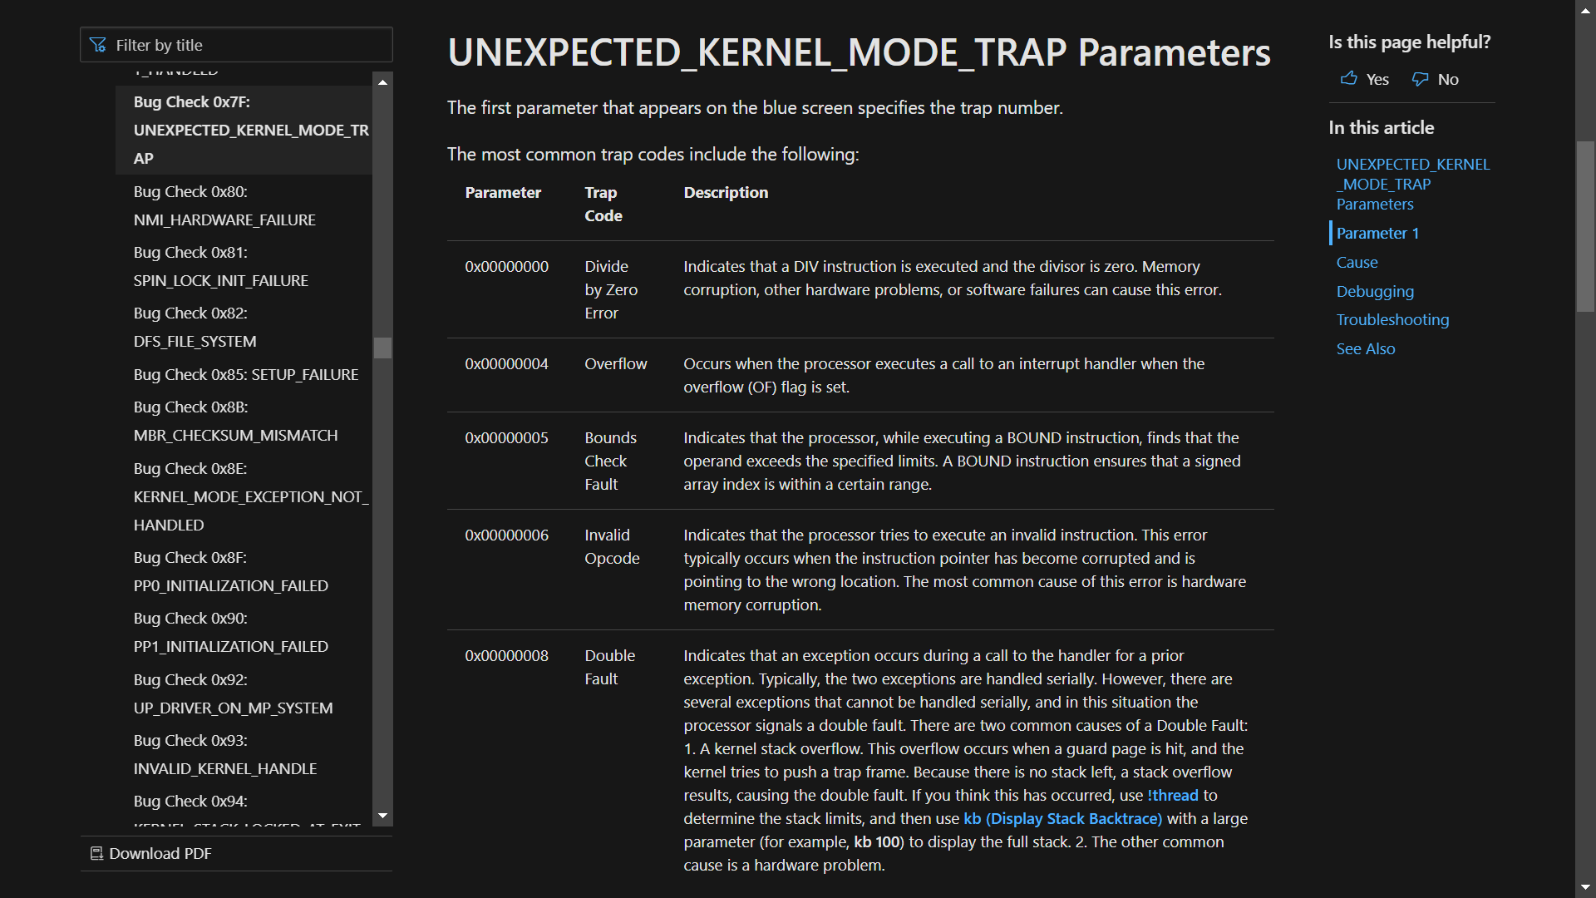
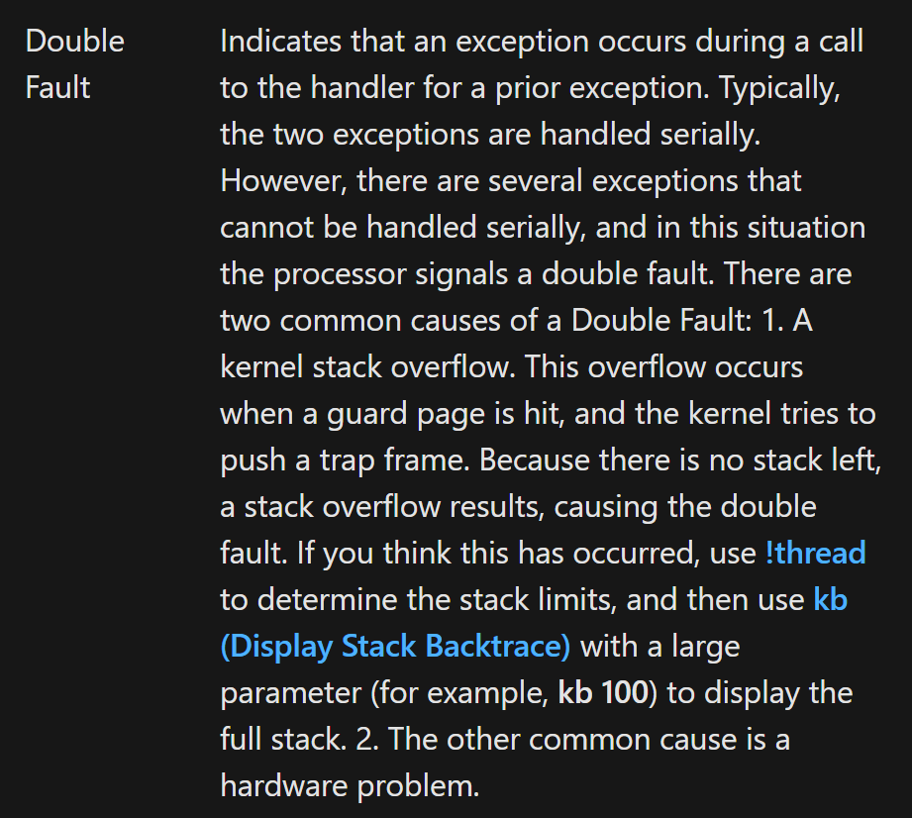
Notes:
[Ref: https://docs.microsoft.com/en-us/windows-hardware/drivers/debugger/bug-check-0x7f--unexpected-kernel-mode-trap]

Slide 37
Preventing the Attack
Disallow user code from mmap()’ing the highest page in low canonical memory
  On Linux, mmap(0x7fff’ffff’f000, 4096, . . .) will return ENOMEM
  Windows uses a similar approach
Ensure that the kernel validates %rcx before executing sysret
Notes:
[Ref: https://www.slideshare.net/nkslides/exploiting-the-linux-kernel-via-intels-sysret-implementation
https://www.intel.com/content/dam/www/public/us/en/documents/manuals/64-ia-32-architectures-software-developer-instruction-set-reference-manual-325383.pdf //See the entry for sysret]

