Slide 1

CS 1610: Lecture 5
2/9/2026
Multithreading and Synchronization

Slide 2
Outline
Overview of Concurrency
Kernel Threads Versus User Threads
The Lifecycle of a Process
Synchronizing Between Kernel Tasks

Slide 3
+
Next sequential IP
Conditions/
%rcx
%rcx
Condition
Sign-extended imm
Instr
Read reg0 idx
size
+
Read reg1 idx
Opcode
Write reg idx
Write reg data
Addr
IP
Current instruction register
ID/EX
EX/MEM
MEM/WB
Memory
Read data 0
Instr
Read data 1
ALU
Registers
?
RdData
Memory
Sign extend
imm to 64-bit
?
Addr
Write reg idx
WrData

Slide 4
Address of instruction after addq
Fetch:addq %r8, %r9
+
Conditions/
%rcx
//IP=addr of addq instr
//Fetch addq instr, increment
//IP to next instr
Next sequential IP
%rcx
Condition
Sign-extended imm
Instr
Read reg0 idx
size
+
Read reg1 idx
Opcode
Write reg idx
Write reg data
Addr
IP
Current instruction register
ID/EX
EX/MEM
MEM/WB
Memory
Read data 0
Instr
Read data 1
ALU
Registers
?
RdData
Memory
Sign extend
imm to 64-bit
?
Addr
Write reg idx
WrData

Slide 5
Decode:addq %r8, %r9
+
Next sequential IP
Conditions/
%rcx
//Opcode=add
//Read reg0=%r8 Read reg1=%r9
//Write reg=%r9
%rcx
Condition
Sign-extended imm
Instr
Read reg0 idx
size
+
Read reg1 idx
Opcode
Write reg idx
Write reg data
Addr
IP
Current instruction register
ID/EX
EX/MEM
MEM/WB
Memory
Read data 0
Instr
Read data 1
ALU
Registers
?
RdData
Memory
Sign extend
imm to 64-bit
?
Addr
Write reg idx
WrData

Slide 6
Execute:addq %r8, %r9
+
Conditions/
%rcx
//Calculate read data 0 +
// read data 1
Next sequential IP
%rcx
Condition
Sign-extended imm
Instr
Read reg0 idx
size
+
Read reg1 idx
Opcode
Write reg idx
Write reg data
Addr
IP
Current instruction register
ID/EX
EX/MEM
MEM/WB
Memory
Read data 0
Instr
Read data 1
ALU
Registers
?
RdData
Memory
Sign extend
imm to 64-bit
?
Addr
Write reg idx
WrData

Slide 7
Memory:addq %r8, %r9
+
Conditions/
%rcx
//Nothing to do here; all
//operands are registers
Next sequential IP
%rcx
Condition
Sign-extended imm
Instr
Read reg0 idx
size
+
Read reg1 idx
Opcode
Write reg idx
Write reg data
Addr
IP
Current instruction register
ID/EX
EX/MEM
MEM/WB
Memory
Read data 0
Instr
Read data 1
ALU
Registers
?
RdData
Memory
Sign extend
imm to 64-bit
?
Addr
Write reg idx
WrData

Slide 8
Writeback: addq %r8, %r9
+
Conditions/
%rcx
//Update %r9 with the
//result of the add
Next sequential IP
%rcx
Condition
Sign-extended imm
Instr
Read reg0 idx
size
+
Read reg1 idx
Opcode
Write reg idx
Write reg data
Addr
IP
Current instruction register
ID/EX
EX/MEM
MEM/WB
Memory
Read data 0
Instr
Read data 1
ALU
Registers
?
RdData
Memory
Sign extend
imm to 64-bit
?
Addr
Write reg idx
WrData

Slide 9
Concurrency on a Single-core Machine
Quasi-concurrency arises because the OS forces different applications to share the single pipeline
Context switches happen during interrupts, exceptions, and traps
IP
IP
IF
IF
Registers
Context switch!
Registers
Suppose that there are two processes (red and yellow) . . .
ID
ID
EX
EX
RAM
RAM
MEM
MEM
WB
WB
Notes:
This quasi-concurrency is what we called “multi-tasking” in Lecture 3!

Slide 10
Concurrency on a Multi-core Machine
On a multi-core machine, there is true concurrency: different pipelines are simultaneously executing independent instruction streams
Each pipeline might be executing instructions from different address spaces . . .
IP
IP
IF
IF
Registers
Registers
Suppose that there are two address spaces (red and yellow) . . .
ID
ID
EX
EX
RAM
MEM
MEM
WB
WB

Slide 11
Concurrency on a Multi-core Machine
. . . or pipelines may be executing instructions from the same address space (i.e., the same %cr3), but different thread contexts (i.e., different values of %rip, %rsp, and other registers)
//Application code
//in red address
//space
int square(int x){
return x*x;
}
bool isZero(int x){
return x==0;
}
IP
IP
IF
IF
Registers
Registers
ID
ID
EX
EX
RAM
Thread context for square()
MEM
MEM
Thread context for isZero()
WB
WB

Slide 12
Outline
Overview of Concurrency
Kernel Threads Versus User Threads
The Lifecycle of a Process
Synchronizing Between Kernel Tasks

Slide 13

Kernel-visible Threads
Virtual address space
Many OSes allow a single address space to contain multiple threads of execution
  Each thread has a separate user-level stack (but shares user-level code, static data, and heap)
  OS associates each thread with:
    A process-wide address space (shared with other threads)
    User-mode register state, including an %rsp (unique per thread, and saved/restored during syscalls etc.)
    A kernel stack
A multi-threaded address space can be simultaneously active on multiple cores!
  Ex: A web server that spawns a new thread to handle each connection
  Ex: A database that uses multiple threads to wait for parallel IO requests to complete
Kernel static data
Kernel code
Thread Z’s kernel stack
Thread X’s kernel stack
Thread Y’s kernel stack
Physical memory map
Thread X’s stack
Thread Y’s stack
Thread Z’s stack
Heap
Static data
Code

Slide 14
Case Study: Kernel-visible Threads on Windows
Unlike Chickadee, Windows allocates kernel stacks from the kernel heap (not using “overallocated” structs)
Like Chickadee, Windows stores register state from paused threads on kernel stacks
EPROCESS structure
Thread list
Owning group+user info
ETHREAD structure
Exit code
Open file table
Exit code
Pointer to thread stack
Exit code
Pointer to thread stack
Address space info
Pointer to thread stack
Enclosing process
PID
Enclosing process
Enclosing process
TID
TID
TID
Notes:
In pset5, you’ll add thread support to Chickadee! To do so, most students use a Windows-style approach in which a `struct proc` stores (1) bookkeeping information that is relevant to all threads in the process, and (2) a list of pointers to the `struct thread`s that belong to the process. [However, most students do use the “overallocated struct” technique of keeping a thread’s stack at the top of an overallocated per-thread structure---see the comment below.]
Note that Windows does not create a thread’s kernel stack using “overallocated” state at the top of an ETHREAD. Instead, Windows explicitly allocates the stack using the equivalent of a kalloc() call; this is why an ETHREAD structure has a pointer to a thread stack instead of the stack just being at the top of an overallocated ETHREAD structure. Interestingly, Windows allows a kernel thread’s stack to dynamically add new pages if the function depth grows too much, with the “extra” pages being removed when a kernel function’s return would leave no remaining stack frames on a page. For more details, see pages 570—571 of Reference [2]. As explained in the block quote below, Windows uses a thread’s kernel stack to store the thread’s register state when the thread is not currently executing.
As [2] states, “A program is a static sequence of instructions, whereas a process is a container for a set of resources used when executing the instance of the program. At the highest level of abstraction, a Windows process comprises the following:
*A private virtual address space: This is a set of virtual memory addresses that the process can use.
*An executable program: This defines initial code and data and is mapped into the process’s virtual address space.
*A list of open handles: These map to various system resources such as semaphores, synchronization objects, and files that are accessible to all threads in the process. [Mickens: On Windows, a “handle” is roughly equivalent to a Linux-style “file descriptor.”]
*A security context: This is an access token that identifies the user, security groups, privileges, attributes, claims, capabilities, User Account Control (UAC) virtualization state, session, and limited user account state associated with the process, as well as the AppContainer identifier and its related sandboxing information.
*A process ID: This is a unique identifier, which is internally part of an identifier called a client ID.
*At least one thread of execution: Although an “empty” process is possible, it is (mostly) not useful . . .
A thread is an entity within a process that Windows schedules for execution. Without it, the process’s program can’t run. A thread includes the following essential components:
*The contents of a set of CPU registers representing the state of the processor
*Two stacks—one for the thread to use while executing in kernel mode and one for executing in user mode
*A private storage area called thread-local storage (TLS) for use by subsystems, run-time libraries, and DLLs
*A unique identifier called a thread ID (part of an internal structure called a client ID; process IDs and thread IDs are generated out of the same namespace, so they never overlap)
In addition, threads sometimes have their own security context, or token, which is often used by multithreaded server applications that impersonate the security context of the clients that they serve.
The volatile registers, stacks, and private storage area are called the thread’s context. Because this information is different for each machine architecture that Windows runs on, this structure, by necessity, is architecture-specific. The Windows function GetThreadContext provides access to this architecture-specific information (called the CONTEXT block) . . .
A thread’s context and the procedure for context switching vary depending on the processor’s architecture. A typical context switch requires saving and reloading the following data:
*Instruction pointer
*Kernel stack pointer
*A pointer to the address space in which the thread runs (the process’s page table directory)
The kernel saves this information from the old thread by pushing it onto the current (old thread’s) kernel-mode stack, updating the stack pointer, and saving the stack pointer in the old thread’s KTHREAD structure [mickens: Note that the KTHREAD structure is part of the ETHREAD structure]. The kernel stack pointer is then set to the new thread’s kernel stack, and the new thread’s context is loaded. If the new thread is in a different process, it loads the address of its page table directory into a special processor register so that its address space is available[, then] control passes to the new thread’s restored instruction pointer and the new thread resumes execution.”
[Ref: For some medium-level technical gore about the Windows implementation of processes and threads, see:
[1] https://codemachine.com/articles/kernel_structures.html
In particular, see the discussion of EPROCESS, KPROCESS, ETHREAD, and KTHREAD. If you’re interested in additional details about how Windows implements threads and processes (and a variety of additional OS structures), the canonical reference is the book “Windows Internals” by Yosifovich et al.; see
[2] https://archive.org/details/windows-internals-part1-7th
]

Slide 15
Making Kernel-visible Threads On Linux: clone()
fork() creates a new child process from a parent process
  The child has a copy of the memory space of the parent, and copies of a bunch of other state (e.g., open file descriptors, signal handlers, current working directory, etc.)
clone() creates a new thread that might only share *some* state with the original thread
The new thread will
int clone(int (*fn)(void *),
void *child_stack,
int flags,
void *arg)
execute fn(arg)
CLONE_VM: Should the
new thread share the
caller’s addr space,
Ex: A malloc()’d
or receive a new
region in the
copy of the caller’s
calling process
addr space?
Notes:
Note that if CLONE_VM is not specified, then the new process receives a copy of the caller’s address space, ala fork(), with the child starting execution at the provided function, using the provided stack.
[Ref: http://man7.org/linux/man-pages/man2/clone.2.html
http://man7.org/linux/man-pages/man7/pthreads.7.html
http://man7.org/linux/man-pages/man3/pthread_create.3.html]

Slide 16
Linux: Processes and Kernel-visible Threads
Virtual address space
Kernel static data
Linux does not have separate struct types for processes and threads
  Instead, struct task_state represents a schedulable entity and contains info about:
    An address space
    A UID and GID
    A scheduling priority
    An exit code (if it already exists)
  Basically, a Linux task is like a process that might share its address space with other processes!
The task_state is overallocated and contains a kernel stack at the top
A newly-created process has a single task that executes main()
Kernel code
Thread Z’s kernel stack
Thread X’s kernel stack
Thread Y’s kernel stack
Physical memory map
Thread X’s stack
Thread Y’s stack
Thread Z’s stack
Heap
Static data
Code
Notes:
[Linux is a bit weird in that it doesn’t have a separate `struct` to hold process state and a separate `struct` to hold thread state. Instead, Linux defines a single `struct task_state` to hold all of the bookkeeping information for a thread, including information shared across other sibling threads in the same process (e.g., address space information). So, a Linux `struct task_state` kinda sorta represents a process that can share one or more characteristics with other processes, including an address space. For more information on this topic, see https://cylab.be/blog/347/linux-kernel-threads-and-processes-management-task-struct. Also see `union thread_union` in the Linux source code at https://github.com/torvalds/linux/blob/master/include/linux/sched.h#L1908.]

Slide 17
Pure User-level Threads: No Kernel Assistance
User-level code allocates multiple stacks in low canonical memory
  However, the address space only has one kernel-level stack!
User-level assembly defines user_level_thread_switch()
  Pushes callee-saved registers onto the stack
  Stores current thread’s %rip-to-resume-at in a per-thread structure
  Sets %rsp to the stack pointer of the thread to execute
  Jumps to the %rip for the new thread
A thread might invoke user_level_thread_switch() when:
  An IO call would block: if(read(fd, buf, 128) == EWOULDBLOCK){…}
  The thread is polite and willingly yields
What if you want preemption?
  Thread library could do stuff like this:
  signal(SIGALRM, force_thread_switch);
  alarm(1); //Will call force_thread_switch() in 1 second...
  . . . but the corner cases are tricky!
Linux: setcontext(), getcontext(), makecontext(), swapcontext() automate some of this
Similar in spirit to proc::yield()!

Slide 18
A Single Kernel-Visible Thread With Multiple User-level Threads
Virtual address space
Kernel static data
Kernel code
Process X’s kernel stack
At any given moment, one of three things is true:
  No user-level thread is executing, and the address space’s single kernel task isn’t running
  Exactly one user-level thread is executing
  The address space’s kernel task is running
There can’t be truly concurrent execution of the user-level threads, even on a multicore CPU!
  The kernel’s scheduler is unaware of user-level threading abstractions
  When the kernel’s interrupt/exception/syscall-handling code is invoked, the code simply sees the register state for whatever user-level thread was running
Physical memory map
User-level thread Q’s stack
User-level thread R’s stack
User-level thread S’s stack
Heap
Static data
Code

Slide 19
Pure User-level Threads: No Kernel Assistance
User-level code allocates multiple stacks in low canonical memory
  However, the address space only has one kernel-level stack!
User-level assembly defines user_level_thread_switch()
  Pushes callee-saved registers onto the stack
  Stores current thread’s %rip-to-resume-at in a per-thread structure
  Sets %rsp to the stack pointer of the thread to execute
  Jumps to the %rip for the new thread
A thread might invoke user_level_thread_switch() when:
  An IO call would block: if(read(fd, buf, 128) == EWOULDBLOCK){…}
  The thread is polite and willingly yields
What if you want preemption?
  Thread library could do stuff like this:
  signal(SIGALRM, force_thread_switch);
  alarm(1); //Will call force_thread_switch() in 1 second...
  . . . but the corner cases are tricky!
Linux: setcontext(), getcontext(), makecontext(), swapcontext() automate some of this
Similar in spirit to proc::yield()!
Notes:
Why do we want to check for blocking system calls when we employ user-level threads? Well, the reason is that all of the threads share a single kernel-level stack. So, if a user-level thread makes a system call and the kernel needs to make the associated kernel task sleep; *ALL* of the user-level threads are prevented from doing anything. However, if a user-level thread only uses non-blocking IO, then the thread can say, “Ah, if performing this IO would put me to sleep, let me willingly yield to a different thread; I’ll try to perform the IO attempt later, and hopefully, the IO will be ready.”
[Note that, to get a non-blocking read(), the file must be open()’ed with the O_NONBLOCK flag.]
Implementing preemptive user-level threads using SIGALRM requires some subtle reasoning. For example, what happens if a thread is in the middle of voluntarily calling user_level_thread_switch() when a SIGALRM arrives and tries to forcibly kick off the currently executing thread? The user-level threading library should treat signals the same way that a kernel treats “real” interrupts: when the threading library is invoked, it should disable signals, do its work, and then reenable signals.
[Ref: https://linux.die.net/man/3/swapcontext
https://www.cs.utexas.edu/users/dahlin/Classes/UGOS/labs/labULT/proj-ULT.html]

Slide 20
Kernel threads
User-level threads
Advantages
Advantages
Multiple threads from the same process can run simultaneously on different cores
A thread in a process can block without forcing the entire process to block
A process can implement application-specific scheduling algorithms
Thread creation, destruction, scheduling don’t require context switches . . .
Disadvantages
Disadvantages
Thread creation, destruction, scheduling require a context switch into and out of the kernel (saving registers, polluting L1/L2/L3 caches, etc.—pure overhead!)
. . . but polling for ready file descriptors (e.g., via the select() system call) does
Can’t leverage multiple cores

Slide 21

Hybrid Threading
A single application can create multiple kernel threads, and place several user-level threads atop each kernel thread
Example: the goroutines in a single Go program
  GOMAXPROCS environment variable sets the number of kernel threads to use for a single Go program
  Calls to the Go runtime (e.g., to perform IO) allow the goroutine scheduler to run
  Each goroutine gets a 2 KB user-mode stack at first
  Each function preamble checks whether there’s enough stack space to execute the function; if not, runtime doubles the size of the stack, copies old stack into new space, updates stack pointer
The Go squirrel or whatever
Notes:
[Ref: http://www.sarathlakshman.com/2016/06/15/pitfall-of-golang-scheduler
https://blog.cloudflare.com/how-stacks-are-handled-in-go/
https://alexanderobregon.substack.com/p/goroutine-stacks-in-go
https://dave.cheney.net/2013/06/02/why-is-a-goroutines-stack-infinite
https://golang.org/pkg/runtime/
https://gcc.gnu.org/wiki/SplitStacks]

Slide 22
Outline
Overview of Concurrency
Kernel Threads Versus User Threads
The Lifecycle of a Process
Synchronizing Between Kernel Tasks

Slide 23

The Lifecycle of a Process
Running
Runnable
Finished
Blocked
Parent process
calls fork()
Notes:
Strictly speaking, in the life-cyle diagram, I’m showing the lifecycle of a particular kernel-visible thread. However, the term “process” is often used as shorthand to say “the kernel-visible thread in a process that only has a single kernel-visible thread.”

Slide 24

The Lifecycle of a Process
Scheduler
Running
Runnable
Finished
Scheduler
Blocked
Parent process
calls fork()
Scheduler
Scheduler Algorithms
Run queue
FIFO?
Priorities?
Notes:
Just like every acorn desires to be a mighty oak tree, every process in the “runnable” state desires to be a process in the “running” state. A process in the “running” state is actually executing on the CPU. As you might imagine, at any given time, there could be multiple processes that want to run on a particular CPU. So, ****** the operating system maintains a ready queue for each CPU. The ready queue contains all of the processes that are runnable. The operating system also defines a piece of logic called the scheduler. The OS runs the scheduler when the CPU becomes free. The scheduler takes a process from the ready queue and starts executing the process on the CPU. Now, you might think to yourself, “How does the scheduler determine which process from the queue should get to run?” As it turns out, scheduling is a deep and enchanting science. We’ll talk about it in more depth in a few weeks. For now, it suffices to say ***** that there a variety of algorithms that the scheduler might use. It might use a first-in, first-out queueing discipline, under the assumption that processes should get access to the CPU in the order in which those processes became runnable. Alternatively, the scheduler could use a priority-based algorithm. In that kind of algorithm, each process is assigned a level of importance. When the scheduler has to decide which process to run, the scheduler picks the process with the highest priority. You can imagine a bunch of other scheduling algorithms, each of which has different trade-offs, so we’ll discuss this stuff in more detail in a few days. For now, I just want to note that the scheduler can actually kick a process OFF of the CPU if the scheduler thinks that another process deserves to run. ***** This explains the transition in the state diagram from “running” to “runnable.”

Slide 25



The Lifecycle of a Process
Scheduler
Running
IO
started
Runnable
Finished
Scheduler
Synchronization
IO completes
(e.g., lock acquisition)
Blocked
Synchronization
completes
Scheduler
Run queue
Blocked queue
Notes:
The next state we’ll look at is the “blocked” state. A process enters the “blocked” state when the process cannot make additional progress until an event happens. For example, ****** suppose that the program does a blocking read operation on a file or a network socket. The semantics of a blocking read are that, when the read operation returns, the requested data will be ready. However, actually getting that data will often require non-zero time. For example, if the application is reading from a file on disk, and the requested data is not cached, then the operating system will have to schedule a read operation on the underlying storage device. That read operation will suffer from seek latency, because the device has to locate the desired information and then return it. What does all of this mean? It means that, when a process issues a blocking read for non-cached file data, that data will often require at least a few milliseconds to show up. A few milliseconds is a long time to a computer. So, when the process issues the blocking read, the operating system *****will place the process in the blocked state by placing the process on a queue that has other blocked processes. The OS will schedule the disk operation, and then move the process to the “ready” state when the IO operation completes.
Note that ***** synchronization operations can also move a process into the waiting state. For example, if a process tries to grab certain kinds of locks, and that lock is currently held by someone else, then the process will go into the blocked state until the lock can be successfully acquired. A process goes from the blocked state to the ready state ***** when IO completes or a synchronization operation completes.

Slide 26
The Lifecycle of a Process
Scheduler
Running
exit()
IO
started
Runnable
Finished
Scheduler
Synchronization
IO completes
(e.g., lock acquisition)
Blocked
Synchronization
completes
Scheduler
Run queue
Blocked queue
Notes:
The final process state that we’ll examine is the “finished” state. A process can explicitly terminate itself by calling the exit() function. Note that, if a program reaches the “return” statement at the end of main(), the return statement will eventually end up calling exit().
[Aside: A zombie process is one that has exit()ed, but whose parent hasn’t called wait(). An orphan process is one that is still executing, but whose parent has died. All orphan processes are reparented so that init is their parent; init basically sits in a loop, repeatedly calling wait(). Note that, once wait() is called for a child, the child struct proc can be deleted.]

Slide 27

Synchronizing Between Kernel Tasks

Slide 28

A Bad Thing That We Should Avoid
Suppose that, on a single core machine, a kernel task is executing with interrupts enabled . . .
//proc::exception() calls
//::yield_noreturn(), and the call
//chain eventually invokes
//cpustate::schedule(), which will
//try to examine the run queue.
runq_lock_.lock_noirq();
//Deadlock: will spin forever
//because the lock is already
//held by this core!
//A kernel task wants to add
//a new struct proc to the local
//run queue.
this_cpu()->runq_lock_.lock_noirq();
//Doesn’t disable interrupts!
//Timer interrupt occurs!
Time
Notes:
Remember the reason why proc::exception() call ::yield_noreturn()---when the timer interrupt fires, Chickadee declares the current [kernel-visible thread’s time slice has elapsed, meaning that Chickadee needs to pick another kernel-visible thread to run!]

Slide 29
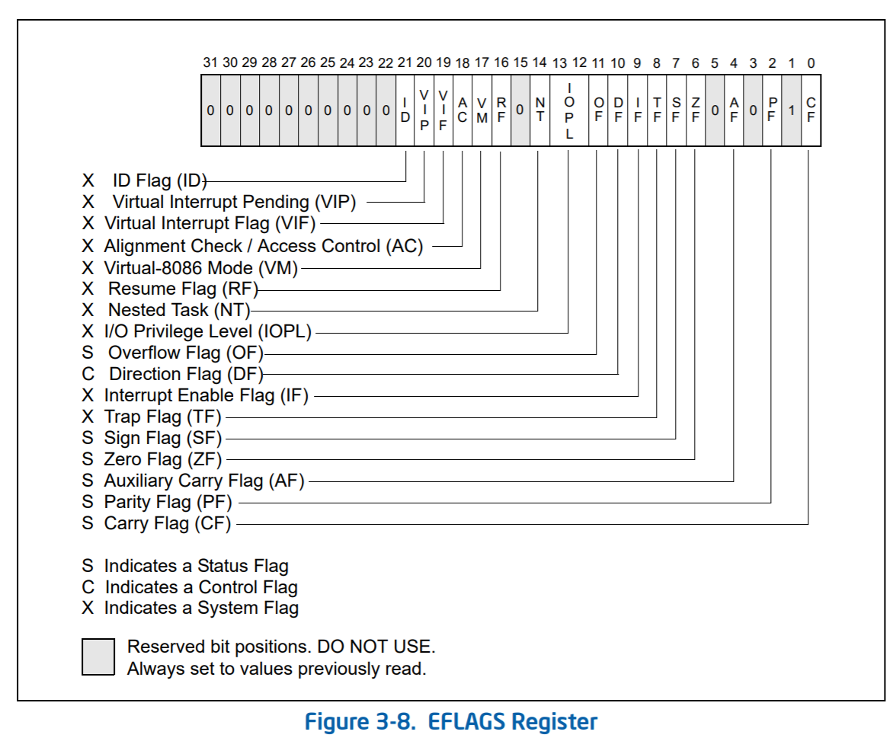
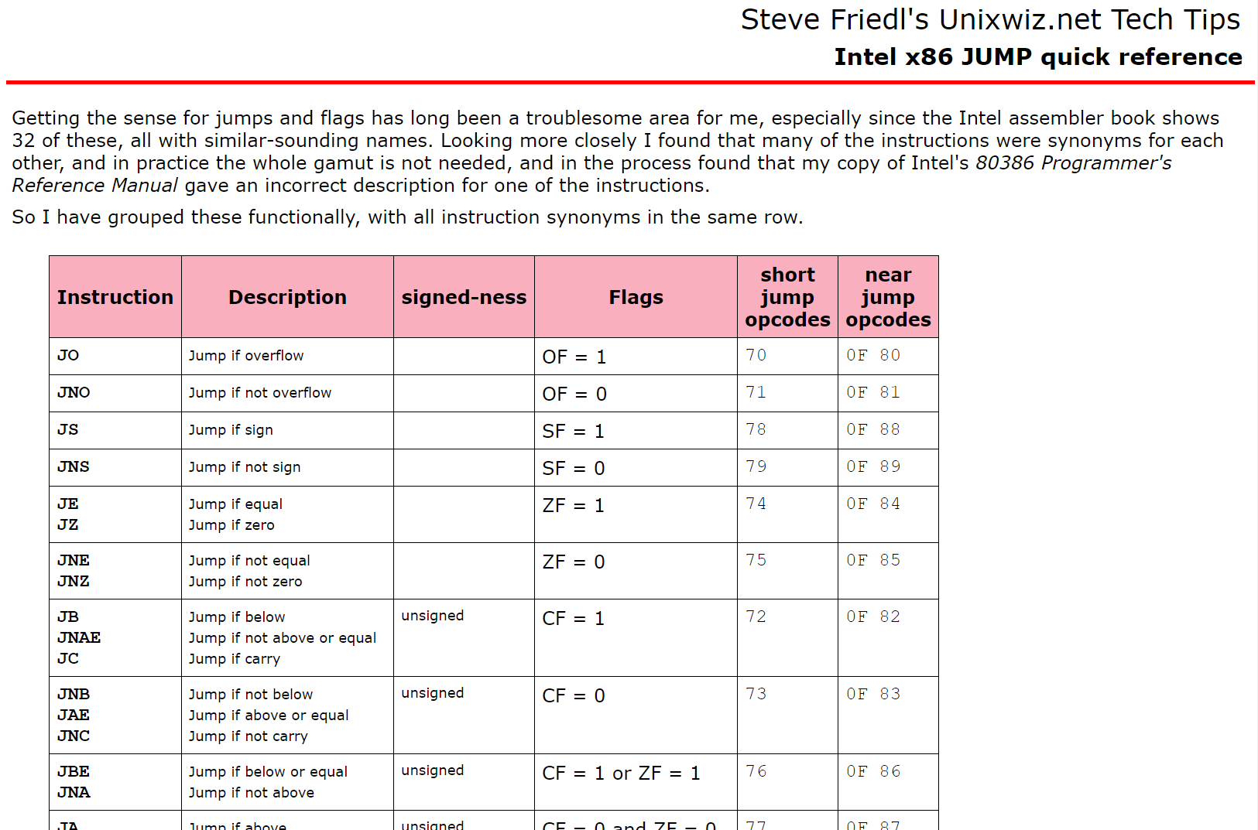
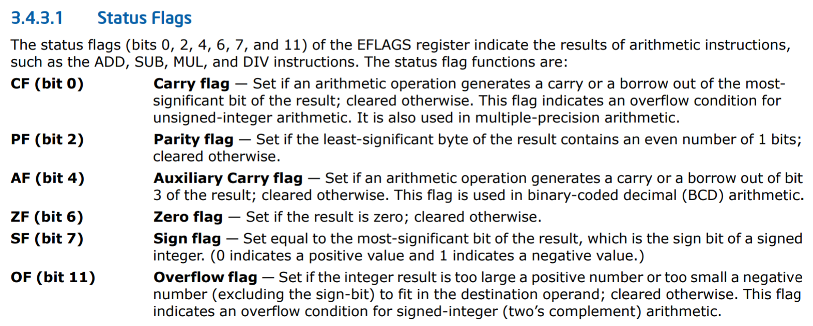
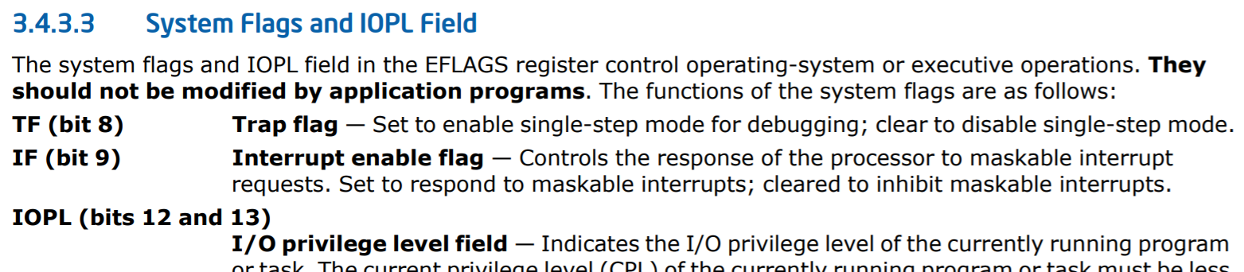
//Chickadee’s k-lock.hh
struct irqstate {
uint64_t flags_; //A copy of %rflags
//Constructor.
irqstate()
: flags_(0) {
}
static irqstate get() {
irqstate s;
s.flags_ = rdeflags(); //Reads
//%rflags
return s;
}
void restore() {
if (flags_ & EFLAGS_IF) {
sti(); //Enable interrupts
}
flags_ = 0;
}
};
Notes:
[Note that %rflags is just the x86-64 version of the x86-32 %eflags register--%rflags has equivalent bit offsets as %eflags. As Intel’s manual states, “the upper 32 bits of RFLAGS register is reserved. The lower 32 bits of RFLAGS is the same as EFLAGS.”]
[The TF (trap flag) bit is what debuggers like gdb use to single-step through a program. If the TF bit is set, then the CPU will raise a debugging interrupt after executing a single instruction. The OS can then inform the debugger, who can examine the suspended program whose instruction caused the debugging interrupt.]
[Ref: https://www.intel.com/content/dam/www/public/us/en/documents/manuals/64-ia-32-architectures-software-developer-vol-1-manual.pdf
http://www.unixwiz.net/techtips/x86-jumps.html]

Slide 30
//Chickadee’s k-lock.hh
struct spinlock {
private:
std::atomic_flag f_; //True means that the
//lock is held.
public:
//Constructor
spinlock() {
f_.clear(); //Atomically sets the flag
//to false, i.e., lock is unheld.
}
void lock_noirq() {
//f_.test_and_set() atomically sets the
//flag to true and returns the previous
//flag value.
while (f_.test_and_set()) { //While someone
//else has the
//lock . . .
pause();
}
}
void unlock_noirq() {
f_.clear(); //Atomically sets the flag
//to false.
}
irqstate lock() {
irqstate irqs = irqstate::get();
cli(); //Disable interrupts if not already
//disabled: clears the ``interrupt
//enabled’’ bit in %rflags.
lock_noirq();
adjust_this_cpu_spinlock_depth(1);
return irqs;
}
void unlock(irqstate& irqs) {
adjust_this_cpu_spinlock_depth(-1);
unlock_noirq();
irqs.restore();
}
bool is_locked() const {
return f_.test(std::memory_order_relaxed);
}
};
//Chickadee’s x86-64.h
__always_inline void pause() {
asm volatile("pause");
//The pause instruction temporarily
//places the CPU in a lower power
//state---this is helpful when you
//are spin-waiting!
}
Notes:
Remember from CS 61 that C++ provides the std::atomic library. This library provides a variety of mechanisms for atomically reading and writing to memory locations. The atomic primitives are very helpful for building higher-level synchronization primitives like spinlocks.
[Ref: https://cs61.seas.harvard.edu/site/2018/Synch2/
https://read.seas.harvard.edu/cs1610/2026/doc/spinlocks/
https://en.cppreference.com/w/cpp/atomic/atomic_flag
https://www.felixcloutier.com/x86/pushf:pushfd:pushfq //Internally, Chickadee’s rdeflags() function uses pushq
//to read rflags. Chickadee’s wreflags() uses popfq to
//assign to rflags.
]

Slide 31


It is immoral to go to sleep while holding a spinlock!
When a process goes to sleep, dozens or hundreds of milliseconds may elapse before the process is scheduled again
If process Q is asleep while holding a spinlock, process R that wants the spinlock may spin-wait on a core (with interrupts disabled!) for dozens or hundreds of milliseconds!
  Disabling interrupts for long periods makes a machine unresponsive
  Meanwhile, R’s core cannot be used by other processes

Slide 32
//Chickadee’s k-lock.hh
struct spinlock {
irqstate lock() {
irqstate irqs = irqstate::get();
cli(); //Disable interrupts if not already
//disabled: clears the ``interrupt
//enabled’’ bit in %rflags.
lock_noirq();
adjust_this_cpu_spinlock_depth(1);
return irqs;
}
void unlock(irqstate& irqs) {
adjust_this_cpu_spinlock_depth(-1);
unlock_noirq();
irqs.restore();
}
//...other stuff...
};
//cpustate::spinlock_depth_ += 1
//cpustate::spinlock_depth_ -= 1
// cpustate::schedule()
// Run a process, or the current CPU's idle task if no runnable
// process exists.
void cpustate::schedule() {
assert(spinlock_depth_ == 0); // no spinlocks are held

Slide 33

In most cases, interrupt handlers should not sleep!
An interrupt typically doesn’t “belong” to the interrupted process
  Ex: A network packet for process X arrives while process Y is running
  Ex: A keypress for process Q arrives while process R is running
So, an otherwise-runnable process shouldn’t have to sleep due to interruption by a handler that needs to sleep
Notes:
[As described by http://books.gigatux.nl/mirror/kerneldevelopment/0672327201/ch06lev1sec5.html, “When executing an interrupt handler or bottom half, the kernel is in interrupt context. Recall that process context is the mode of operation the kernel is in while it is executing on behalf of a process---for example, executing a system call or running a kernel thread. In process context, the current macro points to the associated task. Furthermore, because a process is coupled to the kernel in process context, process context can sleep or otherwise invoke the scheduler.
Interrupt context, on the other hand, is not associated with a process. The current macro is not relevant (although it points to the interrupted process). Without a backing process, interrupt context cannot sleep---how would it ever reschedule? Therefore, you cannot call certain functions from interrupt context. If a function sleeps, you cannot use it from your interrupt handler---this limits the functions that one can call from an interrupt handler.
Interrupt context is time critical because the interrupt handler interrupts other code. Code should be quick and simple.”]

Slide 34
In most cases, interrupt handlers should not sleep!
Linux’s strategy
Linux has per-CPU stacks for interrupts:
  Unlike Chickadee, Linux doesn’t immediately move state to a kernel stack!
  Instead, initial interrupt handling totally occurs using the per-CPU interrupt stack
Linux has two basic types of interrupt handlers
  A top-half handler executes quickly, with interrupts disabled, doing initial interrupt handling and then reenabling interrupts
  A bottom-half handler can be interrupted, and can execute slower code or sleep (e.g., because the handler is executed by a dedicated kernel thread that has no user-level part)
Notes:
[Ref: Valentin Rothburg: “Interrupt Handling in Linux” https://opus4.kobv.de/opus4-fau/files/6722/report.pdf
https://web.archive.org/web/20191208212951/https://linux-kernel-labs.github.io/master/labs/deferred_work.html
https://www.oreilly.com/library/view/linux-device-drivers/0596000081/ch09s05.html]

