Slide 1

Wait queues
CS 1610: Lecture 7
2/23/2026

Slide 2

Implementing sleep(ms) Inefficiently
//kernel.hh
#define HZ 100 // # of ticks per second
//kernel.cc
std::atomic<unsigned long> ticks; // # of timer interrupts
// so far on CPU 0; it’s
// incremented when the
// timer interrupt fires
Will overflow if machine runs for a long time!

Slide 3


Implementing sleep(ms) Inefficiently
//kernel.cc
switch(regs->reg_rax) {
case SYSCALL_MSLEEP: {
unsigned long wakeup_time = ticks +
(regs->reg_rdi + 9) / (1000/HZ);
while (long(wakeup_time - ticks) > 0) {
this->yield();
}
return 0;
}
//...Other syscalls...
User-mode part of process goes to sleep, but . . .
. . . kernel-half stays runnable, repeatedly testing the exit condition and then yielding! Polling is gross.
Like wakeup_ticks > ticks, but works even if ticks or wakeup_ticks overflows!
Notes:
The +9 part ensures that we sleep for at least one timer interrupt period if a positive ms argument is used. For example, if the caller specifies a sleep duration of 1 ms, then the kernel will sleep for (1+9)/10=1 timer interrupt period; since HZ = 100, one timer interrupt period is 10 ms. If the caller specifies a sleep duration of 9 ms, then the kernel will sleep for (9+9)/10 = 1 timer interrupt period; remember that in C, integer division uses truncation towards 0. [Ref: https://stackoverflow.com/a/3602857]
The long() trick works as long as (1) the computer uses two’s complement to represent numbers, (2) the subtraction of two unsigned longs wraps around, and (3) the difference between the two is in the range of an unsigned long. Note that hardware ensures (1), and the C++ standard guarantees (2).
For example:
a = 0101 b = 0110
0101
1001
+ 1
-----
1111 = 15 unsigned = -1 signed
Remember that in two’s complement, a leading bit of 1 means the number is negative, and a leading bit of 0 means that the number is positive. For a negative number, the magnitude is determined by flipping all of the bits and then adding 1. This is why 1111 in binary is -1 signed decimal.
[Ref: https://stackoverflow.com/questions/2061245/how-to-subtract-two-unsigned-ints-with-wrap-around-or-overflow
https://en.wikipedia.org/wiki/Signed_number_representations#History
https://www.cs.cornell.edu/~tomf/notes/cps104/twoscomp.html]

Slide 4
The Challenges of Blocking
Kernel tasks often need to block until an event occurs
Ex: A certain amount of time has elapsed (as in sleep(ms))
Ex: Keyboard data arrives
Ex: A (non-spinlock) lock is released
How can the kernel create an efficient mechanism to handle arbitrary types of blocking events?
Notes:
[A spinlock doesn’t have a queue because acquiring a spin lock “blocks” by just repeatedly testing the lock condition!]

Slide 5


Wait Queues to the Rescue!
Have a queue for each type of blocking event
Threads that wait for the same event will sleep on the same queue
When the event is noticed by a running thread, that thread will wake the sleepers in the relevant queue
Correctly implementing
a wait queue is tricky!
True blocking is
now possible!
Notes:
Note that I’m being a bit sloppy with terminology here. By “thread” here, I mean “a kernel-level execution context.” However, “thread” is easier to say than “kernel-level execution context” :-D. In general, when we say “thread” in this class, we mean “kernel-level execution context” unless otherwise stated.

Slide 6

Formalizing the Blocking Problem
Let x be a subset of program state
A sleeping thread blocks until f(x) is true
A running thread modifies x in a way that makes f(x) true
Sounds trivial, right?
COMPLETELY AND UTTERLY FALSE
YOU MORTAL FOOLS
Notes:
Examples of program state are register values and memory values.

Slide 7
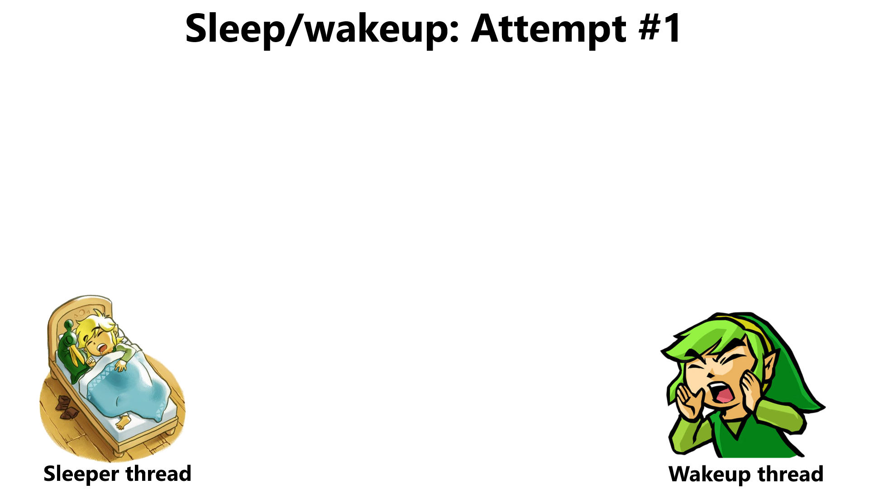

Computes f(x) == false
Decides to sleep (but hasn’t slept yet!)
Modifies x so that f(x) is true
Looks for sleeping threads, finds none to wake up
Does other stuff
Goes to sleep, blocks forever, infinite suffering occurs
Maybe locks can help us avoid bad interleavings?

Slide 8
Sleep/wakeup: Attempt #2
x_lock.lock()
Computes f(x) == false
Decides to sleep and goes to sleep
Tries to x_lock.lock() and blocks
Sleeps forever (holding x_lock), society degenerates into chaos

Slide 9
Sleep/wakeup: Attempt #3
x_lock.lock()
Computes f(x) == false
Decides to sleep (but hasn’t slept yet!)
x_lock.unlock()
x_lock.lock()
Does stuff so f(x) is true
Finds no sleeping threads to wake
x_lock.unlock()
Goes to sleep, blocks forever, all teddy bears are destroyed
Problem: Lost wakeups
Cause: Releasing the lock and blocking aren’t atomic from the perspective of the wakeup thread!

Slide 10

Sleep/wakeup: Solution #1
x_lock.lock()
Computes f(x) == false
Decides to block (but isn’t sleeping yet!)
cond_wait(&x_cond, &x_lock)
x_lock.lock()
Does stuff so f(x) is true
cond_signal(&x_cond) wakes up sleeping thread
x_lock.unlock()
Atomically releases lock
and blocks thread; when it
returns, the lock is held by caller
What if the wakeup thread runs first?
Notes:
If the sleeper thread calls cond_wait(), the sleeper will only awake once the wakeup thread has called cond_signal() and released the lock. The sleeper thread cannot wake up immediately after cond_signal() has been invoked because the semantics of cond_wait() are that a thread which call cond_wait() cannot unblock until the thread has grabbed the lock.

Slide 11
Sleep/wakeup: Solution #1
x_lock.lock()
Computes f(x) == false
Decides to block (but isn’t sleeping yet!)
cond_wait(&x_cond, &x_lock)
with no threads to wake
x_lock.lock()
Does stuff so f(x) is true
cond_signal(&x_cond) wakes up sleeping thread
x_lock.unlock()
Computes f(x) == true
Does stuff involving x
x_lock.unlock()
Locking and cond_* semantics eliminate bad interleavings!
Notes:
Note that `x_lock` serializes the critical sections of the sleeper thread and the wakeup thread, preventing those two critical sections from executing simultaneously!

Slide 12
Case study: OS/161
Notes:
OS/161 is the teaching OS that this class used before switching to Chickadee! You can find more about OS/161 here: http://www.os161.org/.

Slide 13
Condition variables in OS/161
//The sleeper thread
x_lock->lock();
while (f(x) != true) {
wchan_sleep(wc, x_lock);
//Atomically block and
//release the lock via
//thread_switch(S_SLEEP,
//wc, x_lock); upon
//return, grab x_lock.
}
do_stuff(x);
x_lock->unlock();
//The waker thread
x_lock->lock();
make_fx_true(x);
wchan_wakeone(wc, x_lock);
x_lock->unlock();
Notes:
[Remember that wchan_wakeone() looks like this . . .
/**
* Wake up one thread sleeping on a wait channel.
* The associated spinlock should be locked.
*/
void wchan_wakeone(struct wchan *wc, struct spinlock *lk) {
struct thread *target = threadlist_remhead(&wc->wc_threads);
if (target == NULL) {
/* Nobody was sleeping. */
return;
}
/* Add the thread to a runqueue. */
thread_make_runnable(target);
}
. . . And that wchan_sleep() looks like this:
void wchan_sleep(struct wchan *wc,
struct spinlock *lk){
thread_switch(S_SLEEP, wc, lk);
spinlock_acquire(lk);
}
]

Slide 14
Case Study: OS/161
/* Wait channel. A wchan is protected by
* an associated spinlock. */
struct wchan{
char *wc_name; //Name for this channel
struct threadlistwc_threads; //Queue of waiting
//threads for this
//channel
};

Slide 15
Case Study: OS/161
/**
* Yield the cpu to another process, and go to sleep on the
* specified wait channel whose associated spinlock is lk.
* The spinlock must be locked.
*/
void wchan_sleep(struct wchan *wc,
struct spinlock *lk){
thread_switch(S_SLEEP, wc, lk); //Similar to Chickadee’s
//proc::yield(), but also
//adds the current thread
//to wc->wc_threads and
//then releases the lock.
spinlock_acquire(lk);
}
Notes:
OS/161’s thread_switch() is similar to Chickadee’s proc::yield() because it saves a thread’s kernel-level register context on a thread’s kernel stack and then switches to a different thread. A difference is that, if the thread that we’re switching away from wants to sleep, we add the thread to a wchan queue.
Note that, at the end of wchan_sleep(), the spinlock_acquire() may block if the waker hasn’t released the lock yet! We’ll see an example of this in a few slides.
[The OS/161 code that performs the equivalent of Chickadee’s proc::yield is the handwritten assembly function switchframe_switch—see https://github.com/ops-class/os161/blob/6edf0d19dc9b0b7c1f16c8b4be61a1eaeaecdcde/kern/arch/mips/thread/switch.S#L42. The MIPS code looks like this:
switchframe_switch:
/*
* a0 contains the address of the switchframe pointer in the old thread.
* a1 contains the address of the switchframe pointer in the new thread.
*
* The switchframe pointer is really the stack pointer. The other
* registers get saved on the stack, namely:
*
* s0-s6, s8
* gp, ra
*
* The order must match <mips/switchframe.h>.
*
* Note that while we'd ordinarily need to save s7 too, because we
* use it to hold curthread saving it would interfere with the way
* curthread is managed by thread.c. So we'll just let thread.c
* manage it.
*/
/* Allocate stack space for saving 10 registers. 10*4 = 40 */
addi sp, sp, -40
/* Save the registers */
sw ra, 36(sp)
sw gp, 32(sp)
sw s8, 28(sp)
sw s6, 24(sp)
sw s5, 20(sp)
sw s4, 16(sp)
sw s3, 12(sp)
sw s2, 8(sp)
sw s1, 4(sp)
sw s0, 0(sp)
/* Store the old stack pointer in the old thread */
sw sp, 0(a0)
/* Get the new stack pointer from the new thread */
lw sp, 0(a1)
nop /* delay slot for load */
/* Now, restore the registers */
lw s0, 0(sp)
lw s1, 4(sp)
lw s2, 8(sp)
lw s3, 12(sp)
lw s4, 16(sp)
lw s5, 20(sp)
lw s6, 24(sp)
lw s8, 28(sp)
lw gp, 32(sp)
lw ra, 36(sp)
nop /* delay slot for load */
/* and return. */
j ra
]

Slide 16
Case Study: OS/161
/**
* Puts the current thread on the appropriate queue;
* another thread to run is selected and switched
* to. If NEWSTATE is S_SLEEP, the thread is queued
* on the wait channel wc, protected by the spinlock
* lk. Otherwise wc and lk should be NULL.
*/
void thread_switch(threadstate_t newstate,
struct wchan *wc,
struct spinlock *lk){
/* Lock the run queue. */
spinlock_acquire(&curcpu->c_runqueue_lock);
switch (newstate) {
case S_READY:
/* Enqueue the thread on the runqueue! */
thread_make_runnable(cur);
break;
case S_SLEEP:
/* Add the thread to the list in the wait
* channel, and unlock it. If the wakeup
* thread was spinning on the lock, the
* wakeup thread can grab the lock now. */
threadlist_addtail(&wc->wc_threads, cur);
spinlock_release(lk);
break;
/* ...Other code...
* Scheduler eventually dequeues a thread
* from the runqueue and runs it.
*/
From the perspective of an external wakeup thread, the current thread has atomically released the lock and blocked!
Notes:
The S_SLEEP case is subtle—it does the atomic releasing of the lock and putting the holder to sleep. The code may not look like its atomic, since the two lines of code are executing a bunch of instructions. However, the two lines of code are atomic from the perspective of an outside party who wants to acquire the wait channel lock. There’s no way for a lost wakeup to occur, because the wakeup thread cannot grab the lock and send the wakeup without the sleeper already being asleep and moving to the wait queue.

Slide 17
Case Study: OS/161
/**
* Wake up one thread sleeping on a wait channel.
* The associated spinlock should be locked.
*/
void wchan_wakeone(struct wchan *wc, struct spinlock *lk) {
struct thread *target = threadlist_remhead(&wc->wc_threads);
if (target == NULL) {
/* Nobody was sleeping. */
return;
}
/* Add the thread to a runqueue. */
thread_make_runnable(target);
}
/**
* Yield the cpu to another process, and go to
* sleep, on the specified wait channel whose
* associated spinlock is lk. The spinlock must
* be locked.
*/
void wchan_sleep(struct wchan *wc,
struct spinlock *lk){
thread_switch(S_SLEEP, wc, lk);
spinlock_acquire(lk);
}
Sleeping thread wakes up and runs the code after thread_switch() . . .
Notes:
[The function wchan_wakeall() looks like this:
void wchan_wakeall(struct wchan *wc, struct spinlock *lk)
{
struct thread *target;
struct threadlist list;
KASSERT(spinlock_do_i_hold(lk));
threadlist_init(&list);
/*
* Grab all the threads from the channel, moving them to a
* private list.
*/
while ((target = threadlist_remhead(&wc->wc_threads)) != NULL) {
threadlist_addtail(&list, target);
}
while ((target = threadlist_remhead(&list)) != NULL) {
thread_make_runnable(target, false);
}
threadlist_cleanup(&list);
}
]

Slide 18

Example: Wakeup thread runs first
Core 1
Core 2
S
W
x_lock->lock()
Does stuff so f(x) is true
cond_signal(&x_cond), but there’s no sleeping thread to awake
x_lock->unlock()
x_lock->lock()
//Waits to acquire lock
Time
Acquires lock
Computes f(x) == true
Does stuff involving x
x_lock->unlock()

Slide 19
Example: Sleeper thread runs first
Core 1
Core 2
S
W
x_lock->lock()
Computes f(x) == false
wchan_sleep(struct wchan *wc, struct spinlock *lk)
thread_switch(S_SLEEP, wc, lk)
threadlist_addtail(&wc->wc_threads, cur);
spinlock_release(lk);
//Scheduler on Core 1 now saves S’s state
//on S’s kernel stack (like Chickadee’s
//proc::yield() does) and switches to another
//thread; we’ll return here when S is
//rescheduled . . .
x_lock->lock()
//Waits to acquire lock
Time
Does stuff so f(x) is true
wchan_wakeone(struct wchan *wc,
struct spinlock *lk) {
struct thread *target =
threadlist_remhead(&wc->
wc_threads);
if (target == NULL) {
return; //Nobody’s waiting on wc!
}
//Add the thread to a runqueue.
thread_make_runnable(target);
}

Slide 20
Core 1
Core 2
S
W
x_lock->lock()
Computes f(x) == false
wchan_sleep(struct wchan *wc, struct spinlock *lk)
thread_switch(S_SLEEP, wc, lk)
threadlist_addtail(&wc->wc_threads, cur);
spinlock_release(lk);
//Scheduler on Core 1 now saves S’s state
//on S’s kernel stack (like Chickadee’s
//proc::yield() does) and switches to another
//thread; we’ll return here when S is
//rescheduled . . .
x_lock->lock()
//Waits to acquire lock
Time
Does stuff so f(x) is true
//S resumes and thread_switch() returns
wchan_wakeone(struct wchan *wc,
struct spinlock *lk) {
struct thread *target =
threadlist_remhead(&wc->
wc_threads);
if (target == NULL) {
return; //Nobody’s waiting on wc!
}
//Add the thread to a runqueue.
thread_make_runnable(target);
}
spinlock_acquire(lk);
//Waits to acquire lock
x_lock->unlock()
Does stuff involving x
x_lock->unlock()

Slide 21

What Do Other OSes Do?
FreeBSD and xv6 implement blocking in a similar way to OS/161
Scheduler must be aware of wait queue abstractions
Linux and Chickadee employ a different wait queue design
Goal: Loosen the binding between the scheduler and the condition/wait abstraction
Idea: Maintain wait queues outside of the scheduler

Slide 22

Chickadee-style wait queues are more complicated than OS/161’s approach

Slide 23
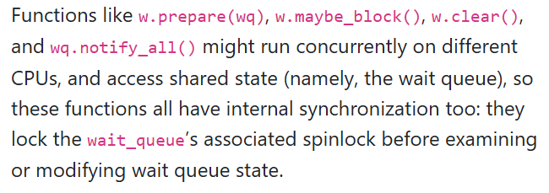
Chickadee Wait Queues: Data Structures
struct wait_queue {
list<waiter, &waiter::links_> q_;
mutable spinlock lock_;
//. . . other stuff . . .
}
struct waiter {
//The process that needs
//to wait.
proc* p_;
//The wait queue where the process should wait.
wait_queue* wq_;
//The links that let a `struct waiter` be added
//to the wait queue.
list_links links_;
//. . . other stuff . . .
}
Notes:
[Ref: https://read.seas.harvard.edu/cs1610/2026/doc/wait-queues/]

Slide 24
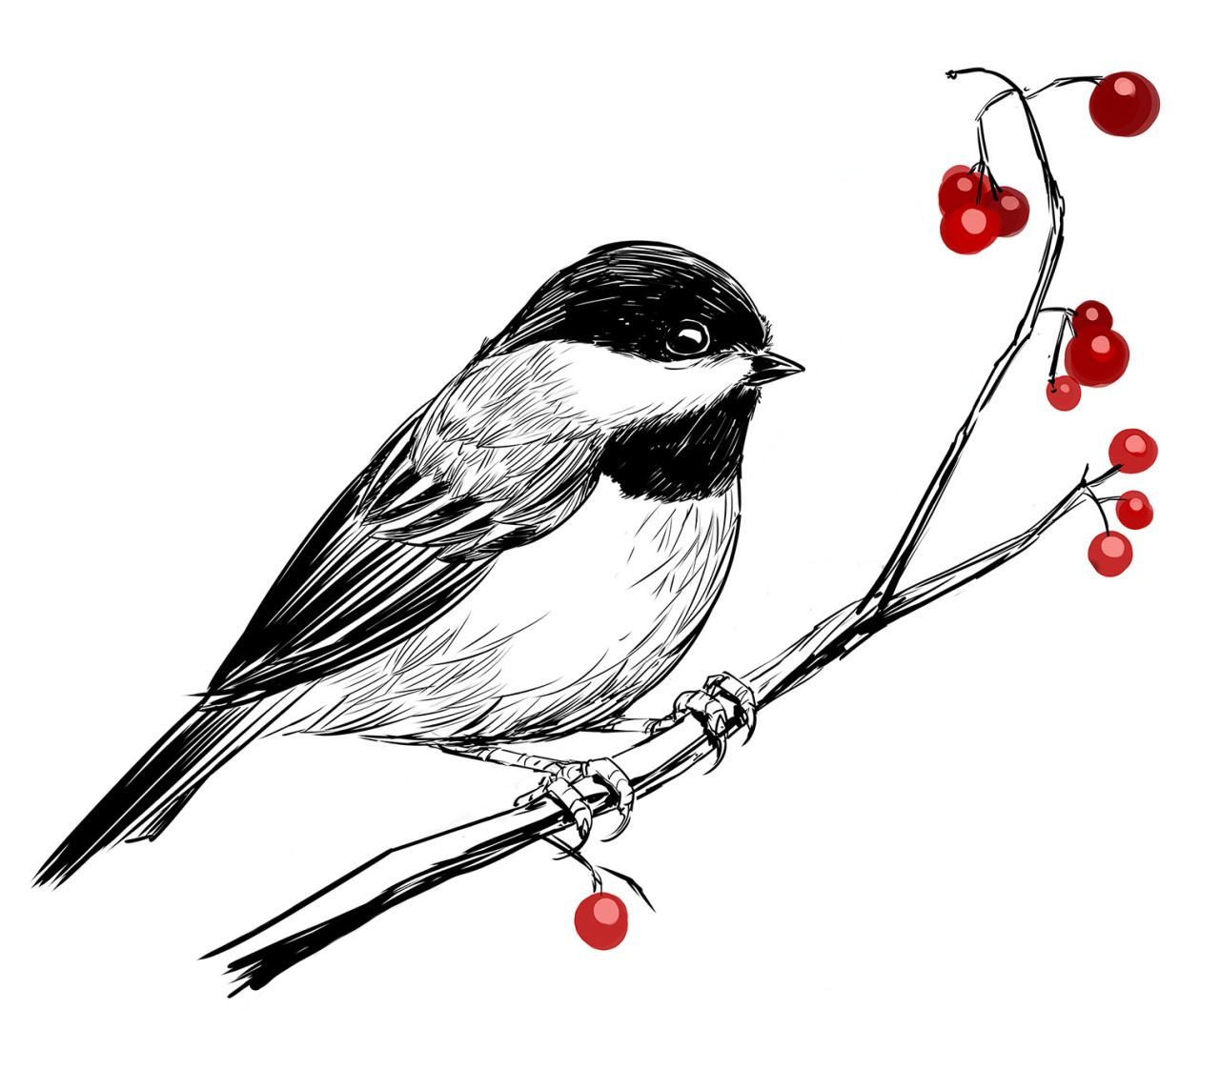
Chickadee Wait Queues
//The wakeup thread
void wt_func() {
spinlock_guard guard(x_lock);
//Code that makes f(x) true,
//and then . . .
wq.notify_all(); //Wake up
//blocked processes by
//calling p->unblock()
//on each one
}
//Simplified proc::unblock().
void proc::unblock() {
pstate_ = ps_runnable;
cpus[runq_cpu_].reenqueue(this);
//Only enqueues if the proc has
//!runq_links_.is_linked() and
//proc isn’t currently running
}
//The sleeper thread
waiter w;
auto irqs = x_lock.lock();
while (true) {
w.prepare(waitq);
if (f(x)) {
break;
}
x_lock.unlock(irqs);
w.maybe_block();
irqs = x_lock.lock();
}
w.clear();
//Compute using x
x_lock.unlock(irqs);
Grab the lock that protects x, because we’re about to check whether f(x) is true.
Notes:
[Ref: https://read.seas.harvard.edu/cs1610/2026/doc/wait-queues/]

Slide 25
Chickadee Wait Queues
Add the current process to the wait queue, and set
current()->pstate_ to proc::ps_blocked, but don’t actually block yet! Then, see if we need to block. If not (because f(x) is true), break out of the loop with x_lock still held.
//The sleeper thread
waiter w;
auto irqs = x_lock.lock();
while (true) {
w.prepare(waitq);
if (f(x)) {
break;
}
x_lock.unlock(irqs);
w.maybe_block();
irqs = x_lock.lock();
}
w.clear();
//Compute using x
x_lock.unlock(irqs);
Notes:
Note that, after calling `w.prepare(waitq)`, the process’s `pstate_` is `ps_blocked` even though the associated kernel task is running. That’s OK according to the Chickadee synchronization invariants: see https://read.seas.harvard.edu/cs1610/2026/doc/synchronization-invariants/. However, this behavior strikes me (James) as strange, which is one reason why I personally prefer OS/161 wait queues.
[In the highlighted code on the left, we see the fact that the wait queue is maintained outside of the scheduling code---it’s maintained by the sleeping thread and the wake-up thread.]

Slide 26
Chickadee Wait Queues
//The sleeper thread
waiter w;
auto irqs = x_lock.lock();
while (true) {
w.prepare(waitq);
if (f(x)) {
break;
}
x_lock.unlock(irqs);
w.maybe_block();
irqs = x_lock.lock();
}
w.clear();
//Compute using x
x_lock.unlock(irqs);
Remove the current process from the wait queue. If the process’s pstate_ == proc::ps_blocked, set the pstate_ to proc::ps_runnable.
Then, compute using x and finally, release the lock.
Notes:
[Recall that `p_` is an instance variable of the waiter, and corresponds to the `struct proc` associated with the waiter.]

Slide 27
Now imagine that we didn’t break out of the loop . . .

Slide 28
Chickadee Wait Queues
f(x) was false, so we must block. Recall that w.prepare(waitq) set
pstate_ == proc::ps_blocked. Release the lock (so that someone else can make f(x) true!) and call w.maybe_block(). When we wake up, acquire the lock again and see if f(x) is now true.
//The sleeper thread
waiter w;
auto irqs = x_lock.lock();
while (true) {
w.prepare(waitq);
if (f(x)) {
break;
}
x_lock.unlock(irqs);
w.maybe_block();
irqs = x_lock.lock();
}
w.clear();
//Compute using x
x_lock.unlock(irqs);
Notes:
Recall that w.prepare(waitq) set pstate_ == proc::ps_blocked!
[Similar to the OS/161 solution, when the sleeper releases the lock, the sleeper is already on the appropriate wait queue. Unlike the OS/161 solution, the sleeper hasn’t actually started to sleep when the lock is released.]

Slide 29
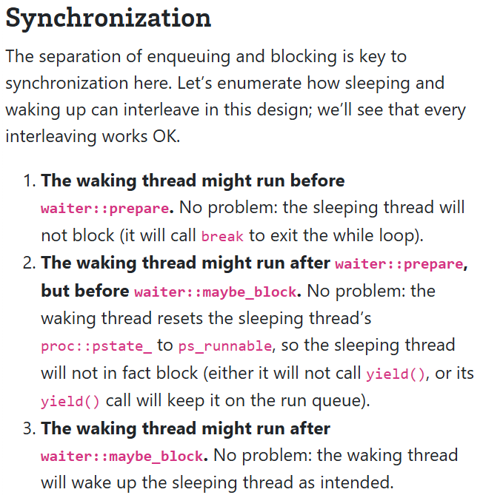
Chickadee Wait Queues
//The sleeper thread
waiter w;
auto irqs = x_lock.lock();
while (true) {
w.prepare(waitq);
if (f(x)) {
break;
}
x_lock.unlock(irqs);
w.maybe_block();
irqs = x_lock.lock();
}
w.clear();
//Compute using x
x_lock.unlock(irqs);
void waiter::maybe_block() {
//When this function is called, the caller
//doesn’t hold x_lock! So, between the caller
//releasing x_lock and the caller invoking
//maybe_block(), a waker thread may have
//grabbed x_lock, noticed that f(x) is true,
//and woken up the process p_ by calling
//p->unblock(). So, p_->pstate_ might or might
//not equal ps_blocked.
//When the function returns, p_->pstate_
//MUST NOT equal ps_blocked, and w->links_
//MUST NOT be linked (i.e., p can’t be in
//a wait queue).
if (p_->pstate_ == proc::ps_blocked) {
p_->yield(); //As p_ yields, a waker on
//another CPU may call p_->unblock(),
//setting p_->pstate_ to ps_runnable
//and trying to lock the CPU runqueue
//at the same time that this CPU is
//in cpustate::schedule() and trying
//to grab the runqueue lock. One core
//will win, adding p_ to the runqueue
//and unlocking; the other core will
//grab the runqueue lock, notice that
//p_->runq_links.is_linked(), and not
//re-add p_ to the runqueue.
}
spinlock_guard guard(wq_->lock_);
if (links_.is_linked()) {
wq_->q_.erase(this);
}
}
//Simplified proc::unblock().
void proc::unblock() {
pstate_ = ps_runnable;
cpus[runq_cpu_].reenqueue(this);
//Only enqueue if the proc has
//!runq_links_.is_linked() and
//proc isn’t currently running
}
Notes:
[Ref: https://read.seas.harvard.edu/cs1610/2026/doc/wait-queues/]
Recall that proc::yields() will store a yieldstate (basically, just a pointer to the callee-saved registers that proc::yields() must store) and then call cpustate::schedule().
Note that p->unblock() sets the pstate_ to ps_runnable and then calls cpustate::reenqueue(p); however, the latter function will not actually add p to the runqueue if p->runq_links_.is_linked().

Slide 30
What Do Other OSes Do?
FreeBSD and xv6 implement blocking in a similar way to OS/161
Scheduler must be aware of wait queue abstractions
Linux and Chickadee employ a different wait queue design
Goal: Loosen the binding between the scheduler and the condition/wait abstraction
Idea: Maintain wait queues outside of the scheduler

Slide 31
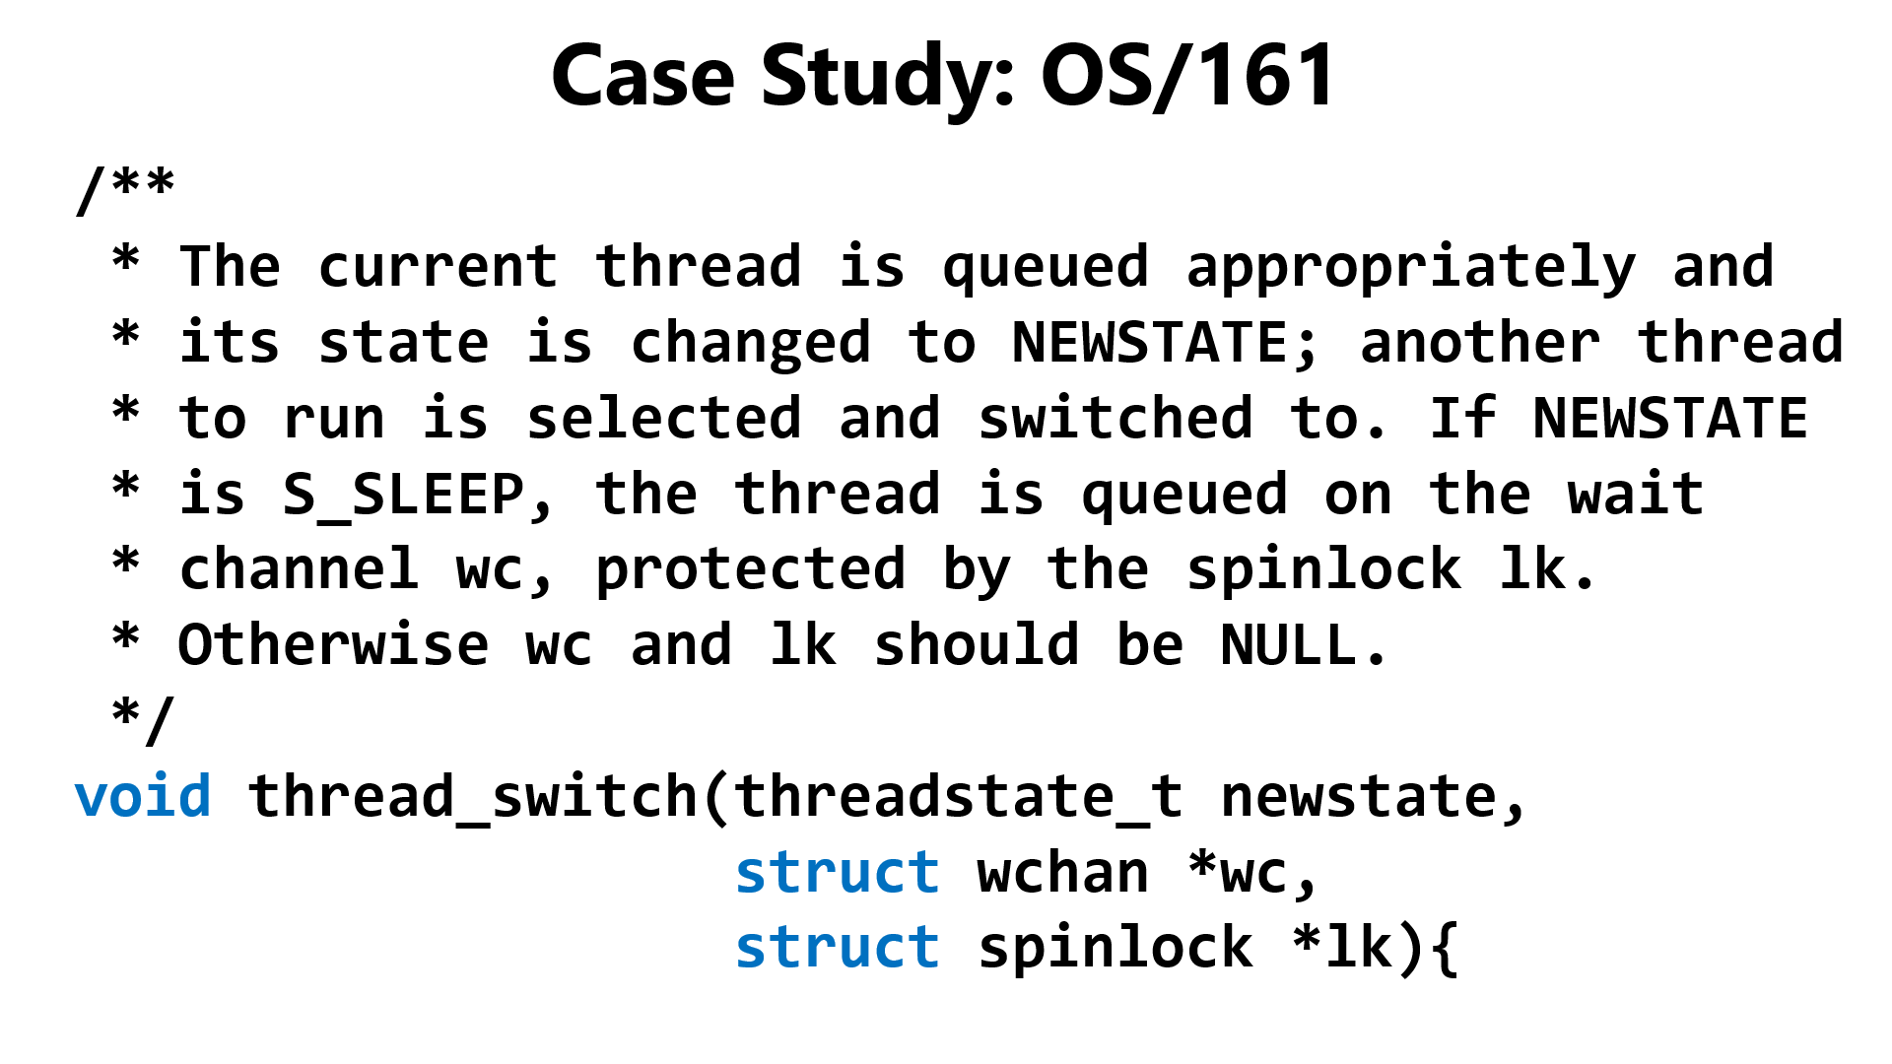
Notes:
Remember that thread_switch() is similar to Chickadee’s cpustate::schedule(). In OS161’s thread switch, the wait queue and the associated spinlock have to be exposed to the scheduler.

Slide 32

Chickadee’s cpustate::schedule()
No wait-queue abstractions must be exposed to the scheduler!
//Run a process, or the current CPU’s
//idle task if no runnable process
//exists. Prefers to run a process
//that is not the most recent process.
void cpustate::schedule() {

Slide 33

I STILL HATE WAIT QUEUES
The scheduler doesn’t directly embed wait queue algorithms, but the scheduler (and the rest of the kernel) must be defensive w.r.t. to concurrent changes to a process’s status!
but wait queues do force you to think carefully
about concurrency, which maybe is good for your soul

