Slide 1

Memory Oversubscription and Swap Devices
CS 1610: Lecture 8
2/25/2026

Slide 2

PSA: You are not the only person to experience a kernel panic

Slide 3
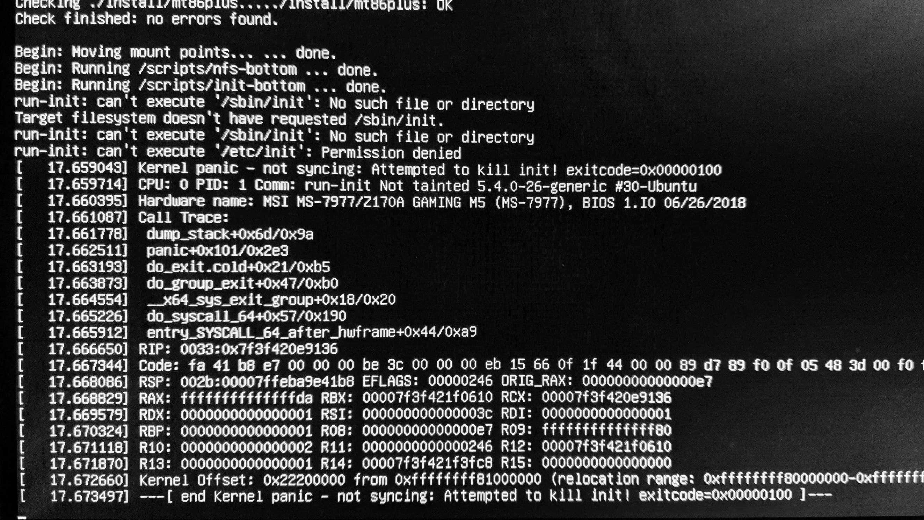
Notes:
This photo depicts a Linux kernel panic! This panic is particularly hilarious: the kernel is saying that it cannot find the executable binary that init should run! The panic prints a stack trace, and also dumps the values of the registers.

Slide 4
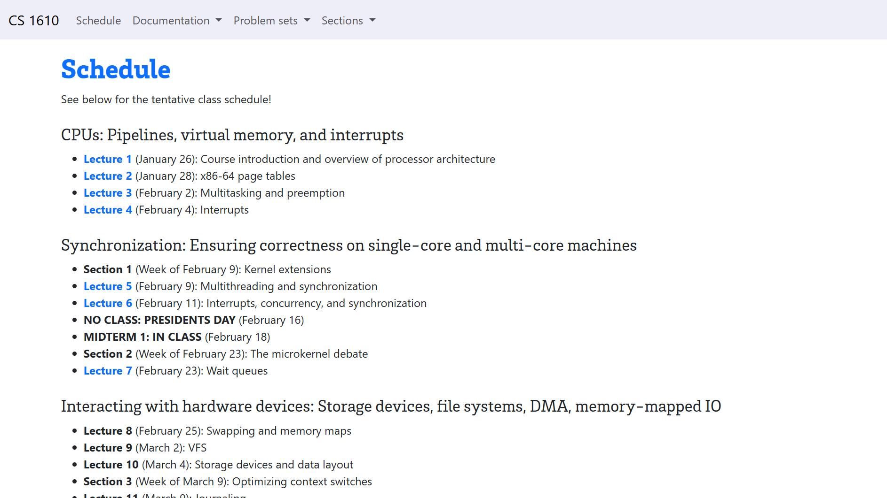

Slide 5
Outline
Copy-on-write Memory Pages
Swapping Pages Between RAM and Disk
Virtual Memory Areas (VMAs)
Working Sets

Slide 6
Implementing fork()
fork() creates a new child process whose address space is a copy of the parent’s address space
A naïve implementation uses synchronous copying
  The OS performs repeated, synchronous page allocations and memcpy() operations to duplicate every valid page in the parent’s low canonical memory
  Child gets a copy of the parent’s page table (updated to point to the newly-created copies of low canonical pages!)
Read+write (e.g., heap)
Read+write (e.g., heap)
Immediately after fork(), in low canonical memory . . .
Read-only (e.g., code)
Read-only (e.g., code)
Parent
Physical RAM
Child

Slide 7
Making fork() Efficient: Copy-on-write
The kernel gives the child a copy of the parent’s page tables, but the OS does not allocate+memcpy() raw page data for low canonical state
Instead, in both the parent and child page tables, the kernel sets PTEs for low canonical pages to be read-only
Read-only (e.g., heap)
Read-only (e.g., heap)
Immediately after fork(), in low canonical memory . . .
Read-only (e.g., code)
Read-only (e.g., code)
Parent
Physical RAM
Child

Slide 8

Making fork() Efficient: Copy-on-write
When one processes tries to write a page that should be writeable (e.g., in the stack or heap), a page-fault exception occurs
The kernel responds by . . .
  Creating a new copy of the page for the child
  Updating the child’s PTE to point to new page
  Marking the relevant PTE for both processes as read/write
Read/write
Read-only (e.g., heap)
Read-only (e.g., heap)
Read/write
Immediately after fork(), in low canonical memory . . .
Read-only (e.g., code)
Read-only (e.g., code)
Parent
Physical RAM
Child

Slide 9

Even with this optimization, physical RAM may be too small to hold all valid virtual pages!

Slide 10
Outline
Copy-on-write Memory Pages
Swapping Pages Between RAM and Disk
Virtual Memory Areas (VMAs)
Working Sets

Slide 11
Swapping Virtual Pages Between RAM and Disk
Physical RAM may be oversubscribed: the number of valid virtual pages may be larger than the number of physical pages
To alleviate pressure, the OS can move (“swap”) virtual pages between physical RAM and a swap device
  A swap device can be a hard disk, an SSD, or even remote network storage
  But how does the OS associate a virtual page with its location in swap storage?
Page X₂
Unmapped
Page X₁
Page X₀
Page X₀
Page Y₁
Virtual address
space X
Physical RAM
Page Y₁
Page X₁
Unmapped
Page X₂
Unmapped
Empty
Page Y₀
Page Y₀
Virtual address
space Y
Swap device
maps to . . .
Notes:
In the example shown on the righthand side of the slide, there are eight potentially valid virtual pages, but only five virtual pages (three yellow, two blue) that are actually valid. There are only two physical pages in physical RAM, so there is no way for all of the valid virtual pages to reside in physical memory at the same time!

Slide 12
Case study: Linux on x86

Slide 13
File-backed Pages vs. Anonymous Pages
A file-backed page is an in-memory copy of an on-disk region
  Ex: A code page containing libc code
  Ex: A page containing data from /home/alice/file.txt
An anonymous page holds dynamic execution state for a process
  Ex: A stack page
  Ex: A heap page
Both file-backed and anonymous pages can be evicted from RAM
  A clean file-backed page can just be dropped from memory
  A dirty file-backed page can be swapped to the associated location in the on-disk file
  An evicted anonymous page must always be written to a special swap file
Notes:
A clean file-backed page can just be dropped from memory because the OS knows that a copy of the page is already on disk and thus can be brought into physical RAM in the future.
[Ref: https://lwn.net/Articles/690079/
https://chrisdown.name/2018/01/02/in-defence-of-swap.html]

Slide 14
What About Kernel Pages?
In theory, kernel pages can be swapped too!
However, life is easier for kernel developers if kernel pages cannot be swapped
  If kernel pages cannot be swapped, the kernel can be interrupted by fewer things (e.g., timer interrupts, but not page faults)
  Some kinds of kernel code (e.g., top-half interrupt handlers) need to execute quickly, and cannot wait for the relevant kernel code/data to be swapped in from a slow IO device
Linux never swaps out kernel pages
Windows *does* allow some kernel pages to be swapped

Slide 15
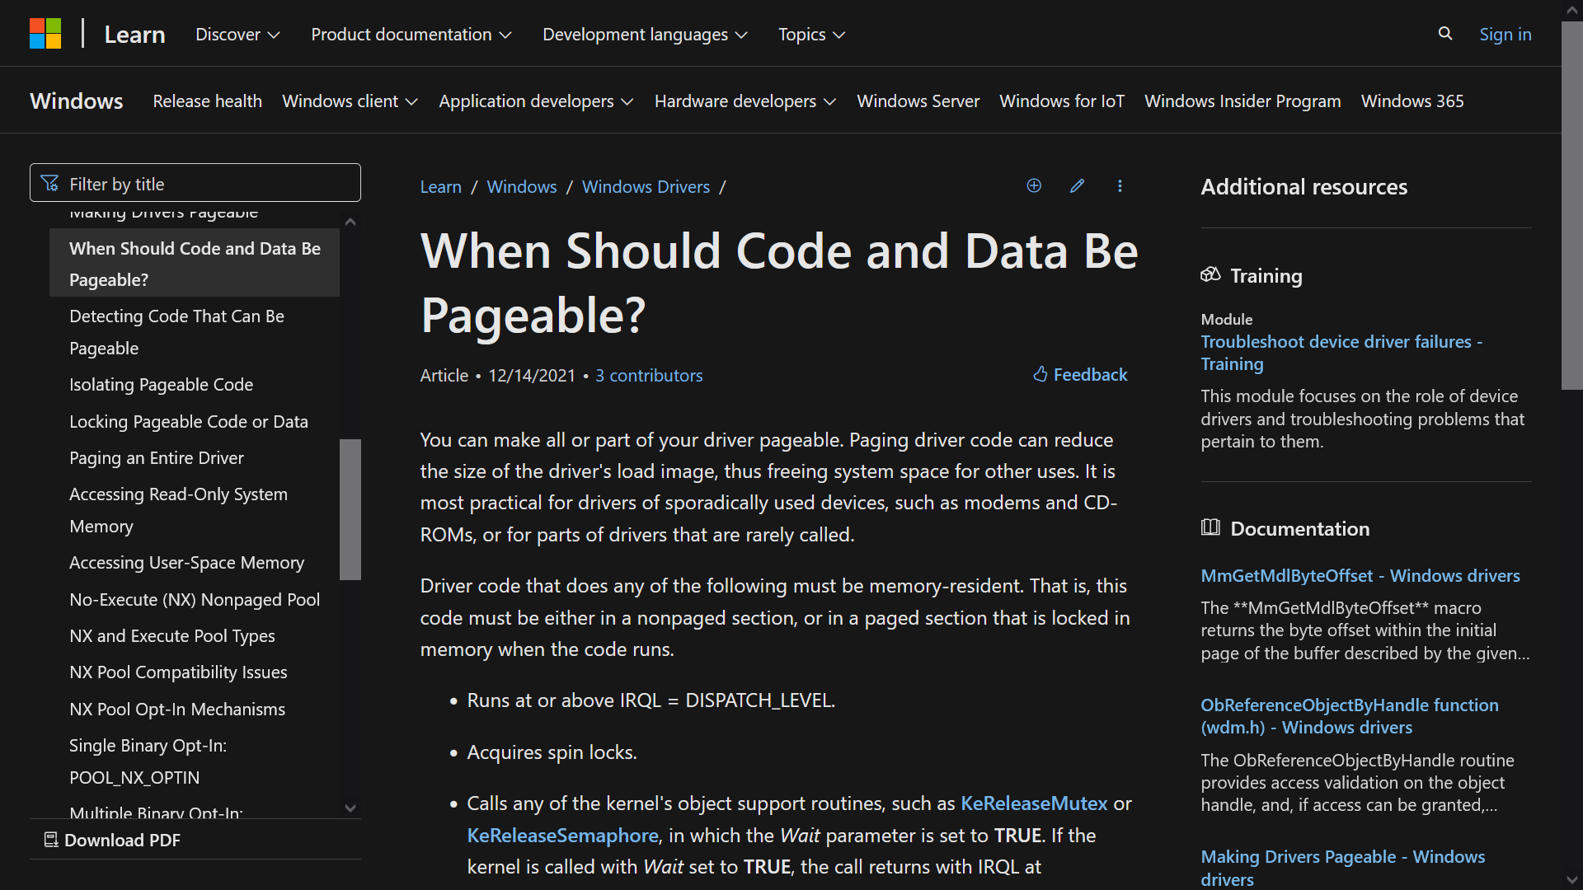

IT IS IMMORAL
TO GO TO SLEEP WHILE HOLDING
A SPINLOCK
Notes:
[Why don’t you want to enable swapping for driver code that holds a spinlock? Consider what would happen if some driver code grabbed a spinlock, did some stuff, and then got swapped to disk before the code could release the lock. Now imagine that a different kernel task wanted to grab the lock. The task would have to wait for the driver code to be swapped back into memory so that the driver could resume execution and release the lock. Remember that IO devices are very slow with respect to the CPU, so we don’t want spinlock operations to depend on swapping data from disk to RAM!]
[Ref: https://docs.microsoft.com/en-us/windows-hardware/drivers/kernel/when-should-code-and-data-be-pageable-]

Slide 16
struct swap_info_struct{
struct file *swap_file; /* Where the swap data lives on-disk */
unsigned char *swap_map; /* An array with an entry for each
* page-sized slot in the swap file;
* each entry is a reference count of
* how many PTEs map to that slot */
unsigned int max; /* Number of entries in swap_map */
unsigned int inuse_pages; /* Number of swap entries that currently
* contain a virtual memory page */
spinlock_t lock;
};
struct swap_info_struct *swap_info[MAX_SWAPFILES];
Present?
If Present?==0, the kernel can use this region to store the location of a page in swap space!
PTE
4KB-aligned physFrame addr
63
48
47
12
11
0
Notes:
If an entry in the `swap_map` array is zero, it means that the corresponding slot in the swap file is empty and can be used to hold a swapped out page.
[Ref: https://elixir.bootlin.com/linux/v6.19.3/source/include/linux/swap.h#L260 //Defines `swap_info_struct`
https://elixir.bootlin.com/linux/v6.19.3/source/mm/swapfile.c#L109 //Defines `swap_info`
https://elixir.bootlin.com/linux/v6.19.3/source/arch/x86/include/asm/pgtable_64.h#L183 //Describes how a PTE is used to
//store swap information.
https://lpc.events/event/18/contributions/1769/attachments/1604/3327/LPC%202024%20mTHP%20and%20SWAP%20allocator%209-17.pdf
//Describes the most recent Linux swap allocator
https://www.kernel.org/doc/gorman/html/understand/understand014.html#text15 //An older, somewhat out-of-date reference that
//is still helpful for getting a big-picture view of
//how swapping works on Linux.
https://www.kernel.org/doc/gorman/pdf/understand.pdf //Another older reference that is quite dated at this point, but provides
//really nice low-level commentary on how Linux v2.4 managed virtual
//virtual memory.
]

Slide 17
struct swap_info_struct{
struct file *swap_file; /* Where the swap data lives on-disk */
unsigned char *swap_map; /* An array with an entry for each
* page-sized slot in the swap file;
* each entry is a reference count of
* how many PTEs map to that slot */
unsigned int max; /* Number of entries in swap_map */
unsigned int inuse_pages; /* Number of swap entries that currently
* contain a virtual memory page */
spinlock_t lock;
};
struct swap_info_struct *swap_info[MAX_SWAPFILES];
Index into swap_map
(lets OS find the page on disk)
Index into swap_info
Present?
PTE
63
59
58
9
8
7
6
5
4
3
2
1
0
Notes:
Once the kernel knows which swap_info the page uses, and what its offset is (i.e., what its swap_map index is), the kernel can tell where on disk the page is!

Slide 18

Page X₂
How does Linux distinguish between . . .
  A non-present PTE representing a mapped but swapped-out page
  A non-present PTE representing a non-mapped page
. . .?
Unmapped
Page X₁
Page X₀
Page X₀
Page Y₁
Virtual address
space X
Physical RAM
Page Y₁
Page X₁
Unmapped
Page X₂
Unmapped
Empty
Page Y₀
Page Y₀
Virtual address
space Y
Swap device
Index into swap_map
(lets OS find the page on disk)
Index into swap_info
Present?
PTE
63
59
58
9
8
7
6
5
4
3
2
1
0
Notes:
In the example on the right, consider virtual address space X. The third-from-the-bottom page (i.e., the gray one) is non-present and unmapped. The virtual page X_1 is mapped but non-present.

Slide 19
Outline
Copy-on-write Memory Pages
Swapping Pages Between RAM and Disk
Virtual Memory Areas (VMAs)
Working Sets

Slide 20
Linux x86-64: Virtual Memory Areas (VMAs)
.vm_flags =
A VMA represents a contiguous chunk of virtual memory that the OS has given to a process.
Stack
VM_READ | VM_WRITE
.vm_flags =
VM_READ | VM_WRITE
Heap
.vm_flags =
VM_READ | VM_WRITE
BSS
.vm_flags =
Data
task_struct
VM_READ | VM_WRITE
.mm
Code
.vm_end
.vm_flags =
mm_struct
Low canonical virtual memory
.vm_start
VM_READ | VM_EXEC
.mmap
vm_area_struct list
Notes:
In Linux, a task_struct is a per-kernel-visible-thread data structure that contains bookkeeping information about the thread.
The data segment contains static variables that are explicitly initialized by a program. The BSS region holds static variables that weren’t given explicit initial values, and should be initialized to zero; remember that in C, static variables without an explicit initializer are set to all-zeroes. The name “BSS” is a historical artifact; you can read the Wikipedia article to learn its origins (which are not interesting). [Ref: https://en.wikipedia.org/wiki/.bss]
[Ref: https://elixir.bootlin.com/linux/v6.19.3/source/include/linux/mm_types.h#L892 //Defines `vm_area_struct`
https://elixir.bootlin.com/linux/v6.19.3/source/include/linux/mm.h#L399 //Defines the `VM_*` flags
https://elixir.bootlin.com/linux/v6.19.3/source/include/linux/sched.h#L819 //Defines `task_struct`
]

Slide 21
Example: Suppose you run less README.md . . .

Slide 22
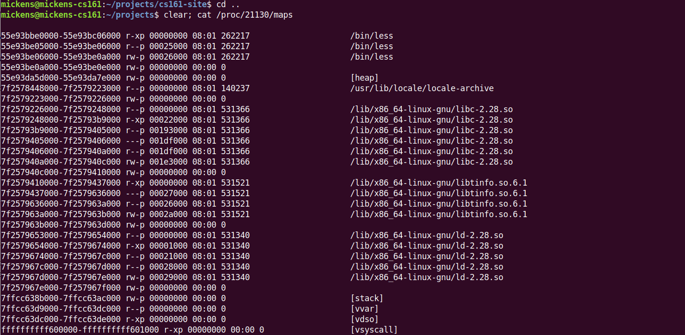
Executable code and static data in the less binary
The heap
libc
The stack
Notes:
The /proc file system isn’t a real file system; in other words, it doesn’t represent actual files on a storage device. Instead, it devices a bunch of pseudofiles that allow you to learn interesting things about the system. For example, by doing cat /proc/<some_pid>, you can find a bunch of pseudofiles with information about the process that has the pid <some_pid>. As a concrete example, this slide shows the contents of the maps file. The maps file shows you the VMAs that are associated with a process. In this slide, the number “21130” is the pid of the less process that I launched.

Slide 23
Linux x86-64: Virtual Memory Areas (VMAs)
From the perspective of user-level code, a virtual address is valid to access if the address is covered by a VMA
However, the “Present?” bit in the relevant PTE indicates whether the relevant page is actually in physical memory
In this example, accessing virtual page i+2 or i+3 causes a page fault
.vm_end
Virtual page i +3
Present? == 0
.vm_flags =
Virtual page i +2
VM_READ | VM_WRITE
Virtual page i +1
Phys page x
.vm_start
Virtual page i
Phys page y
  In the page fault handler, the kernel sees that the faulting address resides in a valid VMA (and thus represents a valid memory access)
  The handler finds the location of the page in swap space by examining the PTE for the faulting address
Notes:
Let’s suppose that the task generates a memory reference which causes a page fault. Linux will look at the given address, and see if it falls within a valid VMA. If so, Linux looks inside the other 31 bits of the PTE to figure out where the physical page is on swap (if at all). Otherwise, Linux can flag the address as invalid (e.g., if the address was to kernel memory), or dynamically allocate a physical page (e.g., if the process asked the OS to extend the heap, and the OS agreed, but the OS hasn’t actually allocated a physical page to back the new heap page).

Slide 24
struct swap_info_struct{
struct file *swap_file; /* Where the swap data lives on-disk */
unsigned char *swap_map; /* An array with an entry for each
* page-sized slot in the swap file;
* each entry is a reference count of
* how many PTEs map to that slot */
unsigned int max; /* Number of entries in swap_map */
unsigned int inuse_pages; /* Number of swap entries that currently
* contain a virtual memory page */
spinlock_t lock;
};
struct swap_info_struct *swap_info[MAX_SWAPFILES];
Index into swap_map
(lets OS find the page on disk)
Index into swap_info
Present?
PTE
63
59
58
9
8
7
6
5
4
3
2
1
0
Notes:
Once the kernel knows which swap_info the page uses, and what its offset is (i.e., what its swap_map index is), the kernel can tell where on disk the page is!

Slide 25
The Lifecycle of a Memory Reference on x86
Virtual address
TLB lookup
No
Yes
TLB hit?
HW walks the page table
Check protection bits
No
Yes
Yes
No
Access ok?
Found PTE for virt frame?
HW updates TLB
HW raises a page fault
HW raises a page fault
Calculate phys addr, send to L1/L2/L3/RAM
Notes:
Note that the protection bits state things like “is this page writable?” and “is this page accessible to user-mode processes?”
If there’s a TLB miss, the hardware walks the page table. If the hardware doesn’t find a valid PTE, i.e., if the PTE for the virtual address is not set to “present,” then the hardware raises a fault. Note that a fault could be raised for one of two reasons: the virtual address may reside in an unallocated part of the virtual address space (e.g., in the hole between the stack and the heap). Alternatively, the virtual address may reside in an allocated page of the address space, but that page is not in physical memory.
[References: https://www.ece.umd.edu/~blj/papers/micro18-4.pdf
http://www.scs.stanford.edu/06au-cs240/notes/l7.pdf
http://wiki.osdev.org/Paging
https://en.wikipedia.org/wiki/Control_register#CR2
https://web.archive.org/web/20140327093001/https://users.ece.cmu.edu/~jhoe/course/ece447/handouts/L21.pdf
]

Slide 26
The Lifecycle of a Memory Reference on x86
Virtual address
TLB lookup
No
Yes
TLB hit?
HW walks the page table
Check protection bits
No
Yes
Yes
No
Access ok?
Found PTE for virt frame?
HW updates TLB
HW raises a page fault
HW raises a page fault
Calculate phys addr, send to L1/L2/L3/RAM
This is when Linux checks VMAs!

Slide 27
Did the faulting address reside in a valid VMA?
.vm_flags =
Stack
VM_READ | VM_WRITE
.vm_flags =
VM_READ | VM_WRITE
Heap
.vm_flags =
VM_READ | VM_WRITE
BSS
.vm_flags =
Data
task_struct
VM_READ | VM_WRITE
.mm
Code
.vm_end
.vm_flags =
mm_struct
Low canonical virtual memory
.vm_start
VM_READ | VM_EXEC
.mmap
vm_area_struct list

Slide 28
Demand Paging
In most OSes, when a new program is loaded, the associated process gets:
  No/very few virtual pages in physical RAM; thus, the process gets . . .
  A page table with all/almost all of the “present” bits turned off
As the process executes, its instructions touch virtual addresses which are not resident in physical RAM
  Page faults induce the OS to bring the missing virtual pages into physical RAM on-demand

Slide 29
Outline
Copy-on-write Memory Pages
Swapping Pages Between RAM and Disk
Virtual Memory Areas (VMAs)
Working Sets

Slide 30

Working Sets
Working set: The set of virtual pages that the process is currently accessing
If there is enough free RAM to hold the working set:
  The process generates page faults until the working set resides in RAM
  The process won’t generate additional page faults until . . .
    The working set changes
    The OS proactively swaps out pages in the working set (e.g., because a higher-priority process arrives and needs RAM space)

Slide 31

Working Sets
If the working set doesn’t fit in memory . . . there is thrashing!
  Most memory accesses will cause page faults
  The system will spend most of its time reading and writing to disk, not performing useful computation!
Thrashing can occur if:
  The OS has a bad eviction strategy for resident pages
  The OS has a bad prefetching strategy for swapped-out pages
  There is inherently too much demand for physical memory space

Slide 32
Thrashing
Page faults/sec
Globally optimal
OS tries to keep the page fault rate in this region
Unfair to other
processes
Physical pages allocated to process

Slide 33
Remember the first lecture . . .

Slide 34

EVEN
M.L. PEOPLE HAVE TO CARE ABOUT SYSTEMS STUFF

Slide 35

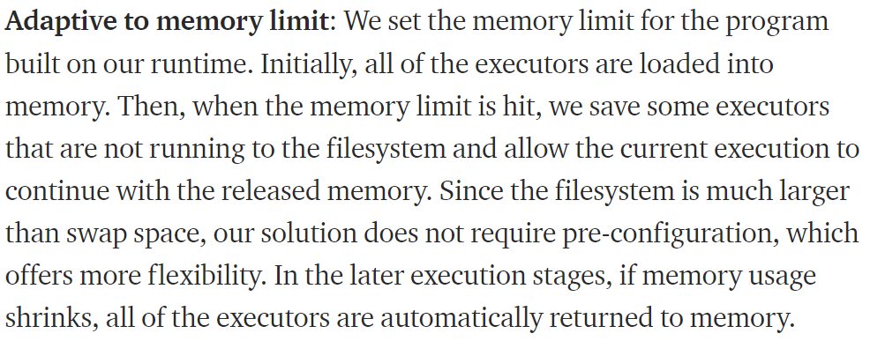
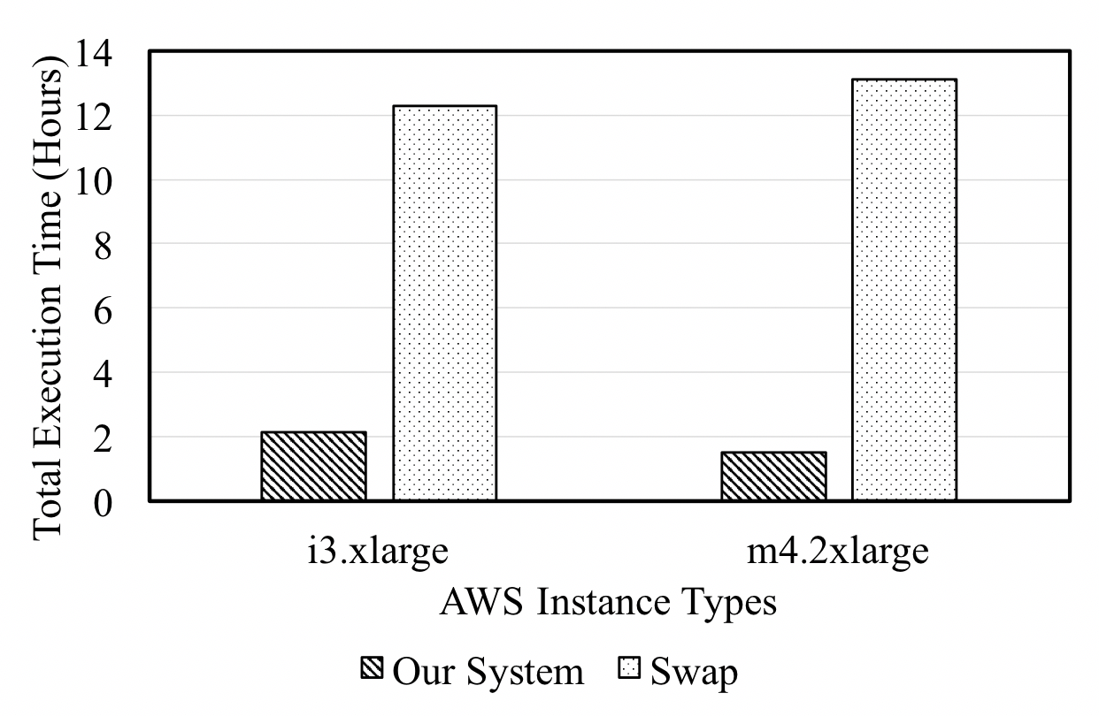

The training data for an ML model can be very large!
Notes:
[Ref: https://medium.com/@Petuum/a-solution-to-the-memory-limit-challenge-in-big-data-machine-learning-49783a72088b
//Note that the “Our system” result refers to an ML training approach in which execution is
//carefully orchestrated to avoid swapping. “Swap” is a naïve approach that relies on the
//kernel’s default swapping approach. “Swap” does worse because it leads to memory thrashing!
]

Slide 36
Least-Recently Used (LRU) Page Replacement
Intuition: A page that hasn’t been recently used will not be used in the near future—so evict it!
Working set {0, 2, 3, 4}
is thrashing!
Time
7
0
1
2
0
3
0
4
2
3
0
3
3
2
3
0
0
Youngest
7
0
1
2
0
3
0
4
2
3
0
3
3
2
3
0
0
page
7
0
1
2
0
3
0
4
2
3
0
0
3
2
3
3
Oldest
7
0
1
2
2
3
0
4
2
2
2
0
0
2
2
page
Fault
Fault
Fault
Fault
Fault
Fault
Fault
Fault
Fault
Working set stabilizes to {0, 2, 3}
Notes:
[Example from: http://www.liralab.it/teaching/OS/files_current/class_6_10.pdf]

Slide 37

Least-Recently Used (LRU) Page Replacement
LRU is a good eviction strategy, but it’s hard to implement efficiently
In a naïve implementation, the kernel has a software-managed list of in-memory virtual pages
  On each memory access, the kernel moves the accessed page to the front of the list
  At eviction time, the kernel evicts the page at the back of the list
This is O(1)!

Slide 38

Problem 1: To detect memory accesses, the OS would have to use page faults, repeatedly marking pages as inaccessible; all of those context switches will be expensive!
Problem 2: Finding the accessed page (to move it to the front of the list) is O(N)!
  On each memory access, the kernel moves the accessed page to the front of the list

Slide 39

HOW ARE WE SUPPOSED TO EVICT PAGES?

Slide 40
Page Replacement: The Clock Algorithm
The clock algorithm approximates LRU
  The algorithm assumes that:
    The hardware will automatically set a “referenced” bit in the PTE when a load or store touches a page
    Once set, the bit will only be cleared by software
  x86 conveniently provides such a bit!

Slide 41
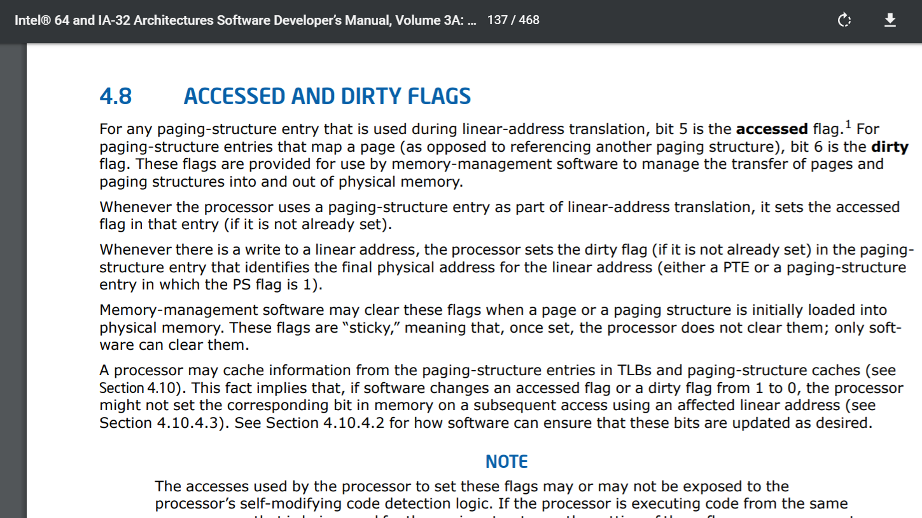
x86-64 Page Tables
L4
L3
L2
L1
Offset
47
39
38
30
29
21
20
12
11
0
PhysAddr
12 bits
4KB page
9 bits
PTE
9 bits
Page table
PDE
User-mode accessible?
%cr3
Writeable?
9 bits
Page directory
Accessed?
PDPTE
Present?
Dirty?
9 bits
Page directory pointer
PML4E
PTE
…
…
64 bits
4KB-aligned physFrame addr
Page map level 4
63
48
47
12
6
5
2
1
0
Notes:
In Intel parlance, a “linear” address is a virtual address.
[Strictly speaking, that’s a bit of a lie. On an 64-bit Intel chip, a linear address is a virtual address. However, this isn’t true on a 32-bit Intel chip. On a 32-bit Intel chip, a “virtual” or “logical” address is translated via segmentation to a linear address; the linear address is then translated to a physical one using paging. On 64-bit chips, segmented memory translation is almost completely disabled (but a few vestiges remain, like the %gs and %fs base+offset calculations that were discussed earlier in the semester). For some additional details about segmentation, see https://www.cs.cmu.edu/~410/doc/segments/segments.html or, of course, the Intel manual.]

Slide 42
Page Replacement: The Clock Algorithm
The clock algorithm approximates LRU
  The algorithm assumes that:
    The hardware will automatically set a “referenced” bit in the PTE when a load or store touches a page
    Once set, the bit will only be cleared by software
  x86 conveniently provides such a bit!
A physical page (annotated with the virtual page number of the virtual page it contains)
Kernel maintains a circular list of physical pages
To evict, search the “clock” for unreferenced page
r:1
r:1
The “referenced” flag in the virtual page’s PTE
VP:3
VP:9
while True:
if physPages[clock].r == 0:
evict(physPages[clock])
break
physPages[clock].r = 0
clock = (clock+1)%numPhysPages
r:0
r:1
VP:6
VP:0
Notes:
Each rectangle represents a physical page. Inside a rectangle, we list the virtual page number, i.e., the id of the virtual page that’s mapped into the physical page. Each physical page is also annotated with the value of its reference bit. Note that the reference bits being read and written live in the PTEs for the associated virtual pages.

Slide 43
Page Replacement: The Clock Algorithm
The clock algorithm approximates LRU
  The algorithm assumes that:
    The hardware will automatically set a “referenced” bit in the PTE when a load or store touches a page
    Once set, the bit will only be cleared by software
  x86 conveniently provides such a bit!
Kernel maintains a circular list of physical pages
To evict, search the “clock” for unreferenced page
r:1
r:1
r:0
VP:3
VP:9
while True:
if physPages[clock].r == 0:
evict(physPages[clock])
break
physPages[clock].r = 0
clock = (clock+1)%numPhysPages
r:0
r:1
r:0
VP:6
VP:0
EVICTED

