Slide 1

The Virtual Filesystem Abstraction
CS 1610: Lecture 9
3/2/2026

Slide 2
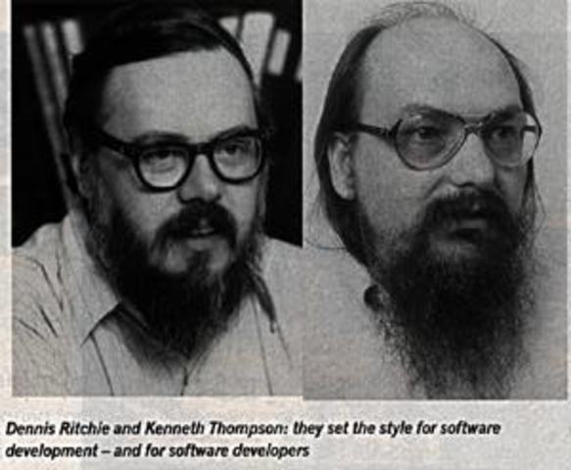
The Unix Philosophy
Try to expose all OS-managed resources using file abstractions!
Notes:
[Ref: "The UNIX TimeSharing System" by Ritchie and Thompson is quite readable, and introduces a bunch of fundamental OS concepts like files, processes, and system calls. You can read the paper at https://dsf.berkeley.edu/cs262/unix.pdf.]

Slide 3

One Abstraction to Rule Them All
In Unix-derived OSes, user-level code often interacts with important resources via the file abstraction
Ex: An actual file like /home/alice/data.txt
Ex: A pipe created by pipe(int pipefd[2])
Ex: A raw storage device like /dev/sda
In Linux, many devices are accessible via the /dev directory
Ex: A raw storage device like /dev/sda
Ex: A terminal like /dev/tty, which represents the terminal for the current process
Ex: The shell command echo hello > /dev/tty will write “hello” to the terminal
A shell interacts with a terminal to receive user input and display results
int main() {
char buf[128];
int fd;
memset(buf, ‘\0’, sizeof(buf));
fd = open("foo.txt", O_RDONLY);
read(fd, buf, sizeof(buf) - 1);
printf("%s\n", buf);
close(fd);
return 0;
}
Notes:
After a call to pipe(pipefd), the read end of the pipe is pipefd[0], and the write end is pipefd[1].
[A storage device path like /dev/sda1 refers to the first partition of the disk /dev/sda.
Ref: https://unix.stackexchange.com/questions/392701/drive-name-what-is-the-correct-term-for-the-sda-part-of-dev-sda]

Slide 4
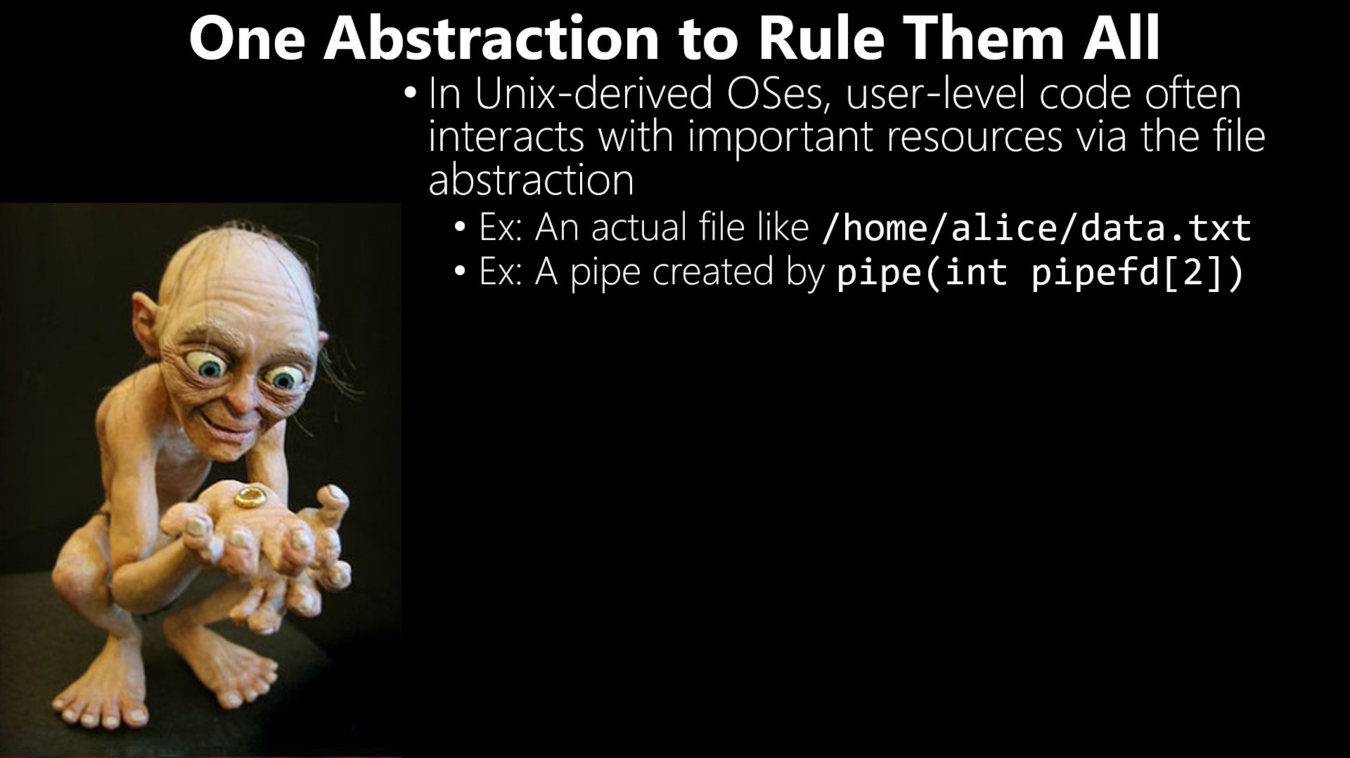
int main() {
int p2c[2]; //Parent-to-child pipe
char buf[1];
char* msg = "hiya!";
pipe(p2c);
if (fork() == 0) { //Child
close(p2c[1]); //Close writing end
while (read(p2c[0], &buf, 1) > 0) {
write(STDOUT_FILENO, &buf, 1);
}
write(STDOUT_FILENO, "\n", 1);
close(p2c[0]);
} else { //Parent
close(p2c[0]); //Close reading end
write(p2c[1], msg, strlen(msg));
close(p2c[1]); //Makes child see EOF
wait(NULL); //Wait for child exit
}
return 0;
}
Notes:
[For a refresher about pipes, here’s the CS 161 discussion: CS 61 discussion of pipes: https://cs61.seas.harvard.edu/site/2025/Process/#stream-communication-pipes]

Slide 5
int main() {
int p2c[2]; //Parent-to-child pipe
char buf[1];
char* msg = "hiya!";
pipe(p2c);
if (fork() == 0) { //Child
close(p2c[1]); //Close writing end
while (read(p2c[0], &buf, 1) > 0) {
write(STDOUT_FILENO, &buf, 1);
}
write(STDOUT_FILENO, "\n", 1);
close(p2c[0]);
} else { //Parent
close(p2c[0]); //Close reading end
write(p2c[1], msg, strlen(msg));
close(p2c[1]); //Makes child see EOF
wait(NULL); //Wait for child exit
}
return 0;
}

Slide 6
One Abstraction to Rule Them All
In Unix-derived OSes, user-level code often interacts with important resources via the file abstraction
Ex: An actual file like /home/alice/data.txt
Ex: A pipe created by pipe(int pipefd[2])
Ex: A raw storage device like /dev/sda
In Linux, many devices are accessible via the /dev directory
Ex: A raw storage device like /dev/sda
Ex: A terminal like /dev/tty, which represents the terminal for the current process
Ex: The shell command echo hello > /dev/tty will write “hello” to the terminal
A shell interacts with a terminal to receive user input and display results
int raw_disk_fd = open("/dev/sda",
O_RDWR);
char* str = "CS 1610 4EVA";
write(raw_disk_fd, str, strlen(str));
close(fd);

Slide 7

int raw_disk_fd = open("/dev/sda",
O_RDWR);
char* str = “CS 1610 4EVA”;
write(raw_disk_fd, str, strlen(str));
close(fd);
DO NOT TRY THIS AT HOME

Slide 8
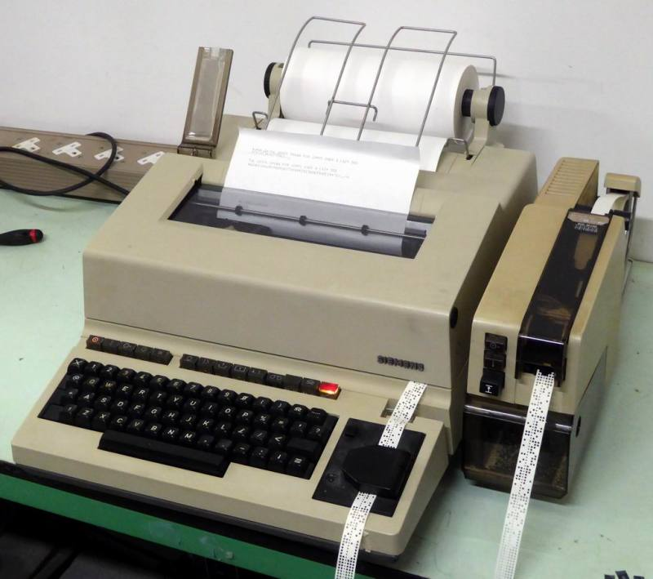
One Abstraction to Rule Them All
In Unix-derived OSes, user-level code often interacts with important resources via the file abstraction
Ex: An actual file like /home/alice/data.txt
Ex: A pipe created by pipe(int pipefd[2])
Ex: A raw storage device like /dev/sda
In Linux, many devices are accessible via the /dev directory
Ex: A raw storage device like /dev/sda
Ex: A terminal like /dev/tty, which represents the terminal for the current process
A shell interacts with a terminal to receive user input and display results
Ex: The shell command echo hello > /dev/tty will write “hello” to the terminal (i.e., the console)
A physical teletypewriter (“TTY”)
Notes:
“TTY” is an abbreviation for “teletypewriter.” A teletypewriter is basically a keyboard, a physical printer, and some type of cable that allows messages to be exchanged with other devices. Back in the old days, a user exchanged data with a computer using a teletypewriter.
In Chickadee, there’s a separate console for displaying output, and a keyboard state for reading characters. A Linux terminal file provides an interface that performs both functions: reading from the terminal returns keyboard state, and writing to the terminal updates the display
[Refs for terminals: https://unix.stackexchange.com/questions/4126/what-is-the-exact-difference-between-a-terminal-a-shell-a-tty-and-a-con
https://stackoverflow.com/questions/8514735/what-is-special-about-dev-tty
http://www.linusakesson.net/programming/tty/index.php]

Slide 9
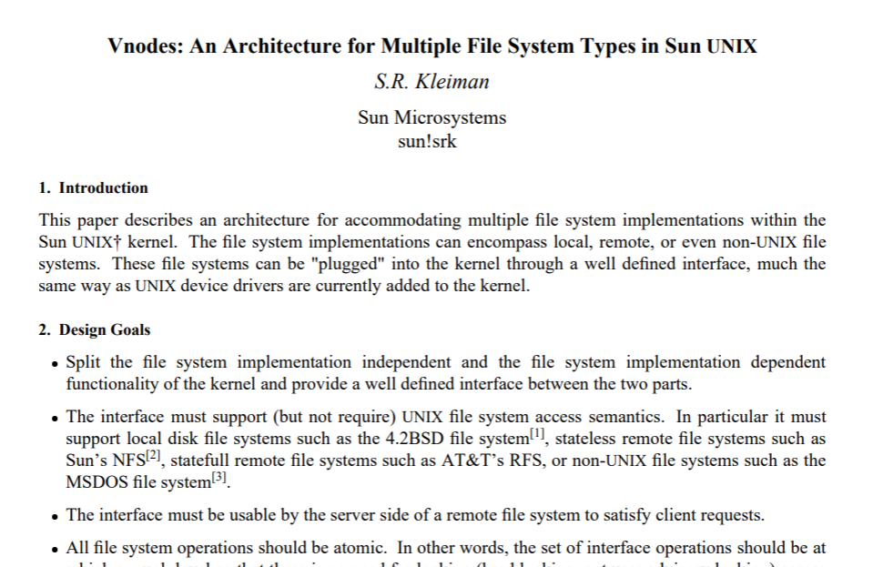
The Virtual File System (VFS) Interface
In The Olden Days, an OS could only use a single, baked-in file system
The VFS interface defines an abstract, generic interface that a file system should present to the OS
A specific file system has to implement the VFS methods
The OS only interacts with the file system through those VFS methods
In a modern OS, the VFS abstractions can also encapsulate “file systems” that don’t involve a disk
Ex: Pipes use a pure in-memory buffer
Notes:
[Aside: The exclamation mark in “sun!srk” indicates that S.R. Kleiman was using a email service that was built atop the UUCP protocol. In that protocol, email addresses were of the form <machine name>!<user name>. Ref: https://en.wikipedia.org/wiki/UUCP#Mail_routing]

Slide 10
VFS: A High-level View
Application code
fwrite()
libc
User
write()
Kernel
System call dispatch
vfs_write()
VFS interface
ext4_write()
btrfs_write()
nfs_write()
tty_write()
ext4
btrfs
NFS
tty

Slide 11
VFS: A High-level View
Application code
Why use libc instead of directly invoking system calls?
fwrite()
libc
Portability: libc isn’t OS-specific
Convenience: libc can make programming easier
Some libc calls have simpler semantics than the underlying system calls
User
write()
Kernel
System call dispatch
vfs_write()
VFS interface
ext4_write()
btrfs_write()
nfs_write()
tty_write()
ext4
btrfs
NFS
tty
Notes:
[Ref: https://courses.cs.washington.edu/courses/cse333/20su/lectures/lec-07/07-posix-20su.pdf
https://utcc.utoronto.ca/%7Ecks/space/blog/unix/SbrkVersusMmap
]

Slide 12
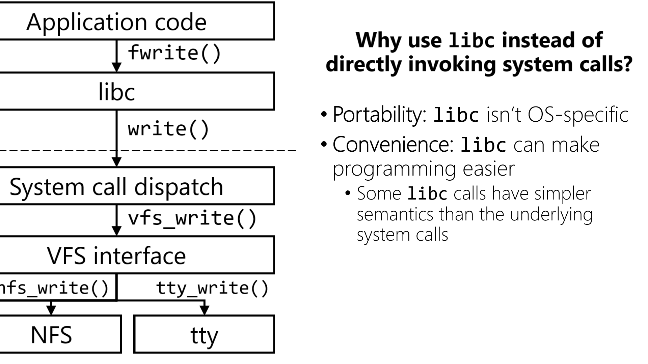
Low canonical
virtual memory
Stack
Changed by mmap() and munmap()
The “break” changed by sbrk()
Heap
malloc()/new and free()/delete hide the complexity of heap-related system calls like sbrk(), mmap(), and munmap()!
Static data
Code
Notes:
malloc()/new() typically uses the sbrk region for small allocations, and mmap()’ed regions for large (e.g., 8 MB) allocations.
[Note that, strictly speaking, new and delete are not defined by libc, but rather by a C++ standard library like libc++. See here for a list of common C++ libraries:
https://en.wikipedia.org/wiki/C%2B%2B_Standard_Library
Note that a C++ library like LLVM’s libc++ may or may not use functionality defined by a libc library; the implementers of a C++ library choose the C++ library is internally implemented!]
[Ref: [1] https://utcc.utoronto.ca/%7Ecks/space/blog/unix/SbrkVersusMmap
[2] https://man7.org/linux/man-pages/man3/malloc.3.html
]

Slide 13
Portability: libc isn’t OS-specific
Convenience: libc can make programming easier
Some libc calls have simpler semantics than the underlying system calls
libc automatically buffers file IO
Prefetches for reads
Batching for writes
Notes:
[Ref: https://courses.cs.washington.edu/courses/cse333/20su/lectures/lec-07/07-posix-20su.pdf]

Slide 14

Case study: Linux’s “vnode”
//Linux’s include/linux/fs.h
struct file_operations {
int (*open) (struct inode *, struct file *);
ssize_t (*read) (struct file *, char __user *,
size_t, loff_t *);
ssize_t (*write) (struct file *, const char __user *,
size_t, loff_t *);
loff_t (*llseek) (struct file *, loff_t, int);
int (*flush) (struct file *, fl_owner_t id);
//...other stuff...
} __randomize_layout;
Instructs gcc to generate different field offsets during each compilation!
Notes:
[Ref: https://github.com/torvalds/linux/blob/master/include/linux/fs.h
https://lwn.net/Articles/722293/]

Slide 15
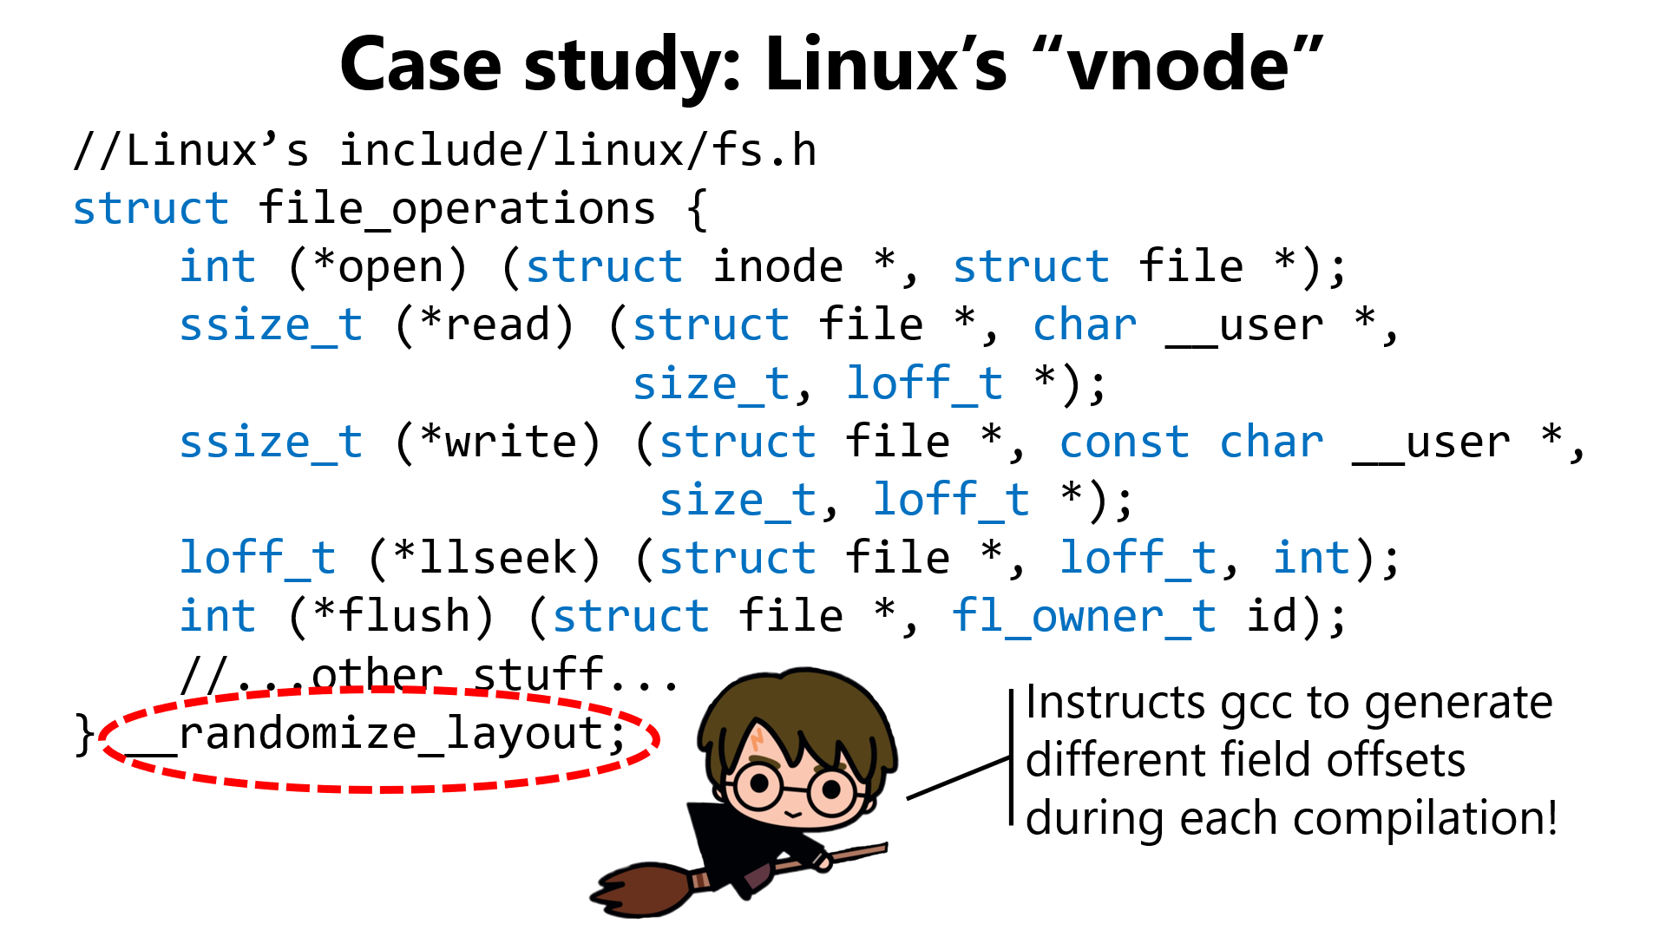
*llseek
...
*write
...
Compilation 3
*flush
...
*open
...
*read
...
struct file_operations
*open
...
*read
...
Compilation 2
*write
...
*llseek
...
*flush
...
struct file_operations
*flush
...
*llseek
...
Compilation 1
*write
...
*read
...
*open
...
struct file_operations

Slide 16


//Chickadee’s kernel.hh
struct proc {
pid_t id_; //0(this)
regstate* regs_; //8(this)
yieldstate* yields_; //16(this)
std::atomic<int> pstate_; //24(this)
x86_64_pagetable* pagetable_; //32(this)
//...other stuff...
};
The buf and buf_len arguments are controlled by untrusted user-level code!
//Imagine that Chickadee added a new syscall . . .
case SYSCALL_VOLDEMORT: {
//A user-level program invokes
// syscall_voldemort(void* buf, size_t buf_len)
//to copy proc::id_ into the provided user-level buf.
memcpy(reinterpret_cast<void*>(regs->reg_rdi), //dst
this, //src
reinterpret_cast<size_t>(regs->reg_rsi));
//num bytes to copy
return 0;
};
Should be min(sizeof(id_), ...)!
Need to validate buf—e.g., is it nullptr? Does it point to valid user-level memory?
Notes:
We provide the `this` pointer as the src argument to memcpy() .The reason is that the `proc::id_` field is the first field in `struct proc`. So, a pointer to a `struct proc` also points to the beginning of the `proc::id_` field.
Now you understand why, in pset3, we ask you to validate user-provided pointers that are passed to the kernel!

Slide 17
//Chickadee’s kernel.hh
struct proc {
pid_t id_; //0(this)
regstate* regs_; //8(this)
yieldstate* yields_; //16(this)
std::atomic<int> pstate_; //24(this)
x86_64_pagetable* pagetable_; //32(this)
//...other stuff...
};
The buf and buf_len arguments are controlled by untrusted user-level code!
//Imagine that Chickadee added a new syscall . . .
case SYSCALL_VOLDEMORT: {
//A user-level program invokes
// syscall_voldemort(void* buf, size_t buf_len)
//to copy proc::id_ into the provided user-level buf.
memcpy(reinterpret_cast<void*>(regs->reg_rdi), //dst
this, //src
reinterpret_cast<size_t>(regs->reg_rsi));
//num bytes to copy
return 0;
};
Read vulnerability: Passing buf_len=40 allows user-level code to read the first five fields of struct proc into a user-level buffer!
Notes:
Indeed, by passing in larger values for buf_len, the user-level code can read larger amounts of kernel memory!

Slide 18

//Chickadee’s kernel.hh
struct proc {
pid_t id_; //0(this)
regstate* regs_; //8(this)
yieldstate* yields_; //16(this)
std::atomic<int> pstate_; //24(this)
x86_64_pagetable* pagetable_; //32(this)
//...other stuff...
};
void cpustate::schedule(proc* yielding_from) {
//Find a runnable process, then . . .
set_pagetable(current_->pagetable_);
current_->resume(); // does not return
}
The buf and buf_len arguments are controlled by untrusted user-level code!
//Imagine that Chickadee added a new syscall . . .
case SYSCALL_VOLDEMORT: {
//A user-level program invokes
// syscall_voldemort(void* buf, size_t buf_len)
//to copy proc::id_ into the provided user-level buf.
memcpy(reinterpret_cast<void*>(regs->reg_rdi), //dst
this, //src
reinterpret_cast<size_t>(regs->reg_rsi));
//num bytes to copy
return 0;
};
Write vulnerability: Setting buf=32(this) and buf_len=8 allows user-level code to overwrite the page table pointer with the bytes in id_!
Something insane will happen at some point
Notes:
Overwriting proc::pagetable_ doesn’t write to the special %cr3 register; so, overwriting proc::pagetable_ won’t immediately change the address space that the code executes in. However, in cpustate::schedule(), the page table for the current process is restored using the value in proc::pagetable_. So, it’s possible that, if malicious user process X sets overwrites its proc::pagetable_pointer with random junk, then the system will likely crash when the page table is switched (e.g., because pagetable_pointer isn’t an aligned value when interpreted as a memory address, causing the write to %cr3 to fail). There are some more interesting cases that you can think about in your free time :-D.
[For example, suppose that the malicious process X sets pagetable_ to the pagetable_ value for process Y. The next time that X is scheduled, it will start executing with Y’s page table! Assuming that Y’s process has a user-mode execution context, the CPU will try to call proc::resume(), which will then check for a regstate or a yieldstate. Suppose that there’s a regstate. In this case, proc::yield() will pop registers off of X’s stack onto the CPU, but then do an iretq into some place in Y’s code---a place of X’s choosing, such that the chosen code will execute will X’s register values!]

Slide 19

Case study: Linux’s “vnode”
Makes it harder for malicious code to read and write known values at known offsets!
//Linux’s include/linux/fs.h
struct file_operations {
int (*open) (struct inode *, struct file *);
ssize_t (*read) (struct file *, char __user *,
size_t, loff_t *);
ssize_t (*write) (struct file *, const char __user *,
size_t, loff_t *);
loff_t (*llseek) (struct file *, loff_t, int);
int (*flush) (struct file *, fl_owner_t id);
//...other stuff...
} __randomize_layout;
Instructs gcc to generate different field offsets during each compilation!
Notes:
Randomizing a struct’s layout makes these kinds of attacks harder!

Slide 20
VFS: A High-level View
Application code
fwrite()
libc
User
write()
Kernel
System call dispatch
vfs_write()
VFS interface
ext4_write()
btrfs_write()
nfs_write()
tty_write()
ext4
btrfs
NFS
tty

Slide 21
Per-process File Metadata
Suppose that a process has two disk files open (one for reading, one for writing) . . .
Each process is associated with a file descriptor table
A file descriptor (e.g., that’s returned by open(“/etc/file.txt”, O_RDWR)) is an index into the local process’s table
A valid file descriptor points to an entry in the system-wide open file table
A valid open file descriptor points to a vnode instance for the associated open file
Terminal IO receives special treatment
By convention, file descriptors 0 (stdin), 1 (stdout), and 2 (stderr) refer to the process’s terminal file
In Chickadee’s pset3, this means that 0, 1, and 2 should point to the open file descriptor for the vnode belonging to the “keyboard+console” file
struct proc
Other fields
Eight-entry fd table
Ref count
Ref count
Ref count
Ref count
Perms
Perms
Offset
Perms
Offset
Perms
Offset
Offset
Vnode
Vnode
Vnode
Vnode
Four-entry open file table
1
1
r/w
0
3
r
5
w
9
struct file_vnode:public vnode
struct kb_c_vnode:public vnode
ssize_t read(…)
ssize_t write(…)
ssize_t read(…)
ssize_t write(…)
Code for
struct file_vnode:public vnode
Code for
struct kb_c_vnode:public vnode
Notes:
[In Chickadee, a vnode for a file will only have one incoming reference from the open file table, although multiple vnodes may refer to the same underlying per-file inode. The meaning of an inode will become clearer in pset4!]
[You might wonder why there would ever be more than one instance of a particular vnode type, if every instance of the vnode provides the same interfaces. For example, every file_vnode provides the same methods for read(), write(), and so on, so why not only have one instance of file_vnode that is pointed to by every file descriptor corresponding to a file? The answer is that a vnode may contain additional state besides function pointers, e.g., a spinlock! This idea will become clearer in pset3 and pset4.]
[For Chickadee’s pset3, students only need to implement support for a modestly-sized file descriptor table, e.g., 32 entries.]
[Ref: https://www.usna.edu/Users/cs/wcbrown/courses/IC221/classes/L09/Class.html
https://stackoverflow.com/questions/5284062/two-file-descriptors-to-same-file
]

Slide 22
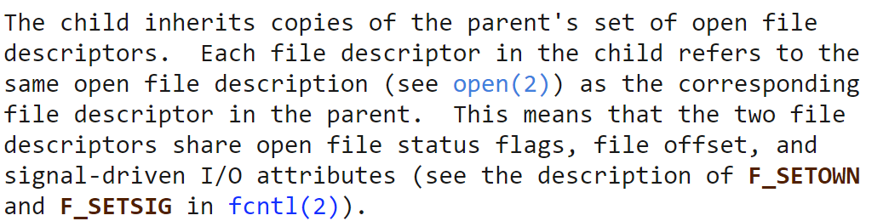
Handling File Descriptors in fork()
File descriptor inheritance is a useful way for a parent to pass information to a child
Ex: A parent makes a pipe (i.e., a pair of pipe file descriptors) and then forks a child, sending commands via the write end
Ex: A parent may open a network connection (i.e., a socket file descriptor) and fork a child to deal with the connection
Notes:
[Ref: https://man7.org/linux/man-pages/man2/fork.2.html]

Slide 23
Example: A fork()’ing Network Server
int listen_sock = socket(...);
bind(.../*Port 80: web server!*/);
listen(listen_sock, ...);
while(true){
int client_sock = accept(listen_sock, ...);
if(fork() == 0){ //Child
//Exchange data with client.
close(listen_sock);
handle_client(client_sock);
close(client_sock);
exit(0); //So child doesn’t continue
//the loop!
}else{ //Parent
close(client_sock);
}
}
struct proc:
parent
struct sock_vnode
(listen_sock)
struct sock_vnode
(client_sock)

Slide 24

Example: A fork()’ing Network Server
int listen_sock = socket(...);
bind(.../*Port 80: web server!*/);
listen(listen_sock, ...);
while(true){
int client_sock = accept(listen_sock, ...);
if(fork() == 0){ //Child
//Exchange data with client.
close(listen_sock);
handle_client(client_sock);
close(client_sock);
exit(0); //So child doesn’t continue
//the loop!
}else{ //Parent
close(client_sock);
}
}
struct proc:
parent
struct proc:
child
struct sock_vnode
(listen_sock)
struct sock_vnode
(client_sock)
Kernel can safely delete the vnode!
Notes:
OSes typically establish a reference count with each vnode, to determine when no processes care about the vnode (meaning that the associated file can be closed and the vnode memory released). This is something that students will need to deal with in pset3!

Slide 25
Is Concurrency Always a Good Idea?
Concurrency allows a program to leverage multiple CPUs
Ex: Creating a new kernel-visible thread via pthread_create()
Ex: Creating a new address space and kernel-visible thread (e.g., via fork())
However, concurrency is not free!
Creating the new thread or process takes time
The kernel needs to store in-memory bookkeeping data for each thread and address space
Context-switching takes time, and pollutes the TLB and L* caches
Even if a program must handle many file descriptors, true concurrency may not be necessary if, at any given moment, only a small number of file descriptors are ready
Notes:
[To learn more about pthreads, see https://sites.cc.gatech.edu/classes/AY2010/cs4210_fall/lectures/04-PthreadsIntro.pdf. Pthreads are what underlie the C++ std:thread implementation that was discussed in CS 61 (https://cs61.seas.harvard.edu/site/2025/SynchSection1/).]

Slide 26
Linux’s epoll() to the rescue!
#define MAX_EVENTS 10
struct epoll_event ev, events[MAX_EVENTS];
int listen_sock, client_sock, nfds, epollfd;
//Elided code: set up a **non-blocking**
//listen_sock using socket(), bind(),
//and listen().
epollfd = epoll_create();
ev.events = EPOLLIN; //Notify us when file
//descriptors are ready
//for reading.
ev.data.fd = listen_sock;
epoll_ctl(epollfd, EPOLL_CTL_ADD,
listen_sock, &ev);
#define MAX_EVENTS 10
struct epoll_event ev, events[MAX_EVENTS];
int listen_sock, client_sock, nfds, epollfd;
//Elided code: set up a **non-blocking**
//listen_sock using socket(), bind(),
//and listen().
epollfd = epoll_create();
ev.events = EPOLLIN; //Notify us when file
//descriptors are ready
//for reading.
ev.data.fd = listen_sock;
epoll_ctl(epollfd, EPOLL_CTL_ADD,
listen_sock, &ev);
while (true) {
//Blocks until at least one file descriptor
//(but no more than MAX_EVENTS) can be read
//without blocking.
nfds = epoll_wait(epollfd, events, MAX_EVENTS);
for (int n = 0; n < nfds; n++) {
if (events[n].data.fd == listen_sock) {
client_sock = accept(listen_sock,
/*etc*/);
make_non_blocking(client_sock);
ev.events = EPOLLIN | /*other stuff*/;
ev.data.fd = client_sock;
epoll_ctl(epollfd, EPOLL_CTL_ADD,
client_sock, &ev);
} else {
read_from_client(events[n].data.fd);
}
}
}
Linux’s epoll() allows a process to:
Register a bunch of file descriptors of interest
Block until any of those file descriptors are “ready” (e.g., can be read or written without blocking)
Internally, epoll() uses wait queues to notify a process!
The process is now waiting on the wait queues belonging to all the file descriptors that have been EPOLL_CTL_ADD’ed!
Kernel will call listen_sock’s VFS poll() method to register the socket’s wait queue with the epoll metadata that the kernel associates with the process.
Notes:
[Aside: Internally, Linux uses a red-black tree to track all of the file descriptors that have been EPOLL_CTL_ADDED for a particular process. A red-black tree guarantees that adding or removing a file descriptor will be guaranteed logarithmic time. [Strictly speaking, the tree doesn’t contain just file descriptors---each entry in the tree is a struct that contains (among other things) a file descriptor, a pointer to the associated open file object, and other stuff. Note that two different file descriptors may point to the same open file object, e.g., because of dup(). The red-black tree sorts the structs by the virtual address of the pointed-to open file object; ties are broken by comparing the file descriptor values.] Another neat thing about epoll() is that Linux implements it in a way that avoids the scalablity challenges of the older select() system call. See https://www.usenix.org/legacy/event/usenix99/full_papers/banga/banga_html/node3.html for a discussion of select() and its performance disadvantages. The basic problem is that select() scales linearly in the number of file descriptors to monitor; for example, when select() returns, the user-level code must iterate through all of the file descriptors to see which ones are ready. In contrast, epoll() only exposes the *ready* file descriptors to the user-level code. If you want to know more gore about how the kernel implements epoll(), see here:
http://www.makelinux.net/ldd3/chp-6-sect-3.shtml
https://fd3kyt.github.io/posts/implementation-of-epoll/
https://idndx.com/the-implementation-of-epoll-1/
https://idndx.com/the-implementation-of-epoll-2/
https://idndx.com/the-implementation-of-epoll-3/
https://idndx.com/the-implementation-of-epoll-4/
]
[As described by https://man7.org/linux/man-pages/man2/epoll_ctl.2.html, epoll() supports notification of several types of events on file descriptors. The most important ones are EPOLLIN (indicating the a file descriptor can be read without blocking) and EPOLLOUT (indicating that the file descriptor can be written without blocking).]
[Example modified from https://man7.org/linux/man-pages/man7/epoll.7.html.]

